Slide 1


Nuclear Lattice Effective Field Theory
Young-Ho Song (중이온가속기연구소, IBS)
NLEFT collaboration
이론 미팅, 2023.06.12, CENS, IBS

Slide 2
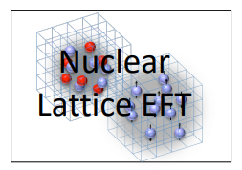
Nuclear Lattice Effective Field Theory Collaboration
Serdar Elhatisari(Gaziantep Islam Science and Technology)
Lukas Bovermann(Ruhr)
Evgeny Epelbaum (Bochum)
Dillon Frame (Juelich)
Fabian Hildenbrand(Darmstadt)
Hermann Krebs(Ruhr)
Timo A. Lähde (Juelich)
Dean Lee (MSU)
Ning Li(Sun Yat-sen)
Bing-Nan Lu( Graduate School of China Academy of Engineering Physic)
Myungkuk Kim(CENS,IBS)
Youngman Kim (중이온가속기연구소,IBS)
Young-Ho Song(중이온가속기연구소,IBS)
Yuanzhuo Ma(Peking)
Ulf-G. Meißner (Bonn/Juelich)
Gautam Rupak(Mississippi State)
Shihang Shen (Juelich)
Gianluca Stellin( CEA Paris-Saclay)

Slide 3
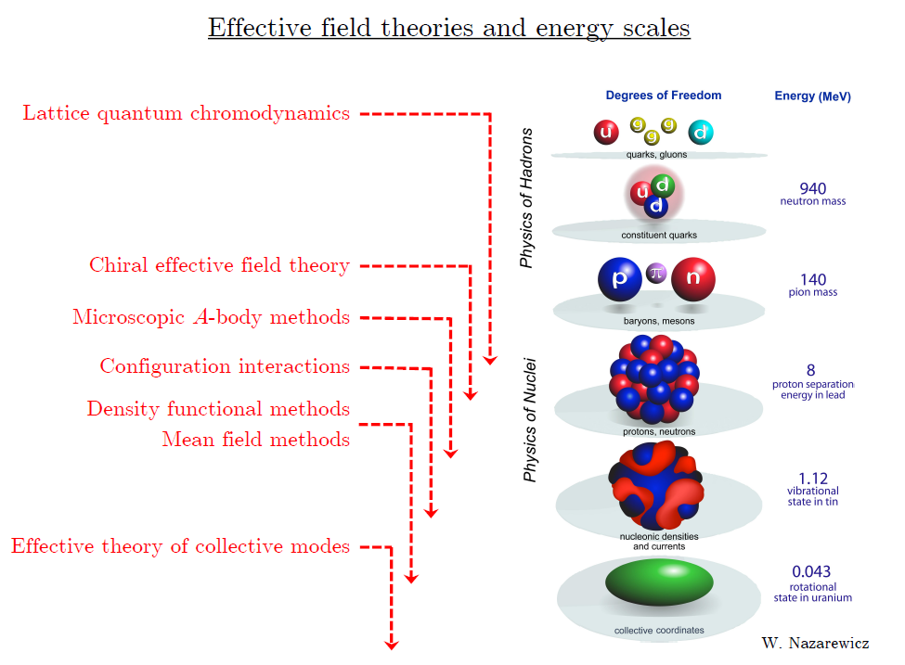
Ab initio
Nuclear
Theory

Slide 4
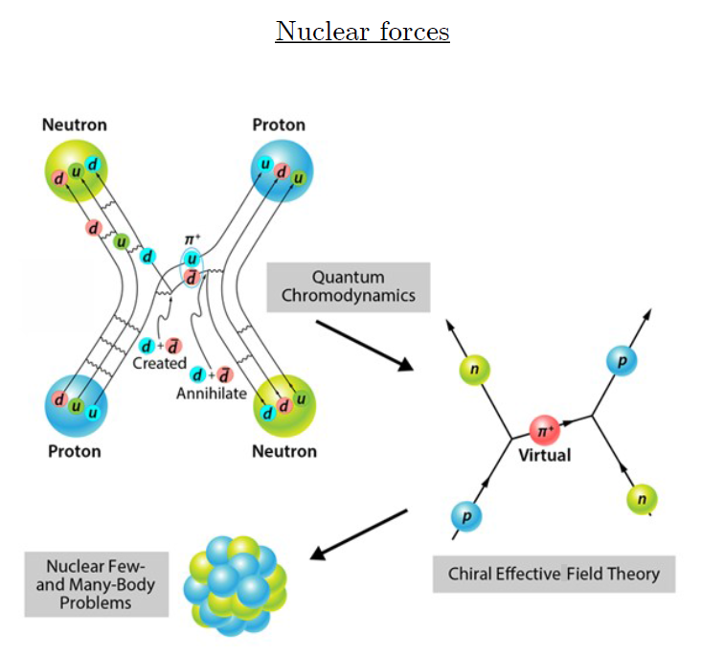
Ab-initio method
Ab-initio can mean many different things.
ab-initio Nuclear Physics
(1) nucleon degrees of freedom
(2) nucleon-nucleon interaction
Goal: predict wide range(structure, reaction, nuclear matter) of nuclear phenomena (without parameter fitting, model assumption) from nuclear interaction (for 2-body,3-body, many-body, based on QCD)

Slide 5
Ab initio many-body
(ab initio) Nuclear physics is challenging.
Nuclear many body problem
Requires Non-perturbative method.
Ab-initio nuclear many body methods
Greens function Monte Carlo(GFMC)
No-core shell model(NCSM)
Coupled Cluster (CC)
IM-SRG, VS-SRG
Nuclear Lattice Effective Field Theory(NLEFT)
And more
With recent progress in ab-initio methods
Binding energies for wide range of nuclei
Some reaction calculation for light nuclei.

Slide 6
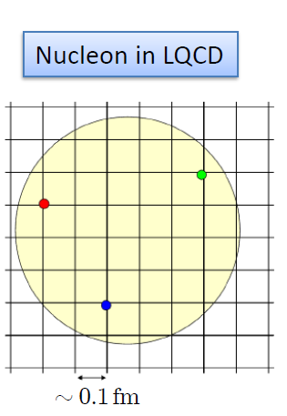

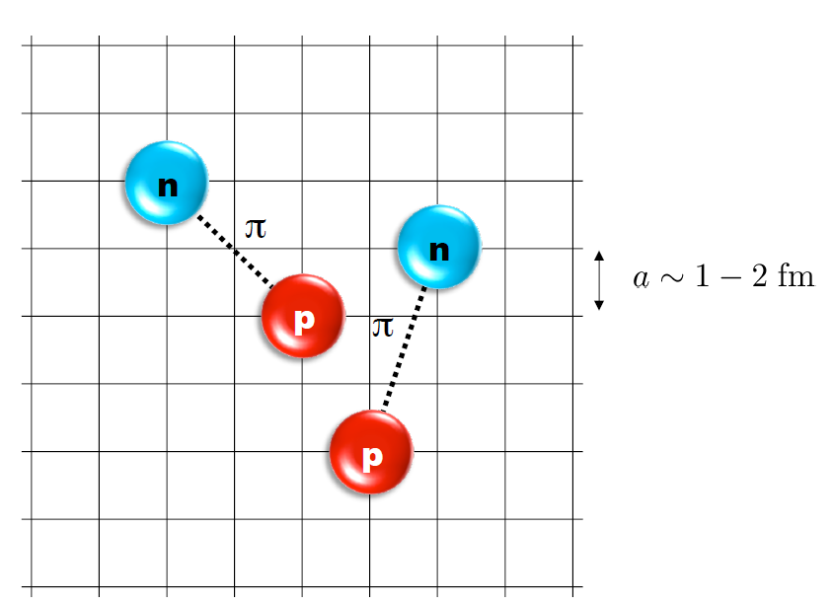
Nuclear Lattice Effective Field Theory
One of ab initio method for many fermion system

Slide 7
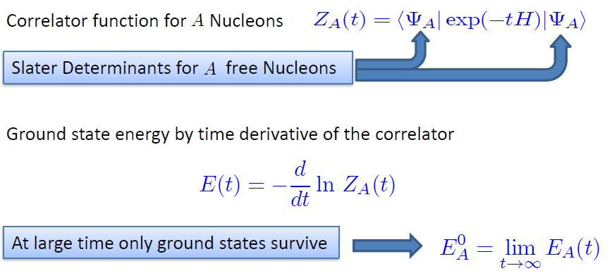

Path integral

Slide 8
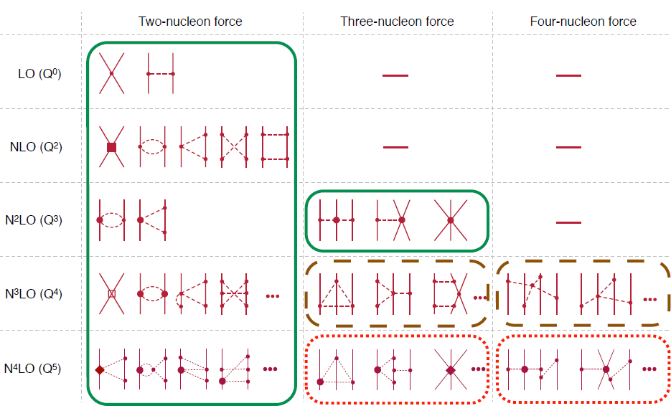
Chiral Effective Field Theory

Slide 9
Lattice Hamiltonian
We need to introduce a lattice scale in space and time:
momentum space cutoff ~ 150 MeV → lattice size a= 1.316 fm
Time cutoff ~ 1000 MeV
We need to determine coefficients of interaction for the lattice size. (regularization scale.)
Two-body interaction coefficients can be determined from phase shifts of np scattering.
Three-body interaction can be fixed from binding energy of A>=3.

Slide 10
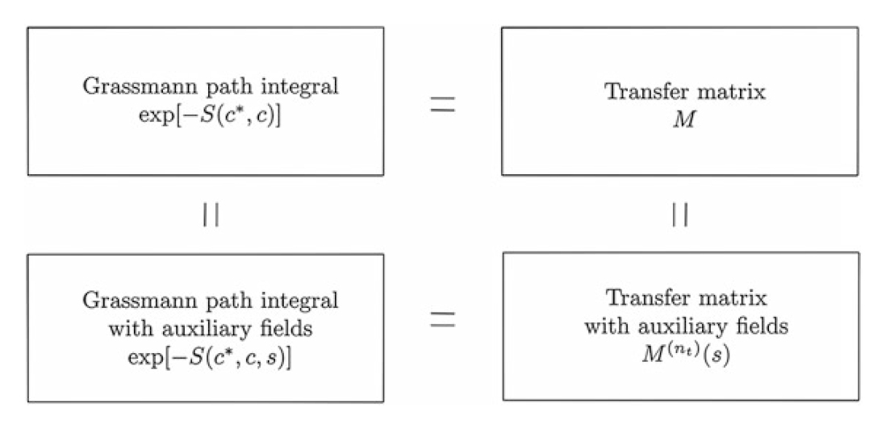

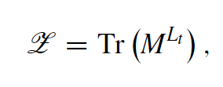
lattice formulations
All formulations are equivalent.
Here, we will only consider transfer matrix formulation

Slide 11
Simplest 1-body problem on lattice
Simple one-body problem : H = K + U
K : kinetic energy, U : external potential
Hamiltonian is a 1-body operator ( a^dagger a )
No spin, isospin(only one kind of fermion)
The goal is to find eigen-values and eigen-functions of Hamiltonian or transfer matrix. H x = E x or M x = W x
One can directly solve in lattice exactly for one-body.

Slide 12
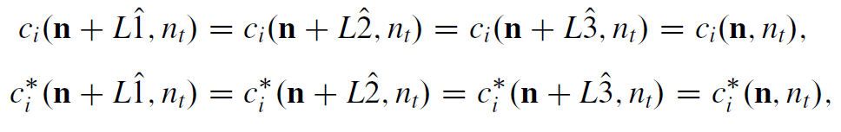
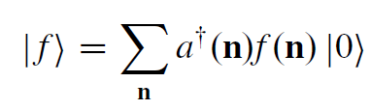
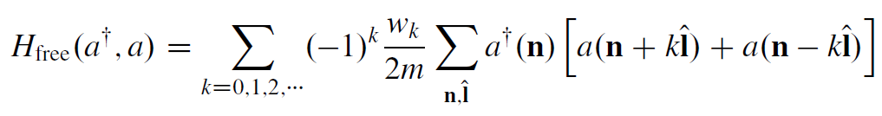
Simplest 1-body problem on lattice
Lattice spacing : a ← basic lattice “unit”
Lattice site : n = (nx,ny,nz)
Periodic Lattice size and volume : L , L^3
Lattice coordinate basis, |n> = a^dagger(n) | 0>
Kinetic Hamiltonian in lattice.

Slide 13
Simplest 1-body problem on lattice
s.p. wave function becomes a L^3 component vector in this basis.
(f(1),f(2), …, f(n), …. f(L^3) )
What is the matrix element of Hamiltonian in this basis?
< n | H | n’ > !
One can compute all L^3 x L^3 Hamiltonian matrix elements.
Then, one can solve directly with linear algebra library
Sum_{n’} <n|H|n’> <n’|f> = E < n|f>
For simplicity, choose up to k=1 approximation. (w_0=1 , w_1=1)
The Hamiltonian matrix elements are non-zero only up to one hopping.
U = \sum_{n} U(n) a^\dagger(n) a(n)

Slide 14
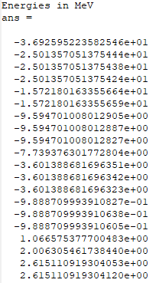
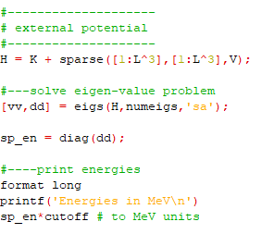
Simplest 1-body problem on lattice
For example,
L=10, a= 150 MeV
U is a square-well with radius 3fm, depth = 50 MeV case
Note degeneracy in excited states.
states near or above E=0
can be sensitive to the lattice size L

Slide 15
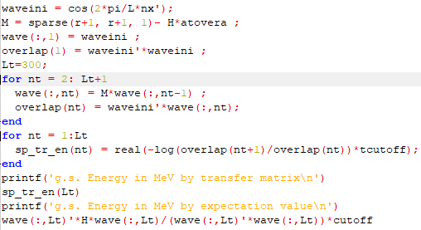

Simplest 1-body problem on lattice
In one-body case,
Transfer matrix becomes M = I- alpha_t H

Slide 16
2-body problem on lattice
Two-body problem can also be solved exactly on lattice
Complication
Separation of center of mass motion
Two-body basis → use relative coordinate (n1,n2) -> (n = n1-n2)
Two-body interaction
Need to construct Hamiltonian matrix for two-body
Transfer matrix is not M = I – H alpha_t for two-body
It would be possible to solve exactly up to 3-body in lattice.
However, many-body problem requires different approach.
One cannot directly diagonalize Hamiltonian for many-body.

Slide 17
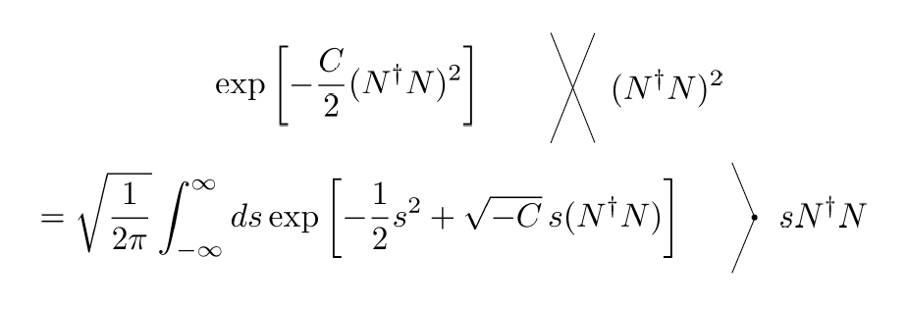
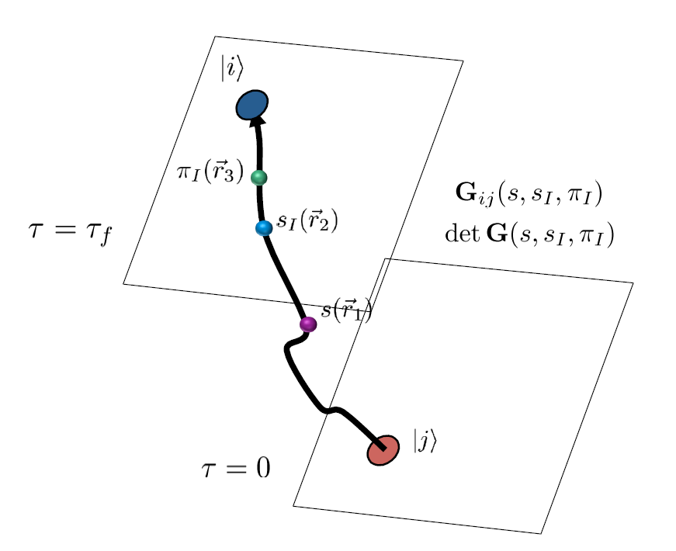
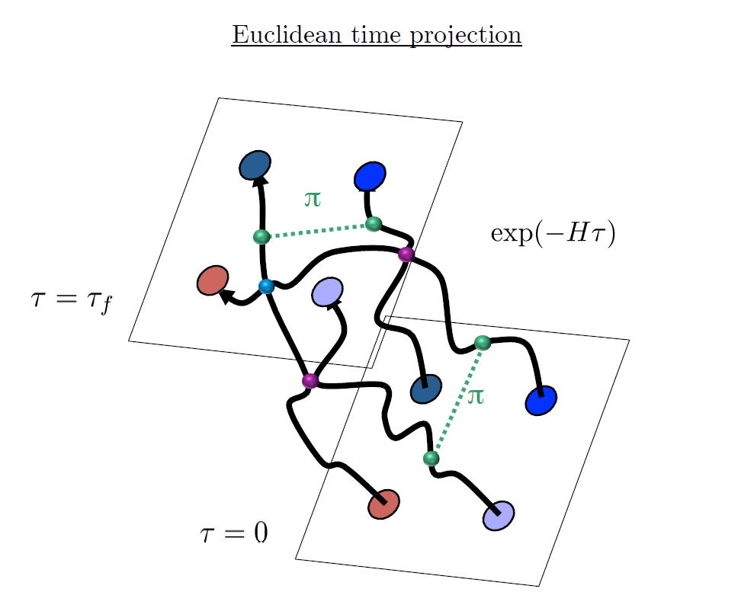
Auxiliary Field Monte Carlo

Slide 18
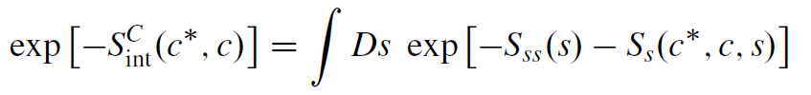
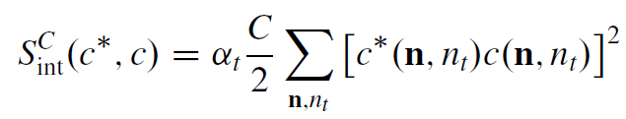
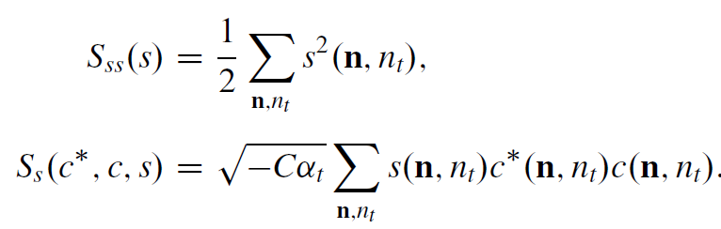

Slide 19
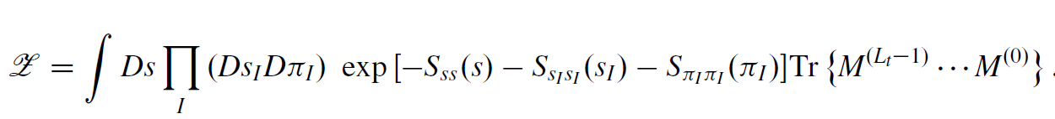

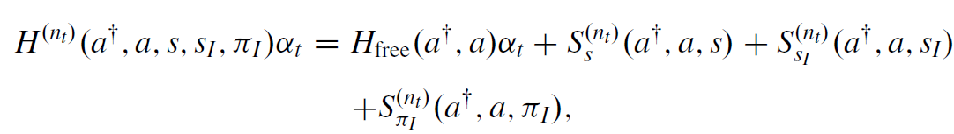
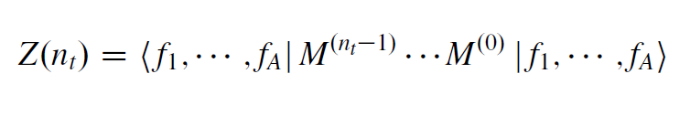
Hamiltonian in auxiliary field lattice
compute fermion amplitude
Integration over auxiliary fields
M.C. integral

Slide 20
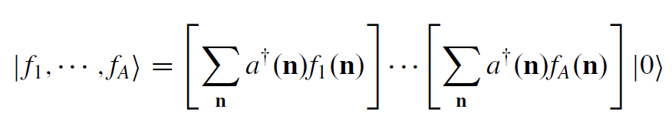
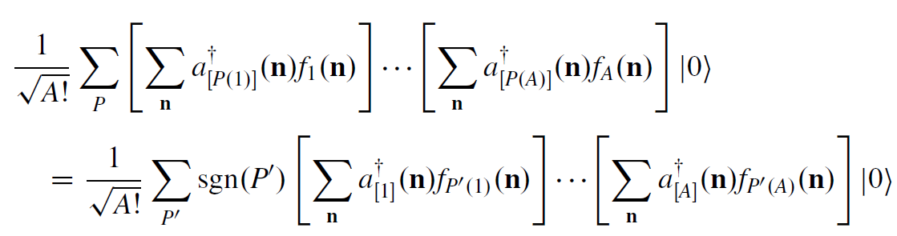
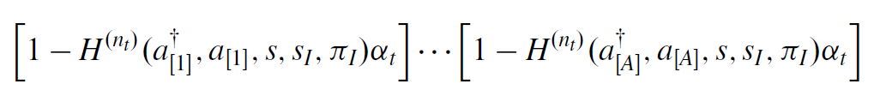

Fermion amplitude
Introduce extra index, but keeping anti-symmetrization
Transfer matrix can be written as

Slide 21
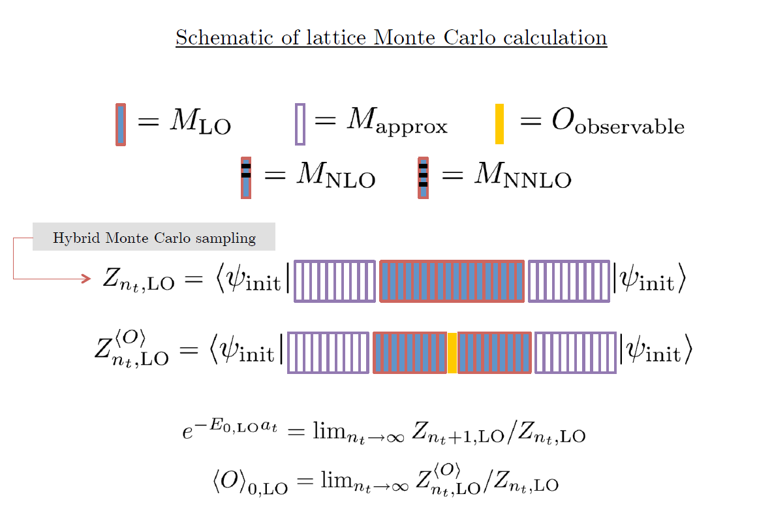

Slide 22
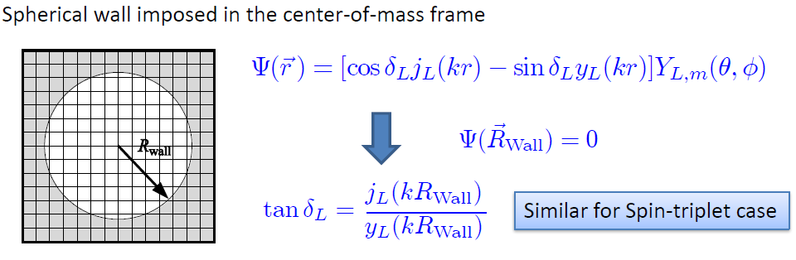
Low energy constants in lattice EFT
All LECs(parameters in the Hamiltonian) are fixed in A<=3
(They have to be fixed for given lattice regularization)
N-P scattering phase shifts, Deuteron binding energy
Triton binding energy, Triton beta decay.
Scattering phase shifts on the Lattice: Wall method.

Slide 23
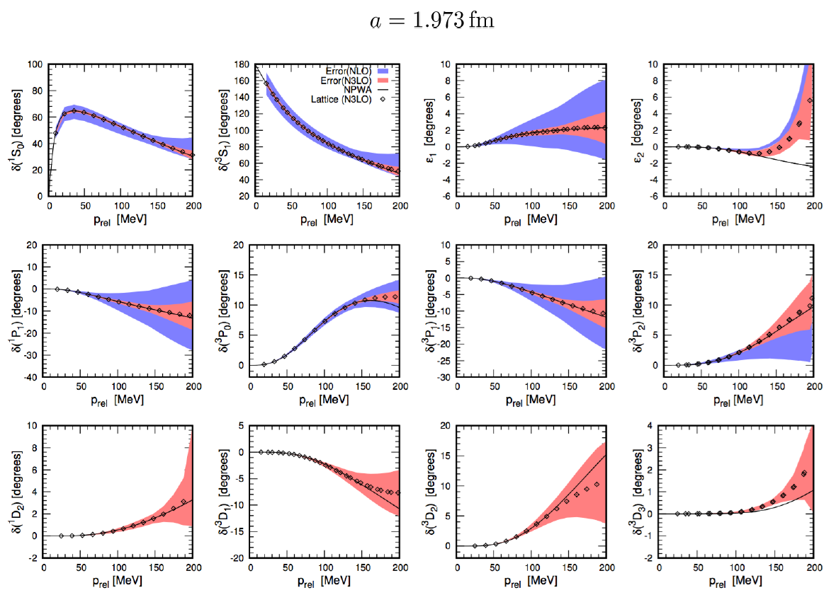
Determine LECs by fitting phase shifts of N-N scattering

Slide 24
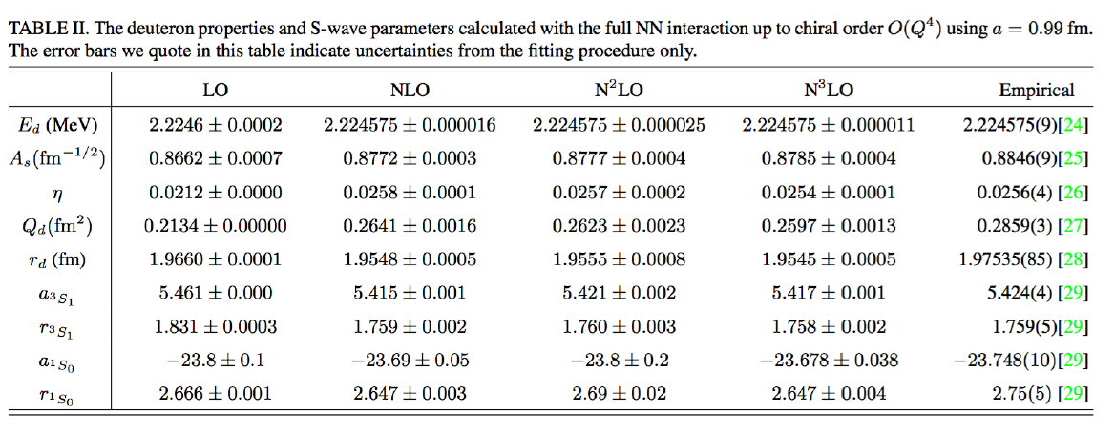

Slide 25
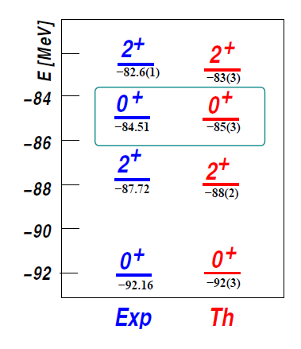

Applications of NLEFT
Has been successfully applied to
Nuclear matter, Cold atom, dilute fermion system
Finite nuclei (A<=50)
First ab-initio calculation of Hoyle state
Cluster structure of ¹²C and ¹⁶O
NN scattering, N-D scattering
Alpha-alpha scattering
radiative capture, fusion
Etc.
The first ab-initio calculation of
Hoyle state

Slide 26
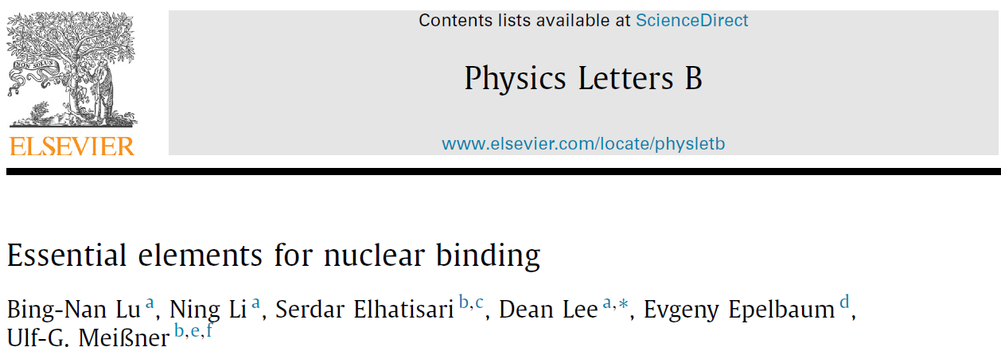



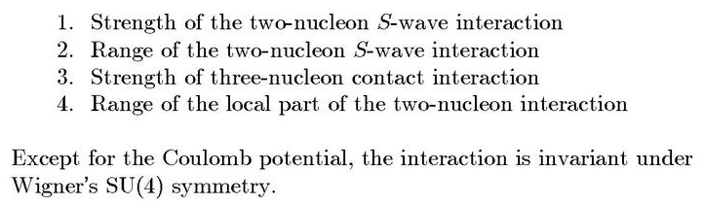
Minimal nuclear interaction
Which reproduce
Light nuclei
medium mass nuclei
neutron matter
simultaneously up to few percent error in binding energy and charge radius
Only Four parameters

Slide 27
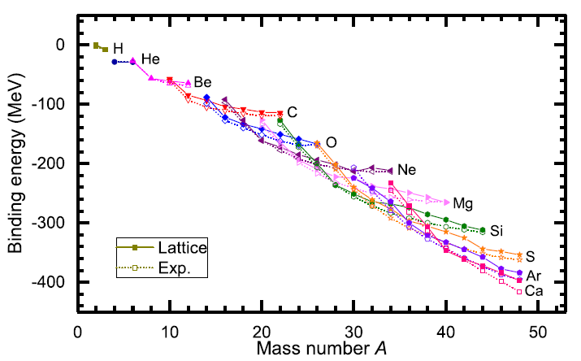
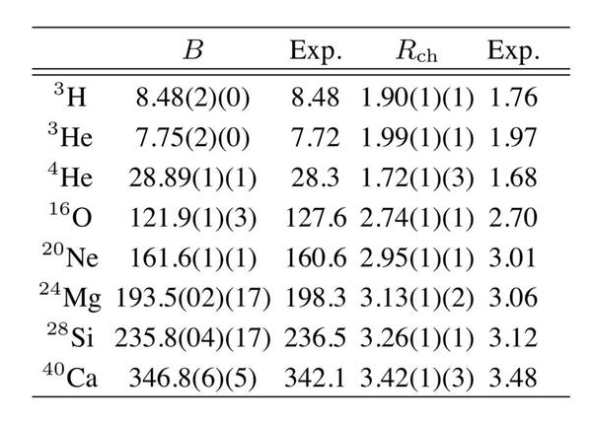
Can we improve the agreement by
Including higher order corrections?

Slide 28
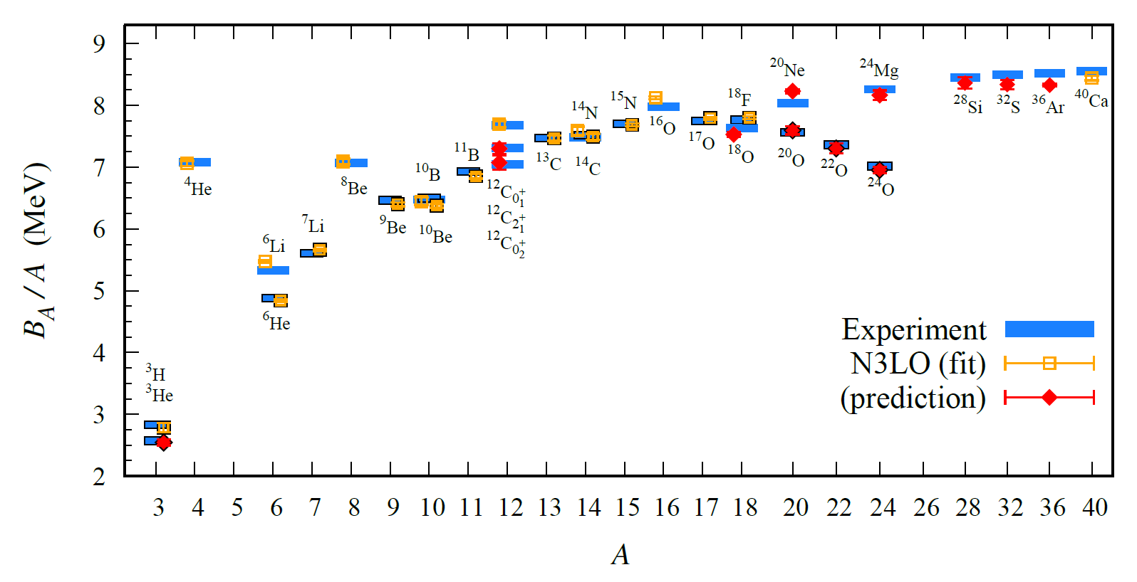
BE/A from WFM up to N3LO
Preliminary

Slide 29
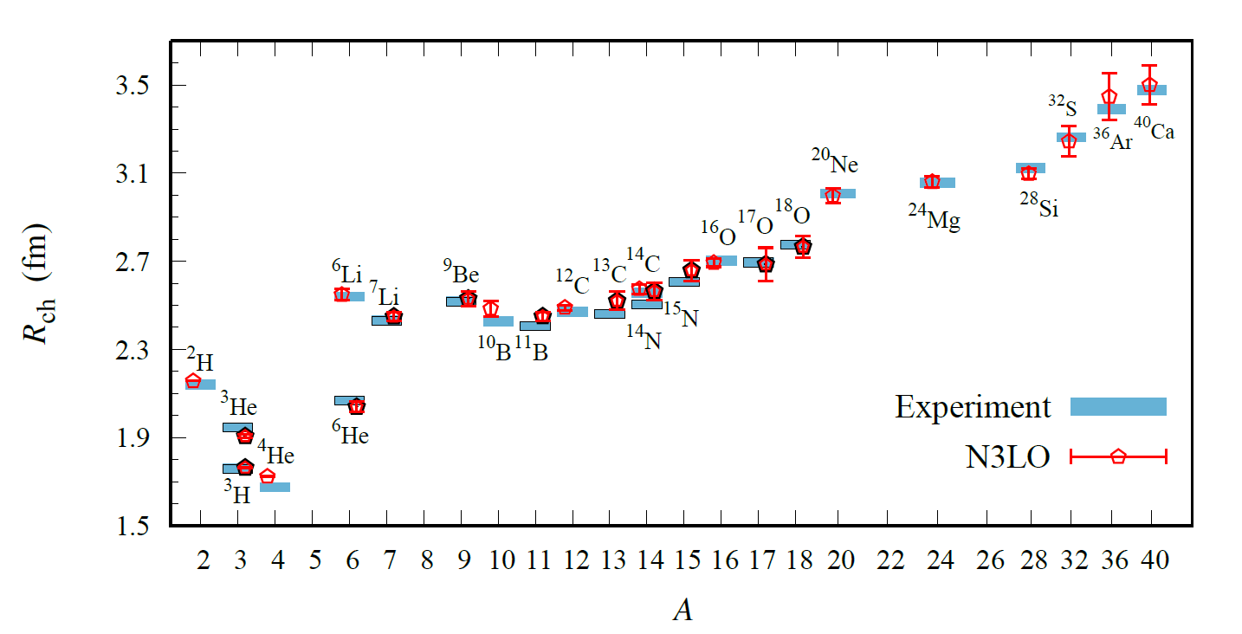
Charge Radius in WFM upto N3LO
Preliminary

Slide 30
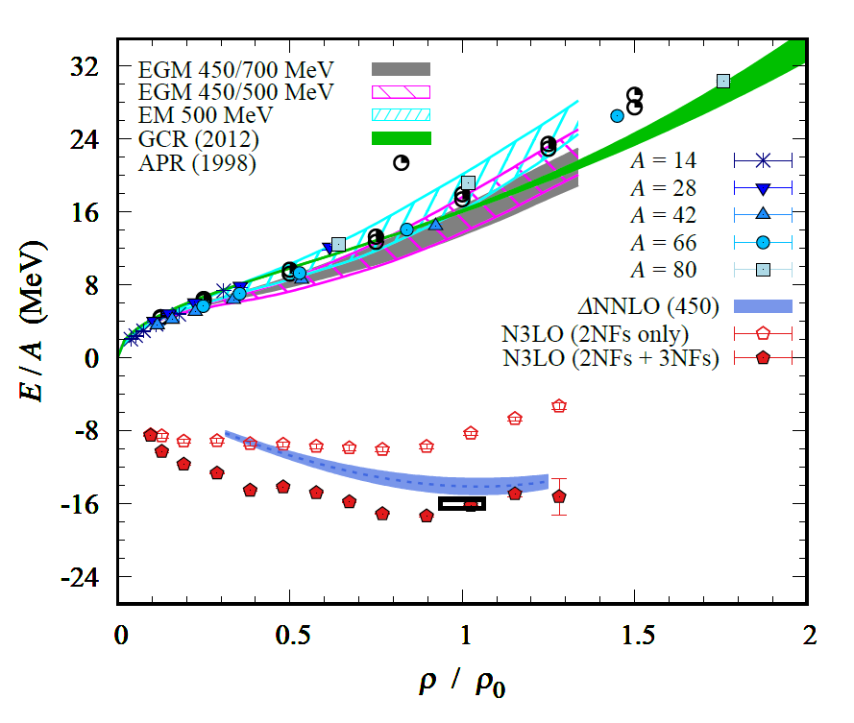
Nuclear/Neutron Matter in WFM (N3LO)
Neutron matter:
A=4~80
box size 6.6 ~ 13.2 fm.
Nuclear matter:
A=4 ~ 160
Box size 7.92~9.24 fm.
Preliminary

Slide 31
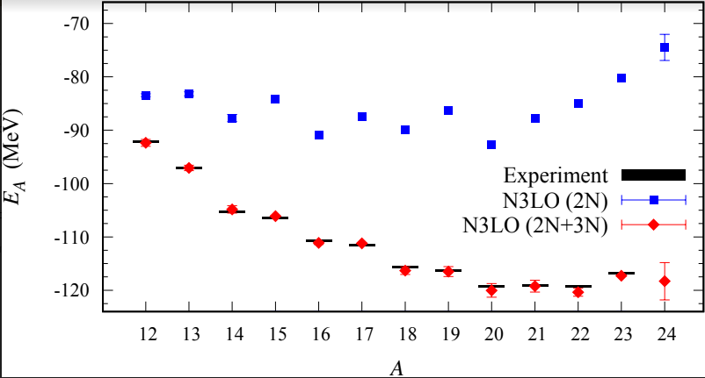
Carbon isotopes

Slide 32
Summary
Wave function matching method seems to be promising
New method to improve the N3LO calculation of NLEFT
Preliminary study shows promising results for wide range of observables
NN scattering
Binding energy (from 3H to 40Ca)
Symmetric Nuclear matter
Neutron matter
Dripline of Oxygen isotope.
Carbon excited states
Further investigation on the finite volume effects is on-going.
Also, Carbon isotopes, odd Oxygen isotopes, Cluster structure, excited states will be studied.

