Slide 1
Graphic User interface for easy nuclear reaction calculation
Y.-H. Song(RISP,IBS)
2020.OCT.07 CENS

Slide 2
Introduction
There are many nuclear reaction codes available(DWUCK, ECIS, FRESCO, TWOFNR, …)
https://people.nscl.msu.edu/~brown/reaction-codes/
Most of them are written in Fortran and require specific input file format
Usually, not easy for beginner
Usually need separate plotting tools
The aim of the new GUI is to make it easy and intuitive to do a simple nuclear reaction calculation.
(DWBA calculation)

Slide 3
Introduction
GUI code is still under development.
Even name is not decided. (Please, suggest one)
Have not tested much yet. (Need feedback from testers/users)
Plan to improve the code to satisfy user’s needs.
(Contact me for suggestion, help.)

Slide 4
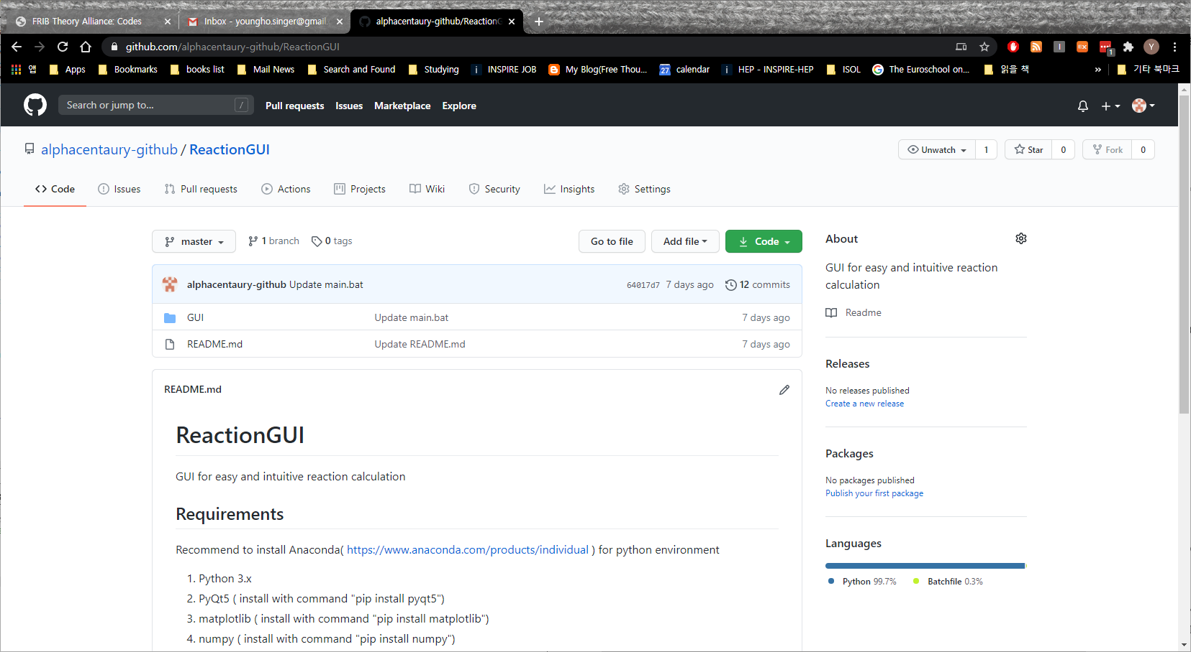
Installation
https://github.com/alphacentaury-github/ReactionGUI

Slide 5
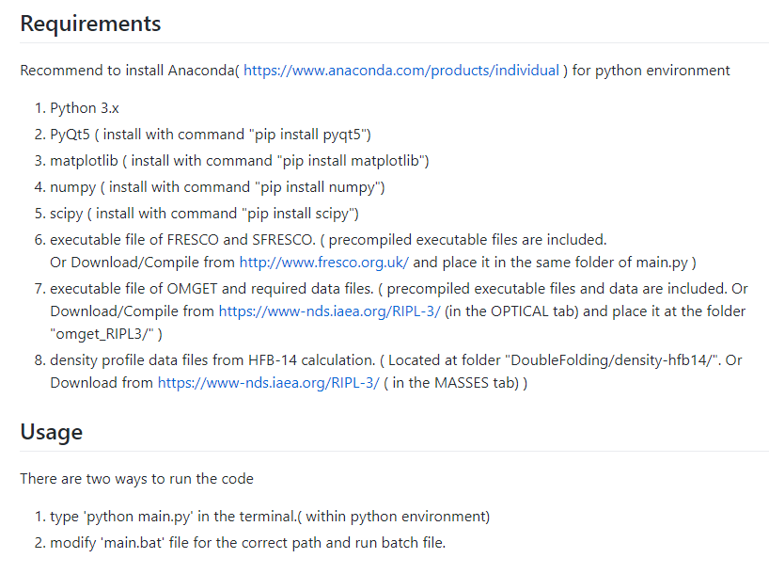
Installation

Slide 6
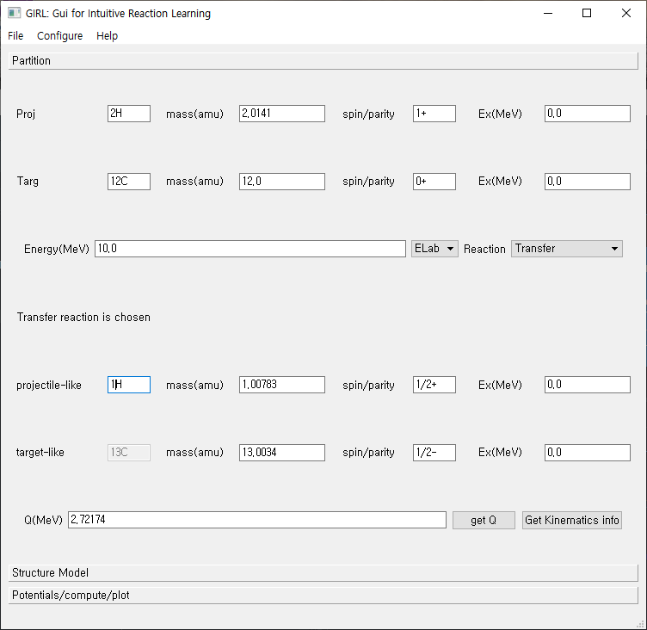
File:
Save/Load
Input parameter values
Configure:
Specify the executable file
Locations
(OS other than Windows)

Slide 7

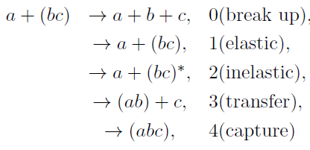
Reactions
Reaction Q-value:
(Released energy)
Suppose projectile/target is composed with two particle
Traditionally,
Projectile is light, Target is heavy .
Experiment measure projectile-like particle
‘Pickup/stripping/break up’ are used w.r.t. projectile

Slide 8
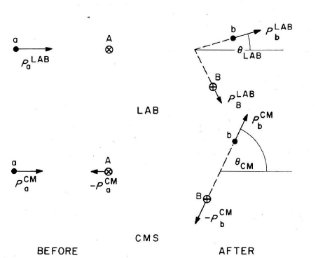
Kinematics
(Satchler fig2.1)

Slide 9
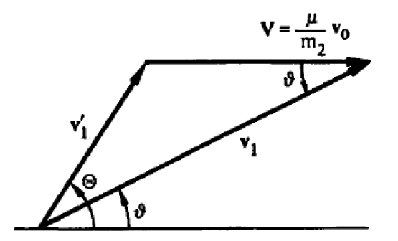

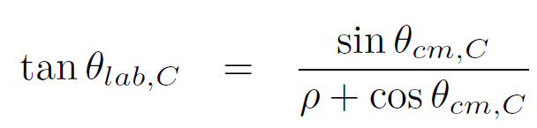
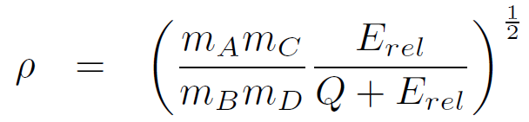



Kinematics
vcm
vlab
Q= (mA+mB –mC -mD) c^2,
Q=0 for elastic scattering
Cross section at lab frame and at CM frame

Slide 10
Neutron : 1n
Proton : 1H
Deuteron : 2H
projectile
target
Incident Energy/
Type of reaction
kinematics

Slide 11
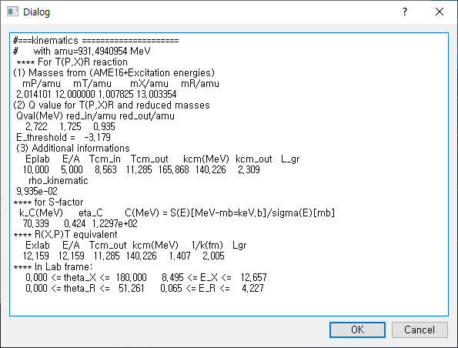
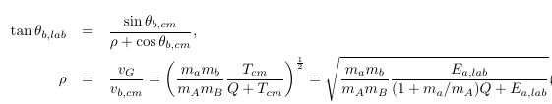

Get kinematics
button

Slide 12




wave function
Simplification of many-body wave function :
sum of channel wave functions
(bound state wave functions of projectile and target)
and (wave function for relative motion)
Suppose Bound-state wave function is known from structure model
Relative wave function determine the flux → cross section
b
a
A
B

Slide 13


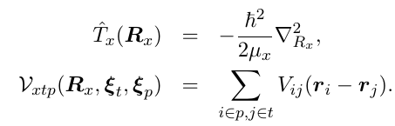

Schrodinger equation
Coupled channel equations

Slide 14
Elastic scattering: Optical model
The cross section can be obtained from the asymptotic form of scattering wave function
Optical potential model is used to obtain the scattering wave function for elastic scattering by solving Schrodinger equation.
It treat projectile and target as point particles(ignores internal structure)
Effects of other reaction channels appears as a imaginary part of the optical potential
Usually determined phenomenologically

Slide 15



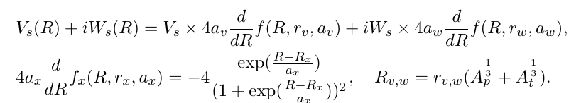
Elastic scattering: Optical model

Slide 16
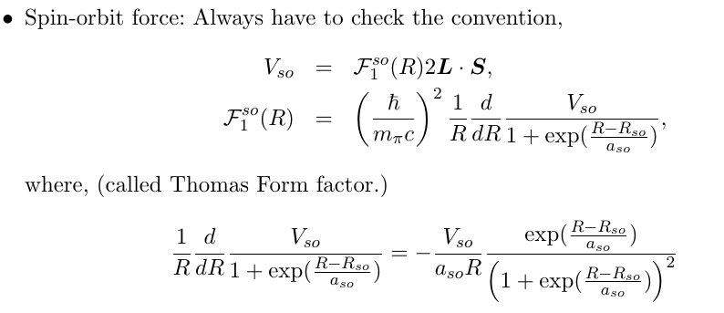
Elastic scattering: Optical model

Slide 17
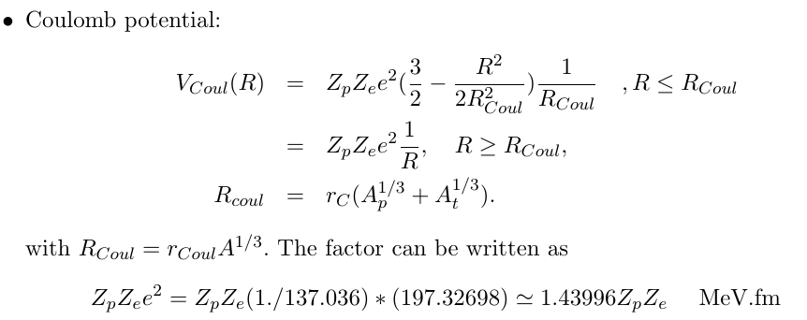
Elastic scattering: Optical model

Slide 18
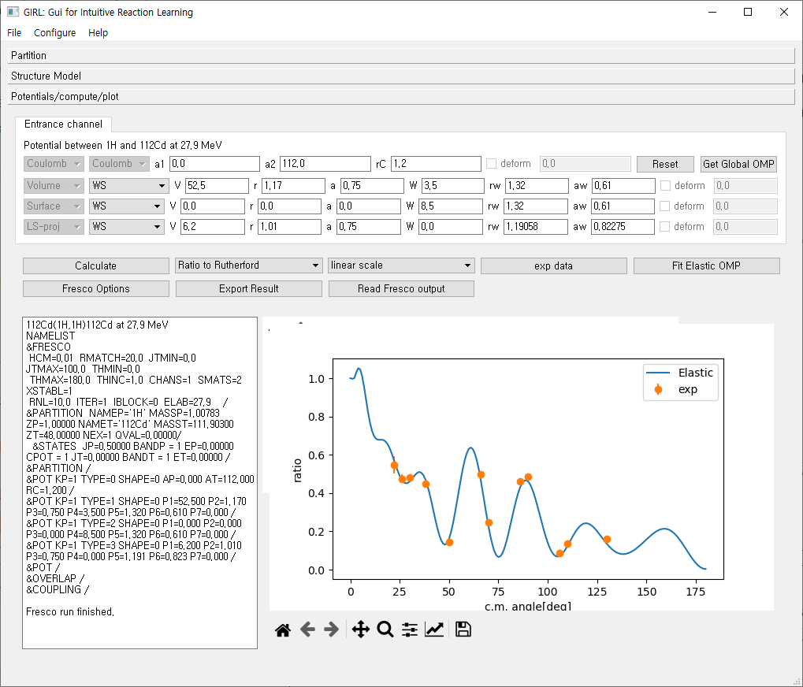

Slide 19
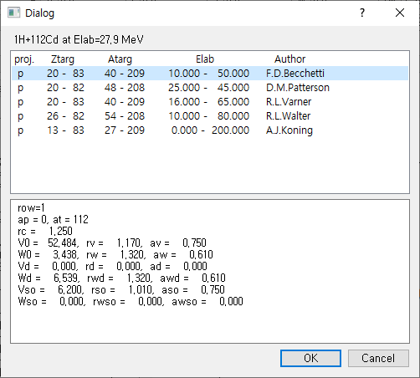
Get Global OMP
Get optical potential parameters
from RIPL-3 If available.
(p,n, 2H, 3H, 4He projectiles)

Slide 20
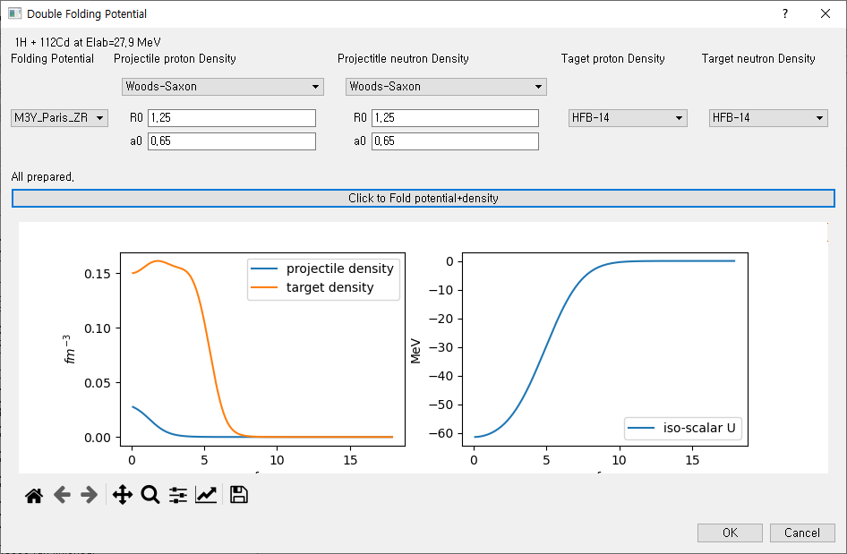
Get Folding V
Get density profile from HFB-14 results If available.
(From RIPL-3)
Or User input

Slide 21
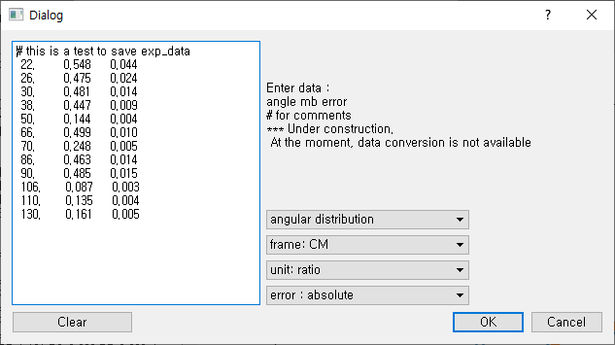
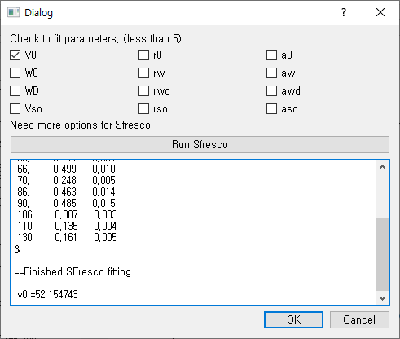
Exp
data
Fit
Elastic
OMP

Slide 22
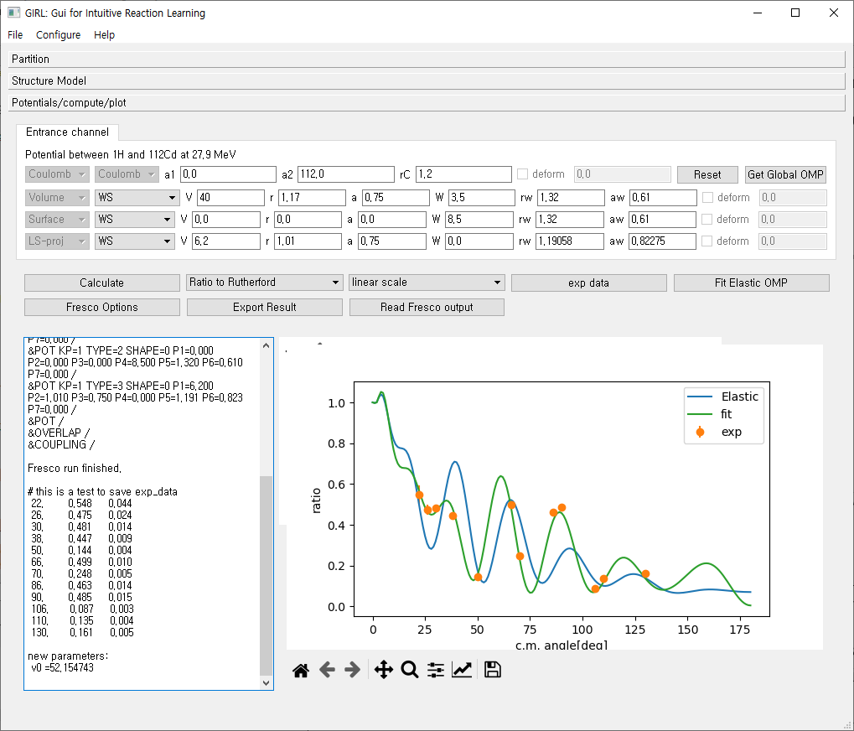
At the moment, no automatic update of parameter after fitting available

Slide 23
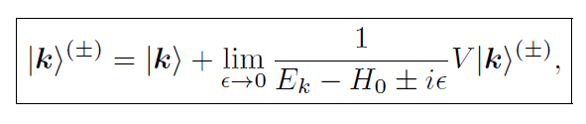


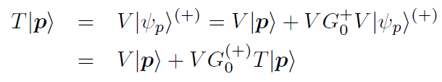
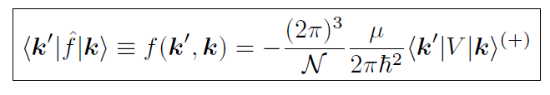
LS equation for t-matrix
T-operator

Slide 24
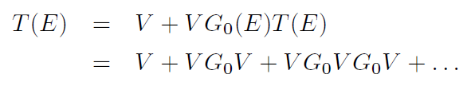
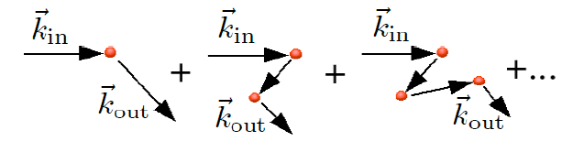
Born Series
If potential is strong, the born series have bad convergence.
Distorted Wave Born Approximation can be used

Slide 25
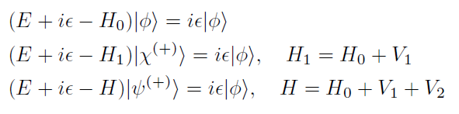


Two potential formula
Suppose there are strong potential and weak potential
(Plane wave)
(Distorted Wave)
(Full scattering wave)

Slide 26



DWBA
Distorted Wave Born Approximation(DWBA)

Slide 27
Inelastic scattering (Rotational Model)
Coupling to inelastic channel requires structure information (models)
For inelastic scattering: Commonly used models are
Collective Excitation Model : Rotational or Vibrational
Or
Single Particle Excitation Model

Slide 28


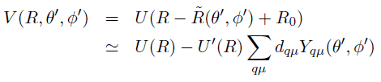
Inelastic scattering (Rotational Model)
I
I : spin of nuclei
K: bandhead ,
Spin projection at body-fixed frame
K
Symmetry axis
Deformed Nucleus
Deformed potential
In z’-axis, R0(1+beta)
R

Slide 29


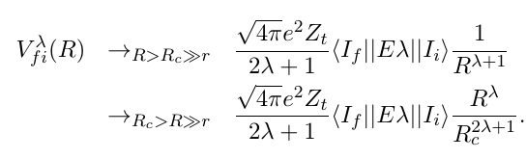
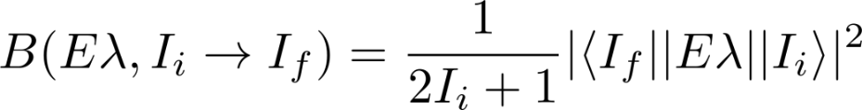
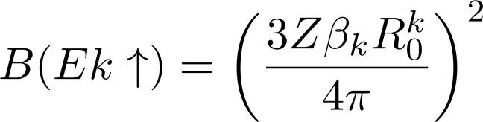
Inelastic scattering (Rotational Model)
Axially deformed case : deformation length, fractional deformation
Skipping calculation of transition matrix for change of rotational state
In simple rotational model,
Deformation length(or beta) is an input.
Deformation → Coulomb and Nuclear
(may differ)
Reduced transition probability

Slide 30
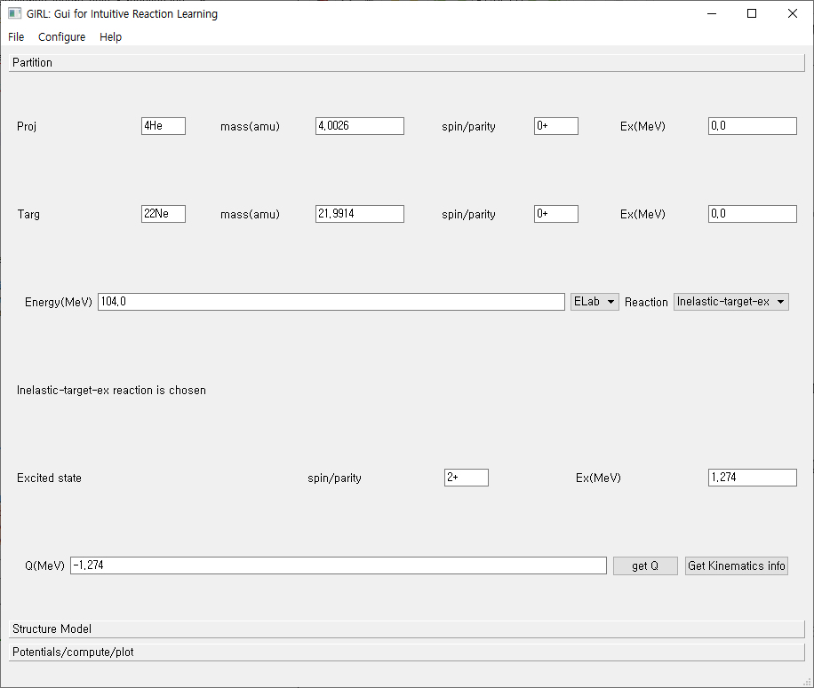

Slide 31
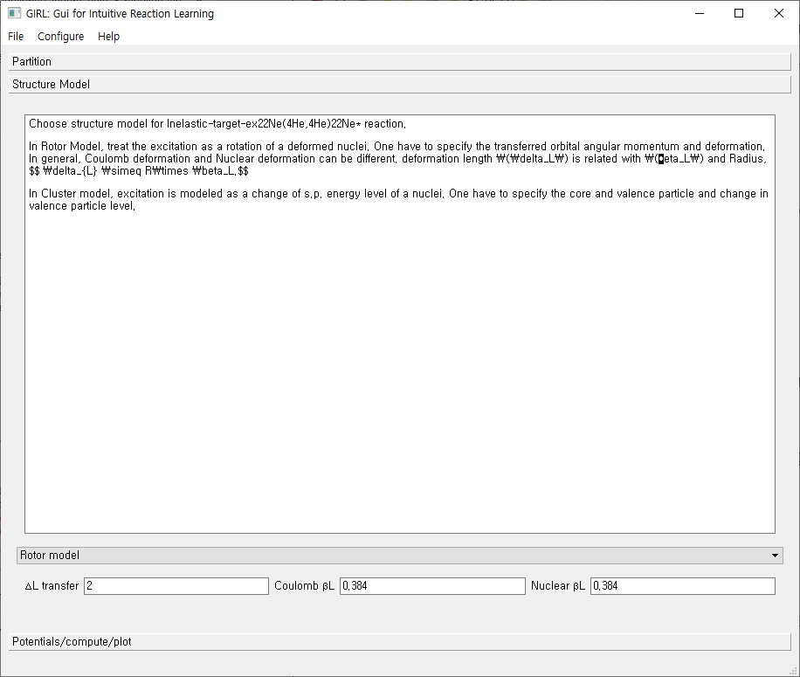
Deformation length
Is calculated
With r0=1.2

Slide 32
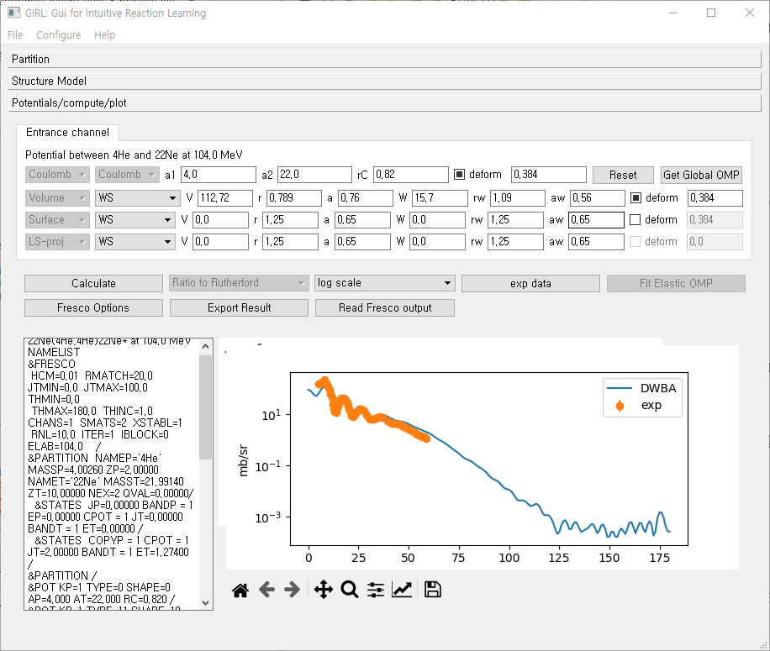

Slide 33
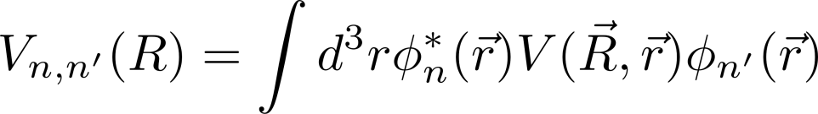


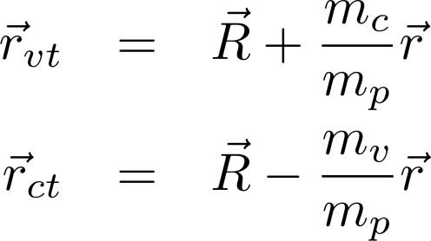

Inelastic scattering (Single Particle Excitation Model)
Model the bound state of a nucleus as (core)+(valence particle)
Bound state is characterized by (valence particle wave function)
Inelastic excitation corresponds to the change in bound state wave function
v
r
c
R
T

Slide 34
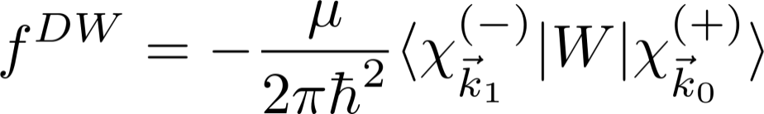
Inelastic scattering (Single Particle Excitation Model)
In some code,
The last two terms are neglected
DWBA calculation requires
Kinematic info ( incident energy, Q-value)
Initial and Final State, transferred angular momentum
Optical potential between projectile and target
Initial and final Bound state wave function → binding interaction, spectroscopic factor
Inelastic (residual) Potential

Slide 35






Transfer reaction
Consider the stripping reaction,
p(=c+n)+c’ → c+t(=c’+n)
In rearrangement,
initial and final partition is different.
n
c
c’
p=c+n
t=n+c’

Slide 36


Transfer reaction
n
In general this coupling gives
Non-local kernel
Finite-range transfers
Local approximation of kernel
Zero-range transfers
(treat interaction potential
as approximately zero range )
c
c’
p=c+n
t=n+c’

Slide 37
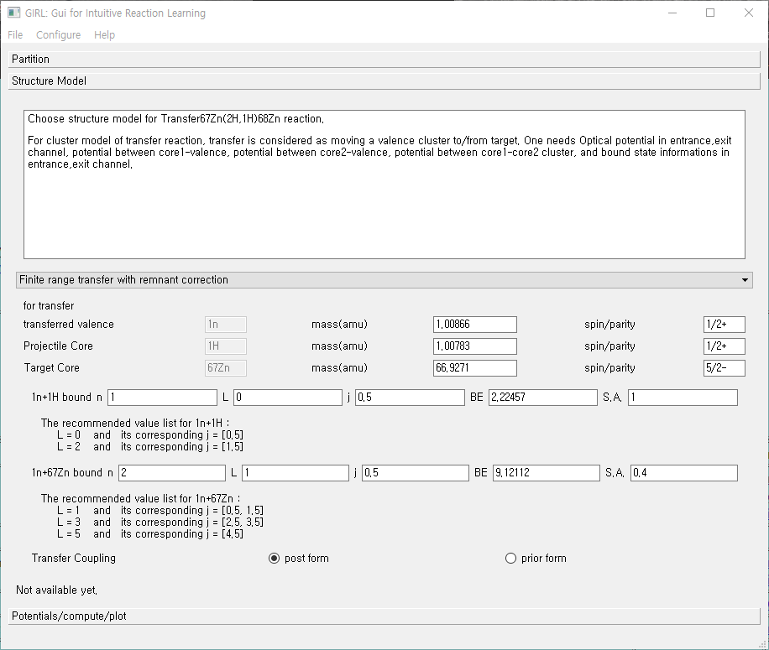

Slide 38
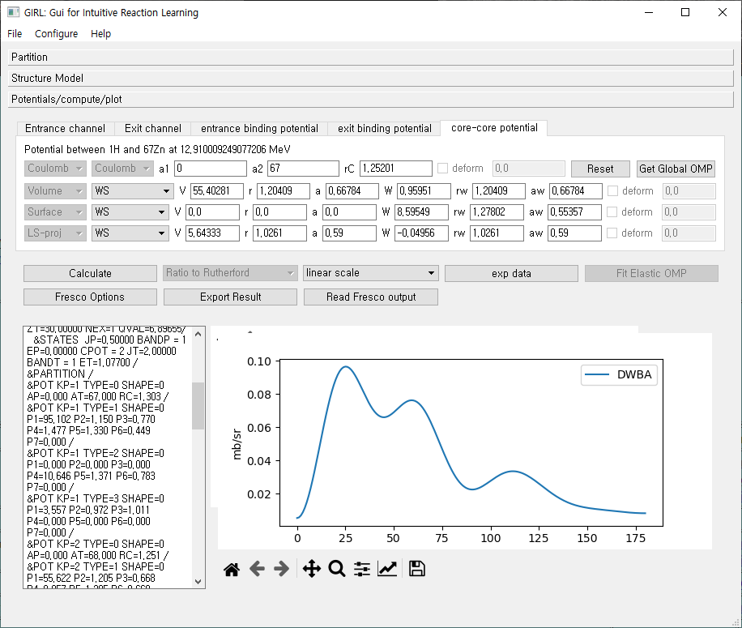
Bound state
Wave functions
Are obtained in
Well-depth
Prescription
Always check
Parameters.
No automatic
Determination
Of potential parameter
Is Available.
One can export
The result of DWBA
Calculation as a file.

Slide 39
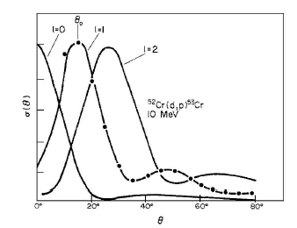
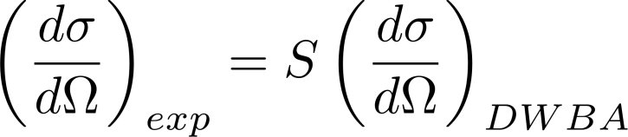
Transfer reaction as a spectroscopic tool
Transfer reaction cross section is sensitive
To the transferred angular momentum
(1) By analyzing angular distribution,
one can determine
the transferred orbital angular momentum
The quantum number of s.p. states
(2) In a s.p. picture,
one can extract S.F. from experiments
→ Spectroscopic information

Slide 40





Overlap function, Spectroscopic factor, ANC
Overlap function: For B=A+v
In principle, overlap function comes from many-body calculation.
It is common to use a simple single-particle picture.
To be exact, Anti-symmetry
of wave function have to be considered
Spectroscopic factor
B
r
A
Spectroscopic amplitude

Slide 41




Overlap function, Spectroscopic factor, ANC
From the nucleon separation energy, we expect
Asymptotic Normalization Constant
If we approximate many-body overlap function into s.p. wave function
Well-depth prescription is
Commonly used for s.p.w.
Single particle ANC
Basically, the spectroscopic amplitude is square root of
Spectroscopic factor.

Slide 42
Halo nuclei
Deuteron is a weakly bound nuclei. → Couplings to break up channel can be important.
Many Rare isotope are weakly bound, Especially Halo nuclei. → Couplings to break up channel can be important.
One of ways to include break up channel effects in transfer reaction is to use ADWBA.
Another way is to use CDCC.
Recently, there are efforts to use ab-initio or Faddeev method for transfer reaction.

Slide 43
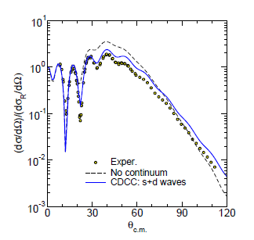
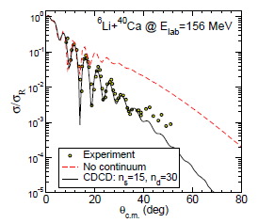
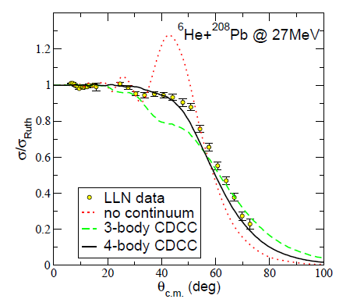
Break up Channel effects
(elastic scattering example)

Slide 44
Development of GUI for reaction calculation
Currently, developing a simple GUI program for RAON Users to do reaction calculation.
At the moment, it is aimed to do DWBA calculation for elastic , in-elastic, transfer reaction in a very simple structure model.
Later, plan to add radiative capture, fusion reaction and coupled channel methods(also ADWA, CDCC).
Also, trying to include several useful functions for the convenience of Users.

