Slide 1
Reaction GUI
Y.-H. Song(RISP,IBS)

Slide 2
Introduction
There are many direct nuclear reaction codes available(DWUCK, ECIS, FRESCO, TWOFNR, …)
Most of them are written in Fortran and require specific input file format
Usually they are not easy for beginner to use
Usually they need separate plotting tools
The aim of the new GUI is to make it easy and intuitive to do a simple nuclear reaction calculation.
(DWBA calculation)

Slide 3
Introduction
GUI code is developed by Y.-H. Song and I.J. Shin.
Combines Qt + Fresco + other utility codes
Plan to improve the code to satisfy user’s needs.
(contact yhsong@ibs.re.kr for suggestions, errors, troubles)

Slide 4
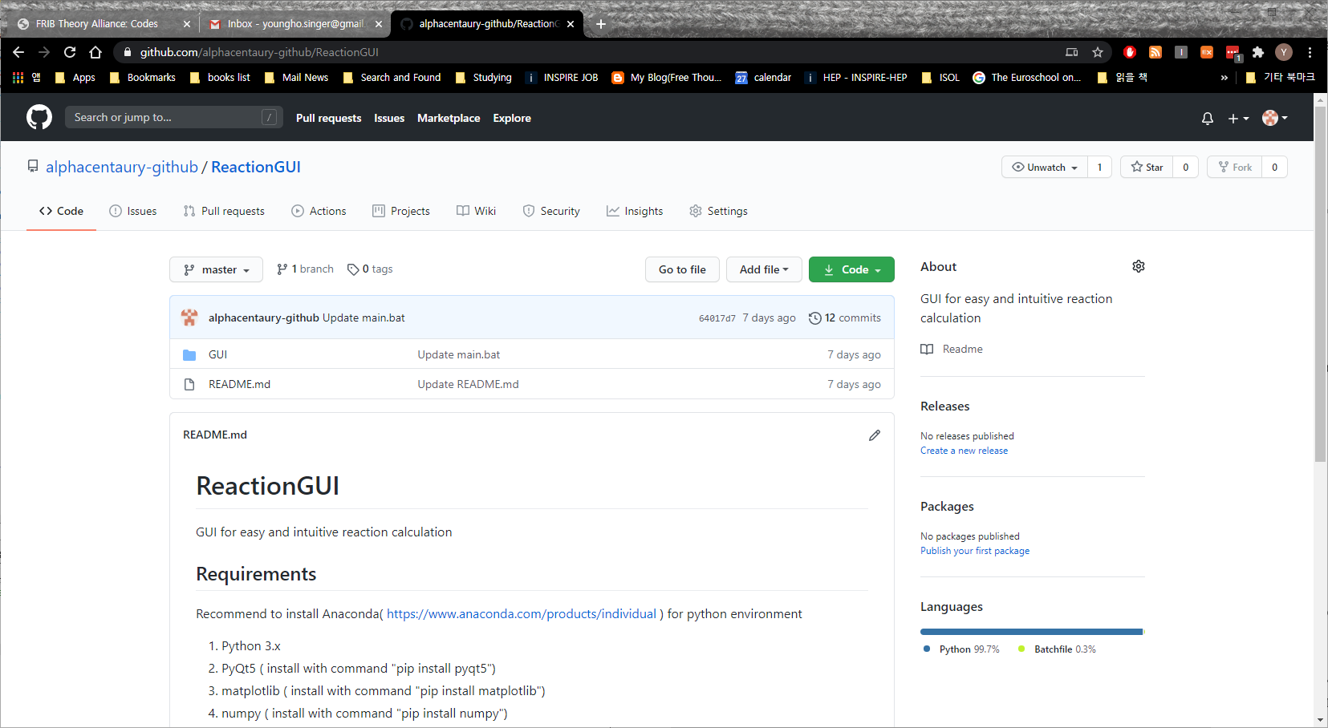
Installation
Search “ReactionGUI” at GitHub
https://github.com/alphacentaury-github/ReactionGUI

Slide 5
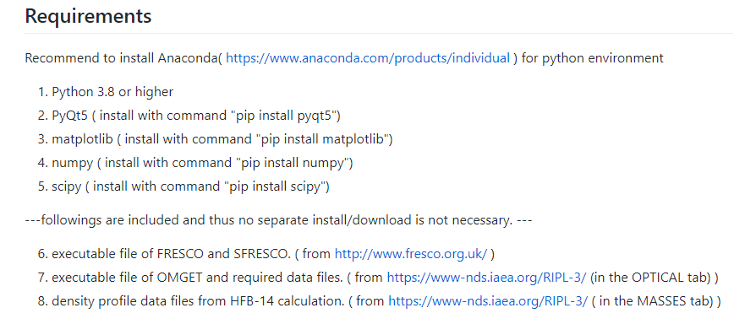
Installation

Slide 6
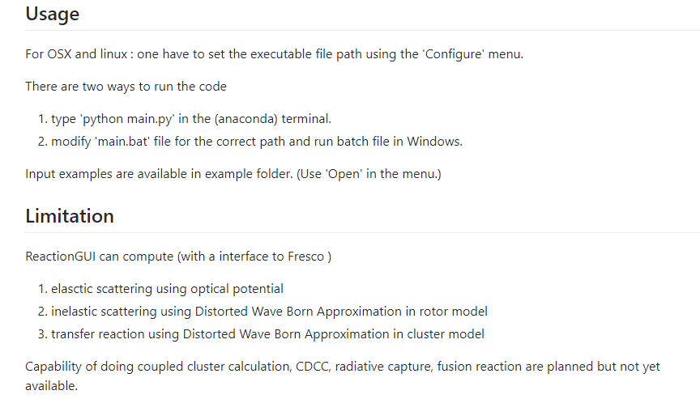

Slide 7
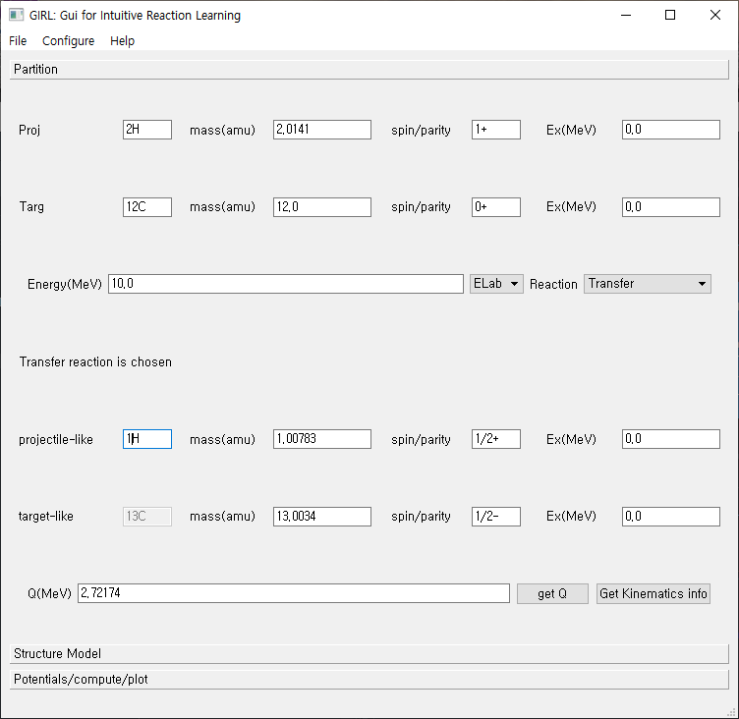
File:
Save/Load
Input parameter values
Three tabs
Partition
Structure Model
Potentials/compute/plot

Slide 8
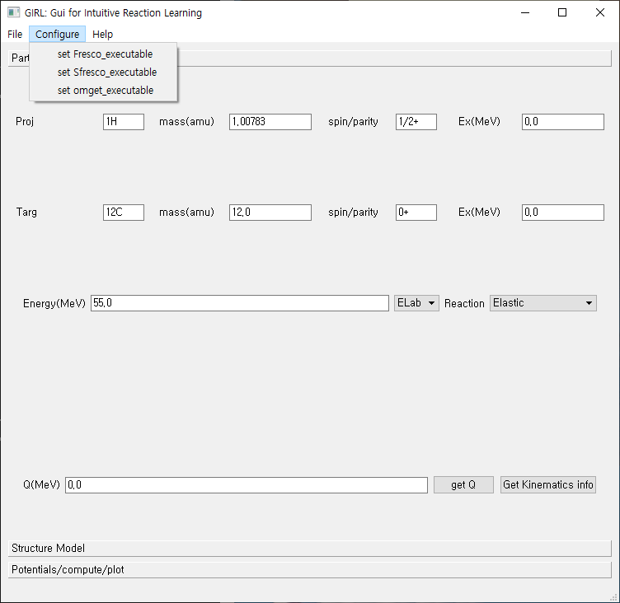
Configure:
Specify
the executable file
Locations
(OS(osx,linux) other than Windows)

Slide 9
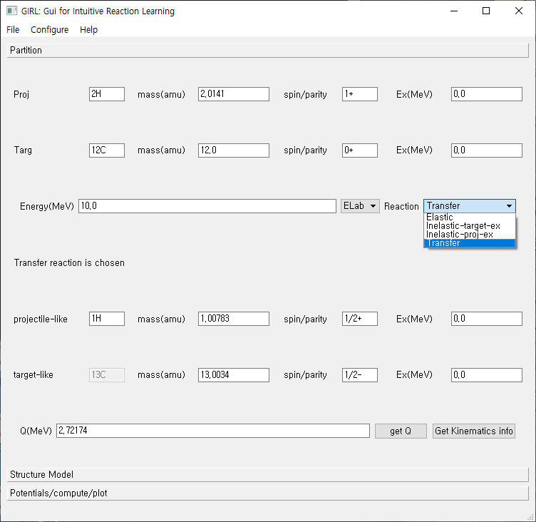
Neutron : 1n
Proton : 1H
Deuteron : 2H
projectile
target
Incident Energy/
Type of reaction
kinematics

Slide 10
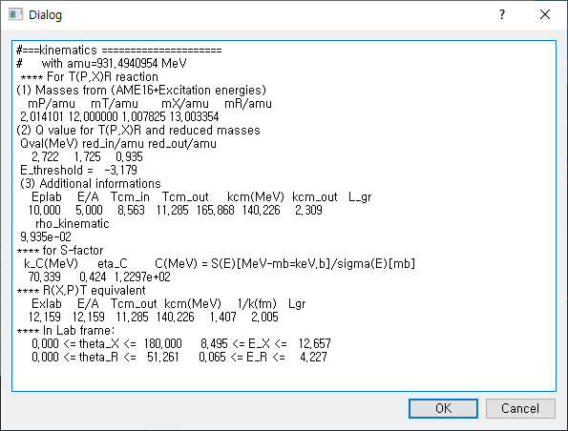
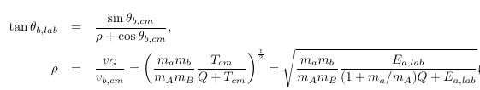

Get kinematics
button

Slide 11



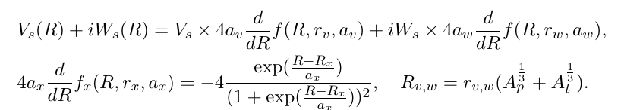
Elastic scattering: Optical model

Slide 12
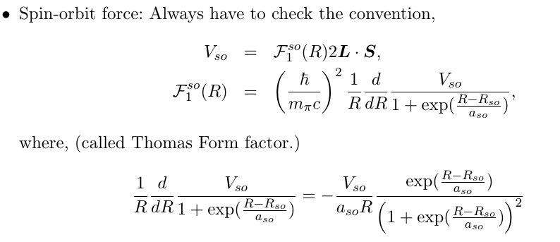
Elastic scattering: Optical model

Slide 13
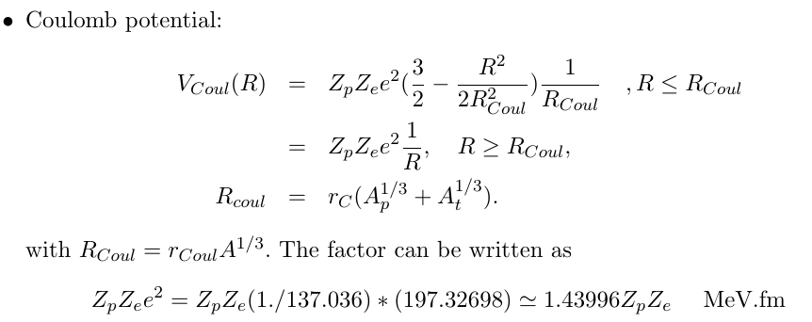
Elastic scattering: Optical model

Slide 14
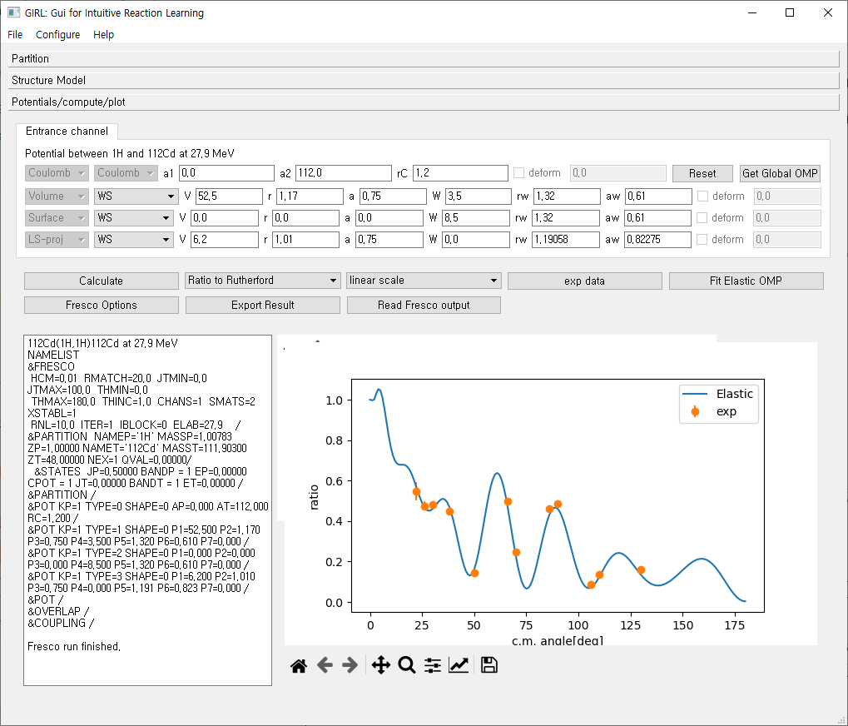

Slide 15
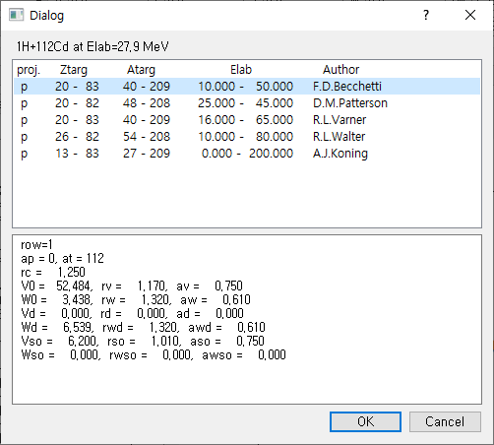
Get Global OMP
Get optical potential parameters
from RIPL-3 If available.
(p,n, 2H, 3H, 4He projectiles)

Slide 16
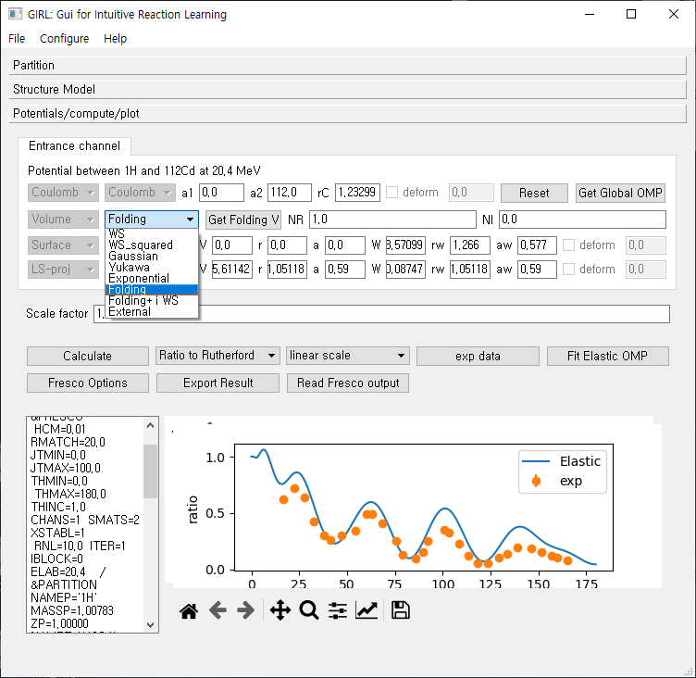
Various potential shapes

Slide 17
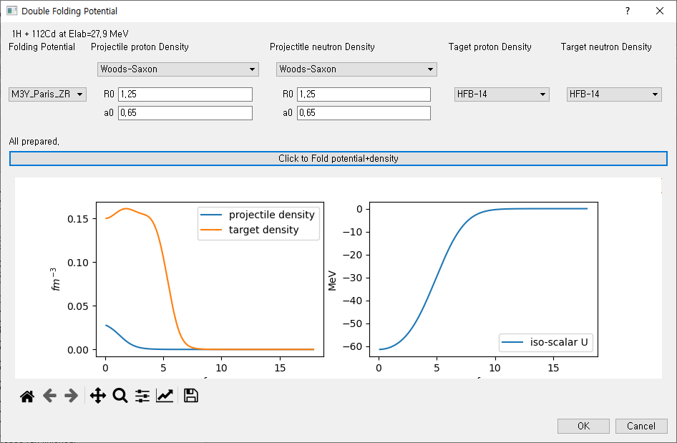
Get Folding V
Get density profile from HFB-14 results If available.
(From RIPL-3)
Or User input of density profile
* Because of double folding, it requires density even for proton.

Slide 18
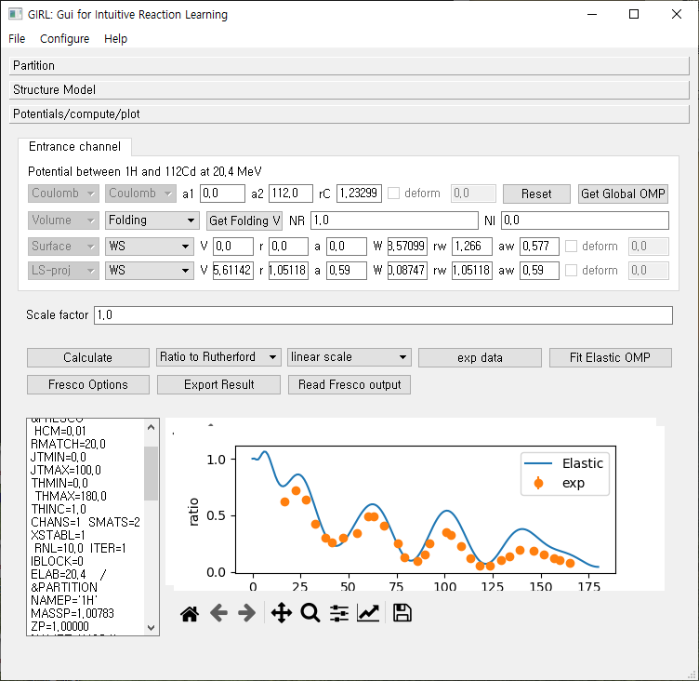
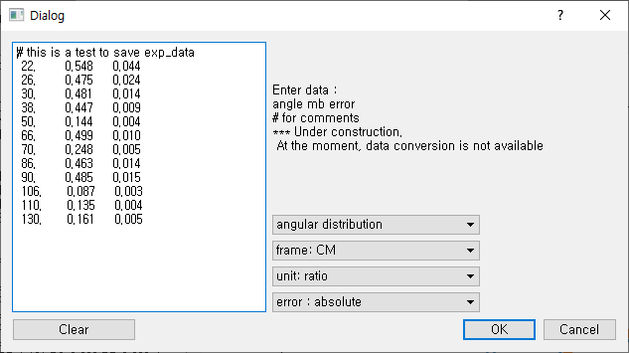
Experimental data input
Exp
data

Slide 19
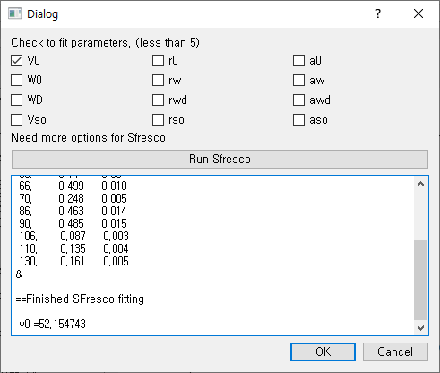
Fitting of optical potential parameters
For elastic scattering
(need to press “exp data” once.)
Fit
Elastic
OMP

Slide 20
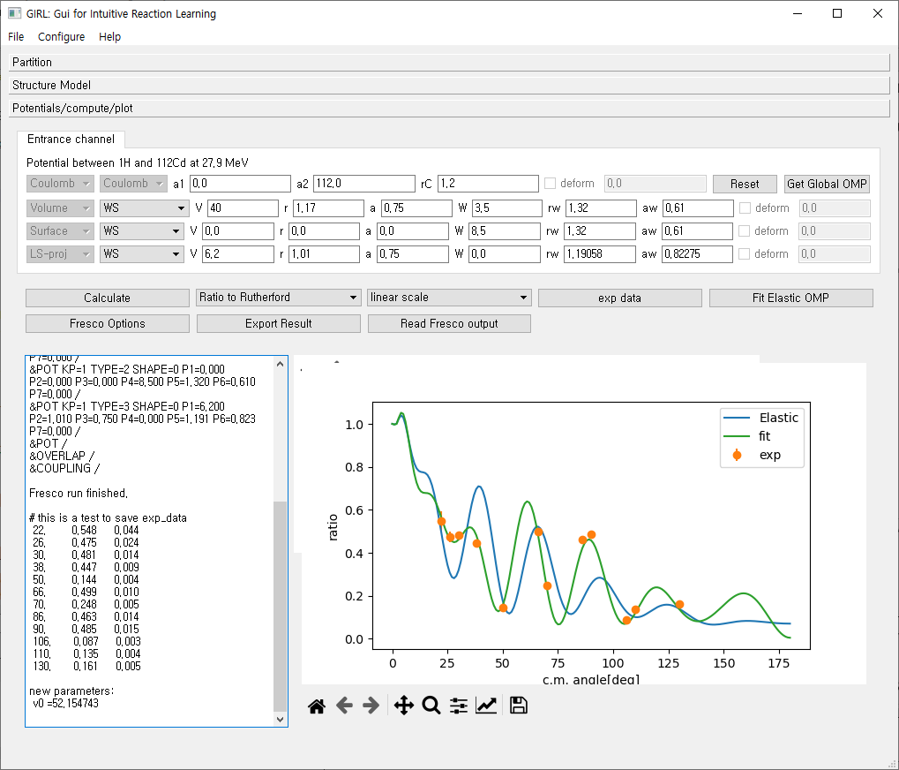
Result of fitting
At the moment, no automatic update of parameter after fitting available

Slide 21


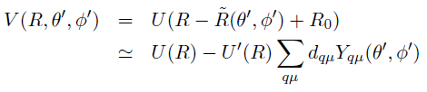
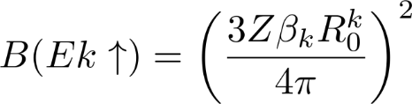
Inelastic scattering (Rotational Model)
I
I : spin of nuclei
K: bandhead ,
Spin projection at body-fixed frame
K
Symmetry axis
Deformed Nucleus
Deformed potential
In z’-axis, R0(1+beta)
R

Slide 22
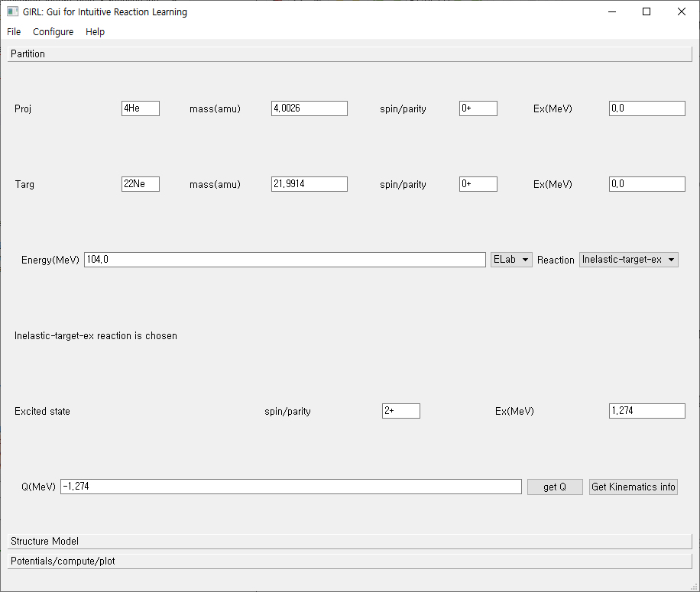
Inelastic scattering case

Slide 23
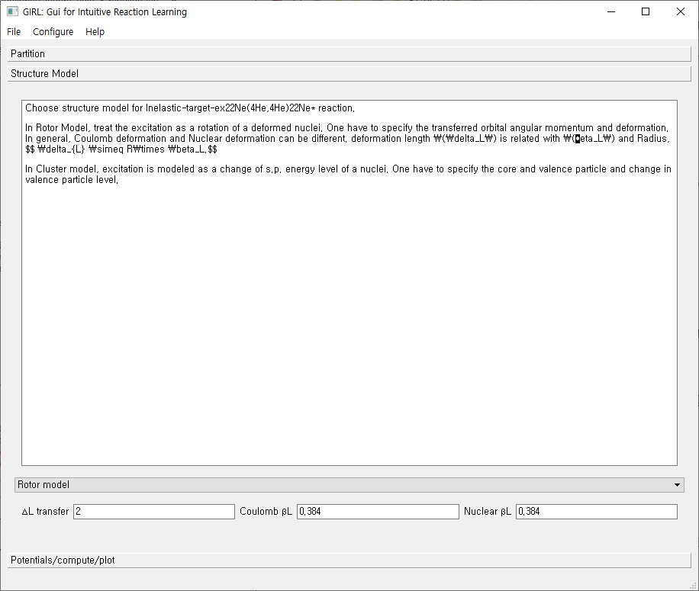
Deformation length
Is calculated
With r0=1.2

Slide 24
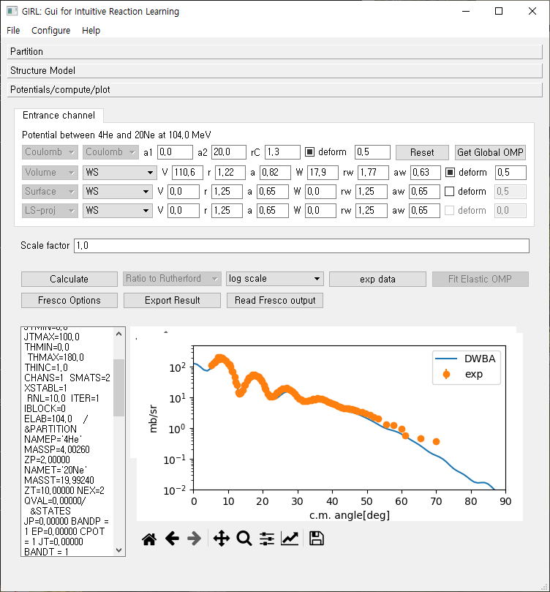

Slide 25






Transfer reaction
p(=c+n)+c’ → c+t(=c’+n)
In rearrangement,
initial and final partition is different.
n
c
DWBA need
Optical potential in entrance channel
Optical potential in exit channel
Binding potential in entrance channel
Binding potential in exit channel
(optional) Core-Core potential
c’
p=c+n
t=n+c’

Slide 26
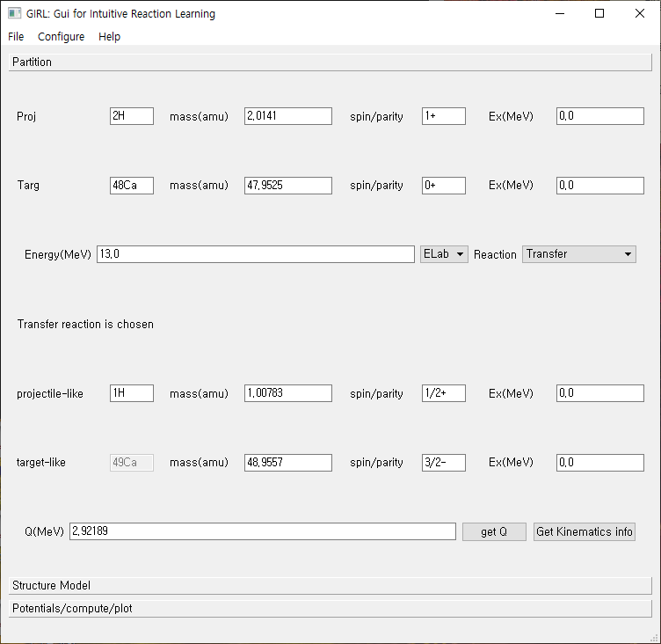
Transfer reaction case

Slide 27
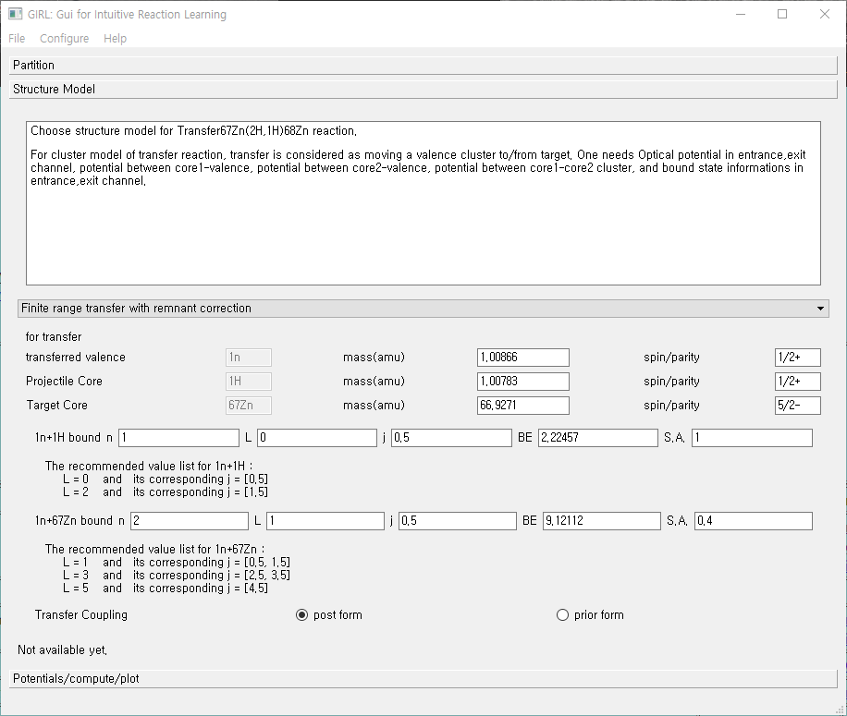
N, L, J of cluster state
S.A. = spectroscopic
amplitude
Post/prior form

Slide 28
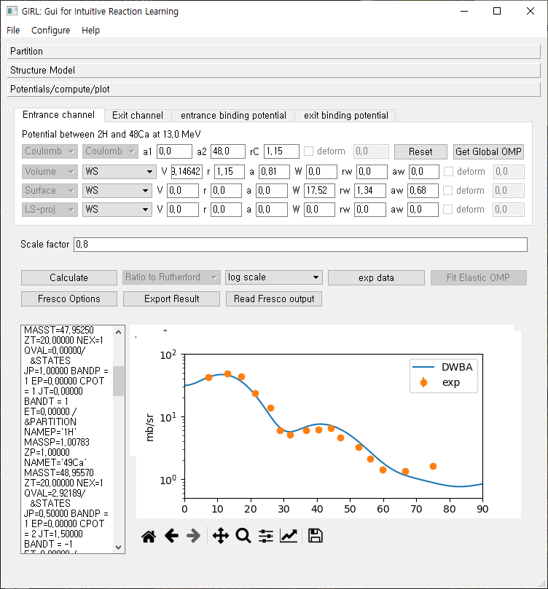
Bound state
Wave functions
Are obtained in
Well-depth
Prescription
Always check
Parameters.
No automatic
Determination
Of potential parameter
Is Available.
One can export
The result of DWBA
Calculation as a file.

Slide 29
Summary/Plan
Development of a simple GUI program for RAON Users to do reaction calculation.
At the moment, it is aimed to do DWBA calculation for elastic , in-elastic, transfer reaction in a very simple structure model.
Later, plan to add radiative capture, fusion reaction and coupled channel methods(also ADWA, CDCC).
Also, trying to include several useful functions for the convenience of Users. (Larger collection of optical potential, frame conversion etc.)

Slide 30
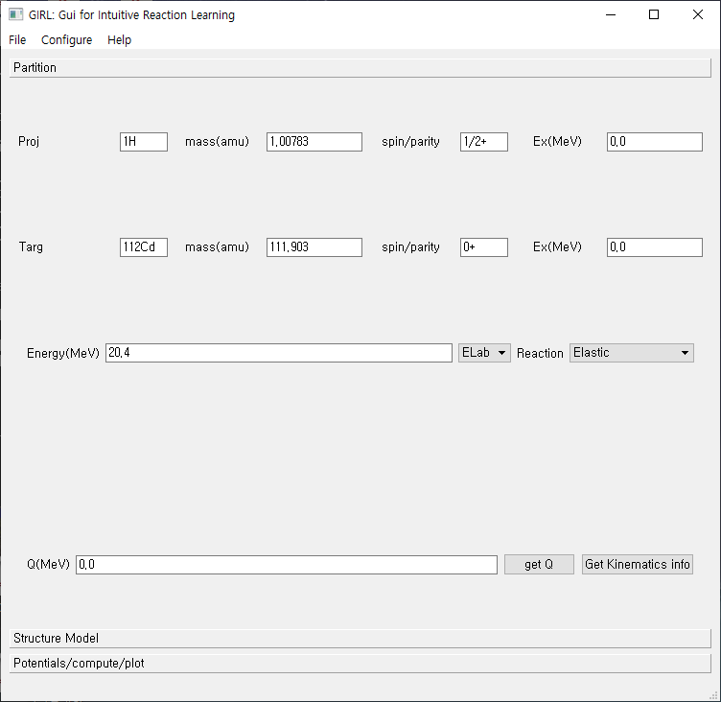
Ex1: Elastic scattering
p+112Cd elastic scattering
At E=20.4 MeV
* Experimental data from
Jour. of Physics, Part G
(Nucl.and Part.Phys.),
Vol.15, p.181 (1989), UK
* You can load this example
By using “Open” in the menu.
(find
“example/Ex1_p_112Cd_E20.4.dat_in”
file)

Slide 31
Ex1: Elastic scattering
p+112Cd elastic scattering
At E=20.4 MeV
* Experimental data from
Jour. of Physics, Part G
(Nucl.and Part.Phys.),
Vol.15, p.181 (1989), UK
* You can load this example
By using “Open” in the menu.
(find
“example/Ex1_p_112Cd_E20.4.dat_in”
file)
Enter projectile and target
information
2. Enter projectile energy
3. Choose “ Elastic “
4. Press “Sturcture Model” tab
5. Press “Potential/compute/plot” tab

Slide 32
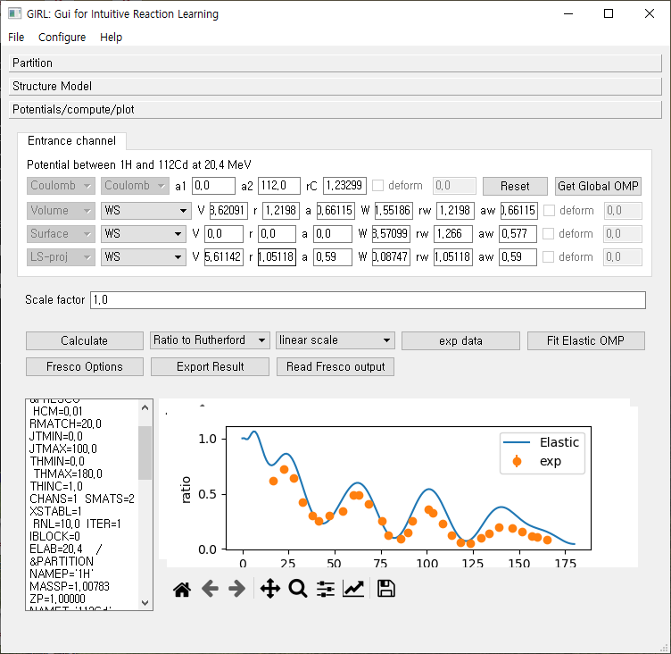
Ex1: Elastic scattering
6. Enter optical potential parameters
(In this example,
press “Get Global OMP”)
7. Choose optical potential parameter
(You may compare results
from different optical potentials)
press “OK”
8. Press “Calculate” button
* You can change the graph
Rutherford ratio <-> mb/sr
Linear <-> Log scale view

Slide 33
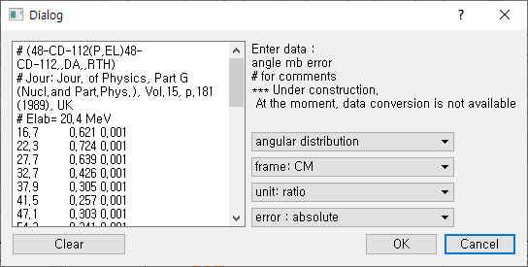
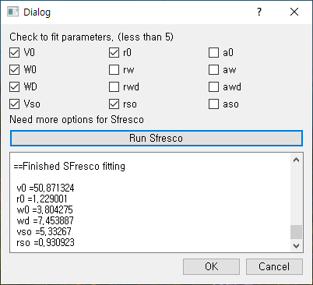
Ex1: Elastic scattering
To input experimental data
Press “exp data” button
Change the information
according to the data.
(reference frame, unit, error)
3. Press “OK”
To fit optical potential parameter
Press “Fit Elastic OMP”
Choose parameters to fit
Press “run sfresco” button
Wait for the fitting
Press “OK”

Slide 34
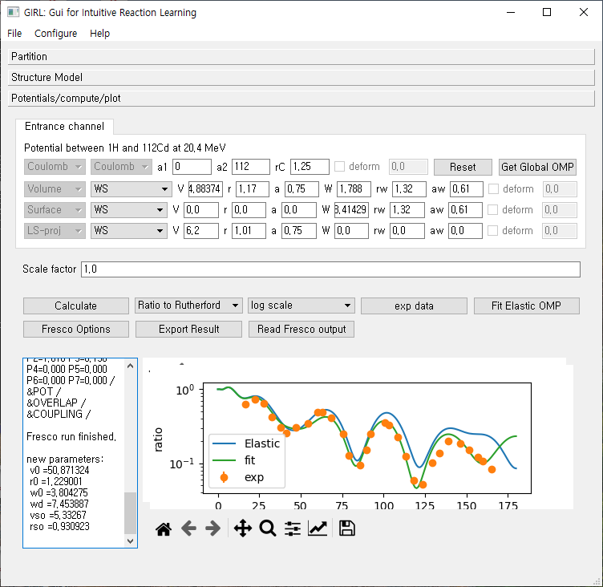
Ex1: Elastic scattering
* Results of before/after fitting
are plotted.
* The fitted parameter values
Are shown in the left text area.
(optical potential parameters are
Not updated automatically.)
You can save the figure by using
the icon below the figure
Or, save as a table by using
“Export Result” button

Slide 35
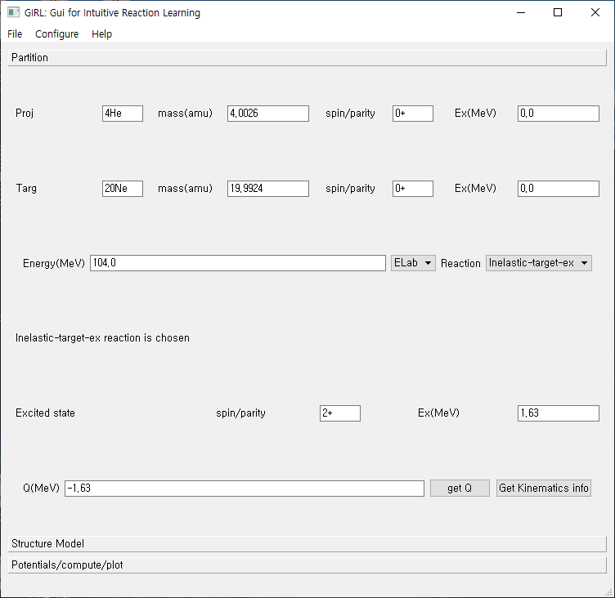
Ex2: Inelastic scattering
20Ne(4He,4He’)20Ne*
At 104 MeV
Inelastic target excitation
You can load this example from
“example/Ex2_He4_Ne20_104_inel.dat_in”
* Experimental data
http://www-nds.iaea.org/EXFOR/D0215.003
Enter projectile and target information
Enter energy
choose “inelastic-target-ex”
Enter excited state information
Press “get Q”
Press “Get Kinematics info” for
the additional information
7. Press “Structure Model” tab

Slide 36
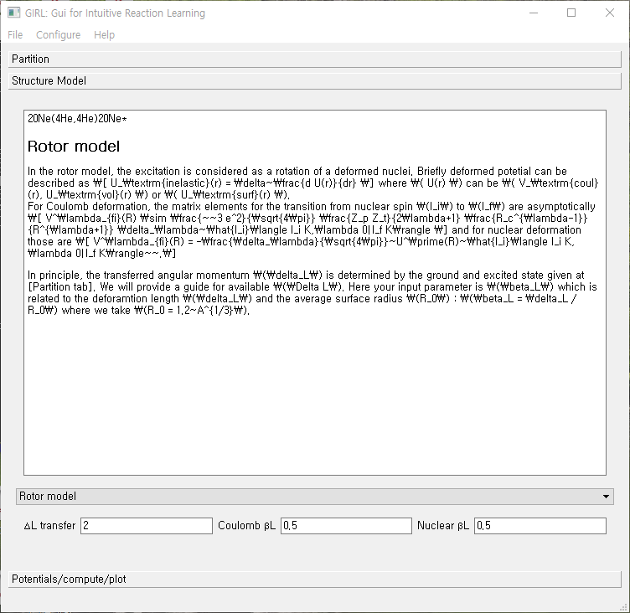
Ex2: Inelastic scattering
Enter transferred orbital angular momentum
(In this example, 0+ -> 2+ transition,
it is 2.)
2. Enter deformation parameter beta values
(Coulomb and Nuclear deformation
can be different)
3. Press the third tab.

Slide 37
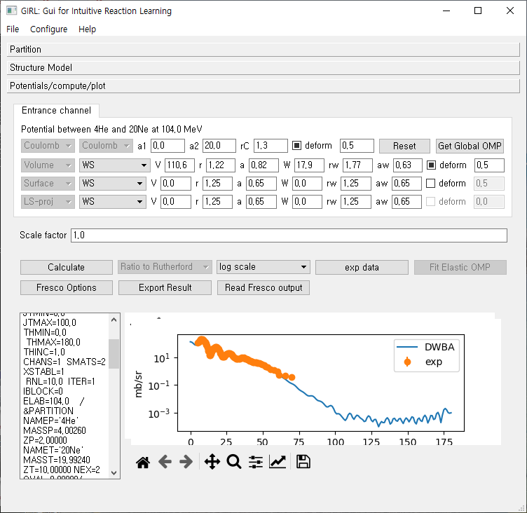
Ex2: Inelastic scattering
Enter optical potential parameters
Modify the deformation parameter
Press “calculate”
To change the range of the graph
You can either
Use Icon below the graph. Or
Press “Fresco Options” and change
THMIN and THMAX value
and press “calculate” again.

Slide 38
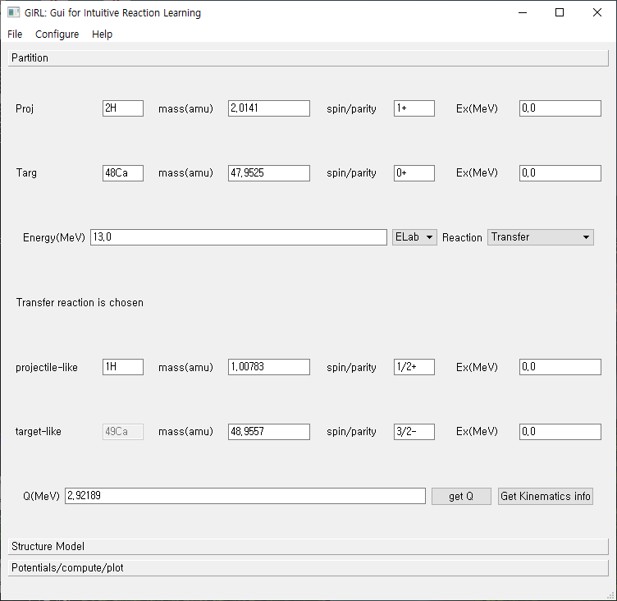
Ex3 :transfer reaction
*48Ca(d,p)49Ca reaction
At 13 MeV.
* Experimental Data from
PRC77,051601(R),(2008)
Example file:
“example/Ex3_Ca48_dp_13.dat_in”
Enter projectile and target
Enter energy and choose reaction
Enter exit channel info
Press second tab(Structure model)

Slide 39
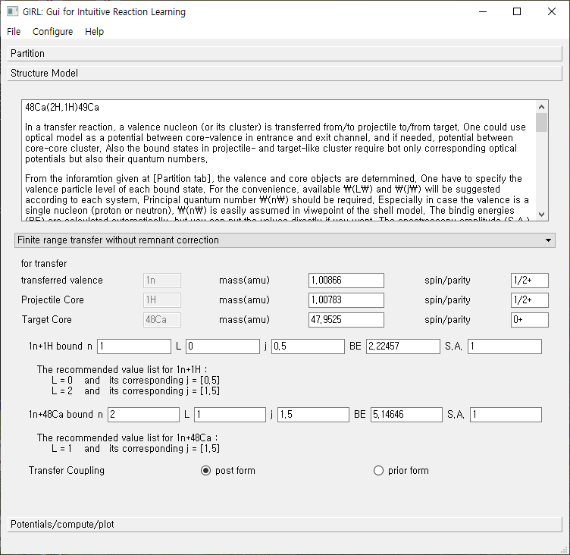
Ex3 :transfer reaction
Structure Model
Choose transfer model
(finite range transfer
with/without remnant correction.
additional model will be added later. )
2. Enter the entrance channel bound state information
3. Enter the exit channel bound state information
4. Choose coupling type
N : principal quntum number (starting from 1)
L : orbital angular momentum of valence particle
J : totoal angular momentum of valence particle (J=L+S)
S.A. : spectroscopic amplitude

Slide 40
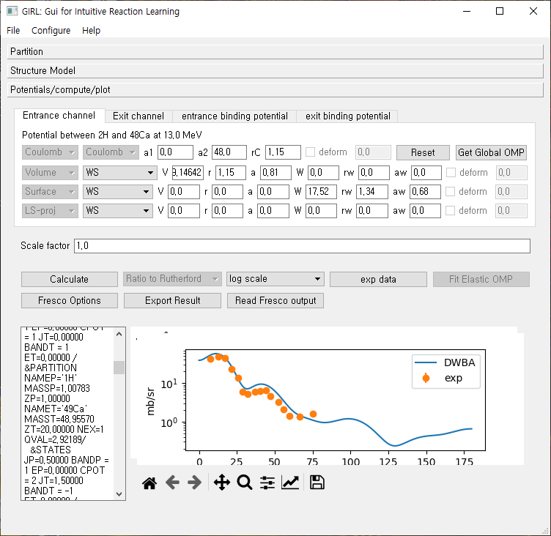
Ex3 :transfer reaction
Potential
Enter entrance channel optical potential
Enter exit channel optical potential
Enter entrance channel binding potential
Enter exit channel binding potential
(Optional) Enter core-core optical potential
Press “Calculate”
Adjust “Scale factor” to fit experimental data.
Sometimes, Fresco may give Error message. Change the options in “Fresco Options” in that case.
(Change HCM, RMATCH, RNL value
add CUTL=… according to the error.)

