Slide 1
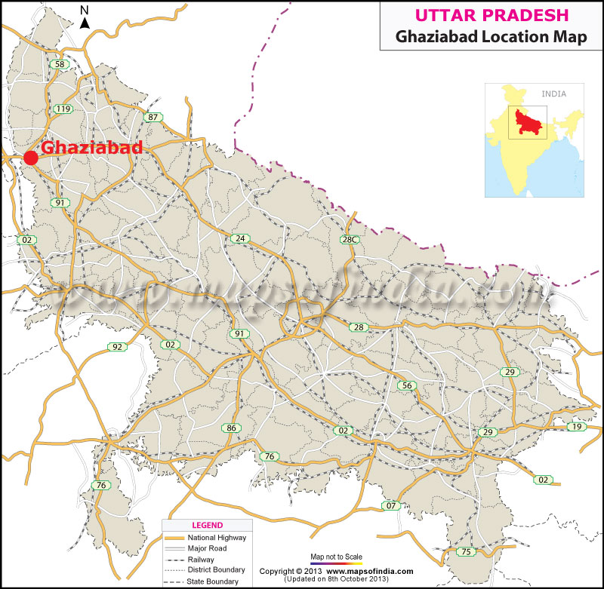
TRAFFIC MANAGEMENT OF
GHAZIABAD

Slide 2
PROBLEM STATEMENT
Traffic management and administration system based solution

Slide 3
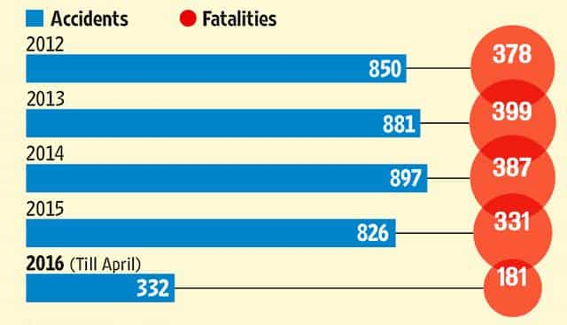
Lets analyse the ACCIDENTS rates of ghaziabad

Slide 4
THE POOR TRAFFIC MANAGEMENT OF GHAZIABAD
1. NO INDICATORS FOR THE VEHICLES ON NATIONAL HIGHWAY 58 AND RAJ NAGAR EXTENSION AREA.
2. DELAYED ACTION BY THE CONCERNED AUTHORITIES DURING ANY KIND OF ACCIDENT.
3. FAILURE OF THE AUTHORITIES TO KEEP A CHECK ON THE MAINTANIENCE OF THE HIGHWAY.
3. NO SUFFICIENT NUMBER OF STREETS LIGHTS ON THE HIGHWAY.
4. PROBLEM OF TRAFFIC CONGESTION

Slide 5
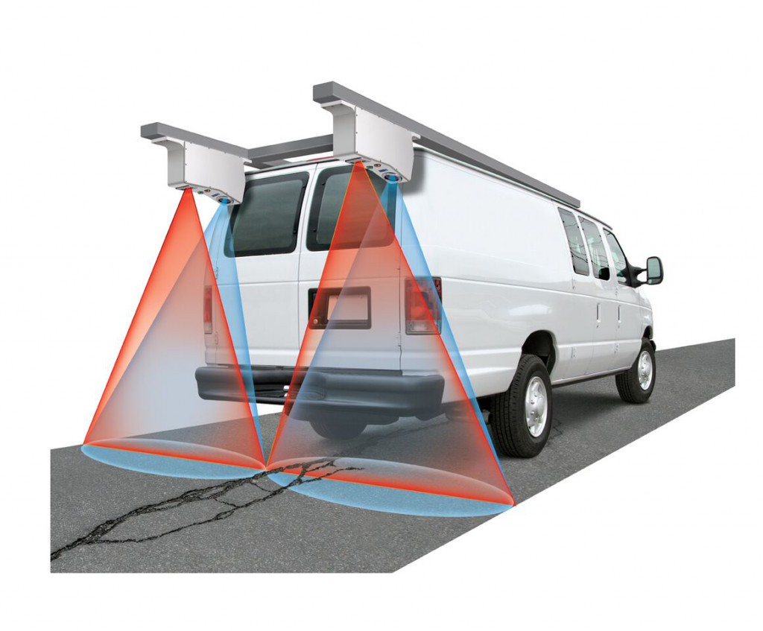
SOLUTION
A laser crack sensor device to detect the cracks and uneven levelling of the roads and to generate the 3-D model for the same
The following device can be assigned for certain ranges ranging from 10 to 20 kilometres.

Slide 6
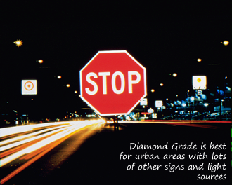
MODIFICATIONS TO IT
THE ROAD STUDS SHOULD BE ELEVATED TO A CERTAIN HEIGHTS FOR HEAVY VEHICLES ESPICALLY FOR THE HIGHWAYS LIKE NH 58. DUE TO THE NARROW VIEW OF THE ROAD IT MIGHT NOT BE POSSIBLE FOR THE DRIVERS TO SEE THE STUDS CLEARLY . ELEVATING THEM TO CERTAIN HEIGHT WILL MAKE IT EASIER FOR THE DRIVER TO SPOT IT FROM A CERTAIN DISTANCE.

Slide 7
COST ISSUE
1.
The funding issue can be prevented by managing the things effectively
….
2.
The toll tax funding can be implemented for this project
……
3.
It will case create jobs prospects for the youth as it will require a tem work
……

Slide 8
PROBLEMS INTERLINKED
TRAFFIC
ACCIDEDNT
POLLUCTION
DAMAGED ROAD
DELAYED ACTIONS

Slide 9
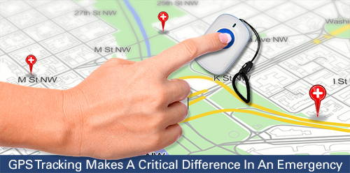
GPS ALERT
In case the respective victim is unable to contact the respective authorities , the website is provided with a alert link so that they can get exact location of the accident.

