Slide 1
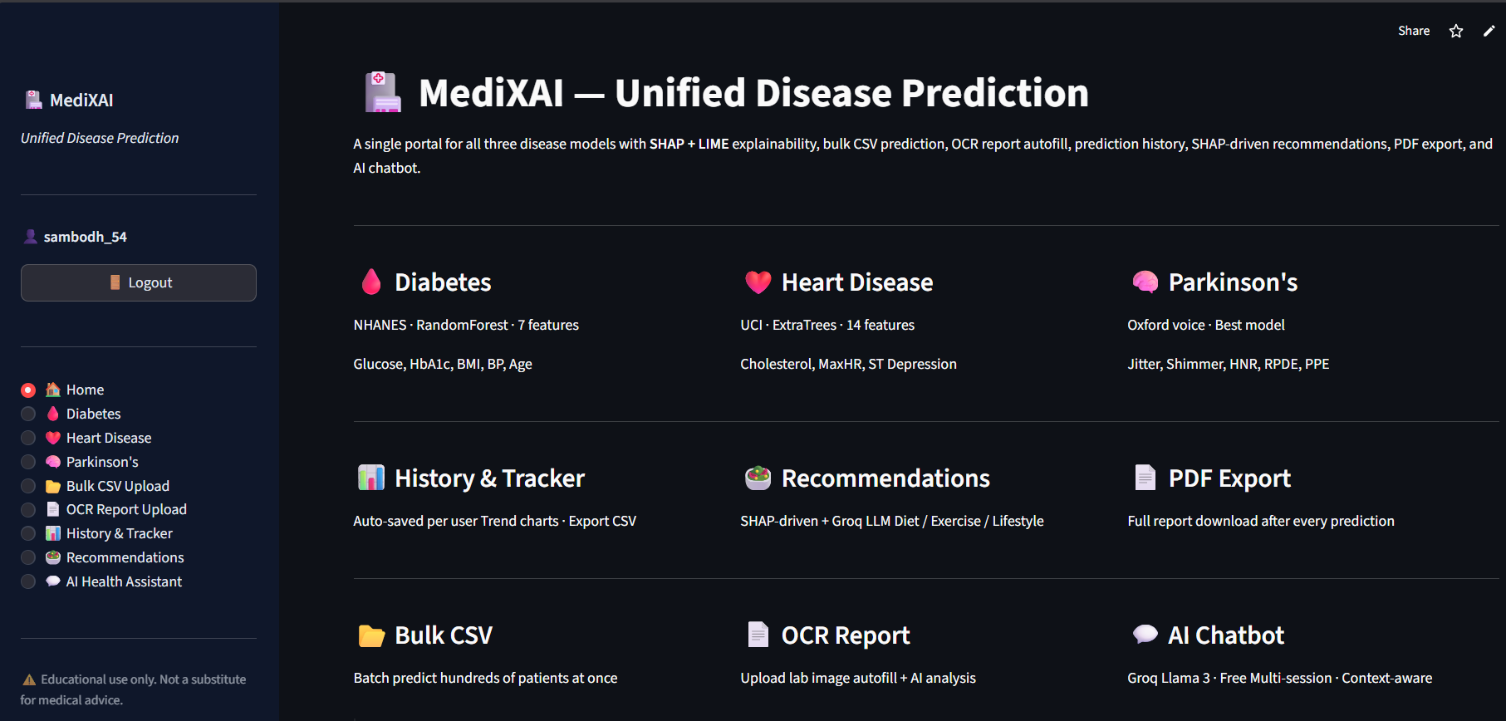
IIIT Senapati, Manipur · Dept. of Computer Science & Engineering
MediXAI
Sambodh Gupta
Roll No: 230101019 Semester VI · B.Tech CSE
Supervised by
Dr. Kishorjit Nongmeikapam
Associate Professor, CSE
IIIT Senapati, Manipur
April 2026
Explainable Unified Multi-Disease Prediction System
Diabetes
Heart Disease
Parkinson's
530M+
Diabetics
17.9M
CVD Deaths/yr
10M+
Parkinson's

Slide 2
Introduction, Motivation & Contributions
Problems with Existing Systems
MediXAI vs Existing
My Contributions
Opacity
Feature | Others | MediXAI
Diseases | 1 | 3
Explainability | NA | SHAP+LIME
Web UI | NA | Streamlit
AI Chatbot | NA | Groq LLaMA
OCR / CSV | NA | Tesseract
PDF Report | NA | fpdf2
Dataset Pipeline
Black-box models give no explanation — a barrier to clinical trust.
Programmatic NHANES CDC download, merging, imputation for 10,000+ records
Fragmentation
17-Algorithm Benchmarking
Existing tools are single-disease; no unified multi-disease platform.
Bagging, Boosting, Ensemble & Individual classifiers per disease
Accessibility
Research models live in Jupyter notebooks, inaccessible to clinicians.
XAI Integration
SHAP TreeExplainer + LIME TabularExplainer with real training-data backgrounds
Objectives
1. Unified prediction for 3 chronic diseases
Feature Engineering
3 composite heart features + 3 voice features for Parkinson's
2. Best ML model via 17-algorithm benchmarking
3. SHAP + LIME for feature-level explanations
Full-Stack Web App
4. Accessible UI + OCR + AI chatbot + PDF export
14-module Streamlit app: auth, OCR, bulk CSV, chatbot, PDF, history

Slide 3
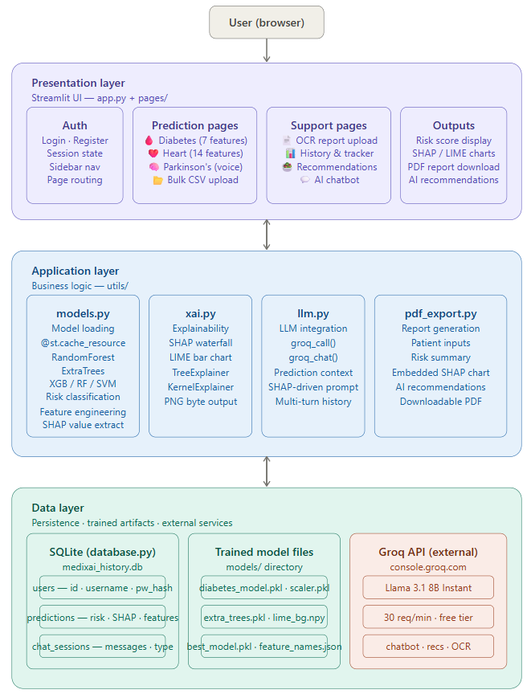






System Architecture & Tech Stack
Tech Stack
Python 3.10+
SQLite3
Streamlit
Pickle model artefacts
SHAP + LIME
fpdf2 Reports
XGBoost / RF / ExtraTrees
pytesseract OCR
Matplotlib / Plotly
Groq Llama 3.1
SHAP Charts
AI Health Chatbot
Pipeline: Input → Preprocessing → ML Inference → SHAP/LIME → Risk Score + PDF + Chatbot

Slide 4
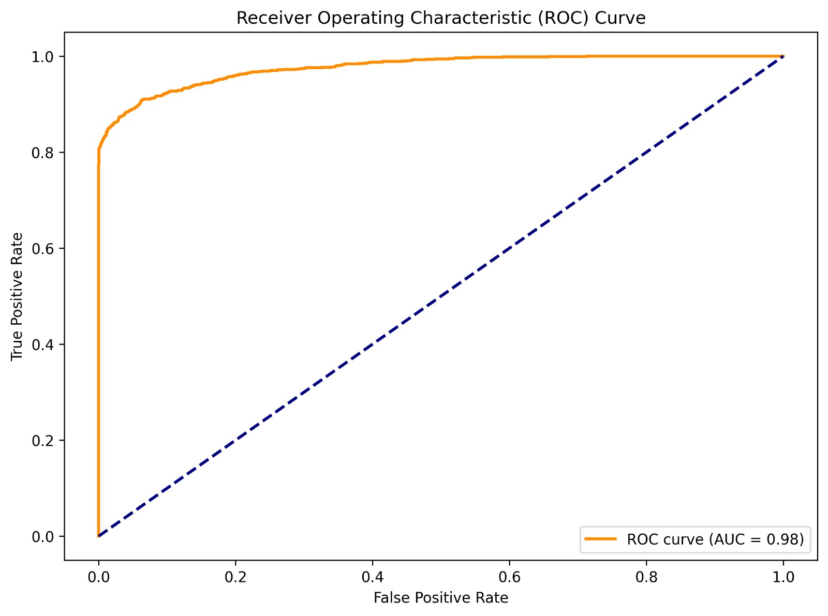
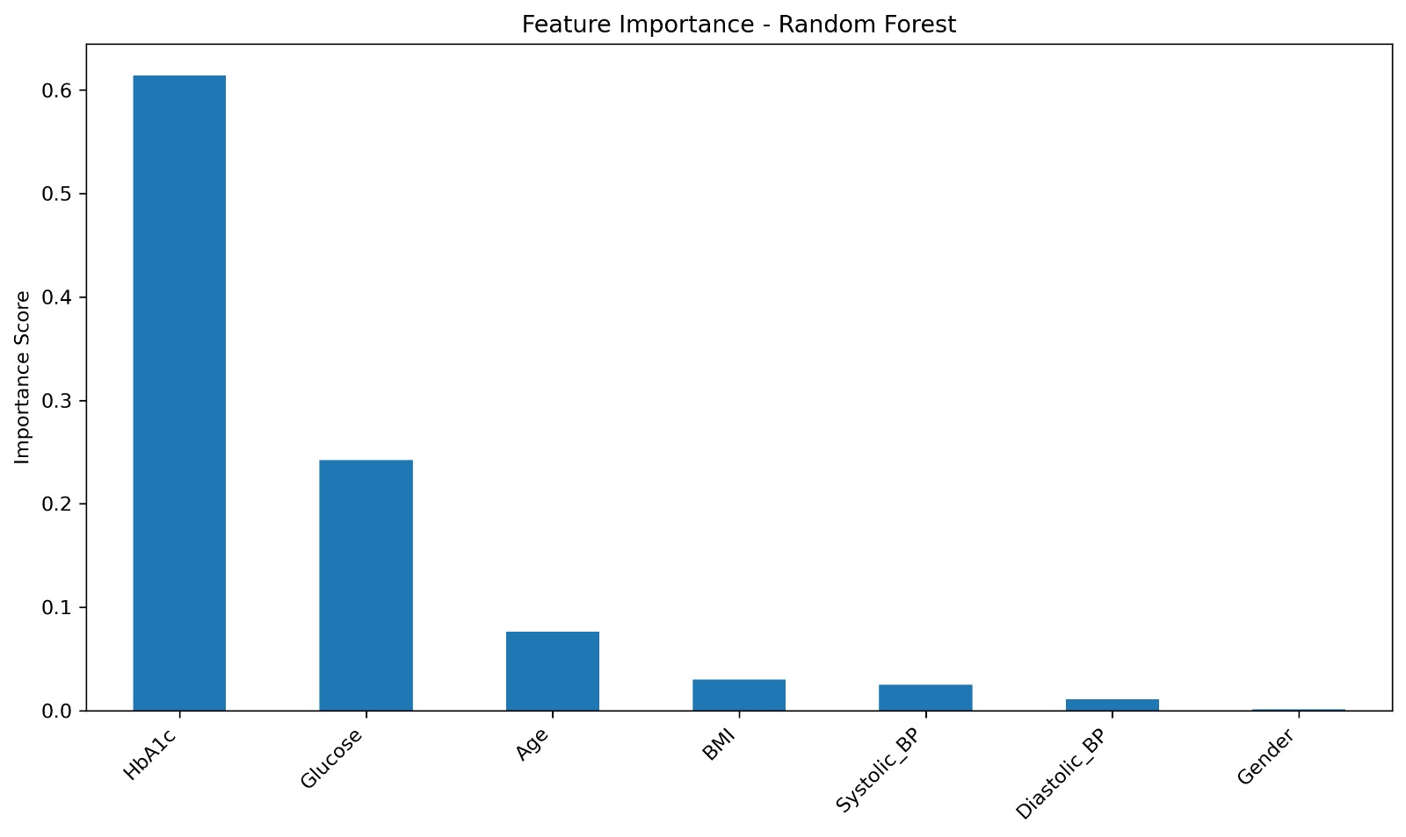
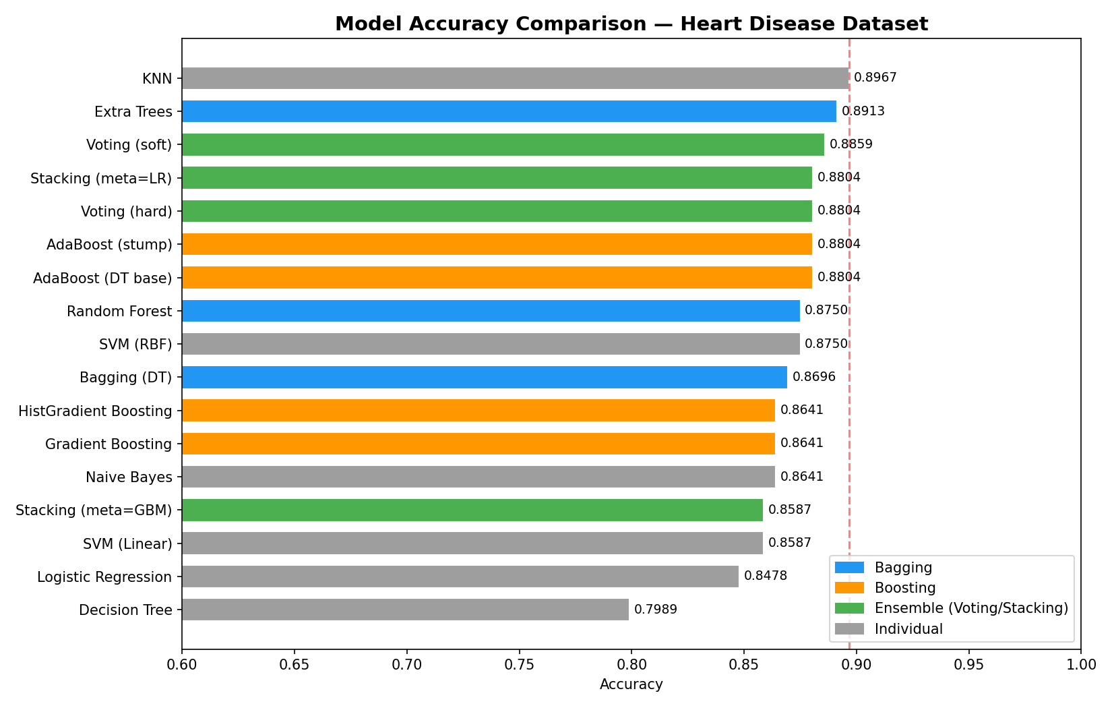
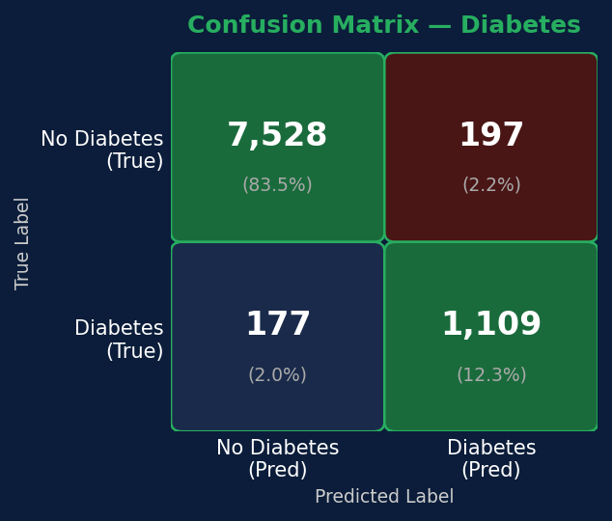
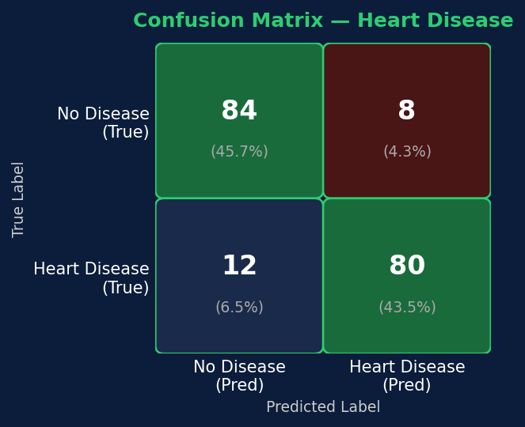
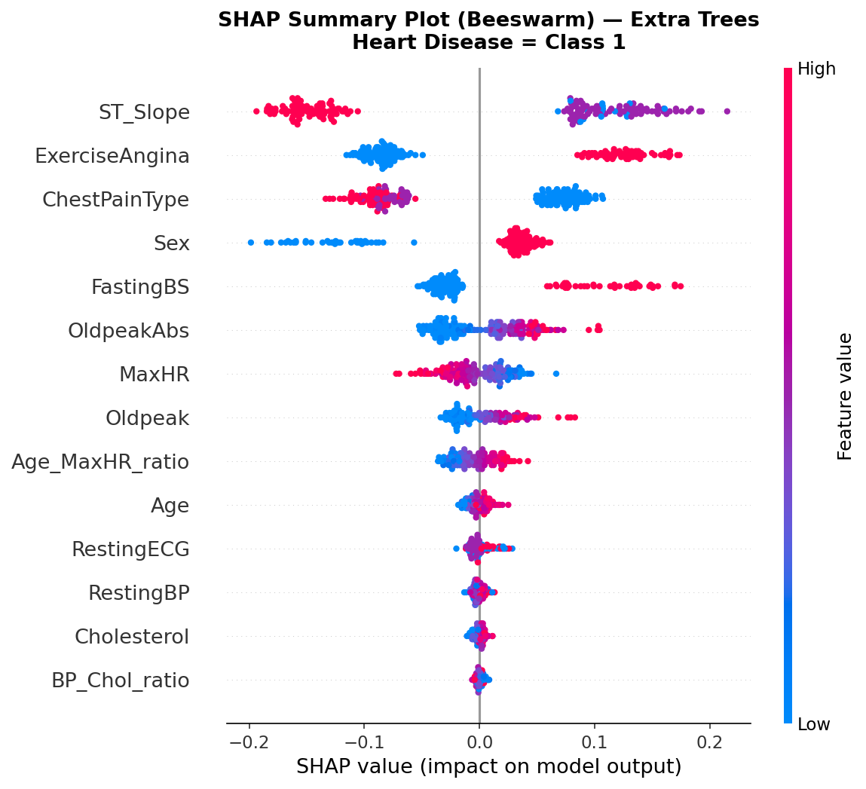
Results — Diabetes & Heart Disease Models
Diabetes — Random Forest on NHANES
Heart Disease — ExtraTrees (Best of 17)
95.85%
0.9761
92%
89.13%
0.97
91.1%
Accuracy
ROC-AUC
Recall
Accuracy
ROC-AUC
10-Fold CV
ROC Curve (AUC=0.98)
Feature Importance
17-Algorithm Comparison
Confusion Matrix — Diabetes
Confusion Matrix — Heart
SHAP Feature Attribution (Heart)
Glucose = 26.89 × HbA1c − 45.54

Slide 5
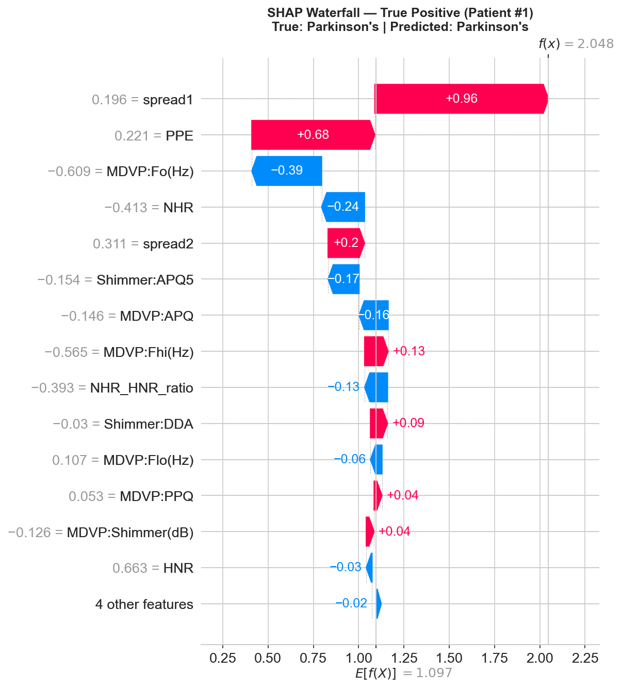
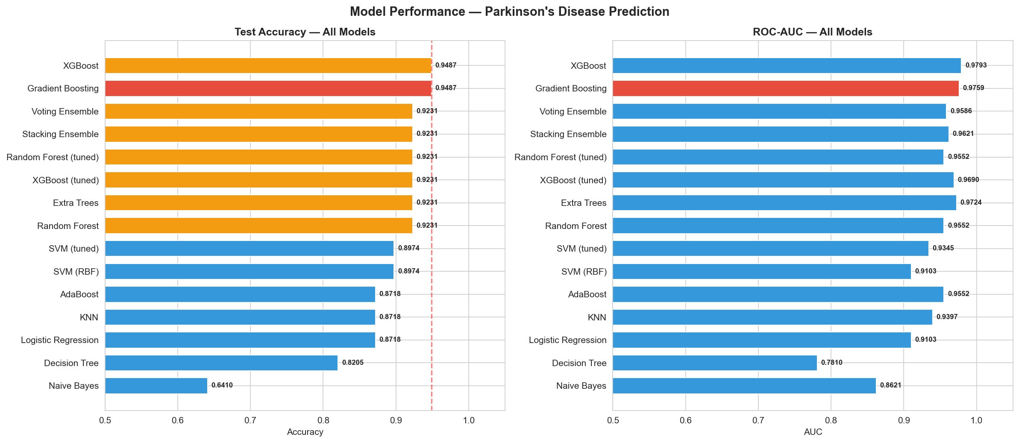
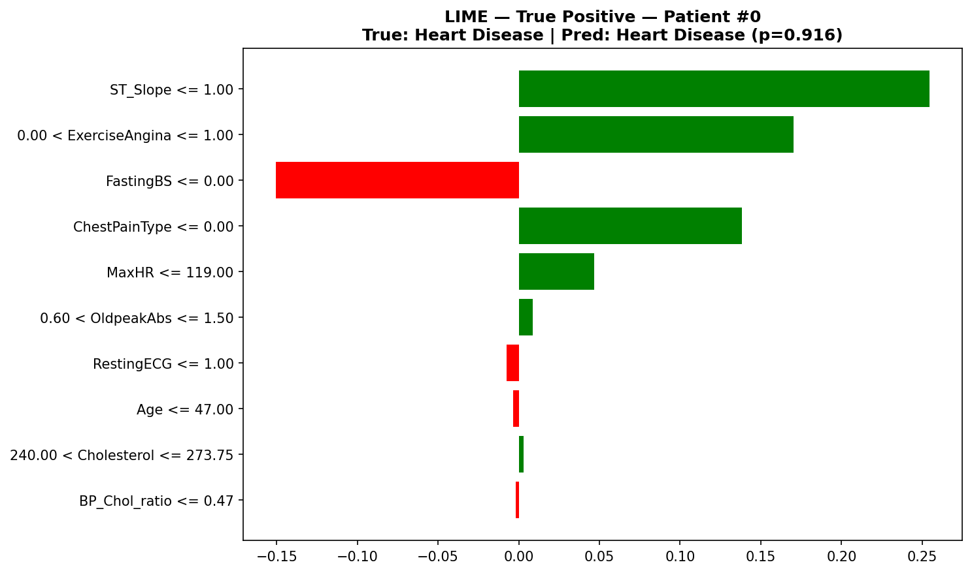
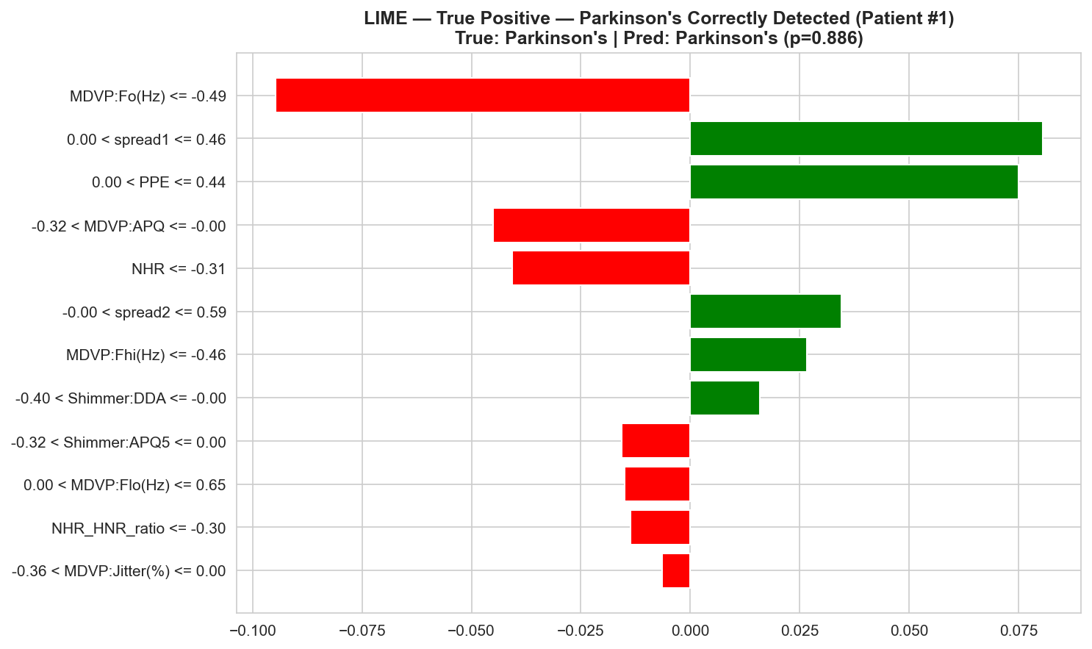
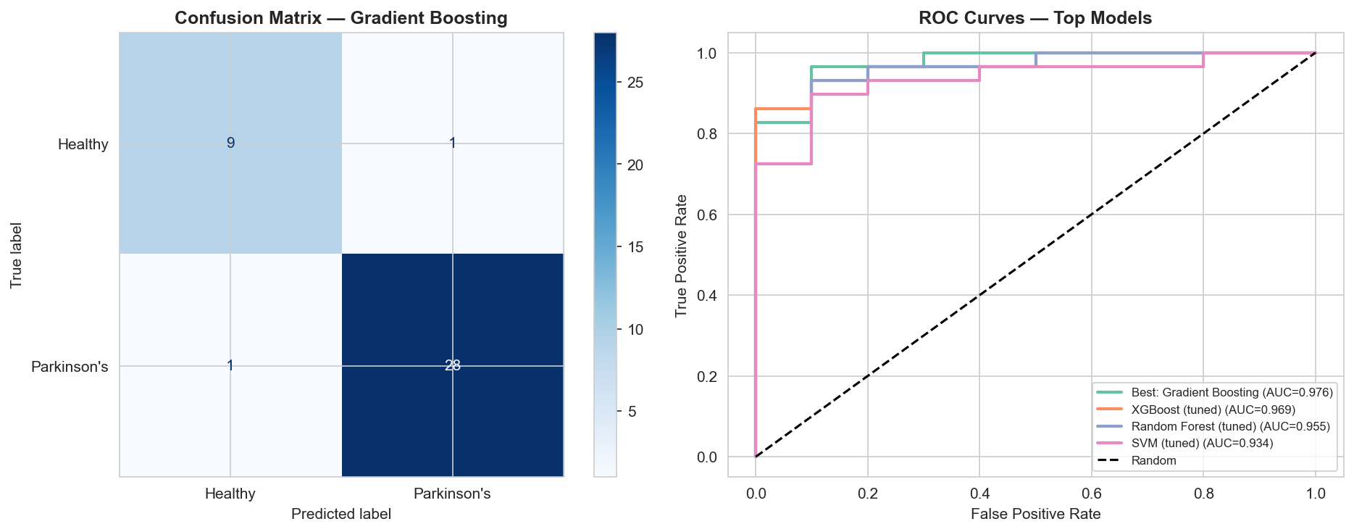
Results — Parkinson's Model & Explainability (SHAP + LIME)
Parkinson's — XGBoost on Oxford Voice Dataset
Explainability: SHAP Waterfall + LIME
~95%
0.9793
~97%
SHAP Waterfall — Parkinson's True Positive
Accuracy
ROC-AUC
Precision
Multi-Algorithm Accuracy & AUC
LIME — Heart Disease (left) & Parkinson's (right)
Confusion Matrix & ROC Curves
SHAP & LIME agree on top features — mutual reinforcement builds clinical confidence.

Slide 6
Conclusion & Future Scope
95.85%
89.13%
~95%
0.97
0.9793
Diabetes
(Random Forest)
Heart Disease
(ExtraTrees)
Parkinson's
(XGBoost)
Heart Disease
AUC
Parkinson's
AUC
Key Findings
Future Scope
SHAP + LIME materially improve clinical trust — consistent agreement on top features
EHR Integration via FHIR API
Real-time clinical data from hospital records
Ensemble methods outperform all individual classifiers by 6–12% accuracy
Federated Learning
Privacy-preserving model training across hospitals
Feature engineering validated by SHAP — domain knowledge adds measurable value
Longitudinal Modelling
Wearable & time-series risk trajectory assessment
Real training-data LIME backgrounds produce stable, clinically coherent explanations
Expanded Disease Coverage
CKD, stroke risk, liver disease, depression modules
Modular architecture: new disease modules added without touching existing code
Cloud & Mobile Deployment
Docker containerised, scalable on AWS/GCP

