Slide 1
Search
Name |  | Modality |  | Date |  | Status
No | Patient Name | Modality | BirthDay | Status | StartDate | EndDate | Link
1 | Alexey | CT | 4/3/1990 | progress | 10/1/220 | 10/2/220
First Interface

Slide 2
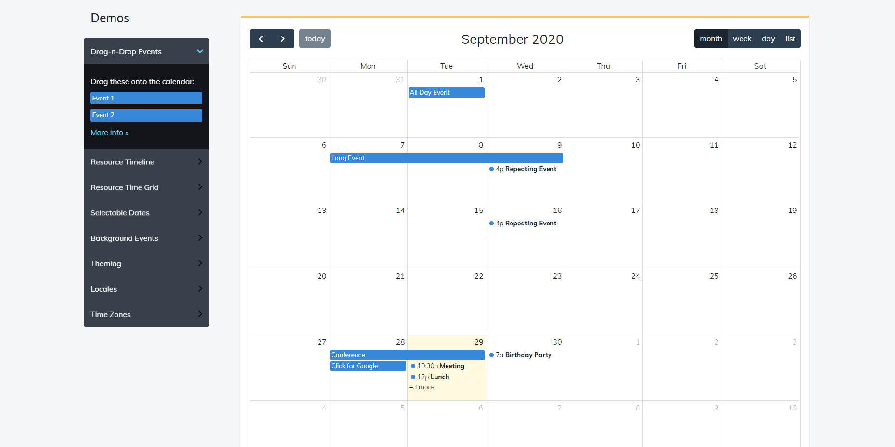
Second Interface

Slide 3
Dicom
Server
Word
order
Broker
report
HL7 MSG
System

