Slide 1
Implementing a Unified DICOM Broker for Cardiology – An Experience
Aravind GunduRao
Philips Healthcare
April 09, 2008

Slide 2
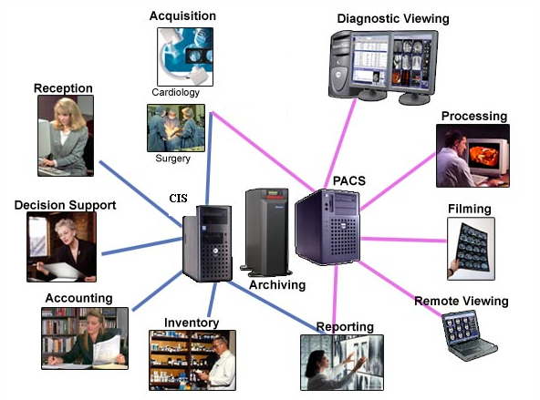
Agenda
Dynamics in Echo and Cath Workflow
Xcelera Connect Unified Broker
Implementing DICOM MWL & MPPS
Using MWL and MPPS in a Multi-Modality Cath Lab
Realizing DICOM compliant Hemodynamic modality
Challenges faced during deployment
Summary

Slide 3
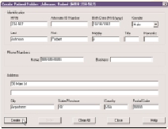
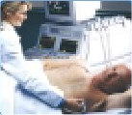
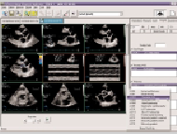
Dynamics in Echo Workflow
Inbound HL7
Automatically transfer demographics & MRN
Check in Patient
Receive ADT from HIS
Order a Study
Perform Exam
Acquire, review,
select & edit images
Perform measurements
& calculations
Export to PACS (Xcelera)
Demographics
& Schedule info to
Modalities
Transfer exams &
measurements
to PACS
Finalize Report
Review serial studies & stress
Measurements & calculations
Score wall motion
Record clinical finding codes
Finalized Echo reports
Clinical data to Repository
Finding codes to HIS
Outbound HL7

Slide 4

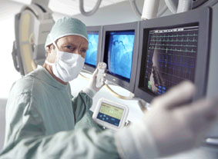
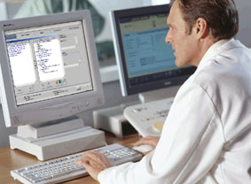
Dynamics in Cath Workflow
Cath Lab front desk
Make worklist for Cath lab rooms
Enter pre-procedure details
Control room
View previous Cath lab reports
Procedure logging
Enter technical details
Control room
Cardiologist’s office
Add images
to report
Create clinical report

Slide 5

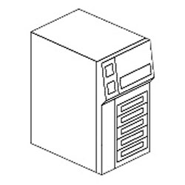
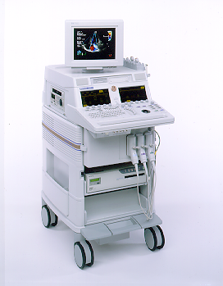
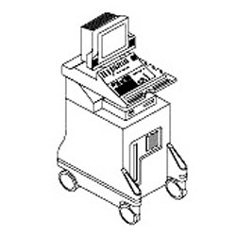
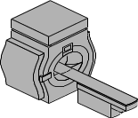
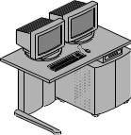





Xcelera Connect Unified Broker
DICOM Modalities
CVIS
US Vascular
US Echo
MR
CV
Hemo
Order Mgmt
Result Mgmt
HL7
Prop
DICOM
HIS
HL7
Patient Mgmt
Financial Mgmt
Archive
Xcelera
Xcelera Connect
HL7
EPR
Xcelera Workstations
Clinical History

Slide 6
Modality Worklist
HIS
DICOM Modality
US
CV
Demographics
CVIS
SCU
Patient Update
(Cath/Echo Orders)
DICOM MWL
HL7
Prepare exam/patient
Perform Exam(s)
Schedule/Update Study
SCP
HL7
Appointment System
Non DICOM
Modality
PACS
HL7
Schedule/
Update Study
Xcelera Connect
(Echo Orders)
Sonos
Xcelera

Slide 7
Modality Performed Procedure Step
DICOM Modality
CV
US
CVIS
SCU
HL7 Compliant
Examination Results
Forward Examination Results
DICOM MPPS
SCP
HL7
PACS
CVIS
DICOM
Xcelera Connect
Forward MPPS
Xcelera
DICOM Compliant

Slide 8
Multi Modality Cath Lab
Procedure starts on a modality
CVIS
DICOM Modality
IVUS
MR
CV
Hemo
Xcelera CLM
Issue MWL Query / Send MPPS
Prepare exam/patient
Perform Exam(s)
Schedule Study / Update Study
DICOM
PPS Status
PACS
HL7
Xcelera Connect

Slide 9
DICOM Compliant Hemo Modality
Hemo
DICOM MWL
CVIS
SCU
SCP
SCU
SCP
DICOM MPPS
Xcelera Connect

Slide 10

Challenges in Deploying the Broker
Migration from the pre-existing broker at the hospital to the new interface engine without affecting the modality topology
Custom requirements at the hospital site
  Custom query
  Worklist filtering
Diagnosing the field issues
DICOM to HL7 Mapping and Vice-Versa

Slide 11

Summary
It is possible to integrate the DICOM needs of Echocardiography workflow and Cardiac Catheterization workflow
This solution can be extended to other departments with in cardiology domain, say Electrophysiology department, to have a unified DICOM broker for Cardiology department
Interoperability, Enterprise brokering and Customization will be the challenge moving ahead

Slide 12


