Slide 1



QUANTUM TRAFFIC BRAIN
Team Lead
Karthick
Team Members
Sriram
Shan
From : Chennai
Team QUAN104
Quantum Traffic Brain

Slide 2
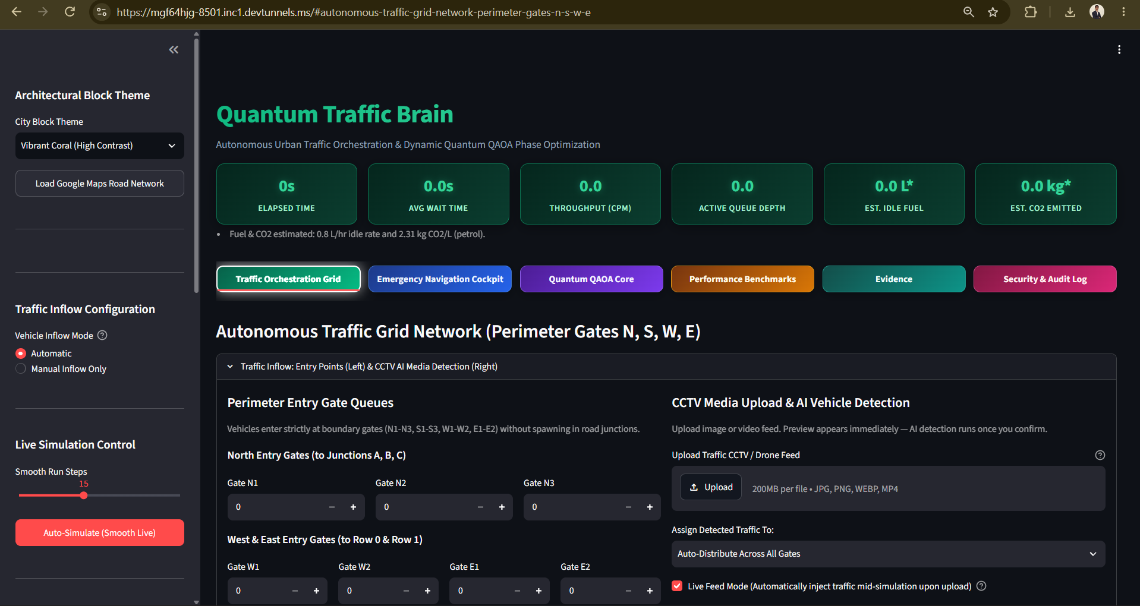
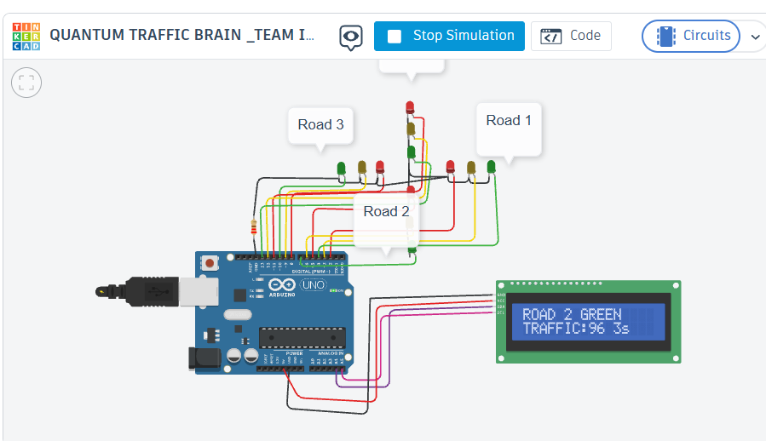
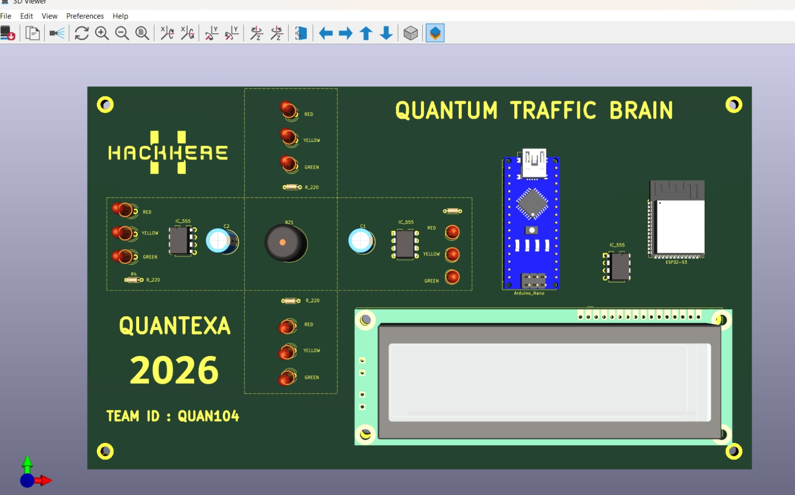
From Problem → Product
----------------------------------------------------------------------------------
Team QUAN104
Quantum Traffic Brain

Slide 3
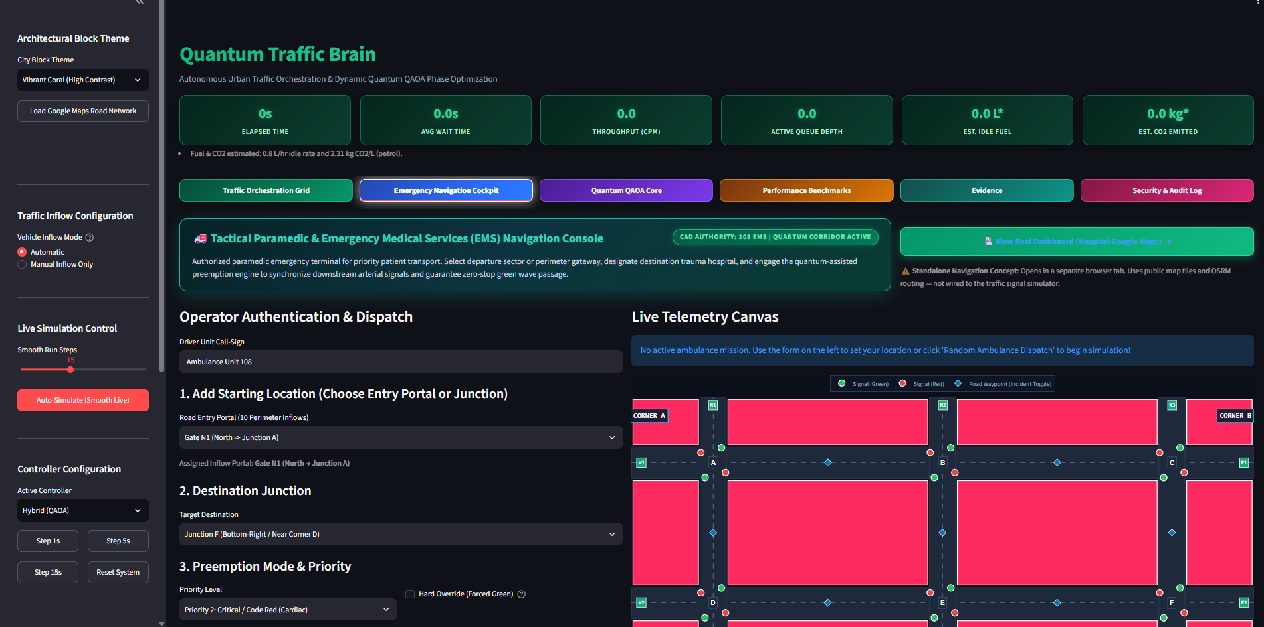
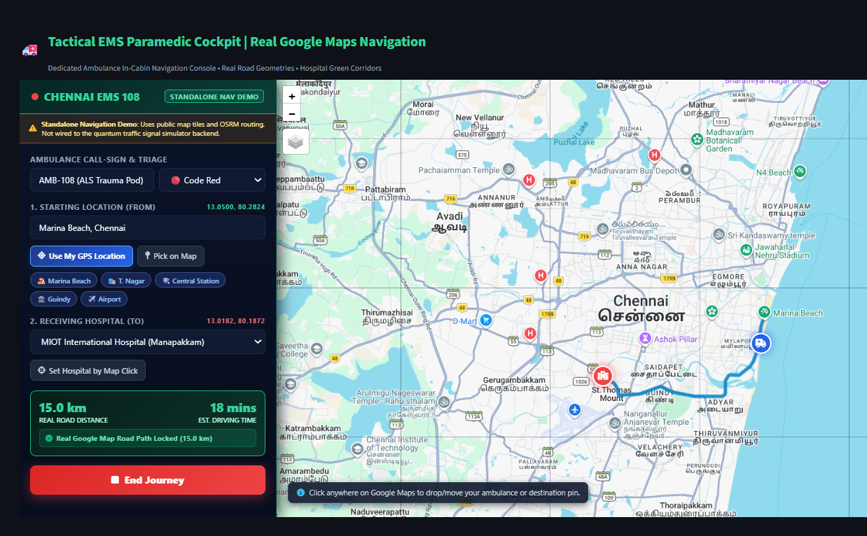
From a real-world traffic problem to a real-world engineered product.
----------------------------------------------------------------------------------
Quantum Traffic Brain
https://mgf64hjg-8502.inc1.devtunnels.ms/ : LIVE PRODUCT LINK
Team QUAN104
Quantum Traffic Brain

Slide 4
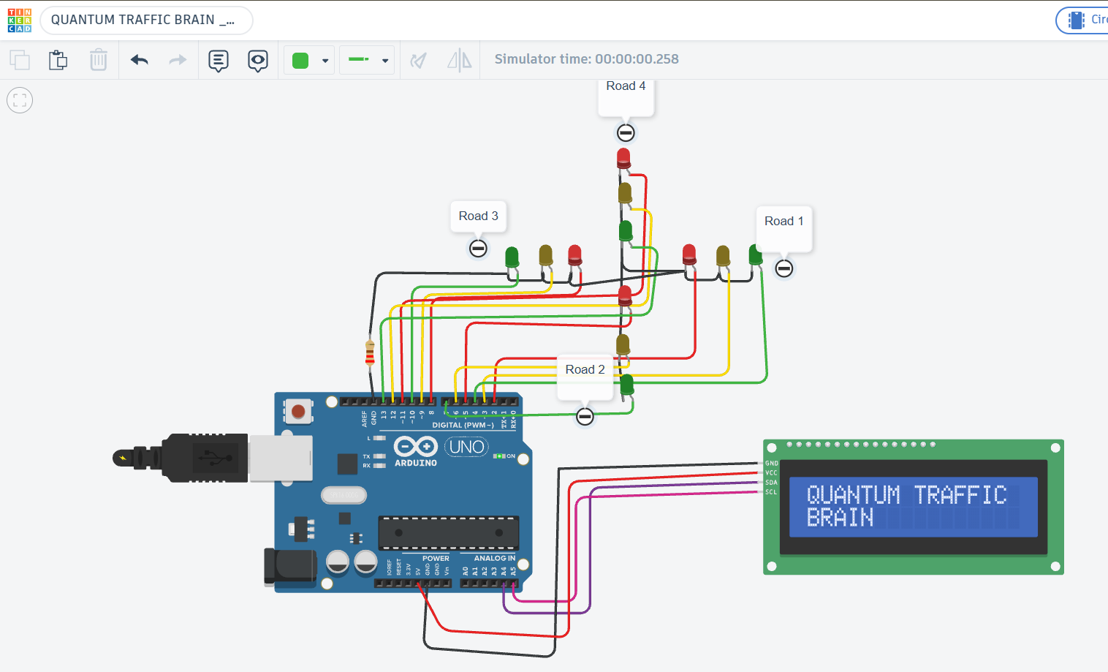
SOFTWARE + SIMULATION PROOF
----------------------------------------------------------------------------------
https://www.tinkercad.com/things/avdV1QiEt6N-quantum-traffic-brain-team-idquan104?sharecode=FS0DLPCgv9yiYIXxlqNLesDsihH7RtUN1n0kKCt6kTU
WE DIDN'T JUST DESIGN IT — WE TESTED IT
Team QUAN104
Quantum Traffic Brain

Slide 5
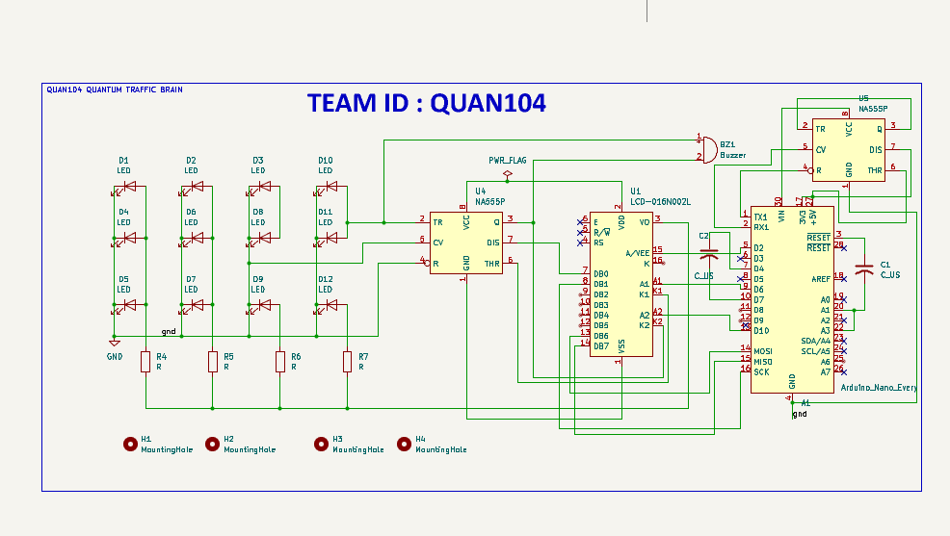
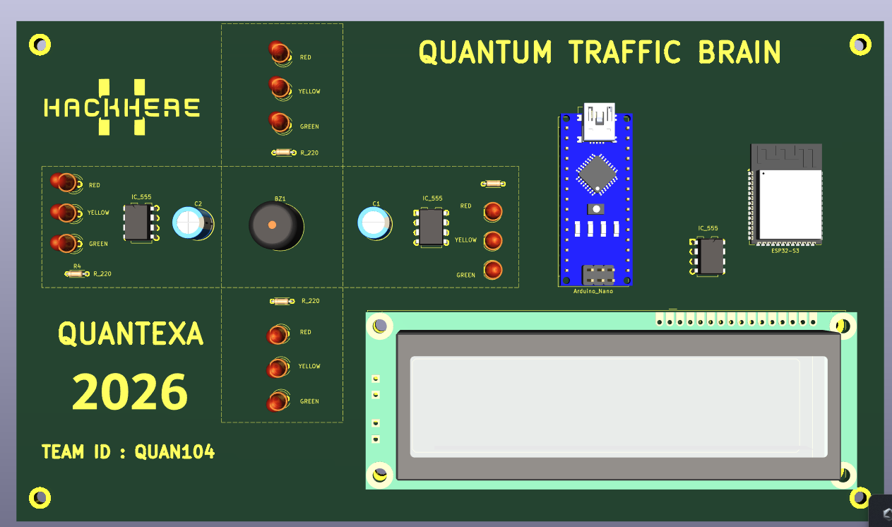
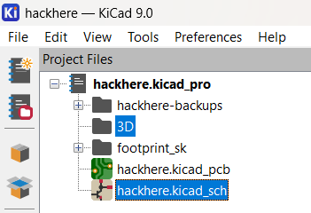
FROM CIRCUIT → CUSTOM PCB → PRODUCT
----------------------------------------------------------------------------------
Team QUAN104
Quantum Traffic Brain

Slide 6
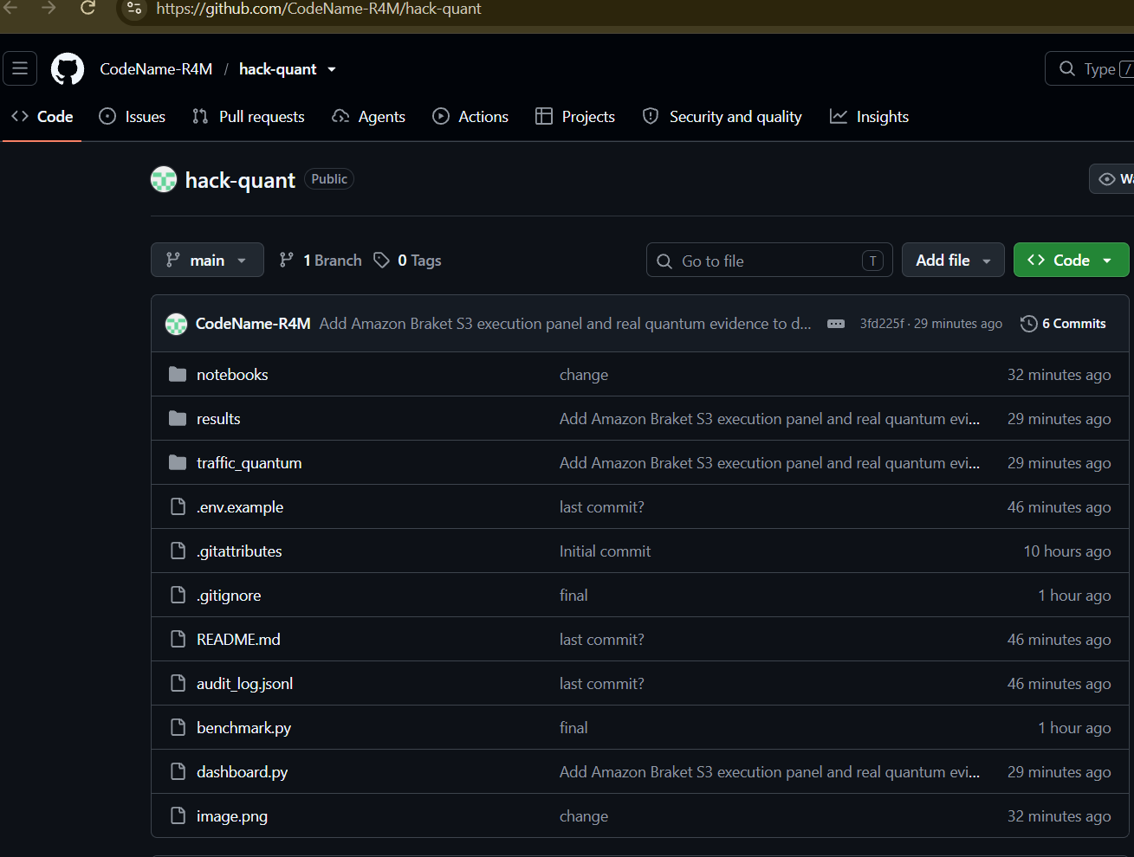

GIT HUB REPO LINK
----------------------------------------------------------------------------------
https://github.com/CodeName-R4M/hack-quant
Team QUAN104
Quantum Traffic Brain

Slide 7
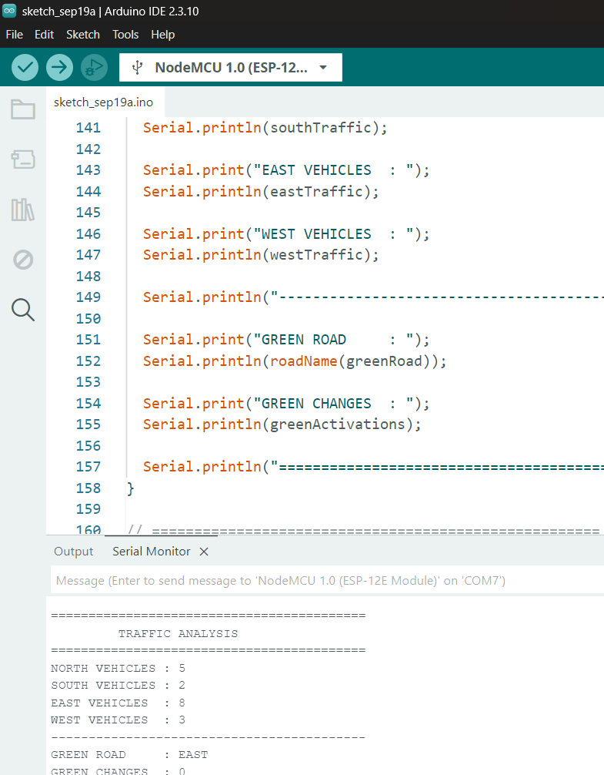
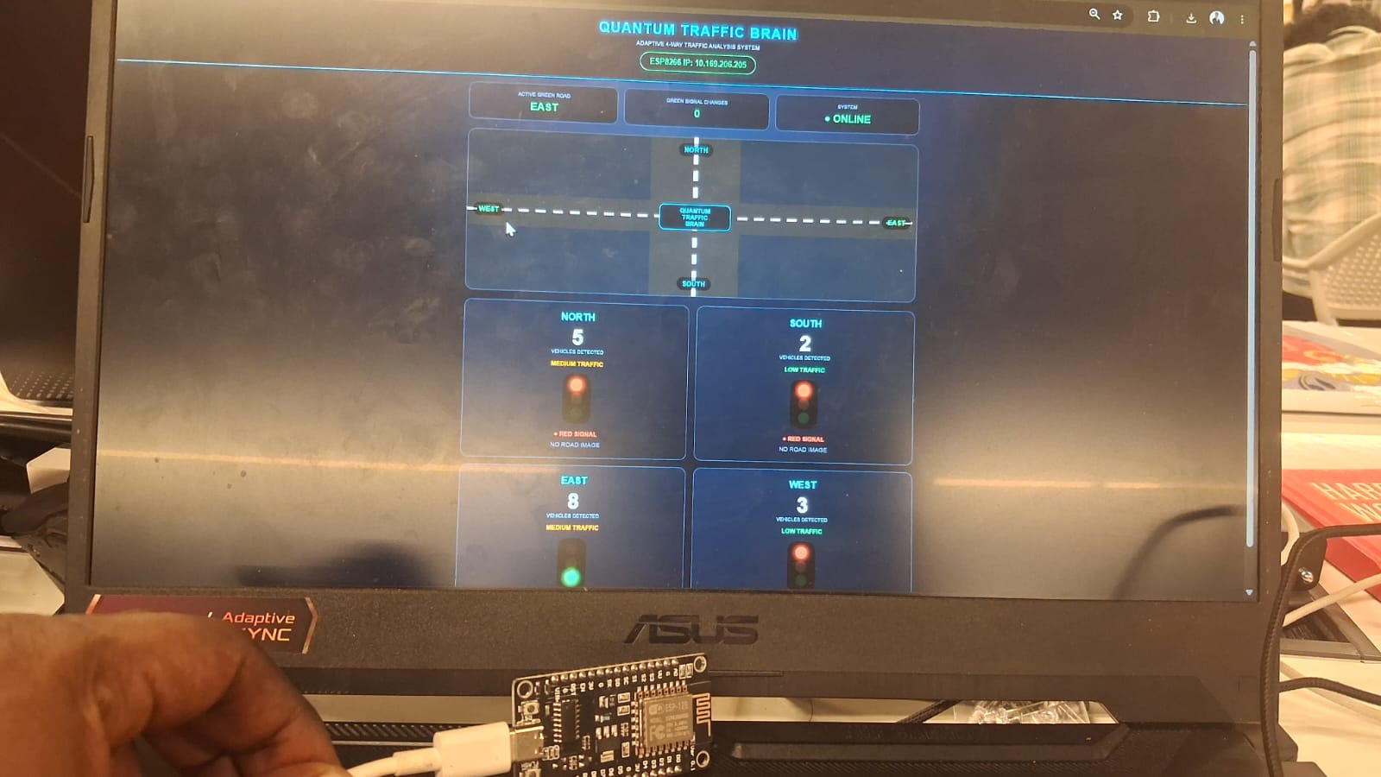
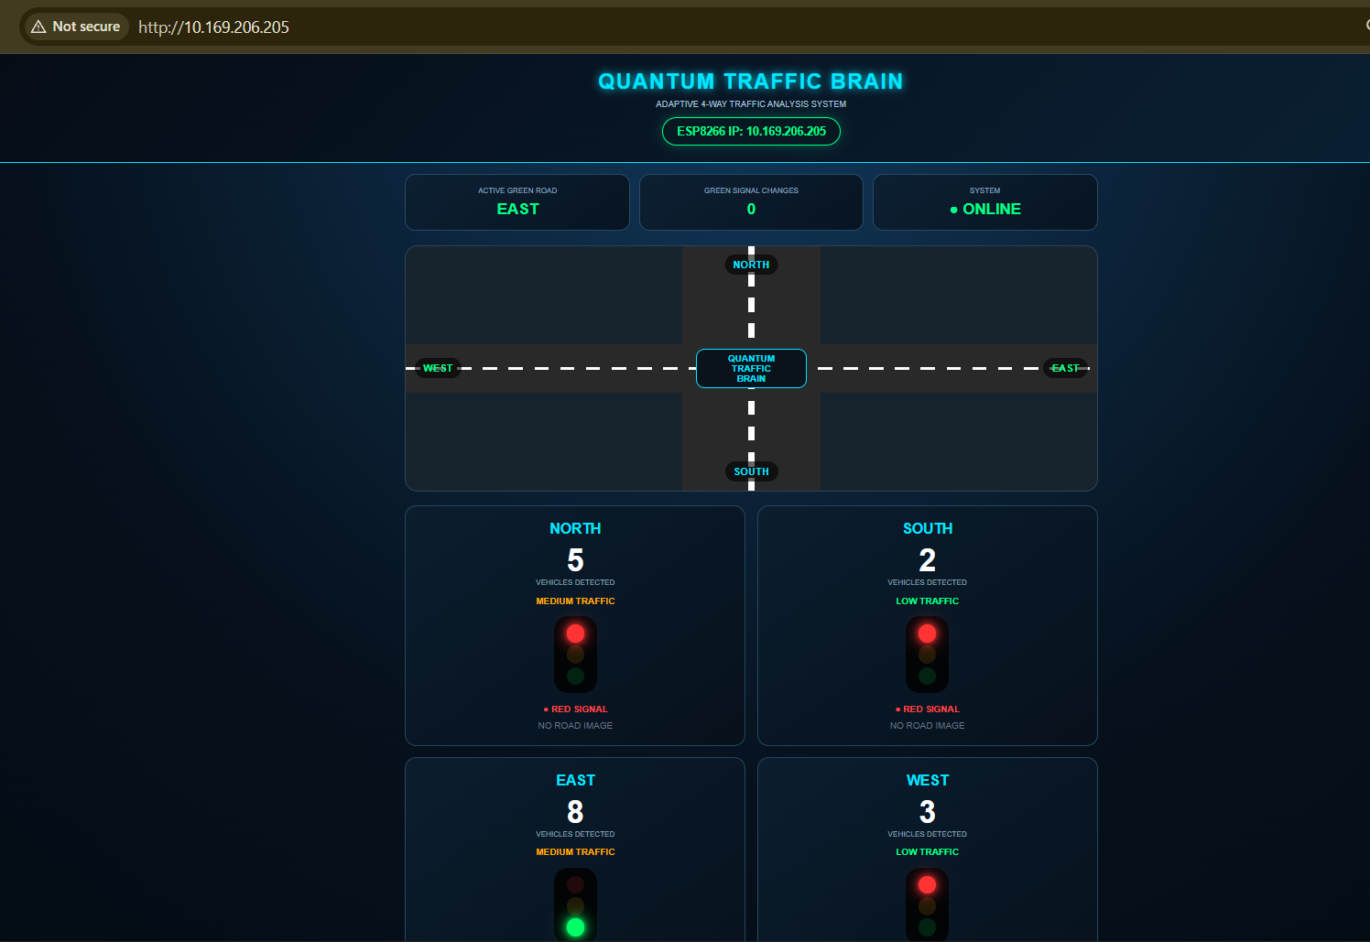
Hardware model design using esp8266 (iot board)
Team QUAN104
Quantum Traffic Brain

Slide 8

“Thank you for this opportunity to innovate, learn, and turn an idea into a working product.”
QUANTUM TRAFFIC BRAIN
From Problem → Prototype → Product
Team QUAN104
Team QUAN104
Quantum Traffic Brain

