Slide 1
East Midlands ERDF Competitiveness Programme
2007-2013
Michelle Targett
ERDF Priority Axis 2 Manager

Slide 2
Changes from the 2000-06 Programme
Less funding for the 2007-13 Programme
Shift in focus to Lisbon
Set within the framework of the Regional Economic Strategy (RES)
No imposed map but a requirement to achieve greater impact and concentration
Mono-funded Programme, i.e. no European Social Fund (ESF) activity
Currently administered by RDAs

Slide 3
Financial Allocation
€ | ERDF | National Public | National Private | Total | Grant Rate
PA1 Innovation and sustainable business practice | 115m | 142m | 30m | 288m | 40%
PA2 Sustainable economic and enterprise activity | 142m | 74m | 10m | 226m | 62.72%
PA3: Technical Assistance | 10m | 10m | - | 21m | 50%
Total | 268m | 228m | 40m | 536m | 50%
Notes:
The East Midlands 2007-2013 ERDF allocation is €268.5m. At current exchange rates this equates to £213.7m having fallen back from a recent high of £216.1m (the lowest Sterling value to date was £177.3m in February 2007). Our first N+2 target at the end of 2009 is approximately £29m ERDF (this figure is, of course, also subject to exchange rate fluctuations).

Slide 4
Who can apply?
Public Sector;
Private (‘not for profit’); and
Third Sector organisations.
ERDF is not paid directly to profit-distributing private sector organisations or for an organisation’s own benefit.

Slide 5
Priority Axis 1
Innovation and sustainable business practice

Slide 6
Priority Axis 1
Strands and Indicative Actions
  Supporting Knowledge and Technology Transfer, Innovation and R&D;
  Innovation Support for Business;
  Creating the Environment for Innovation; and
  Resource Efficiency.

Slide 7
Priority Axis 2
Sustainable economic and enterprise activity in disadvantaged communities

Slide 8
Target Districts
2011-13
Spatial Category | Districts
Urban | Derby City, Leicester City, Lincoln, Nottingham City, Oadby and Wigston
Coastal/Peripheral | East Lindsey
Former Industrial | Ashfield, Bassetlaw, Bolsover, Chesterfield, Corby, Mansfield

Slide 9
PA2 Aims and Objectives
Increase the size and diversity of the enterprise base;
Stimulate demand for new services within localities ie exploiting local procurement opportunities;
Support the development of local enterprise initiatives to support the resource efficiency objective;
Increase the level of private sector investment in disadvantaged communities;
Improve access to employment opportunities; and
Improve the physical (green and built) environments and attractiveness of disadvantaged areas.
Notes:
The challenge for Priority Axis 2 is to target resources at areas of need with low levels of economic and enterprise performance to help create the right conditions to generate new and sustainable forms of economic activity which will lead to a more knowledge intensive economic base.
It is anticipated that during the lifetime of the Programme, some businesses and social enterprises that are supported under Priority Axis 2 will be able to benefit from support under Priority Axis 1. For example, initiatives under Priority Axis 2 should lead to new enterprises being created in disadvantaged areas as a result of new market opportunities being created in key sectors and initiatives to improve resource efficiency and to increase take up of renewable energy. These enterprises may then need higher level innovation-specific support to support continued growth.

Slide 10
Priority Axis 2
Strands and Indicative Actions
    Enterprise support;
    Access to finance;
    Access to resources and support; and
    Reviving local infrastructure and environments.
Notes:
Enterprise Support
Mention ‘Regionally Managed’ provision
Enterprise Support
The focus of this theme is on stimulating enterprise by providing bespoke programmes of support for local people with enterprise aspirations, and helping local businesses exploit opportunities by: adopting appropriate technology solutions (including ICT); supporting their innovation and knowledge needs to improve products and/or services; and helping them develop new markets. There will also be support for the development of social enterprises to deliver services that will improve the economic, social and environmental capacity of a local area.
Creation and refurbishment of associated premises, employment sites and small scale enterprise facilities will also be supported under this strand. Importantly, Priority Axis 2 will also be used to harness the flow of economic activities and investments to link areas of need to areas of growth, and thus increase the spread of both economic opportunities and benefits to where they are needed most. It is possible, therefore, that limited resources could be used to fund the provision of employment sites and enterprise centres outside the target areas provided they support the enterprise development needs of the local community.
Access to finance
CDFI (Enterprise Loans) - £1m ERDF
SFIE (now Grant for Business Investment - GBI) - £1.5m ERDF - SFIE is identified as the only ‘capital investment grant product’ under BSSP and delivery may not be delegated to third parties.
Access to resources and support
Access to employment opportunities and public services remains a key constraint limiting growth in many disadvantaged areas. The Programme will support local transport initiatives and ICT initiatives where there is a clear need to support enterprise development.
It may be possible to link access to employment initiatives directly with activities under Priority Axis 1, where innovation support is targeted at key sectors and high growth businesses. These linkages will be identified as part of the Investment Framework development process.
It should be noted that, within the overall position of reduced funding for this type of activity and its contribution to Lisbon targets, limited activity is expected within this strand. Proposals will need to demonstrate clear market failure before funding is approved and will need to demonstrate that they are set within an overall urban or rural development plan in order to ensure that activities are linked to wider economic and enterprise investment.
Reviving local infrastructure and environments
Physical infrastructure and environmental improvements are considered an important part of reviving disadvantaged areas to attract new businesses and to improve communities’ perceptions of a locality. Through the consultation process it was agreed that funds should be available to support activities that seek to improve and revive local environments to improve economic prospects and encourage private sector investment. Funding will be available to apply design and construction best practice; ensure integration of green infrastructure factors in capital development projects such as employment sites and premises; and support public realm activity. As above, it should be noted that, within the overall position of reduced funding for this type of activity and its contribution to Lisbon targets, only a small number of specific, targeted projects are expected within this area of activity. Proposals will need to demonstrate clear market failure before funding is approved and will need to demonstrate that they are set within an overall urban or rural development plan in order to ensure that activities are linked to wider economic and enterprise investment.

Slide 11
PA2 First Half (2007 – 2010)
  Between £2.4m - £8.1m to each of the Districts (2007/10)
  Partners produced investment Plans that outlined local ERDF priorities/objectives
  Governance – Lead Partners and process for local engagement
  Grouped allocations

Slide 12
PA2 Second Half (2011 – 2013)
  Between £2.4m - £8.3m to each of the Districts (2011-13)
  Partners refreshed their investment Plans to outline local ERDF priorities/objectives for 2011-2013

Slide 13
Priority Axis 3:
Technical Assistance
Technical Assistance funds will be available to support the management, monitoring, evaluation, information and control activities of the Programme, together with activities to reinforce the administrative capacity for implementing the funds. This will include the Programme’s publicity and communication strategy, support for the cross cutting themes, and the development of programme monitoring and evaluation systems.

Slide 14
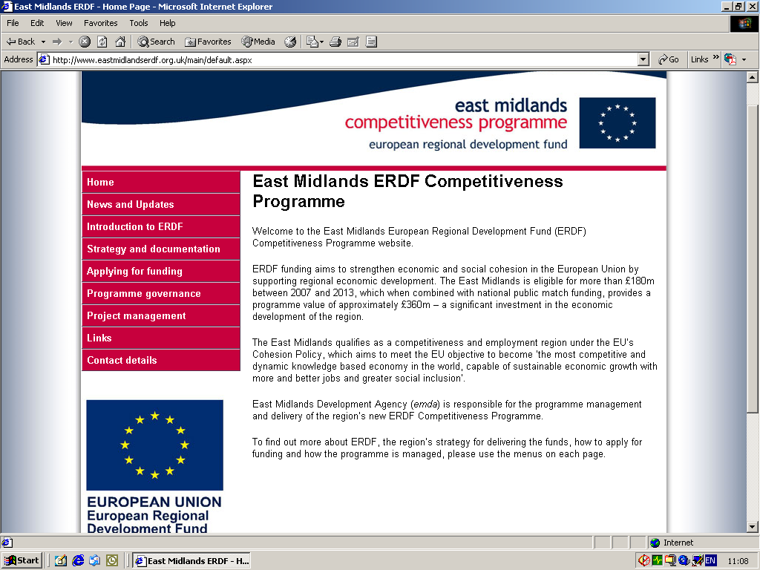
Programme Information
East Midlands ERDF website:
Primary source for Programme Information and Guidance
Key information includes:
  Strategy and Documentation
  Applying for Funding
  Governance and Meeting Papers
  Project Management
www.eastmidlandserdf.org.uk

