Slide 1

Simon Fraser
Permanent Secretary
John Beddington Chief Scientific Adviser
Government Office for Science
Bernadette Kelly
Director General
Fair Markets Group
Philip Rutnam
Director General
Business Group
Howard Orme
Director General
Finance and Commercial Group
Rachel Sandby-Thomas
Director General
Legal, People and Communications Group
Adrian Smith
Director General
Science and Research Group
Vicky Pryce
Director General
Economic and Policy Analysis Group
Stephen Marston
Director General
Universities and Skills Group
Philip Rycroft
Director General
Innovation Enterprise and Better Regulation Executive
Stephen Lovegrove
Chief Executive
Shareholder Executive
Andrew Cahn
Chief Executive
UK Trade and Investment
Detail to follow
Richard Abel
Director
Ministerial and Parliamentary Support Group
Government Skills Group
Ian Jones
Director
Office of Manpower Economics
Alun Evans
Director
Strategy Group

Slide 2
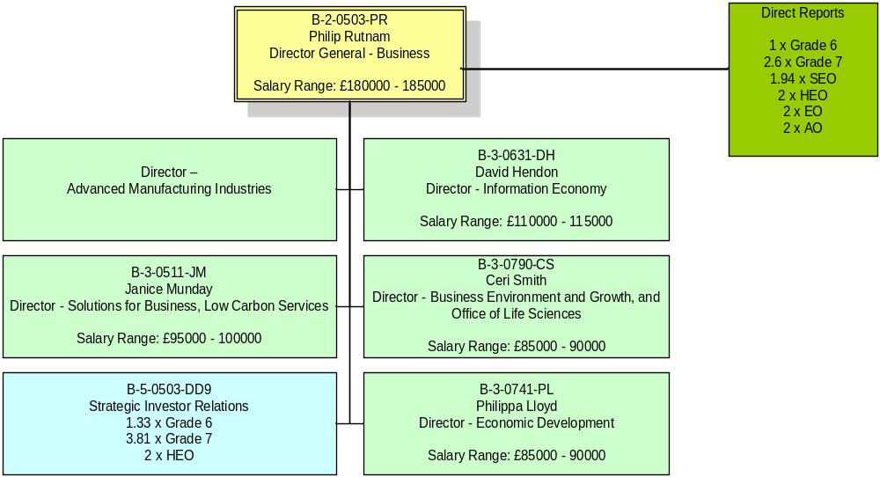
Return to Front Page
Grade | Grade 6 | Grade 7 | SEO | HEO | EO | AO | AA
Pay Range | £50043 - £75983 | £40686 - £64151 | £28741 - £49798 | £22300 - £45000 | £18763 - £35000 | £16325 - £22126 | £13605 - £15117

Slide 3
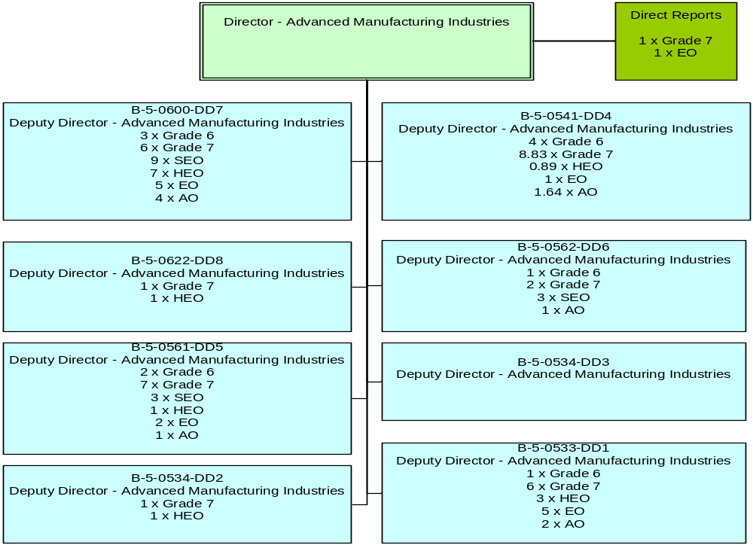
Return to Front Page
Grade | Grade 6 | Grade 7 | SEO | HEO | EO | AO | AA
Pay Range | £50043 - £75983 | £40686 - £64151 | £28741 - £49798 | £22300 - £45000 | £18763 - £35000 | £16325 - £22126 | £13605 - £15117

Slide 4
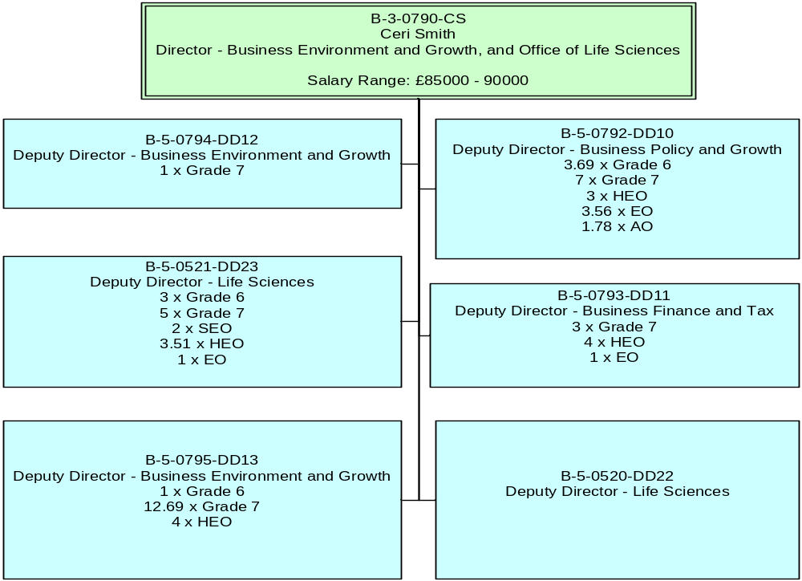
Return to Front Page
Grade | Grade 6 | Grade 7 | SEO | HEO | EO | AO | AA
Pay Range | £50043 - £75983 | £40686 - £64151 | £28741 - £49798 | £22300 - £45000 | £18763 - £35000 | £16325 - £22126 | £13605 - £15117

Slide 5
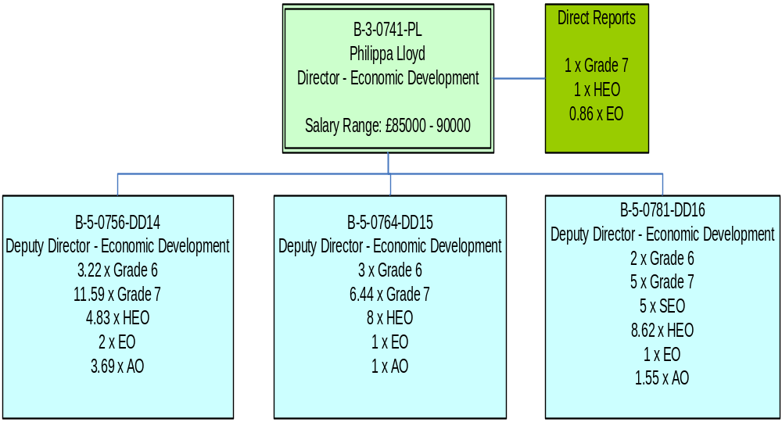
Return to Front Page
Grade | Grade 6 | Grade 7 | SEO | HEO | EO | AO | AA
Pay Range | £50043 - £75983 | £40686 - £64151 | £28741 - £49798 | £22300 - £45000 | £18763 - £35000 | £16325 - £22126 | £13605 - £15117

Slide 6
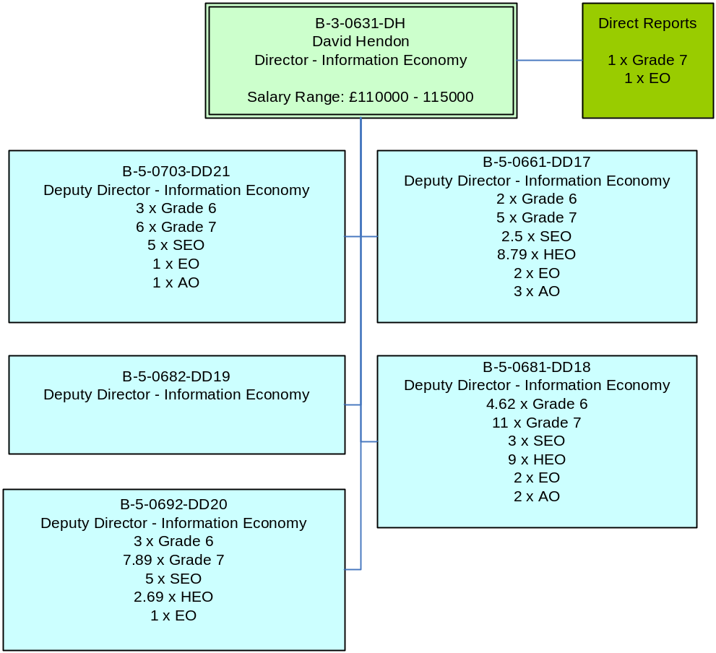
Return to Front Page
Grade | Grade 6 | Grade 7 | SEO | HEO | EO | AO | AA
Pay Range | £50043 - £75983 | £40686 - £64151 | £28741 - £49798 | £22300 - £45000 | £18763 - £35000 | £16325 - £22126 | £13605 - £15117

Slide 7
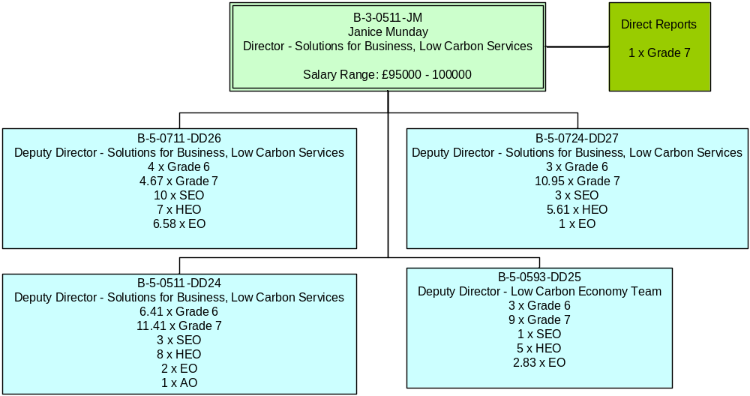
Return to Front Page
Grade | Grade 6 | Grade 7 | SEO | HEO | EO | AO | AA
Pay Range | £50043 - £75983 | £40686 - £64151 | £28741 - £49798 | £22300 - £45000 | £18763 - £35000 | £16325 - £22126 | £13605 - £15117

Slide 8
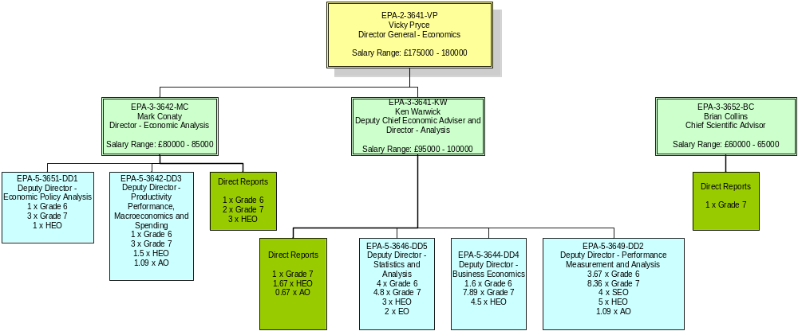
Return to Front Page
Grade | Grade 6 | Grade 7 | SEO | HEO | EO | AO | AA
Pay Range | £50043 - £75983 | £40686 - £64151 | £28741 - £49798 | £22300 - £45000 | £18763 - £35000 | £16325 - £22126 | £13605 - £15117

Slide 9
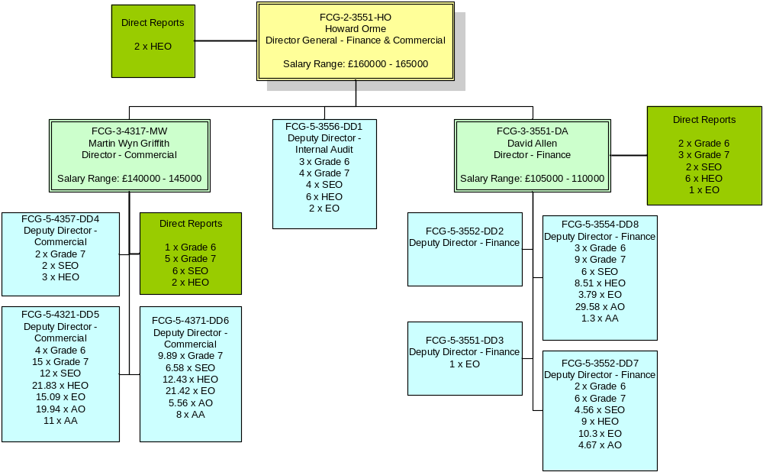
Return to Front Page
Grade | Grade 6 | Grade 7 | SEO | HEO | EO | AO | AA
Pay Range | £50043 - £75983 | £40686 - £64151 | £28741 - £49798 | £22300 - £45000 | £18763 - £35000 | £16325 - £22126 | £13605 - £15117

Slide 10
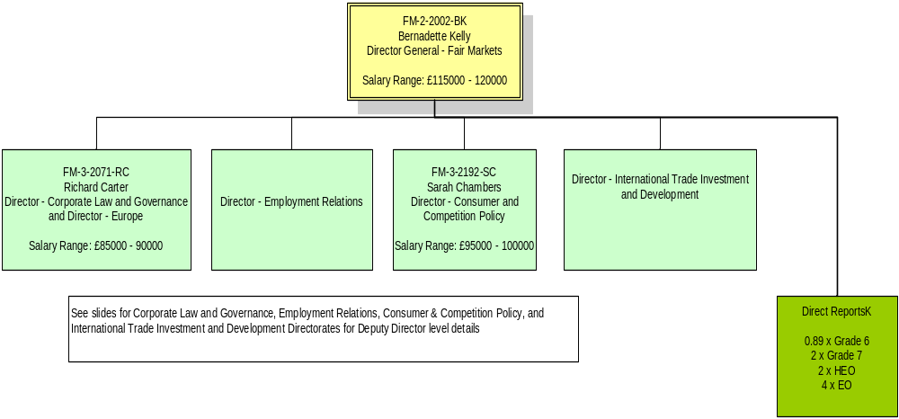
Return to Front Page
Grade | Grade 6 | Grade 7 | SEO | HEO | EO | AO | AA
Pay Range | £50043 - £75983 | £40686 - £64151 | £28741 - £49798 | £22300 - £45000 | £18763 - £35000 | £16325 - £22126 | £13605 - £15117

Slide 11
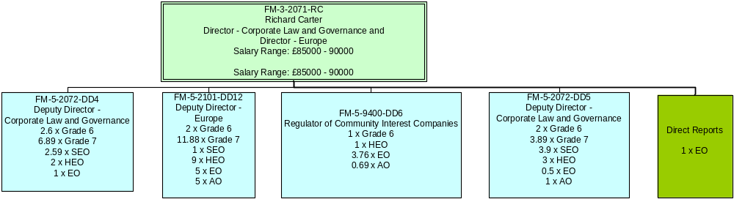
Return to Front Page
Grade | Grade 6 | Grade 7 | SEO | HEO | EO | AO | AA
Pay Range | £50043 - £75983 | £40686 - £64151 | £28741 - £49798 | £22300 - £45000 | £18763 - £35000 | £16325 - £22126 | £13605 - £15117

Slide 12
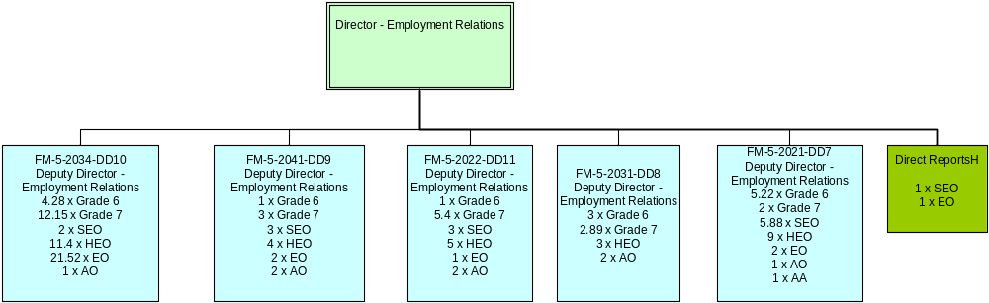
Return to Front Page
Grade | Grade 6 | Grade 7 | SEO | HEO | EO | AO | AA
Pay Range | £50043 - £75983 | £40686 - £64151 | £28741 - £49798 | £22300 - £45000 | £18763 - £35000 | £16325 - £22126 | £13605 - £15117

Slide 13
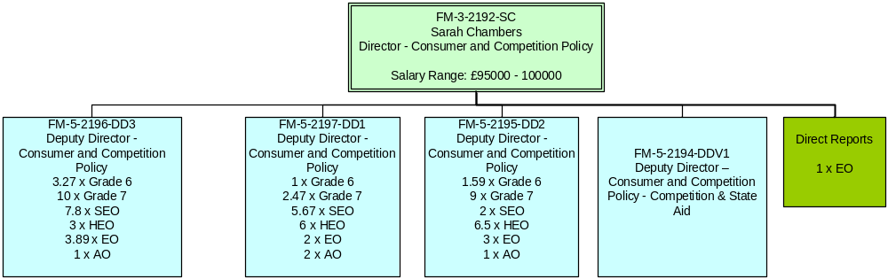
Return to Front Page
Grade | Grade 6 | Grade 7 | SEO | HEO | EO | AO | AA
Pay Range | £50043 - £75983 | £40686 - £64151 | £28741 - £49798 | £22300 - £45000 | £18763 - £35000 | £16325 - £22126 | £13605 - £15117

Slide 14
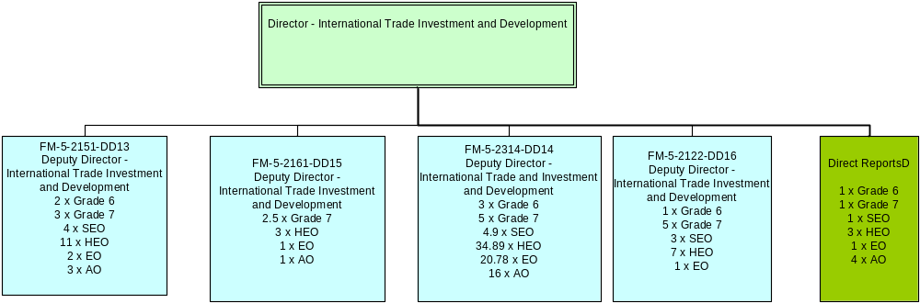
Return to Front Page
Grade | Grade 6 | Grade 7 | SEO | HEO | EO | AO | AA
Pay Range | £50043 - £75983 | £40686 - £64151 | £28741 - £49798 | £22300 - £45000 | £18763 - £35000 | £16325 - £22126 | £13605 - £15117

Slide 15
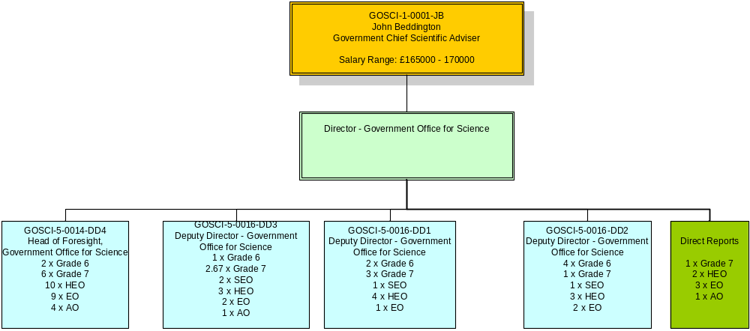
Return to Front Page
Grade | Grade 6 | Grade 7 | SEO | HEO | EO | AO | AA
Pay Range | £50043 - £75983 | £40686 - £64151 | £28741 - £49798 | £22300 - £45000 | £18763 - £35000 | £16325 - £22126 | £13605 - £15117

Slide 16
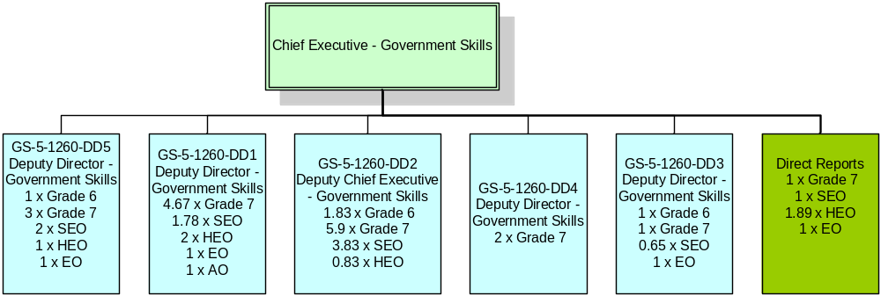
Return to Front Page
Grade | Grade 6 | Grade 7 | SEO | HEO | EO | AO | AA
Pay Range | £50043 - £75983 | £40686 - £64151 | £28741 - £49798 | £22300 - £45000 | £18763 - £35000 | £16325 - £22126 | £13605 - £15117

Slide 17
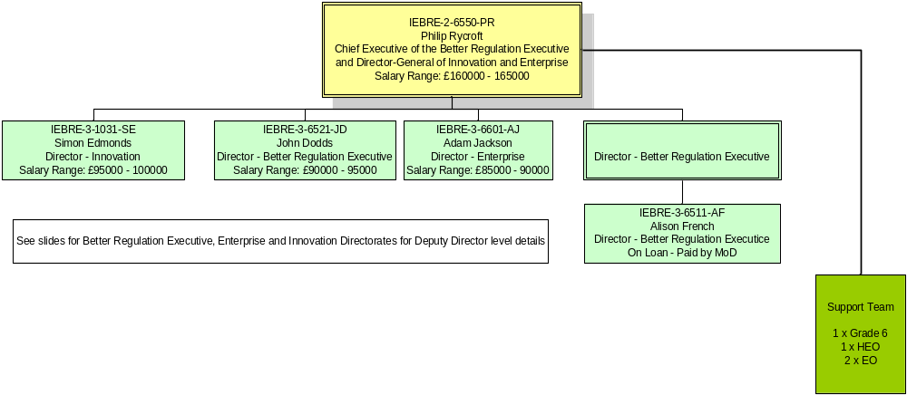
Return to Front Page
Grade | Grade 6 | Grade 7 | SEO | HEO | EO | AO | AA
Pay Range | £50043 - £75983 | £40686 - £64151 | £28741 - £49798 | £22300 - £45000 | £18763 - £35000 | £16325 - £22126 | £13605 - £15117

Slide 18
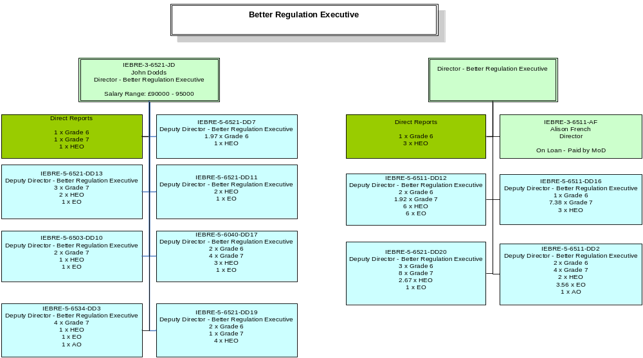
Return to Front Page
Grade | Grade 6 | Grade 7 | SEO | HEO | EO | AO | AA
Pay Range | £50043 - £75983 | £40686 - £64151 | £28741 - £49798 | £22300 - £45000 | £18763 - £35000 | £16325 - £22126 | £13605 - £15117

Slide 19
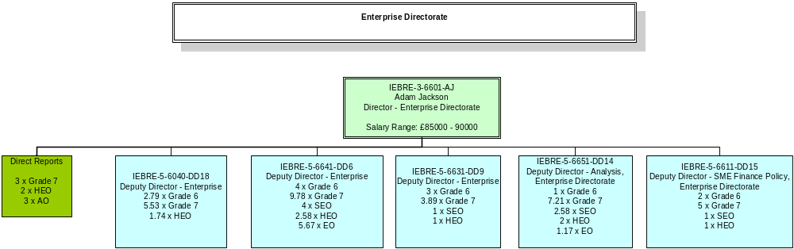
Return to Front Page
Grade | Grade 6 | Grade 7 | SEO | HEO | EO | AO | AA
Pay Range | £50043 - £75983 | £40686 - £64151 | £28741 - £49798 | £22300 - £45000 | £18763 - £35000 | £16325 - £22126 | £13605 - £15117

Slide 20
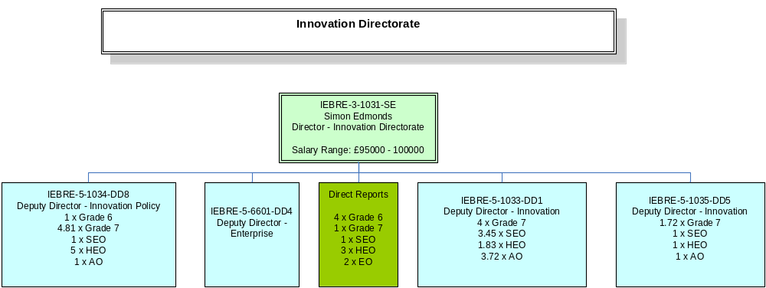
Return to Front Page
Grade | Grade 6 | Grade 7 | SEO | HEO | EO | AO | AA
Pay Range | £50043 - £75983 | £40686 - £64151 | £28741 - £49798 | £22300 - £45000 | £18763 - £35000 | £16325 - £22126 | £13605 - £15117

Slide 21
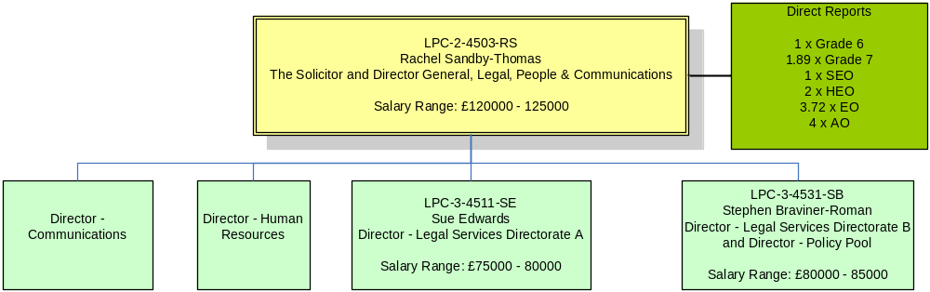
Return to Front Page
Grade | Grade 6 | Grade 7 | SEO | HEO | EO | AO | AA
Pay Range | £50043 - £75983 | £40686 - £64151 | £28741 - £49798 | £22300 - £45000 | £18763 - £35000 | £16325 - £22126 | £13605 - £15117

Slide 22
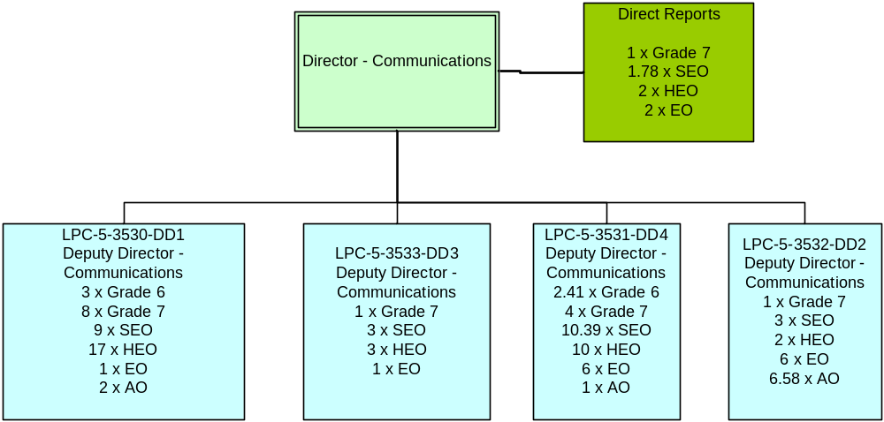
Return to Front Page
Grade | Grade 6 | Grade 7 | SEO | HEO | EO | AO | AA
Pay Range | £50043 - £75983 | £40686 - £64151 | £28741 - £49798 | £22300 - £45000 | £18763 - £35000 | £16325 - £22126 | £13605 - £15117

Slide 23
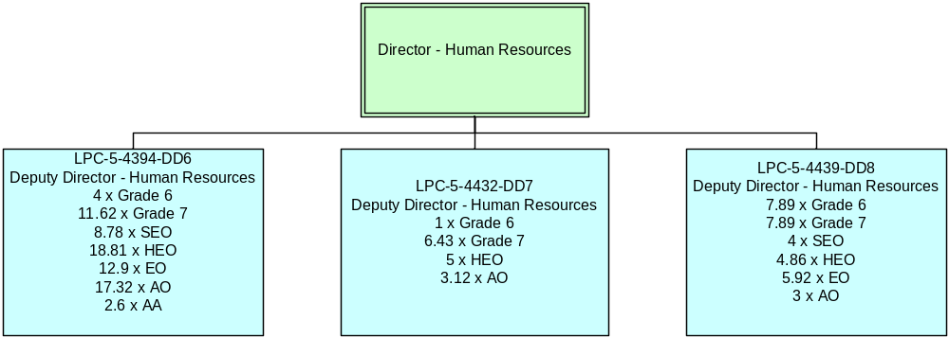
Return to Front Page
Grade | Grade 6 | Grade 7 | SEO | HEO | EO | AO | AA
Pay Range | £50043 - £75983 | £40686 - £64151 | £28741 - £49798 | £22300 - £45000 | £18763 - £35000 | £16325 - £22126 | £13605 - £15117

Slide 24
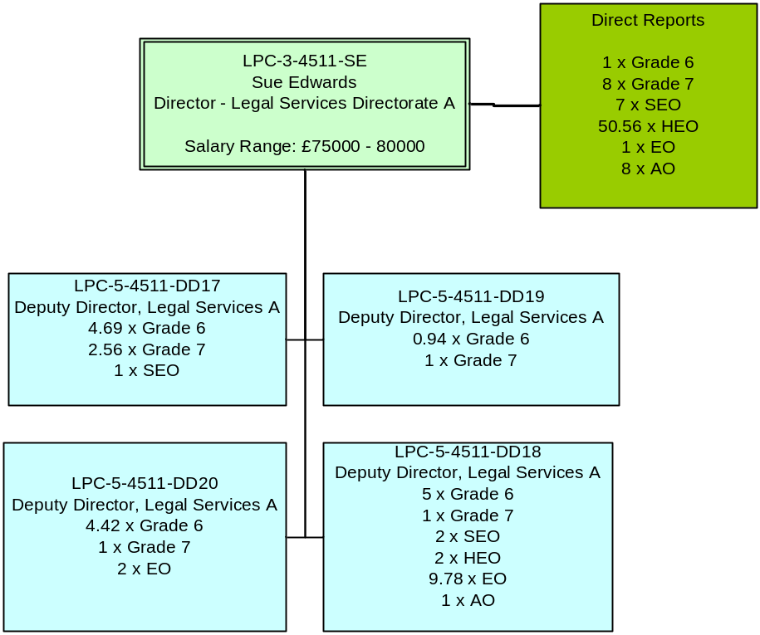
Return to Front Page
Grade | Grade 6 | Grade 7 | SEO | HEO | EO | AO | AA
Pay Range | £50043 - £75983 | £40686 - £64151 | £28741 - £49798 | £22300 - £45000 | £18763 - £35000 | £16325 - £22126 | £13605 - £15117

Slide 25
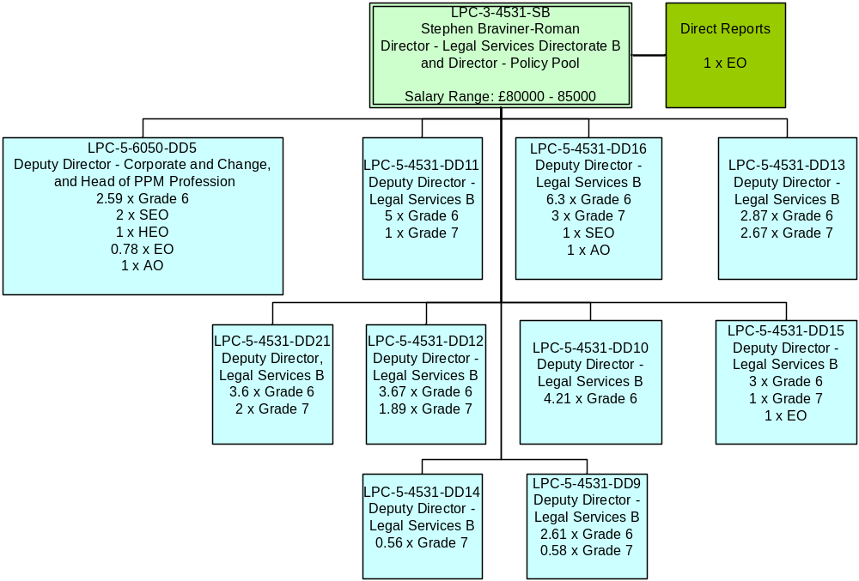
Return to Front Page
Grade | Grade 6 | Grade 7 | SEO | HEO | EO | AO | AA
Pay Range | £50043 - £75983 | £40686 - £64151 | £28741 - £49798 | £22300 - £45000 | £18763 - £35000 | £16325 - £22126 | £13605 - £15117

Slide 26
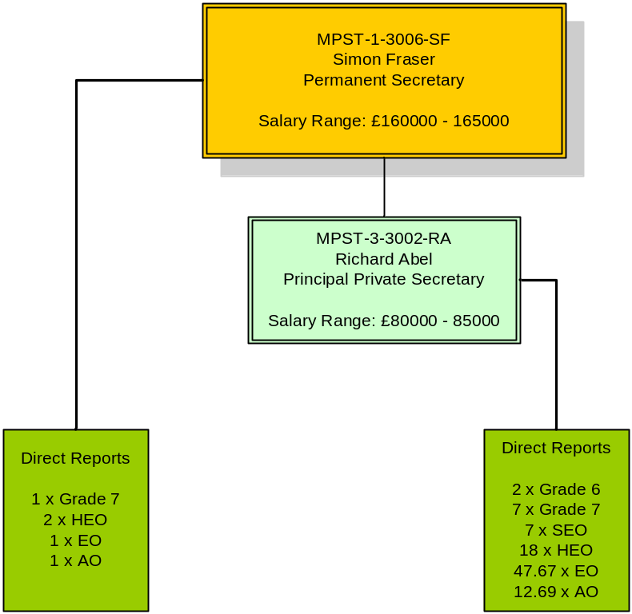
Return to Front Page
Grade | Grade 6 | Grade 7 | SEO | HEO | EO | AO | AA
Pay Range | £50043 - £75983 | £40686 - £64151 | £28741 - £49798 | £22300 - £45000 | £18763 - £35000 | £16325 - £22126 | £13605 - £15117

Slide 27
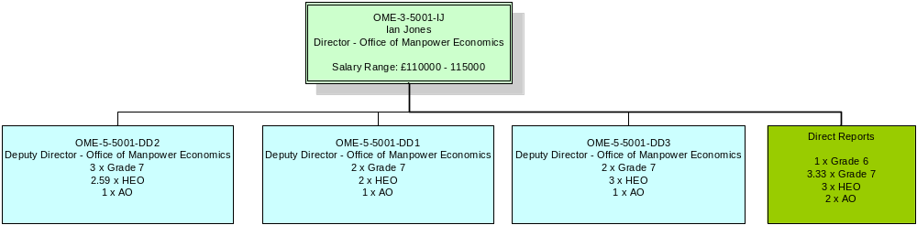
Return to Front Page
Grade | Grade 6 | Grade 7 | SEO | HEO | EO | AO | AA
Pay Range | £50043 - £75983 | £40686 - £64151 | £28741 - £49798 | £22300 - £45000 | £18763 - £35000 | £16325 - £22126 | £13605 - £15117

Slide 28
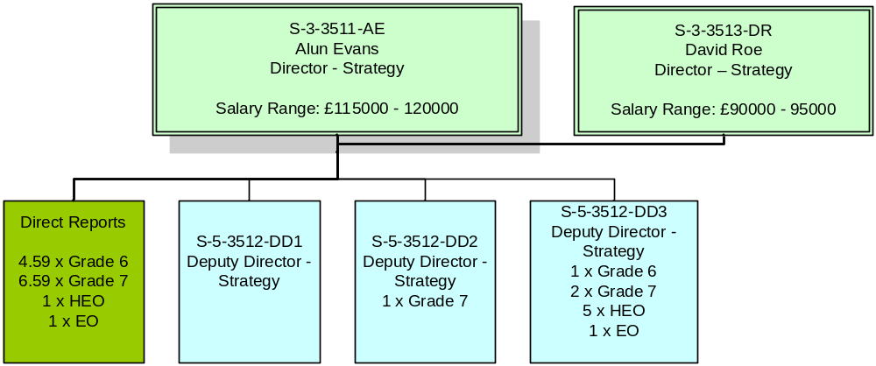
Return to Front Page
Grade | Grade 6 | Grade 7 | SEO | HEO | EO | AO | AA
Pay Range | £50043 - £75983 | £40686 - £64151 | £28741 - £49798 | £22300 - £45000 | £18763 - £35000 | £16325 - £22126 | £13605 - £15117

Slide 29
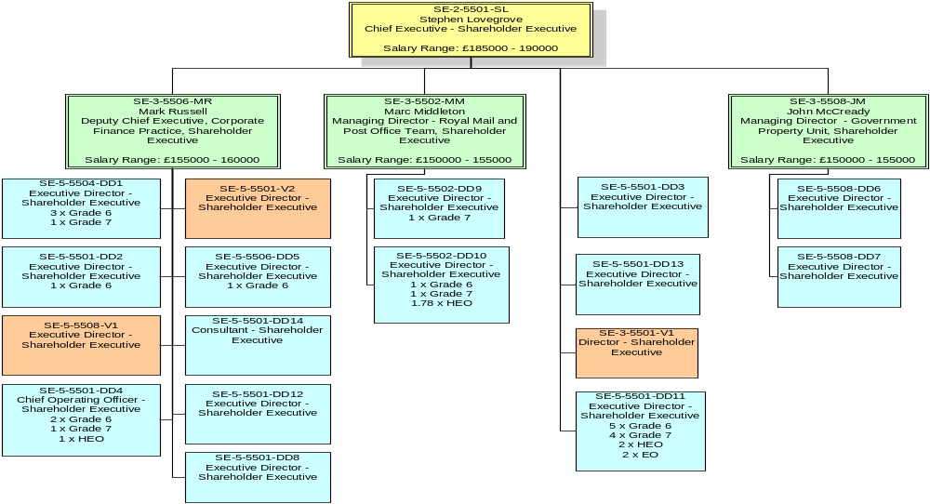
Return to Front Page
Grade | Grade 6 | Grade 7 | SEO | HEO | EO | AO | AA
Pay Range | £50043 - £75983 | £40686 - £64151 | £28741 - £49798 | £22300 - £45000 | £18763 - £35000 | £16325 - £22126 | £13605 - £15117

Slide 30
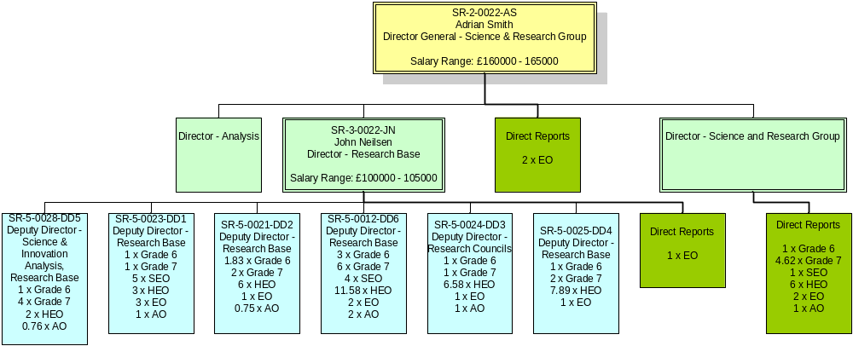
Return to Front Page
Grade | Grade 6 | Grade 7 | SEO | HEO | EO | AO | AA
Pay Range | £50043 - £75983 | £40686 - £64151 | £28741 - £49798 | £22300 - £45000 | £18763 - £35000 | £16325 - £22126 | £13605 - £15117

Slide 31
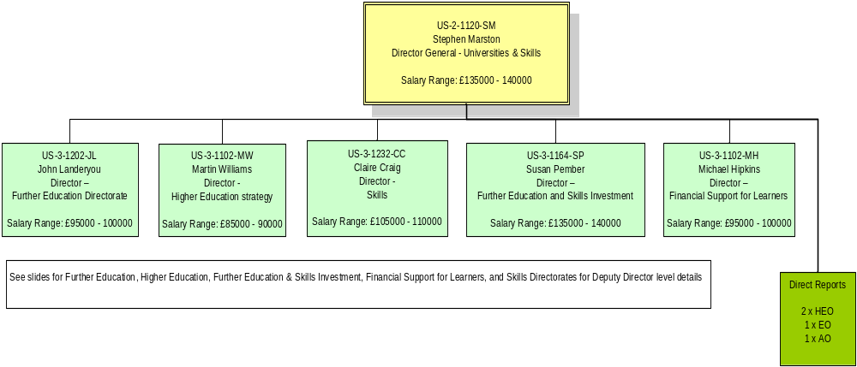
Return to Front Page
Grade | Grade 6 | Grade 7 | SEO | HEO | EO | AO | AA
Pay Range | £50043 - £75983 | £40686 - £64151 | £28741 - £49798 | £22300 - £45000 | £18763 - £35000 | £16325 - £22126 | £13605 - £15117

Slide 32
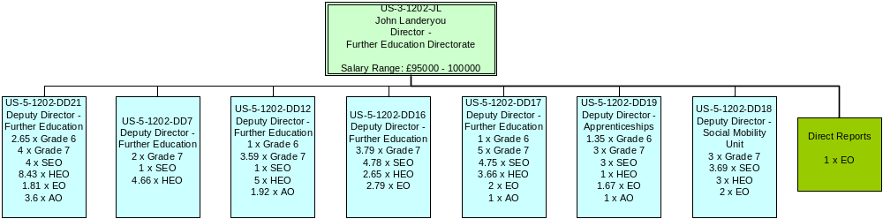
Return to Front Page
Grade | Grade 6 | Grade 7 | SEO | HEO | EO | AO | AA
Pay Range | £50043 - £75983 | £40686 - £64151 | £28741 - £49798 | £22300 - £45000 | £18763 - £35000 | £16325 - £22126 | £13605 - £15117

Slide 33
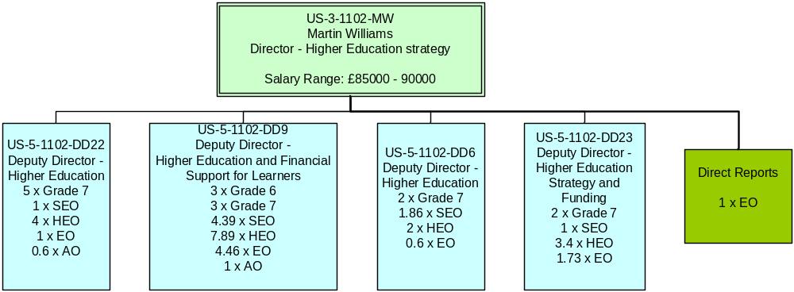
Return to Front Page
Grade | Grade 6 | Grade 7 | SEO | HEO | EO | AO | AA
Pay Range | £50043 - £75983 | £40686 - £64151 | £28741 - £49798 | £22300 - £45000 | £18763 - £35000 | £16325 - £22126 | £13605 - £15117

Slide 34
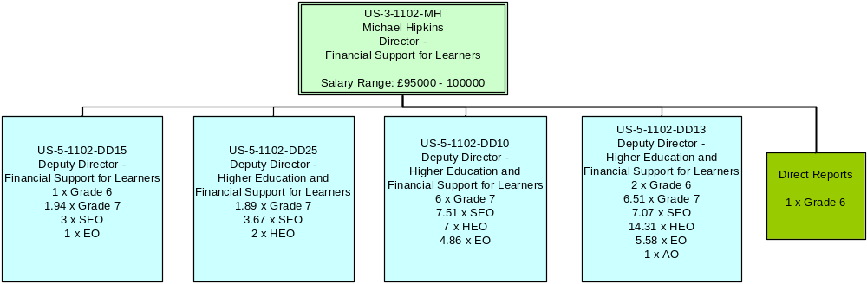
Return to Front Page
Grade | Grade 6 | Grade 7 | SEO | HEO | EO | AO | AA
Pay Range | £50043 - £75983 | £40686 - £64151 | £28741 - £49798 | £22300 - £45000 | £18763 - £35000 | £16325 - £22126 | £13605 - £15117

Slide 35
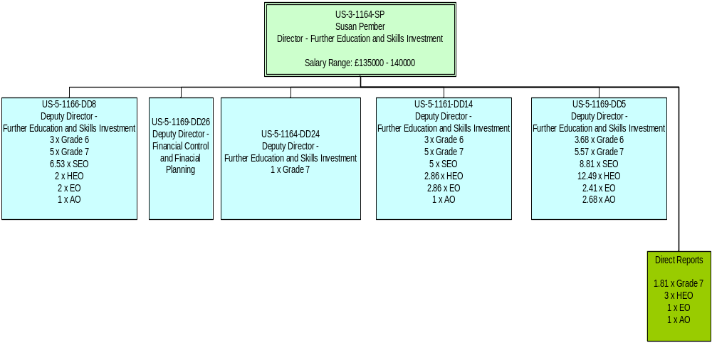
Return to Front Page
Grade | Grade 6 | Grade 7 | SEO | HEO | EO | AO | AA
Pay Range | £50043 - £75983 | £40686 - £64151 | £28741 - £49798 | £22300 - £45000 | £18763 - £35000 | £16325 - £22126 | £13605 - £15117

Slide 36
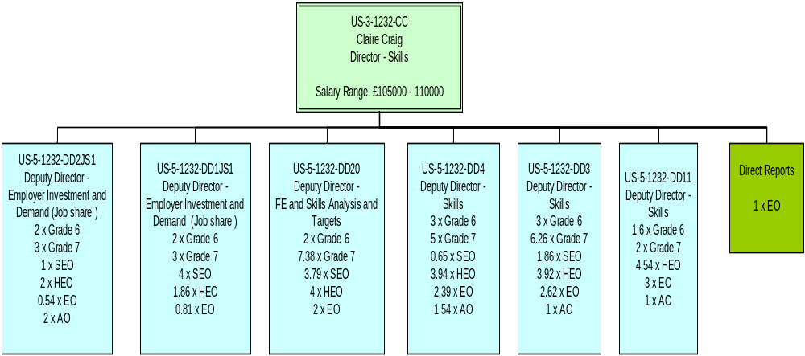
Return to Front Page
Grade | Grade 6 | Grade 7 | SEO | HEO | EO | AO | AA
Pay Range | £50043 - £75983 | £40686 - £64151 | £28741 - £49798 | £22300 - £45000 | £18763 - £35000 | £16325 - £22126 | £13605 - £15117

