Slide 1



Internal Market Information System
JULY 2009
http://www.bis.gov.uk/servicesdirective
Email: servicesdirective@berr.gsi.gov.uk

Slide 2
Introduction
Aims and Objectives
Overview of the Services Directive
Overview of the IMI System
Practical use of the IMI system
Notes:
Aims and objectives of the training event:
Aim:
To provide participants of a background knowledge and practical experience of the IMI system from which they develop and train others within their authority. This should ensure that the system is used to its full potential.
Objectives:
Authorities are sufficiently trained to begin using of the system and are aware of further training and support available
Authorities are aware of why the IMI system is developed (barriers to co-operation) and what he benefits to using it are
Authorities are aware of their responsibilities and what they can therefore expect from other MS authorities

Slide 3
After this training
You should be able to confidently:
  Log on to the IMI system
  Navigate the IMI system
  Be aware of the different user roles within IMI
  Send and Receive simple requests
  Know the procedures for escalating a request
  Be aware of the IMI Co-ordinator and their responsibilities
  Be aware of your responsibilities as a Competent Authority

Slide 4
The European Services Directive
Overview:
Aim:
  Open up the internal market in services by removing unjustifiable barriers to the cross-border provision of services
  Introduce measures to help increase cross-border provision of services
Worth up to £4-6 billion a year in the longer term
Potentially expecting up to 80,000 new jobs in the UK
Direct Cost and time savings for Competent Authorities
Notes:
Background: Services are by far the largest sector of the European economy accounting for, on average, 70% of GDP and of total employment in EU MS.
The objective of the SD is therefore to release the potential of services for economic growth and job creation. Through a programme of administrative and regulatory simplification, providers and recipients of services will benefit from this greater freedom and two fundamental freedoms established in the European Community Treaty.
The freedom to provide services across borders gives the rights of SP est. in one MS to carry out economic activity in another MS without being est there. Likewise for service recipients to freely receive services.
The freedom of establishment enables, whether individuals or companies) to carry out an economic activity in a stable and continuous way in one or more member states.

Slide 5
What is the scope of the Services Directive?
Covers a wide range of economic activities in the services sector
Unless explicitly excluded the directive applies to them all
Examples covered by the Directive include: construction services, accommodation and food services and tourism related services
Examples NOT covered by the Directive include: financial services, health care services and gambling activities
For a comprehensive list see the user guidance materials

Slide 6
What the Directive requires:
Abolish restrictive legislation and practices hindering service providers
Set up Point of Single Contact enabling businesses to find out what licences and authorisations they need and to apply electronically
Mutual Assistance between other EU countries using the IMI system
Has to be transposed into national law by 28 December 2009

Slide 7
Administrative Cooperation (Mutual Assistance)
Through legal obligations to cooperate the Directive requires:
Proper regulatory supervision of service providers operating across the EU
An obligation to co-operate with EU counterparts by:
  carrying out checks on service providers
  supplying information to other Authorities
Reduce regulatory burdens on businesses and authorities alike
Notes:
AC is essential to make the SD work.

Slide 8
Main scenarios for Administrative Cooperation
Cases of provision of services- a service provider legally established in Member State A is providing services in Member State B without establishing a presence there.
Cases of establishment- a service provider establishes a legal presence in a Member State or where a provider is already lawfully established in a Member State and wishes to open up a second establishment

Slide 9
Administrative Cooperation (cont)
Web-based Internal Market Information (IMI) system will allow secure messaging for Authorities to communicate directly
There will be one National Liaison Point (NLP) in BIS whose role will be to assist authorities
Send alerts to other EU countries
  activity that could cause serious damage to people’s health or safety or the environment

Slide 10
Existing Barriers to Co-operation
Lack of clearly identified partners in other Member States
Different administrative structures and cultures
Lack of administrative procedures for cross border co-operation
Language barriers
Notes:
- Multiple languages
Management of 351 bilateral relationships
Lack of regular communication between MS administrations has resulted in proliferation of rules applicable to providers and a duplication of controls for cross border activities.
In the absence of cooperation between MS administrations it is virtually impossible to ensure proper supervision of service activities for eg:
Whether a SP is lawfully est in another MS
Whether a SP is entitled to exercise a given routine
Whether a document has really been issued by a CA from another MS
Whether a submitted document is still valid

Slide 11
Organisational Structure of the Services Directive
European Commission
EU Competent Authorities
IMI Co-ordinator (NLP) at BIS
IMI
UK Competent Authorities
UK Service Providers
PSC
Notes:
How to CA’s fit into the bigger picture?
European Commission- develops, maintains and runs IMI, provides translations, central helpdesk
Competent Authorities- find relevant CA’s within other MS, exchange information with other MS, administer data and users within their authority
IMI Co-ordinators- (NIMIC, DIMIC, SDIMIC) technical support, registration and support of CA’s, act as an CA and exchange information with other CA’s

Slide 12
Internal Market Information System (IMI)
Overview
Internet based secure communications system
Authorities can be identified across the EU
Used to securely exchange and share information
Translate requests
Send and receive alerts
Notes:
Designed by the EC in co-operation with other MS
It is developed and run by the Commission
IMI main purpose of being here today, so this will be an interactive session

Slide 13
IMI: Advantages
Search for a Competent Authority in other EU Member States using translation facility
Use pre-defined and pre-translated question sets enabling greater scope for communication
Add attachments such as certificates and ensure that requests are dealt with within an agreed time period
Undertake administration of numerous cross border requests therefore build trust and confidence
Escalation mechanisms should a response not meet the required standard (referral process)
Notes:
IMI is a single interface for cross border co-operation between CA’s
-

Slide 14
Organisational Structure of IMI
UK CA’s
UK co-ordinator (NLP)
Competent Authorities (CA’s)
  Exchange information
  Administer data and users in their authority
IMI Coordinators
  National Liaison Point
  Registration and support for CA’s
European Commission
  Central helpdesk
  Maintains and runs IMI
IMI
EU MS CA’s
EU MS co-ordinator

Slide 15
Accessing IMI
IMI is accessible via the internet on the IMI homepage
http://ec.europa.eu/internal_market/imi-net/index_en.html
Authorities will need to be registered by their IMI Co-ordinator at BIS
First users are automatically given all user rights including LDA rights (see slide 19) and can appoint other users with different user status within their authority
Access is restricted to registered users within the authenticated authorities
Later versions will have the facility to self-register
http://ec.europa.eu/internal_market/imi-net/index_en.html
Notes:
Q. What happens if I put in my password wrong 5 times?
You will be locked out of the system and need to contact your IMI co-ordinator to get re registered. You will receive an automatic email with a new temporary password.
Q. What happens if I forget my security code or password?
You will need to contact your IMI co-ordinator to reset.
Q. What happens when I register?
The first person in a CA to register will automatically be sent an email containing a temporary password. The username will be communicated to the first user by the IMI co-ordinator separately. The first user will automatically receive ‘Local Data Administrator’ rights and be able to register other people within their authority.
The number of people registered will depend on the size of the authority and the number of requests expected.
NOTES:
-CA’s will only need to be registered once in IMI even if they have access to different legislative areas
-Different ‘user roles’ are appointed to each user to ensure that security is maintained to the highest level.

Slide 16
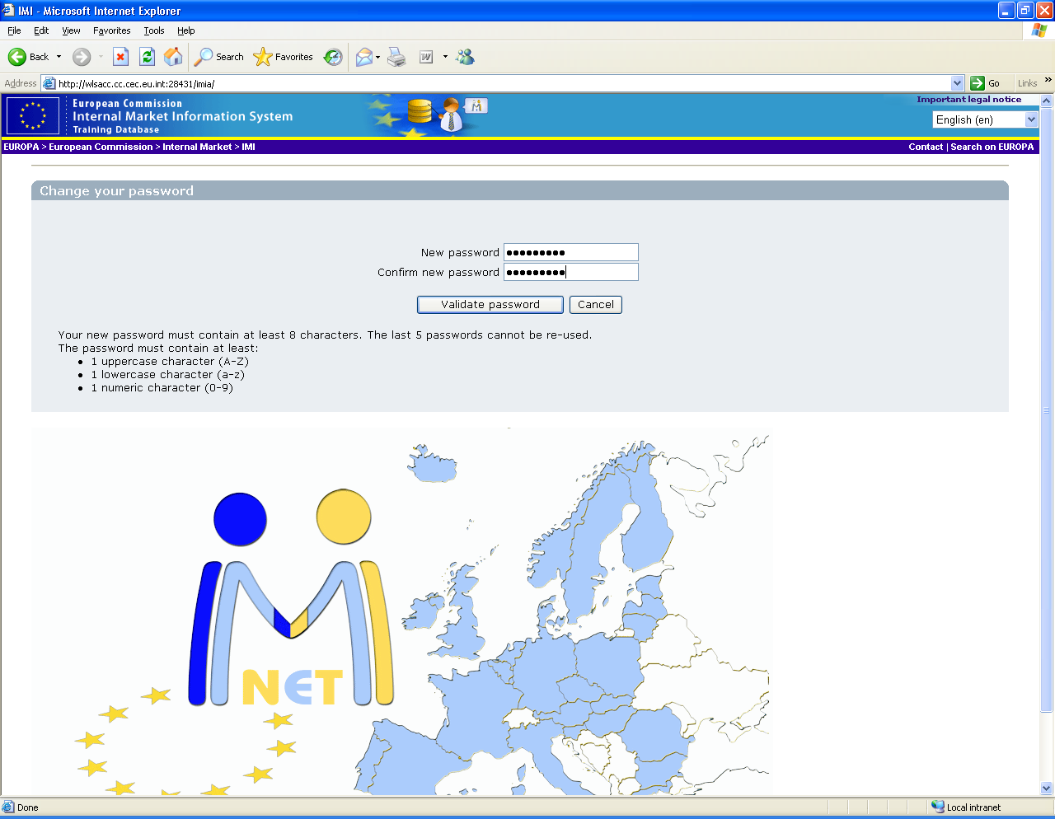
Logging in to IMI
Notes:
Exercise 1: Get them to turn on computer. Should already be an icon on the desktop that takes them to the EU services directive webpage.
Trainer:
Provide an overview of the various functions on the homepage.
Remind them of the different systems ie. Today using the training database but normally will use the IMI production system.
Exercise 1: Get them to log in to the training database through the IMI website. They can login using the username and passwords and usernames that are provided.
Trainer: Overview of the homepage
Key Points: Resetting passwords: within a CA the local data administrator will have the ability to reset passwords of other users.

Slide 17
Logging in to IMI (2)
Once you are registered to use the IMI system (currently done by BIS)
Login with username and temporary password
Be careful with upper and lower cases- IMI is case sensitive
Create a new password
Create a 12 digit security code
Note down the new password and security code
Notes:
Have a list of the usernames and temp passwords ready.
Get them to log in, reset temp password, and a 12 digit code. (remember to make a note of these)
Explain the layout of the homepage.
Trainer: remind them that once the authority is registered they will receive an automatic email with a temp password and that the IMI coordinator will send them their username via a different method.

Slide 18
EXERCISE 1: Logging in to IMI
Using the username and password provided, log in to the IMI system
Remember:
  It is case sensitive
  You are only allowed 3 attempted log-ins before being locked out of the system

Slide 19
The Local Data Administrator in IMI
Every Authority is responsible for its own data and user administration
The first registered user is automatically given all user rights including LDA and should therefore:
    Update information on its own authority
    Register new users within its own authority
Notes:
Trainer: Ensure that the LDA understands the importance of registering other users inc. another LDA? Can this been done
Exercise 2: Get them to add a description of their authority. (admin, manage my authority’s data,
Additional tasks of the LDA who receives an automatic email:
Update information concerning the authority
Information should be updated regularly to assist other MS
Informal title should be short, clear and be easy to understand for other MS.
Areas of competence: These are decided after the authority has registered

Slide 20
User Administration & Management
Depending on the size/expected traffic flow of your authority will determine how many users should be registered.
2 users with LDA rights should be registered (in case of sickness/holiday etc)
All information should be kept up to date to assist other authorities when searching
First Users can register additional users depending on the size and needs of the Competent Authority.
Every user has to be registered into the system and is given user rights which define what the user can do in the system.
Notes:
Remind them that it is up to the authority to register people as they see fit.

Slide 21
User roles within IMI
Basic user
Request Handler
Allocator
Local Data Administrator
Referral Handler
Notes:
Basic user- CAN. every user, search for a CA, See incoming/outgoing requests, CANNOT send or receive requests, generate save or print reports
Request Handler- CAN (plus those of a basic user) respond to information requests, generate save and print requests
Allocator- Some large authorities may wish to allocate incoming requests to a subset of the authorities request handlers. Eg. Different people responsible for dealing with requests from different countries. CAN attribute a request to one or more request handlers in the authority, reassign a request, generate save and print reports CANNOT send or accept requests (unless it has request handler rights in addition)
LDA- CAN- update data about its CA, register additional users, change user profiles. CANNOT send or accept requests, attribute a request, generate save or print a request.
Referral Handler – IE. the IMI coordinator CAN approve sending requests or sending responses (where approval process has been indicated), indicate agreement or disagreement when a requesting authority is not happy with an answer CANNOT send or respond to requests on behalf of the coordinator (unless has request handler rights in addition)

Slide 22
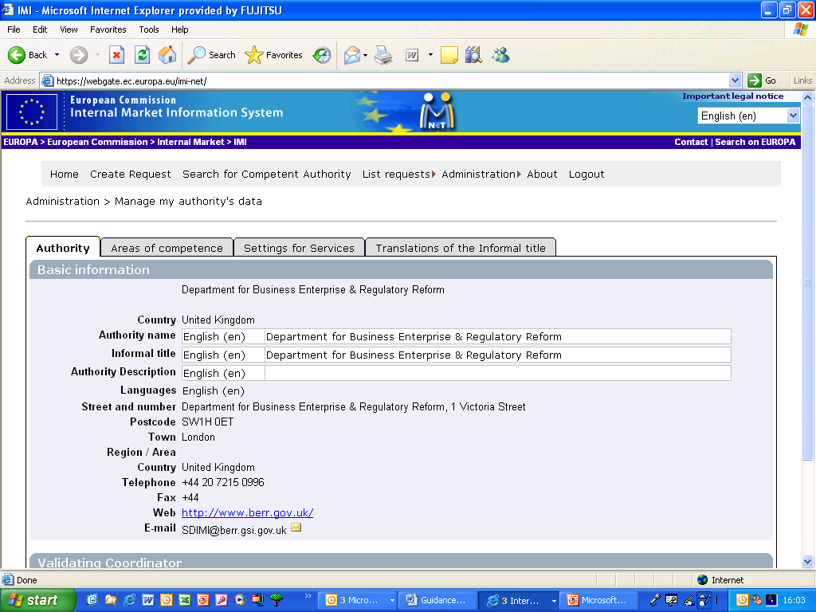
Updating information within your CA: Authority data
Under the title ‘Administration’
‘Manage my authorities data’ complete Exercise 2

Slide 23
Exercise 2: Updating information
The purpose of this exercise is for participants (inc. LDA users) to be aware of how to change information about their authority and ensure it is kept up to date.
Participants should check and change if necessary:
The preferred language of their authority
The area of competence for their authority
To add/change an informal title for their authority

Slide 24
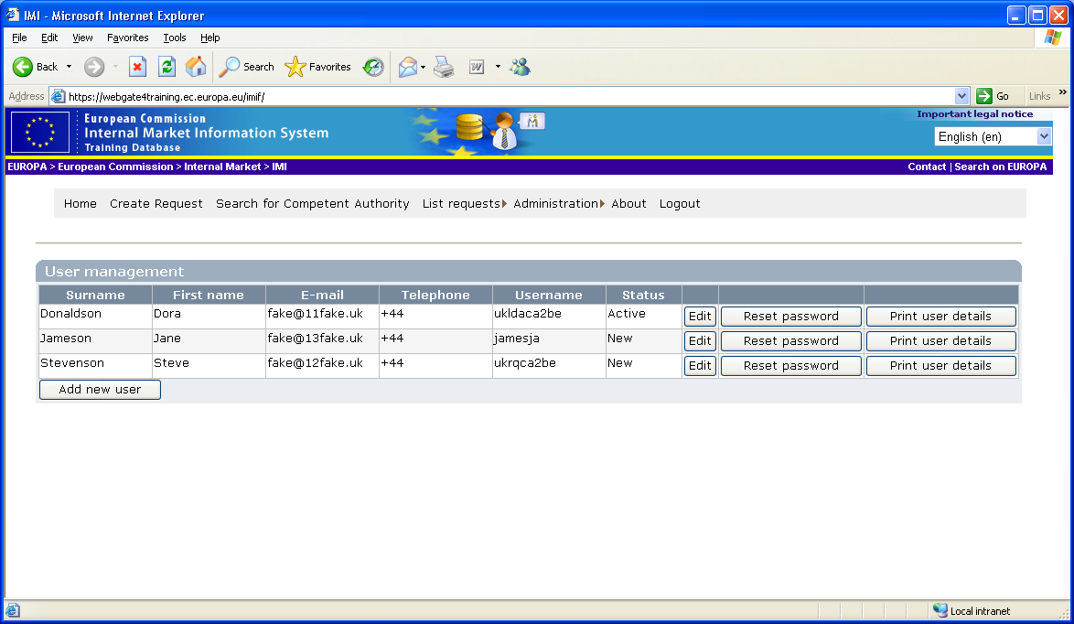
Updating information within your CA: Add a new user
Login as LDA of my authority
Register new user
Give user ‘request handler’ rights
Note down new username
Notes:
Exercise 3: register an additional user for their authority. (Go to administration, manage my authorities users, add user)
with request handler rights within their own authority
Explain that ‘basic user’ is always ticked as everybody has these rights no matter what other user rights they are given.

Slide 25
Exercise 3: Add a new user
The purpose of this exercise is to ensure that users are aware of the procedure to add additional users within their authority
It is recommended that at least two LDA users are registered per authority
It is up to each individual authority as to who and how users are structured

Slide 26
The lifecycle of a simple IMI request
Responding Authority
.
Requesting Authority
Request Sent awaiting acceptance
Request Accepted
Request closed information accepted
Request open full information provided
Notes:
Exercise 4: simple workflow of request
Explain to participants the simple IMI request format
-An information request has a clearly defined lifecycle consisting of a number of basic steps. A status is applied to each request and it is therefore possible to track at which point in the lifecycle a request is at any given time.
-As a request move through the lifecycle its status is automatically updated.
Simple flow
Very basic. There are only 4 steps from the inception of a request to its closure.
The requesting authority creates and sends a new request to the responding authority. The request now has the status ‘request sent awaiting acceptance’
The responding authority accepts the request. The request now has the status ‘request accepted’
The responding authority provide full information to the requesting authority. The request now has the status ‘request open information provided’
The requesting authority accepts the information and the request is closed. Status now ’request closed information accepted’.

Slide 27
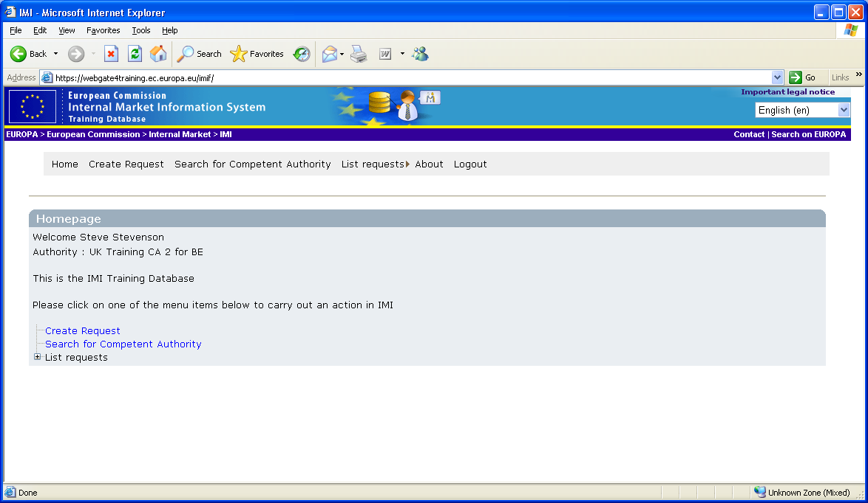
Creating and sending a request
Notes:
Participants to open their accounts and create a request.

Slide 28
Exercise 4:
Creating and sending a request
Participants to create, save and send a request to an authority in another Member State
Please use the specific ‘step by step’ guide to sending a request alongside this exercise if there are any problems
Only ‘request handlers’ are eligible to send and receive requests

Slide 29
Sending a request: Key points
Only ‘request handlers’ can deal with requests
Search Function: If a corresponding authority cannot be found it is recommended that you contact your IMI co-ordinator at BIS
Only one question set can be used per request
All questions relating to a Service Provider marked with a (*) are mandatory
Set the date of proposed date of response using the calendar or a set number of days
Free text comments: if possible use a language that the corresponding authority can understand
Requests must be justified and not merely used as a resource to check that information is correct
Notes:
Explain the difference between cross border service provision and permanent

Slide 30
Responsibilities of CA’s
When SENDING Requests:
JUSTIFY each request sufficiently and clearly
NOT to send systematic requests for information or for checks
  IMI is only to be used for SPECIFIC doubts
Use the REGISTERS before sending a request
Once the responding authority has provided sufficient information the request should be closed, giving it the status ‘request closed-information provided’
Notes:
Requests need to be specific an duly motivated E.G.. If have doubts whether info supplied by a service provider is accurate or if the documents are authentic

Slide 31
IMI Question Sets
What are they?
A practical tool for day-to-day co-operation
Include,
Pre-translated into all official EU languages
Allow for structured communication
Standard questions, replies and motivations
Standard replies
Free text space available
Notes:
- Will allow CA’s of different MS to communicate with each other
What are they?
Questions based on samples of information/documents required by MS
Questions can be changed over time and will be assed during the pilot phase
Important to avoid unnecessary duplication of workload

Slide 32
Accepting a request: Key points
A competent authority receives an automatic email informing you that a request has been received.
(This can also be checked in the ‘action list’ tab)
The request handler can accept the request OR it can ask for more information
Notes:
Do we need to get them to log out and then log in again to receive the request?

Slide 33
Responsibilities of CA’s
When REPLYING to requests:
ALL POSSIBLE MEASURES should be taken to obtain the requested information
It is the RESPONDING CA to decide the most appropriate measures
Reply within an AGREED DEADLINE
  In case of difficulties contact your coordinator in BIS
Notes:
- Answers should be provided in the shortest possible time and by electronic means.
Sometime may be necessary to contact other CA’s or the service provider or carry out factual on site checks.
CA’s must act to the extend of their national law though no need t carry out checks in the territory of other MS

Slide 34
Exercise 5: Replying to a request
The purpose of this exercise is to ensure that candidates are aware of the processes involved when replying to a request.
Automatic email sent to all request handlers in the authority as well as the authority email address.
Obligation to provide information as soon as possible and within the indicative date of reply.

Slide 35
Forwarding a request
CA receives a request, it checks the request and decides that it is not competent to answer it.
  It has to be forwarded to a CA in its own MS
  If unsure what CA is competent then contact the IMI coordinator
  A reason must be given for forwarding the request
Notes:
If accept a request and then decide that cant answer it, is it possible to forward it? What are the next steps?

Slide 36
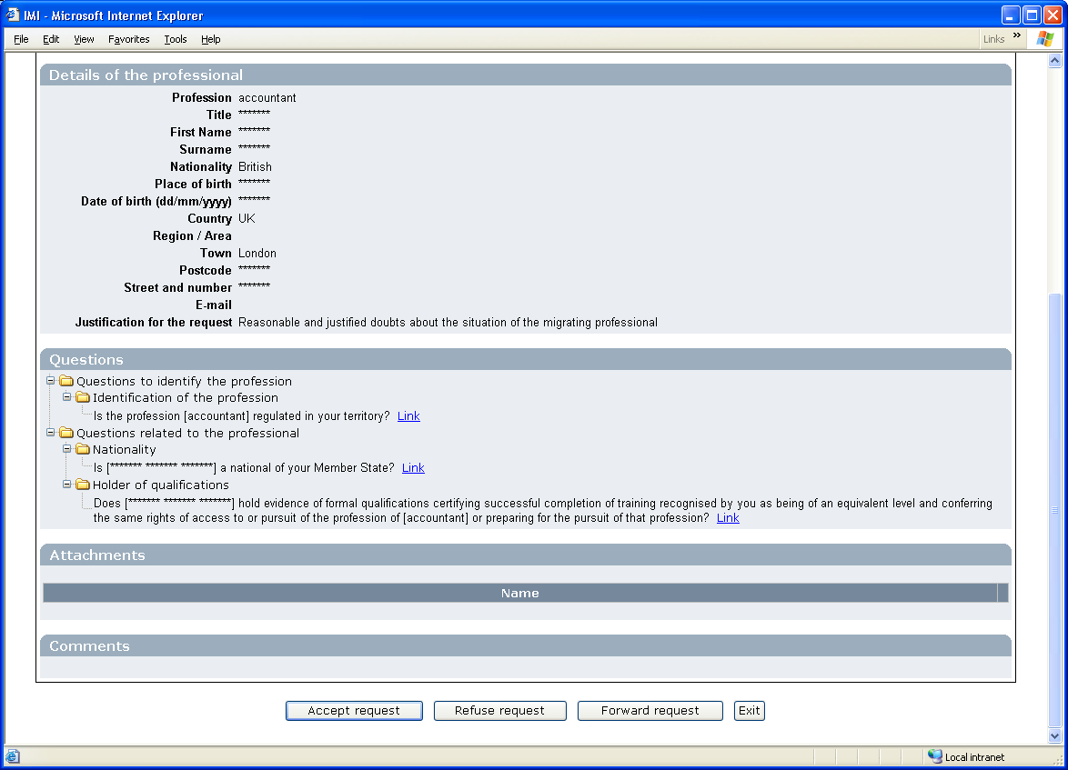
Forwarding a request (2):

Slide 37
Forwarding a request: overview
Member State 1 Member State2
2
Competent Authority 1
Competent Authority 2
1
Request forwarded
Response Accepted and closed
3
Competent Authority 3
Request accepted and responded to

Slide 38
Partial reply to a request:
A CA accepts a request but can only answer part of the question immediately yet requires more time to answer other questions in the request.
Solution?
Partial Reply

Slide 39
Partial Reply: Key points
Responding authorities cannot change the first half of a partially sent response. Therefore, could save as a draft and when have all the answers send a response.
The requesting CA can see the partially sent response but cannot accept the reply until it is complete.
Request remains open in the status:
‘partial response provided, request open’
Notes:
Trainer: Remember to advise the responding authority to communicate with the requesting authority that they are working on a response.

Slide 40
Request additional information
CA receives a response and is not happy with the information that is provided.
Solution?
Send request for additional information
Responding Authority: can refuse to provide further information
Requesting Authority: can insist on being given further information
With differences of opinion the IMI co-ordinator may get involved as a referee (referral process)

Slide 41
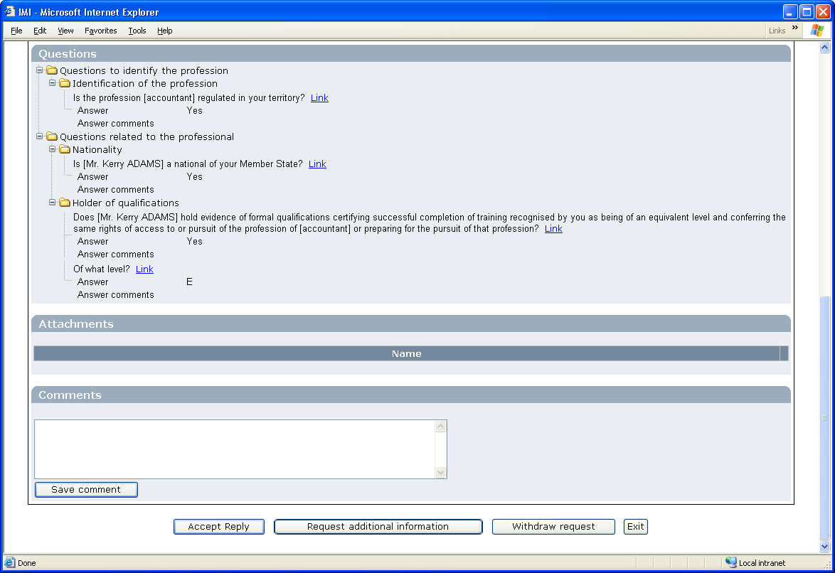
Request additional information (2)

Slide 42
Thank you www.berr.gov.uk/servicesdirective

