Slide 1
Families with Multiple Problems – How we can meet the PM’s commitment
Children and Families Officials Group Paper/Background Paper for Ministerial Group
Families Group DfE
June 2011

Slide 2
On 10th December 2010 the Prime Minister said:
“I set this ambition, by the end of this parliament, I want us to try and turn around every troubled family in the country”
Defining the PM’s ambition….
‘by the end of this Parliament’ – May 2015.
‘every troubled family’ – there is a ‘stock’ of 40-50,000 families with multiple problems and child/youth problems and a potential ‘flow’ from a wider group of 70,000 or more families at greatest risk of developing multiple problems and child/youth problems.
‘to try and turn around’ – all families with multiple problems and child problems (the stock) should receive key-worker-led intensive family interventions. Families at greatest risk of falling into this group (the flow) should be offered an earlier intervention appropriate to their need. Progress will be measured through data published annually on the number of families supported and measures of family outcomes.
‘in the country’ – the campaign covers England only.

Slide 3
What do we know about the ‘stock’ of 40-50,000 families with multiple and child/youth problems?
No parent in the family is working
Poor parenting
Family lives in poor-quality
or overcrowded housing
Truancy, exclusion or low
educational attainment
No parent has any qualifications
Family in debt
Mother has mental health problems
Drugs or alcohol misuse
At least one parent has a long-standing
limiting illness, disability or infirmity
Marriage, relationship
or family breakdown
Family has low income
(below 60% of the median)
Domestic violence
Family cannot afford a number
of food and clothing items
Child protection issues
Risk factors attributed to families with 5 or more disadvantages (from) Families At Risk: Background on families with multiple disadvantages, Social Exclusion Taskforce Research Report, 2007
Additional risk factors from families supported through family intervention (NatCen, Mar 2010).

Slide 4
What do we know about the ‘flow’ of families in and out of the group with multiple and child/youth problems?
    c. 290,000 or 5% families are at greatest risk of social exclusion
    c. 146,000 or 51% of these remain in this category at the end of each year
    c. 20,000 or 7% of these are very persistently at risk – remaining at risk for 4 years out of the 6 year period examined.
Certain trigger events can move families into the severely excluded group eg separation or the birth of a child.
Families at most risk of severe social exclusion are those with:
    lone parents, who are very likely to be in a workless household and in receipt of benefits
    four or more children and children below 5 years old;
    young mothers, mothers from black ethnic groups, mothers with lower levels of education
    social tenants, living in urban areas
But social exclusion alone does not necessarily lead to serious child/youth problems. Additional risks influence child outcomes:
    mothers’ mental health is associated with cognitive and non-cognitive skills and health outcomes of children
    home learning environment and parental attitudes are associated with low educational attainment and cognitive development
    parental conflict is associated with poor parenting, poor parenting is associated with poor child mental health, educational attainment and involvement in crime.
DfE is working with the Cabinet Office to undertake a detailed analysis of Families and Children Survey data to identify the family characteristics and trigger factors which lead to the worst outcomes and match these to the types of local provision appropriate to their needs.

Slide 5
In response to the PM’s ambition to meet the needs of these two groups of families, the Department for Education has made the following commitment within its Business Plan….
A new approach to families with multiple problems will be operating in 50% of Local Authorities by April 2012 (and 90% by April 2013)
The ‘new approach’ involves the local redesign of services to meet the needs of families with multiple problems so that:
  each family is supported by a single ‘key worker’* who helps them turn their lives around and re-engage with education and employment
  other children’s and family services work together to spot and offer help to families at greatest risk of developing serious problems in the future
  other local services invest in, and benefit from, savings generated by supporting families more effectively
This builds on the pioneering work of Family Intervention Projects (or FIPs) which by March 2010 had helped over 1,800 families overcome serious problems as well as developing plans for the implementation of Graham Allen’s proposals on early intervention.
* The value of a single keyworker who considers the whole family context is well evidenced from practice in FIPs and other family services such as Westminster’s Family Recovery Programme. This is also supported by findings from the Munro review which highlighted the need to reduce the number of professionals working with a child, young person and family.

Slide 6
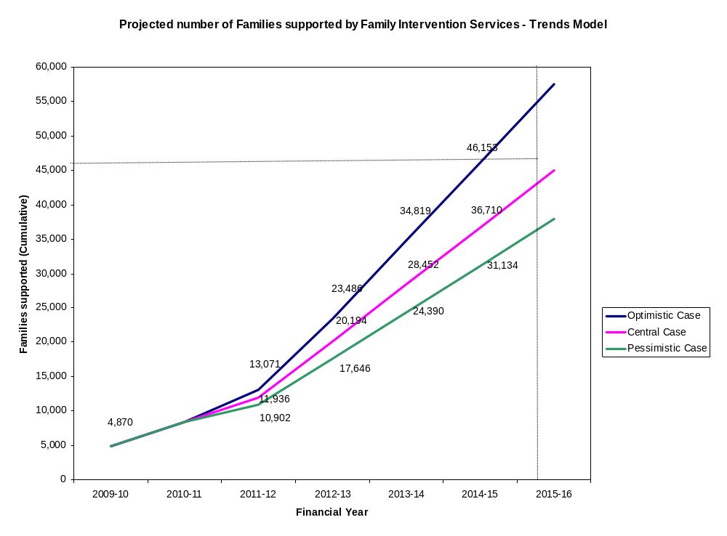
Independently collected local data suggests that every one of the ‘stock’ of 40-50,000 families with multiple problems and child problems could receive a key-worker-led intensive family intervention by 2015
Planned increase in provision in first Community Budget Areas extend to all areas through national roll-out
Includes extra 6,000 families /year to be supported through DWP ESF funding
Caseloads increase as key workers appointed in 2009-11start supporting more families.
Evidence re: cost effectiveness of family intervention and roll-out of Community Budgets s is currently sustaining investment in most areas
Notes:
Assumptions and Caveats
Central case
This assumes that the number of new family interventions delivered in the financial Year 2010-11 will also be delivered in each of the subsequent years. This balances a number of factors on either side.
Factors suggesting an increase
Our latest data[1] on key workers per family suggests current capacity is notably below the previously assumed maximum of 6. If this suggests that newer key workers are still in the process increasing there caseload, additional families may be supported.
Factors suggesting a decrease
A number of areas have already noted that they will be closing their family intervention services.
The central model assumes the aggregate impact of these two factors balances out.
Pessimistic case
The pessimistic case starts with the central case and adjusts the numbers downward to take account of closures and reductions. For those areas with possible or confirmed closure, or for which no decision has been made it is assumed their family interventions cease to contribute to the total (as a proportion of the number of interventions delivered in 2010-11). For the intervention services who have signalled some activity is continuing it is assumed there is a 10% fall in activity.
Optimistic case
The optimistic case starts with the central case and assumes an expansion as Community Budgets (CBs) increase the number of FIPs provided. The figures for what is expected to be provided over and above the norm is taken by looking at the difference between the number of families to be supported in 2011/12 compared with the number of families which were supported in 2010-11 (to estimate the ‘additionality’ of CBs as we estimate some family interventions would have been offered anyway.) It is assumed that this number of additional family interventions is also delivered in each of the remaining years of the spending review.
It is assumed there is a phased rollout of phase 1, 2 and 3 of Community Budgets across the years 2011-12, 2012-13 and 2013-14 respectively. It is assumed the areas in all three phases are of similar size.
However, the later phase CB areas could be less keen to divert resources to Family interventions than previous phases. Whilst this impact might to some extent be mitigated to some extent by success of early stages, high profile, central support and encouragement etc we assume that each subsequent phase of CB’s will roll out at 90% of the previous phase.
Caveats
These caveats are important; the analysis should not be quoted without reference to these:
Much of this analysis is based on highly provisional and unpublished analysis for 2010-11. As result, the analysis which has been derived from this should not be publicly quoted.
This new model is it’s early stages, with likely iterations to the assumptions and the actual data over time which is likely to result in future revisions.
It is assumed that CB areas can achieve the family intervention numbers as quoted. Given the fairly ambitious nature of these targets, and the limited incentives associated with success/failure, we have reason to be cautious about these estimates.
The number of family interventions delivered will be significantly sensitive to the number of families supported per key worker. A number of factors – such as intervention type, relative experience of key worker, relative level of need in family etc may have notable effects on the numbers, particularly if policy/the environment causes a systematic shift in the current ‘mix’.

Slide 7
And that there is the potential to support the ‘flow’ from the 70,000 or more families at greatest risk of multiple and child/youth problems...
 | Data Collection System | (Very) early estimate of no of High-Risk Families supported each year
DfE Evidence-based programme for children on the edge of care | Yes | 500
Family Nurse Partnerships for younger and disadvantaged parents | Yes | 2,000
Early Intervention Services and Early Intervention Places | Variable/Local | 20,000
Targeted programmes operated by Children Centre: | No/Planned | 56,000
Family drug and alcohol interventions | Yes | Further work needed to identify FMP population
Youth Offending Team parenting/ family interventions. | No | 13,000
Voluntary Sector initiatives – BIG Lottery ‘Improving Futures’ Fund | Planned | To be determined
TOTAL: Capacity to support an additional 80,000+ families exists. However more work is needed to match family needs to services and identify recording mechanisms.

Slide 8
The ‘new approach’ will be realised through important but achievable changes . . .
Most local authorities maintaining or expanding family intervention/intensive key-worker led services for the most troubled (46k) families
First phase Community Budgets areas realising their plans to redesign services/reduce the ‘stock’ of families with multiple problems/ deliver cost savings
Earlier intervention reducing the ‘flow’ of families who could develop multiple problems
Ensuring that evidence about the most effective practice is spread widely so that Family Intervention Services deliver strong outcomes
OTHER/SUPPORTING CHANGES:
Local and national adoption of the freedoms, flexibilities and approaches being developed by Baroness Hanham's Group of Council Leaders
Government Departments continuing to remove or find solutions to financial and legal obstacles to local service redesign
Local authority elected members being influenced by the Local Government Group/Council Leaders in the first phase areas
The support offered by LGID, DfE and CLG meeting local needs and ambitions
Overcoming the financial and legal obstacles to innovative finance/cost savings
Local authorities adopting good practice and expertise
Local services continuing to use the family intervention monitoring system to record the numbers of families supported & outcomes achieved
Identifying monitoring arrangements to record earlier interventions

Slide 9
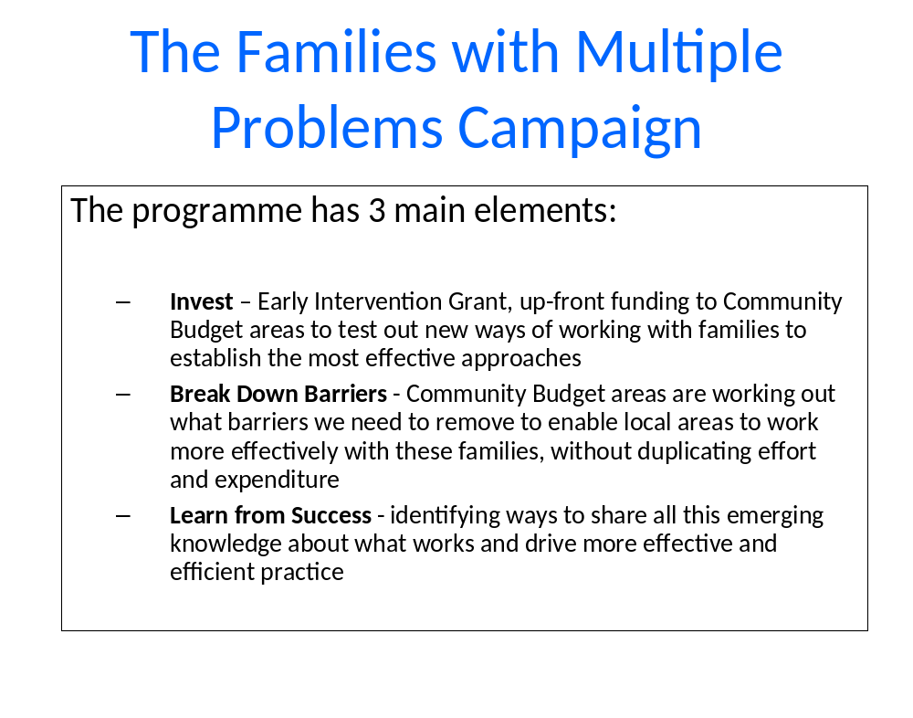
The Government’s commitment to rolling-out Community Budget for families with multiple problems to all areas will make an important contribution to this….
Community Budgets will be rolled out through a joint Local Government Group and Government ‘offer’ to authorities based on:

Slide 10
INVEST
Invest
Break down barriers
Learn from success
All areas will have access to:
Community Budgets: HMT ‘menu’ of local budgets which can be pooled or aligned
DfE Early Intervention Grant: £2.2bn/annum funding for early intervention and preventative services. Not ring-fenced, no breakdown in allocations but £60m from 2010-11 grant for families with multiple problems
DWP European Social Fund : £200m 2011- 14 for employment focussed services for families with multiple problems
Innovative Financing Mechanisms: Social Impact Bond being developed (Cabinet Office), Payment by Results (DfE, MoJ). £8-£40m/ annum, DfE Investment Fund - advances on future years’ DfE funding for service redesign

Slide 11
BREAK DOWN BARRIERS
Invest
Break down barriers
Learn from success
All areas:
will be assigned a ‘Whitehall Champion’ to ‘support and unblock’ local barriers to redesigning services for families with multiple problems. Issues addressed so far include:
    Joint working arrangements between local authorities, Job Centre Plus and employment providers working with families with multiple problems
    Arrangements for working with schools in Community Budget Areas
    Advice from the Information Commissioner on holding family case files
    Developing more flexible assessment arrangements with Munro Review
    Piloting new family proceedings court arrangements
will have the opportunity to adopt freedoms and flexibilities ‘co-designed’ between Government and first phase Community Budgets areas including:
    Simplified Assessment: Munro review flexibilities, expert support
    Data Sharing: data sharing protocols, local exemplar projects, expert support
    Innovative Finance: Social Impact Bonds, advance on future grant funding, payment by results
    Governance: agreements and protocols across Government and with key representative bodies

Slide 12
LEARNING FROM SUCCESS
Invest
Break down barriers
Learn from success
Local Government Group with DfE and CLG support will lead an extensive programme of work:
with Council Leaders, to ensure their views and ambitions inform Government support for Community Budget areas and that the experience and learning from the first phase Community Budget areas are disseminated more widely
LGID programme of work in development. Likely to include communities of practice websites, networking events etc for local authority services. Each phase of Community Budget Areas will be offered:
  Dissemination Hubs: A national network of 10 local authorities will support neighbouring authorities in moving towards Community Budget status, disseminate effective practice, broker exchange of expert practitioners.
  Exemplar projects, Evaluation and Dissemination: 21 local exemplar projects have been funded by DfE to develop new practice on data sharing, employment, safeguarding, crime reduction etc. This will be backed up by national cost-effectiveness research project and expert evaluation support in line with Graham Allen Review recommendations.
  Specialist Expertise: 15 national voluntary organisations with expertise in dealing with family problems have been funded by DfE providing expert support to local services including Interface, a new not-for profit organisation with particular expertise of working with families with multiple problems.
  Workforce Development: DfE has funded the Children’s Workforce Development Council to develop and roll-out accredited training for parent and family workers.
  Monitoring: DfE will continue to fund the National Centre for Social Research (NatCen) to work with local services to monitor the numbers of families supported, family outcomes and service performance. DfE will publish national and local NatCen data every September.
  Voluntary Sector Partnerships: Working Families Everywhere - new national not for profit organisation led by Emma Harrison promoting work-focused interventions in partnership with Government and local authorities, DfE-funded voluntary sector projects on family volunteering, homelessness, support for families of offenders, partnerships with the BIG Lottery - £20m (UK wide) ‘Improving Futures’ initiative to support innovative working between the voluntary sector and local authorities in 20 areas.

Slide 13
Next Steps
TO DATE....
2010
20th October – CSR announces Community Budgets for families with multiple problems and national roll-out by 2013
10th December - PM launches campaign
2011
24th February - DfE announces voluntary sector funding for campaign
1st April - Community Budget Areas operational (20% of LAs), areas notified of DfE funding for exemplar projects
NEXT……..
28th-30th June – Announcement of joint LGG/Government ‘offer’. Expressions of interest invited from authorities for next two phases of Community Budgets
September - Official statistics published on number of families supported by Family Intervention Services and outcomes
September – Dissemination Hubs operational in 10 local authorities
2012
April - 50 2nd phase Community Budget areas operational (50% LAs covered by April 2012)
September - Official statistics on families supported by Family Intervention Services
2013
April - 60 3rd Phase Community Budget areas operational (90% of LAs covered by April 2013)
September - Official statistics on families supported by Family Intervention Services

