Slide 1
Approach to Charging
December 2012
URN 12/1367

Slide 2
Background
The Government launched a formal consultation on 4 August 2011 to look in detail at key questions on the data policy for a Public Data Corporation (as of the Autumn Statement in November 2011 now known as the Public Data Group (PDG)). The consultation questions focused on: charging, licensing and regulatory oversight.
The consultation considered three broad options around charging for data:
  Status quo plus commitment to free: under this option, bodies within the PDG would continue to operate under the existing legal and policy framework, but with a commitment to make more data available free for re-use;
  Harmonisation and Simplification: under this option some data would be made available for free; for all PDG information within the public task, there would be a single price for a particular unit of PDG information and this price would apply to all uses of the information; there would be an ability to charge full cost plus an appropriate rate of return for PDG information and services outside the public task; and
  Freemium: this model is most often used in software and web-based services and works through a basic-level free offer, while charging for advanced features, functionality or related products.
The key messages from the consultation responses around charging were:
  Many respondents wanted all data to be released for free;
  However, a number of respondents and those who took part in workshops held alongside the consultation felt that a PDG should be able to charge for value-added services, and in some cases core data (where a high cost was involved in collection). In addition, although there was no overwhelming preference from respondents for any specific charging approach, there was a preference expressed in the responses for ‘raw data’ to be made available free with the option of charging for value-added services.
As part of the Government response to the consultation, published in March 2012, Government committed that it “will continue to consider the options for charging including those set out in the consultation and will report back by the end of 2012.”
Therefore, based on information supplied by the Public Data Group Trading Funds (Companies House, Land Registry, Met Office and Ordnance Survey), these slides have been put together to clarify the approach to charging.
The approach has been to undertake a series of interviews with the Trading Funds as well as to review prior reports around charging (national archives, consultancy reports etc) and customer surveys.

Slide 3
Conclusions and Next Steps
Broadly each of the PDG Trading Funds has a mix of free, regulated and market based charging models.
The PDG Trading Funds already give away a substantial amount of data for free, and continue to work with Data Strategy Board (DSB) to identify other data sets which might contribute to economic growth:
    Companies House: Free basic company information available via web based search services, Companies House Mobile Application, Uniform Resource Identifier (URI) and bulk product;
    Land Registry: Whole of England and Wales Price Paid data and Transactional data covering Lender and Conveyancing sectors;
    Met Office: 3-hrly core forecasts for over 6,000 sites; 3-hrly forecast and observation map layers for 16 different meteorological properties covering the UK and Ireland, and regularly updated text forecasts for mountain weather, national parks and UK regions – all through Met Office Datapoint;
    Ordnance Survey: All the mid/small scale maps (11 data sets).
For monopoly datasets, the PDG Trading Funds’ charges are designed to be in line with Managing Public Money. The PDG Trading Funds are required to comply with this guidance and so for monopoly datasets, the PDG Trading Funds consistently charge at full cost including standard cost of capital.
For competed products, the PDG Trading Funds’ charging models are designed for the markets in which they operate.
In terms of considering new pricing models, including those set out in the consultation:
  Changes to charging models for monopoly datasets are constrained by existing regulations and guidance;
  The PDG Trading Funds assess their charging models for competed products to respond to changes in their end markets;
  Any harmonisation and simplification of competed data needs to recognise that each PDG Trading Fund generates different types of data, which they sell into different markets;
  To some extent, the Freemium approach is already used. For example, Met Office’s basic level core observations and forecasts are available for free/marginal cost and a premium is paid for advanced services/solutions. For Ordnance Survey, the low/medium specification data is free and a premium is paid for high specification data.
Therefore, based on the work done to date, the PDG Trading Funds’ charging models appear to be designed for the regulatory environments and markets in which they operate.
As such these slides focus on providing greater transparency around the differences between the Trading Funds which underpin their approach to charging, the regulatory and guidance frameworks, their current charging models and summarising some of the work being undertaken by the PDG Trading Funds to respond to changes in their end markets.
However we acknowledge that emerging government policy and new technologies are bringing new opportunities, which means that it is even more important to continually assess approaches to charging.
Next Steps
As part of PDG’s commitment to ongoing collaborations and sharing of best practise, we will continue to build on the work in these slides with a focus on developing appropriate frameworks and guidelines to help deliver new charging models relevant to the PDG Trading Funds and their respective markets.

Slide 4
Table of Contents
Overview of Regulations and Guidance (p.5)
Overview of the PDG Trading Funds (p.6)
Overview of Charging Models (p.7-8)
  Companies House (p.9-11)
  Land Registry (p.12-15)
  Met Office (p.16-18)
  Ordnance Survey (p.19-22)

Slide 5
Overview of Regulations and Guidance
This slide sets out the regulations and guidance that apply to the PDG Trading Funds.
Broadly,
  Where the public service is non competed the charges should be set to be full cost recovery, including a charge for the cost of capital;
  Where the public service is competed, the charges should be set to reflect market prices, so as not to undercut the private sector.
Companies House is also subject to EU legislation which governs its charging and cost recovery policies.
Managing Public Money (“MPM”) (October 2007 A6.2) / Guide to the Establishment and Operation of Trading Funds (Aug 2006) (12.5-12.7)
  The PDG Trading Funds are required to comply with the guidance on fees, charges and levies in Managing Public Money. The standard approach to setting charges for public services (including services supplied by one public sector organisation to another) is full cost recovery. It normally means recovering a 3.5% real charge for the cost of capital.
  However, for services supplied into competitive markets, charges should be set at a commercial rate.
(http://www.hm-treasury.gov.uk/d/mpm_whole.pdf)
(http://www.hm-treasury.gov.uk/d/Guide_to_the_Establishment_and_Operation_of_Trading_Funds.pdf)
The Competition Act 1998 prohibits the abuse of a dominant position in a market. (http://www.legislation.gov.uk/ukpga/1998/41/contents)
Reuse of Public Sector Information Regulations - EU Directive
  Under the 2005 legislation, charges for the re-use of information made by public sector bodies can not exceed the cost of collection, production, reproduction and dissemination of documents; and a reasonable return on investment.
  The revision of this directive is proposing to move to marginal cost but allows for some exceptions.
  (http://www.legislation.gov.uk/uksi/2005/1515/made)
Information Fair Trading Scheme (IFTS)
  This sets and assesses standards for public sector bodies. It requires them to encourage the re-use of information and reach a standard of fairness and transparency. The National Archives (TNA) use the IFTS to monitor the activities of the Trading Funds to ensure that they trade fairly, openly and transparently in information.
  (http://www.nationalarchives.gov.uk/information-management/ifts.htm)

Slide 6
Overview of the PDG Trading Funds
Companies House, Land Registry, Met Office and Ordnance Survey are all Trading Funds and generate Public Sector Information.
As Trading Funds they have a statutory requirement to fund operations and meet their financial objectives (Return on Capital Employed (ROCE) target) from trading income.
However they are all very different in terms of:
  Competitive landscape: Varies from 100% non-competed to 100% competed;
  Funding model: Varies between where data users fund none of the collection costs to where data users fund 100% of the collection costs.
  Channel mix: Varies from 100% non-HMG to a mixed model.
These differences influence the charging models currently used by each of the PDG Trading Funds.
 | Companies House | Land Registry | Met Office | Ordnance Survey
Status | Trading Fund Statutory Body | Trading Fund Statutory Body | Trading Fund | Trading Fund
Competitive Landscape | 100% non-competed (statutory monopoly) | 98% non-competed (statutory monopoly) | Mix of: Non-competed and competed HMG contracts; and Widely competed commercial (non-HMG) contracts. | All products and services are traded in competed markets (apart from OS OpenData).
Funding Model | Registration and search customers fund data collection through statutory fees. Data users fund dissemination costs. | Register users fund data collection through statutory fees. Value added service users fund product development and dissemination. | HMG funds the core underpinning national infrastructure, research and development required for the national weather, core climate services and services to defence. Wholesale data users fund their own data dissemination costs. Users of value added competed services pay for the bespoke development of weather services and the transfer price of the data, which is on the same terms for all parties. | Data users fund data collection, product development and dissemination. Users of value added services pay for the bespoke development of services and the transfer price of the data, which is on the same terms for all parties.
Channel Mix | 99% non-HMG 1% HMG | 100% non-HMG | 79% Core HMG 4% Competed HMG 17% non-HMG | 43% PSMA, OSMA⁽¹⁾ 43% other Chargeable incl. Private Sector 14% OpenData™ (for private and public sector innovation)
1. PSMA: Public Sector Mapping Agreement; OSMA: One Scotland Mapping Agreement

Slide 7
Overview of Charging Models
Products and services are traded in non competed markets. Pricing models used include:
  Free Data: Free basic company information available via web based search services, Companies House Mobile Application, URI and bulk product.
  Cost recovery including cost of capital: All statutory services including registration and search, and bulk data where not provided for free.
Over the past 5 years the cost of bulk products has been reduced by 15% and for some bulk products the cost has fallen by 30%.
A survey in 2011 showed that registration costs for companies in the UK are among the lowest in the world. The average registration cost at Companies House is £17 per company in contrast to £100 in Ireland, £125 in German, £199 in Belgium and £215 in Singapore. 80% of customers are satisfied with the value for money of Companies House products and services.
Companies House
Products and services are traded primarily in non competed markets. Pricing models used include:
  Free: Whole of England and Wales Price Paid data and Transactional data covering Lender and Conveyancing sectors.
  Cost recovery including cost of capital: All statutory services including registration and search.
  Market based: Value added services.
Of the 775 respondents to customer surveys, only 8% were about value for money or pricing. Indicating that value for money or pricing are not primary concerns for the majority of customers.
Based on market research undertaken with PA Consulting, Land Registry is moving its data pricing model to:
  Free: Aggregated data to view/download.
  Marginal cost recovery: Bulk data and Pay as You Go data.
  Market prices: tailored products and services.
Land Registry

Slide 8
Overview of Charging Models (cont’d)
Met
Office
Products and services are traded in a mix of competed and non competed markets. Pricing models used include:
  Free at point of use: The Public Weather Service (PWS) provides free at point of use information and services. Met Office Datapoint provides access to reusable data including 3-hrly core forecasts for over 6,000 sites; 3-hrly forecast and observation map layers for 16 different meteorological properties covering the UK and Ireland, and regularly updated text forecasts for mountain weather, national parks and UK regions.
  Cost recovery including cost of capital: Non-competed government services.
  Marginal cost recovery: Core data (refined forecasts and observational information).
  Market based: Commercial/Competed services.
The Met Office commercial arm purchases core data at the same price as external third parties.
Commercial customers rate price as more important than government customers, but neither indicate that price drives their choice of Met Office services.
Ordnance Survey
All products and services are traded in competed markets and use market based pricing, including:
  Free: a suite of mid/small scale data is provided under OS OpenDataTM funded through an agreement with BIS.
  Chargeable products: this applies to all other data not provided under OS OpenDataTM. Pricing models include annual license fee and usage specific royalty model (e.g. charge per unit or charge per click). Free pilot data is available for evaluation and during product development Ordnance Survey’s value added services arm purchases data products at the same price as external third parties.
In the most recent customer survey, Ordnance Survey scored 6.3-7.6 on pricing. A score above 7 is considered a highly positive result in most industry sectors.
The pricing/licensing model is routinely reviewed to respond to market development.

Slide 9
Companies House – Overview
With the exception of the free data release, all product groups are priced the same across Companies House as they are all considered to be statutory, non-competed products/services:
  Full cost recovery including cost of capital (3.5% real) for each product group. Full cost recovery principles are applied in line with Managing Public Money and European Law.
  There is no cross subsidisation across product groups or between registration and search.
This is in accordance with European Law and HM Treasury guidance.
ROCE has been an average of 9% for the past couple of years because of:
  Costs falling faster than prices can be adjusted (Ministerial approval is required to adjust prices)
  Continued rises in the size of the register above planned expectations, as well as improved compliance on annual returns filed, have yielded more income than anticipated when setting prices.
For bulk data specifically, the overall cost allocated in 2012 was £821k.
There are a range of prices for bulk data depending on the type and therefore cost of delivery.
Over the past 5 years the total cost of bulk products has fallen by 15%, but some products e.g. Daily Image file for Annual Returns have fallen by over 30% (£26k in 2007 to £17.5k in 2012).
Future pricing models will be considered as part of the Companies House Strategic Review (2013).
(For more information go to - http://www.companieshouse.gov.uk/toolsToHelp/ourPrices.shtml)

Slide 10
Companies House - Pricing
Maintaining Data Base
Registration
Information Products
Search Bulk
Examples
New entries or changes to the register: Annual Return, Incorporations, Change of name, Mortgage registration, Dissolution, Liquidation
Searches of the register, download of information and provision of certified copy information
Bulk data products
Competitive Landscape
Companies House is non-competed for registration products, however it is the primary source of search information.
Channel Mix
99% non HMG/ 1% HMG
Revenue
77%
21%
2%
Pricing Approach
Free Data: Free basic company information available via web based search services, Companies House Mobile App, URI and bulk product
Full cost recovery including cost of capital (3.5% real)
Cost Allocation
Activity based costing principles
Direct operational costs are allocated directly onto the product groups.
Overhead costs allocated using generally accepted accounting rules such as by floor area, FTE etc.

Slide 11
Companies House – Customer feedback on pricing
In answer to the question ‘“how do you rate the value for money of our products and services" the percentage of customers who were satisfied in the Q1 2012/13 survey was c. 80%.
As part of this survey, Companies House also invites specific comments on services. Companies House have very few comments related to pricing, but a sample of those which are have been provided here.
Some of these comments have already been addressed:
  A fee change at the beginning of October enabled company appointment information to be released for free.
Survey Question: How do you rate the value for money of our products and services? | Q4 2011/12 | Q1 2012/13 | Q2 2012/13
General | 78% | 79% | 84%
Companies House Direct - online subscription service (Cert Copies) | 87% | 78% | 78%
Contact Centre - provides printed and emailed output (Cert Copies) | 81% | 73% | 77%
Note that Companies House don’t have a specific question for the WebCHeck service as the vast majority of searches are free and those which aren’t are priced at £1.
“Directors names being available for free since they are a matter of public record”
“The company information screen should contain details of current officers as well as the amount of issued share capital”
“The inclusion of the names of the directors of companies in the basic (free) WebCHeck service would be a great benefit to someone wishing to courteously communicate with a company.”
“Additional information should really be free”

Slide 12
Land Registry - Overview
In accordance with Managing Public Money:
  Overall, statutory products (registration and search) are priced based on full cost recovery including a cost of capital of 3.5% real;
  Value added services reflect market pricing.
On 22 October 2012, Land Registry implemented a fee reduction to reflect their recently completed Accelerated Transformation Program. The fee reduction was only implemented once the program was substantially complete as there is a cost to the customers of changing their systems.
Land Registry is also in the process of refreshing its 5 year strategy, which covers both data pricing and cost efficiency.
In terms of data pricing, Land Registry is proposing the following as part of their revised strategy:
  The aim is to deliver a sustainable financial model, with the ability to pass on benefits to customers as volume usage increases.
  There will be a mixed model of:
    Free data releases: Aggregated data to view/download
    Marginal Cost License: Bulk data and “Pay as You Go”
    Tailored services and products: Only where there is a clear market need and Land Registry has distinct expertise. Market price reflects market need, size and cost to serve.
    Currently examining scope to use TNA’s proposed chargeable license
  The strategy also includes investment in IT systems, which will drive efficiencies and reduce the marginal cost of data dissemination.
(For more information go to - http://www.landregistry.gov.uk/public/forms)

Slide 13
Land Registry – Existing Pricing
Maintaining Data Base
Registration
Data Products
Search
Value Added Services
Examples
New entries or changes to existing entries on the register (includes state indemnity).
First registration, dealing of whole, dealing of part.
Searches of the register, official copies etc
Tailored products e.g. Data Matching, Property Monitoring (where Land Registry offers distinct expertise)
Competitive Landscape
Non Competed (statutory)
Average 80% competed and 20% non-competed (e.g. only Land Registry hold polygons)
Channel Mix
100% non HMG
100% non HMG
Revenue
c. 80%
c. 18%
c. 2%
Pricing Approach
Transaction based pricing
This structure includes a pricing scale based on both the application type and, where applicable, the value of the underlying property/land.
This base line is adjusted to recover full cost of the statutory services including a cost of capital of 3.5% real.
Competed products priced at full cost recovery including cost of capital to reflect market based pricing. Non competitive products priced at full cost recovery including cost of capital.
Some aggregate data sets e.g. PPI, released for free.
Cost Allocation
Currently costs are not allocated by product group.
Full costs include the cost of processing all the registrations/searches and an overhead allocation which includes IT, legal, finance, HR etc.
Direct costs and apportioned indirect costs are allocated at product level.

Slide 14
Land Registry - Customer feedback on pricing
Statutory Services
Add Value Services
From the last two waves of the Customer Satisfaction Surveys (June and September 2012 – 600 respondents), a small proportion (33 comments) were made about value for money (including pricing/fees) of statutory services.
The majority of these 33 comments were regarding a “price reduction”.
Since this survey Land Registry has implemented a 10% price reduction.
From the August 2012 Add Value Satisfaction Survey (175 respondents), 28 comments were made about pricing/fees of Add Value services.
The majority of comments noted “Services too expensive” – other examples have been provided below (blue).
Land Registry also retained PA Consulting to undertake a significant research study into opportunities around their data sets – some of the pricing related comments are provided below (grey).
‘Reduce the fees for standard applications’’
‘Their charges are far too high for anyone other than lawyers’
‘If price more reasonable and services more updated I’d use the service more’
‘Overall customers were more price sensitive for add value products than for statutory services. They also wanted a close relationship between price elements and the value of the data for them (i.e. menu based pricing)’
‘Cost! Make it cheaper to do searches! It should be a free service and should not charge’
‘It’s a reasonable price and it is easy to use’
‘The pricing is dependent on volume of results, If you get less than 30 results back you have to pay an additional fee and it would be better if you had to pay per result’
‘Offer discounts for regular users’
‘they could make available sample data sets (and their supply criteria) on their website (i.e. freemium)’
‘It’s a bit expensive. One off fee for large users like ourselves’
‘If you have large land holdings the cost can be prohibitive. The costs were too much they’ve come down somewhat but the increase is marginal. If the price was brought down we would be more frequent users’
‘While a menu driven pricing approach could result in reduced income from specific customers for some services, it will attract others. It will also strengthen the customer relationship – providing a more customised service
‘Its £4 for a title plan and £4 for a title. I think it should be £4 for both’

Slide 15
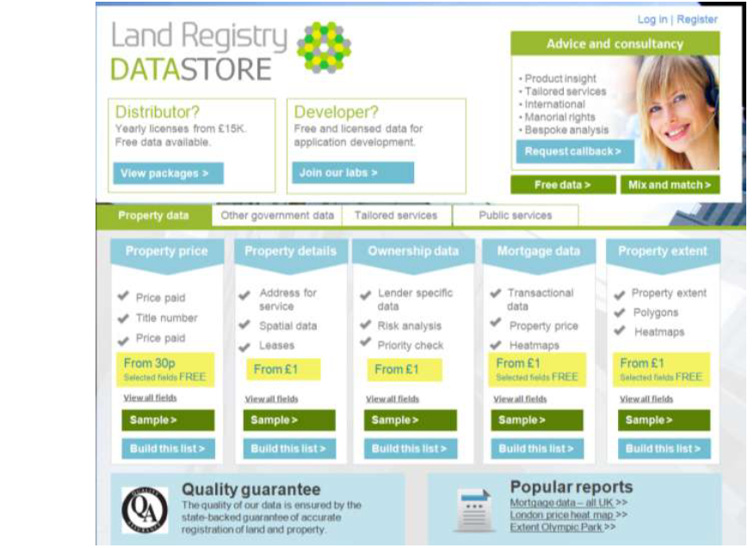
Land Registry - Future pricing based on research and insight
Insight has determined the following future model around the data pricing:
  Licensed Data:
    Aggregated data will be increasingly released for free under Open Government license.
    Price points key to encourage wider take-up/usage (through menu driven pricing, price/volume discount dependant on demand/volume & price elasticity testing, based on marginal cost).
    Land Registry will provide a suite of prices based on use type (sensitive data) and numbers of users.
    Land Registry will ensure commercial entities (large and small) have access to and increase user choice through a mixed model.
    Data will be provided through licensed contracts where commercial confidentiality and data sensitivity exists.
  Tailored services and products:
    Charging will be undertaken to cover an appropriate service rate (consultancy/product or service) which will cover our costs and provide a margin relative to the work undertaken. Market price reflects market need, size & cost to serve.
Indicative example of how data will be made available

Slide 16
Met Office - Introduction
The Met Office’s business model distinguishes clearly between two types of customer:
  Central government bodies requiring services which cannot sensibly be competed; and
  Services provided on a commercial (usually competed) basis to customers both inside and outside Government.
The Met Office’s pricing policy is aligned to these types of customers.
Non-Competed Services for Government
In its role as the National Meteorological Service, the Met Office provides a range of non-competed services to other government departments. These services account for the majority of Met Office revenues.
Separate arrangements are made for each Customer-Supplier Agreement and pricing of services conforms to the terms agreed.
The prices for such services are set at a level consistent with HM Treasury guidance.
Competed Services
Competed commercial services are priced on an individual basis, depending on the nature of the service and the requirements of the customer. This applies equally to public sector and private sector customers in cases where the contract is awarded through competitive tender. No cross subsidy is allowed from public to competed services.
Other data and services that do not come under these categories, but are relevant to pricing include:
  Free Data: The Met Office Public Weather Service provides free-at-the-point-of-use (no license fee, no handling charge) weather information and severe weather warnings for the UK, including the general public and the resilience community. Data is also available in reusable formats, subject to a Fair Use Policy, on a free-at-point-of-use basis through Met Office Datapoint.
  Wholesale Data: This is predominantly Public Sector Information and the Met Office may charge extraction, handling, distribution and delivery costs. Wholesale Data is supplied to the Met Office's commercial services arm on the same terms and conditions as to external customers.
  (For more information go to - http://www.metoffice.gov.uk/about-us/legal/pricing-policy)

Slide 17
Met Office – Pricing Models
Core weather and climate services to government/public sector
Data products/forecasts for 3rd party use
Commercial services
Examples
Public Weather Service: Services include core weather forecasts and severe weather warnings - 'free at point of use‘ for the general public and all re-users.
Other contracts e.g. Defence (MoD), Hadley Centre Climate Programme (DECC / DEFRA).
Refined data from forecasting model and observational information
Competed, value-added products/services to the public and private sector e.g. Regulated aviation, market specific services (e.g. marine, utilities, renewables) etc.
Competitive Landscape
Non competed
Non competed
Competed
Channel Mix
100% HMG
Mixed
Mixed
Revenue
c.83%
0.7%
c. 16%
Pricing Approach
Charge to HMG - Cost recovery including cost of capital (3.5%).
Met Office data – either marginal cost recovery or exchanged (with other NMSs) for free.
3rd party data - sold at mandated wholesale price.
Commercial services are priced at a fair market value to deliver profit.
Cost Allocation
Costs allocated to agreements.
Costs allocated to Met Office’s Commercial arm.
-
Extraction, handling, distribution and delivery costs may be charged for wholesale data

Slide 18
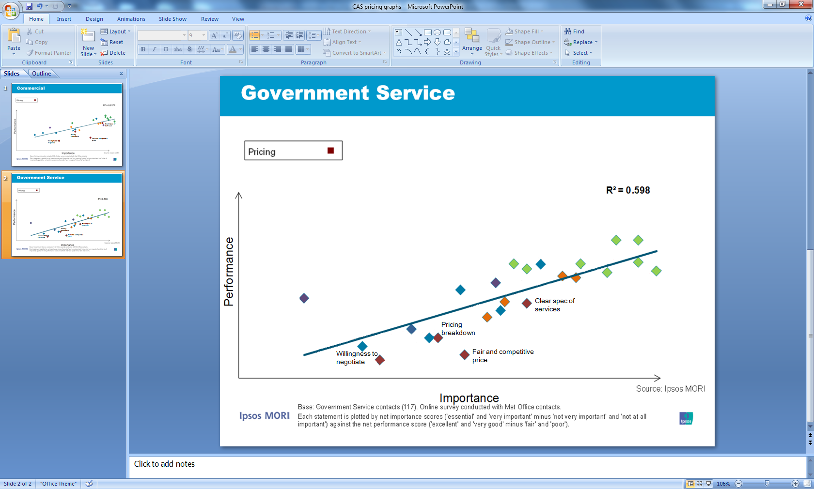
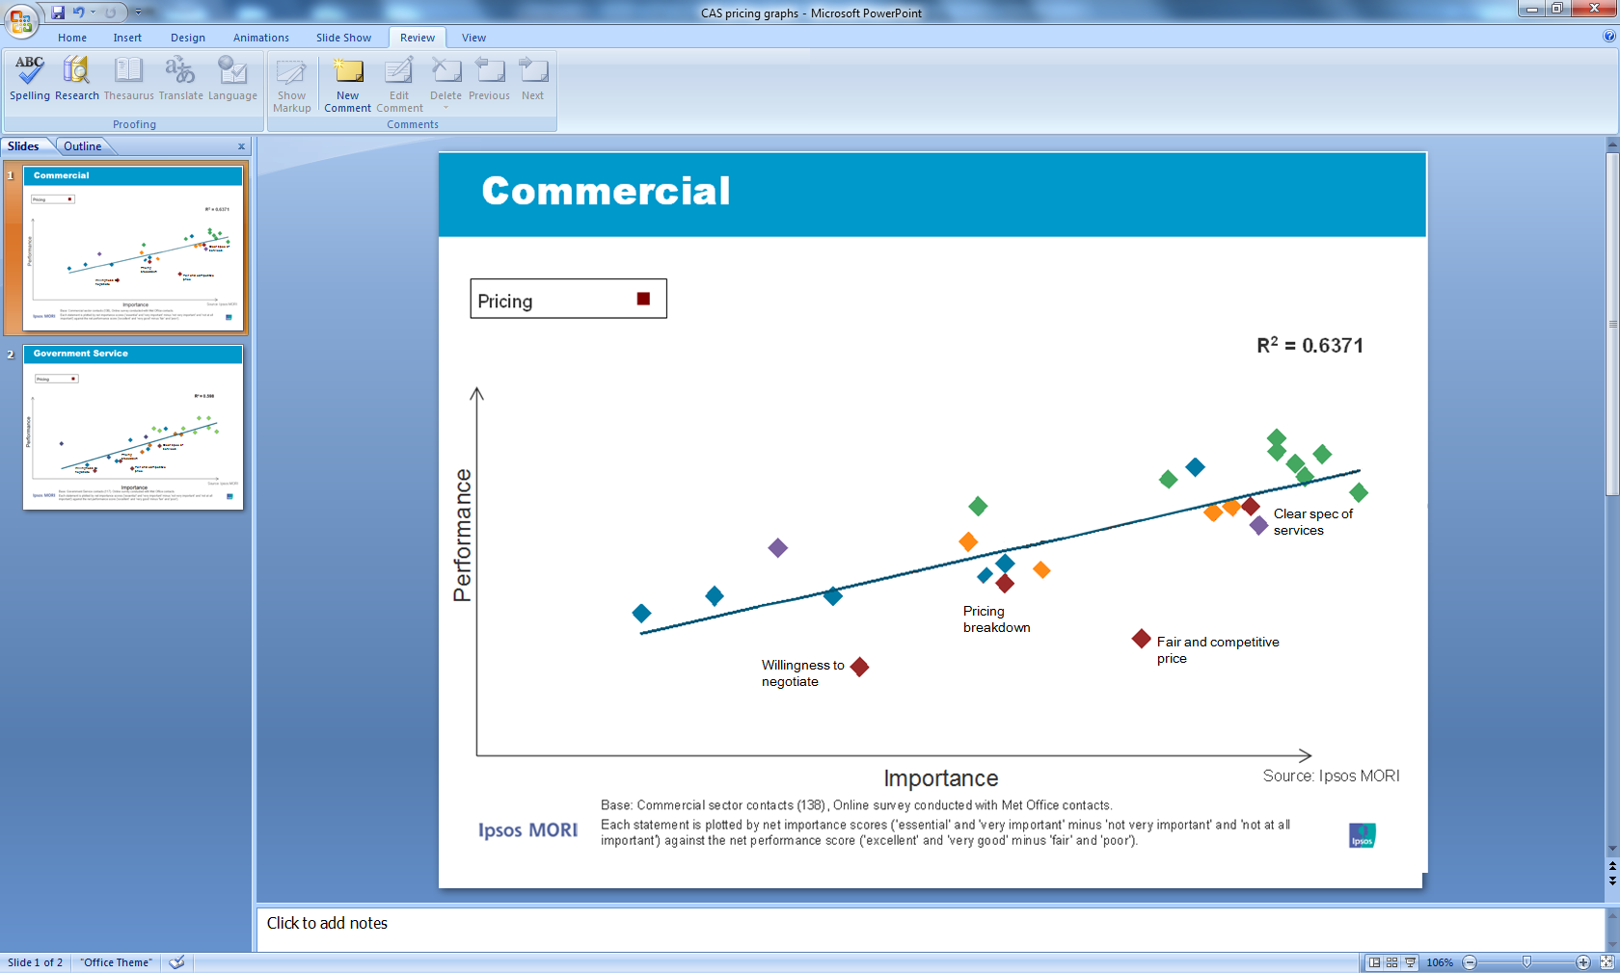
Met Office - Customer feedback on pricing
The Met Office conducts a customer attitude survey. Through this survey they receive some feedback on pricing and this is included below.
Commercial customers rate price as more important than government customers, but neither indicate that price drives their choice of Met Office services.
Note: Excludes PWSCG

Slide 19
Ordnance Survey - Introduction
Ordnance Survey has statutory obligations: The 1841 Act prescribes collection but not methods of dissemination, and hence no statutory charging regime. Historically maps have always been charged for.
As a Trading Fund, Ordnance Survey has a statutory requirement to fund operations and meet its financial objectives (ROCE target) from trading income. Therefore pricing models seek to maximise license usage while generating sufficient trading income to recover costs and rate of return.
There are high levels of common costs whether viewed by channel to market, customer or product. These common costs are based on collection, once at the detailed level and then using in many different products including at simplified levels. Common costs include investment in infrastructure to support the maintenance and delivery of authoritative data where c10,000 changes to datasets are made daily.
Ordnance Survey utilises market-based pricing to maximise access to the data whilst recovering direct costs and making a contribution to common costs:
  Pricing acknowledges the nature and value of use in each specific market (differential pricing);
  The model complies with competition legislation as all users in a given market pay the same price.
The Public Sector Mapping Agreement (PSMA), the One Scotland Mapping Agreement (OSMA) and OS OpenData™ were initiated by central or devolved government. All are negotiated Crown-to-Crown agreements based on commercial prices.
The pricing and licensing model is routinely reviewed to respond to market developments.

Slide 20
Ordnance Survey – Pricing models
Data Products
Value Added Products / Services
Open Data
Direct sales & value added reseller channels
Consumer mapping
Services
Examples
OS OpenData™.
Small and mid scale maps.
OS MasterMap Topo, AddressBase, Integrated Transport Network, Boundaries data, Vector maps.
Paper Maps, GetaMap, web shop
Surveying, Consultancy, Cartography.
Competitive Landscape
OS IPR released in 2010.
All these products and services are traded in competed markets. There is a level of competition for all products and services.
Channel Mix
Freely available to all
PSMA & OSMA
100% public sector
91% private sector; 9% public sector
Revenue
£20m
£61m
£61m
Pricing Approach
Market-based pricing through commercially negotiated Crown-to-Crown agreements
Market-based pricing through both direct and indirect channels
Market based pricing, or by exception
cost-plus
Cost Allocation
For cost-recovery contracts, direct cost allocation. Otherwise, pricing is not based on cost allocation.
Internal recharging for use of data products or group resources.
Pricing is not based on cost allocation.

Slide 21
Ordnance Survey –Market-based pricing and licensing
Pricing and Licensing Mechanisms for Data
Data products are licensed through both direct and indirect channels.
Direct channel licenses provide the customer with a data licence for internal business use over the term of the licence (typically multi year).
  Price list applies consistently across all market sectors.
  Pricing of collective agreements (PSMA and OSMA) reference list prices.
  Re-seller channel enables re-sale of internal business use licences (discount on price list applies).
Pricing of direct licences include the following variables:
  Extent of coverage of GB (geographic area);
  Number of terminals (users);
  Density of data (some products only, notably OS MasterMap Topo);
  Scale (some products only, notably OS MasterMap Topo).
Indirect (partner) channel distinguishes between:
  Distributors: re-sellers of direct licences as above, and
  Value Added Resellers: where data products are licensed for specific end-market uses including:
    Navigation;
    Consumer applications and websites;
    Printed products;
    View, tracking & scheduling.
Pricing of specific use partner licences is determined by the commercial practices and needs of the particular market. For example, viewing data via websites is typically priced per click. The value (price) is determined through a market usage approach and extensive consultation with the licensed partners in each market sector and is under constant review to reflect changing markets.

Slide 22
Ordnance Survey - Customer feedback on pricing
Ordnance Survey conducts ongoing customer satisfaction surveys which feed into an Agency Performance Monitor (APM). The principal survey mechanism is 6-monthly Customer Satisfaction Index (CSI) and Net Promoter Score (NPS) tracker conducted independently by professional survey provider GfK NOP. The survey covers a wide range of customer satisfaction elements: pricing & licensing; product range, quality and ease of use; pre and post-sales support and responsiveness; fulfilment; on-line experience.
The CSI is a widely-established industry standard methodology for assessing customer satisfaction by separate constituent elements that make up overall satisfaction. Respondents state their level of satisfaction on a scale of 1 to 10. A net score above 7 is a highly positive result in most industry sectors.
The most recent survey was delivered to Ordnance Survey in Spring 2012, with results based on 2,725 interviews including 377 B2B, 441 B2G and 1,907 B2C customers. The results are combined with first half-year to give total for the financial year. Results are analysed by market sector (B2G, B2B and B2C) and provide an insight into the relative and absolute importance of each service element. The results below set out those elements most relevant to Pricing for B2G and B2B.
Government
CSI results improved significantly over previous survey in 2012.
Results are positive for value for money (VFM) and pricing. This is likely to be due to most B2G customers receiving products under PSMA and OSMA central agreements.
Results for the pricing-related elements tend to be in line with other elements such as product quality or after-sales service.
Business
Results for the pricing-related elements tend to be lower than other elements of satisfaction .
Satisfaction with clarity of T&Cs has fallen slightly, the other elements have improved marginally over prior survey.
Separate analysis of partners and direct channels were introduced in the November 2012 survey.
Consumer
Satisfaction scores are high, although reduced over last survey due to issues in the early part of the introduction of GetaMap™ subscription service (e.g. Terms and Conditions do not apply to paper maps).
B2G | Overall B2G 2011/12 2010/11
Clarity of T&Cs | 6.82 | 5.93
Value for Money | 8.05 | 6.89
Pricing | 7.57 | 6.33
B2B | Overall B2B 2011/12 2010/11
Clarity of T&Cs | 6.37 | 6.60
Value for Money | 6.84 | 6.74
Pricing | 6.33 | 6.23
B2C | Overall B2C 2011/12 2010/11
Clarity of T&Cs | 8.22 | 8.54
Value for Money | 7.47 | 8.00
Pricing | 7.25 | 7.78

