Slide 1

Export Control Organisation
Customer Satisfaction Survey 2010
- Summary of Main Findings
ECO Awareness Team
September 2010
URN 10/1197

Slide 2
Background
Survey issued via ECO’s SPIRE export licensing database between January and April 2010 – https://www.spire.bis.gov.uk
Triggered by issuing of final licensing decision when applying for Standard Individual Export Licences.
41% response rate (1618 responses)

Slide 3
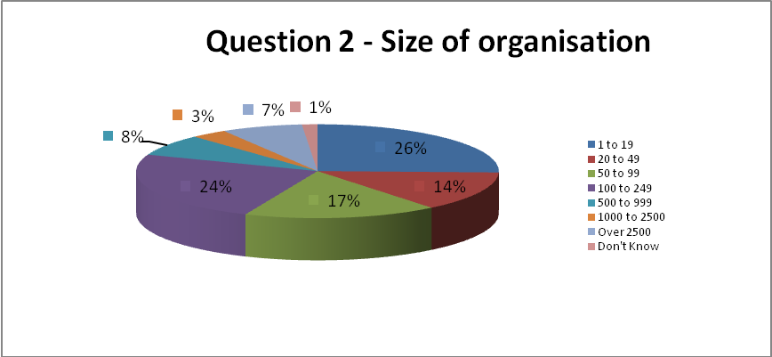
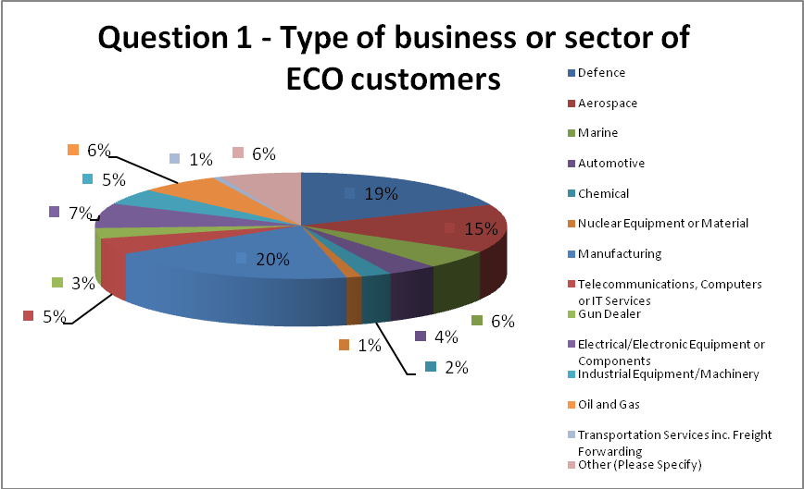
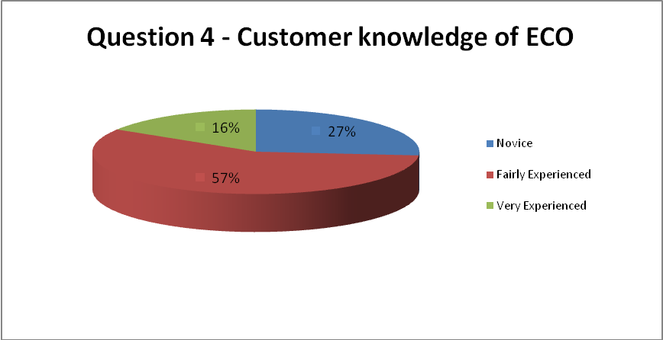
Customer Insight
Companies exporting “dual-use” goods comprise large proportion of ECO survey respondents
40% of survey respondents are small and medium (SME) sized companies
Significant proportion (27%) of respondents defined themselves as “novice” users of ECO’s services
Who responded to the ECO Customer Survey 2010?

Slide 4
Key Insights
67% of respondents have a positive opinion of the ECO and are satisfied with the overall service level ECO provides.
Only 4% of respondents are strongly dissatisfied (raises to 21% if not had satisfactory response to significant licensing delay)
Views on Licensing Service and Staff
Levels of Satisfaction (%)
Staff are courteous
84%
Staff are helpful
73%
Suggested customer improvements include:
Speed of licence processing – timescales and targets
Relationship Management of companies
Consistency of Licensing Advice
Open Licensing
Charging
Guidance issues and customer training needs
Improving the ECO Helpline
Improving the ECO website
Improving the Checker Tools
Tone and attitude of customer communications
Staff Knowledge
Staffing Levels
Staff are knowledgeable
63%
SPIRE is easy to use
75%
Licensing process in general is
communicated well
64%
Final licensing decision is
communicated clearly
87%
Informed and aware of licensing
responsibilities
87%
Prompt response to specific query
57%

Slide 5
ECO Response - Action Plan
Action Point | Key finding/suggestion | ECO Actions | Review Date and Lead
AP1a | Speed of Licence Processing – Timescales and Targets | We recognise that customers expect a response to applications and enquiries within the targets set out in our Performance Code. Our immediate focus will be on reviewing the delivery of the Rating Enquiry Service including provision of assistance to self rate goods. | January – March 2011 Licensing Unit/Policy Team/Awareness Unit
AP1b | Communication about progress/delay in licence processing | We recognise that dissatisfaction with ECO’s service is often linked to experiences and perceptions of the processing of specific licence applications. While our role is to make a careful, considered assessment of each application, we recognise some frustration can result from the processing and communication involved in dealing with the application. As a result we will be investigating ways to improve the “progress” tracking messages on the SPIRE system. | Ongoing Licensing Unit
AP1c | Relationship Management of companies | We have previously considered introducing greater relationship management of companies in the licensing process. Indeed this is one of the reasons why we have Open Individual Export Licences OIELs) which are designed for companies with a track record in licensing. Introducing further relationship management of companies could potentially be counter productive and actually risk slowing down the application process as a result of increased querying of applications. It would also be difficult to introduce relationship management based on size of company or geographic location in the UK since this s not a factor in the final licensing decision. Nevertheless, we do recognise that there may be opportunities to widen the role of the existing Compliance Officers and this issue will be reviewed by ECO’s internal Change Group. | March 2011 Licensing Unit/Compliance Unit ECO Change Group

Slide 6
Action Plan
Action Point | Key finding/suggestion | ECO Actions | Review Date and Lead
AP1d | Consistency of Licensing Advice | All export licensing decisions are made on a case by case basis in relation to the EU and National Arms Export Licensing Criteria. We are reviewing our internal training and communications with staff to ensure that all staff remain fully informed of current licensing procedures. | Early January 211 Licensing Unit
AP1e | Improving the ECO Helpline | We plan to improve the Helpline by introducing a call options function and reviewing our provision of our training and advice provided. We will review the new service after 6 months of operation. | November 2010 Licence Reception Team
AP1f | Tone and attitude to customer communications | SPIRE caters for a wide range of applicants ranging from novice system users to more ‘expert’ applicants. SPIRE’s functionality is continuously being assessed and reviewed. Further changes are planned to upgrade the system by issuing details of ratings on the final licence document. We plan to review how SPIRE reports on the progress of specific licence applications. | Ongoing Licensing Unit / Awareness Team
AP1f | Improving the usability of SPIRE | We are very conscious of our communications with customers which range from our guidance material, Notices to Exporter notifications, communications about specific licences and the final licensing decision. We will issue revised guidance to staff on best practice in dealing with customers and review our training procedures. Sometimes, however, it is necessary to use a more firm tone to encourage companies to take swift action as a result. | October 2010 Licensing Unit/Awareness Team

Slide 7
Action Plan
Action Point | Key finding/suggestion | ECO Actions | Review Date and Lead
AP1h | Staff Knowledge | We are reviewing our internal procedures about how we train and update staff. | October 2010 Licensing Unit
AP2 | Open Licensing | We have recently introduced a new OGEL which might be suitable for companies to use for the export of their goods in relation to the Typhoon Project (subject to meeting the terms and conditions). We are currently reviewing the introduction of further OGELs where possible, depending on the nature of the goods and destinations. In conjunction with the issuing of new OGELs, we will review our communications and training about OGELs to ensure that exporters understand as clearly as possible how they can be beneficial and aid their exporting potential. We will also explore the possibility of promoting the use of OIELs more widely and looking at the track record of companies that might be able to consider this licensing option. | Ongoing as new OGELs published Compliance and Awareness Teams
AP3 | Charging | Licensing is a statutory service. Any potential changes such as the introduction of a charging policy would have to be considered carefully in terms of all implications and impact and consulted on extensively. | To be reviewed separately
AP4a | Guidance issues and customer training needs | We have recently introduced an End-User Undertaking Form and associated Checklist with additional guidance on the difference between an end-user and a consignee. We have also taken action to improve the drafting of all our communications. For instance, our Notices to Exporters are now drafted, as far as possible, to include further background explanation which puts the update into context and aims to guide companies in the actions that they need to take. | Action complete Ongoing Licensing Unit/Awareness Team

Slide 8
Action Plan
Action Point | Key finding/suggestion | ECO Actions | Review Date and Lead
AP4b | Guidance issues and customer training needs | We already provide a good range of training courses including on-site training. This includes information on using tools such as the Goods Checker and OGEL Checker. All our courses are now fully advertised via both the Businesslink and UK Trade & Investment websites and their respective Events databases. We will monitor this awareness advertising to ensure that as many exporters as possible continue to be informed in good time of our continuing training programme both in London and across the UK. For those companies who have requested additional information about the seminar programme, our external feedback should ask the question about how companies want to receive/ be alerted to the information | Ongoing Awareness Team
AP4c | Improving the ECO website | Having export control guidance on the Businesslink pages is beneficial in enabling information to reach a potentially wider audience of small and medium sized companies and to identify greater linkages with other related export and trade issues. At a recent website review meeting held with industry representatives in September 2010, it was agreed that the new export control pages on the Businesslink website were fit for purpose. The Committee on Arms Export Controls (CAEC) has also endorsed the move to Businesslink and the content of the new website. | Ongoing Awareness Team

Slide 9
Action Plan
Action Point | Key finding/suggestion | ECO Actions | Review Date and Lead
AP4d | Improving the Checker Tools | The Checker Tools are recognised as valuable tools by a wide range of exporters and also overseas export control organisations and trade bodies. We aim to explore new ways of funding further development of the Checker Tools to ensure that the tools can continue to develop. However, it should be recognised in the current budgetary climate that this is not a top priority. With a continued interest in self-rating, we are also investigating the development of a Ratings Search Tool to complement the Goods Checker database. We are also reviewing our exporter training courses in this area. | Late 2012 Awareness Team
AP4e | Getting the Basics Right | We plan to issue an updated and more comprehensive Service Code and Complaints Procedure to our customers and issuing corresponding guidelines to our staff. We plan to publish more information showing trends in complaints, both formal and informal, and the action we have taken as a result, providing a mechanism for receiving customer and staff feedback on the effectiveness of the complaints procedure. We will consider introducing new measures (such as a Customer Satisfaction Index and mystery shopping) to monitor our performance in all customer contact areas in relation to standards for timeliness and quality of customer service. | January 2011 Awareness Team
AP5 | Staff Levels | As with other organisations, we need to work within our allocated resource budget. We are, however, constantly reviewing the way we work and are currently looking at options for improving the efficiency and effectiveness of our licence processing operation in the light of increasing licence application volumes. | Ongoing ECO Director

Slide 10
Website: http://www.businesslink.gov.uk/exportcontrol or http://www.bis.gov.uk/exportcontrol
ECO Helpline
Tel: 020 7215 4948
Email: eco.help@bis.gsi.gov.uk

