Slide 1
Enterprise Mentoring
Summary of Evidence on the Provision and use of Mentoring by Small and Medium sized Enterprises
20 September 2012

Slide 2
Mentoring Research
BIS has developed its understanding of business mentoring through extensive market engagement and external research
BIS has also commissioned primary research to address evidence gaps
  Use and benefits of mentoring
    IFF (2010) Small Business Survey 2010
    IFF (2010-12) BIS SME Business Barometer
  Supply of mentoring
    GHK (2012) Estimating the Provision of Business Mentoring
The evidence collected has informed the policy action plan which BIS has also published

Slide 3
Many small businesses do not make sufficient use of external advice and information
1) Challenge
New and existing SMEs help drive economic growth by raising competition, stimulating innovation and have been shown to make a disproportionately large contribution to job creation
Using external information, advice and guidance can have a major impact on improving business skills and, through this, business outcomes
In 2010, 49% of SME employers have sought external advice or information on matters affecting their business
It is estimated that as many as 3 in 10 businesses may have unmet demand for external business advice
  In many cases lack of use will stem from market failures such as a lack of information on the potential benefits
Mentoring is particularly suitable for engaging with entrepreneurs as it meets a common preference for learning to be informal, from experienced peers, and it can be tailored to the needs of their business
Source: NIESR (2006) ‘Business start-ups, Closures and Economic churn- a review of literature’; Anyadike-Danes et al (2011) ‘Job creation and destruction in the UK: 1998-2010’;
SQW Consulting (2009) A review of mentoring literature and best practice’; BIS calculations based on Small Business Survey 2010
and ‘Research to Understand the barriers to take up and use of business support’ CEEDR and BMG (2011)

Slide 4
Factors that make mentoring appealing to entrepreneurs also help make it difficult to measure
1) Challenge
Business mentoring is hard to measure:
  Often informal, with mentors experienced peers rather than specialists
  Can be tailored to the needs of individuals and evolve over time
  Definition of mentoring is fluid, those involved may not realise they are involved in mentoring
  Mentoring can form part of a wider professional service (eg accountants)
Informality and flexibility are both factors that make mentoring particularly suitable for entrepreneurs…
…but the wide variation in what constitutes mentoring and what it may offer help make it difficult to assess potential benefits and costs

Slide 5
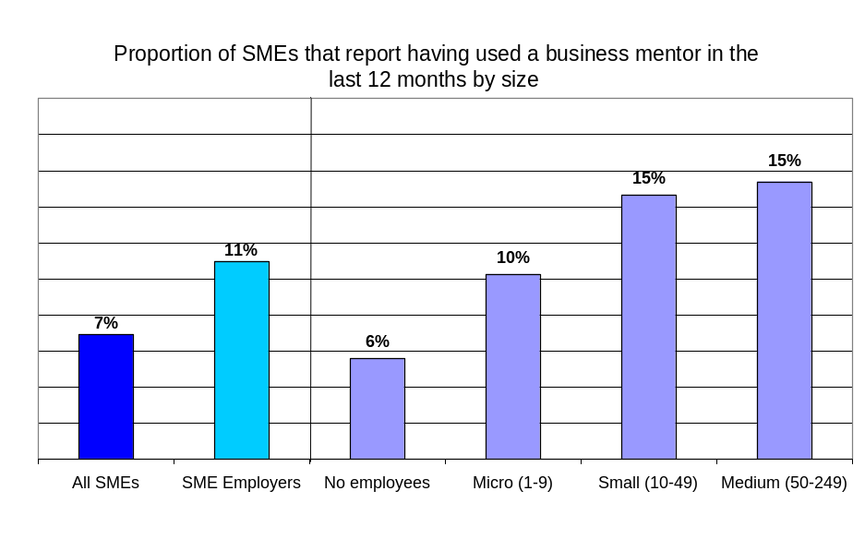
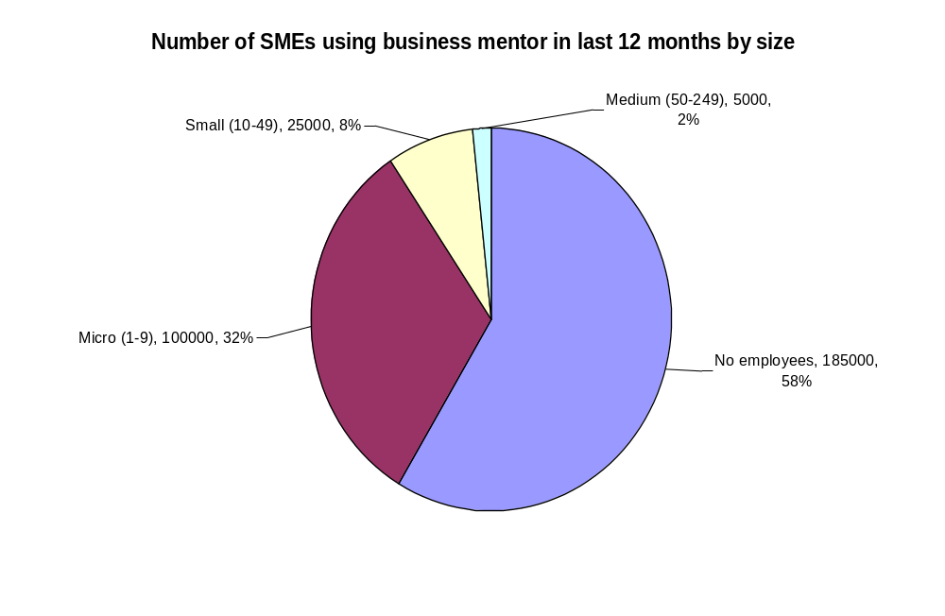
In 2010, more than 300,000 SMEs had used a mentor in the previous year
2) SMEs and Mentoring
larger SMEs are more likely to have used a mentor
But as most SMEs are non-employers, only 2 in 5 (130,000) of those using mentoring are employers
Younger business more than twice as likely to be using a mentor
  (15% of those trading for less than 3 years had used a mentor compared to 6% of older firms)
Source: BIS analysis of the Small Business Survey 2010 and Business Population Estimates

Slide 6
…with large numbers benefiting from mentoring
2) SMEs and Mentoring
Of SME employers using a mentor more than 9 in 10 have benefited
In the last year use of business mentoring has helped:
100,000 SME employers improve their ability to develop business plans and strategy
60,000 SME employers improve their enhance their leadership and management skills
70,000 SME employers to increase sales or profits
40,000 SME employers to obtain finance
Source: BIS analysis of the SBS 2010, Business Population Estimates and BIS Barometer surveys (August 2011, November 2011 and February 2012)

Slide 7
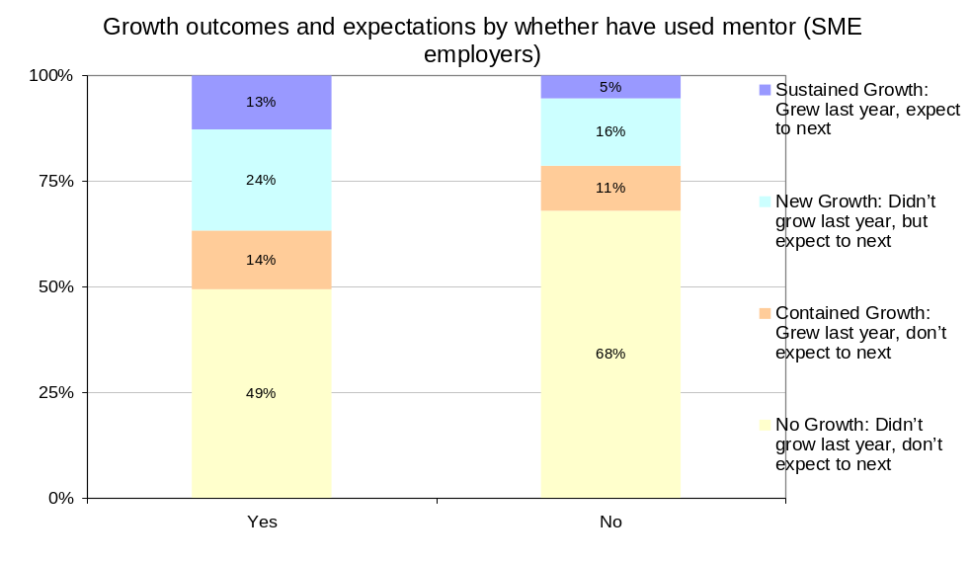
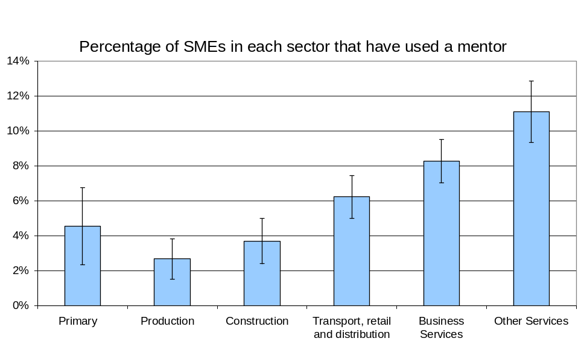
Growing enterprises are more likely to use a mentor, as are those in service sectors
2) SMEs and Mentoring
SMEs that used a mentor are more likely to be growing
  They are also more likely to have provided training to their staff and management
SMEs in service sectors are more likely to use a mentor than those in other sectors
  Further analysis is required to identify whether these differences are due to sectors or a result of other characteristics by sector
Source: BIS analysis of the Small Business Survey 2010

Slide 8
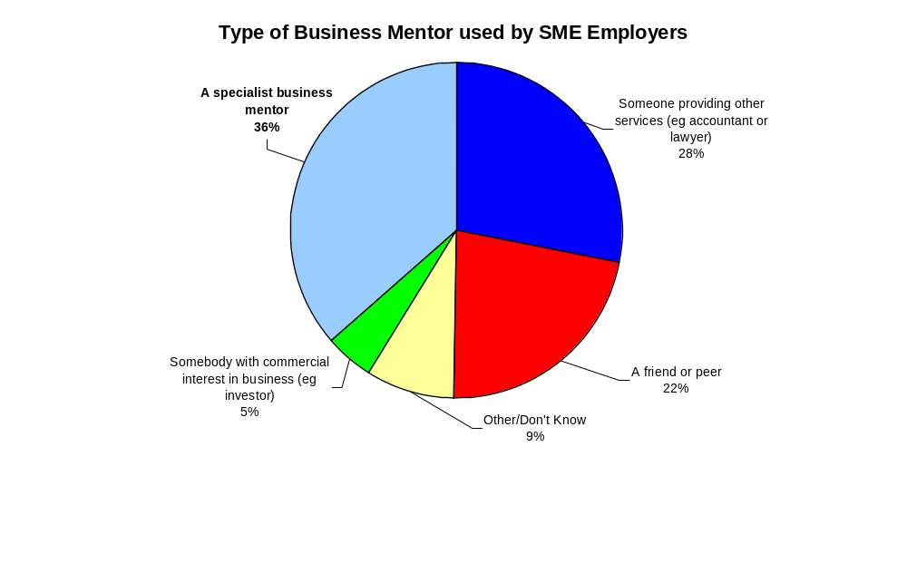
Of employers using a mentor, less than 40% said they were using a specialist business mentor
2) SMEs and Mentoring
Almost 4 in 10 were using someone who was a specialist mentor
For 3 in 10 their mentor was providing other professional services
2 in 10 were mentored by a friend or peer
1 in 10 by other individuals, such as those with a commercial interest in their business (eg Business Angel)
Source: BIS analysis of the Barometer surveys (August 2011, November 2011 and February 2012)

Slide 9
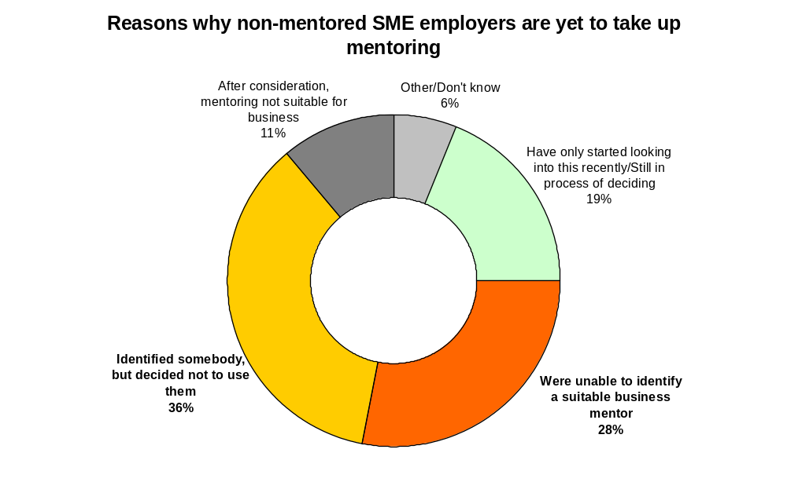
Latest data indicates that 6% of SME employers are or have considered taking on a mentor
2) SMEs and Mentoring
BIS estimates that 11% of SME employers (130,000) had used a business mentor
A further 6% (70,000) had considered doing so
  For over half of these, the reasons for non-use could be linked to difficulties finding a suitable mentor
Both responses may indicate difficulties finding a suitable mentor
Source: BIS analysis of the Barometer surveys (August 2011, November 2011 and February 2012)
Notes:
.

Slide 10
Most SMEs are not involved in mentoring, whether this be as a mentor or mentee
2) SMEs and Mentoring
9%
Are mentoring others
13%
Have been mentored in last year
Amongst SME employers…
Many SME employers are also mentoring others
5%
Are thinking of becoming a mentor
6%
Have at least considered being mentored
…and a further
…and a further
72%
Have not been involved in mentoring during the last year and have not considered doing so
There is overlap between these groups. When brought together we find that…
Just 20%
of SME employers are being mentored or mentoring others
8%
Thinking of mentoring or being mentored
Source: BIS analysis of the Barometer surveys (August 2011, November 2011 and February 2012)

Slide 11
Those who are mentoring others are also deriving benefits
2) SMEs and Mentoring
Our survey data indicates that of SME employers who are mentoring others:
55% believe being a mentor had helped develop their own leadership and management abilities
35% believe that being a mentor had led to increased profits in their own business from being able to reflect on their own strategy
Source: BIS analysis of the Barometer surveys (August 2011, November 2011 and February 2012)

Slide 12
Estimated that as many as 400 organisations are providing business mentoring in England
3) Mentoring Organisations
GHK commissioned to ‘baseline’ current provision of business mentoring in England
  Focused on identifying formal market – organisations or individuals that were advertising provision of enterprise mentoring
    The research excludes those helping friends or associates through informal mentoring or mentoring individuals on their own professional development
  Survey of organisations was conducted in January/February 2012
  Surveyed 183 mentoring organisations, which represented around 11,500 mentors
Research confirms earlier assessment that the market for mentoring is very varied
Very difficult to assess scale of market, but GHK estimated that in January/February 2012 there were:
  Around 400 organisations that provide some form of mentoring
    Many of these were small with few mentors and some served particular clients (eg Students at a University)
  Up to 21,000 mentors operating through these organisations
Many are therefore not likely to be appropriate for the Mentorsme portal
Source: GHK (2012) ‘Estimating the Provision of Business Mentoring’

Slide 13
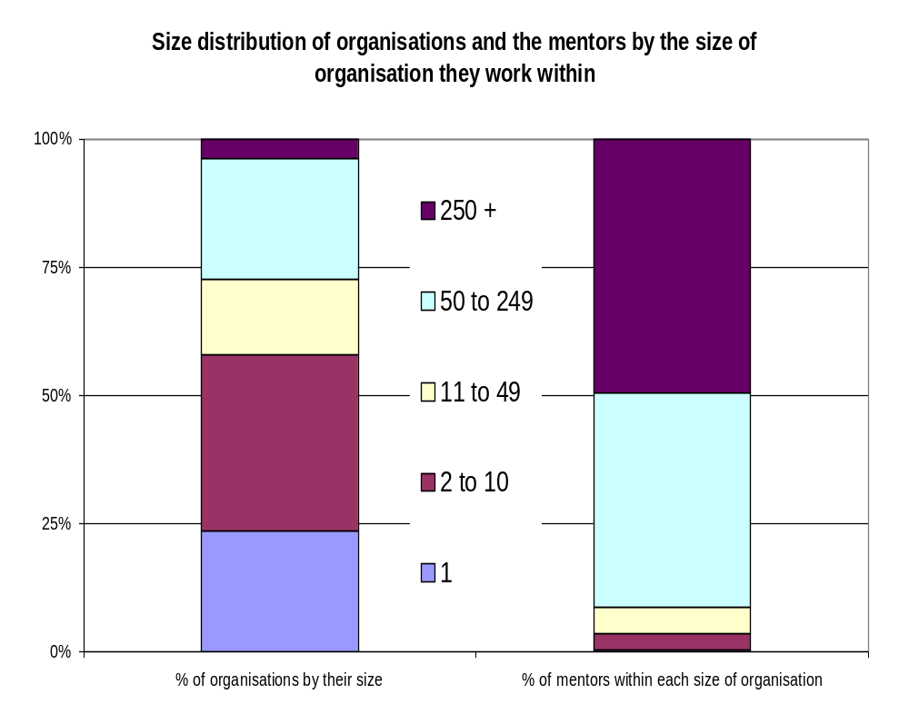
Most organisations are small, but most mentors operate through a large organisation…
3) Mentoring Organisations
Almost 60% of indentified organisations had fewer than 10 mentors
  Around a quarter had only one mentor
Over 90% of mentors are provided by organisation with at least 50 registered mentors
  Half operate with organisations with more than 250 mentors
Source: BIS analysis of GHK (2012) ‘Estimating the Provision of Business Mentoring’

Slide 14
…mentors tend to operate through more than one organisation…
3) Mentoring Organisations
60% of organisations contain mentors that also work through other organisations
Share of mentors who offer their services elsewhere by the number of mentors
Number of mentors | Share of mentors who also offer services elsewhere
0 to 10 | 57% | 6% | 7% | 4% | 27% | 0%
11 to 49 | 15% | 44% | 19% | 7% | 15% | 0%
50 to 249 | 16% | 44% | 14% | 12% | 14% | 0%
250 + | 29% | 29% | 29% | 0% | 0% | 14%
All organisations | 40% | 21% | 11% | 6% | 21% | 1%
The smallest organisation are most likely to have mentors that do not also operate with other organisations
Source: GHK (2012) ‘Estimating the Provision of Business Mentoring’
Notes:
Organisations with sole use of mentors contain only around 20% of identified mentors

Slide 15
…for most organisations mentoring was not their main activity
3) Mentoring Organisations
Mentoring is only the primary activity for a quarter of organisations
  Only a handful of organisations only provide mentoring
  For almost half (48%) mentoring accounts for less than a quarter of their activity
  There was little difference across size of the organisations – with almost half of mentors in organisations where mentoring represents less than a quarter of activity
Activities provided alongside mentoring were mainly other forms of business support
  82% general business advice
  54% coaching
  48% other forms of training (eg workshops)
Source: GHK (2012) ‘Estimating the Provision of Business Mentoring’

Slide 16
Most provided at least some face-to-face mentoring and a majority charged at least some mentees for their services
3) Mentoring Organisations
Most mentoring organisations will look to cover both short term support on a particular issue (91%) and longer term developmental support (86%)
  Three in five also provided support in an enabling or networking capacity
  Two fifths offered support to particular disadvantaged enterprise groups
Almost all organisations provided at least some face-to-face mentoring (98%), with three-quarters also providing a web-based offer.
Half of organisations charged for the mentoring provided (50%) with a further one in five (17%) charging ‘for some’ mentoring. One third of mentoring organisations provided all mentoring at no cost to mentees.
Most organisations generated referrals through word of mouth recommendations (80%) referrals from other organisations (76%).
  Many also used their own promotional activity, own website or web directories
  Over one third of organisations were not listed on any web directories (39%)
Source: BIS analysis of GHK (2012) ‘Estimating the Provision of Business Mentoring’

Slide 17
Most organisations have seen an increase in demand and were looking to increase their capacity
3) Mentoring Organisations
Most organisations have seen demand increase…
  In the previous 6 months (ie since Mentorsme was launched) 80% had experienced increase in demand: 41% significantly, 39% slightly
…but there were mixed views on where this left the current balance of supply and demand
  Organisations disagreed on current supply and demand for mentoring: in balance/greater supply/greater demand
Almost all felt there was scope for further growth
  90% of organisations believe potential exists to increase business mentoring levels; 53% significantly
The majority were planning to increase their own capacity
  Capacity: 57% of organisations plan to increase capacity over next 6 months
  Only 20% had previously faced difficulties recruiting mentors
Current referrals come from a wide range of sources, but mentorsme was then still in its infancy
  Referrals: 80% word of mouth; 76% other organisations; 64% own web-site; 58% own marketing; 45% web directories
Source: GHK (2012) ‘Estimating the Provision of Business Mentoring’

Slide 18
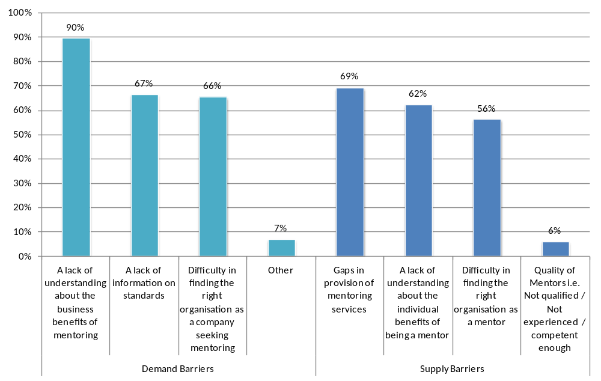
Organisations most likely to say that information failures are barriers to growth of mentoring
3) Mentoring Organisations
Although no gaps were apparent in the evidence on preceding slides, the majority of organisations see gaps in provision as a constraint
BIS is exploring the nature of these gaps with a group of mentoring organisations
Source: GHK (2012) ‘Estimating the Provision of Business Mentoring’

Slide 19
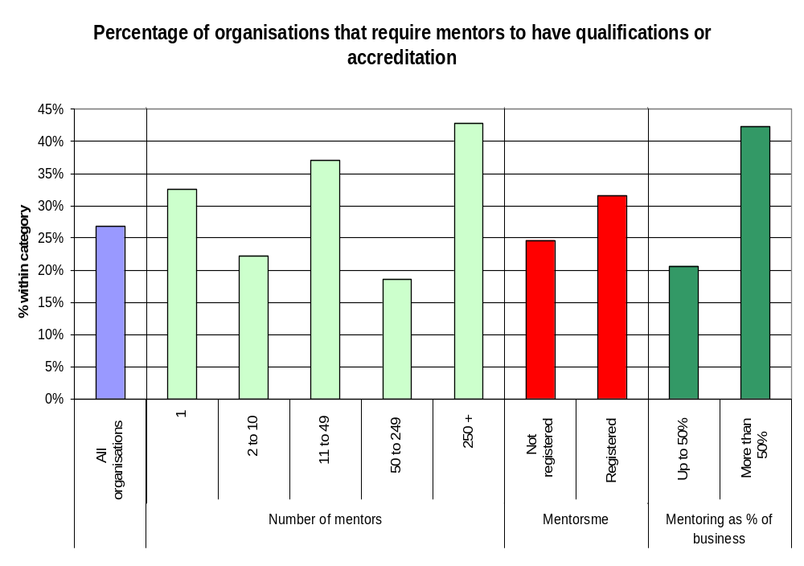
A quarter of mentoring organisations require mentors to hold qualification or accreditation
3) Mentoring Organisations
Likely that most organisations value business experience over specific training as a mentor
Organisations focused on mentoring more likely to require qualifications or accreditation
Source: BIS analysis of GHK (2012) ‘Estimating the Provision of Business Mentoring’

Slide 20
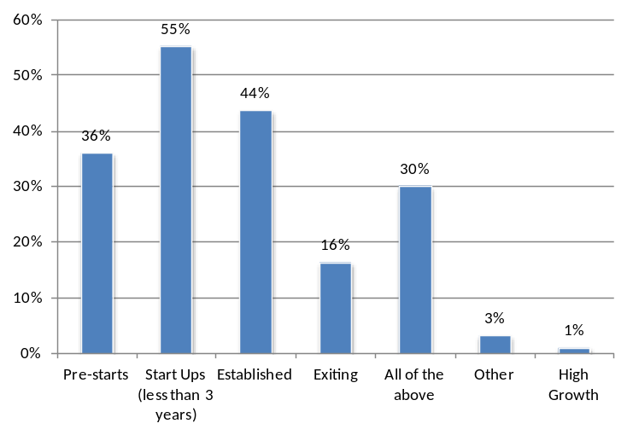
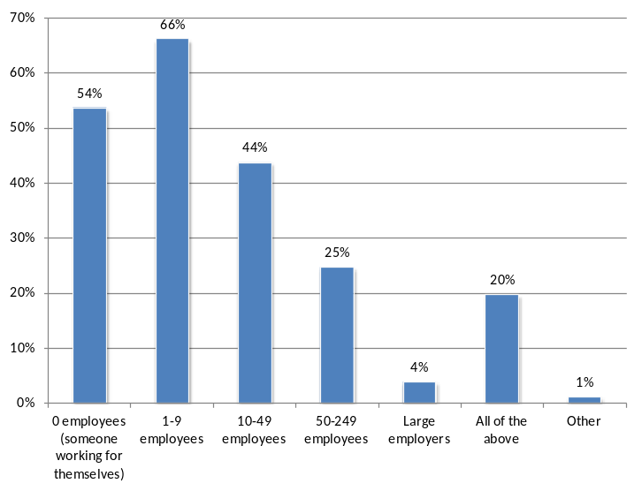
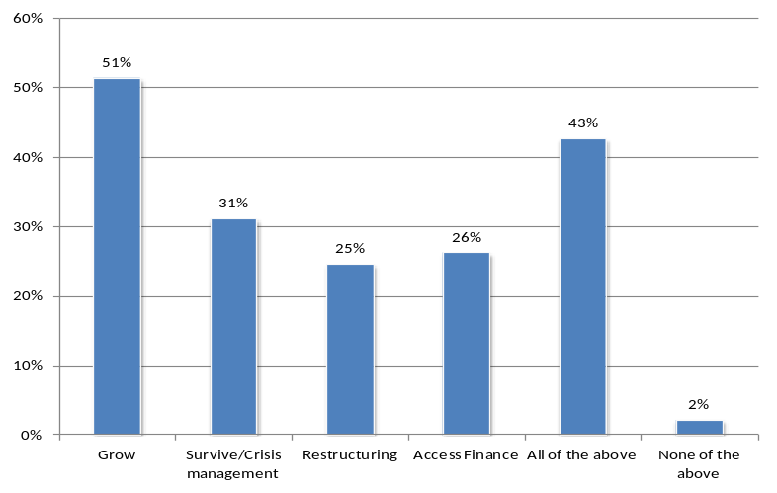
Most organisations do not focus on specific ‘life stages’ of firms
3) Mentoring Organisations
Organisations by stage target
Mentoring providers were found to be more likely to target
  Early stage businesses
  Those looking to grow
  Micro businesses, but the percentage targeting larger SMEs was greater than their share of the business population
Organisations by size target
Organisations by strategy target
Source: GHK (2012) ‘Estimating the Provision of Business Mentoring’

Slide 21
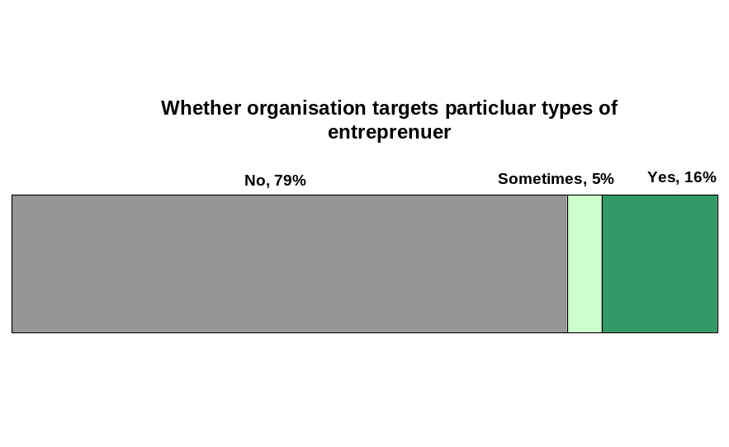
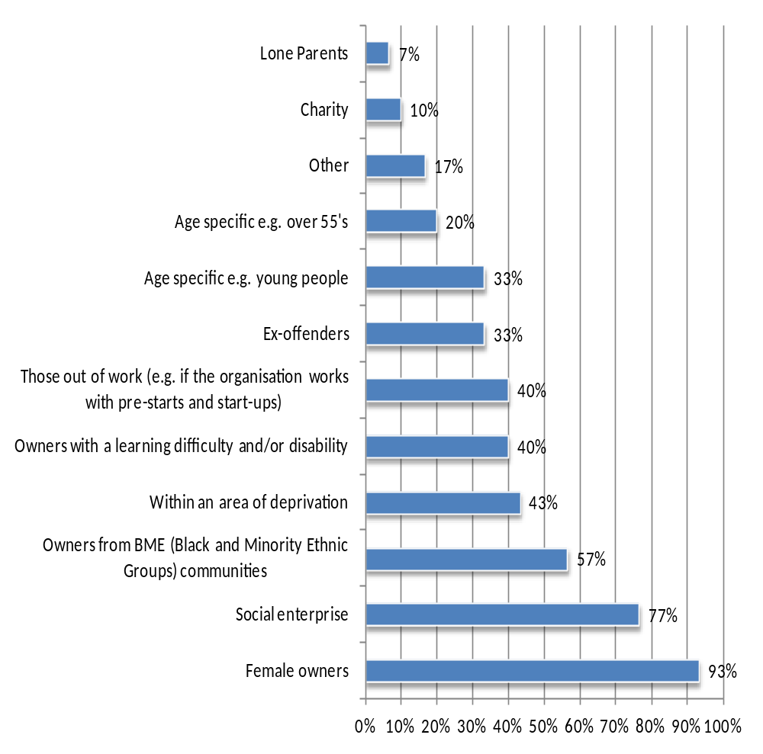
Most organisations do not focus on specific types of firms or entrepreneurs
3) Mentoring Organisations
Two fifths of organisations offered support to particular disadvantaged enterprise groups…
…but just 16% of organisation explicitly target specific types of entrepreneurs
  A further 5% sometimes do so
When targeting support, female owners, social enterprise and owners from BME groups were a key focus
  Many other groups were also targeted including areas of deprivation, ex-offenders, age specific (eg 50+) and people with learning difficulties
Source: GHK (2012) ‘Estimating the Provision of Business Mentoring’

Slide 22
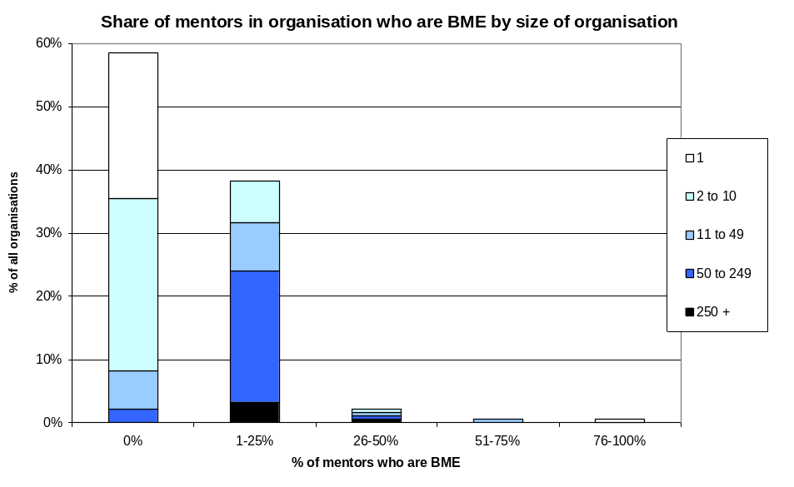
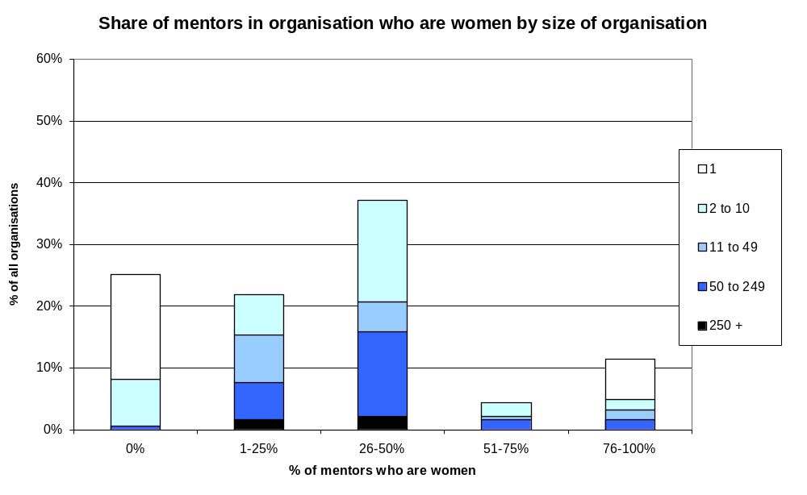
There are many women mentors and mentors from minority ethnic groups
3) Mentoring Organisations
Most large organisations (those with at least 10 mentors) have mentors who are from BME groups
  Organisation without any mentors from BME groups tend to be the smallest
Three quarters of mentoring organisations have at least one female mentor.
  Almost all of those without female mentors are small organisations
  In over a third of organisations, between a quarter and a half of mentors are women
Of the volunteers trained through Get Mentoring, 11% are from ethnic minority groups and 41% are female
Source: BIS analysis of GHK (2012) ‘Estimating the Provision of Business Mentoring’

Slide 23
Take-up amongst SMEs led by women and BME groups are higher than for all SME employers…
3) Mentoring Organisations
Women-led SME employers are more likely to have used a business mentor in the last year
  15% of women-led SME employers had used a business mentor, compared to 11% for all SME employers
Black and Minority Ethnic Group (BME) led SME employers are more likely to have used a business mentor in the last year
  14% of BME-led SME employers had used a business mentor, compared to 11% for all SME employers
Source: BIS analysis of GHK (2012) ‘Estimating the Provision of Business Mentoring’

Slide 24
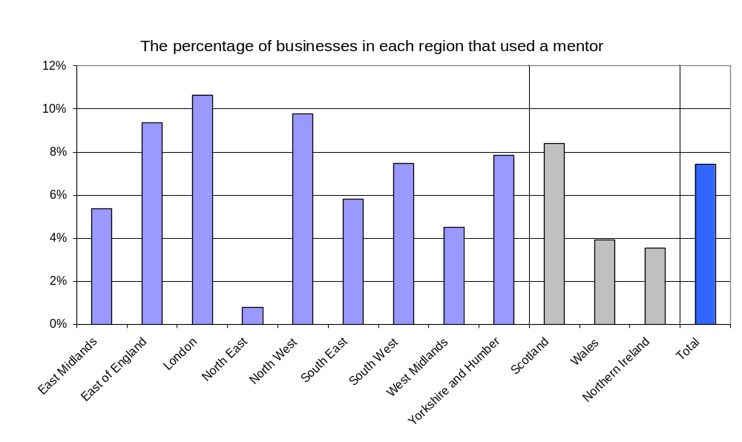
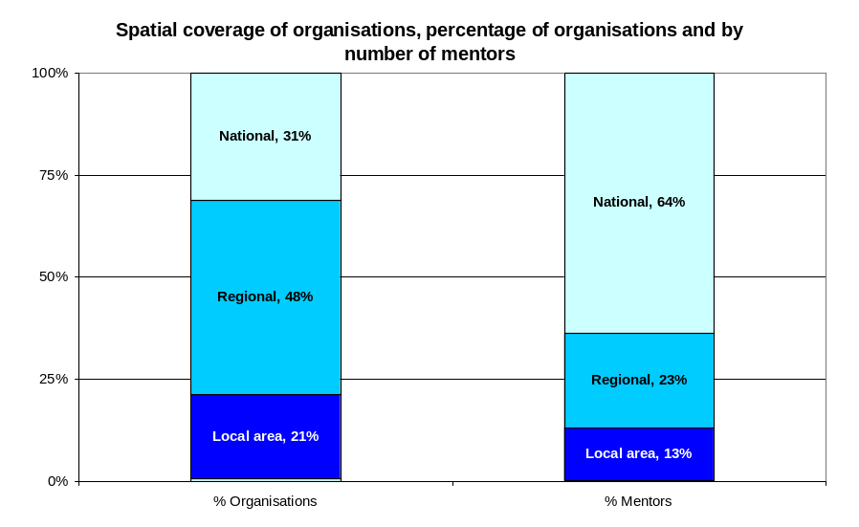
Use of mentoring appears to vary by region – but no evidence there’s a lack of supply
4) Region
SMEs in some regions are more likely to use a mentor than those in others
  Use in North East particularly low. Potentially an erroneous result due to small sample, but other surveys have shown that general use of business support is below average in this region
More than two thirds of mentoring organisations operate at regional or local level
Expected that there is a mentoring organisation based in each LEP
However most mentors (64%) work for national organisations
Source: BIS analysis of SBS 2010 and GHK (2012) ‘Estimating the Provision of Business Mentoring’’

Slide 25
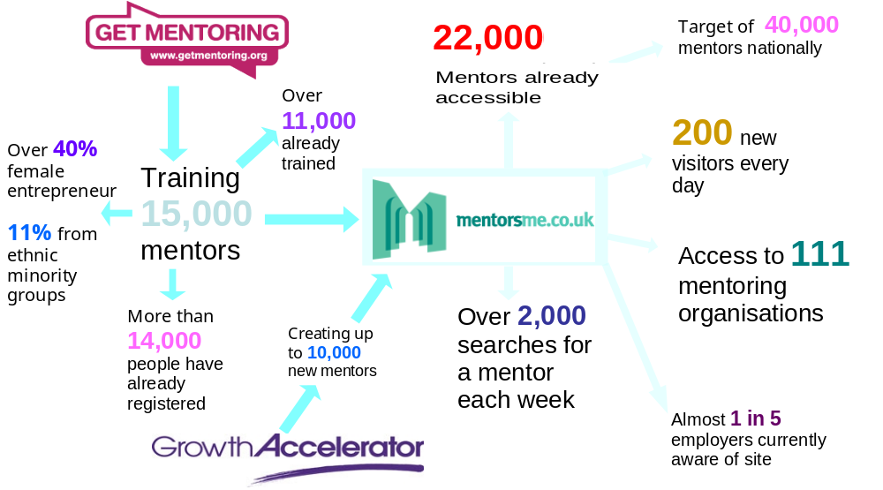
BIS is supporting activity that promotes the use of business mentoring
5) Policy Response
Boosting Supply
Connecting
Raising Demand

Slide 26
Organisations registered with Mentorsme are optimistic about potential benefits to them
5) Policy Response
Organisations registered on Mentorsme were surveyed in January and February 2012, six months after launch. Results were encouraging:
  Most organisations viewed their engagement with the Mentorsme portal as positive (44%), with only 14 per cent having a negative experience
  Almost two-thirds of organisations would recommend the mentorsme portal to other businesses
    Registered organisations identify the added value of the site as a credible and impartial ‘one stop shop’
  Mentorsme was yet to generate a significant volume of traffic
    Awareness of the website was still growing and half of those surveyed joined after the launch, despite this 38% were already receiving referrals
      This may be an underestimate the impact of Mentorsme as it does not make direct referrals
  Since the survey was conducted use and awareness of the portal has increased.
Source: GHK (2012) ‘Estimating the Provision of Business Mentoring’

Slide 27
Mentorsme now provides access to 111 mentoring organisations and up to 22,000 mentors
5) Policy Response
The number of organisations available on mentorsme has almost trebled since launch…
…and the number of mentors available has more than doubled
Organisations available on Mentorsme
111
September 2012
40
July 2011
Mentors available through Mentorsme
22,000 September 2012
10,000
July 2011
Source: BBA and SFEDI

Slide 28
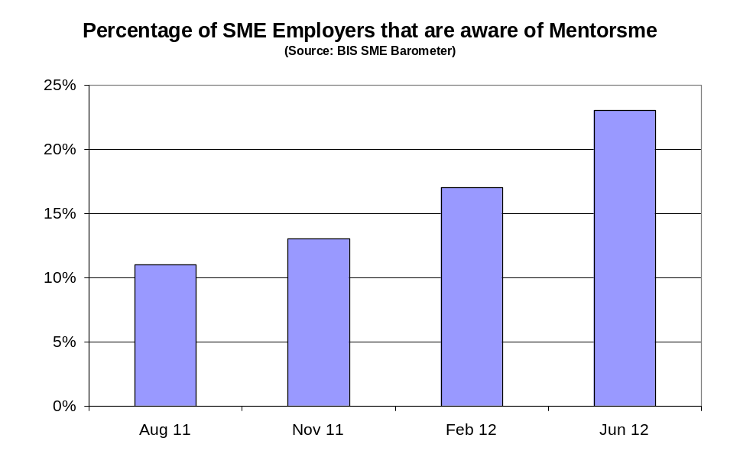
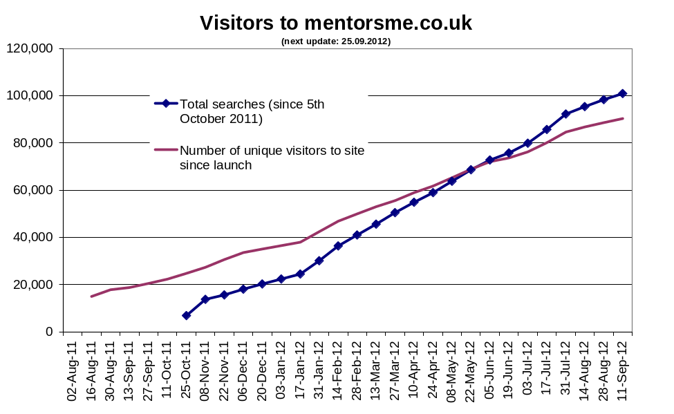
Awareness and use of the Mentorsme portal are increasing
5) Policy Response
Latest data indicates that almost a quarter of SME employers are now aware of Mentorsme
Since launching in July 2011, Mentorsme has had over 90,000 unique visitors…
…with more than 100,000 searches completed since October 2011
Source: BIS SME Barometer and analysis of BBA monitoring data for mentorsme

Slide 29
The Get Mentoring campaign and Bank Volunteers are increasing the availability of mentors…
5) Policy Response
The Get Mentoring Campaign was launched in November 2011 with the objective of recruiting and training 15,000 new volunteer business mentors. By 12 September 2012:
  14,390 volunteers had registered and of these 9,766 had completed their training
Over 1000 employees at British Banks are now trained business mentors and available to support new and existing small businesses
Source: BBA and SFEDI

Slide 30
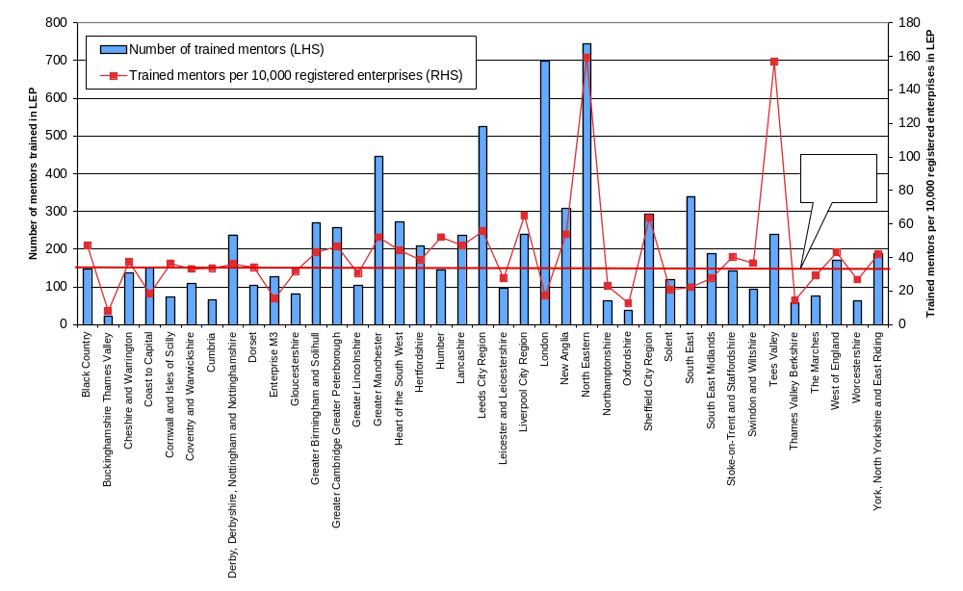
…with the Get Mentoring campaign increasing the number of mentors in all LEPs
5) Policy Response
Highest number of mentors have been trained in London and the North East.
However, as a proportion of the registered business population high numbers have been trained in the North East and Tees Valley
This may address the apparent low level use of mentoring in the North East
Source: SFEDI and BIS analysis

Slide 31
BIS will continue to collect evidence on the use of mentoring and the impact of programmes it supports
6) Next Steps
Small Business Survey 2012
  The survey is underway and will provide the next full assessment of use of business mentoring by enterprises of all sizes
Mentorsme
  Monitoring the use of the portal is on-going
  The BBA and BIS are working with mentoring organisations to consider further improvements to the site
Get Mentoring
  SFEDI are conducting research and evaluation to understand outcomes

Slide 32
© Crown copyright 2012
You may re-use this information (not including logos) free of charge in any format or medium, under the terms of the Open Government Licence. Visit www.nationalarchives.gov.uk/doc/open-government-licence, write to the Information Policy Team, The National Archives, Kew, London TW9 4DU, or email: psi@nationalarchives.gsi.gov.uk.
This publication is also available on our website at www.bis.gov.uk
Any enquiries regarding this publication should be sent to:
Department for Business, Innovation and Skills
1 Victoria Street
London SW1H 0ET
Tel: 020 7215 5000
If you require this publication in an alternative format, email enquiries@bis.gsi.gov.uk, or call 020 7215 5000.
URN 12/1163

