Slide 1
Working with AddressBase® Premium
Graham Sanson
Technical Product Manager
September 2013
Notes:
Intro to presentation
Times
Q’s at End

Slide 2
Quick look at the Base and Plus data models
AddressBase
AddressBase Plus
Created to look like OS Address Point and OSMM Address Layer 2 (respectively).
AddressBase contains PAF depiction of addresses (where they have been matched to the LA address in the NAG hub).
AddressBase Plus contains the current Local Authority address and the PAF depiction of that address where it has been matched.
Both are flat files (‘database lingo’ that basically means that complex address hierarchies are not possible).
Both have a simple lifecycle ( a single start, entry, update and end date for each address).

Slide 3
The AddressBase Premium data model
Cross
Ref
Successor
Property
Class
Organisation
Street
Description
Geographic
Address
Delivery
Address
Street
Geometry
Notes:
‘Property’ = core spatial element relating to the physical object that is addressed.
‘CrossRef’ = Lookup table between the UPRN and other useful address datasets (e.g. TOIDs, VOA data).
‘Class’ is the classification of the BLPU (e.g. Residential Dwelling).
‘Organisation’ = This is an optional table that contains business names that have been captured by the local authority.
‘Geographic Address’ = Local Authority address label for the BLPU (e.g. ‘29’ or ‘Coleman House’).
‘Street Geometry’ = The Core spatial attribution relating to the street (e.g.
Street Start and End Geometry and Street Type).
‘Street Description’ = This is the Local Authority defined name or description of the street (e.g. High Street).
‘Delivery Address’ = This is the Royal Mail depiction of the BLPU. This depiction will only be shown where it can be matched to the Local Authority depiction of the BLPU.
‘Successor’ = This is not currently populated and is included as a placeholder for future requirements. This table is designed to allow historic addresses to reference the address that succeeded it. (e.g. a historic address would have a successor record that contained the address that replaced it).

Slide 4
1.Each table has it’s own lifecycle (CSV)
Why have a relational data model?
START_DATE
END_DATE
LAST_UPDATE_DATE
ENTRY_DATE
Cross
Ref
START_DATE
END_DATE
LAST_UPDATE_DATE
ENTRY_DATE
START_DATE
END_DATE
LAST_UPDATE_DATE
ENTRY_DATE
Successor
Property
START_DATE
END_DATE
LAST_UPDATE_DATE
ENTRY_DATE
START_DATE
END_DATE
LAST_UPDATE_DATE
ENTRY_DATE
Class
Organisation
START_DATE
END_DATE
LAST_UPDATE_DATE
ENTRY_DATE
START_DATE
END_DATE
LAST_UPDATE_DATE
ENTRY_DATE
Street
Description
Geographic
Address
Delivery
Address
START_DATE
END_DATE
LAST_UPDATE_DATE
ENTRY_DATE
Street
Geometry
Notes:
All tables in the CSV data contain lifecycle information. This richness of information gives additional functionality to anyone wishing to manage the lifecycle of each table.

Slide 5
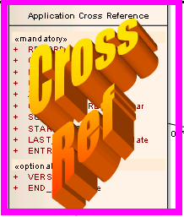
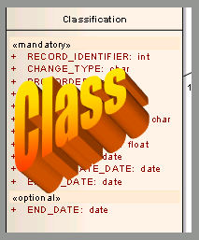
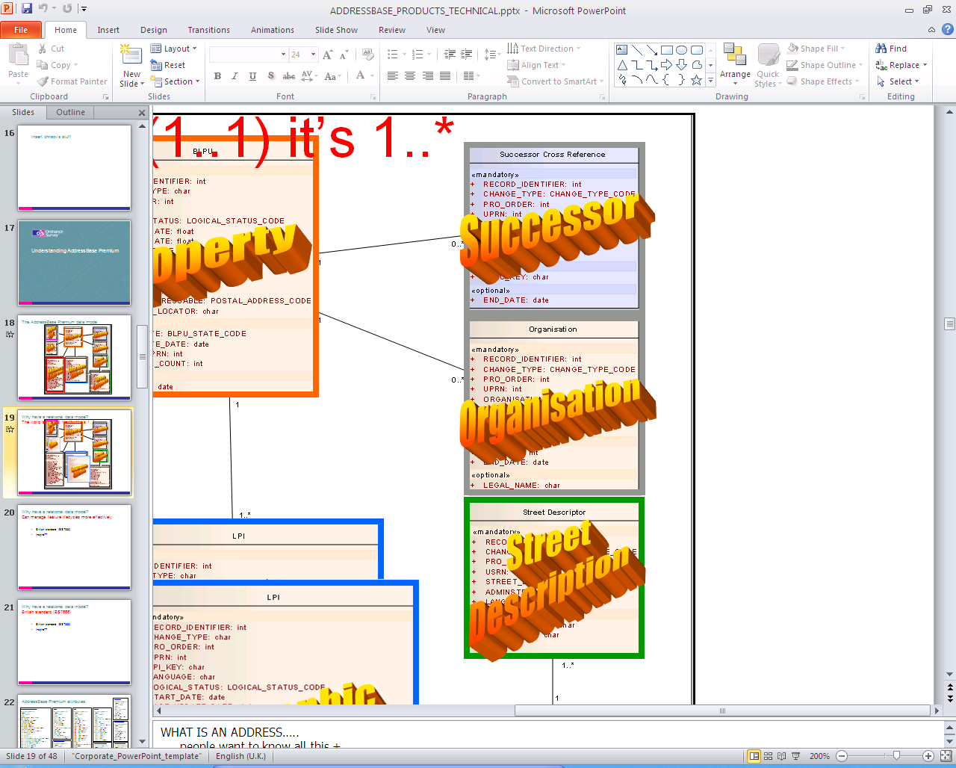
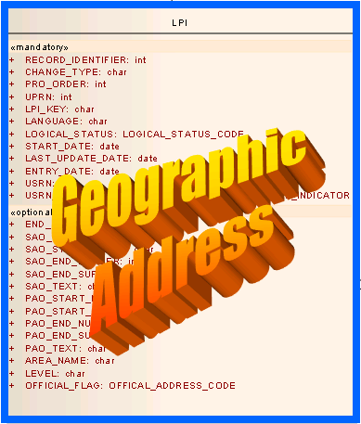
2.Address relationships can be complex
Cross
Ref
Successor
Property
Class
Organisation
Street
Description
Geographic
Address
Delivery
Address
Street
Geometry
Notes:
The Premium data model allows for address multiplicities.
Class = This allows for more than one classification for an object. Typically this complex functionality is used by Local Authorities to capture an ‘Open’ classification (in use) and a ‘closed’ classification (archived).
Cross Ref = Currently a BLPU could have a AL2 Xref, Topo Xref, ITN Xref, VOA Council Tax Xref, VOA NDR Xref, Ward and Parich Xrefs.
Organisation =Typically this complex functionality is used by Local Authorities to capture an ‘Open’ organisation (in use) and a ‘closed’ organisation (archived).
Street Description = Allows for alternative languages to be captured for the street.
Geographic Address = Allows for more than 1 address to be linked to a BLPU (e.g. Approved, Alternative, Provisional, Historic, alternative languages).

Slide 6
AddressBase Premium attributes
APP X Ref
RECORD_IDENTIFIER
CHANGE_TYPE
PRO_ORDER
UPRN
XREF_KEY
CROSS_REFERENCE
VERSION
SOURCE
START_DATE
END_DATE
LAST_UPDATE_DATE
ENTRY_DATE
Delivery Point Address
RECORD_IDENTIFIER
CHANGE_TYPE
PRO_ORDER
UPRN
PARENT_ADDRESSABLE_UPRN
RM_UDPRN
ORGANISATION_NAME
DEPARTMENT_NAME
SUB_BUILDING_NAME
BUILDING_NAME
BUILDING_NUMBER
DEPENDENT_THOROUGHFARE_NAME
THROUGHFARE_NAME
DOUBLE_DEPENDENT_LOCALITY
DEPENDENT_LOCALITY
POST_TOWN
POSTCODE
POSTCODE_TYPE
WELSH_DEPENDENT_THOROUGHFARE_NAME
WELSH_THOROUGHFARE_NAME
WELSH_DOUBLE_DEPENDENT_LOCALITY
WELSH_DEPENDENT_LOCALITY
WELSH_POST_TOWN
RM_PO_BOX_NUMBER
RM_PROCESS_DATE
START_DATE
END_DATE
LAST_UPDATE_DATE
ENTRY_DATE
BLPU
RECORD_IDENTIFIER
CHANGE_TYPE
PRO_ORDER
UPRN
LOGICAL_STATUS
BLPU_STATE
BLPU_STATE_DATE
PARENT_UPRN
X_COORDINATE
Y_COORDINATE
RPC
LOCAL_CUSTODIAN_CODE
START_DATE
END_DATE
LAST_UPDATE_DATE
ENTRY_DATE
POSTAL_ADDRESS
POSTCODE_LOCATOR
MULTI_OCC_COUNT
LPI
RECORD_IDENTIFIER
CHANGE_TYPE
PRO_ORDER
UPRN
LPI_KEY
LANGUAGE
LOGICAL_STATUS
START_DATE
END_DATE
LAST_UPDATE_DATE
ENTRY_DATE
SAO_START_NUMBER
SAO_START_SUFFIX
SAO_END_NUMBER
SAO_END_SUFFIX
SAO_TEXT
PAO_START_NUMBER
PAO_START_SUFFIX
PAO_END_NUMBER
PAO_END_SUFFIX
PAO_TEXT
USRN
USRN_MATCH_INDICATOR
AREA_NAME
LEVEL
OFFICIAL_FLAG
Street
RECORD_IDENTIFIER
CHANGE_TYPE
PRO_ORDER
USRN
RECORD_TYPE
SWA_ORG_REF_NAMING
STATE
STATE_DATE
STREET_SURFACE
STREET_CLASSIFICATION
VERSION
STREET_START_DATE
STREET_END_DATE
LAST_UPDATE_DATE
RECORD_ENTRY_DATE
STREET_START_X
STREET_START_Y
STREET_END_X
STREET_END_Y
STREET_TOLERANCE
Organisation
RECORD_IDENTIFIER
CHANGE_TYPE
PRO_ORDER
UPRN
ORG_KEY
ORGANISATION
LEGAL_NAME
START_DATE
END_DATE
LAST_UPDATE_DATE
ENTRY_DATE
Classification
RECORD_IDENTIFIER
CHANGE_TYPE
PRO_ORDER
UPRN
CLASS_KEY
CLASSIFICATION_CODE
CLASS_SCHEME
SCHEME_VERSION
START_DATE
END_DATE
LAST_UPDATE_DATE
ENTRY_DATE
Street Descriptor
RECORD_IDENTIFIER
CHANGE_TYPE
PRO_ORDER
USRN
STREET_DESCRIPTION
LOCALITY_NAME
TOWN_NAME
ADMINISTRATIVE_AREA
LANGUAGE
Successor X Ref
RECORD_IDENTIFIER
CHANGE_TYPE
PRO_ORDER
UPRN
SUCC_KEY
START_DATE
END_DATE
LAST_UPDATE_DATE
ENTRY_DATE
SUCCESSOR
The specification for AddressBase Premium can seem overwhelming at first but, if we break it down logically, we can highlight the most useful parts.

Slide 7
Database Keys
OS MasterMap TOIDS
Address Layer 2
SOURCE: ‘7666MA’
Topography
SOURCE: ‘7666MT’
ITN Road-link
SOURCE: ‘7666MI’
VERSION =
TOID VERSION
LEGEND
RED = Primary Key on table
GREEN = Foreign Key/predicate**
APP X Ref
RECORD_IDENTIFIER
CHANGE_TYPE
PRO_ORDER
UPRN
XREF_KEY
CROSS_REFERENCE
VERSION
SOURCE**
START_DATE
END_DATE
LAST_UPDATE_DATE
ENTRY_DATE
Delivery Point Address
RECORD_IDENTIFIER
CHANGE_TYPE
PRO_ORDER
UPRN
PARENT_ADDRESSABLE_UPRN (optional)
RM_UDPRN
ORGANISATION_NAME
DEPARTMENT_NAME
SUB_BUILDING_NAME
BUILDING_NAME
BUILDING_NUMBER
DEPENDENT_THOROUGHFARE_NAME
THROUGHFARE_NAME
DOUBLE_DEPENDENT_LOCALITY
DEPENDENT_LOCALITY
POST_TOWN
POSTCODE
POSTCODE_TYPE
WELSH_DEPENDENT_THOROUGHFARE_NAME
WELSH_THOROUGHFARE_NAME
WELSH_DOUBLE_DEPENDENT_LOCALITY
WELSH_DEPENDENT_LOCALITY
WELSH_POST_TOWN
RM_PO_BOX_NUMBER
RM_PROCESS_DATE
START_DATE
END_DATE
LAST_UPDATE_DATE
ENTRY_DATE
BLPU
RECORD_IDENTIFIER
CHANGE_TYPE
PRO_ORDER
UPRN
LOGICAL_STATUS
BLPU_STATE
BLPU_STATE_DATE
PARENT_UPRN (optional)
X_COORDINATE
Y_COORDINATE
RPC
LOCAL_CUSTODIAN_CODE
START_DATE
END_DATE
LAST_UPDATE_DATE
ENTRY_DATE
POSTAL_ADDRESS
POSTCODE_LOCATOR
MULTI_OCC_COUNT
LPI
RECORD_IDENTIFIER
CHANGE_TYPE
PRO_ORDER
UPRN
LPI_KEY
LANGUAGE
LOGICAL_STATUS
START_DATE
END_DATE
LAST_UPDATE_DATE
ENTRY_DATE
SAO_START_NUMBER
SAO_START_SUFFIX
SAO_END_NUMBER
SAO_END_SUFFIX
SAO_TEXT
PAO_START_NUMBER
PAO_START_SUFFIX
PAO_END_NUMBER
PAO_END_SUFFIX
PAO_TEXT
USRN
USRN_MATCH_INDICATOR
AREA_NAME
LEVEL
OFFICIAL_FLAG
Street
RECORD_IDENTIFIER
CHANGE_TYPE
PRO_ORDER
USRN
RECORD_TYPE
SWA_ORG_REF_NAMING
STATE
STATE_DATE
STREET_SURFACE
STREET_CLASSIFICATION
VERSION
STREET_START_DATE
STREET_END_DATE
LAST_UPDATE_DATE
RECORD_ENTRY_DATE
STREET_START_X
STREET_START_Y
STREET_END_X
STREET_END_Y
STREET_TOLERANCE
Organisation
RECORD_IDENTIFIER
CHANGE_TYPE
PRO_ORDER
UPRN
ORG_KEY
ORGANISATION
LEGAL_NAME
START_DATE
END_DATE
LAST_UPDATE_DATE
ENTRY_DATE
Classification
RECORD_IDENTIFIER
CHANGE_TYPE
PRO_ORDER
UPRN
CLASS_KEY
CLASSIFICATION_CODE
CLASS_SCHEME
SCHEME_VERSION
START_DATE
END_DATE
LAST_UPDATE_DATE
ENTRY_DATE
Street Descriptor
RECORD_IDENTIFIER
CHANGE_TYPE
PRO_ORDER
USRN* (use with language)
STREET_DESCRIPTION
LOCALITY_NAME
TOWN_NAME
ADMINISTRATIVE_AREA
LANGUAGE**
Successor X Ref
RECORD_IDENTIFIER
CHANGE_TYPE
PRO_ORDER
UPRN
SUCC_KEY
START_DATE
END_DATE
LAST_UPDATE_DATE
ENTRY_DATE
SUCCESSOR
The data has a number of key fields and reference numbers that are used to uniquely identify each record in each table and to link the tables together. These are very important for use in databases and addressing software (especially the UPRN and USRN).

Slide 8
Data loading and management attributes
APP X Ref
RECORD_IDENTIFIER
CHANGE_TYPE
PRO_ORDER
CROSS_REFERENCE
VERSION
SOURCE
START_DATE
END_DATE
LAST_UPDATE_DATE
ENTRY_DATE
Delivery Point Address
RECORD_IDENTIFIER
CHANGE_TYPE
PRO_ORDER
ORGANISATION_NAME
DEPARTMENT_NAME
SUB_BUILDING_NAME
BUILDING_NAME
BUILDING_NUMBER
DEPENDENT_THOROUGHFARE_NAME
THROUGHFARE_NAME
DOUBLE_DEPENDENT_LOCALITY
DEPENDENT_LOCALITY
POST_TOWN
POSTCODE
POSTCODE_TYPE
WELSH_DEPENDENT_THOROUGHFARE_NAME
WELSH_THOROUGHFARE_NAME
WELSH_DOUBLE_DEPENDENT_LOCALITY
WELSH_DEPENDENT_LOCALITY
WELSH_POST_TOWN
RM_PO_BOX_NUMBER
RM_PROCESS_DATE
START_DATE
END_DATE
LAST_UPDATE_DATE
ENTRY_DATE
BLPU
RECORD_IDENTIFIER
CHANGE_TYPE
PRO_ORDER
LOGICAL_STATUS
BLPU_STATE
BLPU_STATE_DATE
X_COORDINATE
Y_COORDINATE
RPC
LOCAL_CUSTODIAN_CODE
START_DATE
END_DATE
LAST_UPDATE_DATE
ENTRY_DATE
POSTAL_ADDRESS
POSTCODE_LOCATOR
MULTI_OCC_COUNT
LPI
RECORD_IDENTIFIER
CHANGE_TYPE
PRO_ORDER
LANGUAGE
LOGICAL_STATUS
START_DATE
END_DATE
LAST_UPDATE_DATE
ENTRY_DATE
SAO_START_NUMBER
SAO_START_SUFFIX
SAO_END_NUMBER
SAO_END_SUFFIX
SAO_TEXT
PAO_START_NUMBER
PAO_START_SUFFIX
PAO_END_NUMBER
PAO_END_SUFFIX
PAO_TEXT
USRN_MATCH_INDICATOR
AREA_NAME
LEVEL
OFFICIAL_FLAG
Street
RECORD_IDENTIFIER
CHANGE_TYPE
PRO_ORDER
RECORD_TYPE
SWA_ORG_REF_NAMING
STATE
STATE_DATE
STREET_SURFACE
STREET_CLASSIFICATION
VERSION
STREET_START_DATE
STREET_END_DATE
LAST_UPDATE_DATE
RECORD_ENTRY_DATE
STREET_START_X
STREET_START_Y
STREET_END_X
STREET_END_Y
STREET_TOLERANCE
Organisation
RECORD_IDENTIFIER
CHANGE_TYPE
PRO_ORDER
ORGANISATION
LEGAL_NAME
START_DATE
END_DATE
LAST_UPDATE_DATE
ENTRY_DATE
Classification
RECORD_IDENTIFIER
CHANGE_TYPE
PRO_ORDER
CLASSIFICATION_CODE
CLASS_SCHEME
SCHEME_VERSION
START_DATE
END_DATE
LAST_UPDATE_DATE
ENTRY_DATE
Street Descriptor
RECORD_IDENTIFIER
CHANGE_TYPE
PRO_ORDER
STREET_DESCRIPTION
LOCALITY_NAME
TOWN_NAME
ADMINISTRATIVE_AREA
LANGUAGE
Successor X Ref
RECORD_IDENTIFIER
CHANGE_TYPE
PRO_ORDER
START_DATE
END_DATE
LAST_UPDATE_DATE
ENTRY_DATE
SUCCESSOR
Each table (in CSV) will have 3 fields that are used during the data import process and for data update management.
Only people who deal with the raw data need to worry about these fields.

Slide 9
Address filters – Dates
APP X Ref
RECORD_IDENTIFIER
CHANGE_TYPE
PRO_ORDER
CROSS_REFERENCE
VERSION
SOURCE
START_DATE
END_DATE
LAST_UPDATE_DATE
ENTRY_DATE
Delivery Point Address
RECORD_IDENTIFIER
CHANGE_TYPE
PRO_ORDER
ORGANISATION_NAME
DEPARTMENT_NAME
SUB_BUILDING_NAME
BUILDING_NAME
BUILDING_NUMBER
DEPENDENT_THOROUGHFARE_NAME
THROUGHFARE_NAME
DOUBLE_DEPENDENT_LOCALITY
DEPENDENT_LOCALITY
POST_TOWN
POSTCODE
POSTCODE_TYPE
WELSH_DEPENDENT_THOROUGHFARE_NAME
WELSH_THOROUGHFARE_NAME
WELSH_DOUBLE_DEPENDENT_LOCALITY
WELSH_DEPENDENT_LOCALITY
WELSH_POST_TOWN
RM_PO_BOX_NUMBER
RM_PROCESS_DATE
START_DATE
END_DATE
LAST_UPDATE_DATE
ENTRY_DATE
BLPU
RECORD_IDENTIFIER
CHANGE_TYPE
PRO_ORDER
LOGICAL_STATUS
BLPU_STATE
BLPU_STATE_DATE
X_COORDINATE
Y_COORDINATE
RPC
LOCAL_CUSTODIAN_CODE
START_DATE
END_DATE
LAST_UPDATE_DATE
ENTRY_DATE
POSTAL_ADDRESS
POSTCODE_LOCATOR
MULTI_OCC_COUNT
LPI
RECORD_IDENTIFIER
CHANGE_TYPE
PRO_ORDER
LANGUAGE
LOGICAL_STATUS
START_DATE
END_DATE
LAST_UPDATE_DATE
ENTRY_DATE
SAO_START_NUMBER
SAO_START_SUFFIX
SAO_END_NUMBER
SAO_END_SUFFIX
SAO_TEXT
PAO_START_NUMBER
PAO_START_SUFFIX
PAO_END_NUMBER
PAO_END_SUFFIX
PAO_TEXT
USRN_MATCH_INDICATOR
AREA_NAME
LEVEL
OFFICIAL_FLAG
Street
RECORD_IDENTIFIER
CHANGE_TYPE
PRO_ORDER
RECORD_TYPE
SWA_ORG_REF_NAMING
STATE
STATE_DATE
STREET_SURFACE
STREET_CLASSIFICATION
VERSION
STREET_START_DATE
STREET_END_DATE
LAST_UPDATE_DATE
RECORD_ENTRY_DATE
STREET_START_X
STREET_START_Y
STREET_END_X
STREET_END_Y
STREET_TOLERANCE
Organisation
RECORD_IDENTIFIER
CHANGE_TYPE
PRO_ORDER
ORGANISATION
LEGAL_NAME
START_DATE
END_DATE
LAST_UPDATE_DATE
ENTRY_DATE
Classification
RECORD_IDENTIFIER
CHANGE_TYPE
PRO_ORDER
CLASSIFICATION_CODE
CLASS_SCHEME
SCHEME_VERSION
START_DATE
END_DATE
LAST_UPDATE_DATE
ENTRY_DATE
Street Descriptor
RECORD_IDENTIFIER
CHANGE_TYPE
PRO_ORDER
STREET_DESCRIPTION
LOCALITY_NAME
TOWN_NAME
ADMINISTRATIVE_AREA
LANGUAGE
Successor X Ref
RECORD_IDENTIFIER
CHANGE_TYPE
PRO_ORDER
START_DATE
END_DATE
LAST_UPDATE_DATE
ENTRY_DATE
SUCCESSOR
Similarly, most tables have “date” metadata such as “Last update date” and “Start date”. These are indicators of currency and lifecycle.

Slide 10
Address filters – Classifications
APP X Ref
RECORD_IDENTIFIER
CHANGE_TYPE
PRO_ORDER
CROSS_REFERENCE
VERSION
SOURCE
Delivery Point Address
RECORD_IDENTIFIER
CHANGE_TYPE
PRO_ORDER
UPRN
PARENT_ADDRESSABLE_UPRN
RM_UDPRN
ORGANISATION_NAME
DEPARTMENT_NAME
SUB_BUILDING_NAME
BUILDING_NAME
BUILDING_NUMBER
DEPENDENT_THOROUGHFARE_NAME
THROUGHFARE_NAME
DOUBLE_DEPENDENT_LOCALITY
DEPENDENT_LOCALITY
POST_TOWN
POSTCODE
POSTCODE_TYPE
WELSH_DEPENDENT_THOROUGHFARE_NAME
WELSH_THOROUGHFARE_NAME
WELSH_DOUBLE_DEPENDENT_LOCALITY
WELSH_DEPENDENT_LOCALITY
WELSH_POST_TOWN
RM_PO_BOX_NUMBER
RM_PROCESS_DATE
START_DATE
END_DATE
LAST_UPDATE_DATE
ENTRY_DATE
BLPU
RECORD_IDENTIFIER
CHANGE_TYPE
PRO_ORDER
UPRN
LOGICAL_STATUS
BLPU_STATE
X_COORDINATE
Y_COORDINATE
RPC
LOCAL_CUSTODIAN_CODE
POSTAL_ADDRESS
POSTCODE_LOCATOR
MULTI_OCC_COUNT
LPI
RECORD_IDENTIFIER
CHANGE_TYPE
PRO_ORDER
UPRN
LANGUAGE
LOGICAL_STATUS
START_DATE
END_DATE
LAST_UPDATE_DATE
ENTRY_DATE
SAO_START_NUMBER
SAO_START_SUFFIX
SAO_END_NUMBER
SAO_END_SUFFIX
SAO_TEXT
PAO_START_NUMBER
PAO_START_SUFFIX
PAO_END_NUMBER
PAO_END_SUFFIX
PAO_TEXT
USRN
USRN_MATCH_INDICATOR
AREA_NAME
LEVEL
OFFICIAL_FLAG
STREET CLASSIFICATION:
Street
RECORD_IDENTIFIER
CHANGE_TYPE
PRO_ORDER
USRN
RECORD_TYPE
SWA_ORG_REF_NAMING
STATE
STREET_SURFACE
STREET_CLASSIFICATION
VERSION
STREET_START_DATE
STREET_END_DATE
LAST_UPDATE_DATE
RECORD_ENTRY_DATE
STREET_START_X
STREET_START_Y
STREET_END_X
STREET_END_Y
STREET_TOLERANCE
Value | Description
4 | Pedestrian
6 | Cycle
8 | All vehicles
9 | Restricted byway
10 | Bridleway
Organisation
RECORD_IDENTIFIER
CHANGE_TYPE
PRO_ORDER
UPRN
ORG_KEY
ORGANISATION
LEGAL_NAME
START_DATE
END_DATE
LAST_UPDATE_DATE
ENTRY_DATE
CLASSIFICATION CODE
CH01YH
C - Commercial
H - Hotel/Motel/
Boarding/Guest
House
01 - Hostel
YH - Youth Hostel
Classification
RECORD_IDENTIFIER
CHANGE_TYPE
PRO_ORDER
UPRN
CLASSIFICATION_CODE
CLASS_SCHEME
SCHEME_VERSION
START_DATE
END_DATE
LAST_UPDATE_DATE
ENTRY_DATE
Street Descriptor
RECORD_IDENTIFIER
CHANGE_TYPE
PRO_ORDER
USRN
STREET_DESCRIPTION
LOCALITY_NAME
TOWN_NAME
ADMINISTRATIVE_AREA
LANGUAGE
Successor X Ref
RECORD_IDENTIFIER
CHANGE_TYPE
PRO_ORDER
UPRN
SUCC_KEY
START_DATE
END_DATE
LAST_UPDATE_DATE
ENTRY_DATE
SUCCESSOR
Each Basic Land and Property Unit has one or more classifications associated with it. This is a four-tier structure as illustrated above. Streets are also classified.

Slide 11
Address filters – State/Status
APP X Ref
RECORD_IDENTIFIER
CHANGE_TYPE
PRO_ORDER
VERSION (optional)
Delivery Point Address
RECORD_IDENTIFIER
CHANGE_TYPE
PRO_ORDER
UPRN
PARENT_ADDRESSABLE_UPRN
RM_UDPRN
ORGANISATION_NAME
DEPARTMENT_NAME
SUB_BUILDING_NAME
BUILDING_NAME
BUILDING_NUMBER
DEPENDENT_THOROUGHFARE_NAME
THROUGHFARE_NAME
DOUBLE_DEPENDENT_LOCALITY
DEPENDENT_LOCALITY
POST_TOWN
POSTCODE
POSTCODE_TYPE
WELSH_DEPENDENT_THOROUGHFARE_NAME
WELSH_THOROUGHFARE_NAME
WELSH_DOUBLE_DEPENDENT_LOCALITY
WELSH_DEPENDENT_LOCALITY
WELSH_POST_TOWN
RM_PO_BOX_NUMBER
RM_PROCESS_DATE
START_DATE
END_DATE
LAST_UPDATE_DATE
ENTRY_DATE
BLPU
RECORD_IDENTIFIER
CHANGE_TYPE
PRO_ORDER
UPRN
LOGICAL_STATUS
BLPU_STATE (optional)
BLPU_STATE_DATE
PARENT_UPRN
X_COORDINATE
Y_COORDINATE
RPC
LOCAL_CUSTODIAN_CODE
POSTAL_ADDRESS
POSTCODE_LOCATOR
MULTI_OCC_COUNT
LPI
RECORD_IDENTIFIER
CHANGE_TYPE
PRO_ORDER
UPRN
LPI_KEY
LANGUAGE
LOGICAL_STATUS
START_DATE
END_DATE
LAST_UPDATE_DATE
ENTRY_DATE
SAO_START_NUMBER
SAO_START_SUFFIX
SAO_END_NUMBER
SAO_END_SUFFIX
SAO_TEXT
PAO_START_NUMBER
PAO_START_SUFFIX
PAO_END_NUMBER
PAO_END_SUFFIX
PAO_TEXT
USRN
USRN_MATCH_INDICATOR
AREA_NAME
LEVEL
OFFICIAL_FLAG
Street
RECORD_IDENTIFIER
CHANGE_TYPE
PRO_ORDER
USRN
RECORD_TYPE
SWA_ORG_REF_NAMING
STATE
STREET_SURFACE
VERSION
STREET_START_DATE
STREET_END_DATE
LAST_UPDATE_DATE
RECORD_ENTRY_DATE
STREET_START_X
STREET_START_Y
STREET_END_X
STREET_END_Y
STREET_TOLERANCE
LOGICAL_STATUS
BLPU_STATE
LOGICAL_STATUS
STATE
Value | Description
6 | Provisional
1 | Approved
8 | Historic
Value | Description
1 | Under Const.
2 | In use
3 | Vacant
4 | Demolished
5 | Planning ok
Value | Description
1 | Under Const.
2 | Open
4 | Closed
Organisation
RECORD_IDENTIFIER
CHANGE_TYPE
PRO_ORDER
UPRN
ORG_KEY
ORGANISATION
LEGAL_NAME
START_DATE
END_DATE
LAST_UPDATE_DATE
ENTRY_DATE
Value | Description
6 | Provisional
1 | Approved
8 | Historic
3 | Alternative
STREET_SURFACE
Value | Description
1 | Metalled
2 | UnMetalled
4 | Mixed
Street Descriptor
RECORD_IDENTIFIER
CHANGE_TYPE
PRO_ORDER
USRN
STREET_DESCRIPTION
LOCALITY_NAME
TOWN_NAME
ADMINISTRATIVE_AREA
LANGUAGE
Successor X Ref
RECORD_IDENTIFIER
CHANGE_TYPE
PRO_ORDER
UPRN
SUCC_KEY
START_DATE
END_DATE
LAST_UPDATE_DATE
ENTRY_DATE
SUCCESSOR
OFFICIAL_FLAG
SUCCESSOR
Value | Description
Y | Official
N | Unofficial
NOT CURRENTLY AVAILABLE
This information describes the physical state or status of an address. For many users, these are the critical attributes on which to filter results.

Slide 12
Address filters – Type
Delivery Point Address
RECORD_IDENTIFIER
CHANGE_TYPE
PRO_ORDER
UPRN
PARENT_ADDRESSABLE_UPRN
RM_UDPRN
ORGANISATION_NAME
DEPARTMENT_NAME
SUB_BUILDING_NAME
BUILDING_NAME
BUILDING_NUMBER
DEPENDENT_THOROUGHFARE_NAME
THROUGHFARE_NAME
DOUBLE_DEPENDENT_LOCALITY
DEPENDENT_LOCALITY
POST_TOWN
POSTCODE
POSTCODE_TYPE
WELSH_DEPENDENT_THOROUGHFARE_NAME
WELSH_THOROUGHFARE_NAME
WELSH_DOUBLE_DEPENDENT_LOCALITY
WELSH_DEPENDENT_LOCALITY
WELSH_POST_TOWN
RM_PO_BOX_NUMBER
RM_PROCESS_DATE
START_DATE
END_DATE
LAST_UPDATE_DATE
ENTRY_DATE
BLPU
RECORD_IDENTIFIER
CHANGE_TYPE
PRO_ORDER
UPRN
BLPU_STATE_DATE
PARENT_UPRN
X_COORDINATE
Y_COORDINATE
RPC
LOCAL_CUSTODIAN_CODE
POSTAL_ADDRESS
POSTCODE_LOCATOR
MULTI_OCC_COUNT
LPI
RECORD_IDENTIFIER
CHANGE_TYPE
PRO_ORDER
UPRN
LPI_KEY
LANGUAGE
START_DATE
END_DATE
LAST_UPDATE_DATE
ENTRY_DATE
SAO_START_NUMBER
SAO_START_SUFFIX
SAO_END_NUMBER
SAO_END_SUFFIX
SAO_TEXT
PAO_START_NUMBER
PAO_START_SUFFIX
PAO_END_NUMBER
PAO_END_SUFFIX
PAO_TEXT
USRN
USRN_MATCH_INDICATOR
AREA_NAME
LEVEL
Street
RECORD_IDENTIFIER
CHANGE_TYPE
PRO_ORDER
USRN
RECORD_TYPE
SWA_ORG_REF_NAMING
STREET_START_DATE
STREET_END_DATE
LAST_UPDATE_DATE
RECORD_ENTRY_DATE
STREET_START_X
STREET_START_Y
STREET_END_X
STREET_END_Y
STREET_TOLERANCE
LANGUAGE
RECORD_TYPE
POSTAL_ADDRESS
Value | Description
1 | Official name
2 | Description
3 | Numbered
4 | Unofficial name
9 | LLPG access description
Value | Description
S | Single
M | Parent
C | Child
N | Non-Postal
Value | Description
ENG | English
CYM | Welsh
GAE | Gaelic
Organisation
RECORD_IDENTIFIER
CHANGE_TYPE
PRO_ORDER
UPRN
ORG_KEY
ORGANISATION
LEGAL_NAME
START_DATE
END_DATE
LAST_UPDATE_DATE
ENTRY_DATE
USRN_M_INDICATOR
Street Descriptor
RECORD_IDENTIFIER
CHANGE_TYPE
PRO_ORDER
USRN
STREET_DESCRIPTION
LOCALITY_NAME
TOWN_NAME
ADMINISTRATIVE_AREA
LANGUAGE
Value | Description
1 | LA OWPA manual match
2 | OS OWPA auto match
LANGUAGE
Value | Description
ENG | English
CYM | Welsh
GAE | Gaelic
This information describes the address type. The postal address and usrn_match_indicator provide a useful way for users to group addresses (for example, identify non-postal addresses).

Slide 13
Address filters – Positional elements
Delivery Point Address
RECORD_IDENTIFIER
CHANGE_TYPE
PRO_ORDER
UPRN
PARENT_ADDRESSABLE_UPRN
RM_UDPRN
ORGANISATION_NAME
DEPARTMENT_NAME
SUB_BUILDING_NAME
BUILDING_NAME
BUILDING_NUMBER
DEPENDENT_THOROUGHFARE_NAME
THROUGHFARE_NAME
DOUBLE_DEPENDENT_LOCALITY
DEPENDENT_LOCALITY
POST_TOWN
POSTCODE
POSTCODE_TYPE
WELSH_DEPENDENT_THOROUGHFARE_NAME
WELSH_THOROUGHFARE_NAME
WELSH_DOUBLE_DEPENDENT_LOCALITY
WELSH_DEPENDENT_LOCALITY
WELSH_POST_TOWN
RM_PO_BOX_NUMBER
RM_PROCESS_DATE
START_DATE
END_DATE
LAST_UPDATE_DATE
ENTRY_DATE
BLPU
RECORD_IDENTIFIER
CHANGE_TYPE
PRO_ORDER
UPRN
LOGICAL_STATUS
BLPU_STATE
BLPU_STATE_DATE
PARENT_UPRN
X_COORDINATE
Y_COORDINATE
RPCPC
LOCAL_CUSTODIAN_CODE
START_DATE
END_DATE
LAST_UPDATE_DATE
ENTRY_A
POSTAL_ADDRESS
POSTCODE_LOCATOR
LPI
RECORD_IDENTIFIER
CHANGE_TYPE
PRO_ORDER
UPRN
LPI_KEY
LANGUAGE
LOGICAL_STATUS
START_DATE
END_DATE
LAST_UPDATE_DATE
ENTRY_DATE
SAO_START_NUMBER
SAO_START_SUFFIX
SAO_END_NUMBER
SAO_END_SUFFIX
SAO_TEXT
PAO_START_NUMBER
PAO_START_SUFFIX
PAO_END_NUMBER
PAO_END_SUFFIX
PAO_TEXT
USRN
USRN_MATCH_INDICATOR
AREA_NAME
LEVEL
OFFICIAL_FLAG
Street
RECORD_IDENTIFIER
CHANGE_TYPE
PRO_ORDER
USRN
RECORD_TYPE
SWA_ORG_REF_NAMING
STATE_DATE
VERSION
STREET_START_DATE
STREET_END_DATE
LAST_U
PDATE_DATE
RECORD_ENTRY_DATE
STREET_START_X
STREET_START_Y
STREET_END_X
STREET_END_Y
STREET_TOLERANCE
Organisation
RECORD_IDENTIFIER
CHANGE_TYPE
PRO_ORDER
UPRN
ORG_KEY
ORGANISATION
LEGAL_NAME
START_DATE
END_DATE
LAST_UPDATE_DATE
ENTRY_DATE
Street Descriptor
RECORD_IDENTIFIER
CHANGE_TYPE
PRO_ORDER
USRN
STREET_DESCRIPTION
LOCALITY_NAME
TOWN_NAME
ADMINISTRATIVE_AREA
ADMINISTRATIVE_AREA
LANGUAGE
Having the BLPU X and Y coordinate of the land or property means it can be plotted on a map. This is critical for any spatial analysis that a user may want to conduct. The start and end coordinates of the Street and the creating authority codes are also included.

Slide 14
Address filters – Accuracy
Delivery Point Address
RECORD_IDENTIFIER
CHANGE_TYPE
PRO_ORDER
UPRN
PARENT_ADDRESSABLE_UPRN
RM_UDPRN
ORGANISATION_NAME
DEPARTMENT_NAME
SUB_BUILDING_NAME
BUILDING_NAME
BUILDING_NUMBER
DEPENDENT_THOROUGHFARE_NAME
THROUGHFARE_NAME
DOUBLE_DEPENDENT_LOCALITY
DEPENDENT_LOCALITY
POST_TOWN
POSTCODE
POSTCODE_TYPE
WELSH_DEPENDENT_THOROUGHFARE_NAME
WELSH_THOROUGHFARE_NAME
WELSH_DOUBLE_DEPENDENT_LOCALITY
WELSH_DEPENDENT_LOCALITY
WELSH_POST_TOWN
RM_PO_BOX_NUMBER
RM_PROCESS_DATE
START_DATE
END_DATE
LAST_UPDATE_DATE
ENTRY_DATE
BLPU
RECORD_IDENTIFIER
CHANGE_TYPE
PRO_ORDER
UPRN
LOGICAL_STATUS
BLPU_STATE
BLPU_STATE_DATE
PARENT_UPRN
RPC
PC
START_DATE
END_DATE
LAST_UPDATE_DATEY_ATE
POSTAL_ADDRESS
POSTCODE_LOCATORMUTI_OCC_COUNT
LPI
RECORD_IDENTIFIER
CHANGE_TYPE
PRO_ORDER
UPRN
LPI_KEY
LANGUAGE
LOGICAL_STATUS
START_DATE
END_DATE
LAST_UPDATE_DATE
ENTRY_DATE
SAO_START_NUMBER
SAO_START_SUFFIX
SAO_END_NUMBER
SAO_END_SUFFIX
SAO_TEXT
PAO_START_NUMBER
PAO_START_SUFFIX
PAO_END_NUMBER
PAO_END_SUFFIX
PAO_TEXT
USRN
USRN_MATCH_INDICATOR
AREA_NAME
LEVEL
OFFICIAL_FLAG
Street
RECORD_IDENTIFIER
CHANGE_TYPE
PRO_ORDER
USRN
RECORD_TYPE
STATE_DATE
VERSION
STREET_START_DATE
STREET_END_DATE
LAST_U
PDATE_DATE
RECORD_ENTRY_DATE
STREET_TOLERANCER
Organisation
RECORD_IDENTIFIER
CHANGE_TYPE
PRO_ORDER
UPRN
ORG_KEY
ORGANISATION
LEGAL_NAME
START_DATE
END_DATE
LAST_UPTE_DATE
ENTRY_DATE
RPC (REPRESENTATIVE POINT ACCURACY)
Value | Description
1 | Centre BLPU
2 | Within BLPU
3 | SW corner of 100m grid sq.
4 | Street start
5 | Postcode unit
9 | Centre Auth.
Street Descriptor
RECORD_IDENTIFIER
CHANGE_TYPE
PRO_ORDER
USRN
STREET_DESCRIPTION
LOCALITY_NAME
TOWN_NAME
ADMINISTRATIVE_AREA
ADMINISTRATIVE_AREA
LANGUAGE
The RPC flag indicates the status/quality of the BLPU coordinates (address).
Street Tolerance states how accurate (in metres) the street coordinates are.

Slide 15
Address – Local Authority (Geographic Address)
Delivery Point Address
RECORD_IDENTIFIER
CHANGE_TYPE
PRO_ORDER
UPRN
PARENT_ADDRESSABLE_UPRN
RM_UDPRN
ORGANISATION_NAME
DEPARTMENT_NAME
SUB_BUILDING_NAME
BUILDING_NAME
BUILDING_NUMBER
DEPENDENT_THOROUGHFARE_NAME
THROUGHFARE_NAME
DOUBLE_DEPENDENT_LOCALITY
DEPENDENT_LOCALITY
POST_TOWN
POSTCODE
POSTCODE_TYPE
WELSH_DEPENDENT_THOROUGHFARE_NAME
WELSH_THOROUGHFARE_NAME
WELSH_DOUBLE_DEPENDENT_LOCALITY
WELSH_DEPENDENT_LOCALITY
WELSH_POST_TOWN
RM_PO_BOX_NUMBER
RM_PROCESS_DATE
START_DATE
END_DATE
LAST_UPDATE_DATE
ENTRY_DATE
BLPU
RECORD_IDENTIFIER
CHANGE_TYPE
PRO_ORDER
UPRN
LOGICAL_STATUS
BLPU_STATE
BLPU_STATE_DATE
PARENT_UPRN
X_COORDINATE
Y_COORDINATE
RPC
LOCAL_CUSTODIAN_CODE
START_DATE
END_DATE
LAST_UPDATE_DATE
ENTRY_DATE
POSTCODE_LOCATOR
MULTI_OCC_COUNT
LPI
RECORD_IDENTIFIER
CHANGE_TYPE
PRO_ORDER
UPRN
LPI_KEY
LANGUAGE
LOGICAL_STATUS
START_DATE
END_DATE
SAO_START_NUMBER
SAO_START_SUFFIX
SAO_END_NUMBER
SAO_END_SUFFIX
SAO_TEXT
PAO_START_NUMBER
PAO_START_SUFFIX
PAO_END_NUMBER
PAO_END_SUFFIX
PAO_TEXT
AREA_NAME
LEVEL
OFFICIAL_FLAG
Organisation
RECORD_IDENTIFIER
CHANGE_TYPE
PRO_ORDER
UPRN
ORG_KEY
ORGANISATION
LEGAL_NAME
START_DATE
END_DATE
LAST_UPDATE_DATE
ENTRY_DATE
Street Descriptor
RECORD_IDENTIFIER
CHANGE_TYPE
PRO_ORDER
USRN
STREET_DESCRIPTION
LOCALITY_NAME
TOWN_NAME
ADMINISTRATIVE_AREA
ADMINISTRATIVE_AREA
LANGUAGE
These attributes form the core elements of the geographic address. The geographic address is based on the British standard for addressing (BS7666) and is the legal address as created under statutory authority by 380 Local Authorities.

Slide 16
Address – Royal Mail (Delivery Point Address)
Delivery Point Address
RECORD_IDENTIFIER
CHANGE_TYPE
PRO_ORDER
UPRN
PARENT_ADDRESSABLE_UPRN
RM_UDPRN
ORGANISATION_NAME
DEPARTMENT_NAME
SUB_BUILDING_NAME
BUILDING_NAME
BUILDING_NUMBER
DEPENDENT_THOROUGHFARE_NAME
THROUGHFARE_NAME
DOUBLE_DEPENDENT_LOCALITY
DEPENDENT_LOCALITY
POST_TOWN
POSTCODE
POSTCODE_TYPE
WELSH_DEPENDENT_THOROUGHFARE_NAME
WELSH_THOROUGHFARE_NAME
WELSH_DOUBLE_DEPENDENT_LOCALITY
WELSH_DEPENDENT_LOCALITY
WELSH_POST_TOWN
RM_PO_BOX_NUMBER
RM_PROCESS_DATE
START_DATE
END_DATE
LAST_UPDATE_DATE
ENTRY_DATE
These are sourced from the Royal Mail® Postal Address from the Postcode Address File (PAF®) where the PAF address can be matched to the Local Authority address.

Slide 17
AddressBase Premium - Key attributes
APP X Ref
RECORD_IDENTIFIER
CHANGE_TYPE
PRO_ORDER
UPRN
XREF_KEY
CROSS_REFERENCE
VERSION
SOURCE
START_DATE
END_DATE
LAST_UPDATE_DATE
ENTRY_DATE
Delivery Point Address
RECORD_IDENTIFIER
CHANGE_TYPE
PRO_ORDER
UPRN
PARENT_ADDRESSABLE_UPRN
RM_UDPRN
ORGANISATION_NAME
DEPARTMENT_NAME
SUB_BUILDING_NAME
BUILDING_NAME
BUILDING_NUMBER
DEPENDENT_THOROUGHFARE_NAME
THROUGHFARE_NAME
DOUBLE_DEPENDENT_LOCALITY
DEPENDENT_LOCALITY
POST_TOWN
POSTCODE
POSTCODE_TYPE
WELSH_DEPENDENT_THOROUGHFARE_NAME
WELSH_THOROUGHFARE_NAME
WELSH_DOUBLE_DEPENDENT_LOCALITY
WELSH_DEPENDENT_LOCALITY
WELSH_POST_TOWN
RM_PO_BOX_NUMBER
RM_PROCESS_DATE
START_DATE
END_DATE
LAST_UPDATE_DATE
ENTRY_DATE
BLPU
RECORD_IDENTIFIER
CHANGE_TYPE
PRO_ORDER
UPRN
LOGICAL_STATUS
BLPU_STATE
BLPU_STATE_DATE
PARENT_UPRN
X_COORDINATE
Y_COORDINATE
RPC
LOCAL_CUSTODIAN_CODE
START_DATE
END_DATE
LAST_UPDATE_DATE
ENTRY_DATE
POSTAL_ADDRESS
POSTCODE_LOCATOR
MULTI_OCC_COUNT
LPI
RECORD_IDENTIFIER
CHANGE_TYPE
PRO_ORDER
UPRN
LPI_KEY
LANGUAGE
LOGICAL_STATUS
START_DATE
END_DATE
LAST_UPDATE_DATE
ENTRY_DATE
SAO_START_NUMBER
SAO_START_SUFFIX
SAO_END_NUMBER
SAO_END_SUFFIX
SAO_TEXT
PAO_START_NUMBER
PAO_START_SUFFIX
PAO_END_NUMBER
PAO_END_SUFFIX
PAO_TEXT
USRN
USRN_MATCH_INDICATOR
AREA_NAME
LEVEL
OFFICIAL_FLAG
Street
RECORD_IDENTIFIER
CHANGE_TYPE
PRO_ORDER
USRN
RECORD_TYPE
SWA_ORG_REF_NAMING
STATE
STATE_DATE
STREET_SURFACE
STREET_CLASSIFICATION
VERSION
STREET_START_DATE
STREET_END_DATE
LAST_UPDATE_DATE
RECORD_ENTRY_DATE
STREET_START_X
STREET_START_Y
STREET_END_X
STREET_END_Y
STREET_TOLERANCE
Organisation
RECORD_IDENTIFIER
CHANGE_TYPE
PRO_ORDER
UPRN
ORG_KEY
ORGANISATION
LEGAL_NAME
START_DATE
END_DATE
LAST_UPDATE_DATE
ENTRY_DATE
Classification
RECORD_IDENTIFIER
CHANGE_TYPE
PRO_ORDER
UPRN
CLASS_KEY
CLASSIFICATION_CODE
CLASS_SCHEME
SCHEME_VERSION
START_DATE
END_DATE
LAST_UPDATE_DATE
ENTRY_DATE
Street Descriptor
RECORD_IDENTIFIER
CHANGE_TYPE
PRO_ORDER
USRN
STREET_DESCRIPTION
LOCALITY_NAME
TOWN_NAME
ADMINISTRATIVE_AREA
LANGUAGE
Successor X Ref
RECORD_IDENTIFIER
CHANGE_TYPE
PRO_ORDER
UPRN
SUCC_KEY
START_DATE
END_DATE
LAST_UPDATE_DATE
ENTRY_DATE
SUCCESSOR
 | Geographic Address
 | Delivery Point Address
 | Organisation names
 | BLPU classification
 | Address position
 | Critical filters*

Slide 18
Implementing AddressBase Premium
Notes:
Intro to presentation
Times
Q’s at End

Slide 19
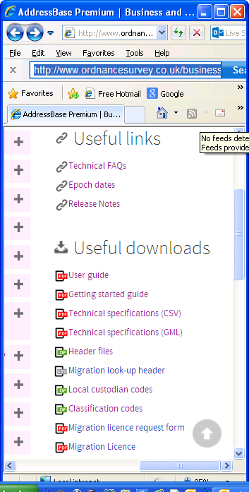
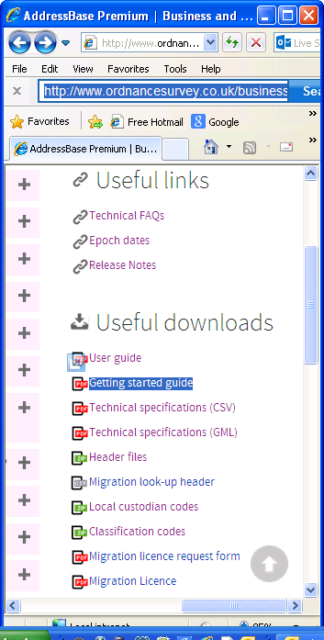
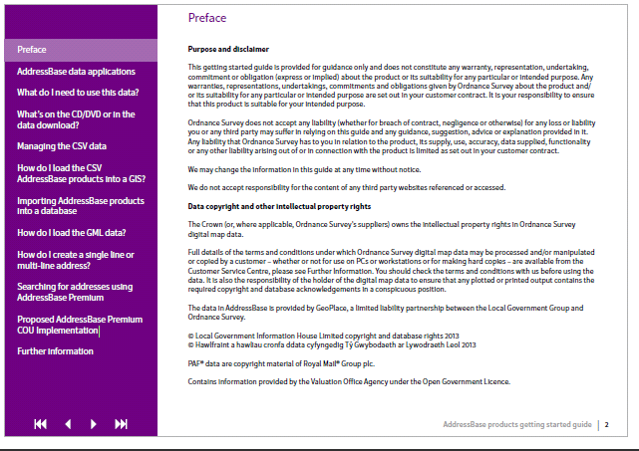
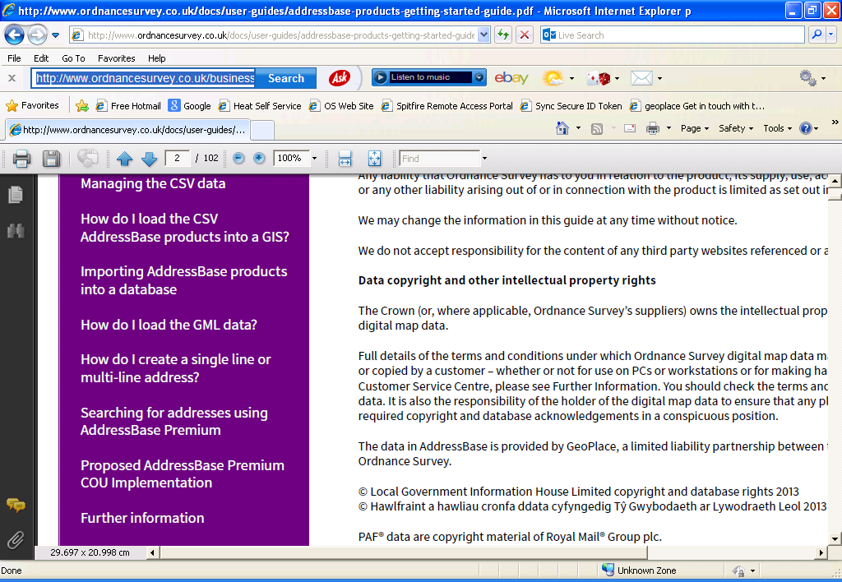
…the data has arrived now what do I do?!
In the main part the Getting Started Guide will walk users through how to load the products into some commonly used applications
Notes:
All of the support literature to implement AB Premium is on the web (link below).
The getting started guide will ‘do what it says on the tin.’
Three new chapters were added in July to help users to implement the product more effectively.
Any feedback is welcome.
http://www.ordnancesurvey.co.uk/business-and-government/help-and-support/products/addressbase-premium.html

Slide 20
Building a single-line or multi-line address using AddressBase Premium – Delivery Point Address
Delivery Point Address Component | Type
DEPARTMENT_NAME | Character
ORGANISATION_NAME | Character
SUB_BUILDING_NAME | Character
BUILDING NAME | Character
BUILDING NUMBER | Integer
PO_BOX_NUMBER | Integer
DEPENDENT THOROUGHFARE_NAME OR WELSH DEPENDENT THOROUGHFARE_NAME | Character
THOROUGHFARE_NAME OR WELSH THOROUGHFARE_NAME | Character
DOUBLE_DEPENDENT_LOCALITY OR WELSH_ DOUBLE_DEPENDENT_LOCALITY | Character
DEPENDENT_LOCALITY OR WELSH_ DEPENDENT_LOCALITY | Character
POST_TOWN OR WELSH_POST_TOWN | Character
POSTCODE | Character
Notes:
All of the attributes required to construct a Delivery Point Address are contained in a single table (DPA).

Slide 21
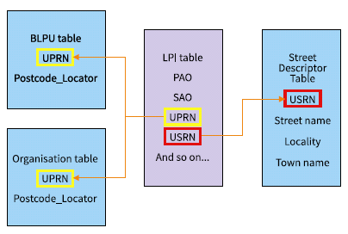
Building a single-line or multi-line address using AddressBase Premium – Geographic Address
Table | Geographic Address
Organisation | ORGANISATION
LPI | SAO_TEXT
LPI | SAO_START_NUMBER
LPI | SAO_START_SUFFIX
LPI | SAO_END_NUMBER
LPI | SAO_END_SUFFIX
LPI | PAO_TEXT
LPI | PAO_START_NUMBER
LPI | PAO_START_SUFFIX
LPI | PAO_END_NUMBER
LPI | PAO_END_SUFFIX
Street Descriptor | STREET_DESCRIPTION
Street Descriptor | LOCALITY_NAME
Street Descriptor | TOWN_NAME
Street Descriptor | ADMINISTRATIVE_AREA*
BLPU | POSTCODE_LOCATOR
Notes:
Database keys should be used to join the prerequisite tables together to produce the geographic address.

Slide 22
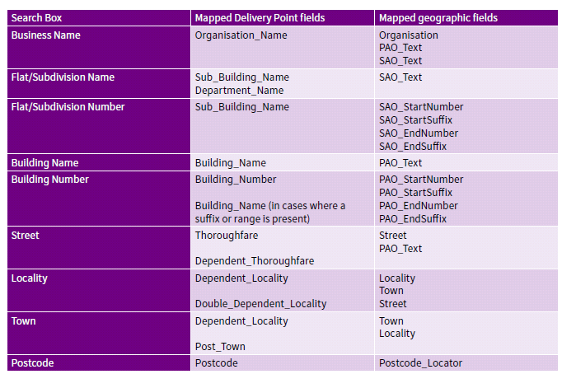
Mapping the 2 together
Notes:
Though the DPA and GEO address attributes are not directly ‘mapable’, rules can be built to do this using mappings such as the one contained in the getting started guide (above).

Slide 23
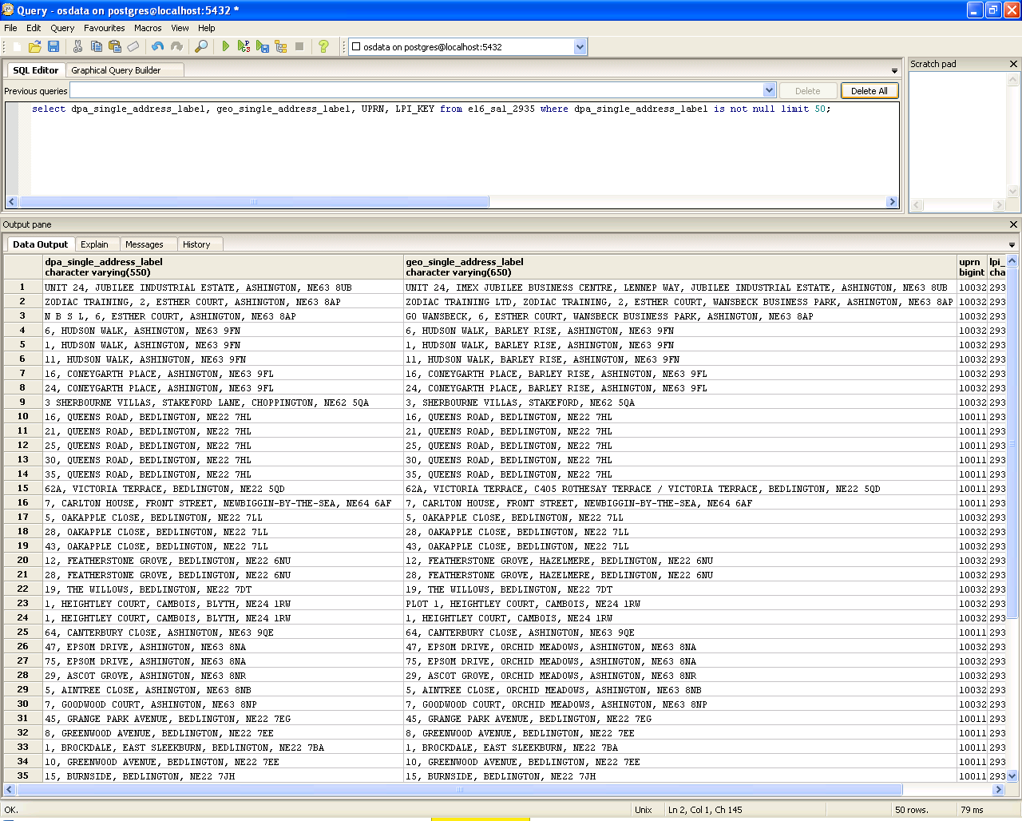
Both address types side by side (database view)
Delivery Point Address
Geographic Address
Notes:
This is a real example of what the DPA and GEO addresses ‘look like’ when viewed side by side using the concatenation method suggested in the getting started guide.

Slide 24
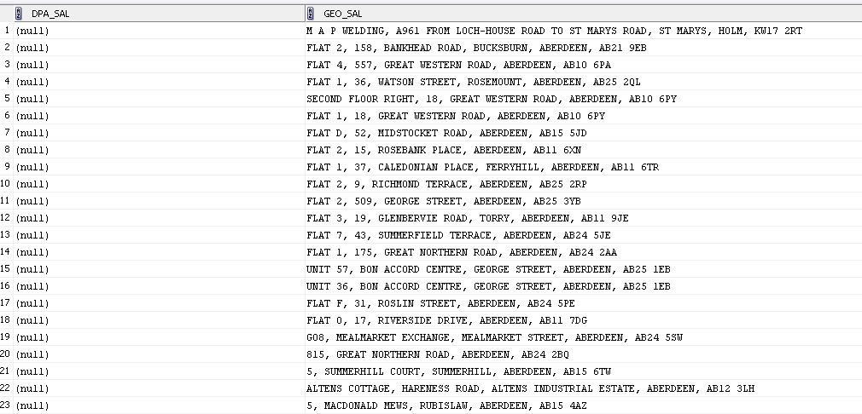
‘Geo’ address where DPA is null (database view)
Delivery Point Address
Geographic Address
A lot of the unmatched addresses are contained as geographic addresses. It’s estimated that there are >1 million geographic addresses that are postally addressable
Notes:
This is a real example of where a DPA address is not present, but a geographic address is.

Slide 25
Make it searchable
UPRN | Address Text Pick list | Status
894756389092 | 4 HIGH STREET WESTVILLE SUNNYTOWN WV17 7HL | Approved + PAF
894756389092 | ROSE COTTAGE 4 HIGH STREET WESTVILLE SUNNYTOWN WV17 7HL | Alternative
894756389092 | ROSE COTTAGE HIGH STREET WESTVILLE SUNNYTOWN WV17 7HL | Alternative
274859037849 | FLAT 4 HIGHBURY COURT HIGH STREET WESTVILLE SUNNYTOWN WV17 7HL | Approved + PAF
482974769830 | MAPS4U LTD HIGH STREET WESTVILLE SUNNYTOWN WV17 7HL | Approved
Notes:
A typical address search will look like this …resulting in a ‘pick-list’ of suitable candidates

Slide 26
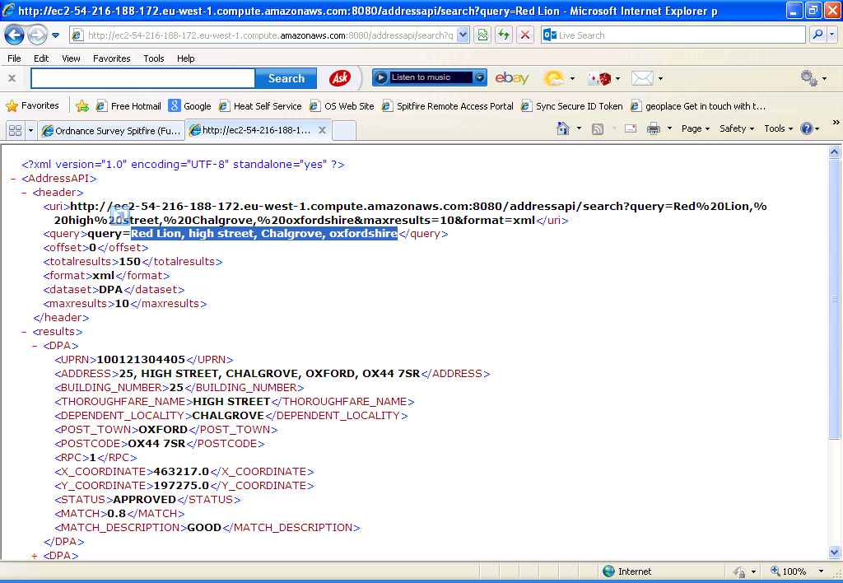
Example – Web Service (XML API)
Notes:
Highlighted text is the search criteria used to return a raw pick-list as per the previous slide. A match confidence flag is useful to include in the implementation, e.g. <MATCH> and <MATCH_DESCRIPTION> tags above.

