Slide 1







AJX INC. Initiates a Strong Buy:
Diamond in the rough, or just another barrel of oil?
XNAS: APA
$24.05

Slide 2


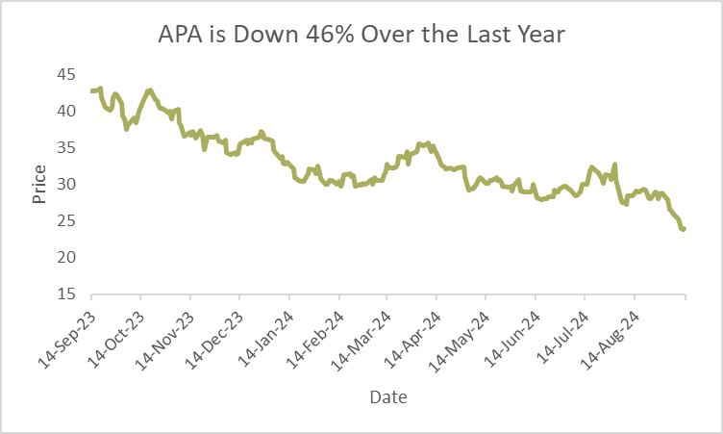
APA’s Price to Book value and Price to Sales values are comparable to COVID numbers despite Revenue doubling indicating undervaluation
2023
2024
OIL
Natural Gas
Natural Gas
Liquids
OIL
Natural Gas
Natural Gas
Liquids
$5.9B
$880M
$508M
$6.8B
$643M
$562M
METRICS | Sep. 2023 | Sep. 2024
Price to Book Value | 5.98 | 1.36
Market Cap | $11.59B | $8.86B
Revenue | $9.21B | $8.765B
EBITDA | $5.89B | $5.42B
Indicates Potential for Upside
1

Slide 3
Positive Outlook
2024 Assumptions
Mergers and Acquisition
2023
2024
APA Daily Barrel Production
1) APA acquired Callum Petroleum in an all-stock transaction valued at $4.5 billion.
2) APA's oil-prone acreage in the Midland and Delaware Basin increased by over 50%. due to this transaction.
3) Acquisition boosted oil equivalent production by 25% barrels per day.
70,000
139,000
198.6%
Average Oil Price
$62
$70
12.9%
APA Stock Price
$35
$25
28.6%
2

Slide 4



Risks
Commodity Price Volatility
High Debt Levels
Geopolitical Risks
Impact - APA’s revenue and profitability are sensitive to fluctuations in oil and natural gas prices.
Factors - Global supply and demand, geopolitical events, and economic conditions influence prices.
Impact - Significant debt can strain cash flows, increase interest expenses, and limit financial flexibility.
Factors - Interest payments, refinancing challenges, and financial covenants.
Impact - International operations expose APA to political instability, regulatory changes, and expropriation risks.
Factors - Disruption of operations, increased costs, and potential asset seizures.

Slide 5

APA’s Diversified Portfolio
Diversified Locations
Diversified Products
Diversified Investments
North America
United Kingdom
Oil
Arcadium Lithium: ALTM
56% Rev
Natural Gas
Egypt
New Asset
Natural Gas Liquid
Suriname
35% Rev
Uruguay
9% Rev
New Asset

Slide 6
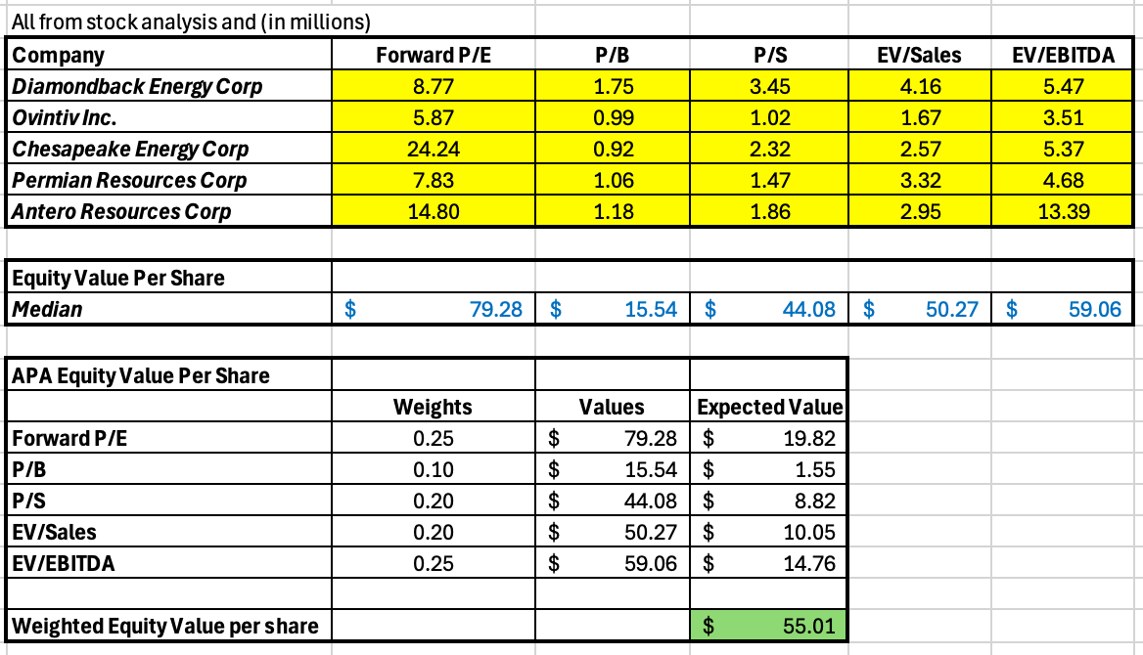
Competitive Analysis
Industry Competitive Analysis
Market Comparables Analysis
Higher Revenue than Diamondback Energy Corp (whose market cap is 3x of APA)
Antero Resources produces half the revenue of APA at the same market cap
APA yields a higher interest coverage ratio (9.86 compared to 9.2) than industry average.

Slide 7
Commitment to Investors
Since 2021, APA has returned...
$2.7 B
Shares
Repurchased
$735 M
Dividend
Payouts
$5.4 B / 64%
Forward Free
Cash Flow
APA has exhibited consistent revenue growth, averaging 8.61% YoY growth since 2016
In 2023, APA finished a $3.2B bond reduction initiative.
Alternatively, tangible book rose from -1.6B in 2021, to $2.6B in 2024, showing APA Corporations commitment to increasing shareholder value.

Slide 8
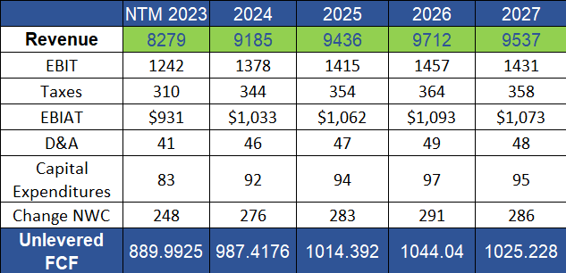
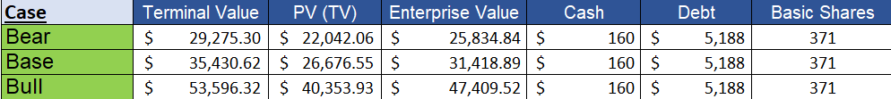
APA has the potential for an 80%+ move
Estimates
Bear:
PT:
$29.13
+21%
Base:
PT:
$44.18
+84%
All values in million (M)
Case By Case Values
Bull:
PT:
$87.28
All values in million (M)
+263%

Slide 9
Decision - Buy APA
1 - Intrinsically undervalued both historically and among peers.
$58.53
2 - Diverse Portfolio Spanning Multiple Geographic Locations, Market Segments, and Growth through Mergers & Acquisitions.
Average Price Target
122.67%
3 - Increase in barrel production, revenue, redistribution of cash to stakeholders.
% Change

