Slide 1

The Alpha 21264 – Data Stream
Matt Ziegler

Slide 2
Alpha 21264 – Pipeline Stages 4-6 [1]
FETCH MAP QUEUE REG EXEC DCACHE
Stage: 0 1 2 3 4 5 6
Branch
Predictors
Int Reg
Map
Int Issue Queue
(20)
Reg File
(80)
Exec
Bus Inter-
face
Unit
Exec
Addr
Sys Bus
L1 Data
Cache
64KB
2-Set
64-bit
Reg File
(80)
Exec
Cache Bus
80 in-flight instructions
plus 32 loads and 32 stores
Addr
128-bit
Next-Line
Address
Exec
Phys Addr
L1 Ins.
Cache
64KB
2-Set
4 Instructions / cycle
44-bit
FP Issue Queue
(15)
Reg File
(72)
FP ADD
Div/Sqrt
FP
Reg
Map
Victim Buffer
FP MUL
Miss Address
Notes:
7

Slide 3
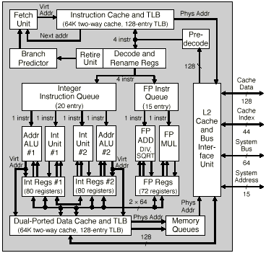
Alpha 21264 – Block Diagram
Effectively
Dual-Ported

Slide 4
Data Stream Overview [1]
Reg File
(80)
Exec
Integer Cluster 1
Bus Inter-
face
Unit
Exec
Addr
Sys Bus
L1 Data
Cache
64KB
2-Set
64-bit
Reg File
(80)
Exec
Cache Bus
Integer Cluster 2
Addr
Exec
128-bit
Phys Addr
44-bit
Reg File
(72)
FP ADD
Div/Sqrt
FP Datapath
Victim Buffer
FP MUL
Miss Address
Notes:
7

Slide 5
Register and Execute Stages [1]
Floating Point
Execution Units
Integer Execution Units
1 cycle delay
m. video
mul
FP Mul
shift / br
shift / br
add / logic
add / logic
FP Reg
Int Reg 1
Int Reg 2
FP Add
add /
logic /
memory
add /
logic /
memory
FP Div
SQRT
1 cycle delay
Notes:
15

Slide 6
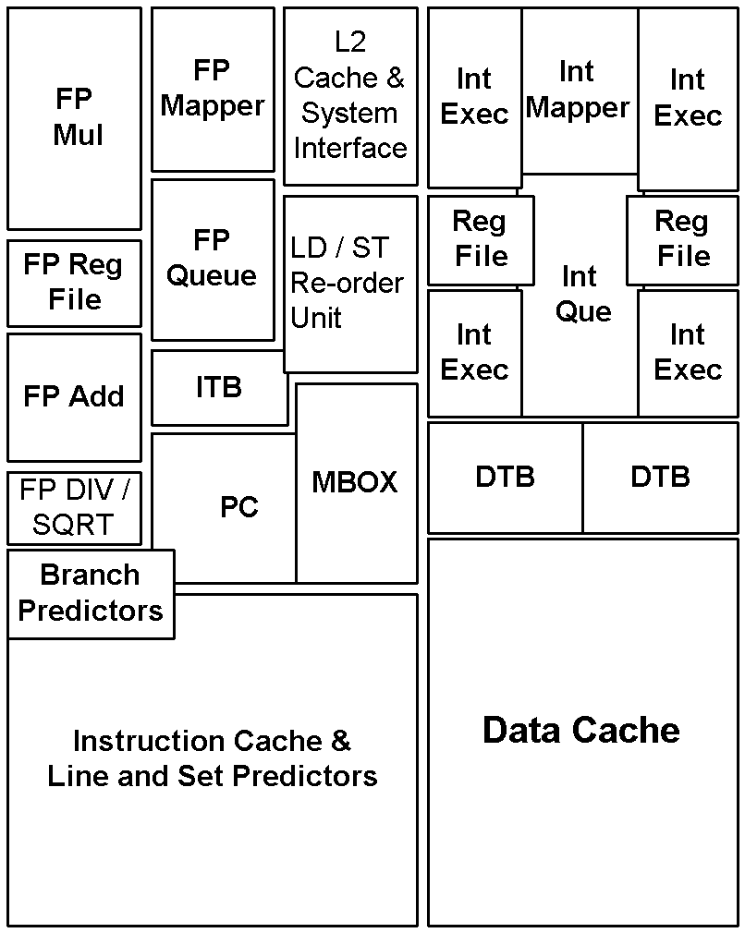
Alpha 21264 Floor Plan – The 6 Datapaths [1]
Notes:
6

Slide 7
Integer Datapath
2 Integer Clusters, 2 Pipes per Cluster 4 Pipes
  Each Cluster has a copy of the Register File
Cluster 1
  Upper Pipe
    MVI/PLZ
    Shifter/Branch
    Add/Logic
  Lower Pipe
    Add/Logical
    Load/Store
Cluster 2
  Upper Pipe
    Integer Multiplier
    Shifter/Branch
    Add/Logic
  Lower Pipe
    Add/Logical
    Load/Store

Slide 8
Floating Point Datapath
Hardware support for the IEEE FP standard
  NaN, Infinity processing, Denormals, etc.
2 Pipes
  Upper Pipe
    FP Multiply
  Lower Pipe
    FP Add
    FP Divide
    FP Square Root

Slide 9
Instruction Latencies
Simple Integer Ops 1
MVI / PLZ 3
Int Multiply 7
Int Load 3
FP Load 4
FP Add 4
FP Multiply 4
FP Divide 12 s-p, 15 d-p
FP Square Root 15 s-p, 30 d-p

Slide 10
Integer and FP Register Files
Int Reg File – 31 Visible, 80 total
Two Integer Processing Clusters
  Two pipes in each cluster
  Each cluster has its own copy of Int Reg File
  Reduces the number of access ports from 8 read / 6 write to 4 read / 6 write
FP Reg File – 31 Visible, 72 total

Slide 11
Alpha 21264 Loads and Stores [1]
L1 Data Cache
  Two loads / stores per cycle (any combination)
    2x clock Frequency: Phase pipelined - no bank conflict
    16 Byte read / write per cycle
Loads and stores issue out-of-order
  32-entry load and store reorder buffers
  Memory references check buffers to enforce ordering
  Uncommitted stores forward data to loads
Notes:
45

Slide 12
Alpha 21264 Floor Plan – Data Cache [1]
Notes:
6

Slide 13
Data Cache Overview
64 KB L1 On-Chip Data Cache
2 Way Set Associative
64 Byte Blocks
Write-Back, Read/Write Allocate
Virtually Indexed / Physically Tagged
128 Entry Fully Associative TLB
8 Entry Victim Buffer

Slide 14
Data Cache – Block Diagram
9 bits
3 bits
tag
index
displ.
64 Bytes Blocks
set1
set2
128
Entry
TLB
tag
AU1
AU8
tag
AU1
AU8
512 set indices
32 KB per set
32 KB per set
?
?
select displ.
select set
64-bit data

Slide 15
Data Cache – Access Cycle
2 memory ops per cycle (loads or stores)
Single-Ported
  “ Double-pumped” – Accesses data on opposite clock phases
  Single port reduces area and delay compared to dual ported
16 Bytes read / write per cycle
Pipelined – 2 latency
pos clk phase
neg clk phase
cache op1
cache op2

Slide 16
Data Stream Summary
4 Integer pipes, divided among 2 clusters
  31 visible Registers, 80 total
2 floating point pipes
  31 visible Registers, 72 total
64 KB D-cache
  2 assoc., 64 Byte Blocks
  Write-Back, Read/Write Allocate
  Virtually Indexed / Physically Tagged
  128 Entry Fully Associative TLB
  8 Entry Victim Buffer

Slide 18
The Alpha 21264 – External L2 and Memory System
Matt Ziegler

Slide 19
Alpha 21264 Performance-Focused Memory System [1]
L1 Dcache: 9+ GB/s
  128b datapath with 3 cycle load-to-use latency
L2 Cache: 6+ GB/s
  128b datapath with 12 cycle load-to-use latency
System port: 3+ GB/s
  64b datapath with 80 cycle load-to-use latency
16 64-byte off-chip memory references
  8 read-misses and 8 write-backs

Slide 20
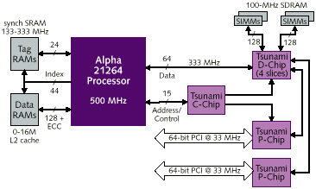
L2 Cache and Memory System Overview
faster

Slide 21
Alpha 21264 External Interface [1]
Independent
Chipset Example
System Port
L2 Cache Port
Duplicate
TAG (opt)
Address Out
Alpha
21264
TAG
L2 Cache TAG RAMs
Control
Address In
Address
PCI
System Data
Data
L2 Cache Data RAMs
Data Slice
2,4,8
64b
128b
Independent data buses allow simultaneous data transfers
L2 Cache: 0 -16MB Synch Direct Mapped Peak Bandwidth:
Example 1: Reg-Reg 133 MHz BurstRAM 2.1 GB/sec
Example 2: ‘RISC’ 200+ MHz Late Write 3.2+ GB/sec
Example 3: Dual Data 400+ MHz 6.4+ GB/sec
Notes:
34

Slide 22
Off-Chip Unified L2 Cache
0 – 16 MB
Physically Indexed
128 bit bus connecting L1 to L2
  16 bytes every 1.5 cycles
  12 cycle latency
Non-blocking
  8 in-flight misses

Slide 24
Alpha 21264 – V LSI Implementation
Matt Ziegler

Slide 25
VLSI Design Strategies
Semi-Custom
Full-Custom
IBM
PowerPC
Intel
Pentium
Compaq
Alpha
Mostly Custom Design
High Cost
High Performance
Extensive Circuit Design
Mainly Place & Route
Low Cost
Fast Design Cycle
Some Place & Route
Some Custom
Mid Range Cost
Medium Design Cycle

Slide 26
Performance vs. Cost
Low
Performance
High
Compaq
Alpha
High
Intel
Pentium
(large market share)
Cost
IBM
PowerPC
Low

Slide 28
High Performance High Power
Matt Ziegler

Slide 29
Consider This:
The Alpha 21264 is like a Ferrari
  Both are Engineering Masterpieces
  Both deliver High Performance
  Both are Gas/Power Guzzlers
So, if you want High Performance, you have to pay for it!

Slide 30
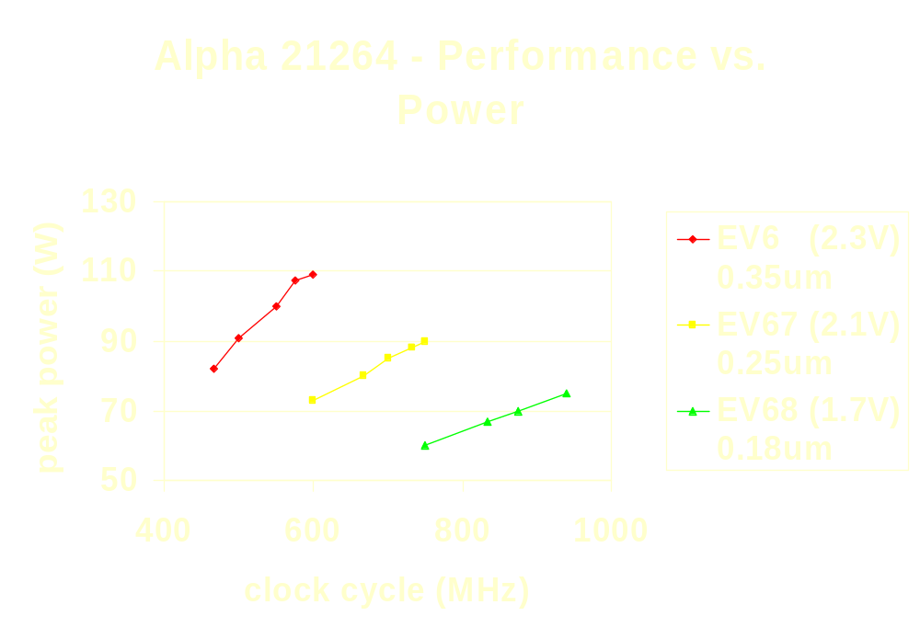

Slide 31
EV6 | 2.7V 0.35um |  | EV67 | 2.1V 0.25um |  | EV68 | 1.7V 0.18um
MHz | Watts
466 | 82
500 | 91
550 | 100
575 | 107.5 |  | MHz | Watts
600 | 109 |  | 600 | 73
 |  |  | 667 | 80
 |  |  | 700 | 85
 |  |  | 733 | 88 |  | MHz | Watts
 |  |  | 750 | 90 |  | 750 | 60
 |  |  |  |  |  | 833 | 67
 |  |  |  |  |  | 875 | 70
 |  |  |  |  |  | 940 | 75

Slide 32
Alpha 21264 Power Distribution
Global Clock Network 32%
Inst Issue Units 18%
Caches 15%
FP Exe Units 10%
Integer Exe Units 10%
MMU 8%
I/O 5%
Misc. Logic 2%

Slide 34
The Alpha Family of Microprocessors the 21264 and Beyond
Matt Ziegler

Slide 35
Alpha Family Overview [1]
E5 (21164)
  In-order 4-wide
EV6 (21264)
  .35 μm, 600 MHz
  4-wide superscalar
  Out-of-order execution
  Backside L2 cache port
EV67
  .25 μm, ~800 MHz
EV68
  .18 μm, >1000 MHz
EV7 (21364)
  .18 μm, >1000 MHz
  L2 cache on-chip
  RAMBUS
  Glueless MP
EV8 (21464)
  .13 μm, 1400 MHz
  8-wide superscalar
  SMT

Slide 36
Alpha Family Evolution [1]
Higher Performance
0.5μm
0.35μm
0.18μm
0.13μm
EV5 21164
EV6 21264
EV7
EV8
Lower Cost
0.35μm
0.25μm
EV5621164
EV67
...
0.35μm
0.18μm
PCA56 21164PC
EV68
0.25μm
PCA57 21164PC
1995
1996
1997
1998
1999
2000 2001
Notes:
45
40

Slide 37
EV7 Overview [1]
21264 core + enhancements:
  Double the number of read-miss and victims (relative to 21264)
  Graphics extensions
On-chip 8-way associative L2 cache, currently 1.5MB
RAMBUS DRAM memory interface
Glue-less scalable, reliable system
70 - 80 SPECint95, 110-130 SPECfp95
Sustained memory bandwidth -- 10GB/sec

Slide 38
EV8 Overview [1]
Enhanced out-of-order execution
8-wide superscalar
4-way simultaneous multi-threading (SMT)
On-chip L2 cache, > 2MB
RAMBUS interface
New instruction fetcher and branch predictor
~ 200 SPECint95, ~ 300 SPECfp95
Sustained memory bandwidth -- 10GB/sec

Slide 39
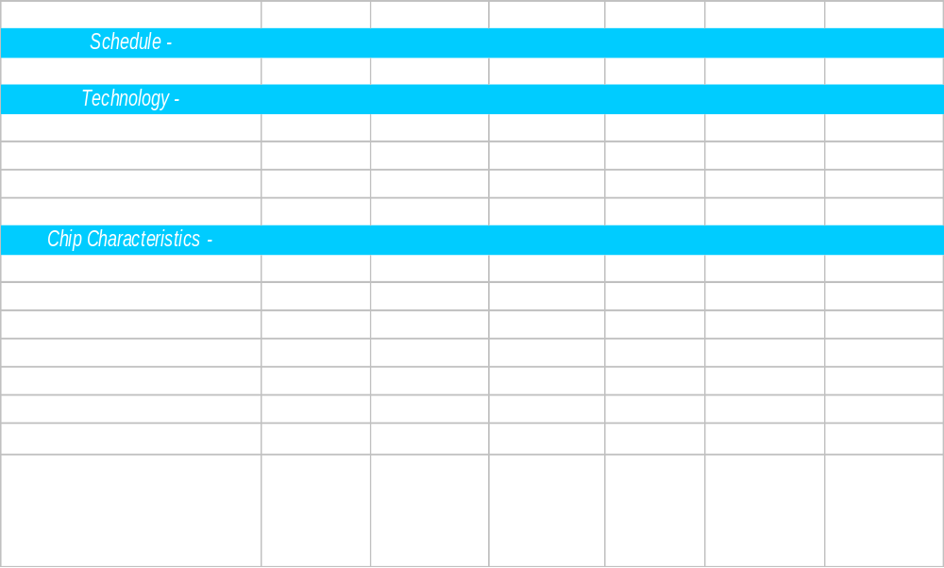
Alpha Family Roadmap [1]

Slide 40
DONE

