Slide 1

ALPHA 21264 Introduction
I- Stream
Dharmesh Parikh

Slide 2

System Overview
RISC instruction Set
64-bit processor
15 million transistors
1st Alpha w/ out-of-order execution
Speculative execution
Notes:
2

Slide 3
Alpha 21264 Key Features
Four-wide Instruction Fetch
Line and Branch Predictor
  Tournament prediction using both local & global history
  Dynamic JSR/JMP prediction
Out-of-Order Execution Pipelines
  Quad-speculative-issue integer pipeline
  Dual-speculative-issue floating-point pipeline
    One ADD, One MULTIPLY
    Also DIV (6 bits/cycle) and SQRT (2 bits/cycle)
Memory System
  Two out-of-order memory references per cycle
  Up to 16 outstanding off-chip memory references
    8 fills and 8 victims
Notes:
2

Slide 4
Alpha 21264 Key Features (2)
80 In-flight Instructions
Registers: 80 Integer, 72 Floating Point
Queue Entries: 20 Integer, 15 Floating Point
128-Entry Fully Associative DTB
128-Entry Fully Associative ITB
64 KB L1 On-Chip Instruction Cache
  Virtual Index/Tag
  2-Way Set Predict
64 KB L1 On-Chip Data Cache
  Virtual Index/Physical tag
  2-Way Set Associative
  Cache-hit prediction logic enhances speculative issue
Notes:
3

Slide 5
Differences from 21164
Out of order issue
Smaller pipeline
Increased memory bandwidth
Memory references can be accessed in parallel to caches
One pipeline for both floating point and integer operations
4x the bandwidth
Notes:
3

Slide 6
Previous instruction types
Branch
Floating point
Memory
Memory/Function code
Memory/branch
Operate
PALcode
Notes:
3

Slide 7
New instructions
Floating Point
Cache prefetching
MVI (motion video instructions)
Notes:
3

Slide 8
Alpha 21264 Instruction Fetch Bandwidth Enablers
The 64 KB two-way associative instruction cache supplies four instructions every cycle
The next-fetch and set predictors provide fast cache access of a direct-mapped cache and eliminate bubbles in non-sequential control flows
The instruction fetcher speculates through up to 20 branch predictions to supply a continuous stream of instructions
The tournament branch predictor dynamically selects between Local and Global history to minimize mispredicts
Notes:
8

Slide 9
Alpha 21264 – 7 Stage Pipeline [1]
FETCH MAP QUEUE REG EXEC DCACHE
Stage: 0 1 2 3 4 5 6
Branch
Predictors
Int Reg
Map
Int Issue Queue
(20)
Reg File
(80)
Exec
Bus Inter-
face
Unit
Exec
Addr
Sys Bus
L1 Data
Cache
64KB
2-Set
64-bit
Reg File
(80)
Exec
Cache Bus
80 in-flight instructions
plus 32 loads and 32 stores
Addr
128-bit
Next-Line
Address
Exec
Phys Addr
L1 Ins.
Cache
64KB
2-Set
4 Instructions / cycle
44-bit
FP Issue Queue
(15)
Reg File
(72)
FP ADD
Div/Sqrt
FP
Reg
Map
Victim Buffer
FP MUL
Miss Address
Notes:
8

Slide 10
Alpha 21264 Instruction Stream Improvements
...
Learns Dynamic Jumps
PC GEN
Instruction Decode,
Branch Prediction
0-cycle Penalty On Branches
Set-Associative Behavior
PC
Tag
S0
Tag
S1
Icache
Data
Next-
Fetch
Pred
Set
Pred
Cmp
Cmp
Hit/Miss/Set Miss
Next LP address + set
Instructions (4)
Notes:
7

Slide 11
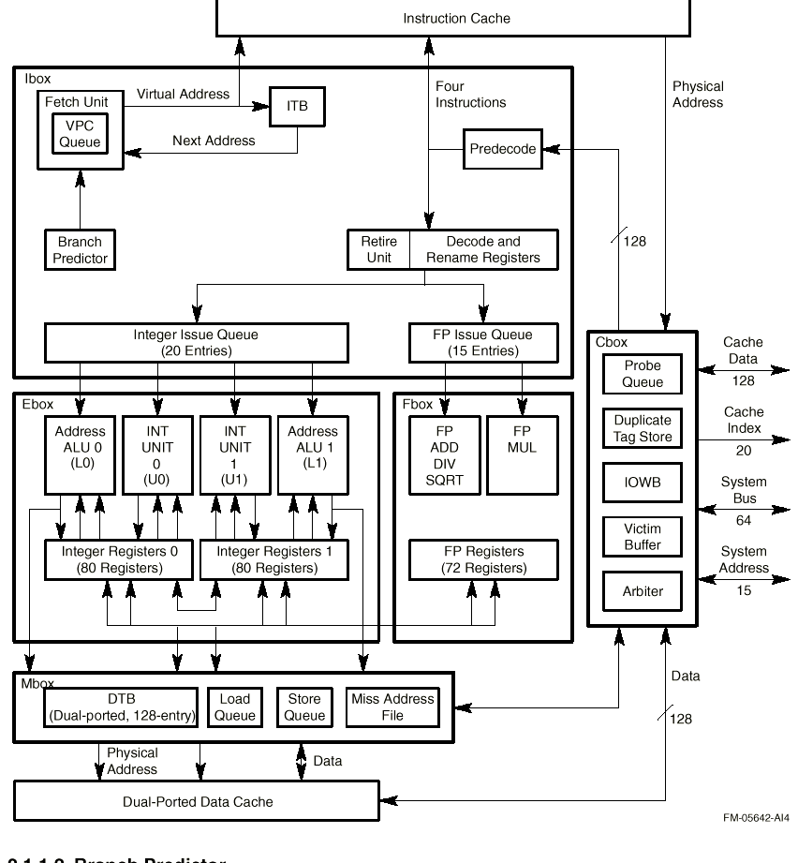
Notes:
7

Slide 12
Instruction Fetch,Issue and Retire Unit
Virtual Program Counter Logic
Branch Predictor
Instruction -Stream Translation Buffer(ITB)
Instruction fetch logic
Register rename maps
Integer and Floating-Point issue Queues
Exception and Interrupt Logic
Retire Logic
Notes:
7

Slide 13
Virtual Program Counter Logic
The virtual program counter (VPC) logic maintains the virtual addresses for instructions that are in flight. There can be up to 80 instructions, in 20 successive fetch slots, in-flight between the register rename mappers and the end of the pipeline. The VPC logic contains a 20-entry table to store these fetched VPC addresses.
Notes:
7

Slide 14
Alpha 21264 Tournament Branch Prediction
Local History (1024x10)
Local Prediction (1024x3)
Global Prediction (4096x2)
Choice Prediction (4096x2)
Program Counter
Path History
Prediction
Notes:
7

Slide 15
Branch Prediction: Motivation
Highly pipelined design introduces additional misprediction penalty cycles .
Instructions typically spend 4-5 cycles in instruction queue -- more delay!
Minimum penalty: 7 cycles
Average penalty: > 11 cycles
2-cycle instruction cache adds another cycle to branch misprediction penalty -- sounds like a lot, but only 10%
Notes:
7

Slide 16
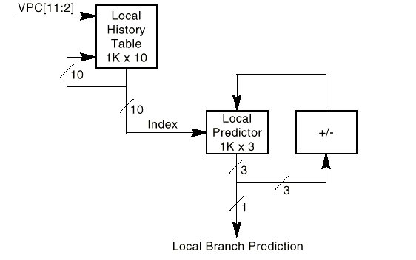
Local Predictor
Notes:
7

Slide 17
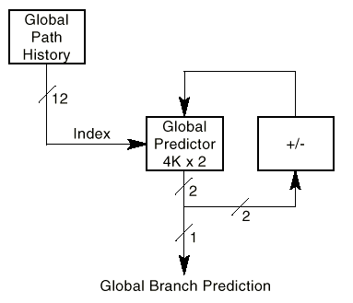
Global Predictor
Notes:
7

Slide 18
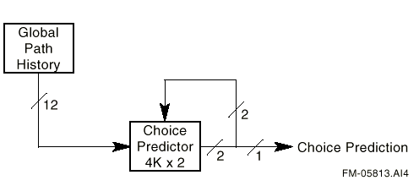
Choice Predictor
Notes:
7

Slide 19
Other Branch Prediction Stuff
32 entry return-address stack to predict target of subroutine returns. Situated near the instruction cache and accessed in parallel.
35K bits of storage for branch history information = 2% of die area.
48K bits of target address information stored in cache .
7-10 mispredictions per 1000 instructions on SPECint95 * 11 cycles per misprediction = .1 CPI loss.
Notes:
7

Slide 20
Branch Prediction Problems
Instructions must always be grouped in fours, with predicted-taken branch in slot four, and branch targets in slot one, in order to issue four instructions on a branch.
Context switching -- every time the CPU does a context switch, branch prediction tables are reset.
Notes:
7

Slide 21
Instruction-Stream
Translation Buffer(ITB)
128-entry, fully associative ITB.
Store recently used instruction-stream(Istream) address translations and page protection information.
ITB is accessed only for the Istream references that miss in the Icache.
Notes:
7

Slide 22
Instruction Fetch Logic
Up to four aligned instructions are fetched from the Icache, in program order.
The branch prediction tables are also accessed in this cycle( instruction fetch cycle or Stage 0).
The branch predictor uses tables and a branch history algorithm to predict a branch instruction target address for one branch or memory format.
Branch prediction and line prediction bits accompany the four instructions.
Notes:
7

Slide 23
I-Cache
Large 64 k byte, two-way set associative instruction cache.
Each fetch block of four instructions includes a line and set prediction.
Prediction indicates where to fetch the next block of instructions from,including which set should be used.
Remove the bubble if the branch is predicted to be taken by the branch predictor.
Notes:
7

Slide 24
I-Cache(continued)
On cache fills, the line predictor value at each fetch line is initialized with the index of the next sequential fetch line, and later retrained by the branch predictor if necessary.
The line predictor does not train on every mispredict.
The mispredict cost is typically a single cycle bubble.
Line predictor is also trained for jumps that use direct register addressing.
Notes:
7

Slide 25
Instruction Fetch Logic(continued)
In the slot stage(stage1), the branch predictor compares the next Icache index that it generates to the index that was generated by the line predictor.
If there is a mismatch, the branch predictor wins and results in one bubble.
The line predictor takes precedence over the branch predictor during memory format calls or jump.
Notes:
7

Slide 26
Register Rename Maps
In addition to the 64 architectural registers,up to 41 integer registers and 41 floating point registers.
Eliminates write-after-read(WAR) and write-after-write(WAR) while preserving true read-after-write(RAW) dependence's.
Provides a means of speculatively executing instructions.
Each instruction is assigned a unique 8-bit number, called an inum, which is used to identify the instruction and it’s program order.
Notes:
7

Slide 27
Register Rename Maps(continued)
Map logic can process four instructions per cycle.
Physical register is not returned to the free list until the instruction using it has been retired.
If a branch mispredict or exception occurs, the map logic backs up the contents of the register rename maps to the state associated with the instruction that triggered the condition,and the prefetcher restarts at the appropriate VPC.
Map logic can back up the contents of the maps to the state associated with any of 80 instructions in flight in a single cycle.
Notes:
7

Slide 28
Alpha 21264 Mapper and Queue Stages Block Diagram
MAPPER ISSUE QUEUE
Saved
Map
State
Arbiter
Request
Grant
Register
Numbers
Renamed
Registers
Register
Scoreboard
MAP
CAMs
80 Entries
4 Instr / Cycle
Issued
Instructions
Instructions
QUEUE
20 Entries
Notes:
7

Slide 29
Integer Issue Queue(IQ)
The 20-integer issue queue, associated with the integer execution units, issues instructions at the maximum rate of four per cycle.
Each queue entry asserts four request signal(one for each sub-cluster( U0,U1,L0 &L1).
There are two arbiters-one for the upper sub-clusters and one for the lower sub-clusters.
Some instructions like load and store can only go to lower sub-clusters and shift instructions can only go to the upper sub-clusters.
Notes:
7

Slide 30
Integer Issue Queue(continued)
Other instructions , such as addition and logic operations, can execute in any sub-clusters and are statically assigned before being placed in the IQ.
The IQ chooses between simultaneous requesters of a sub-cluster based on the age of the request- older request are given priority over newer requests.
Notes:
7

Slide 31
Floating-Point Issue Queue(FQ)
The 15-entry FPQ is associated with the floating point execution units.
Each queue entry has three request lines-one for the add pipeline,one for the multiply pipeline and one for the two store pipelines.
There are three arbiters(one for each). The add and multiply arbiters pick one per cycle,while the store pipeline arbiter picks two requesters per cycle.
The FQ arbiter picks between simultaneous requesters of a pipeline based on the age of the requests.
Notes:
7

Slide 32
Alpha 21264 Register and Execute Stages
Floating Point
Execution Units
Integer Execution Units
m. video
mul
FP Mul
shift / br
shift / br
add / logic
add / logic
Reg
Reg
Reg
FP Add
add /
logic /
memory
add /
logic /
memory
FP Div
SQRT
Notes:
7

Slide 33
Exception and Interrupt Logic
Two types of exception:faults and synchronous traps.Arithmetic exceptions are precise and are reported as synchronous traps.
There are four types of interrupts:Two are hardware, one is software interrupt and the last is Asynchronous systems traps
Notes:
7

Slide 34
Retire Logic
The Instruction box(Ibox) fetches instructions in program order,executes them out of order, and then retires them in order.
The Ibox retire logic maintains the architectural state of the machine by retiring an instruction only if all previous instructions have executed without generating exceptions or branch mispredictions.
Retiring an instruction commits the machine to any changes the instruction may have made to the software-visible state.
Notes:
7

Slide 35
Retire Logic(continued)
The three software-visible states are:
  Integer and floating-point registers
  Memory
  Internal processor registers
The retire logic can sustain a maximum retire rate of 8 instructions per cycle,and can retire up to as many as 11 instructions in a single cycle.
Notes:
7

