Slide 1
Simultaneous Multithreading:
Multiplying Alpha Performance
Dr. Joel Emer
Principal Member Technical Staff
Alpha Development Group
Compaq Computer Corporation

Slide 2
Outline
Alpha Processor Roadmap
Motivation for Introducing SMT
Implementation of an SMT CPU
Performance Estimates
Architectural Abstraction

Slide 3
Alpha Microprocessor Overview
Higher Performance
0.35μm
0.18μm
0.125μm
21264 EV6
EV7
EV8
Lower Cost
0.28μm
0.125μm
21264
EV67
EV78
...
0.18μm
21264
EV68
1998
1999
2000 2001 2002 2003
First System Ship
Notes:
45
40

Slide 4
EV8 Technology Overview
Leading edge process technology – 1.2-2.0GHz
  0.125µm CMOS
  SOI-compatible
  Cu interconnect
  low-k dielectrics
Chip characteristics
  ~1.2V Vdd
  ~250 Million transistors
  ~1100 signal pins in flip chip packaging

Slide 5
EV8 Architecture Overview
Enhanced out-of-order execution
8-wide superscalar
Large on-chip L2 cache
Direct RAMBUS interface
On-chip router for system interconnect
Glueless, directory-based, ccNUMA for up to 512-way SMP
4-way simultaneous multithreading (SMT)

Slide 6
Goals
Leadership single stream performance
Extra multistream performance with multithreading
  Without major architectural changes
  Without significant additional cost

Slide 7
Instruction Issue
Time
Reduced function unit utilization due to dependencies

Slide 8
Superscalar Issue
Time
Superscalar leads to more performance, but lower utilization

Slide 9
Predicated Issue
Time
Adds to function unit utilization, but results are thrown away

Slide 10
Chip Multiprocessor
Time
Limited utilization when only running one thread

Slide 11
Fine Grained Multithreading
Time
Intra-thread dependencies still limit performance

Slide 12
Simultaneous Multithreading
Time
Maximum utilization of function units by independent operations

Slide 13
Basic Out-of-order Pipeline
Fetch
Decode/Map
Queue
Reg Read
Execute
Dcache/Store Buffer
Reg Write
Retire
PC
Register
Map
Regs
Dcache
Regs
Icache
Thread-blind

Slide 14
SMT Pipeline
Fetch
Decode/Map
Queue
Reg Read
Execute
Dcache/Store Buffer
Reg Write
Retire
PC
Register
Map
Regs
Dcache
Regs
Icache

Slide 15
Changes for SMT
Basic pipeline – unchanged
Replicated resources
  Program counters
  Register maps
Shared resources
  Register file (size increased)
  Instruction queue
  First and second level caches
  Translation buffers
  Branch predictor

Slide 16
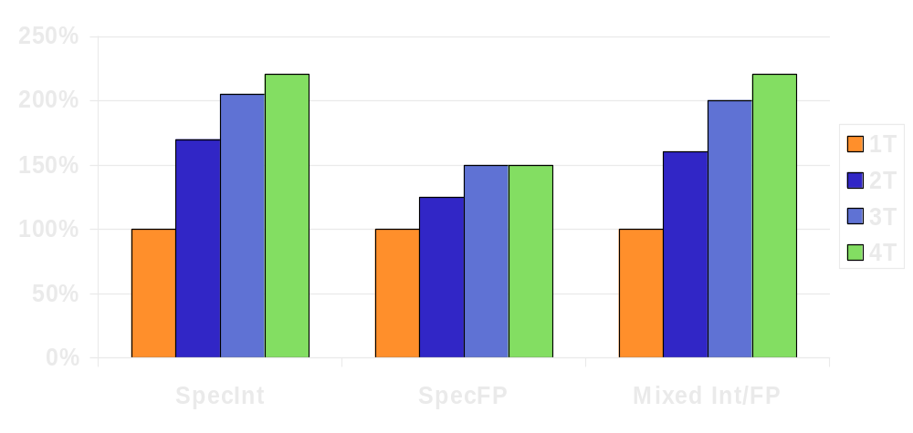
Multiprogrammed workload

Slide 17
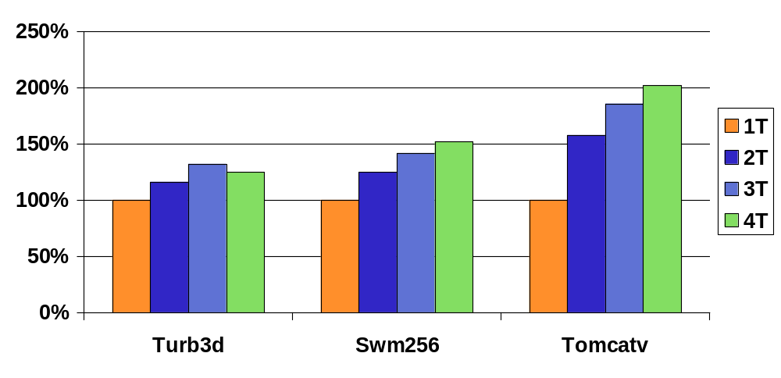
Decomposed SPEC95 Applications

Slide 18
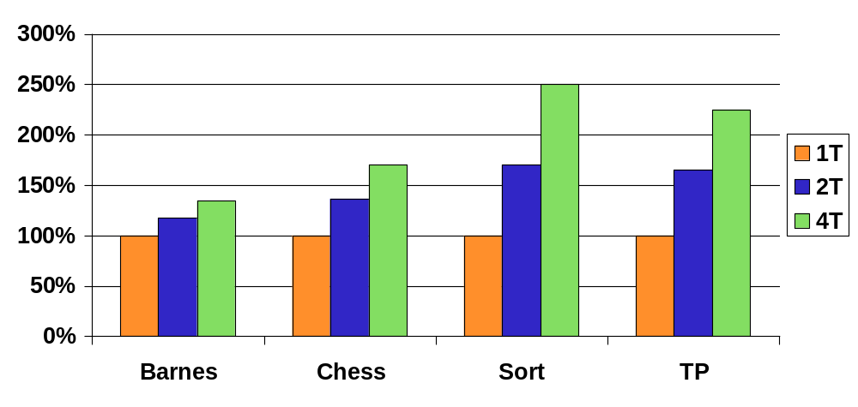
Multithreaded Applications

Slide 19
Architectural Abstraction
1 CPU with 4 Thread Processing Units (TPUs)
Shared hardware resources
TPU 0
TPU1
TPU2
TPU3
Icache
TLB
Dcache
Scache

Slide 20
System Block Diagram
EV8
M
EV8
M
EV8
M
0
1
2
3
IO
IO
IO
EV8
M
EV8
M
EV8
M
IO
IO
IO
EV8
M
EV8
M
EV8
M
IO
IO
IO

Slide 21
Quiescing Idle Threads
Problem:
Spin looping thread consumes resources
Solution:
Provide quiescing operation that allows a
TPU to sleep until a memory location changes

Slide 22
Summary
Alpha will maintain single stream performance leadership
SMT will significantly enhance multistream performance
  Across a wide range of applications,
  Without significant hardware cost, and
  Without major architectural changes

Slide 23
References
"Simultaneous Multithreading: Maximizing On-Chip Parallelism" by Tullsen, Eggers and Levy in ISCA95.
"Exploiting Choice: Instruction Fetch and Issue on an Implementable Simultaneous Multithreaded Processor" by Tullsen, Eggers, Emer, Levy, Lo and Stamm in ISCA96.
“Converting Thread-Level Parallelism to Instruction-Level Parallelism via Simultaneous Multithreading” by Lo, Eggers, Emer, Levy, Stamm and Tullsen in ACM Transactions on Computer Systems, August 1997.
“Simultaneous Multithreading: A Platform for Next-Generation Prcoessors” by Eggers, Emer, Levy, Lo, Stamm and Tullsen in IEEE Micro, October, 1997.

