Slide 1
Design and Implementation of a Parametric RTL Toolbox for Vector and Matrix Addition and Multiplication
By:
Mohammad Ali Abbasi
Supervised By:
Reza Sameni
Department of Computer Science & Engineering and IT,
School of Electrical and Computer Engineering, Shiraz University
Winter 2018

Slide 2
Outline
Problem Definition and Motivations
Issues and Assumptions
Literature Review
Proposed Method and Implementation
Results
Summary
Future Work
References

Slide 3

Problem Definition and Motivations
Linear Algebra (LA)
Linear Algebra is a field of mathematics concerning matrices, vectors, vector spaces, linear mappings and systems of linear equations
It is widely used in many fields of mathematics, physics, engineering, natural sciences, computer science, social science, signal processing, …
Vector-Vector, (Matrix-Vector) and Matrix-Matrix addition or multiplication are commonly used in LA calculations

Slide 4
Problem Definition and Motivations
We may need to use FPGAs to perform the mentioned calculation when:
The FPGA is used as the system’s main (or sole) processor
No need to add another (co-)processor
Security considerations
The FPGA is used as a preprocessor on the system’s front-end
As a method to provide fault-tolerance
During the development process of an ASIC
The FPGA is used as an accelerator in a High Performance Computing system
Not common yet, but FPGAs’ equivalent number of gates has been increasing, the needed tools are being developed, and there is a hard competition to win in terms of performance / watt

Slide 5
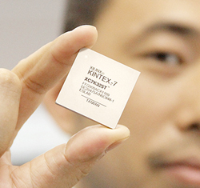

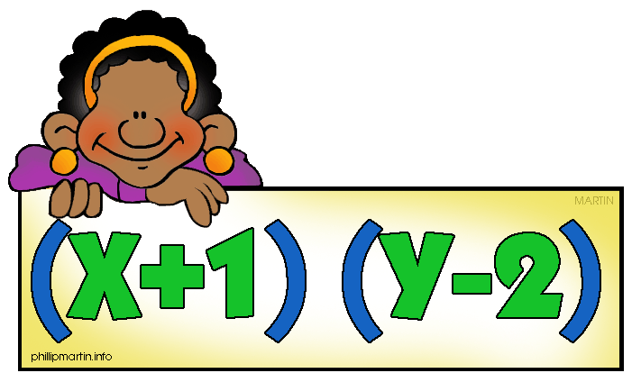
Problem Definition and Motivations
… but are FPGAs suitable for this purpose?
First of all, Reconfigurability!
?
Highly suitable architecture for similar parallel calculations
Presence of dedicated resources for addition and multiplication
Achieving better performance (/ watt)
Distributed resources usage reduction
So, YES!

Slide 6
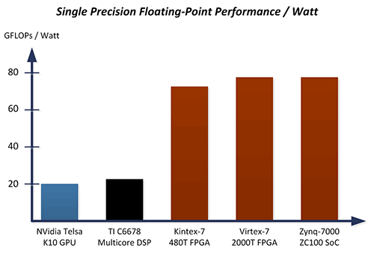
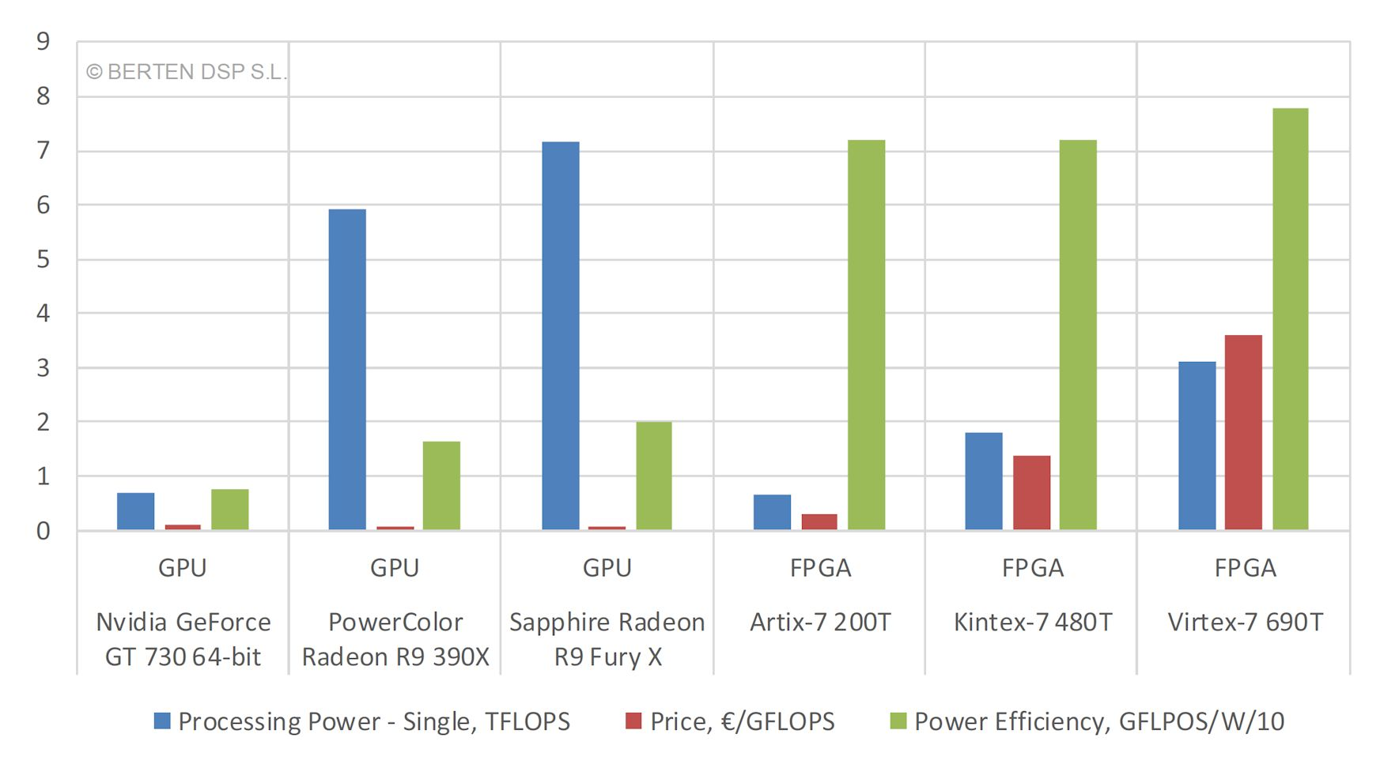
Problem Definition and Motivations
Single Precision Floating-Point:
Nvidia Tesla K10 (Kepler): 28nm
Mentioned Xilinx Devices: 28nm
[Xilinx]
Nvidia GT730 64b: 28nm
Amd R9: 28nm
Mentioned Xilinx Devices: 28nm
[BertenDSP, 2016]

Slide 7
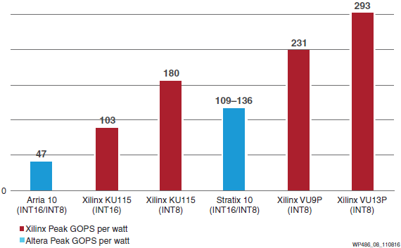
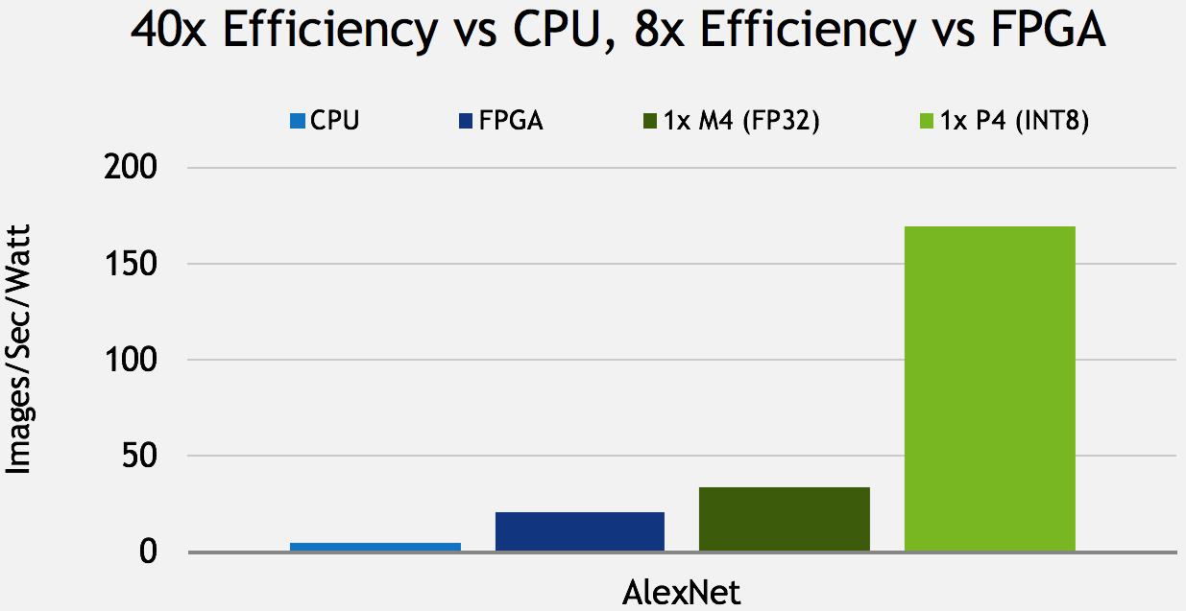
Problem Definition and Motivations
INT8:
Performance per Watt
Intel Arria 10: 20nm
Intel Stratix 10: 14nm
Xilinx KU115: 20nm
Xilinx VU9p & VU13P: 16nm,
231 & 293 GOP/s/watt
[Xilinx, 2016]
CPU: Intel Xeon E5
Intel Arria 10: 20nm
Nvidia Tesla P4 (Pascal): 16nm,
21,800 GOP/s @ 75 (50) watt,
291 (436) GOP/s/watt
[Nvidia, 2016]

Slide 8
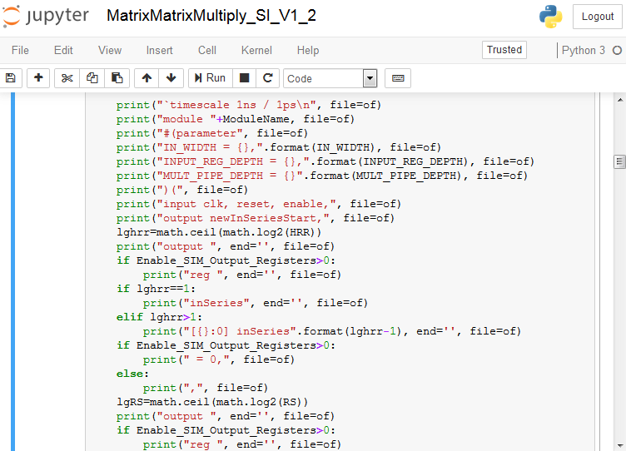
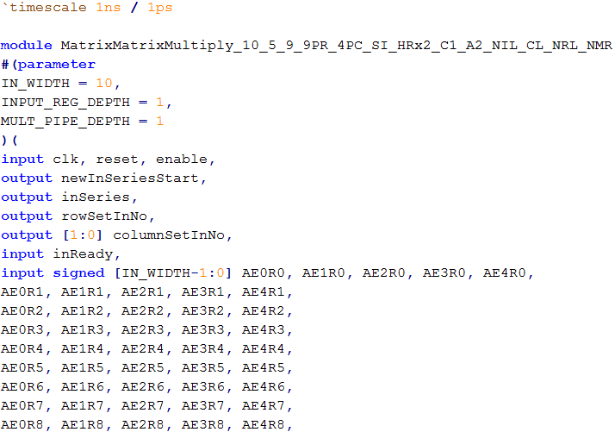
Issues and Assumptions
High Level Synthesis (HLS)
Register Transfer Level (RTL)
Gate Level
Parametric
Abstraction Level: Result is RTL
IPython HDL Code Generator
Rest of the work is done by RTL Synthesis and implementation tools
Resulted Verilog Code

Slide 9
Issues and Assumptions
Scalability
In terms of area (resources): correlated to operation order
In terms of performance
Different Rates and Styles for getting input data
Naïve Implementation: No Hardware Reuse (wastes resources)
But the toolbox should not waste resources! It must be able to reuse same resources when it is possible! (Area Optimality)
Vector elements input styles: parallel or serial (in batches)
This needs a controller (FSM)
Controller
Processing Element 0
Input Data
Data Multiplexer
Processing Element 1
…

Slide 10
Issues and Assumptions
Fixed-point or Floating-point
Signed Qm.n
Dense or Sparse calculations
Speed optimality
The key is usually pipelining, when possible
Power optimality
Disable (temporarily) unused hardware, to reduce dynamic power
Communication Protocol
Custom, Valid/Ready signaling

Slide 11
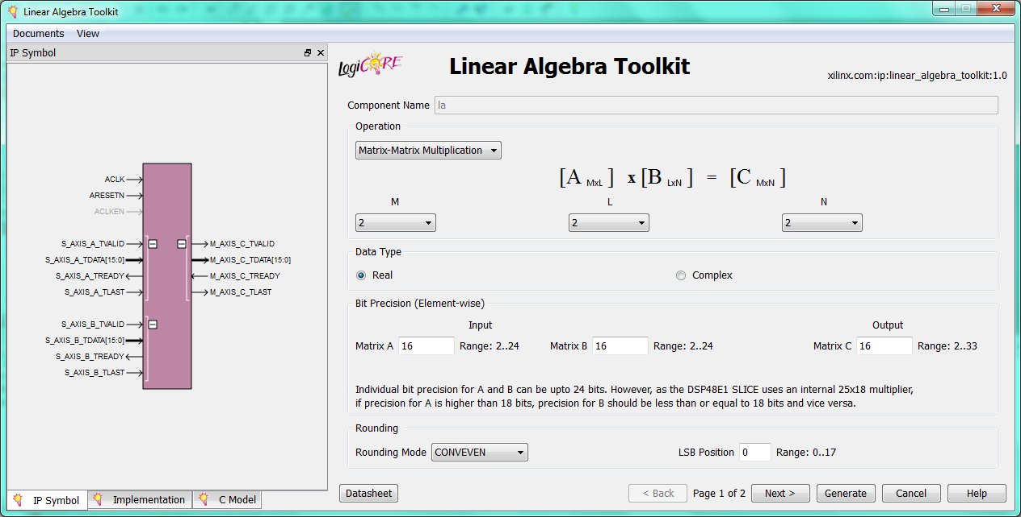
Literature Review
Commercial LA tools for FPGA
Xilinx Linear Algebra Toolkit
HLS-level: Xilinx Vivado HLS LA library, Intel (Altera) OpenCL support
RTL Code Generators: MathWorks HDL Coder, Xilinx System Generator for DSP, Intel (Altera) DSP BUILDER, National Instruments LabVIEW FPGA Module

Slide 12
Literature Review
Academic works
Floating-point, dense matrix-vector multiplication in VHDL [Choi, 2003]
Floating-point, sparse matrix product using Altera Nios soft-core [Sheth, 2003]
Floating-point, sparse matrix-vector multiplication in JHDL [deLorimier, 2005]
Floating-point, sparse matrix-vector multiplication, floating-point dense matrix-vector multiplication, matrix multiplication, LU decomposition in VHDL [zhuo, 2007]
Floating-point, sparse matrix product using Xilinx Microblaze soft-core [Kendrick & Moukarzel, 2007]

Slide 13
Literature Review
Academic works
Floating-point sparse matrix-vector multiplication, dense LU decomposition and linear solver in VHDL[Sun, 2008]
Floating-point dense linear solver in Verilog, and high level parametric programs [Zhang, 2008]
Energy efficient, floating-point sparse matrix-vector multiplication, comparison with CPU and GPU [Dorrance et al, 2014]

Slide 14
Proposed Method and Implementation
Languages and tools
Verilog hardware description language as the target RTL language
IPython (under Jupyter Notebook) for scripting
Xilinx ISE design suite and devices for synthesis and implementation
The code does not depend on any specific device or vendor devices, but is optimized for Xilinx devices
The user can further optimize the code for their target device, e.g., using synthesis attributes

Slide 15





Proposed Method and Implementation
Structure
Addition: Vector Add → Matrix Add
Multiplication: Dot-Product → Matrix-Vector Multiplication → Matrix-Matrix Multiplication
Example: MatrixMatrixMultiply_4_4_3_pr3_pc3_SI_HRx2 _C{MAMCS}_A{BAS}_{(N)}IL_{(N)}CL_{(N)}RL_{(N)}MR
$$A∙B=\sum_{i}{A_{i}B_{i}}$$
$$NOEPS(2)$$
$$PC(3)$$
$${\left[\begin{aligned}\begin{matrix}\begin{matrix}R0E0 & R0E1\end{matrix} & \begin{matrix}R0E2 & R0E3\end{matrix} \\ \begin{matrix}R1E0 & R1E1\end{matrix} & \begin{matrix}R1E2 & R1E3\end{matrix}\end{matrix} \\ \begin{matrix}\begin{matrix}R2E0 & R2E2\end{matrix} & \begin{matrix}R2E2 & R2E3\end{matrix} \\ \begin{matrix}R3E0 & R3E3\end{matrix} & \begin{matrix}R3E2 & R3E3\end{matrix}\end{matrix}\end{aligned}\right]}_{M(4)×N(4)}×{\left[\begin{aligned}\begin{matrix}\begin{matrix}C0E0 & C1E0\end{matrix} & C2E0 \\ \begin{matrix}C0E1 & C1E1\end{matrix} & C2E1\end{matrix} \\ \begin{matrix}\begin{matrix}C0E2 & C1E2\end{matrix} & C2E2 \\ \begin{matrix}C0E3 & C1E3\end{matrix} & C2E3\end{matrix}\end{aligned}\right]}_{N(4)×Q(3)}$$
$$={\left[\begin{aligned}\begin{matrix}\begin{matrix}M0A00 & M0A01\end{matrix} & M0A02 \\ \begin{matrix}M0A10 & M0A11\end{matrix} & M0A12\end{matrix} \\ \begin{matrix}\begin{matrix}M0A20 & M0A21\end{matrix} & M0A22 \\ \begin{matrix}∎ & ∎\end{matrix} & ∎\end{matrix}\end{aligned}\right]}_{M(4)×Q(3)}$$
$$PR(3)$$
$$NOEPS(2)$$

Slide 16
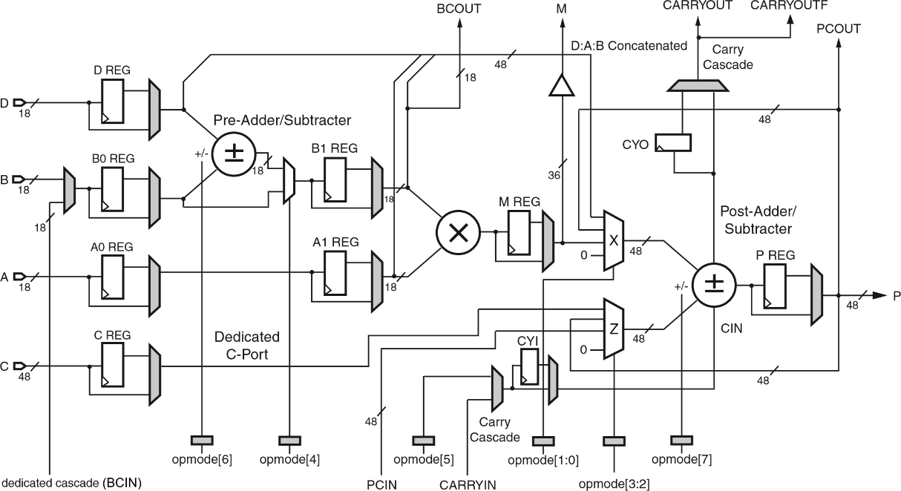
Proposed Method and Implementation
Dedicated Resources
Xilinx DSP48

Slide 17
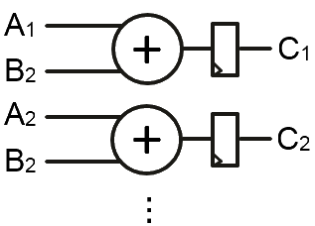
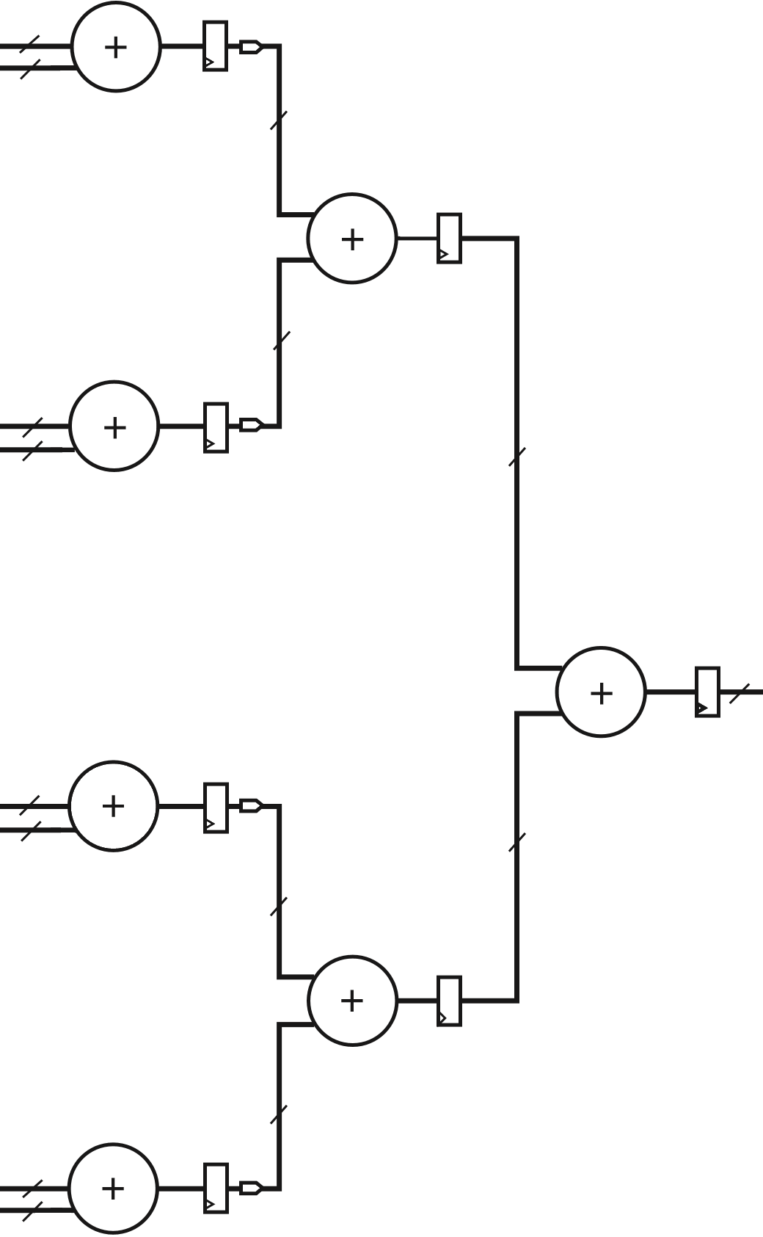
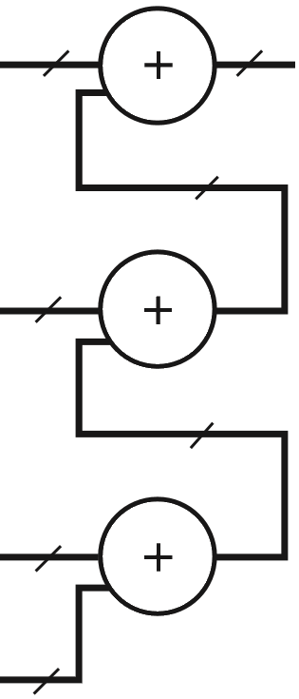
Proposed Method and Implementation
Basic Theoretical Modules
Vector Addition
Adder Chain
Adder tree

Slide 18
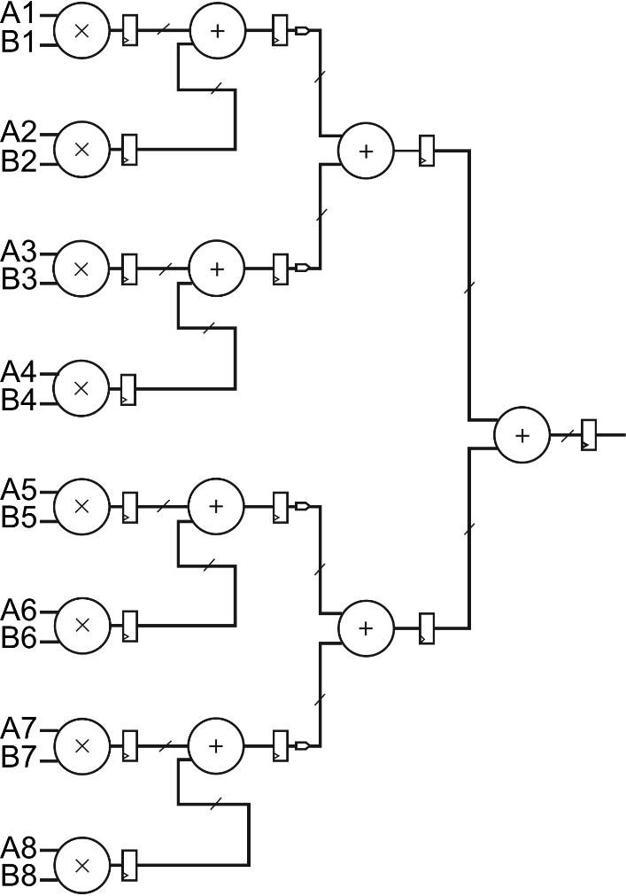
Proposed Method and Implementation
Basic Theoretical Modules
Dot-Product using Adder Tree

Slide 19
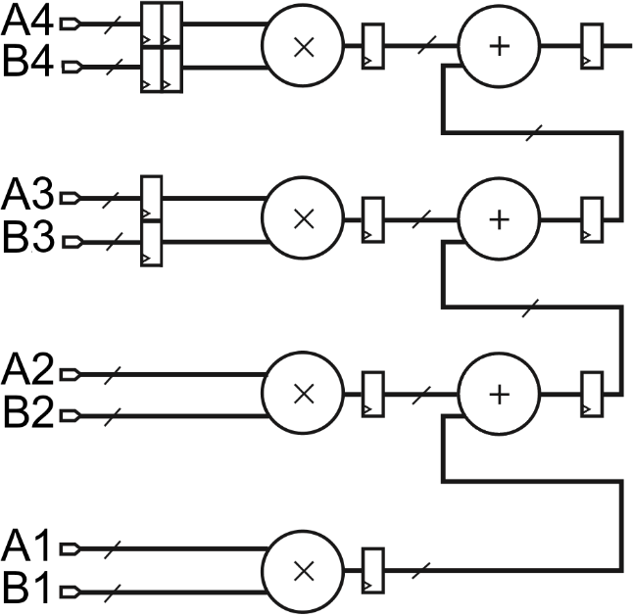
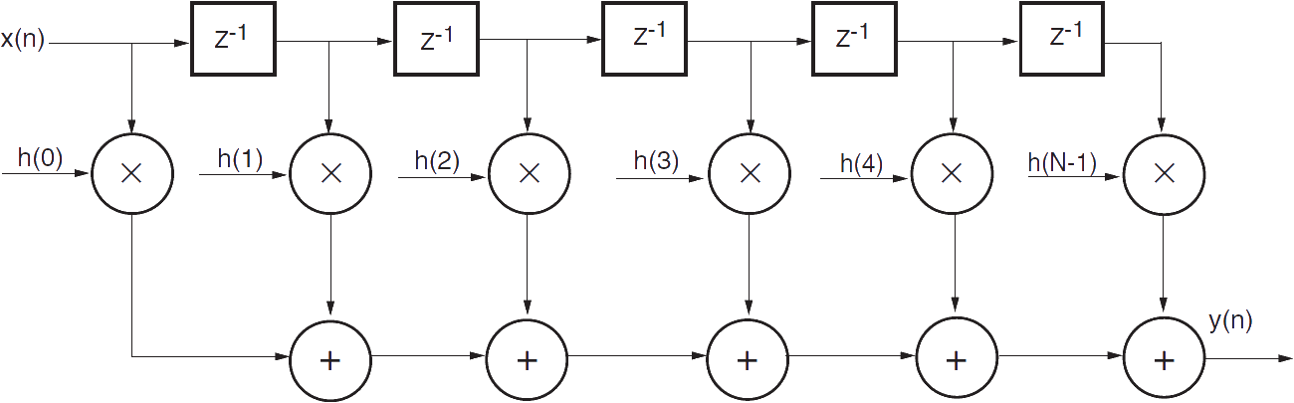

Proposed Method and Implementation
Basic Theoretical Modules
Dot-Product using Adder Chain (Systolic Implementation)
The idea is from systolic implementation of FIR filter
Hybrid of Systolic Dot-Product + Adder Tree is also possible
$$y\left(n\right)=\sum_{i=1}^{N−1}{\left.h(i)x(n−i\right)}$$

Slide 20

Proposed Method and Implementation
Parameters
Verilog Parameters (VP) can be altered before synthesis, other parameters are fixed once the modules are to be generated
Common Parameters:
IN_WIDTH: Width of input elements of the module (VP)
N: No. of the elements in the input vector(s)
HRF (Hardware Reuse Factor) & NOEPS (No. Of Element Per Series):
3 modes: NoHR (NOEPS=N theoretically), NOEPS defined (Series of Elements (SoE) mode), HRF defined (Simultaneous Inputs (SI) mode)
Not all HRFs are possible, but user can control data flow using enable and valid signals

Slide 21
Proposed Method and Implementation
Common Parameters:
M: No. of the rows of the (left) matrix for matrix operations
IL (Inputs Latch): Whether to latch inputs (in the first of HRF clock cycles) when in SI mode, or not
MR (Multiplexer Registers): Whether to register the outputs of SI mode inputs multiplexers, or not

Slide 22
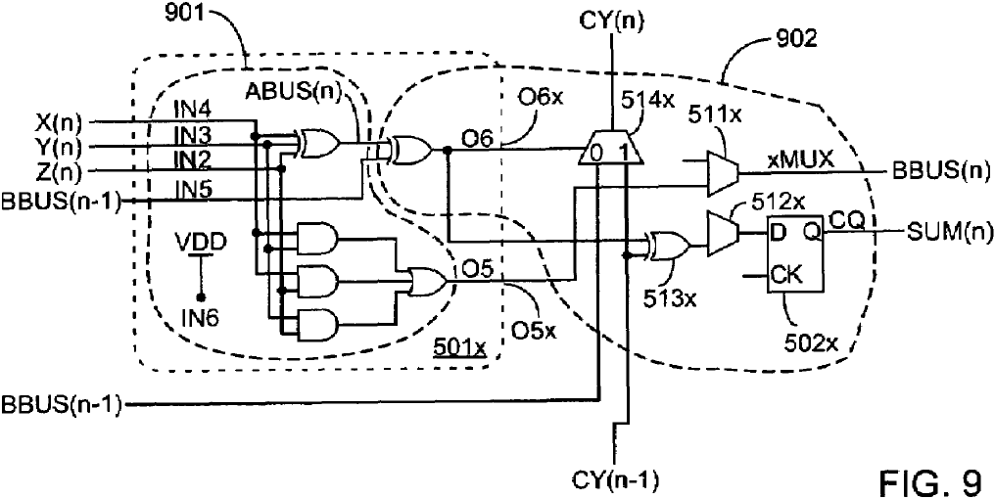
Proposed Method and Implementation
Adder Tree Parameters:
BAS (Base Adder Size): No. of the inputs of the adders used to generate the adder tree
Addition Parameters:
PV (Parallel Vectors): No. of the vectors being added in parallel in matrix addition
IR (Inputs Register): Whether to register the inputs of elements addition module (before addition), or not
US007274211B1 (patented by Xilinx, 2007) describes a method to implement ternary adders with that much resource needed by binary adders on Xilinx FPGAs (inspired by Carry-Save addition method)
[Xilinx, 2007]

Slide 23
Proposed Method and Implementation
Multiplication Parameters:
Q: No. of the columns of the right matrix for matrix multiplication
PR (Parallel Rows): No. of the rows of the (left) matrix being multiplied in parallel in matrix-vector/matrix multiplication
PC (Parallel Columns): No. of the rows of the right matrix being multiplied in parallel in matrix-matrix multiplication
MAMCS (Multiply-Add Maximum Component Size): Maximum size allowed for systolic dot-product element
MAMCS == 1 : Pure multiplication - adder tree implementation
MAMCS == NOEPS : Pure systolic implementation
1 < MAMCS < NOEPS : Hybrid of systolic and adder tree

Slide 24
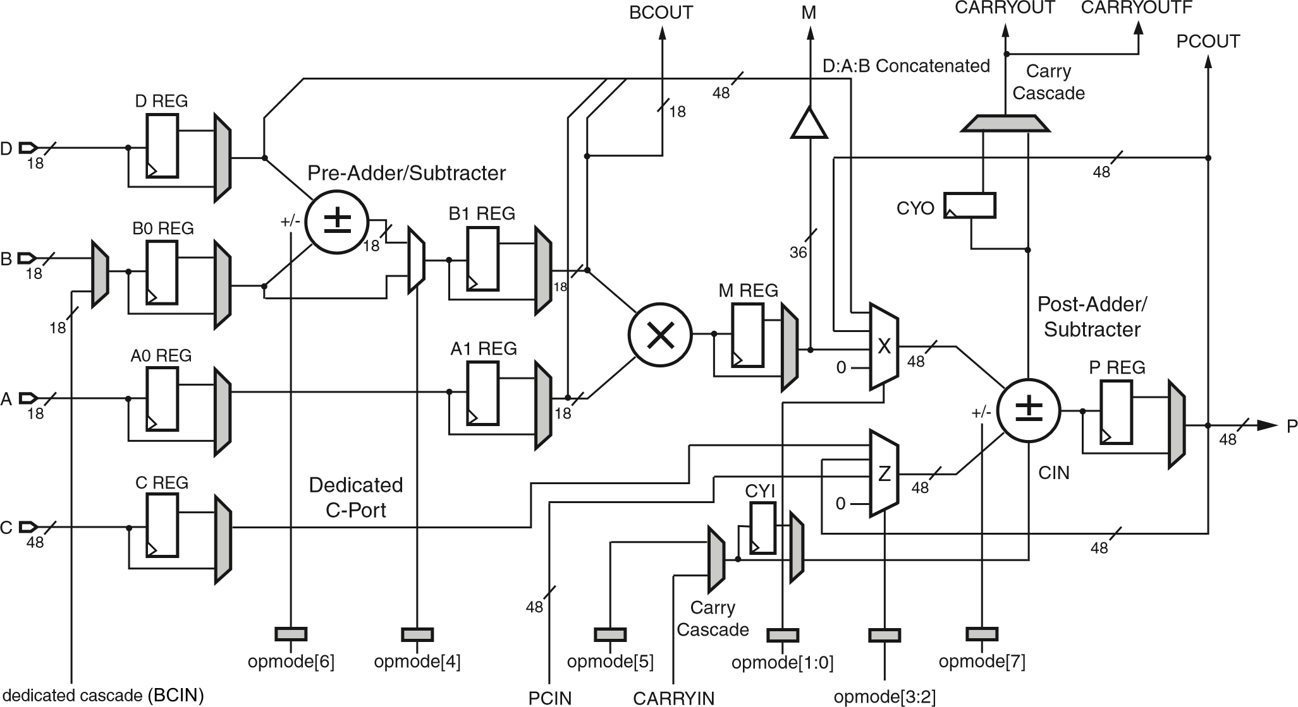
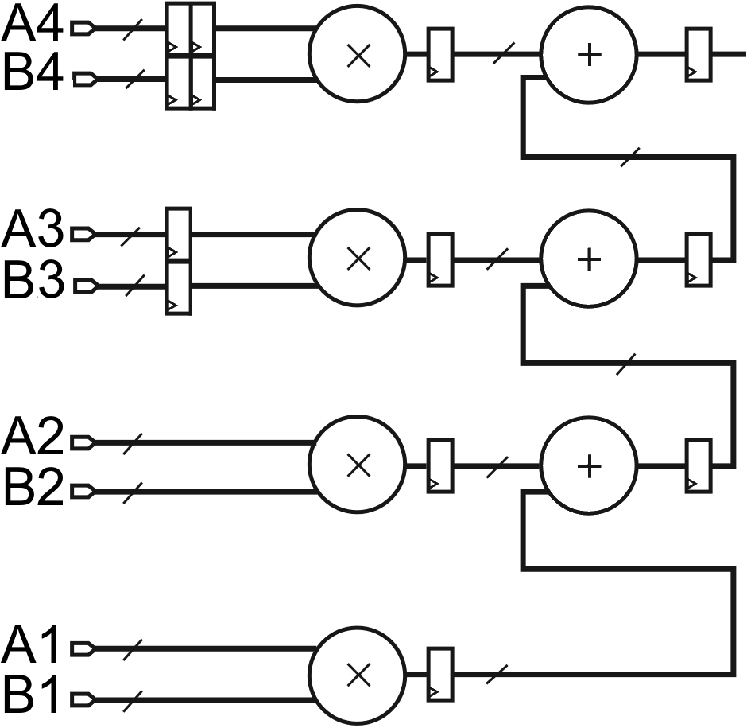
Proposed Method and Implementation
Multiplication Parameters:
VL (Vector Latch), CL (Column Latch) & VL (Row Latch): Whether to latch input element (the first time they are fed) so it not needed to feed them again, or not in matrix-vector/matrix multiplication
MULT_PIPE_DEPTH: No. of the register levels used at the output of DSP48 element multiplier (VP)
INPUT_REG_DEPTH: No. of the register levels used at the input of DSP48 element multiplier (VP)
Also used in systolic dot-product implementation
more than 2 level registers: implemented using distributed resources, maybe using Xilinx Shift Register LUT (SRL) elements

Slide 25
Proposed Method and Implementation
Modules
Common Modules:
RegisteredNto1Adderr_(N)IR: used in adder tree and vector / matrix addition
SItoSoE_N_HRxHRF_(N)IL_(N)OR: used to convert SoE input-mode modules to SI input-mode modules
Adder Tree Module:
AdderTree_N_ABAS
Addition Modules:
VectorAdd_N(_noHR)(_SNOEPSE)_(N)IR
VectorAdd_N_SI_HRxHRF_(N)IR_(N)IL
MatrixAdd_M_N_PV(_noHR)(_SNOEPSE)_(N)IR
MatrixAdd_M_N_PV_SI_HRxHRF_(N)IR_(N)IL

Slide 26
Proposed Method and Implementation
Multiplication Modules:
RegisteredMultiplier: used in dot-product modules
MultiplyAdd: used in DotProduct_Systolic_N module
DotProduct_Systolic_N: implementation of systolic form of dot-product mentioned before
DotProduct_N_noHR_M_ABAS
Moves Adder Tree synchronization registers to multipliers input if needed, so they are absorbed to multipliers input registers
DotProduct_N_noHR_CMAMCS_ABAS
DotProduct_N_SNOEPSE_HRxHRF_CMAMCS_ABAS
DotProduct_N_SI_HRxHRF_CMAMCS_ABAS_(N)IL

Slide 27
Proposed Method and Implementation
Multiplication Modules:
MatrixVectorMultiply_M_N_prPR_noHR_CMAMCS_ABAS_(N)VL
MatrixVectorMultiply_M_N_prPR_SNOEPSE_HRxHRF_CMAMCS _ABAS_(N)VL
MatrixVectorMultiply_M_N_prPR_SI_HRxHRF_CMAMCS_ABAS _(N)IL_(N)VL_(N)MR
MatrixMatrixMultiply_M_N_Q_prPR_pcPC_noHR_CMAMCS_ABAS _(N)CL_(N)RL
MatrixMatrixMultiply_M_N_Q_prPR_pcPC_SNOEPSE_HRxHRF _CMAMCS_ABAS_(N)CL_(N)RL
MatrixMatrixMultiply_M_N_Q_prPR_pcPC_SI_HRxHRF_CMAMCS _ABAS_(N)IL_(N)CL_(N)RL_(N)MR

Slide 28
Results
Generator script
Asks user to select the target module
Asks them the range of input general parameters
Chooses all or a random set of parameters based on user choice
Generates the project (Verilog files)
Generates simulation needed files (Verilog test fixture with random input data, simulation script) and simulates the project (optional)
Generates synthesis and implementation needed files and scripts (for a possible selected target device) and synthesizes the project (optional)
Parses resulted report files, saves some of the simulation and Implementation resulted values (e.g., max clock frequency) to a database (optional)

Slide 29
Results
Register-packed generator script
A script which can pack the top module of the project to a set of input and output registers, so input and output (possibly bottleneck) combinational paths are accounted in the maximum clock frequency calculation process
Results
Selected module: MatrixMatrixMultiply_SI
Ranges of input parameters:
General: {M: [5, 10], N: [5, 10], Q: [5, 10], PR: [1, 10], PC: [1, 10], HRF: [2, 10], MAMCS: [1, 5], BAS: [2, 3], IL: [0, 1], CL: [0, 1], RL: [0, 1], MR': [0, 1]} → 2003904 possible combinations
Verilog: {IN_WIDTH: [10, 20], INPUT_REG_DEPTH: [0, 1], MULT_PIPE_DEPTH: [0, 1]} → 44 possible combinations

Slide 30
Results
Results
2000 randomly chosen general parameters combinations (projects), 2 randomly chosen Verilog parameters combinations for each, totally 4000 combinations
Target Device: xc6slx150-3-fgg900
Biggest Device is Spartan 6 Family
180 DSP48A1s, 92152 Slice LUTs, 184304 Slice Registers
All the combinations were simulated and synthesized
All The simulation results were correct
Synthesize: both bare (for resources usage (area) calculations) and register-packed (for timing (speed) calculations)
The results were saved in a database, then analyzed and used to generate the following charts …

Slide 31
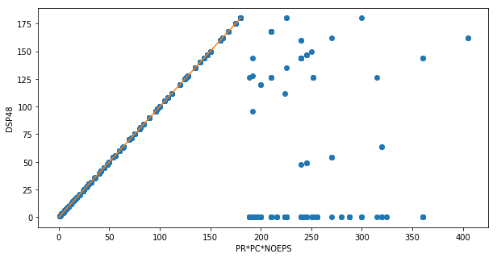
Results
PR: Parallel Rows
PC: Parallel Columns
NOEPS: No. Of Element Per Series
Y=X
For the following charts, the 148 cases which needed more than 180 DSP48s are removed, 3852 cases remained

Slide 32
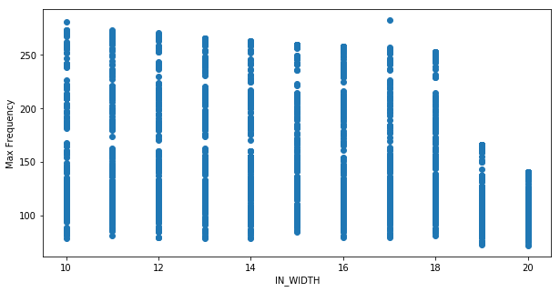
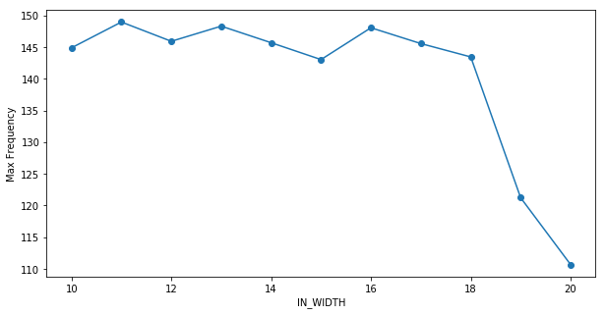
Results

Slide 33
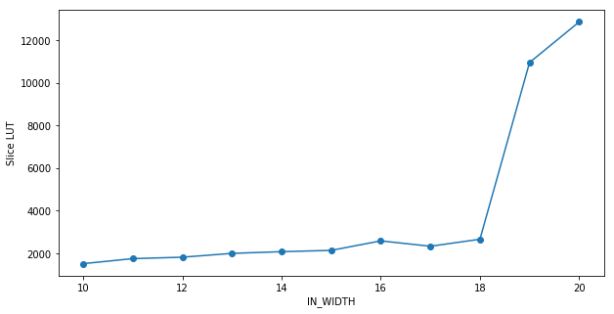
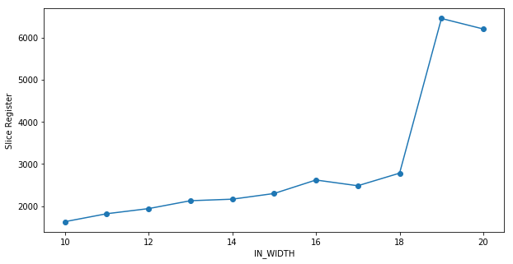
Results

Slide 34
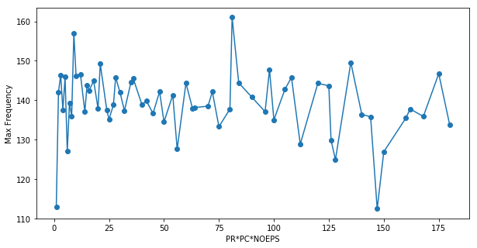
Results
PR: Parallel Rows
PC: Parallel Columns
NOEPS: No. Of Element Per Series
the module is scalable in terms of performance

Slide 35
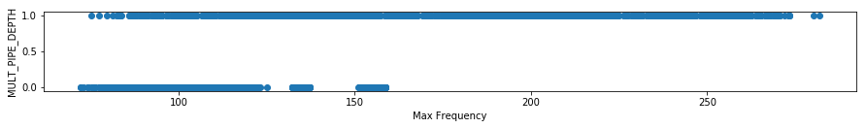
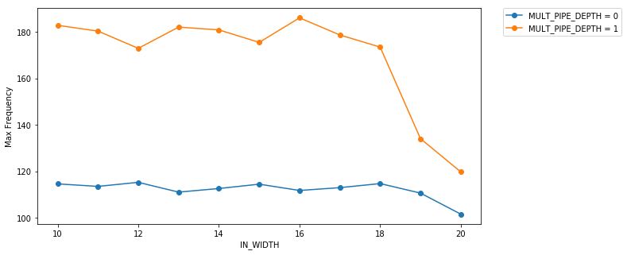
Results

Slide 36
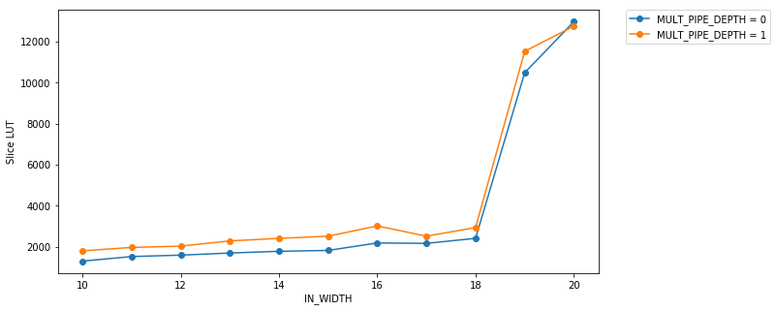
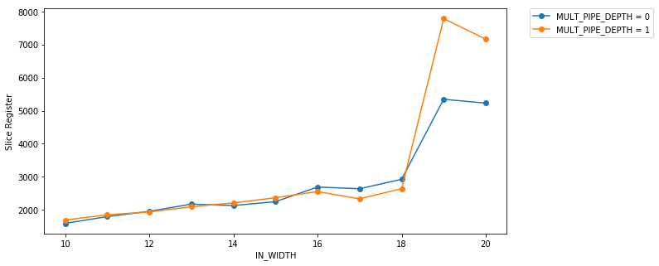
Results

Slide 37
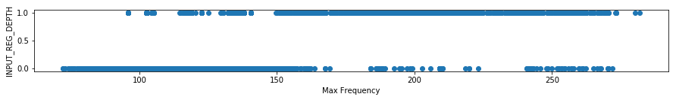
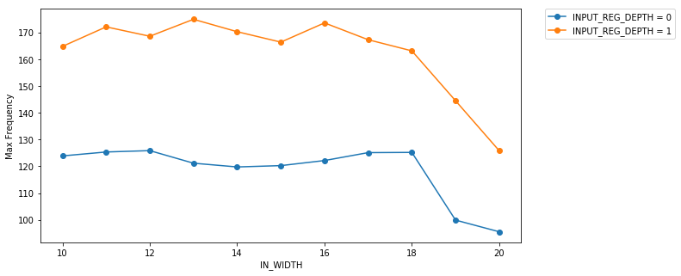
Results

Slide 38
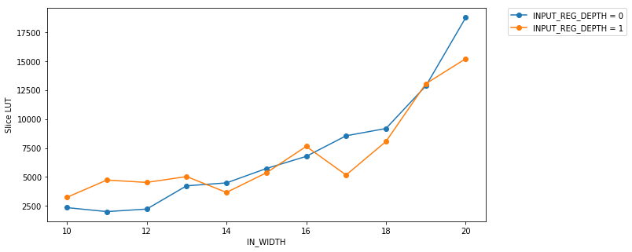
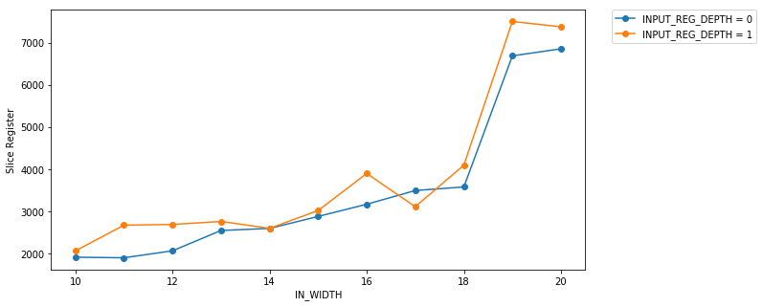
Results

Slide 39

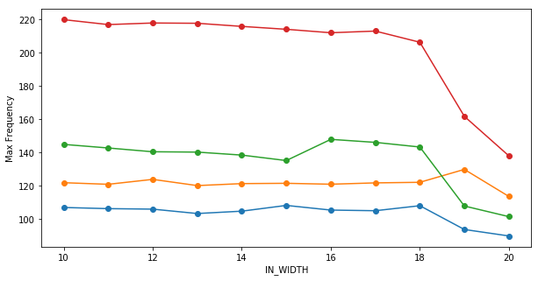
Results

Slide 40
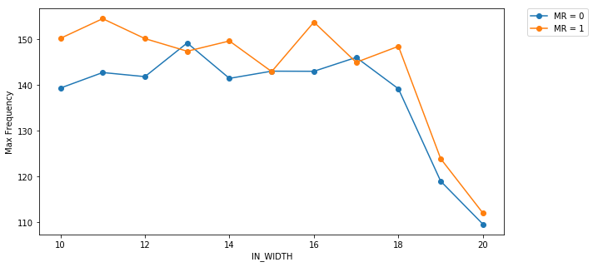
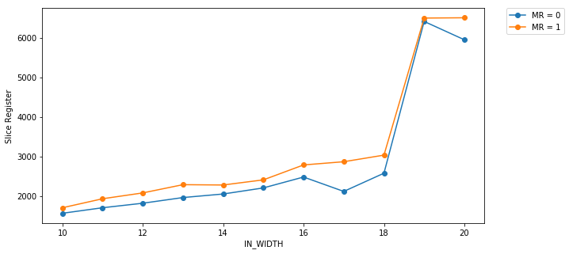
Results
MR:
Multiplexer Registers
Note:
Negligible impact on Slice LUT

Slide 41
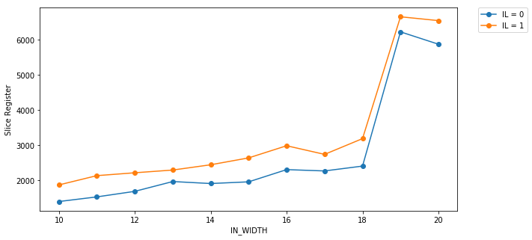
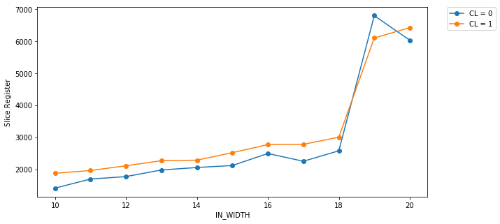
Results
IL:
Inputs Latch
Note:
Negligible impact on Slice LUT
CL:
Column Latch
Note:
Negligible impact on Slice LUT

Slide 42
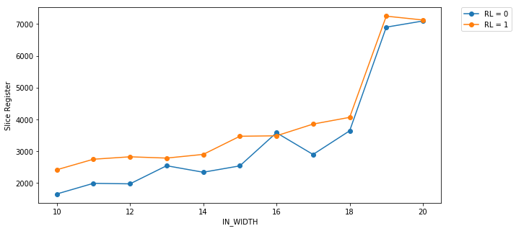
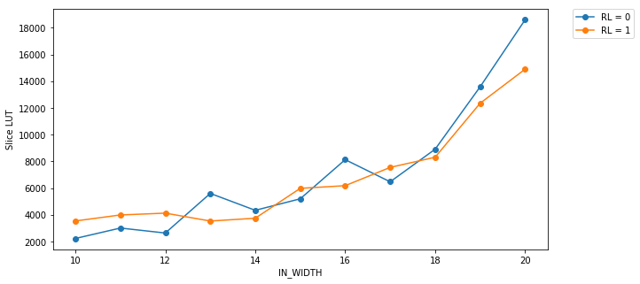
Results
RL:
Row Latch

Slide 43
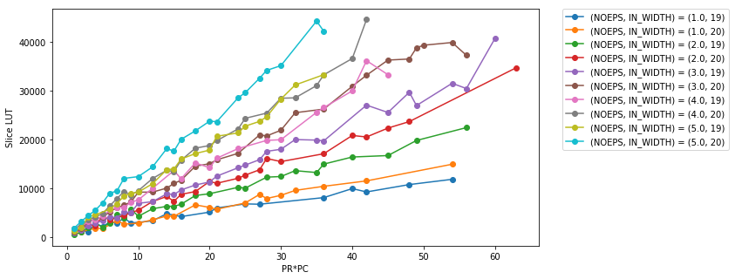
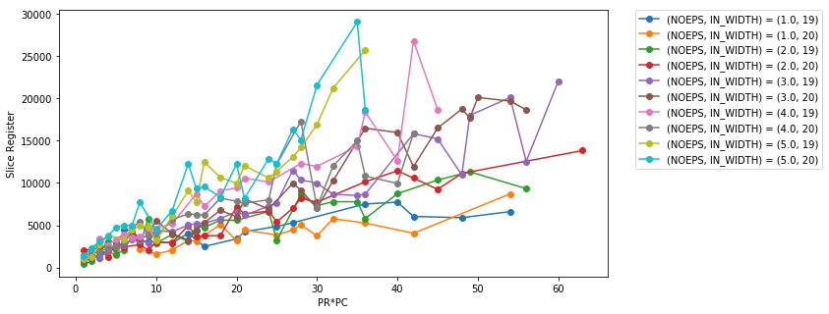
Results
PR: Parallel Rows
PC: Parallel Columns
NOEPS: No. Of Element Per Series
IN_WIDTH≥ 19 :
710 cases

Slide 44
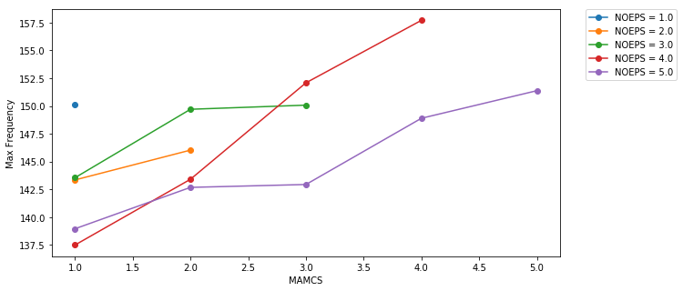
Results
For the following charts, the 710 cases with IN_WIDTH≥ 19 are removed, 3142 cases remained
MAMCS: Multiply-Add Maximum Component Size
NOEPS: No. Of Element Per Series

Slide 45
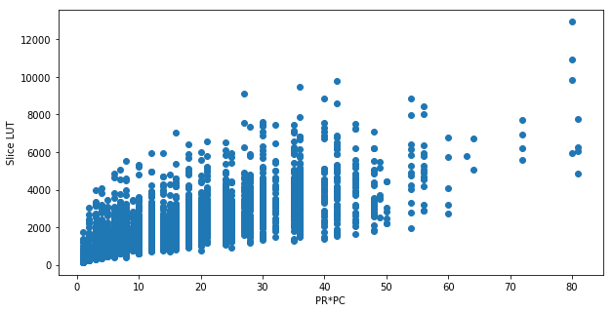
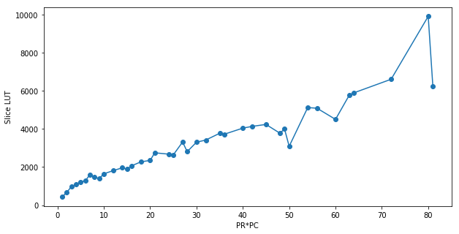
Results
PR: Parallel Rows
PC: Parallel Columns

Slide 46
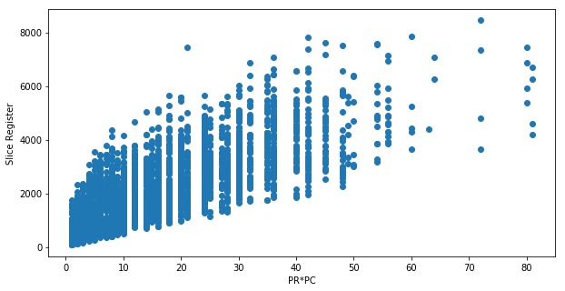
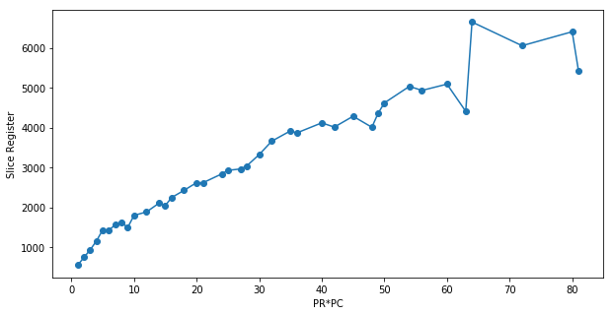
Results
PR: Parallel Rows
PC: Parallel Columns

Slide 47


Results
PR: Parallel Rows
PC: Parallel Columns

Slide 48


Results
PR: Parallel Rows
PC: Parallel Columns
NOEPS: No. Of Element Per Series

Slide 49


Results
PR: Parallel Rows
PC: Parallel Columns

Slide 50


Results
PR: Parallel Rows
PC: Parallel Columns

Slide 51


Results
PR: Parallel Rows
PC: Parallel Columns

Slide 52

Results
For the following charts, only the 76 cases with these conditions (in addition to previous conditions) are remained: IN_WIDTH=15, MR=0, IL=0, CL=0, RL=0
Y=X
Linear regression:
Coefficient (C): 11.80
Score: 0.85
PR: Parallel Rows
PC: Parallel Columns

Slide 53

Results
Y=X
Linear regression:
Coefficient (C): 8.09
Score: 0.95
PR: Parallel Rows
PC: Parallel Columns

Slide 54
Summary
There is an emerging need to use FPGAs for performing vector and matrix addition and calculation
In this thesis, we implemented a parametric and scalable RTL toolbox for the mentioned calculations
We will document the toolbox and release it as an open-source project

Slide 55
Future Work
Optimizing the architecture
Allowing different input widths for the second vector / matrix
Using Multiple dsp48s for multiplies bigger than 18 bit * 18 bit
Implementing pipeline adders and accumulator if needed
Optimizing the controller if needed
Simplifying the module generation process
Finding (better) methods for resource usage and timing estimations
Expanding the toolbox to a more complete Linear Algebra toolbox

Slide 56
References
T.-H. Choi, "Floating-point Matrix-Vector Multiplication Using Reconfigurable System," University of Tennessee, Knoxville, Tennessee, USA, 2003.
A. M. Sheth, "Sparse matrix product implementation on field programmable gate arrays (EPGAS)," New Jersey Institute of Technology, Newark, New Jersey, USA, 2003.
M. deLorimier, "Floating-Point Sparse Matrix-Vector Multiply for FPGAs," California Institute of Technology, Pasadena, California, USA, 2005.
L. Zhuo, "High-performance linear algebra on reconfigurable computing systems," University of Southern California, Los Angeles, California, USA, 2007.
R. Kendrick and M. Moukarzel, "Sparse Matrix Multiplication on a Field-Programmable Gate Array," Worcester Polytechnic Institute, Worcester, Massachusetts, USA, 2007.
J. Sun, "High Performance Reconfigurable Computing for Linear Algebra: Design and Performance Analysis," University of Tennessee, Knoxville, Tennessee, USA, 2008.
W. Zhang, "Portable and Scalable FPGA-Based Acceleration of a Direct Linear System Solver," University of Toronto, Toronto, Canada, 2008.
R. Dorrance, F. Ren and D. Marković, "A Scalable Sparse Matrix-Vector Multiplication Kernel for Energy-Efficient Sparse-Blas on FPGAs," in FPGA '14 Proceedings of the 2014 ACM/SIGDA international symposium on Field-programmable gate arrays, Monterey, California, USA, 2014.

Slide 57
References
"High Performance Computing and Data Storage," Xilinx Inc., [Online]. Available at: http://www.xilinx.com/applications/high-performance-computing.html
“GPU vs FPGA Performance Comparison,” BertenDSP, (2016), [White Paper]. Available at: http://www.bertendsp.com/pdf/whitepaper/BWP001_GPU_vs_FPGA_Performance_Comparison_v1.0.pdf
“Deep Learning with INT8 Optimization on Xilinx Devices,” Xilinx Inc., (2016), [White Paper]. Available at: https://www.xilinx.com/support/documentation/white_papers/wp486-deep-learning-int8.pdf
" New Pascal GPUs Accelerate Inference in the Data Center," Nvidia Corporation, (2016), [Online]. Available at: https://devblogs.nvidia.com/new-pascal-gpus-accelerate-inference-in-the-data-center/
“Spartan-6 FPGA DSP48A1 Slice,” Xilinx corporation, [User Guide]. Available at: https://www.xilinx.com/support/documentation/user_guides/ug389.pdf
Xilinx Inc., (2007), “Structures and Methods For Implementing Ternary Adders/Subtractors in Programmable Logic Devices,” US 7,274,211 B1

Slide 58
Thanks For Your Attention!
Any Questions?

Slide 59

The moon has her light all over the sky, her dark spots to herself.
Rabindranath Tagore

