Slide 1
Subject S012 ECG Data Processing Summary
Generated on 2024-08-30 15:21:12

Slide 2
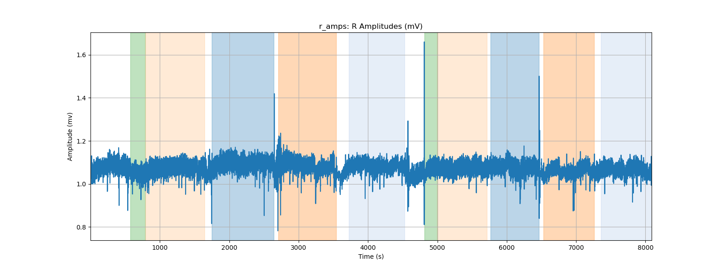
r_amps: R Amplitudes (mV)

Slide 3
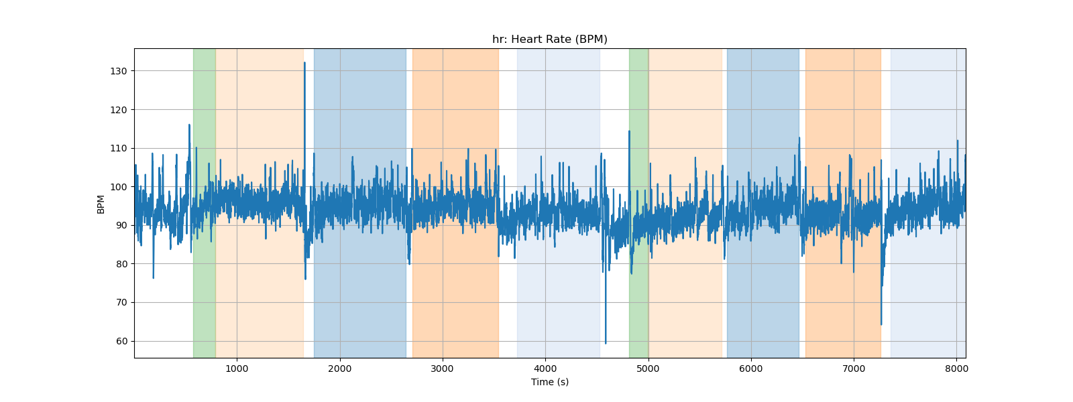
hr: Heart Rate (BPM)

Slide 4
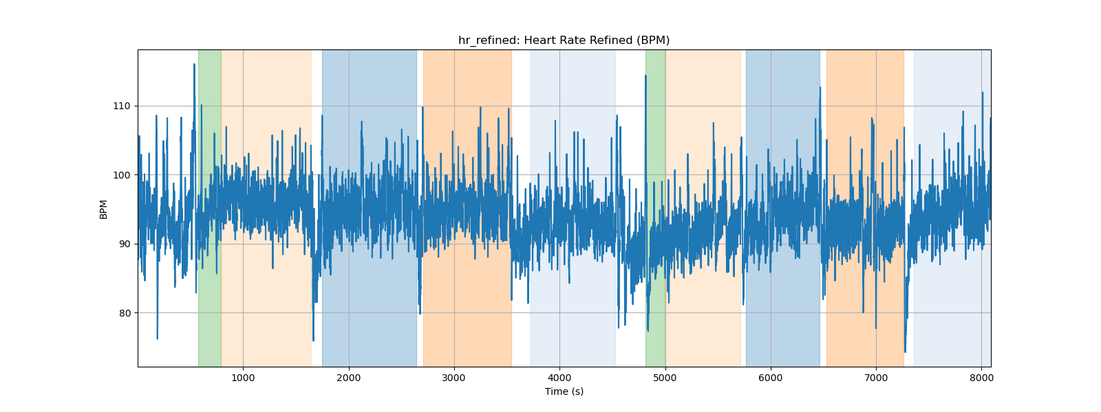
hr_refined: Heart Rate Refined (BPM)

Slide 5
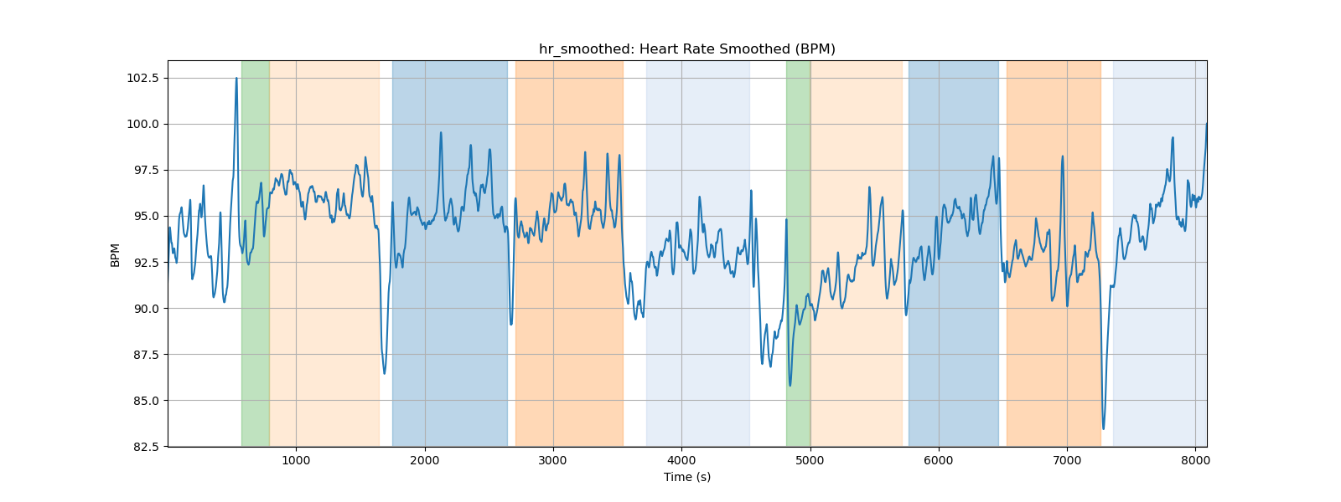
hr_smoothed: Heart Rate Smoothed (BPM)

Slide 6
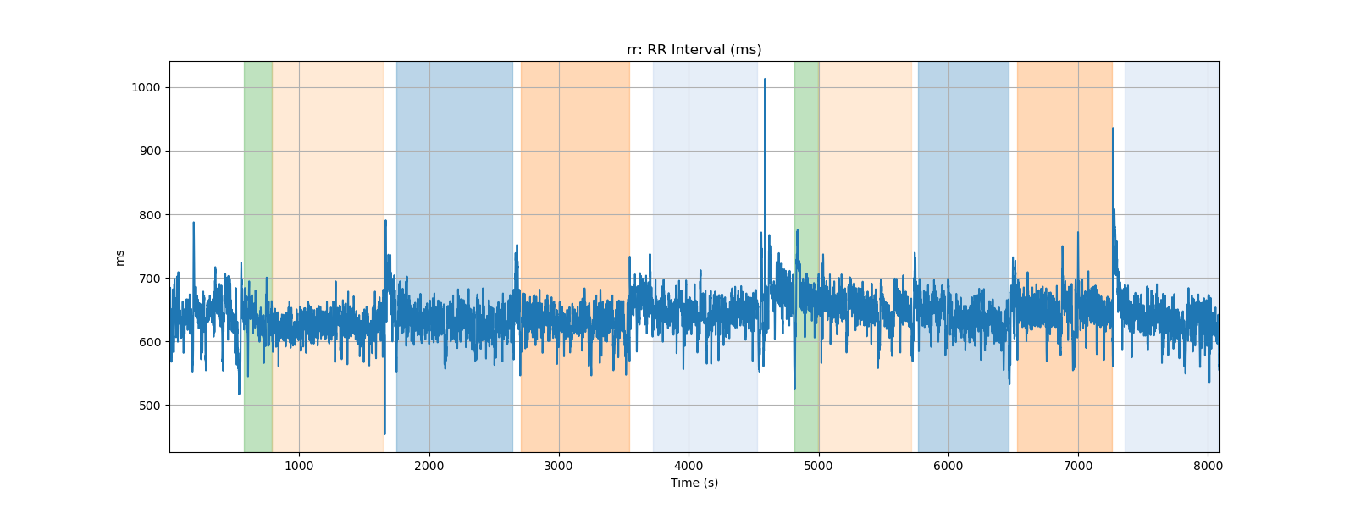
rr: RR Interval (ms)

Slide 7
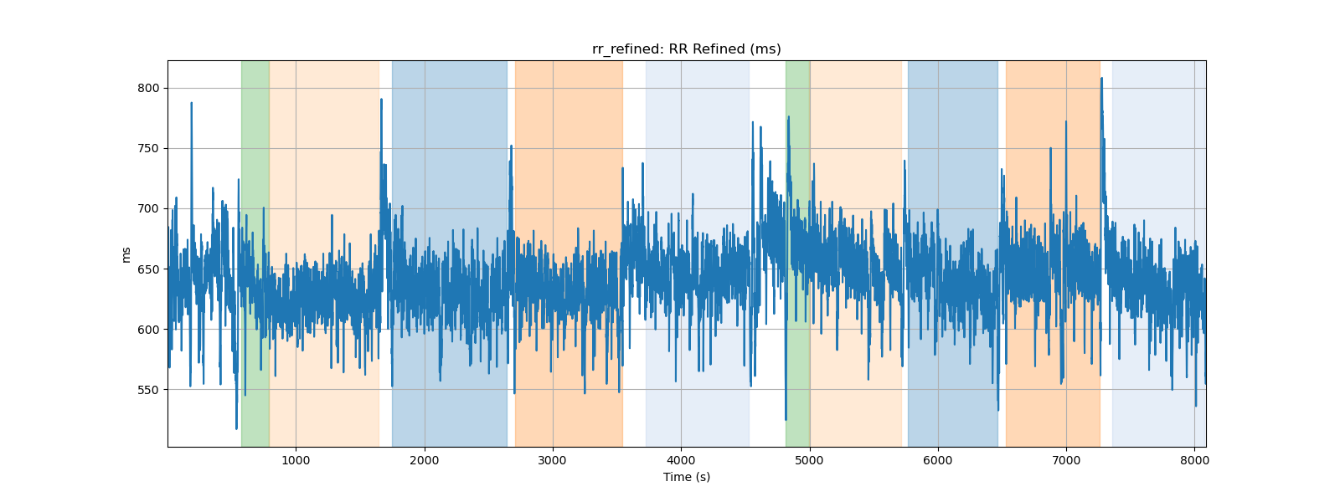
rr_refined: RR Refined (ms)

Slide 8
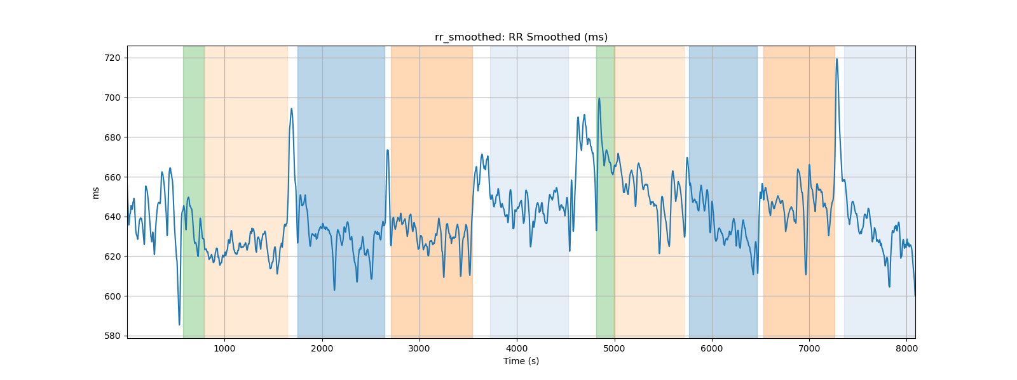
rr_smoothed: RR Smoothed (ms)

Slide 9
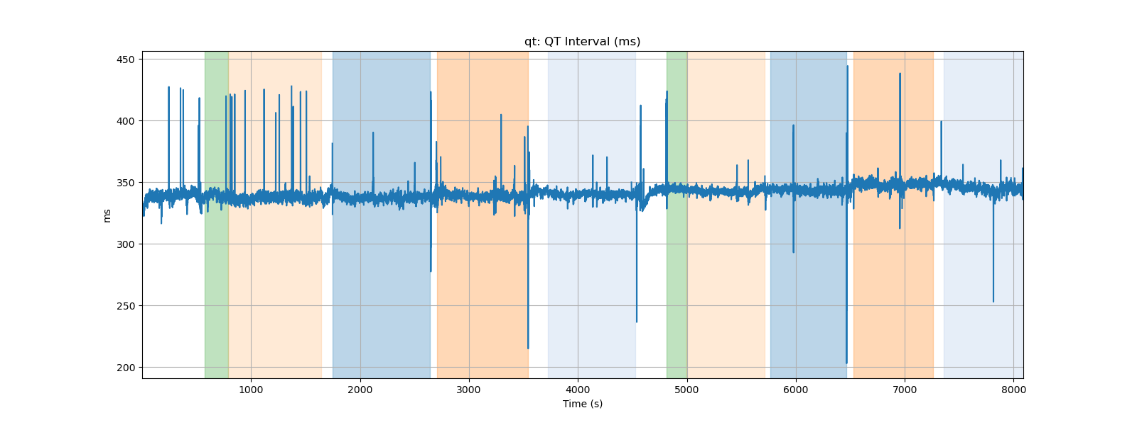
qt: QT Interval (ms)

Slide 10
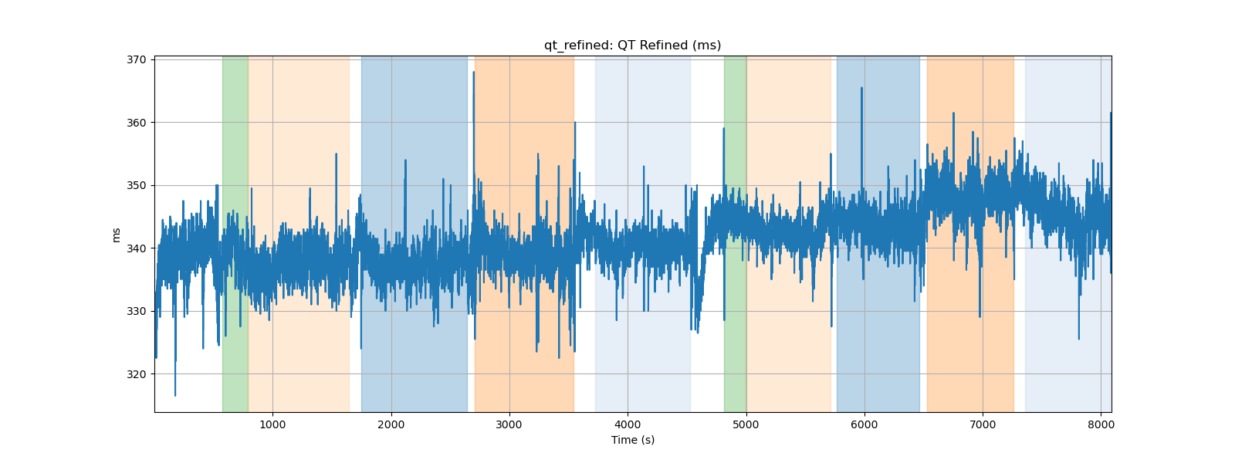
qt_refined: QT Refined (ms)

Slide 11
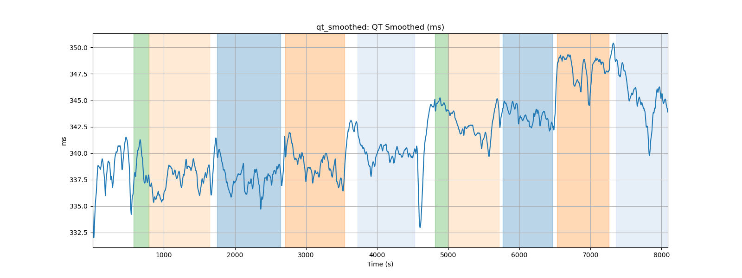
qt_smoothed: QT Smoothed (ms)

Slide 12
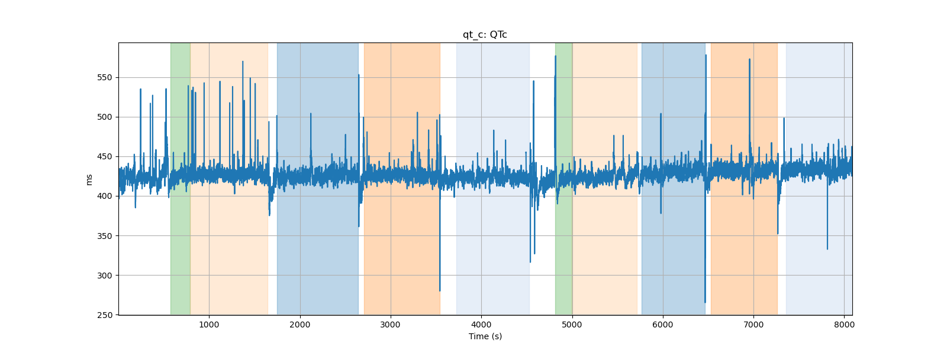
qt_c: QTc

Slide 13
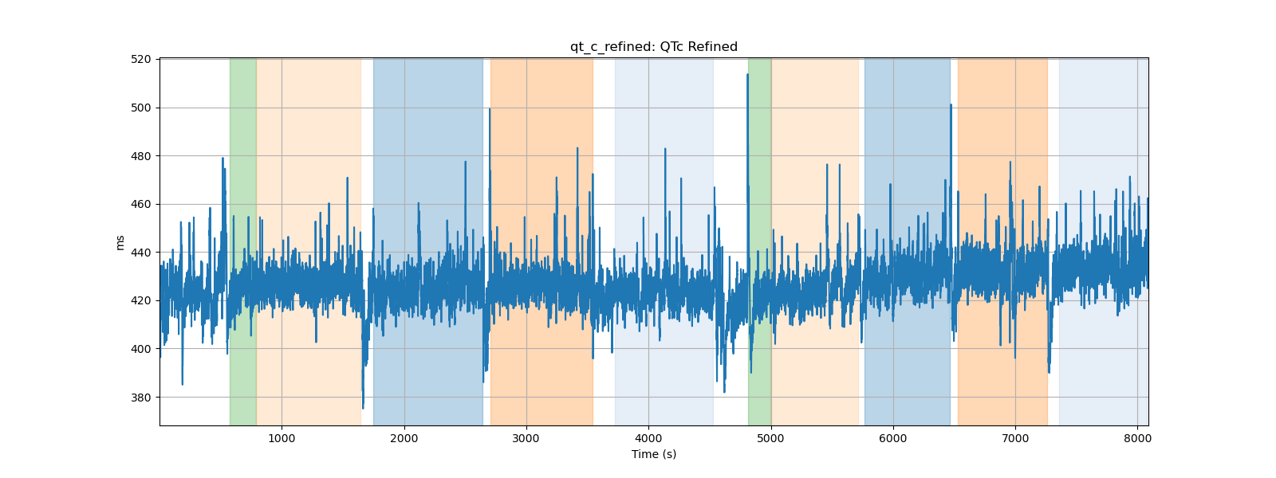
qt_c_refined: QTc Refined

Slide 14
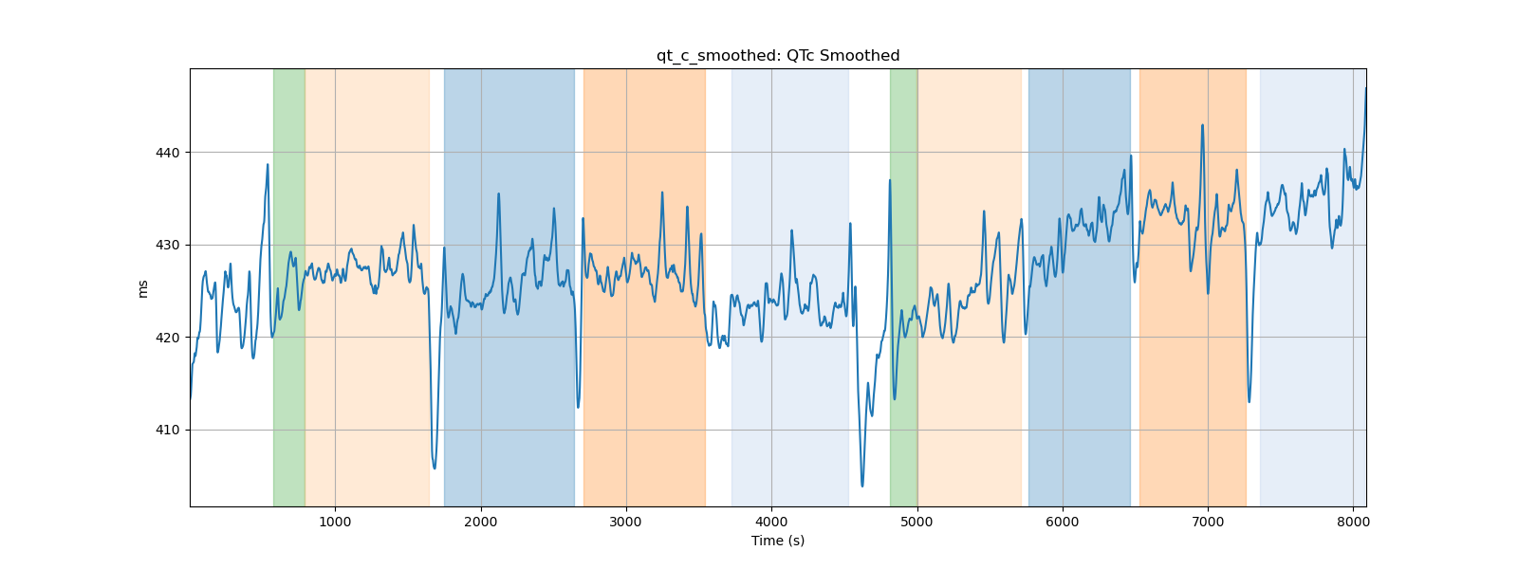
qt_c_smoothed: QTc Smoothed

Slide 15
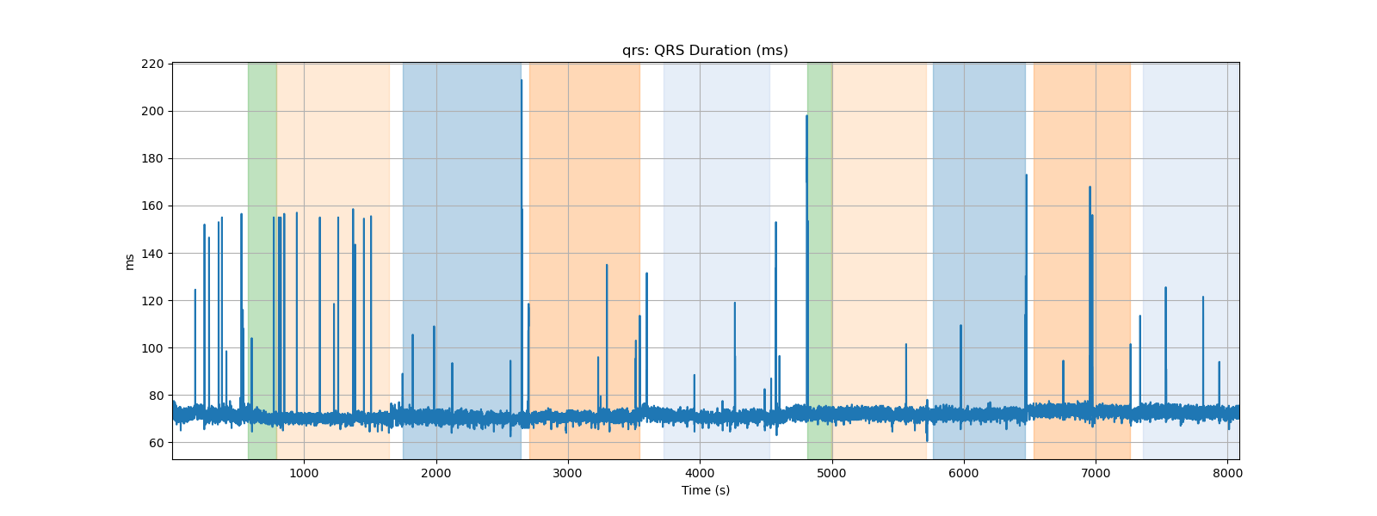
qrs: QRS Duration (ms)

Slide 16
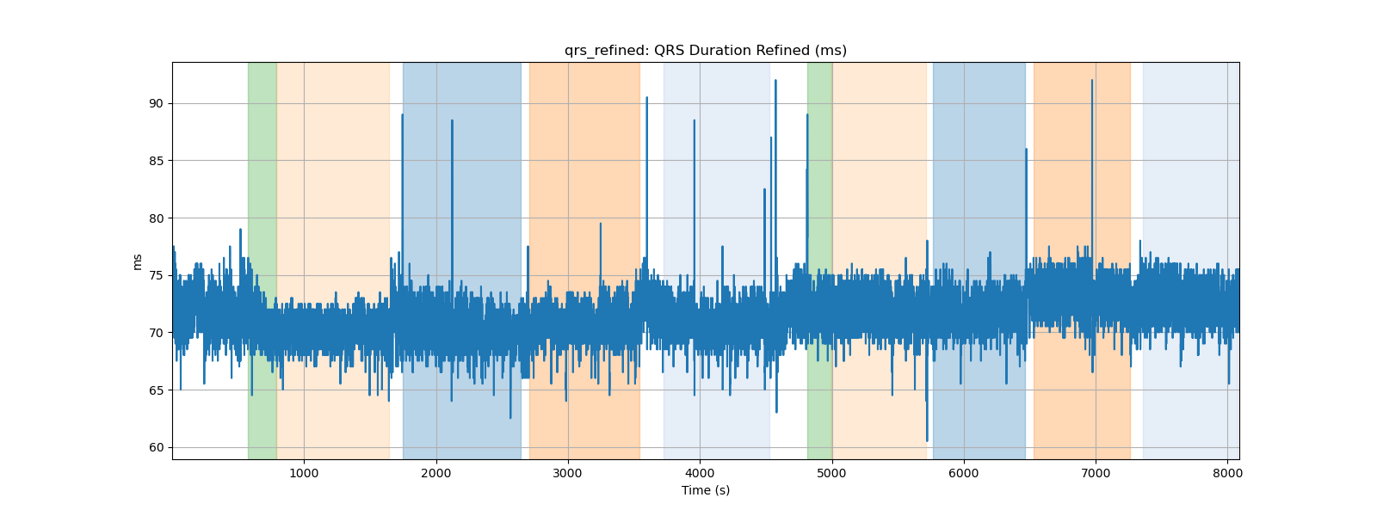
qrs_refined: QRS Duration Refined (ms)

Slide 17
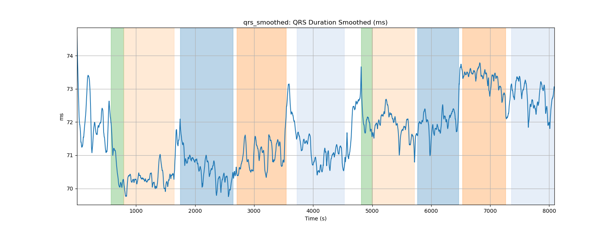
qrs_smoothed: QRS Duration Smoothed (ms)

Slide 18
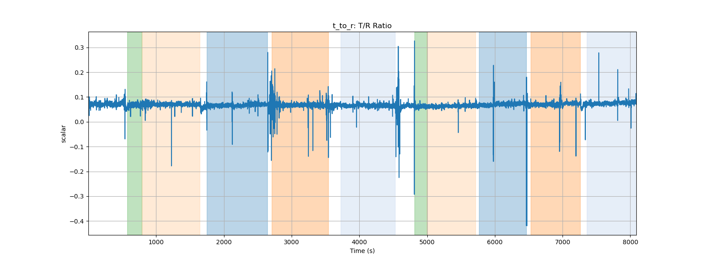
t_to_r: T/R Ratio

Slide 19
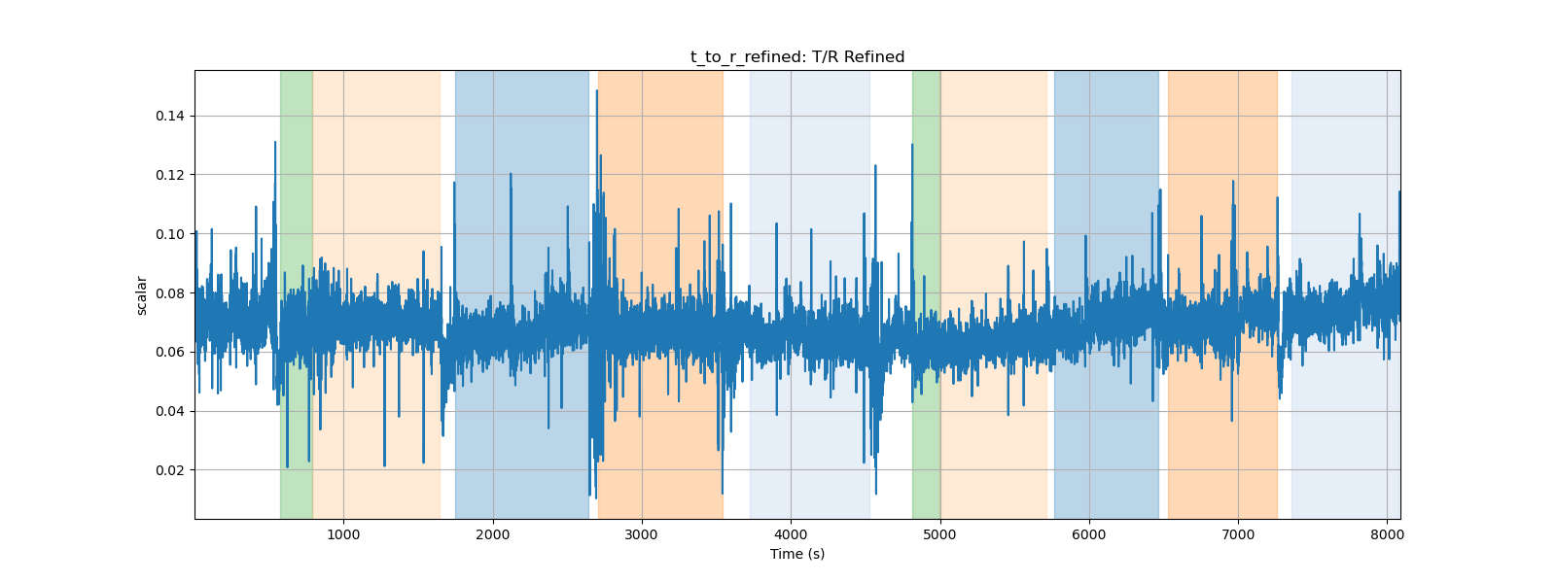
t_to_r_refined: T/R Refined

Slide 20
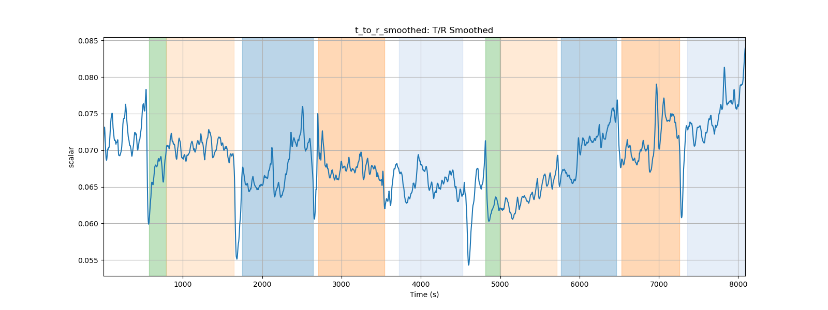
t_to_r_smoothed: T/R Smoothed

Slide 21
Subject P000007 PPG Data Processing Summary
Generated on 2024-08-30 15:21:15

Slide 22
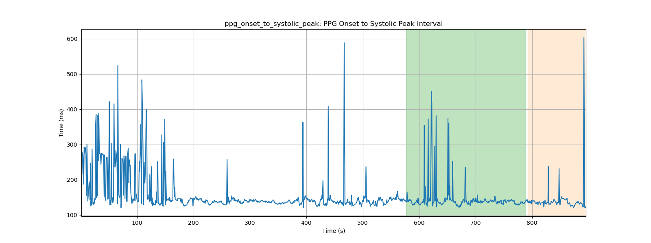
ppg_onset_to_systolic_peak: PPG Onset to Systolic Peak Interval

Slide 23
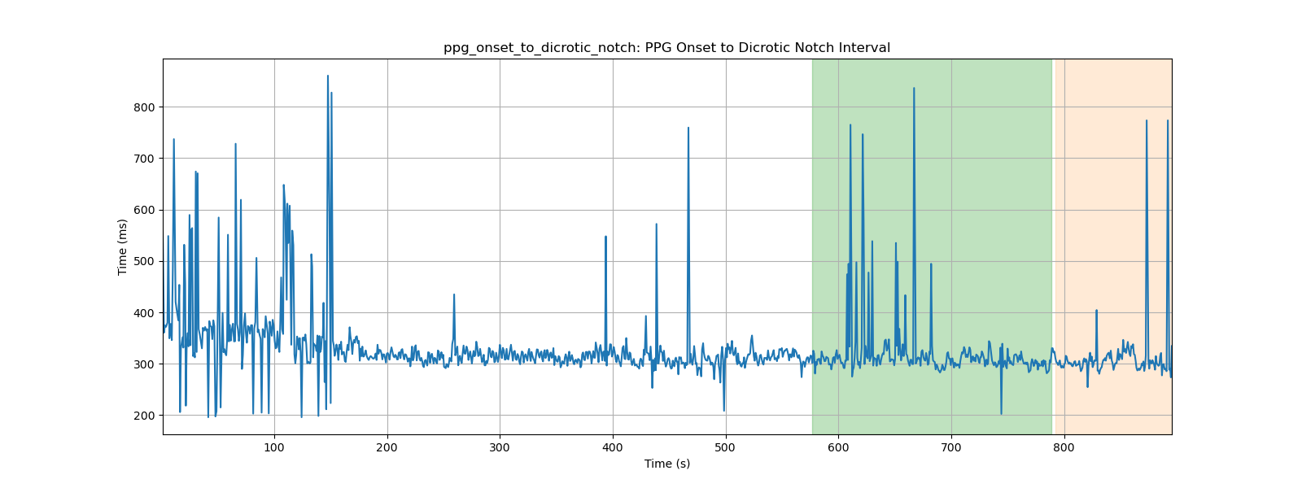
ppg_onset_to_dicrotic_notch: PPG Onset to Dicrotic Notch Interval

Slide 24
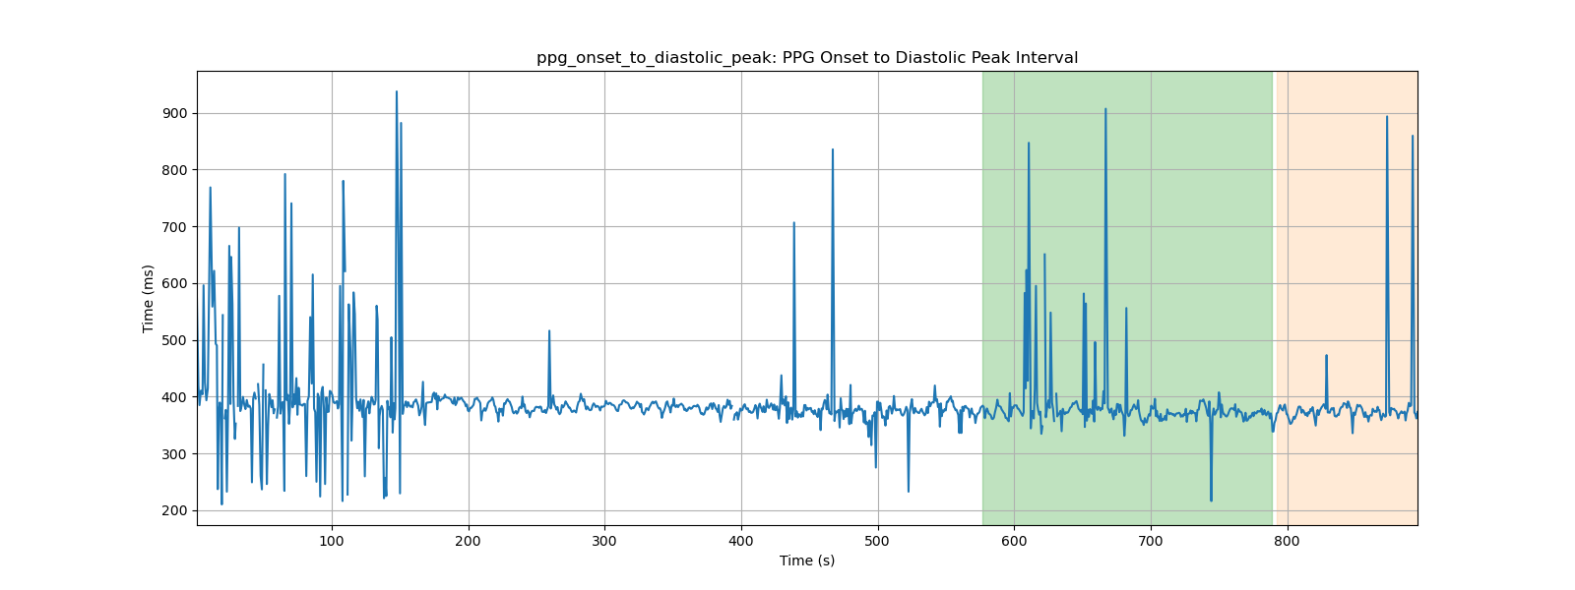
ppg_onset_to_diastolic_peak: PPG Onset to Diastolic Peak Interval

Slide 25
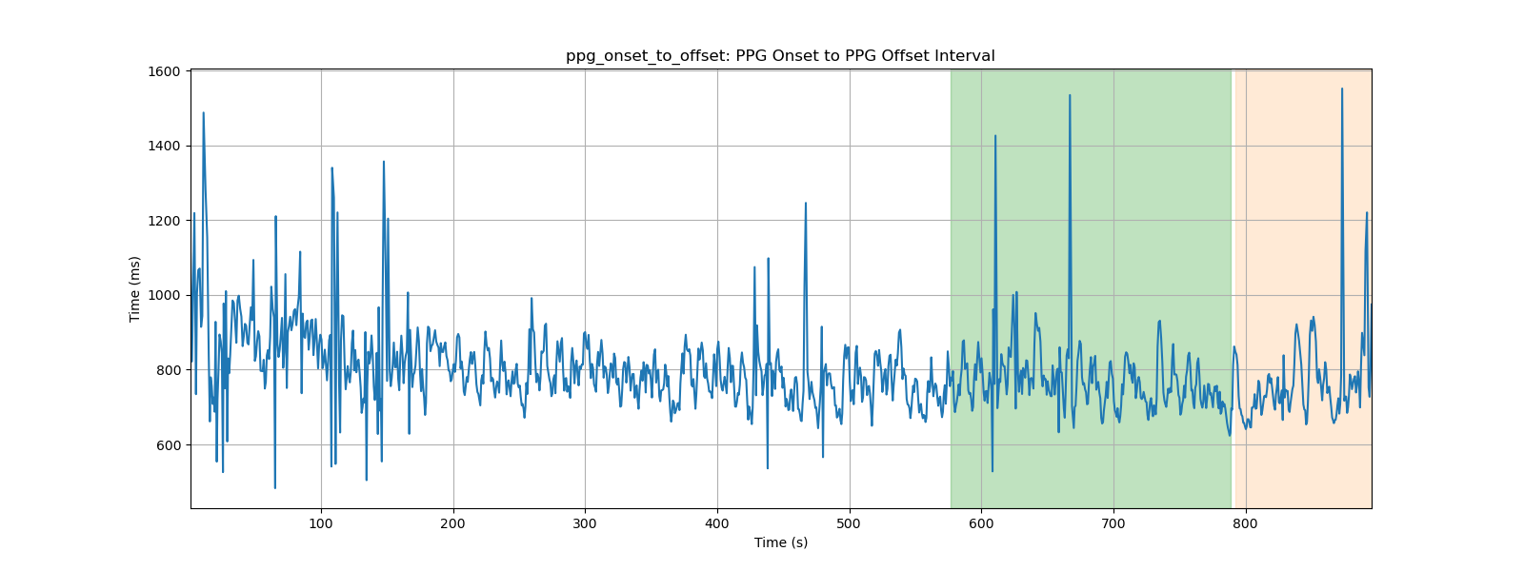
ppg_onset_to_offset: PPG Onset to PPG Offset Interval

Slide 26
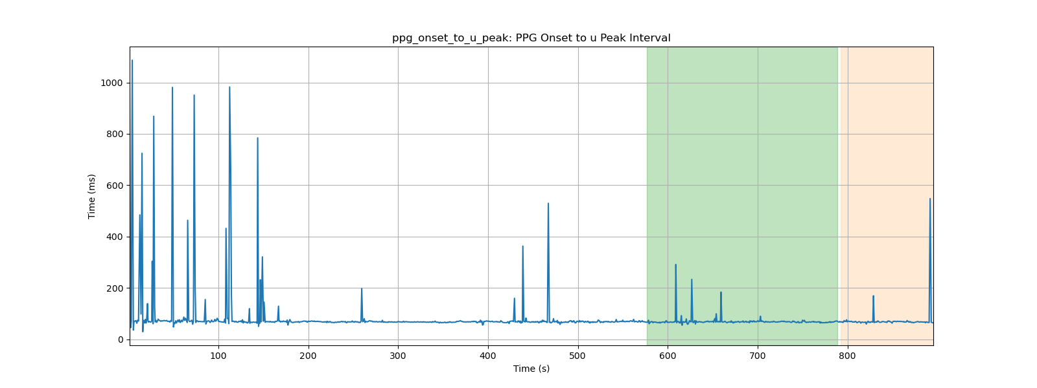
ppg_onset_to_u_peak: PPG Onset to u Peak Interval

Slide 27
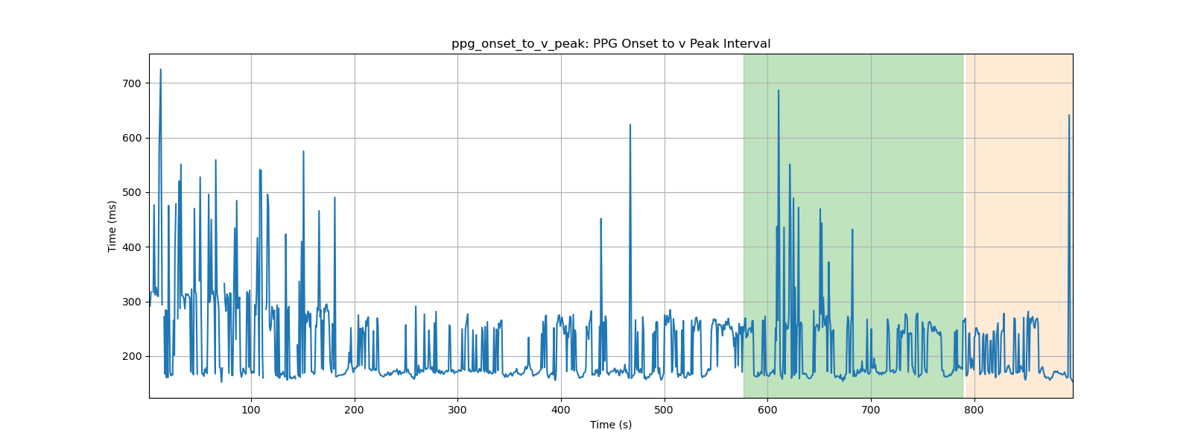
ppg_onset_to_v_peak: PPG Onset to v Peak Interval

Slide 28
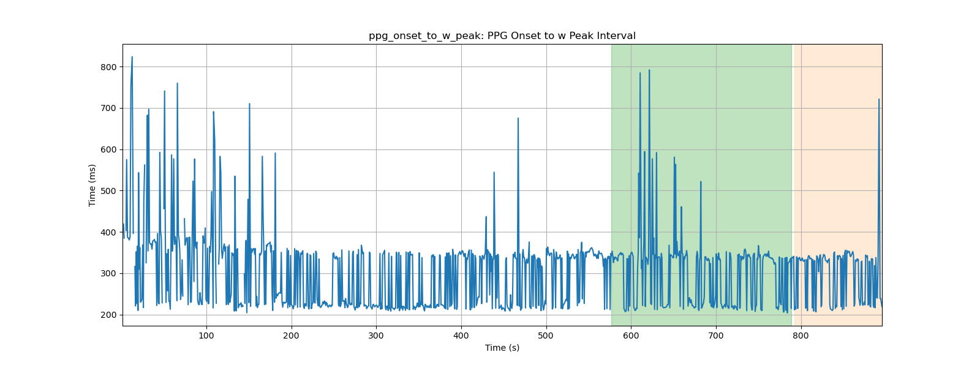
ppg_onset_to_w_peak: PPG Onset to w Peak Interval

Slide 29
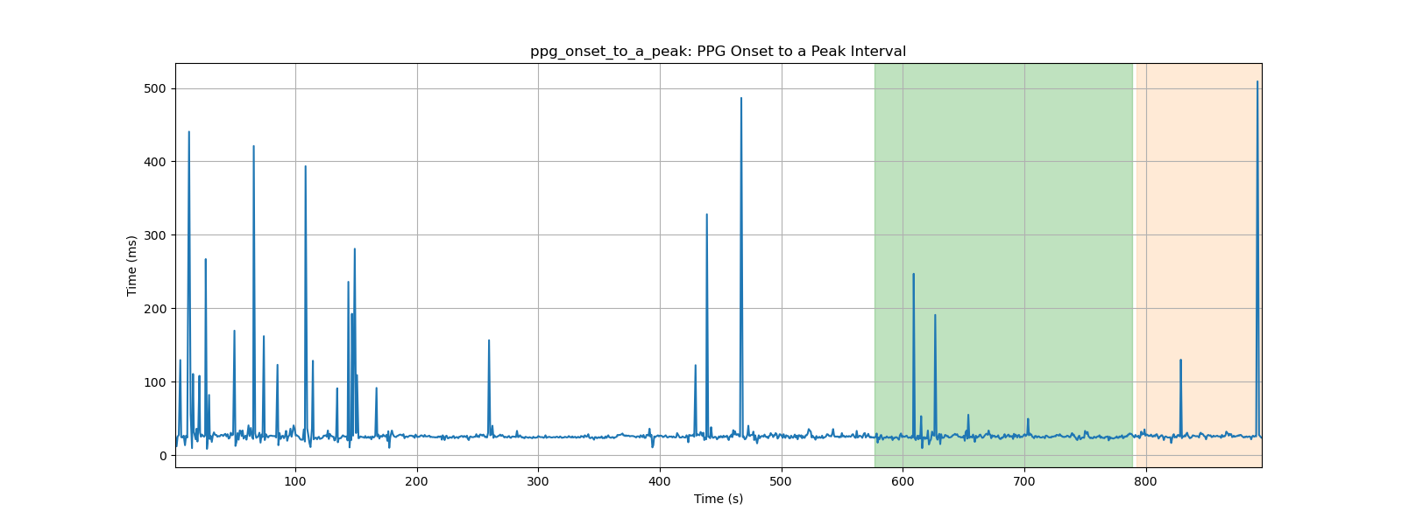
ppg_onset_to_a_peak: PPG Onset to a Peak Interval

Slide 30
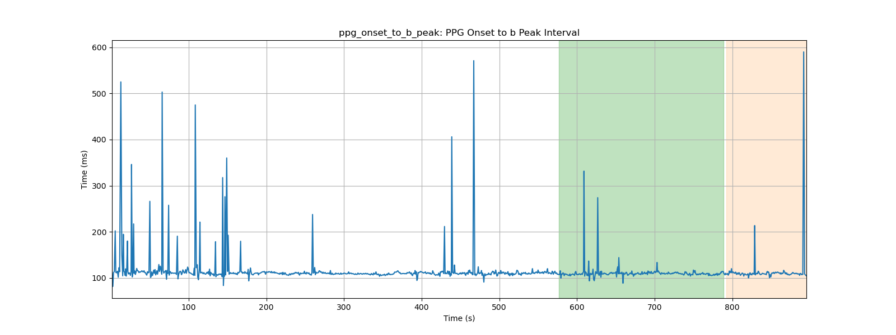
ppg_onset_to_b_peak: PPG Onset to b Peak Interval

Slide 31
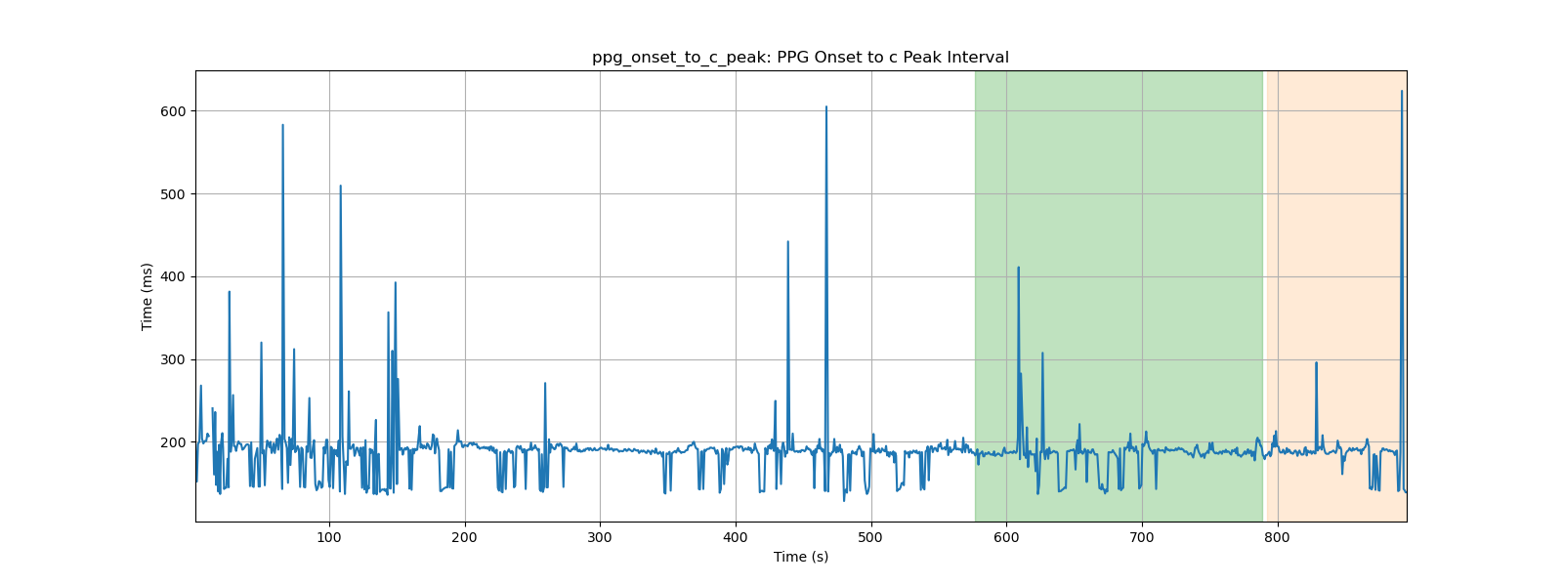
ppg_onset_to_c_peak: PPG Onset to c Peak Interval

Slide 32
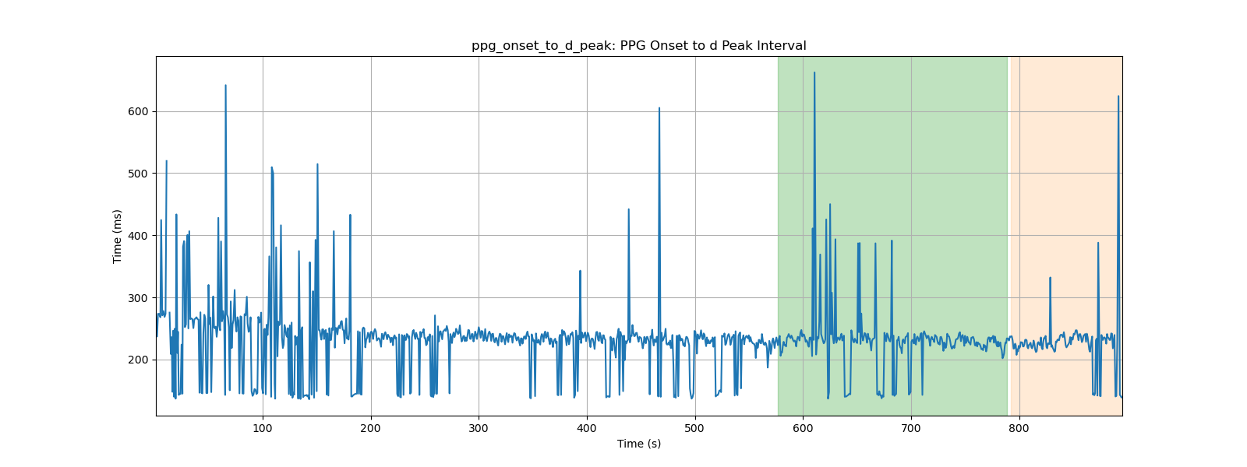
ppg_onset_to_d_peak: PPG Onset to d Peak Interval

Slide 33
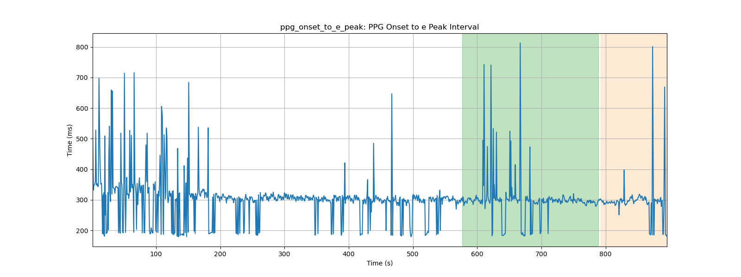
ppg_onset_to_e_peak: PPG Onset to e Peak Interval

Slide 34
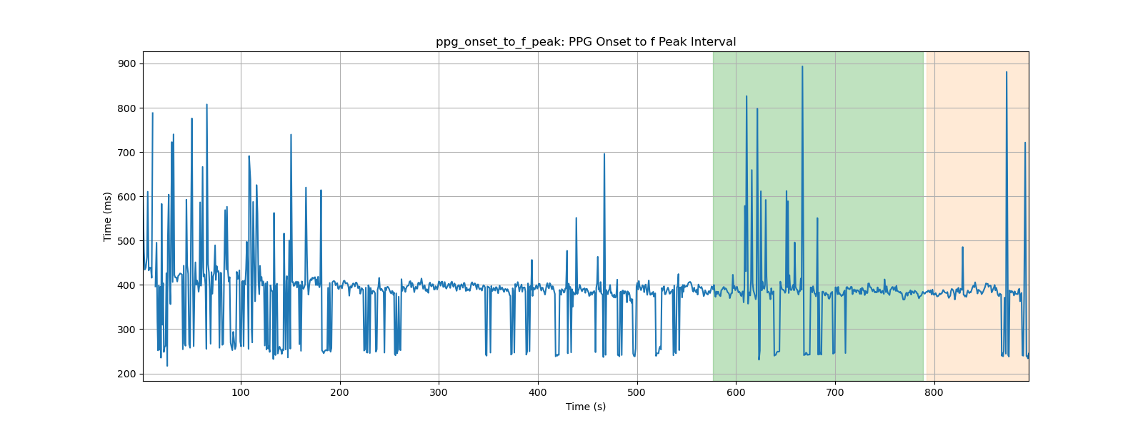
ppg_onset_to_f_peak: PPG Onset to f Peak Interval

Slide 35
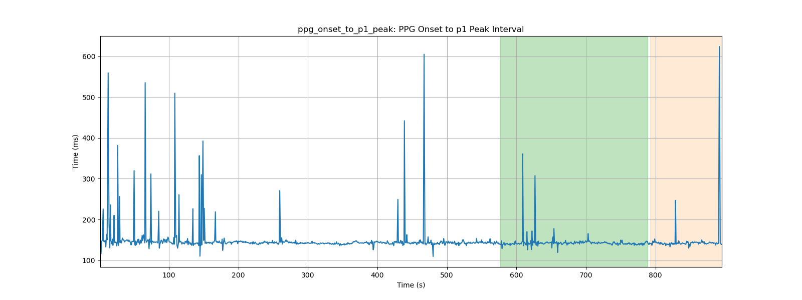
ppg_onset_to_p1_peak: PPG Onset to p1 Peak Interval

Slide 36
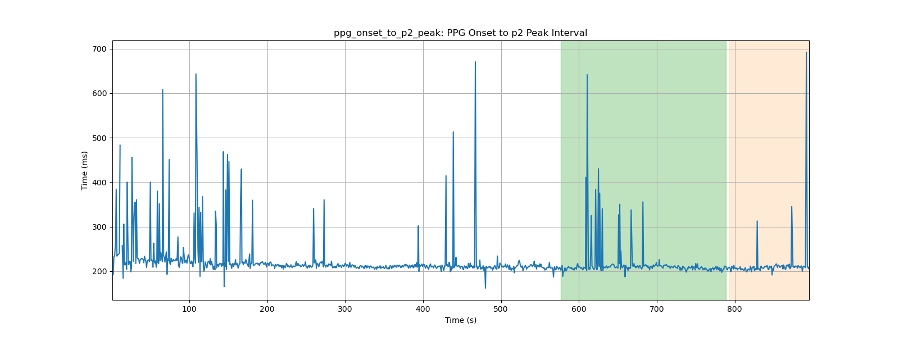
ppg_onset_to_p2_peak: PPG Onset to p2 Peak Interval

