Slide 1
Subject S012 ECG Data Processing Summary
Generated on 2024-09-01 23:23:21

Slide 2
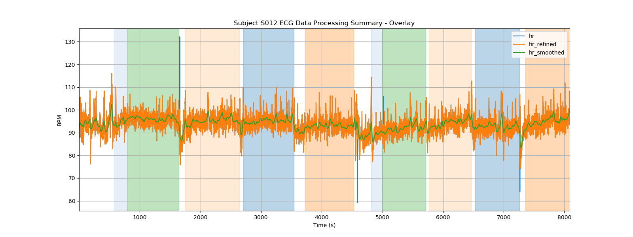
Subject S012 ECG Data Processing Summary - Overlay

Slide 3
Subject S012 ECG Data Processing Summary
Generated on 2024-09-01 23:23:21

Slide 4
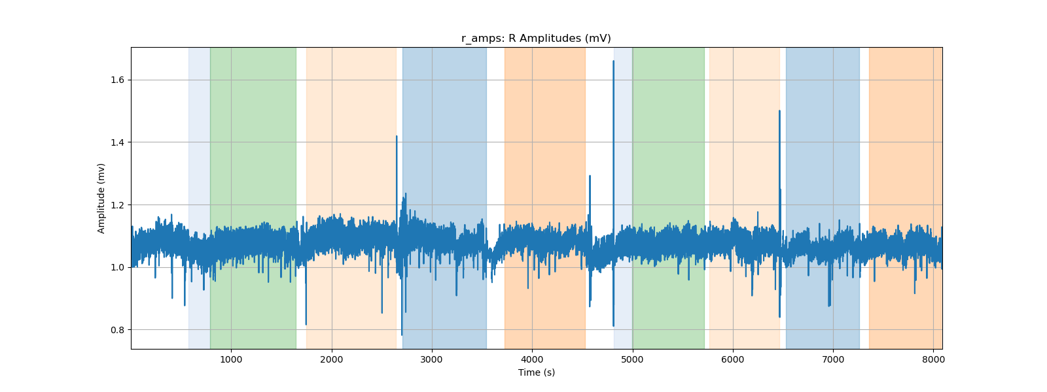
r_amps: R Amplitudes (mV)

Slide 5
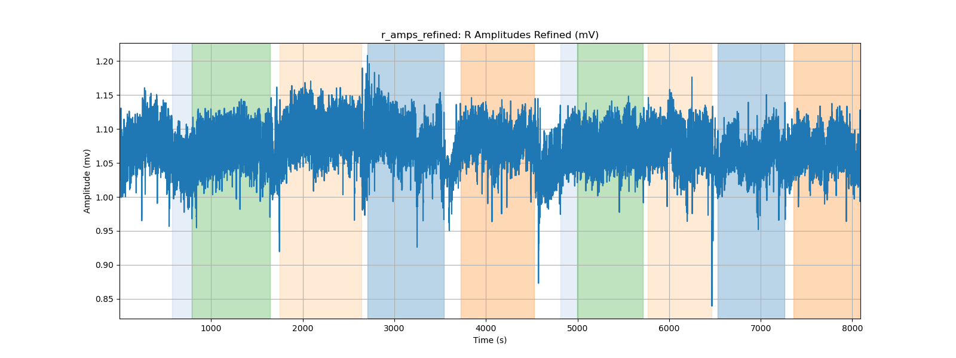
r_amps_refined: R Amplitudes Refined (mV)

Slide 6
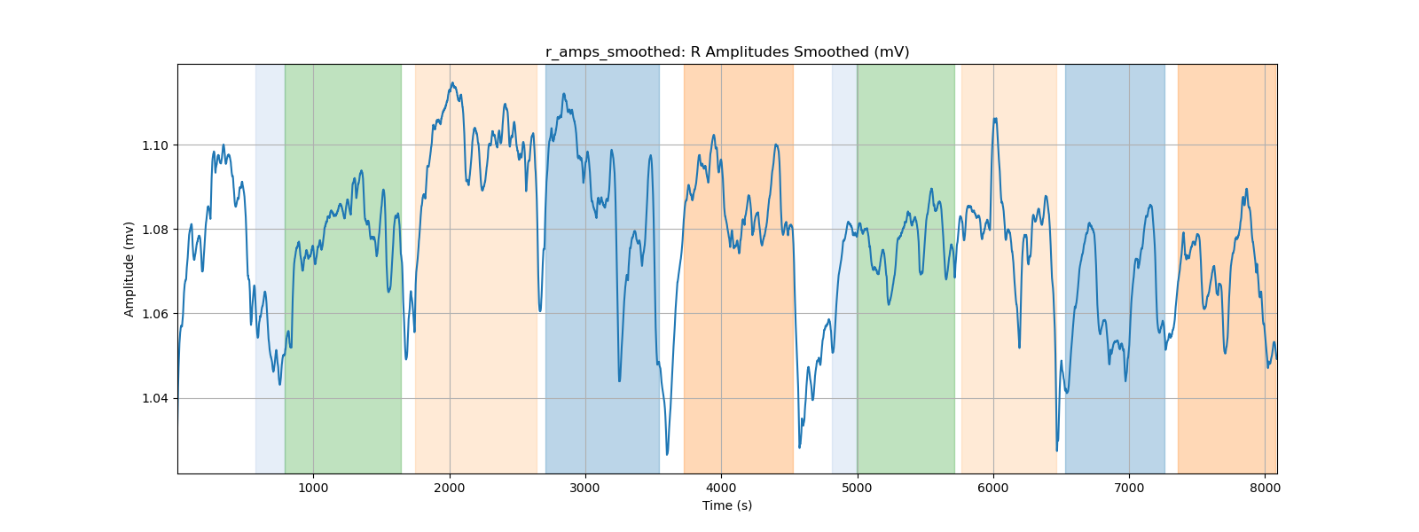
r_amps_smoothed: R Amplitudes Smoothed (mV)

Slide 7
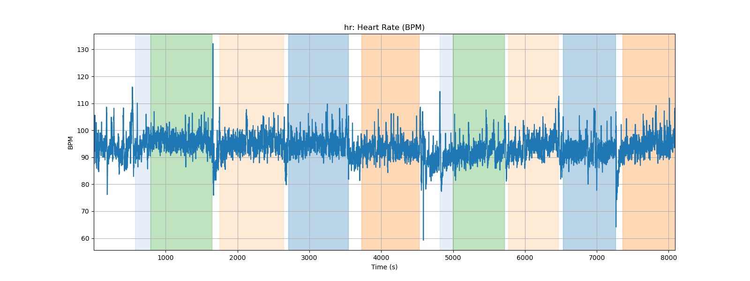
hr: Heart Rate (BPM)

Slide 8
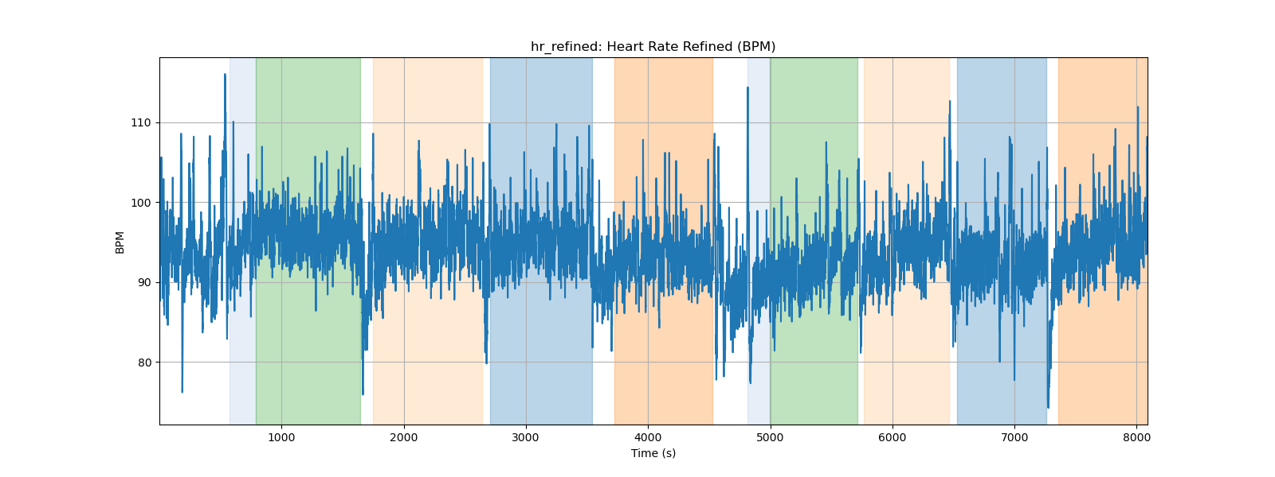
hr_refined: Heart Rate Refined (BPM)

Slide 9
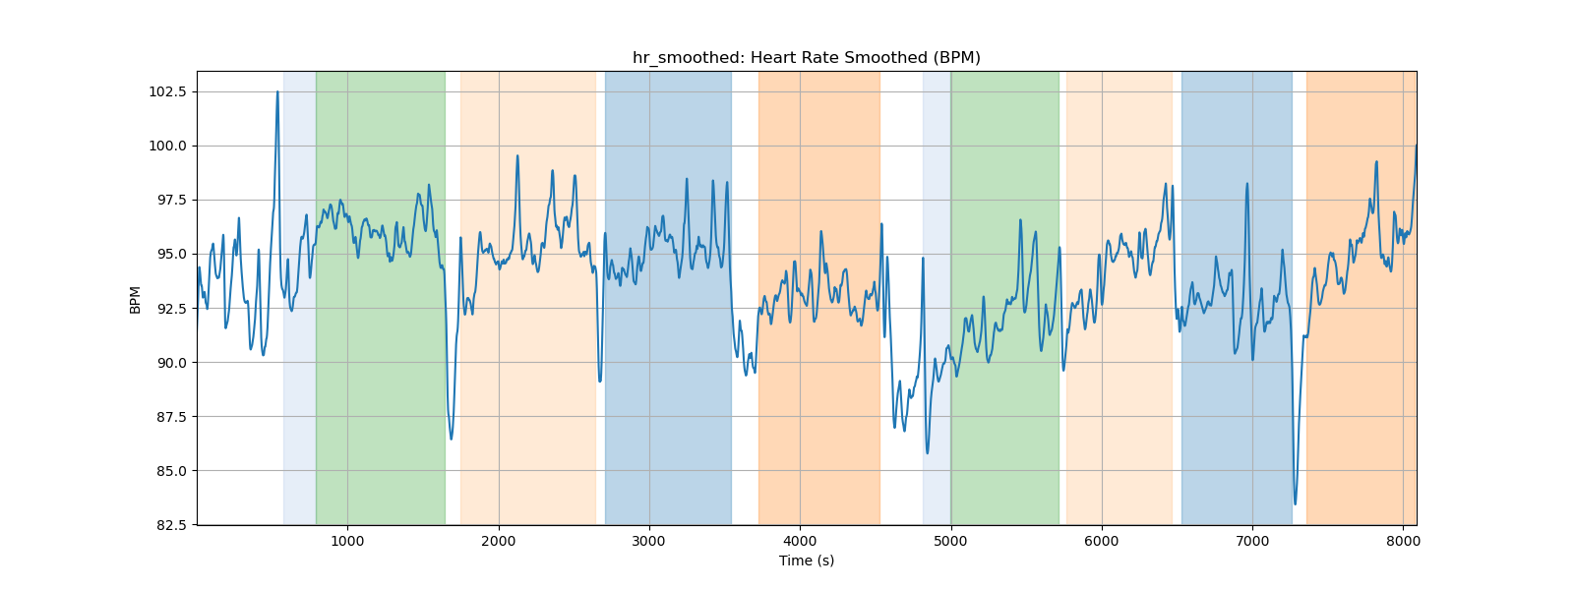
hr_smoothed: Heart Rate Smoothed (BPM)

Slide 10
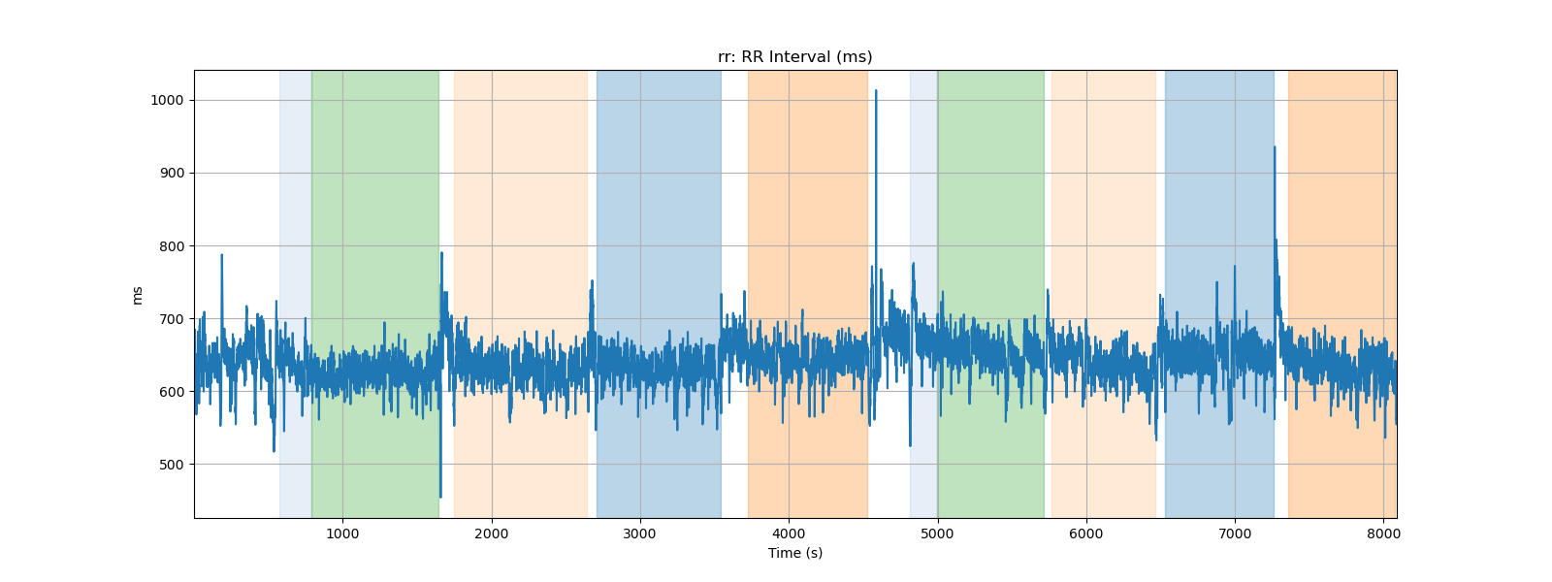
rr: RR Interval (ms)

Slide 11
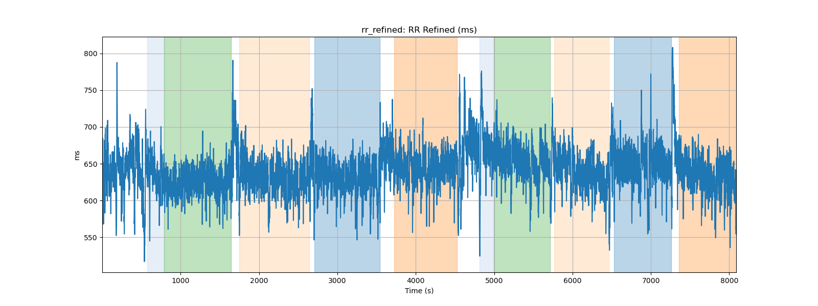
rr_refined: RR Refined (ms)

Slide 12
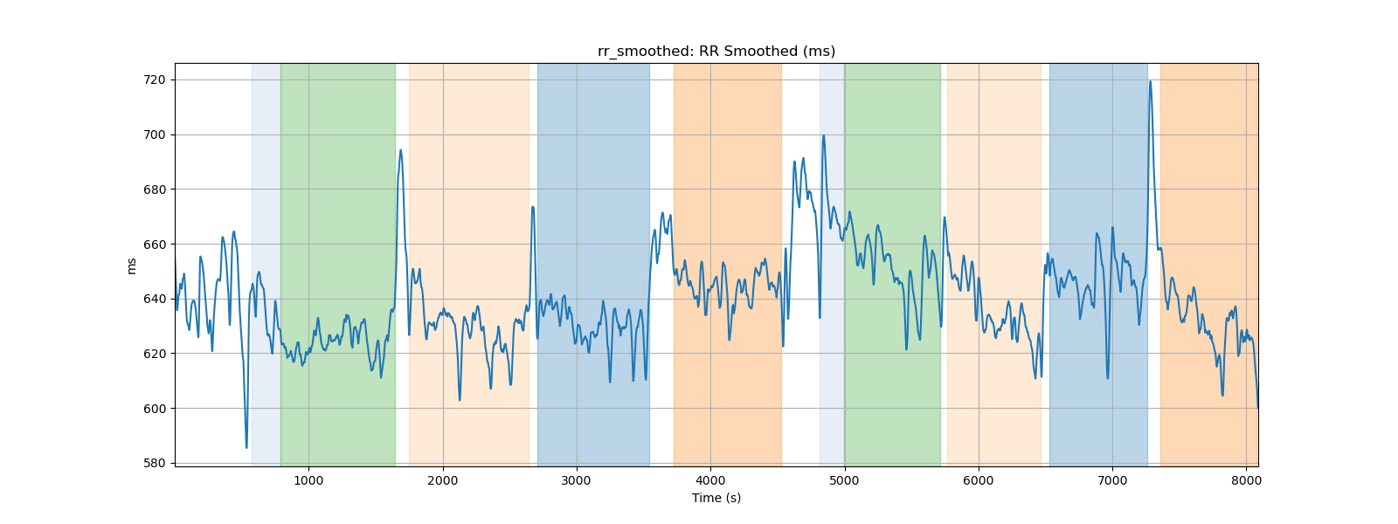
rr_smoothed: RR Smoothed (ms)

Slide 13
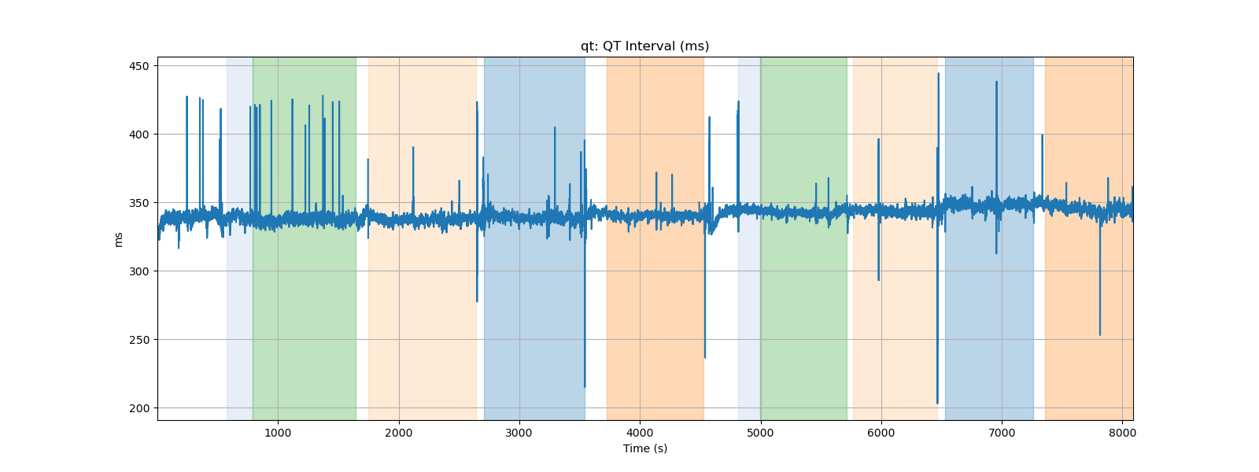
qt: QT Interval (ms)

Slide 14
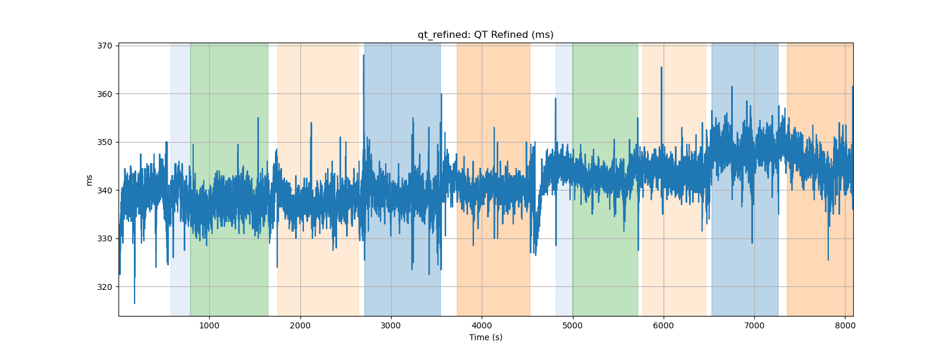
qt_refined: QT Refined (ms)

Slide 15
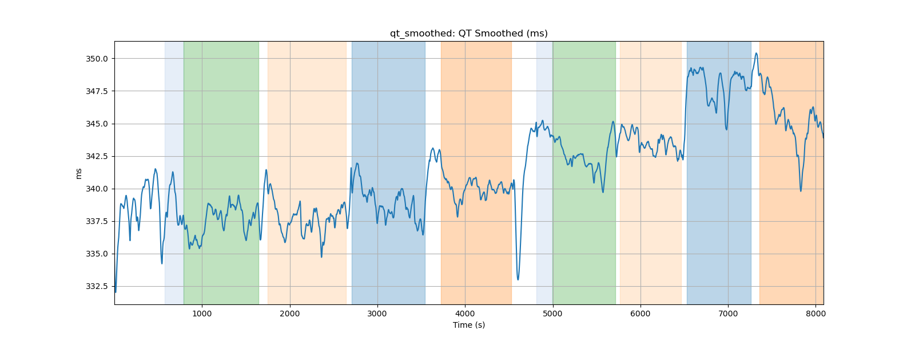
qt_smoothed: QT Smoothed (ms)

Slide 16
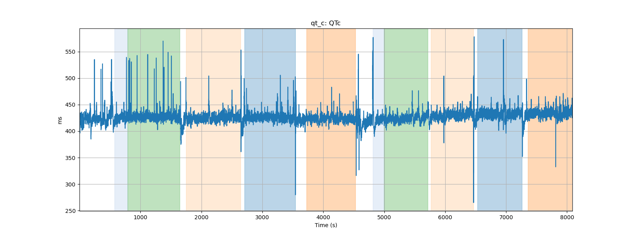
qt_c: QTc

Slide 17
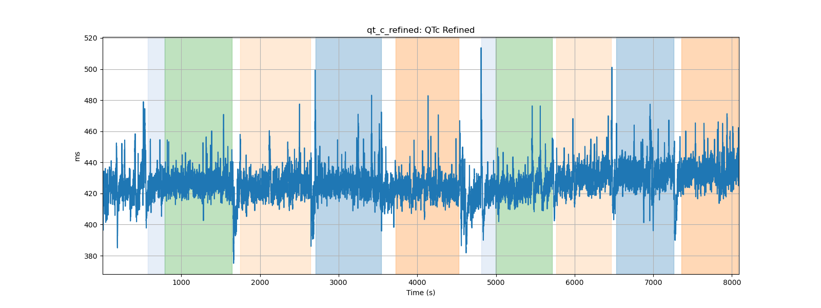
qt_c_refined: QTc Refined

Slide 18
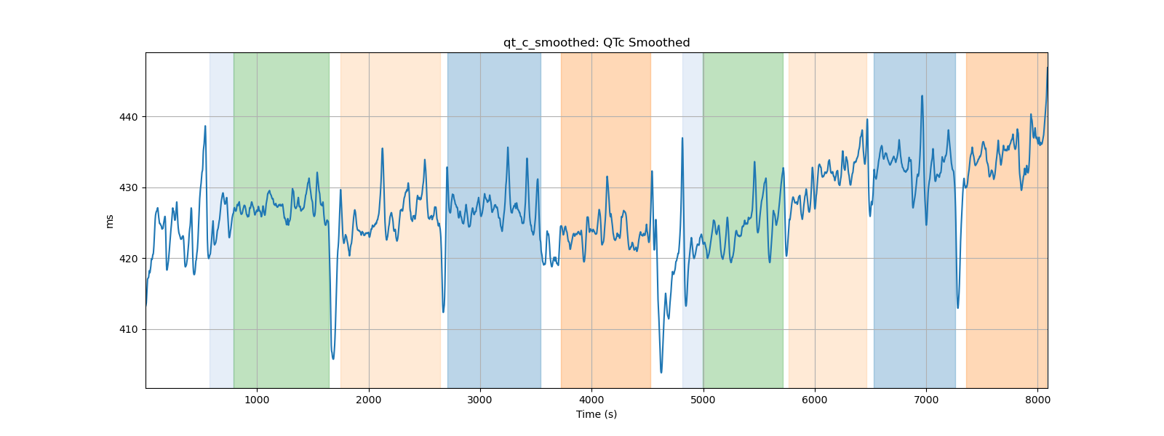
qt_c_smoothed: QTc Smoothed

Slide 19
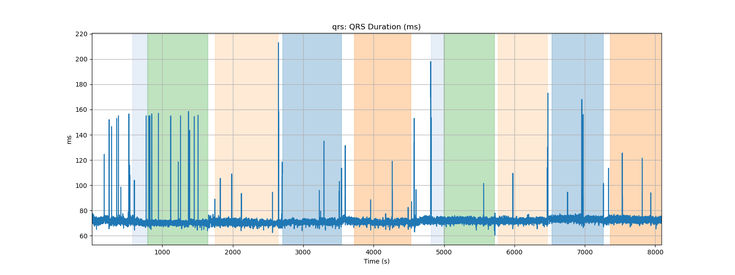
qrs: QRS Duration (ms)

Slide 20
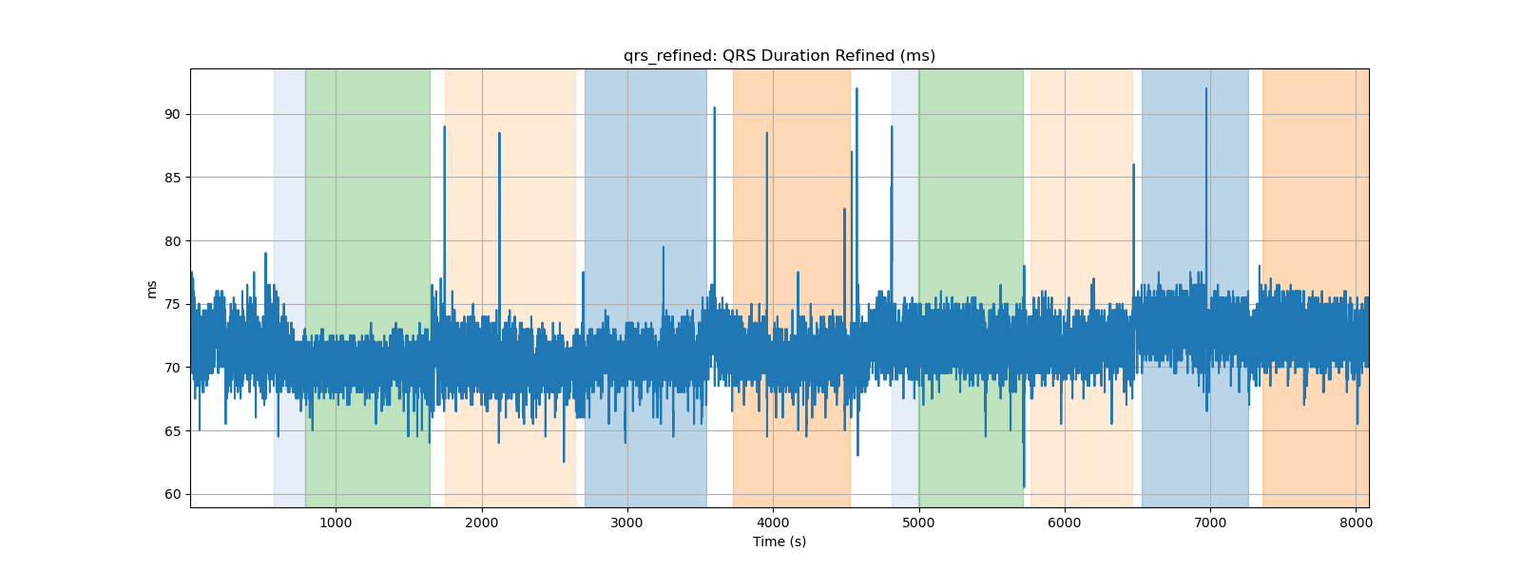
qrs_refined: QRS Duration Refined (ms)

Slide 21
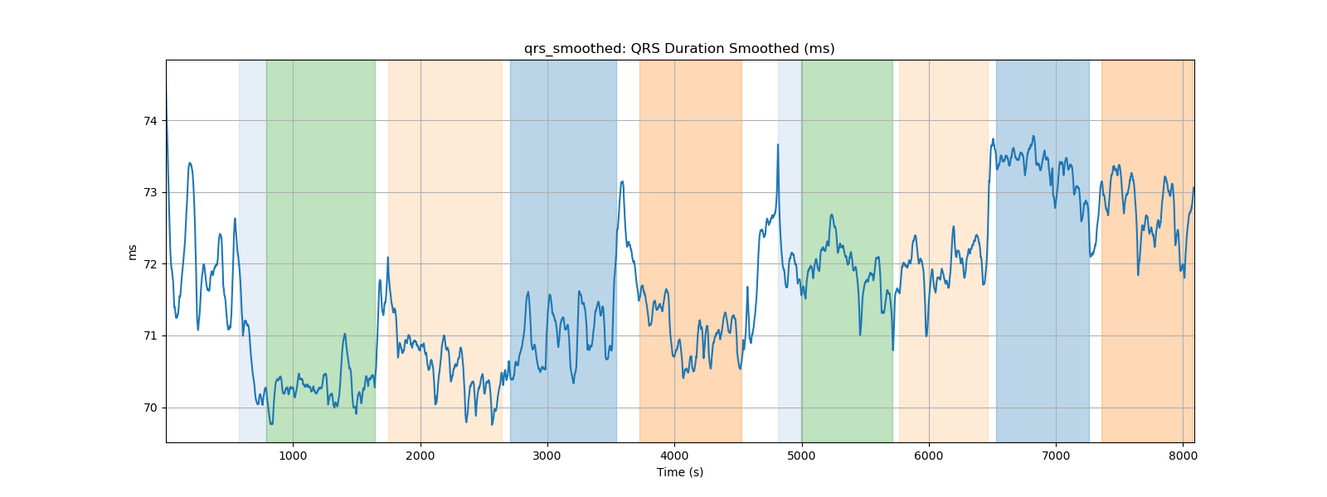
qrs_smoothed: QRS Duration Smoothed (ms)

Slide 22
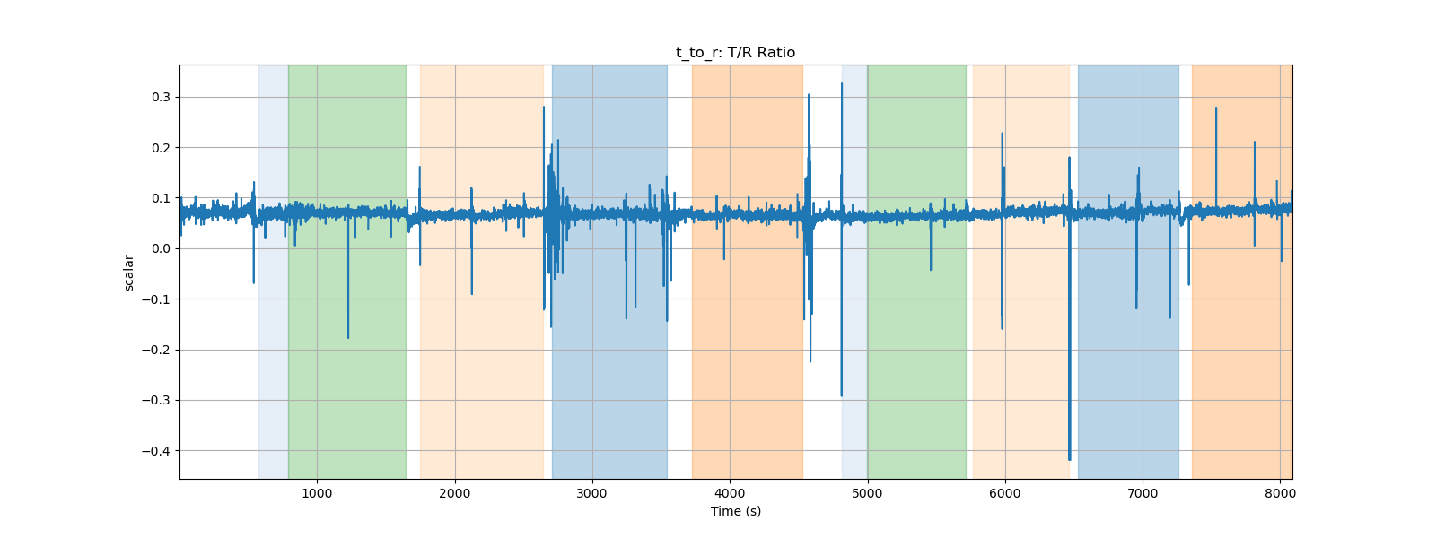
t_to_r: T/R Ratio

Slide 23
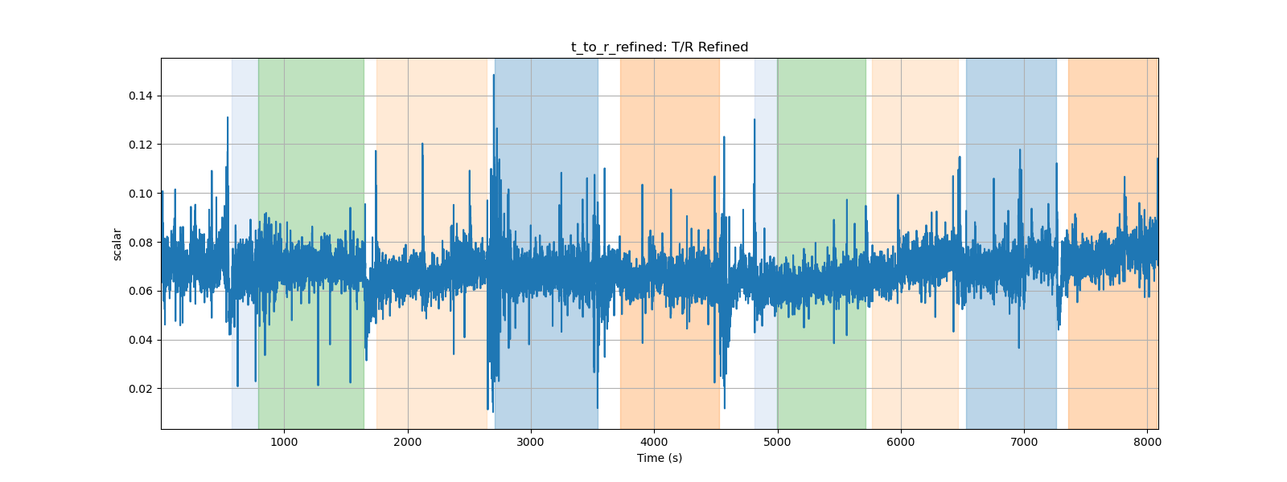
t_to_r_refined: T/R Refined

Slide 24
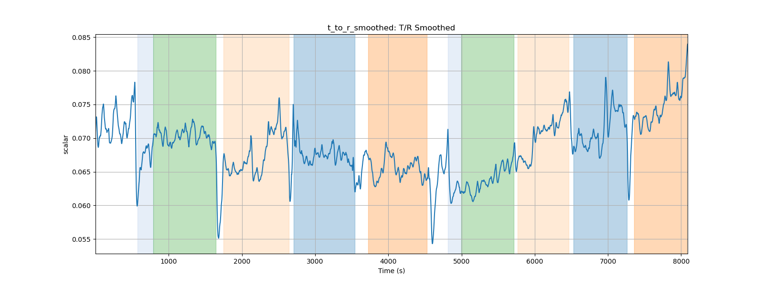
t_to_r_smoothed: T/R Smoothed

Slide 25
Subject P000007 PPG Data Processing Summary
Generated on 2024-09-01 23:23:24

Slide 26
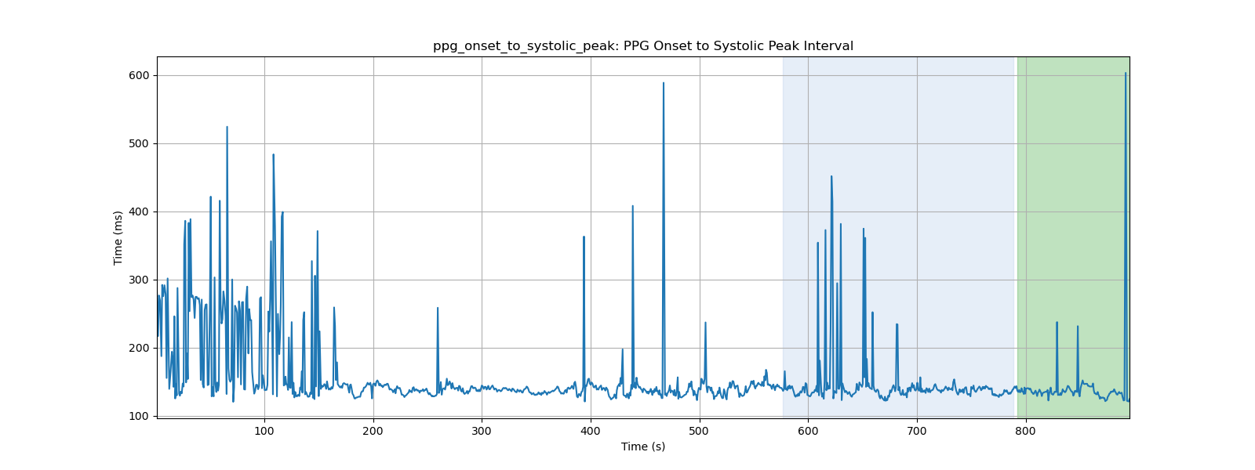
ppg_onset_to_systolic_peak: PPG Onset to Systolic Peak Interval

Slide 27
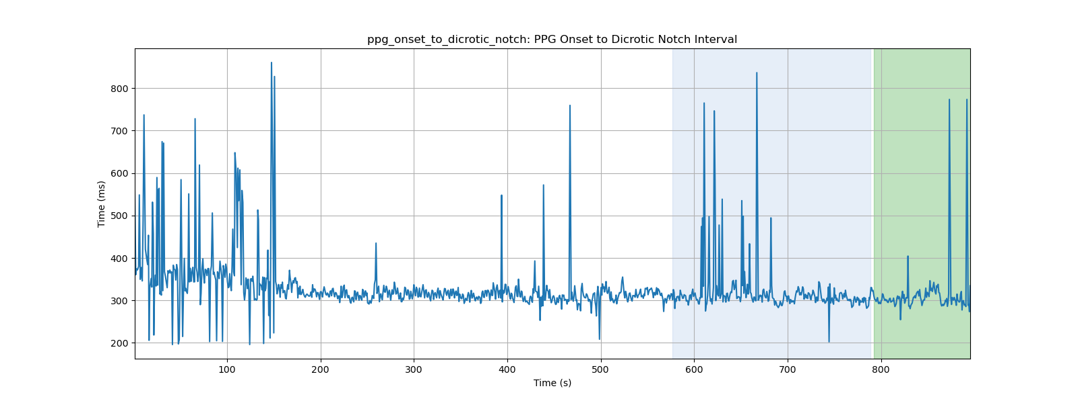
ppg_onset_to_dicrotic_notch: PPG Onset to Dicrotic Notch Interval

Slide 28
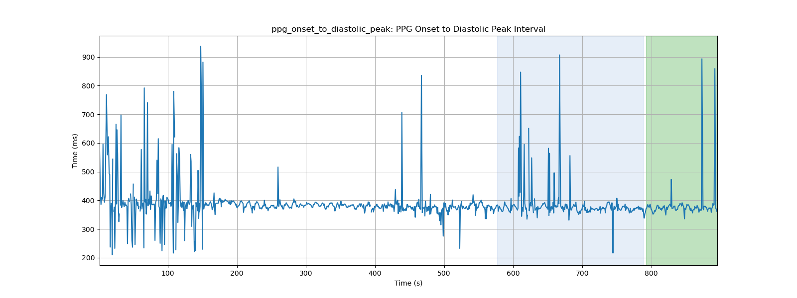
ppg_onset_to_diastolic_peak: PPG Onset to Diastolic Peak Interval

Slide 29
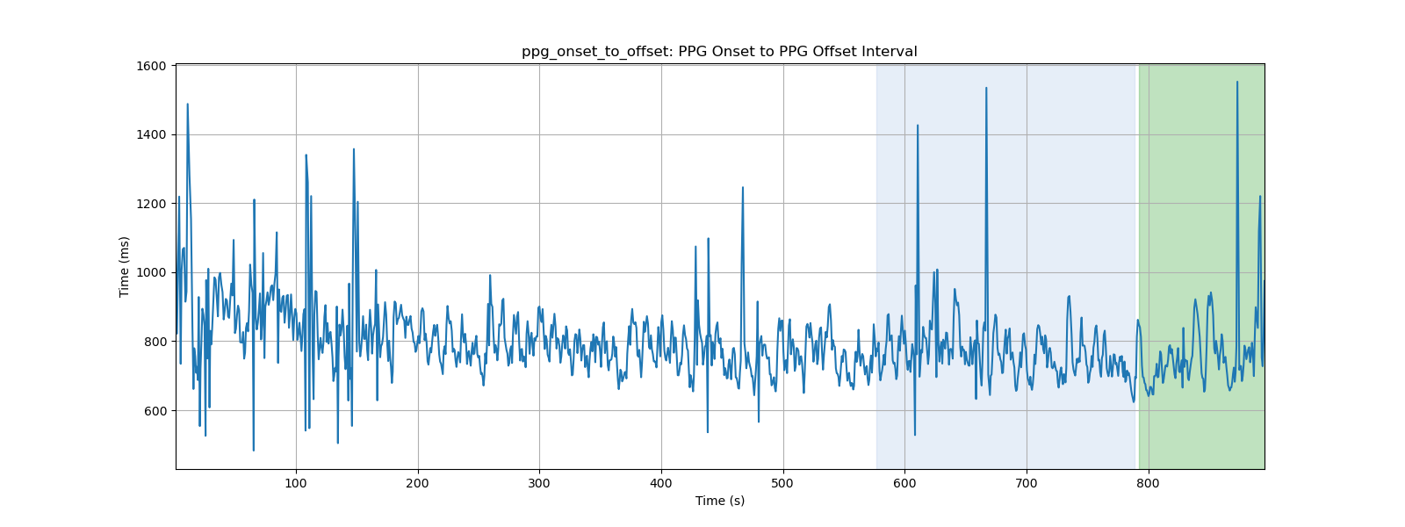
ppg_onset_to_offset: PPG Onset to PPG Offset Interval

Slide 30
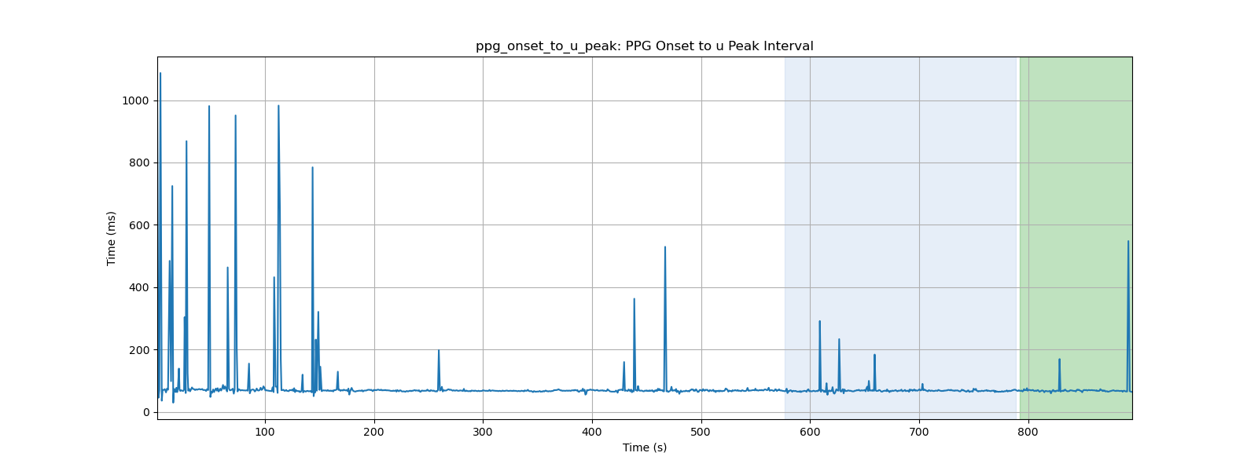
ppg_onset_to_u_peak: PPG Onset to u Peak Interval

Slide 31
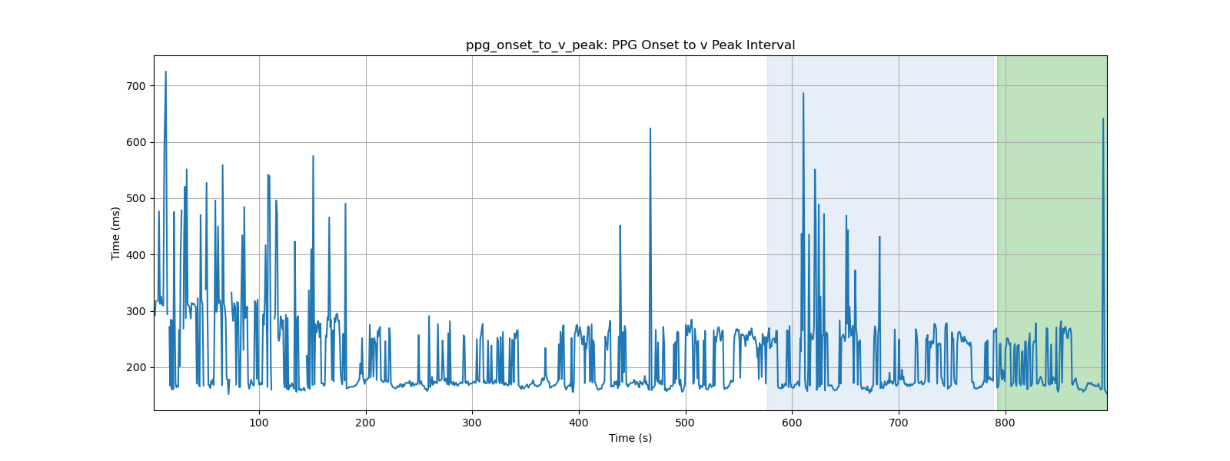
ppg_onset_to_v_peak: PPG Onset to v Peak Interval

Slide 32
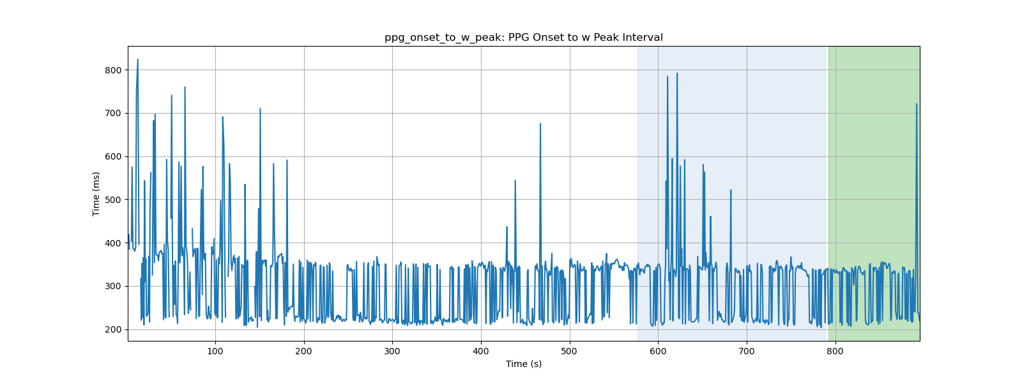
ppg_onset_to_w_peak: PPG Onset to w Peak Interval

Slide 33
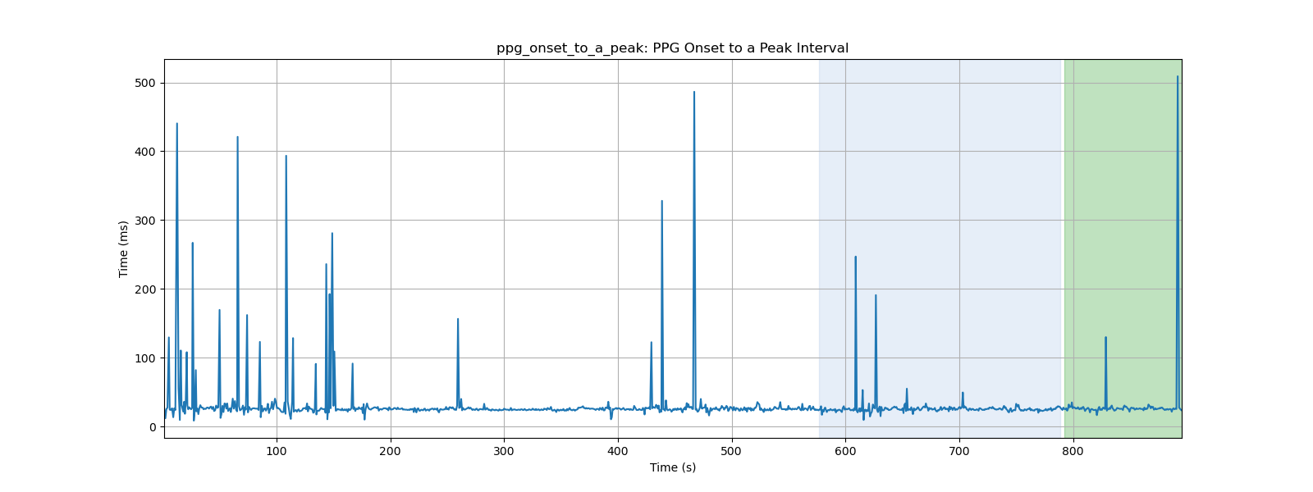
ppg_onset_to_a_peak: PPG Onset to a Peak Interval

Slide 34
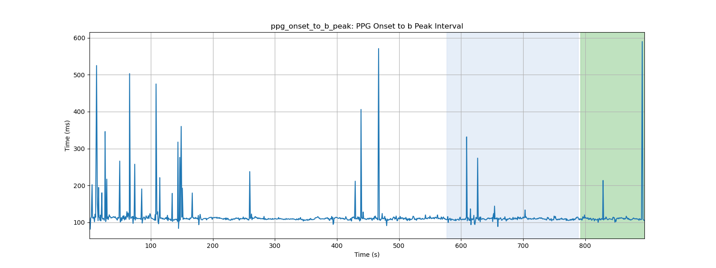
ppg_onset_to_b_peak: PPG Onset to b Peak Interval

Slide 35
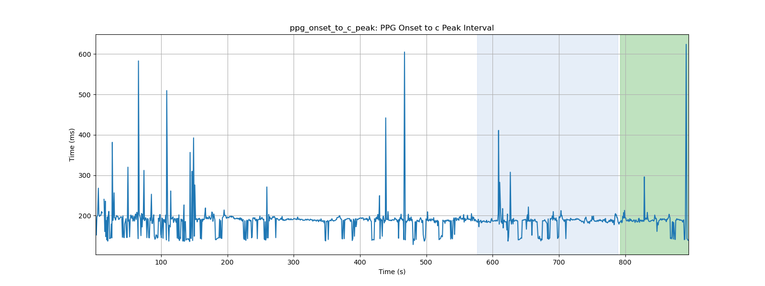
ppg_onset_to_c_peak: PPG Onset to c Peak Interval

Slide 36
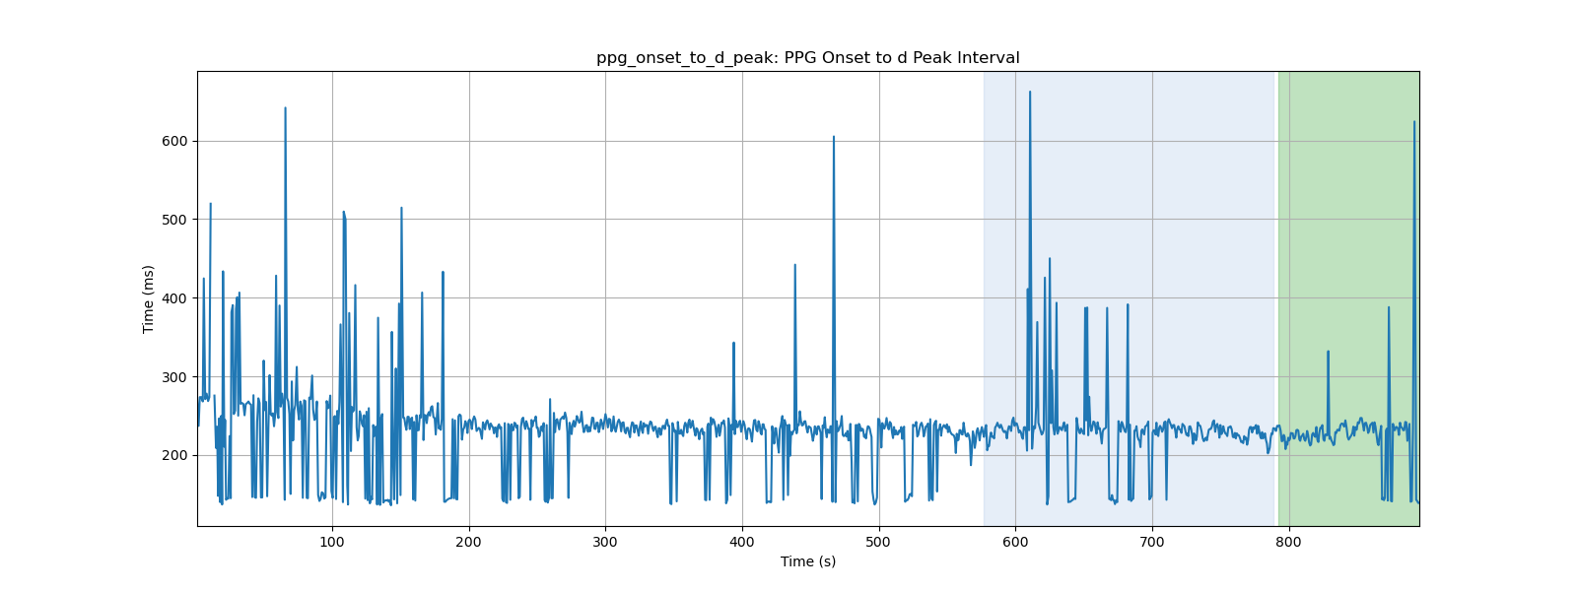
ppg_onset_to_d_peak: PPG Onset to d Peak Interval

Slide 37
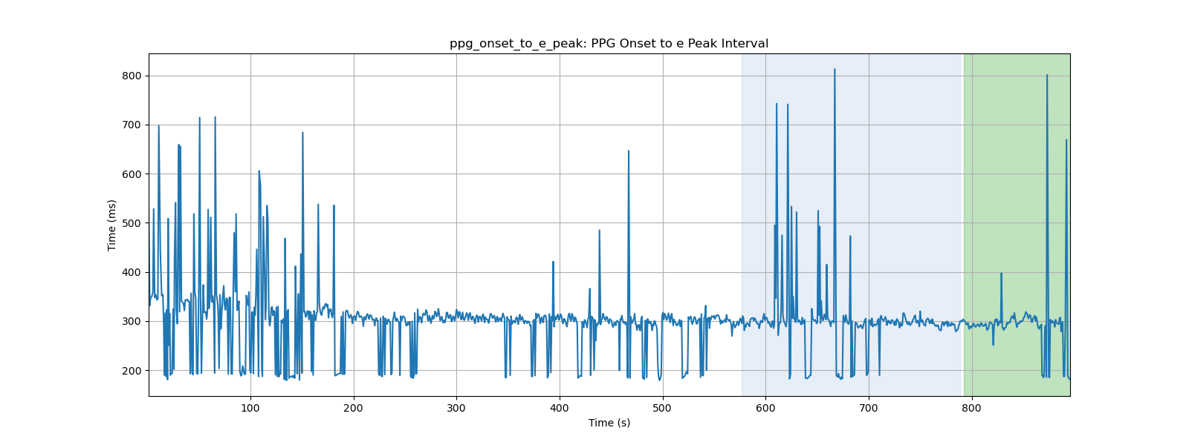
ppg_onset_to_e_peak: PPG Onset to e Peak Interval

Slide 38
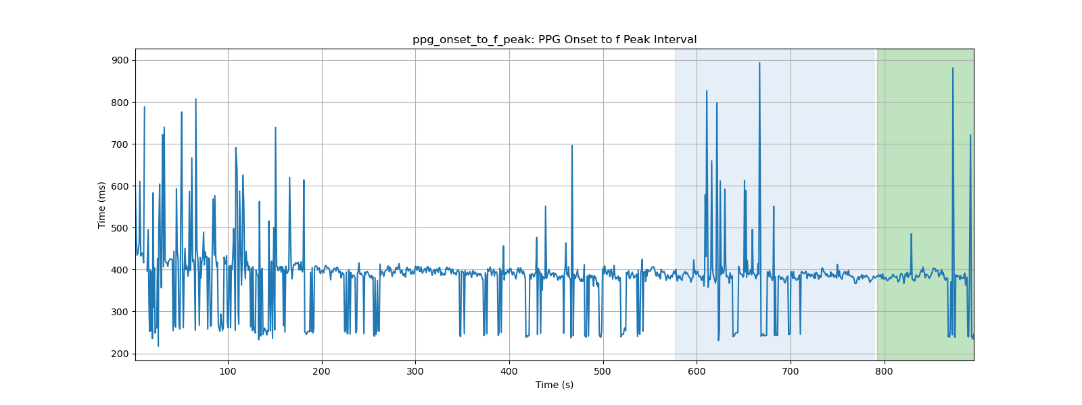
ppg_onset_to_f_peak: PPG Onset to f Peak Interval

Slide 39

ppg_onset_to_p1_peak: PPG Onset to p1 Peak Interval

Slide 40
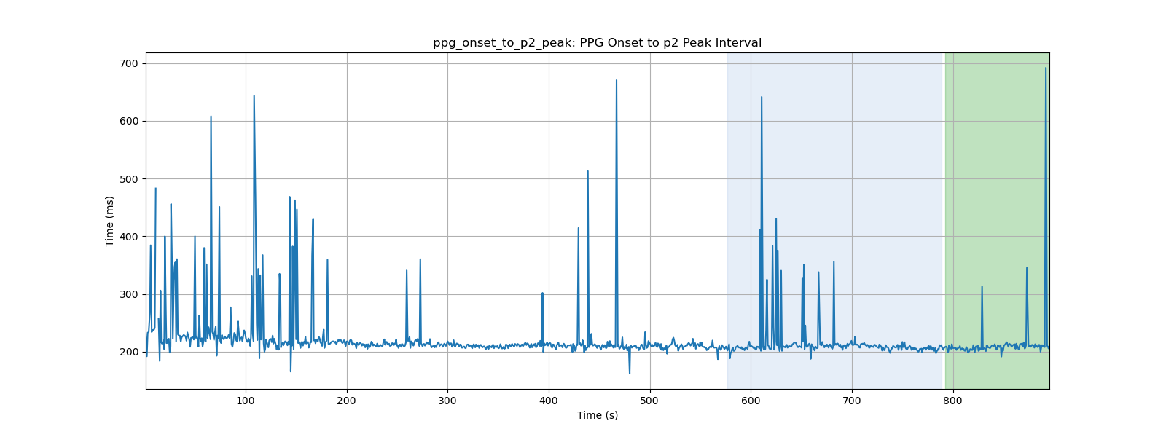
ppg_onset_to_p2_peak: PPG Onset to p2 Peak Interval

