Slide 1
ALPHA OMEGA
AI-Enabled ROTC Accessions in the Army
Accessions Information Environment (AIE)
Mapping the ROTC officer-accessions lifecycle to the AIE Functional RTM — ideas, use cases & business flows on AIE's COTS Salesforce + MuleSoft + DocuSign + Azure foundation.
Briefing Deck · Solution Concept · June 2026
Bracketed IDs (e.g., 3.4.4.18) cite AIE RTM requirements. Human-in-the-loop by design: AI never decides eligibility, selection, suitability, or clearance.
Notes:
AIE is the Army's Accessions Information Environment — COTS, commercial cloud, IL4. ROTC is the officer/scholarship pipeline within it. This deck maps AI to the actual RTM requirements.

Slide 2
AIE at a glance
“A multi-network, multi-device, secure COTS solution in commercial cloud that automates accessions & recruiting.” (OV-1)
~30,000
~14,000
~5,100
~1,000
Cadets recruited & developed
Scholarships managed
Recruiters / staff
ROTC locations
ROTC accessions span three sub-paths, all built on the shared AIE foundation:
Scholarship Program
On-Campus
Summer Training Camps
National 4-yr, Green-to-Gold, on-campus & campus-based awards
MS I–IV enrollment, screening, contracting & Cadet management
Basic & Advanced Camp (CST) and CPDT, with camp medical screening
Alpha Omega — AIE ROTC Accessions · Pre-decisional, RTM-traced
2

Slide 3
AIE capability framework — where ROTC lives
The ROTC lifecycle touches all eight RTM capabilities
1 Foundation
2 CRM
3 Processing
4 On-Boarding
Single record, forms generate/sign, integration, IL4 security
Leads, scholarship apps & boards, pre-screen, digital interview
Eligibility, DoDMERB/security interfaces, contracting, RPA, Cadet mgmt
ROTC accession orders, branch/component, commissioning
5 Intelligence
6 Marketing
7 Training & Leader Dev
8 Sustain & Support
Mission COAs, scholarship-funding modeling, PMS forecasts
Propensity & campaign targeting to feed the pipeline
LMS (MS I–IV), Basic/Advanced Camp, camp medical
DD-918 agreements, retention reviews, Cadre hierarchy
Alpha Omega — AIE ROTC Accessions · Pre-decisional, RTM-traced
3

Slide 4
The ROTC lifecycle in AIE
Ten connected stages — each traced to RTM requirement IDs
S1
Lead & Prospect
S2
Scholarship App & CBEF
S3
Pre-Screen & Eligibility
S4
PMS Interview
S5
DoDMERB Medical
[2.1]
[2.1.4]
[2.3.1.6]
[2.3]
[3.3.1.7]
S6
Selection Boards
S7
Offer & Contract
S8
SF-86 Completion
S9
Invest. & Adjudication
S10
Enroll & Commission
[2.1.4.7]
[3.4.4]
[3.4.4.18]
[3.4.4.25]
[3.10 · 4.7]
Stages 1–9 are the ~1-year application-to-contracting cycle; enrollment, training & commissioning continue across MS I–IV.
Alpha Omega — AIE ROTC Accessions · Pre-decisional, RTM-traced
4

Slide 5
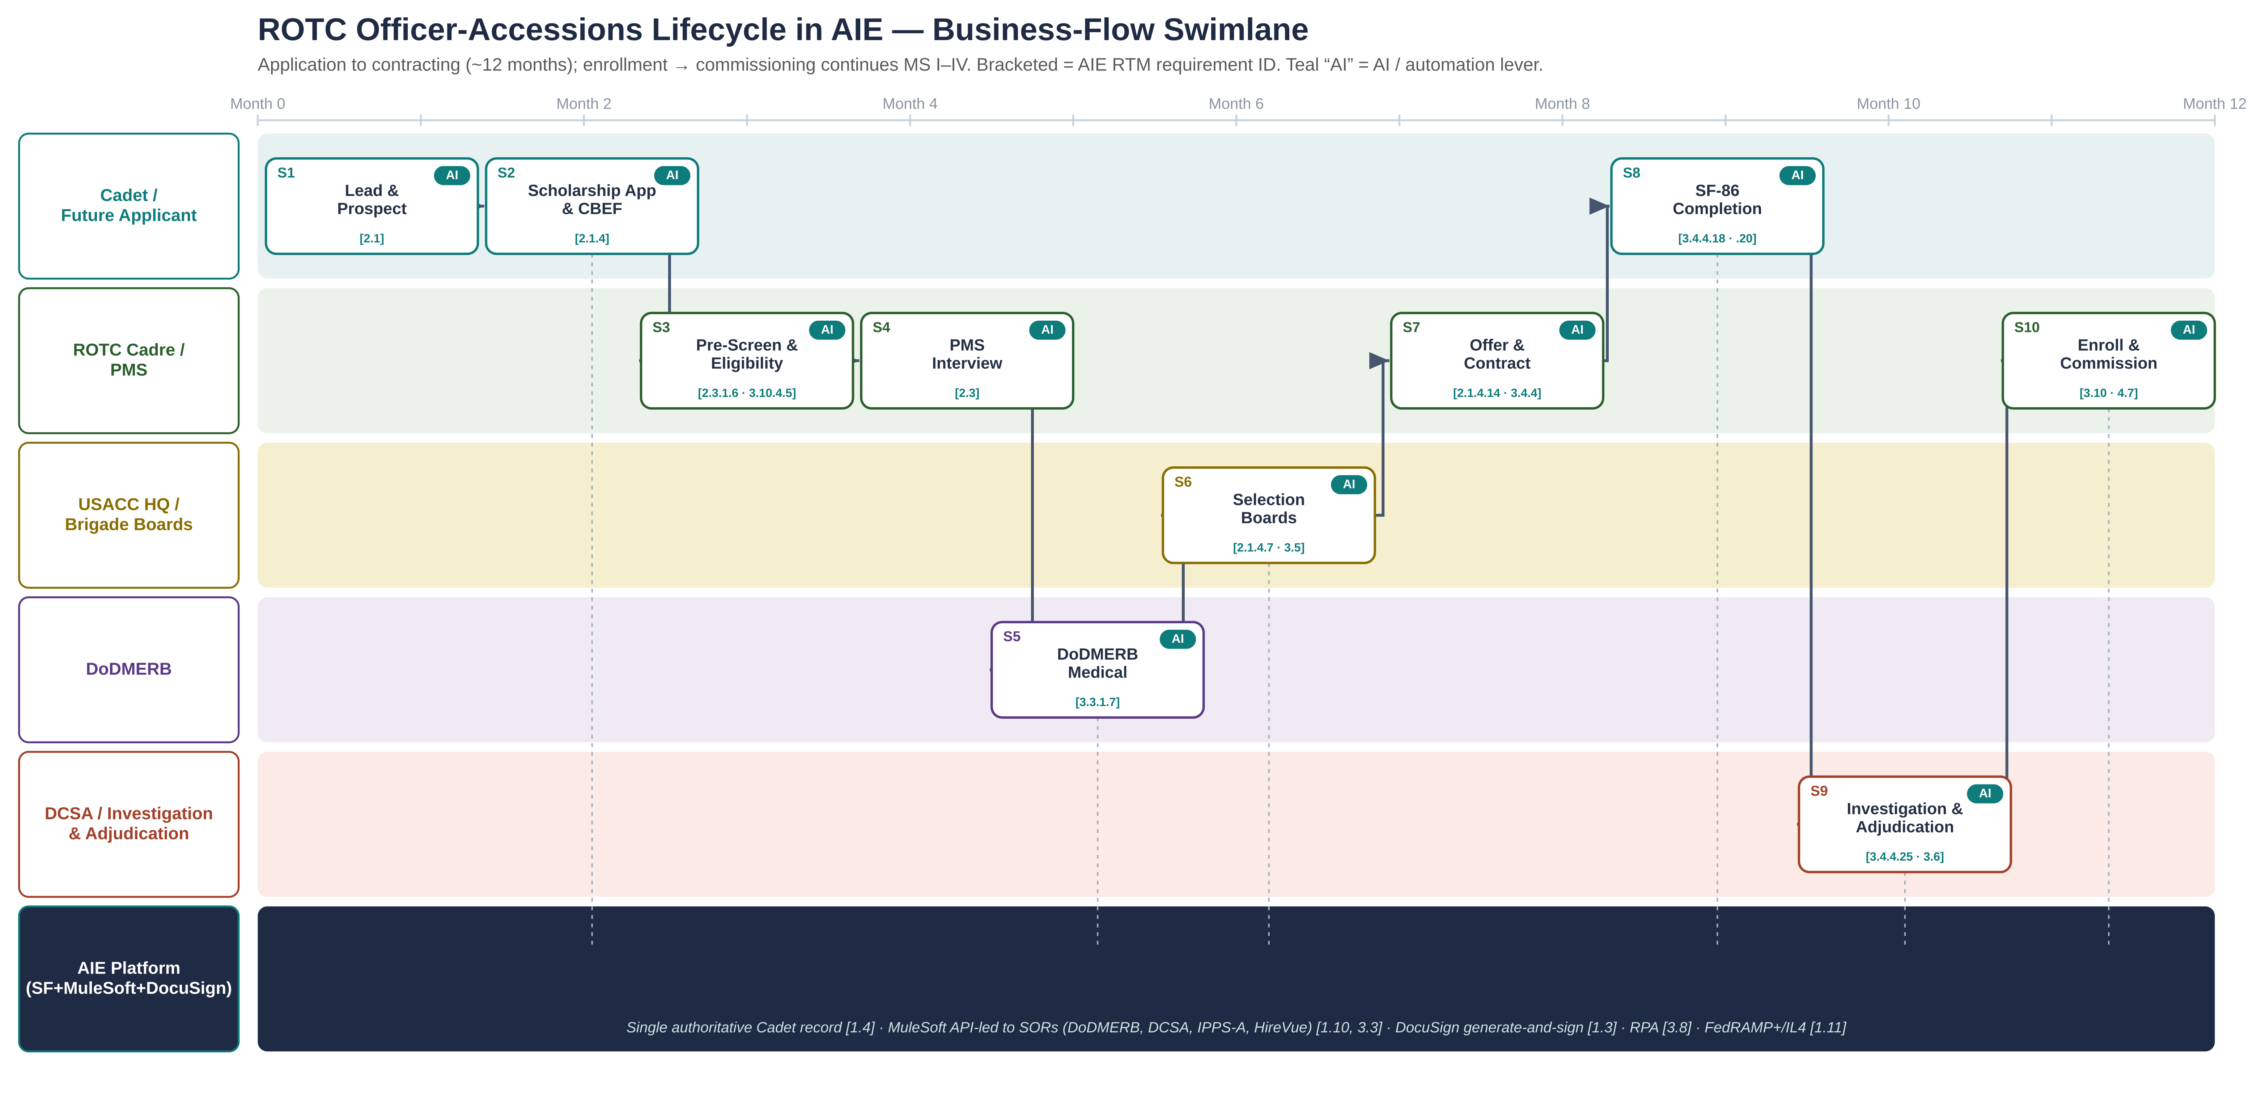
Business-flow swimlane
Who does what, when — traced to AIE requirements
Alpha Omega — AIE ROTC Accessions · Pre-decisional, RTM-traced
5
Notes:
The dark bottom lane is the AIE platform backbone (single record, MuleSoft to SORs, DocuSign, RPA, IL4). Teal AI badges mark AI levers. Bracketed IDs trace to the RTM.

Slide 6
Designing for two people first
The Cadet completing forms & the SF-86 — and the adjudicator reviewing them
The Cadet
The Cadre / Adjudicator
Today
Today
Overlapping forms: scholarship app, CBEF, contracting, then SF-86
Reconstructs years of history from memory for the SF-86
SECRET clearance due within 60 days of contracting [3.4.4.18]
Little feedback until pre-screen or reviewer rejects
Manually reads packets & SF-86s across many SORs
Time lost on incomplete submissions & interrogatories
Heavy manual board assembly & scoring [2.1.4.7]
Hard to prioritize highest-risk / nearest-deadline
With AI
With AI
Conversational guided intake on community portal [2.5]
Consented pre-fill reuses core data across forms [1.4]
Real-time validation = AIE continuous screening [3.4.4.20]
Document capture (IDP) to single record [1.2, 1.4]
Copilot summarizes, flags gaps, links evidence→guideline [3.8.1.1]
Completeness gating; RPA clears SOR steps [3.8]
Queue ranked by deadline & risk; next-best-action
Unified Cadet record, full audit trail [2.6]
Guardrail: AI surfaces & organizes; eligibility, selection, suitability & clearance decisions remain human under SEAD 4.

Slide 7
Deep dive: SF-86 & security clearance
A concrete RTM workflow — and a high-value AI target
Initiate & complete SF-86 within 60 days of contracting for SECRET
Continuous screening & data validation for accurate SF-86
3.4.4.18
3.4.4.20
Auto-identify Cadets needing Top Secret by branch
Interface with DCSA to send/receive SF-86 results & docs
3.4.4.23
3.4.4.25
Support appeal process for denied clearances
Detect existing clearance/investigation from SOR
3.4.4.21
3.4.4.22
AI levers mapped to these requirements
Consented SF-86 pre-fill + real-time validation — fewer errors, faster start
Adjudicator copilot — summarize, flag gaps, link evidence to guideline, draft interrogatories
Predictive case prioritization against the 60-day window; automated nudges
RPA moves SF-86 packages & DCSA responses across SOR interfaces — determinations stay human
Alpha Omega — AIE ROTC Accessions · Pre-decisional, RTM-traced
7

Slide 8
AI opportunity matrix
Pain → method → AIE capability/requirement → value
Stage | Pain today | AI method | AIE capability / req | Value
Application & CBEF | Abandonment, partial data | Conversational AI, pre-fill, validation | CRM 2.1.4; Foundation 1.4 | Speed + exp.
Pre-screen / eligibility | Manual checks, rework | Rules + anomaly; suitability assist | 2.3.1.6, 3.8.1.1 | Quality + risk
Interview | Coordination, scoring drift | Summarization, rubric checks | CRM 2.3 | Quality
Medical (DoDMERB) | Silent delays, waivers | Status sync, doc AI, prediction | 3.3.1.7, 3.2.1.15 | Speed
Selection boards | Packet assembly, ranking | Auto-assembly, completeness, analytics | 2.1.4.7, 3.5 | Speed + quality
Offer & contract | Manual letters, forms | Generated correspondence, e-sign | 2.1.4.14, 1.3 | Speed
SF-86 & clearance | Errors, 60-day window | Pre-fill, validation, copilot, triage | 3.4.4.18–.25 | All four
Enroll & manage | Manual tracking, ETPs | Auto-screening, near-real-time status | 3.10 | Quality + risk
Cross-cutting workload | High manual volume | RPA across SOR steps | 3.8 | All four
Alpha Omega — AIE ROTC Accessions · Pre-decisional, RTM-traced
8

Slide 9
Priority use cases
Each traced to AIE requirements
UC-01
UC-02
UC-04
Conversational app & CBEF intake
Document AI & eligibility screening
Board packet assembly & scoring
RTM: 2.1.4 · 2.5
RTM: 2.3.1.6 · 3.8.1.1
RTM: 2.1.4.7 · 3.5
UC-05
UC-06
UC-07
SF-86 pre-fill, validation & copilot
Adjudicator / reviewer copilot
RPA across SOR steps
RTM: 3.4.4.18 · .20
RTM: 3.8.1.1 · 3.6
RTM: 3.8 · 3.3
Alpha Omega — AIE ROTC Accessions · Pre-decisional, RTM-traced
9

Slide 10
Target-state architecture on the AIE stack
COTS-first, API-led, governed AI, IL4
Experience
Community portal & cadre workspaces on Salesforce [2.5, 1.6] · conversational assistants · DocuSign signing
Engagement / Case
Salesforce across CRM [2], Processing [3], On-Boarding [4] · configurable workflows [3.2] · single record [1.4]
AI + Automation
Azure OpenAI & Azure AI + Einstein (governed, in-boundary) · pre-screen [2.3.1.6] · suitability [3.8.1.1] · RPA [3.8]
Integration (backbone)
MuleSoft API-led per OV-3 [1.10, 3.3] → DoDMERB [3.3.1.7] · Security SOR [3.3.1.9/.10] · DCSA [3.4.4.25] · IPPS-A · HireVue · LMS
Document & e-sign
DocuSign generate-and-sign forms, offers, contracting, consent [1.3]
Platform & security
COTS in commercial cloud (OV-1) · FedRAMP+/IL4 [1.11.1.59] · PII/PHI [1.11.1.75] · multi-tenant upgrades [1.11] · DevSecOps
Alpha Omega — AIE ROTC Accessions · Pre-decisional, RTM-traced
10

Slide 11
Responsible AI, security & governance
Human-in-the-loop by design
1
AI summarizes, validates & recommends. Eligibility, selection, suitability & clearance remain human under SEAD 4. Automated screening/suitability [3.8.1.1, 3.10.4.5] advise, not decide.
Hybrid deterministic + generative AI
2
Rules engines for policy-bound checks (predictable, auditable); generative AI for language tasks within guardrails.
Security & data protection
3
FedRAMP+/IL4 [1.11.1.59] · PII/PHI per DoDD 5400.11 & DoDI 8580.02 [1.11.1.75] · DCSA-aligned SF-86 handling · AI inside the accredited boundary.
Transparency & traceability
4
Model evaluation, explainable scoring, and a logged record of each recommendation — inspection-ready and RTM-traceable.
Alpha Omega — AIE ROTC Accessions · Pre-decisional, RTM-traced
11

Slide 12
Delivery: SAFe + DevSecOps on Azure DevOps
1
SAFe Agile Release Train
2
Azure DevOps hub
Aligned to AIE capabilities; PI planning & continuous demos to USACC, DoDMERB & DCSA stakeholders
Backlog, boards, repos & pipelines as one system — traceable to RTM requirement IDs
3
DevSecOps pipelines
4
Continuous upgrades & ATO
CI/CD for Salesforce (SFDX) & MuleSoft with automated test, security scanning, policy-as-code, rollback
Leverage AIE multi-tenant continuous-upgrade model [1.11]; automate control evidence to sustain authorization
Alpha Omega — AIE ROTC Accessions · Pre-decisional, RTM-traced
12

Slide 13
Phased roadmap
Crawl, walk, run — value at every step
Phase 1 — Crawl
Phase 2 — Walk
Phase 3 — Run
Foundation
Intelligence
Optimization
Single Cadet record & workflows [1.4, 3.2]
DocuSign forms [1.3]
MuleSoft APIs to DoDMERB & security SORs
Quick wins: guided intake, document AI
SF-86 pre-fill & validation [3.4.4.20]
Adjudicator copilot [3.8.1.1]
Board packet assembly [2.1.4.7]
RPA across SORs [3.8]
Mission & funding analytics [5.1.4]
Predictive prioritization
Continuous data-quality & ATO
Extend to enlisted accessions
Alpha Omega — AIE ROTC Accessions · Pre-decisional, RTM-traced
13

Slide 14
Expected outcomes
↓ Cycle time
↑ Data quality
↑ On-time SF-86
↓ Burden
application → contracting
first-pass completeness; SF-86
60-day window [3.4.4.18]
Cadre/adjudicator hours (RPA)
A faster, cleaner, lower-risk ROTC accessions lifecycle for the Cadet and the adjudicator — traceable to the AIE RTM at every step, with every decision in human hands.
Next step: a discovery session and a proof-of-concept to baseline current state and prioritize the first AIE increment.
Rob Brown, SVP National Security Solutions · robert.brown@alphaomega.com · Alpha Omega Integration LLC

