Slide 1
ALPHA OMEGA
Modernizing the Army ROTC Recruitment
& Onboarding Lifecycle with AI
From applicant form entry to ROTC acceptance & contracting — compressing the ~12-month lifecycle, raising data quality, and reducing risk on a DoD Salesforce + MuleSoft + DocuSign + Azure DevOps stack.
Briefing Deck · Solution Concept · June 2026
Human-in-the-loop by design: AI augments eligibility, selection & clearance work — it never decides.
Notes:
Frame the opportunity: the ROTC year is one long, paper-heavy, multi-actor case. We can treat it as a single AI-augmented case and compress it without ever letting AI make the call on eligibility, selection, or clearance.

Slide 2
The challenge: a 12-month, paper-heavy, multi-actor journey
Re-keying the same identity, education & biographic data across the application, DoDMERB, SF-86 and contracting
Incomplete or inconsistent submissions that bounce back weeks later and restart clocks
Manual document collection, verification and status-chasing over email and phone
Limited applicant visibility into status — driving anxiety, abandonment and inbound inquiries
Disconnected systems with no single case record; cadre and adjudicators stitch context by hand
~12 mo
applicant form entry → acceptance
4+
major forms & systems, often re-keyed
Weeks
lost per bounce-back / rework cycle
Alpha Omega — Pre-decisional Solution Concept
2

Slide 3
The lifecycle at a glance
Ten connected stages, treated as a single instrumented case
S1
Awareness &
Lead Capture
S2
Application
Intake
S3
Docs &
Eligibility
S4
Fitness &
Medical
S5
PMS
Interview
S6
Selection
Boards
S7
Offer &
Acceptance
S8
SF-86 &
Adjudication
S9
Contracting &
Onboarding
S10
Case Mgmt
(cross-cutting)
Each stage carries an AI / automation lever — detailed on the following slides.
Alpha Omega — Pre-decisional Solution Concept
3

Slide 4
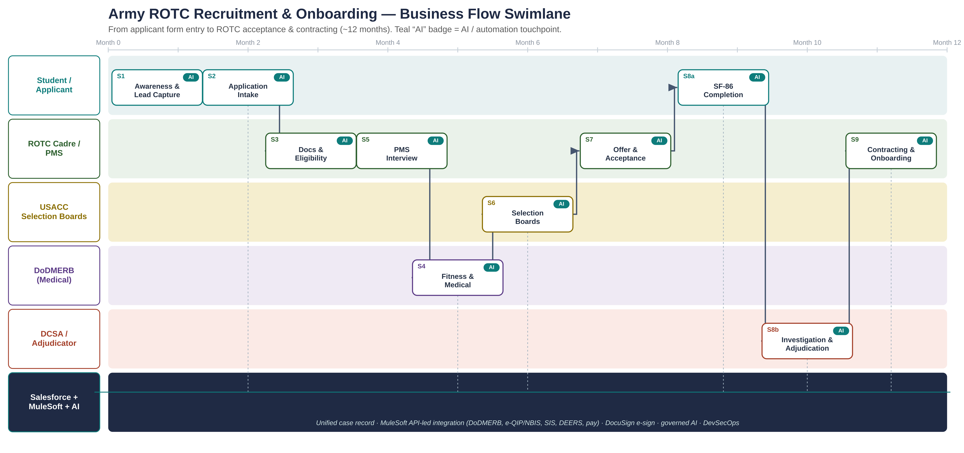
Business-flow swimlane
Who does what, when — across the ~12-month lifecycle
Alpha Omega — Pre-decisional Solution Concept
4
Notes:
Walk the path: lead capture → application → eligibility → interview → medical → boards → offer → SF-86 → adjudication → contracting. The dark bottom lane is the platform backbone that carries the single case record and the API integrations. Teal AI badges mark where AI/automation intervenes.

Slide 5
Designing for two people first
The student completing the forms, and the adjudicator reviewing them
The Student
The Adjudicator / Cadre
Today
Today
Two large, overlapping forms (application, then SF-86)
Reconstructs 7–10 years of history from memory
No feedback until a reviewer rejects the packet
No single view of what's done vs. pending
Manually reads long packets and SF-86s
Time lost on incomplete submissions & interrogatories
Tracking across spreadsheets, email, many systems
Hard to prioritize highest-risk / nearest-deadline
With AI
With AI
Conversational, guided intake in plain language
Consented pre-fill reuses data across forms
Real-time validation & a live 'readiness' score
Photograph a document → auto-extracted & filed
Always-on status portal and proactive nudges
Copilot summarizes packet, flags gaps, links evidence to guideline
Only complete, validated cases reach review
Queue ranked by deadline & risk; next-best-action
Unified case record with full, defensible audit trail
Guardrail: AI surfaces and organizes information; eligibility, selection and clearance decisions remain human under SEAD 4.

Slide 6
AI opportunity matrix
Pain → method → platform component → value lever
Stage | Pain today | AI method | Tech component | Value lever
Application intake | Abandonment, partial data | Conversational AI, pre-fill, validation | Salesforce + Azure OpenAI; MuleSoft | Speed + experience
Docs & eligibility | Manual checks, rework | Document AI (OCR/IDP) + rules | Azure AI Doc Intelligence; SF Flow | Quality + risk
Fitness & medical | Scheduling, silent remedials | Scheduling, status sync, prediction | MuleSoft ↔ DoDMERB; ML | Speed
PMS interview | Coordination, scoring drift | Summarization, rubric checks | Azure OpenAI; Salesforce | Quality
Selection boards | Packet assembly, ranking | Auto-assembly, completeness, analytics | Salesforce; Azure ML (human-decided) | Speed + quality
Offer & acceptance | Manual letters, tracking | Generated correspondence, e-sign | DocuSign; SF; Azure OpenAI | Speed
SF-86 clearance | Errors, long cycle | Pre-fill, validation, copilot, triage | SF; MuleSoft ↔ e-QIP/NBIS; Azure AI | All four
Contracting/onboarding | Manual onboarding | Orchestration, provisioning | SF Flow Orch.; MuleSoft; DocuSign | Speed + risk
Case mgmt (cross-cut) | No unified view | SLA automation, next-best-action | Salesforce Service Cloud / PSS | All four
Alpha Omega — Pre-decisional Solution Concept
6

Slide 7
Priority use cases
Sequenced to deliver early value, then intelligence
UC-01
UC-02
UC-05
Guided conversational intake
Document AI & eligibility checks
Auto packet assembly + scoring
Higher completion, cleaner first-pass data
Faster verification, early exceptions
Boards see only complete packets
UC-07
UC-08
UC-09
SF-86 pre-fill, validation & copilot
Adjudicator / reviewer copilot
Case prioritization & next-best-action
Fewer errors; faster investigation start
Major review-time cut; defensible, logged
Right case worked first; fewer breaches
Alpha Omega — Pre-decisional Solution Concept
7

Slide 8
Target-state architecture
API-led, governed AI, secure by design
Experience
Salesforce Experience Cloud portals (applicant & cadre) · conversational assistants · DocuSign signing
Engagement / Case
Salesforce Service Cloud / Public Sector Solutions — system of record, Flow & Orchestration, SLAs, knowledge
AI services
Azure OpenAI & Azure AI (Document Intelligence, ML) + Salesforce Einstein — governed, in-boundary, human-in-the-loop
Integration (backbone)
MuleSoft API-led layer → DoDMERB · e-QIP/NBIS · SIS/enrollment · DEERS/IdAM · pay (capture once, reuse everywhere)
Document & e-sign
DocuSign for offers, acceptance, contracting and consent capture — integrated to the case
Platform & security
Azure at the appropriate DoD Impact Level · zero-trust · RBAC/ABAC · full audit · DevSecOps pipelines
Alpha Omega — Pre-decisional Solution Concept
8

Slide 9
Responsible AI, security & governance
Human-in-the-loop by design
1
AI summarizes, validates and recommends. Eligibility, selection and clearance determinations are made by authorized humans under SEAD 4 — every assisted step logged.
Hybrid deterministic + generative AI
2
Rules engines handle policy-bound checks for predictability and auditability; generative AI handles language tasks within guardrails.
Data protection & boundary
3
PII minimization, encryption, strict RBAC/ABAC, DCSA-aligned SF-86 handling; AI runs inside the accredited DoD boundary at the correct Impact Level.
Transparency & traceability
4
Model evaluation, explainable scoring, and a clear record of how each recommendation was produced — inspection-ready.
Alpha Omega — Pre-decisional Solution Concept
9

Slide 10
Delivery: SAFe + DevSecOps on Azure DevOps
1
SAFe Agile Release Train
2
Azure DevOps hub
Lifecycle-aligned features, PI planning, continuous demos to USACC, DoDMERB & clearance stakeholders
Backlog, boards, repos & pipelines as one delivery system — traceable requirement → deployed change
3
DevSecOps pipelines
4
Continuous ATO posture
CI/CD for Salesforce (SFDX) & MuleSoft with automated test, security scanning, policy-as-code gates, rollback
Security controls & evidence automated into the pipeline to shorten and sustain authorization
Alpha Omega — Pre-decisional Solution Concept
10

Slide 11
Phased roadmap
Crawl, walk, run — value at every step
Phase 1 — Crawl
Phase 2 — Walk
Phase 3 — Run
Foundation
Intelligence
Optimization
Unified Salesforce case model & lifecycle
DocuSign offers/acceptance
MuleSoft system APIs (DoDMERB, clearance)
Quick wins: guided intake, document AI, status nudges
SF-86 pre-fill & validation
Adjudicator copilot
Automated packet assembly
Generated correspondence; case prioritization
Predictive analytics across the pipeline
Onboarding orchestration
Continuous data-quality
Continuous-ATO maturity; expand to other pipelines
Alpha Omega — Pre-decisional Solution Concept
11

Slide 12
Expected outcomes
↓ Cycle time
↑ Data quality
↓ Rework
↓ Burden
form entry → acceptance
first-pass completeness
interrogatories / bounce-backs
cadre & adjudicator hours
Better experience for the student and the adjudicator — with every eligibility, selection and clearance decision firmly in human hands.
Next step: a discovery session and a Continuum Design proof-of-concept to baseline current state and prioritize the first increment.
Rob Brown, SVP National Security Solutions · robert.brown@alphaomega.com · Alpha Omega Integration LLC

