Slide 1

Software
The main idea

Slide 2
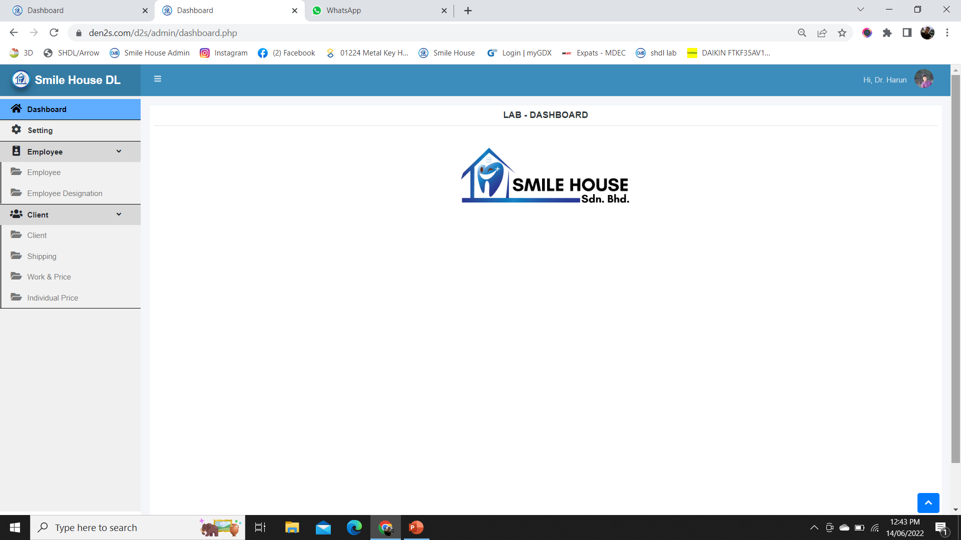
Admin panel view (View Of The Dashboard)

Slide 3
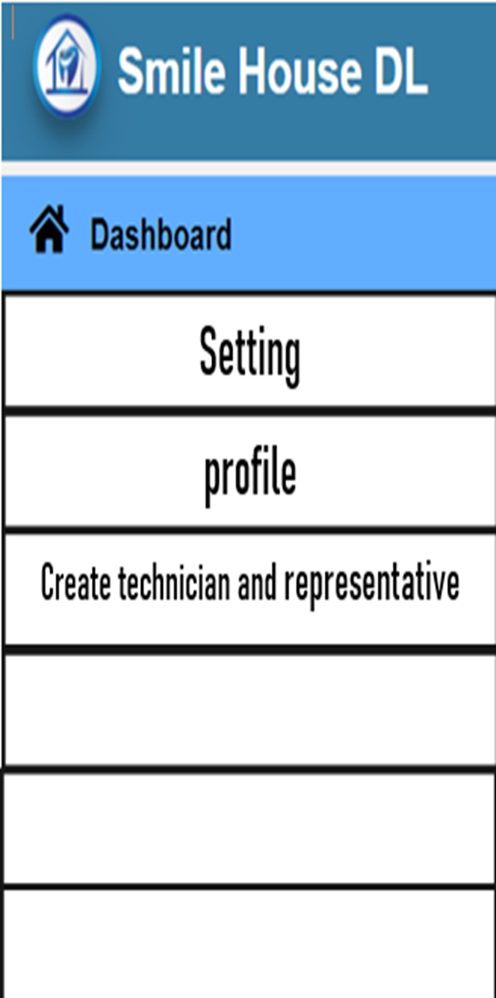
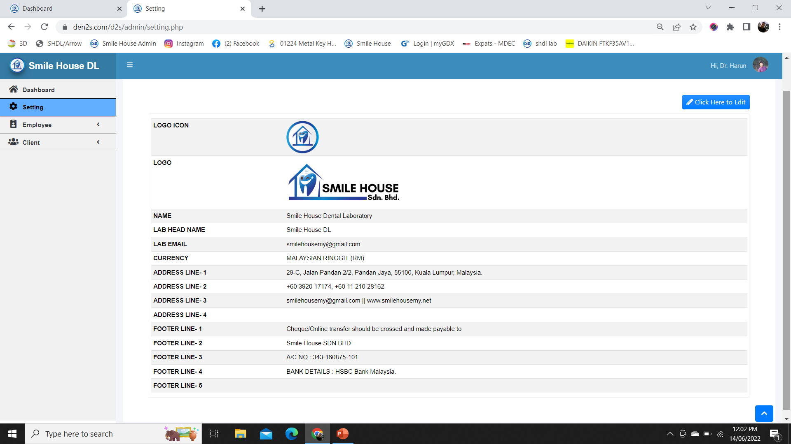
Profile
Settings
(Profile)

Slide 4
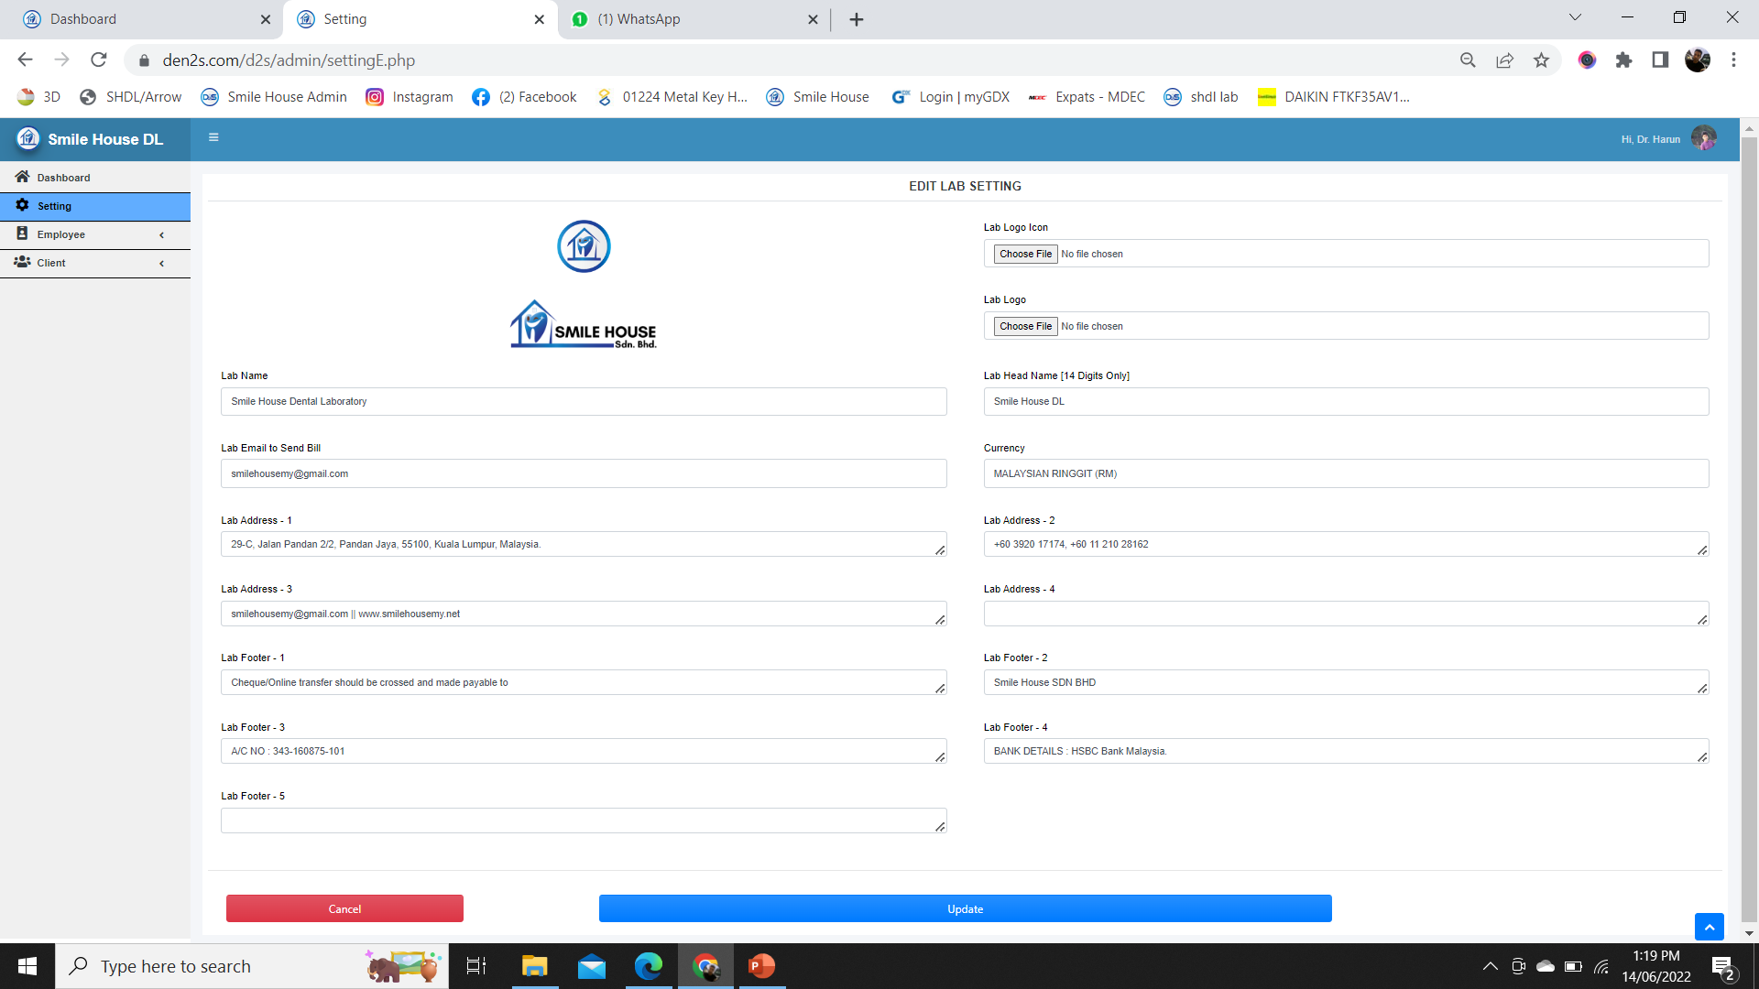
Profile edit form
Settings
(Profile Edit Form)

Slide 5


Create ADMIN, MANAGER, TECHNICIAN (Technician will have access to created task for 72 hours, then will be automatically deactivated the edit and delete option. Manager will have access to the task for up to 45 days, then edit and delete will be deactivated)
Admin |  |  | Manager
Name |  |  | Name
Name |  |  | Name
Name |  |  | Name
Name |  |  | Name
Create |  |  | Create
Technician
Create
Setting
(User)

Slide 6
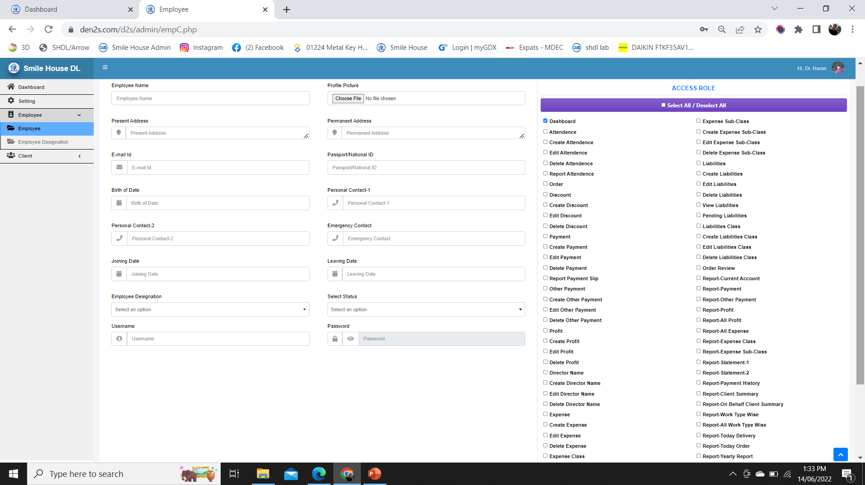
Create user form with access role
Setting
(Create User Form)

Slide 7
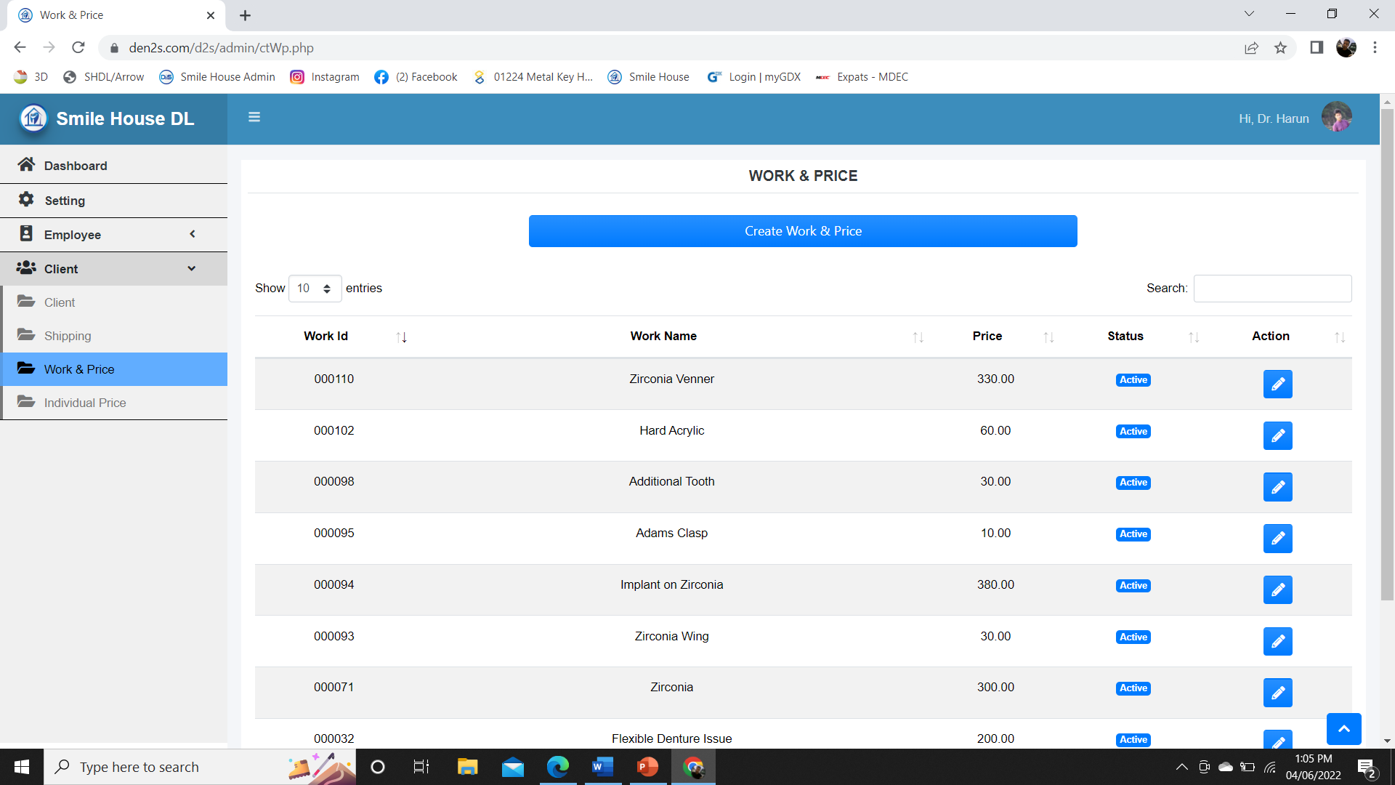
Work and price
Setting
(Work & Price)

Slide 8
Create Work and price (Create group and create work type can be on separate page or on the same page. Depending on the work group selection the options to select the “Order Page” will be visible or invisible)
Setting
(Work and Price View)
Lab Form:
A/B/C
Select Group:
Crown & Bridge
Create Group
Work Name:
PFM Crown
Enter Price:
150.00
Select Status:
Active/ Inactive
N.B: When the status will be selected as Inactive, it won’t be shown on the lab form. But it will still be available on the backend to edit any previous order.
Cancel
Submit

Slide 9
“Create group form” view
Setting
(Create Group Form)
Group Name:
Enter a Name
Select Status:
Active/ Inactive
Cancel
Submit

Slide 10
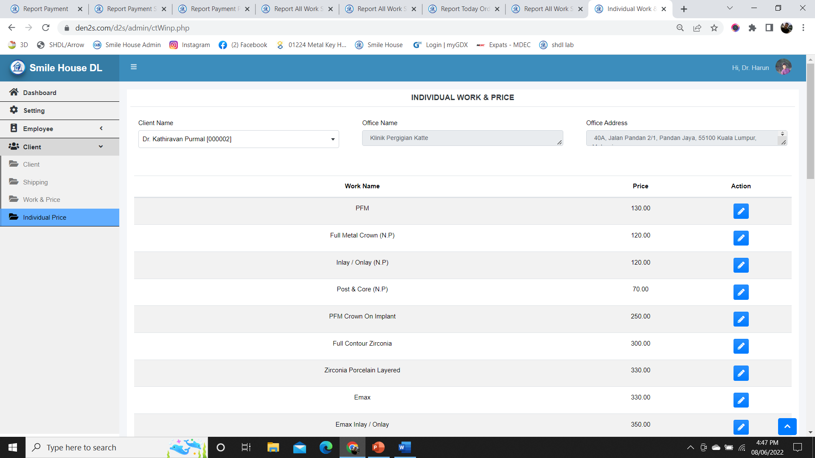
INDIVIDUAL PRICE (General price create and edit)
Setting
(Individual Price)

Slide 11
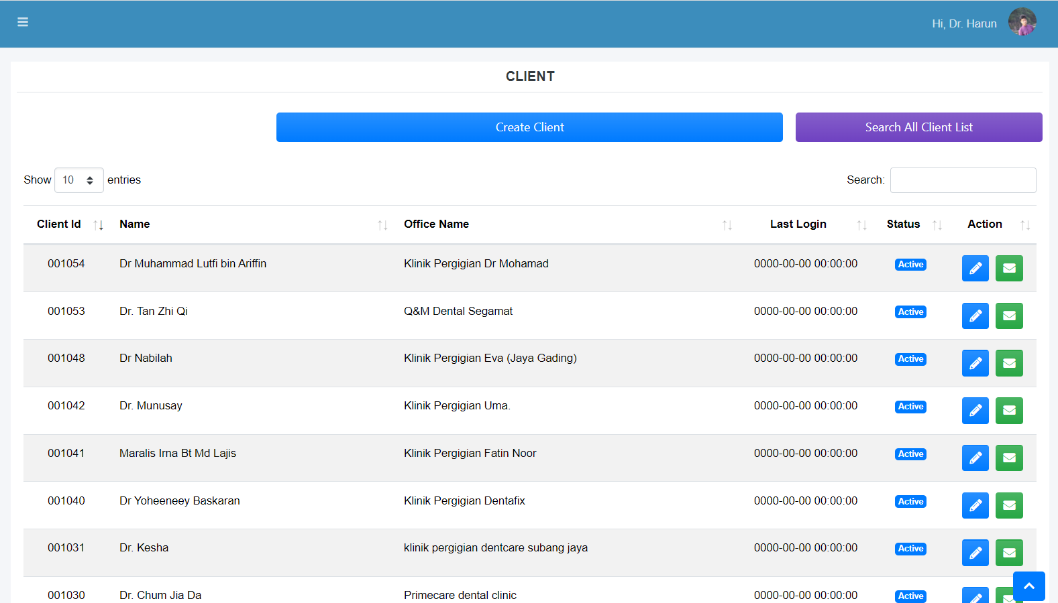
Create client from admin panel (If doctor not interested to create his own account. Also doctor’s details need to be updated on the panel automatically)
Setting
(Created Client List view)

Slide 12
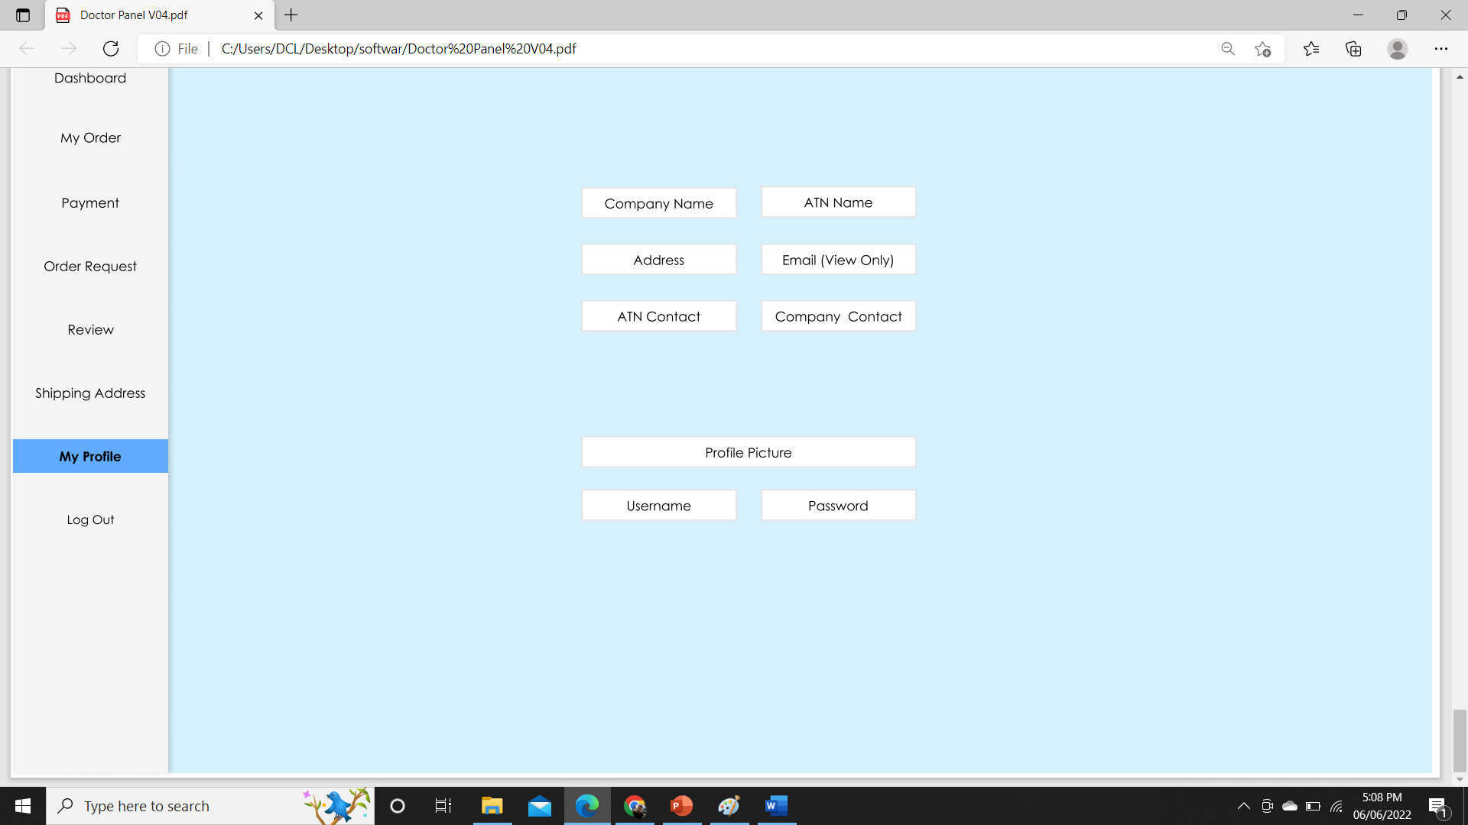
Create client from admin panel (Username and password will be automatically assigned and must be editable. Representative name option need to be listed on the dropdown menu.)
Setting
(Create Client and View - Client Form)
Representative Name or Dealings By
Select Status (Active/Inactive)

Slide 13
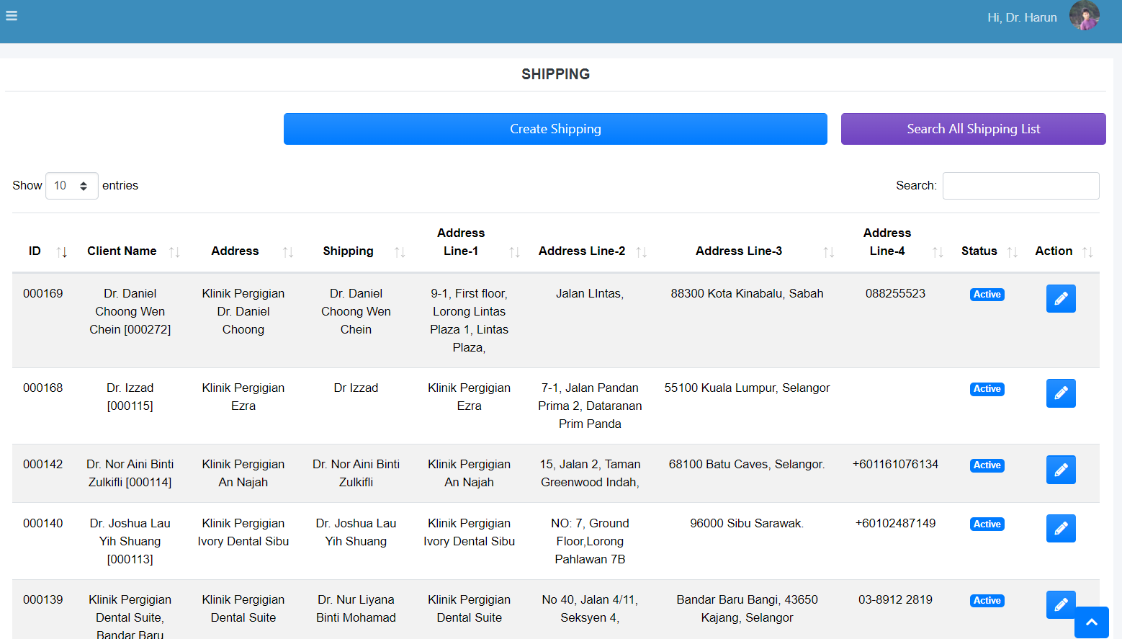
Create shipping (If doctor not interested to create his own shipping. Also doctor’s shipping details need to be updated on the panel automatically. Shown number of items on the report need to be “50” by default.)
Setting
(Shipping Create & View)

Slide 14
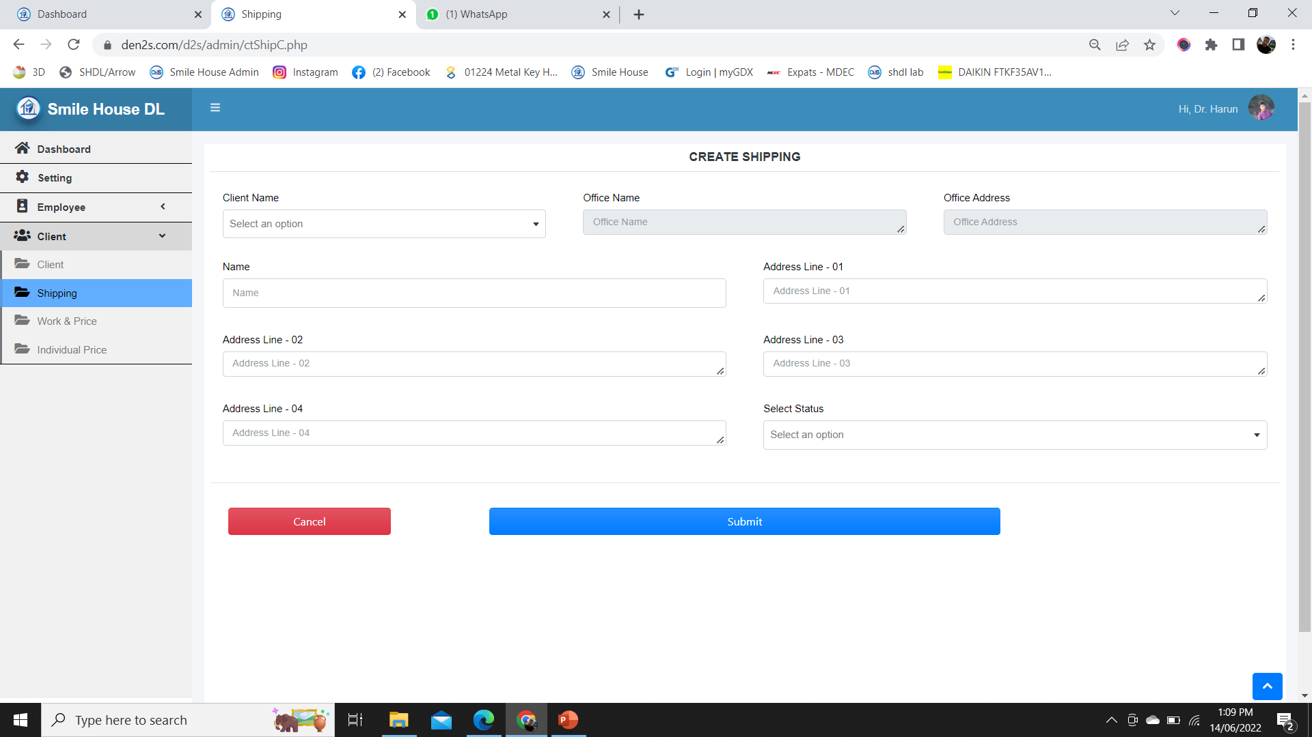
Create shipping form (On The Form Client Name Will Be Selected From The Dropdown List, Office Name And Address Will Be Auto Filled Upon Selection)
Setting
(Shipping Form)

Slide 15
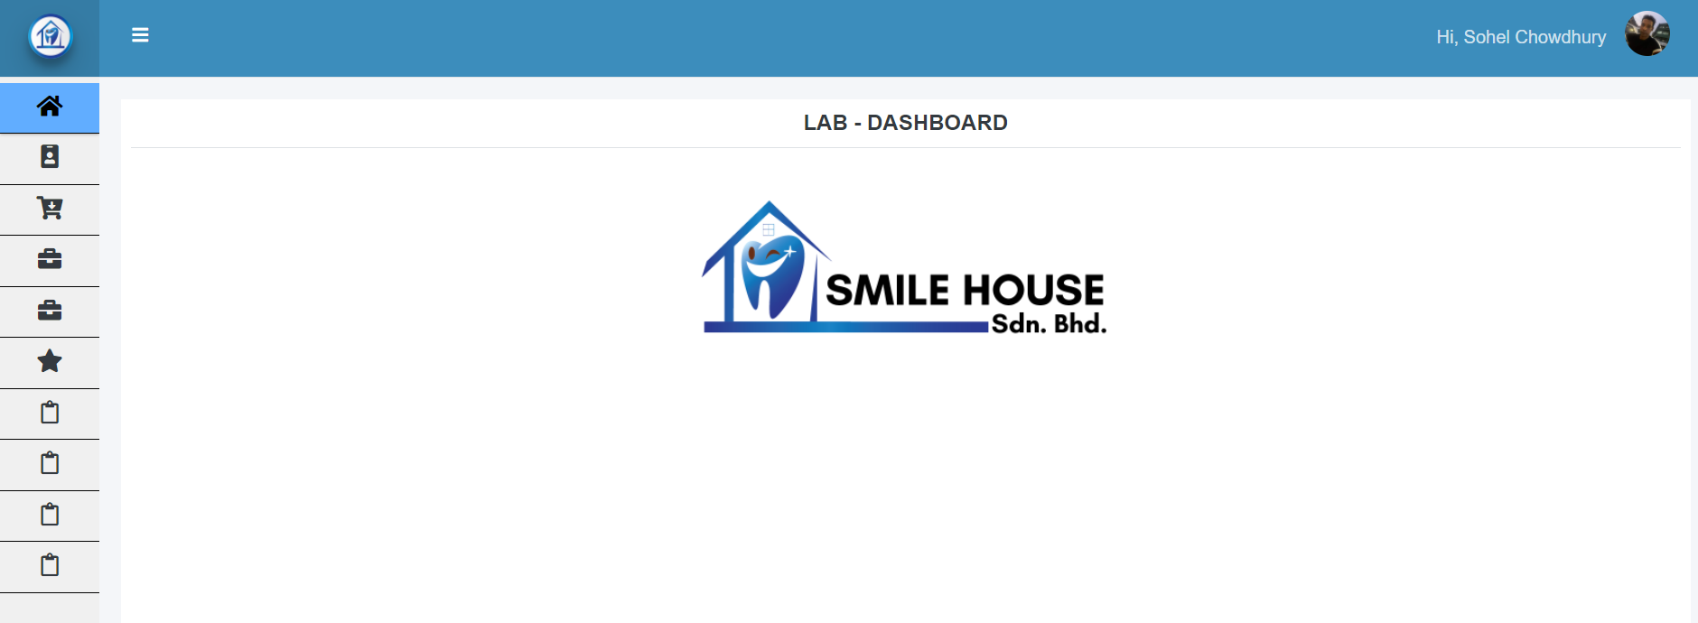
LAB dashboard

Slide 16
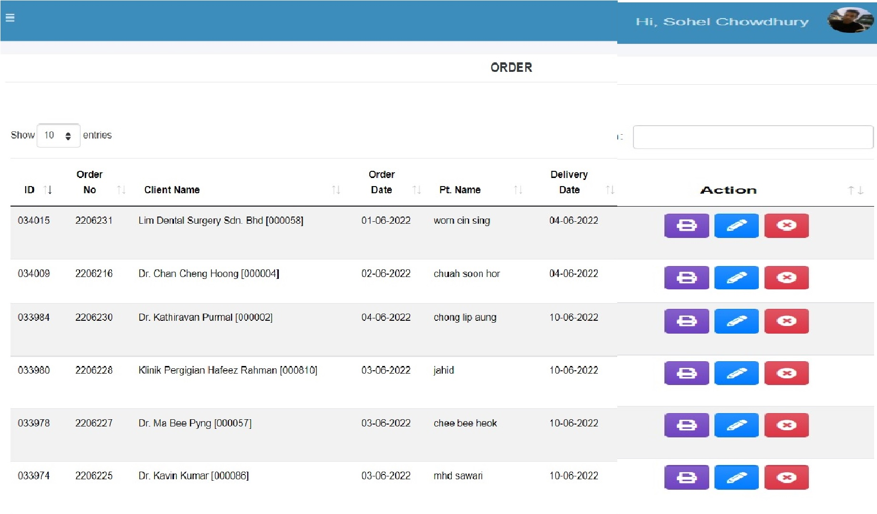
Requested order (Orders requested by the doctors from their panel can be viewed and edited if required. Option to cancel any order on doctor’s panel and on the backend need to be added, so that an Order can be cancelled if required. If the order is cancelled from the doctor or from the admin, the record will be kept but will not be listed in the work status list.)
Setting
Order
(Requested Order)
Accounts
Cancel
Cancel
Client
Cancel
Work Report
Cancel
Cancel
Account Report
Cancel

Slide 17
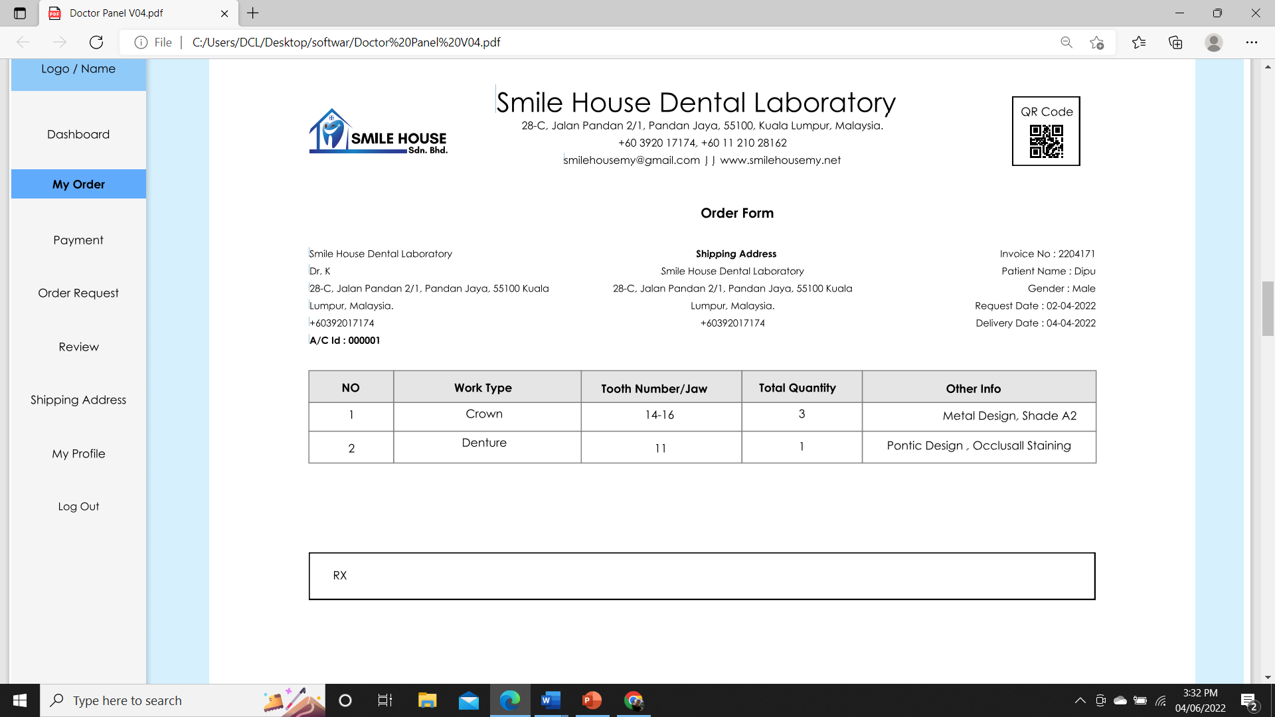
print order (Orders can be printed from the panel)
Setting
Order
(Print Order)
Accounts
Client
Work Report
Account Report

Slide 18
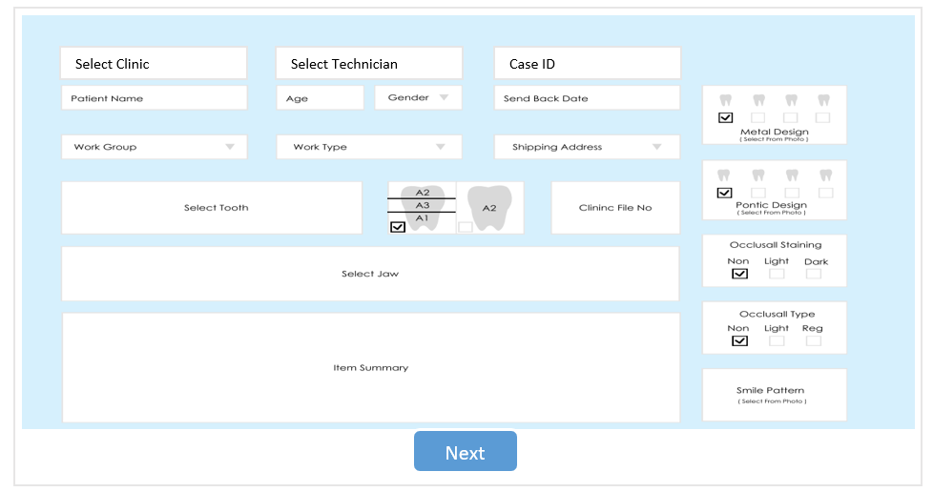
Create/or edit order Form -1 (Orders are placed by the doctors Orders can be created manually from the panel when required. Other than the Removable restoration “Multi selection Shade” and the panel on the Right will be visible. Multiple shade ratio will be indicated as the percentage as color shade matters for teeth. Smile pattern and promo code option will be manageable from the back-end)
Setting
Order
(Create Order Page-1)
Accounts
Client
Work Report
Account Report

Slide 19
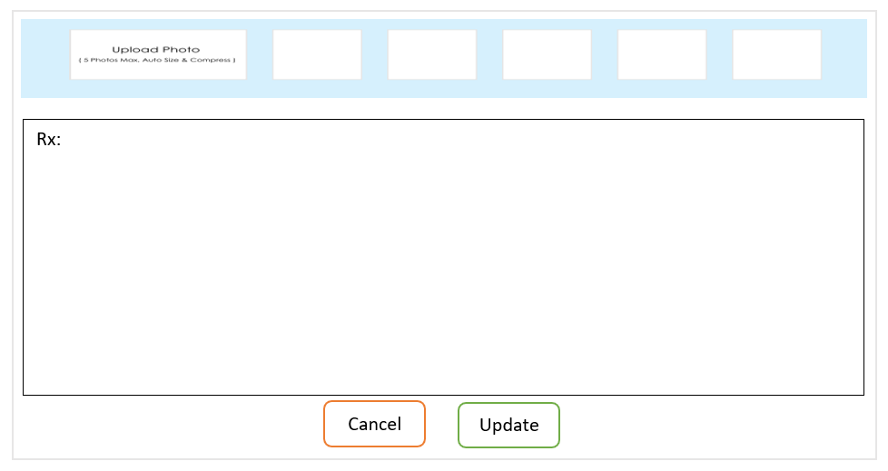
Create/or edit order page-2 (Size limit for the image: 4MB or the doctor can upload any size photo, but it will be automatically resized and compressed while saving on the system. The Rx section will be used as the follow-up instructions from the doctor. If doctor wants to cancel any instruction, he will be able to strike through the line, so that it can be viewed as history.)
Setting
Prom
Code
Order
(Create Order Page-2)
Date: [10-06-22] Time: [10:00 am]
Accounts
Please make the ……….
Can be strike trough…..
Client
Date: [11-06-22] Time: [10:00 am]
Please make the ……….
Work Report
Account Report

Slide 20
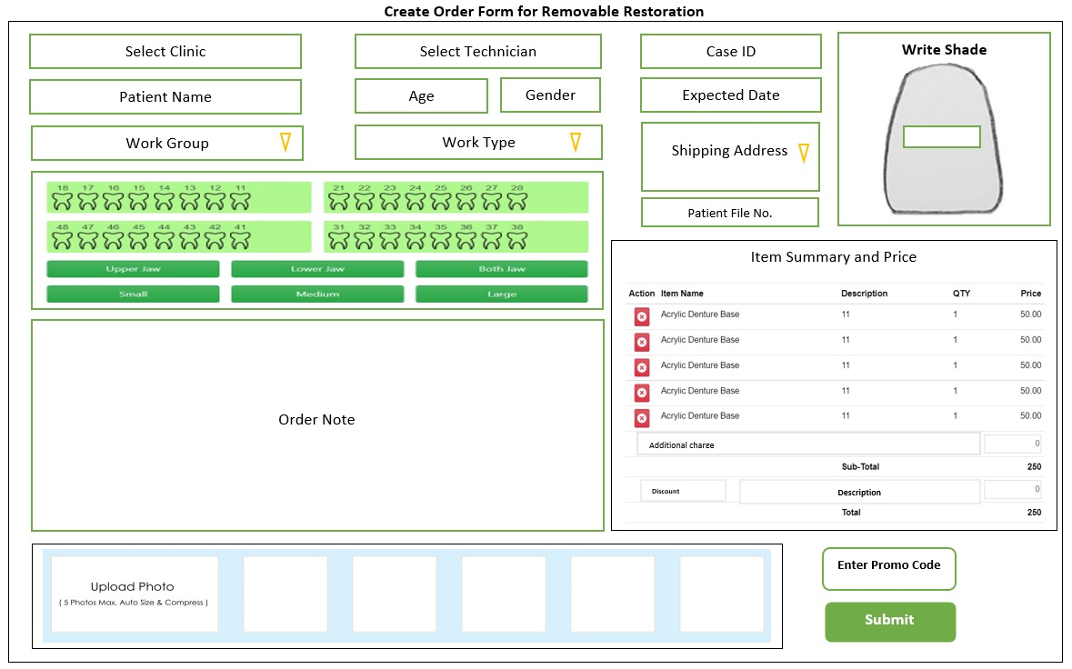
Create/or edit order Form -1 (Orders are placed by the doctors Orders can be created manually from the panel when required. For Removable restoration “Multi selection Shade” and the panel on the Right will be invisible. Smile pattern and promo code option will be manageable from the back-end)
Setting
Order
(Create Order Page-1)
Accounts
Client
Work Report
Account Report

Slide 21
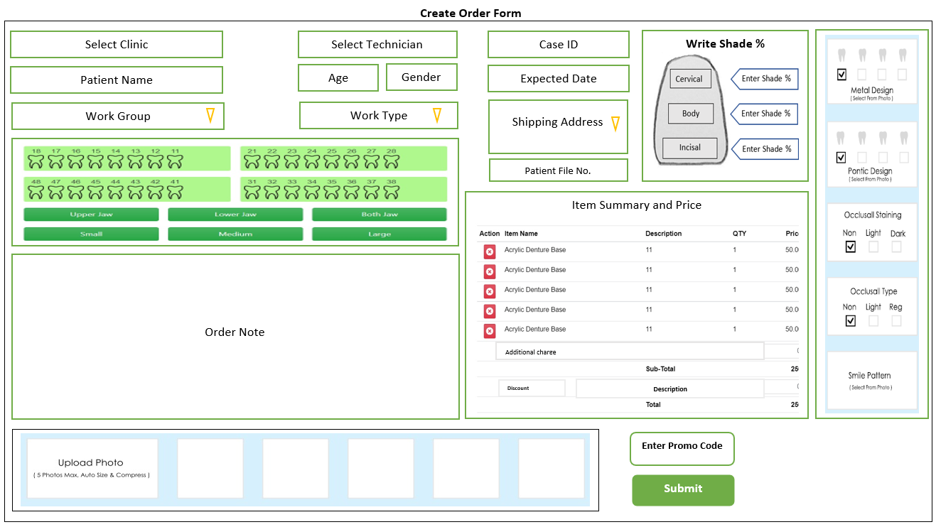
Create/or edit order Form -2 (Orders are placed by the doctors Orders can be created manually from the panel when required. For Removable restoration “Multi selection Shade” and the panel on the Right will be invisible. Smile pattern and promo code option will be manageable from the back-end)
Setting
Order
(Create Order Page-1)
Accounts
Client
Work Report
Account Report

Slide 22
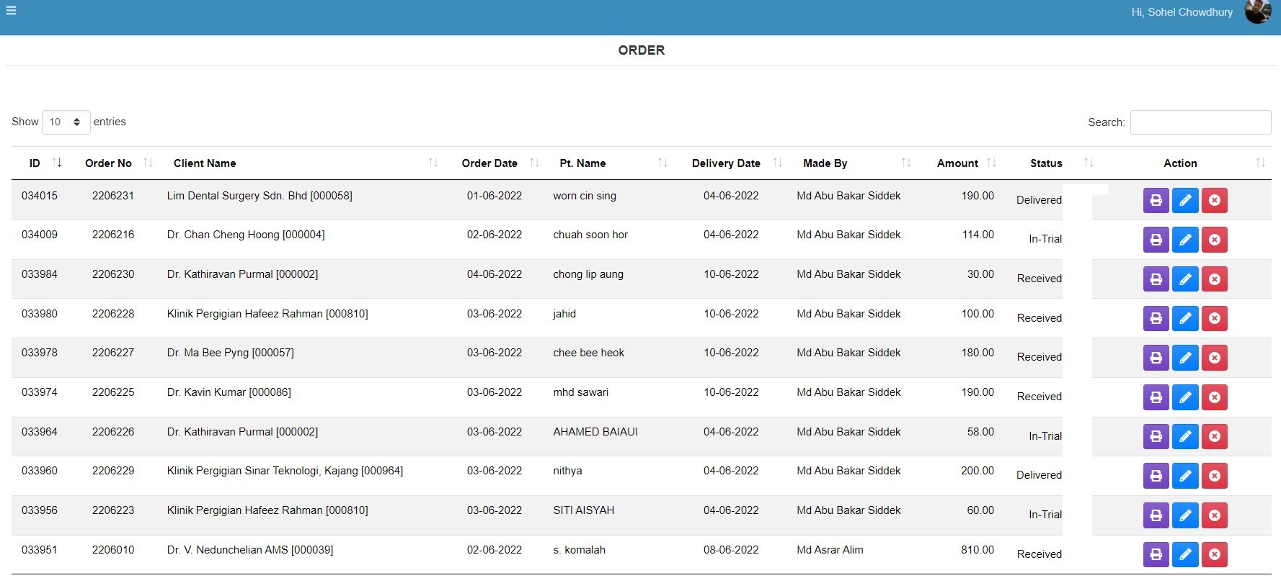

view order (Generate order report for a certain duration on date to date and by client, must start with All Client Option. Representative will be able to see only his own client’s data. Technician will be able to see only his own works. Management will be able to see all. Dedicated Label Printing Button need to be added. The label print will be done for a client, but the printing instruction will be placed from Order list)
Setting
Select Client (Select All Client | Individual Client)
From Date
To Date
Search
Order
(View Order)
LP
Accounts
LP
LP
LP
Client Report
LP
LP
Work Report
LP
LP
Account Report
LP
LP

Slide 23
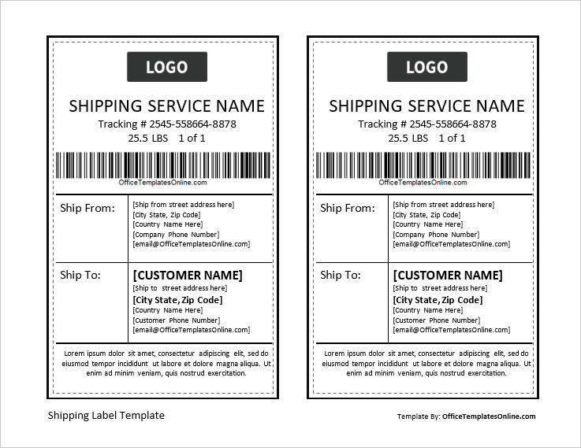
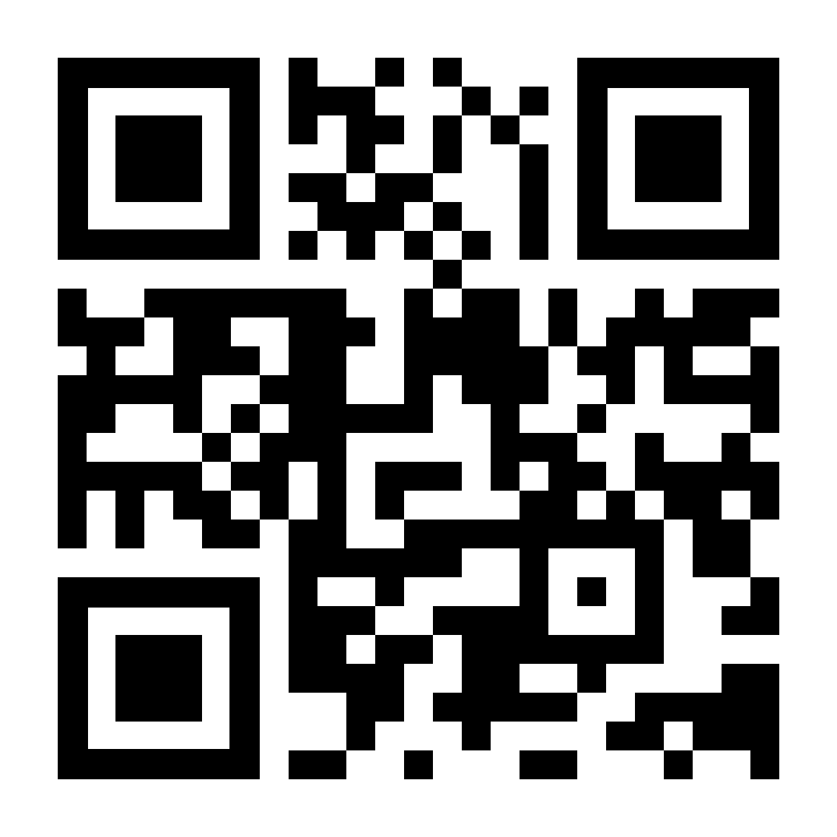
Label printing (Will Be Created As A Separate Functionality to print the delivery label for the trial or completed works)
Printed Label
Setting
SMILE HOUSE DENTAL LAB
N.B: This Label will be generated against a client ,not against an order number. Should be easily accessible from the order list. Print will be done through Thermal Label Printer.

Slide 24
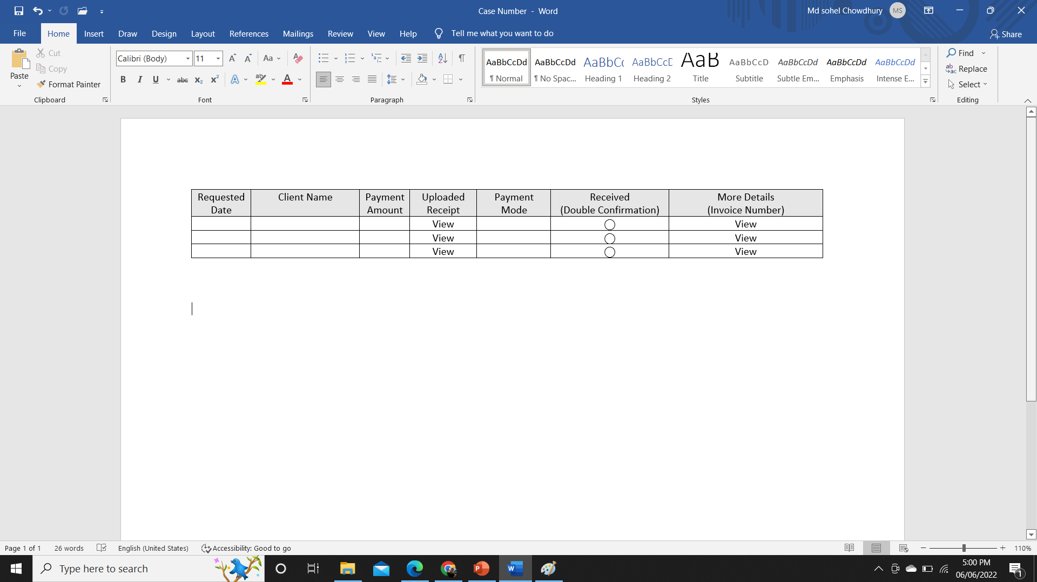
Requested Payment (Requested payment will be displayed in the list for the final approval from the backend.)
Setting
Order
Accounts
(Requested Payment)
Client Report
Work Report
Account Report

Slide 25
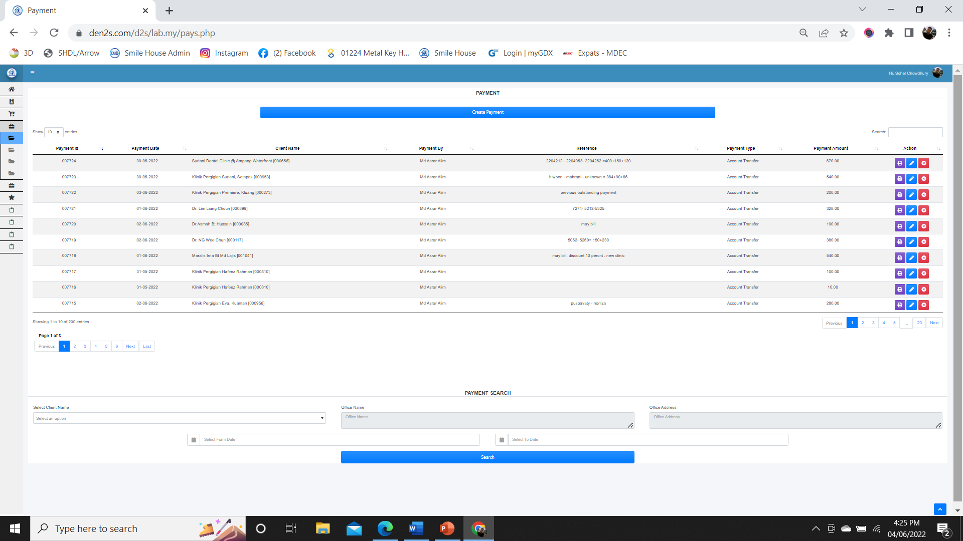
view Payment (Generate Payment report for a certain duration)
Setting
Order
Accounts
(View Payment)
Client report
Work Report
Account Report

Slide 26
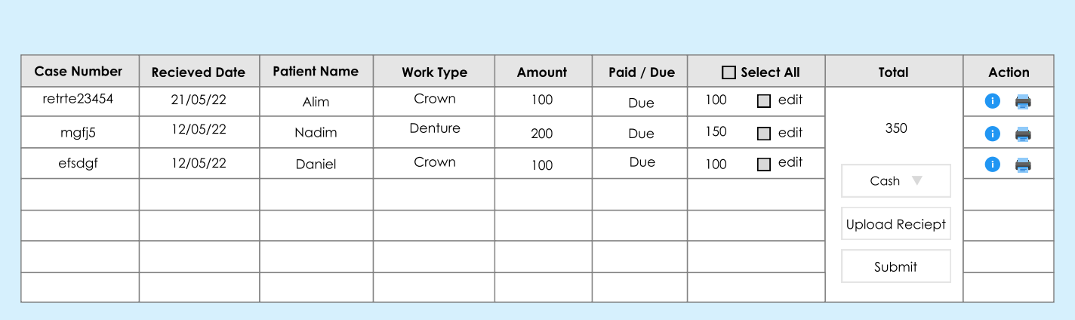
Create Payment (Can be searched by Client or Clinic name. After selecting any from the list, address will be auto filled up. And the details will be shown after clicking the search button. Initially, the Upload Receipt option will be optional, but later on it will be marked as mandatory)
Setting
Client Name Search
Clinic Name Search
Address Auto Fill up
Search
Order
Accounts
(Create Payment)
Client Report
Work Report
Account Report

Slide 27
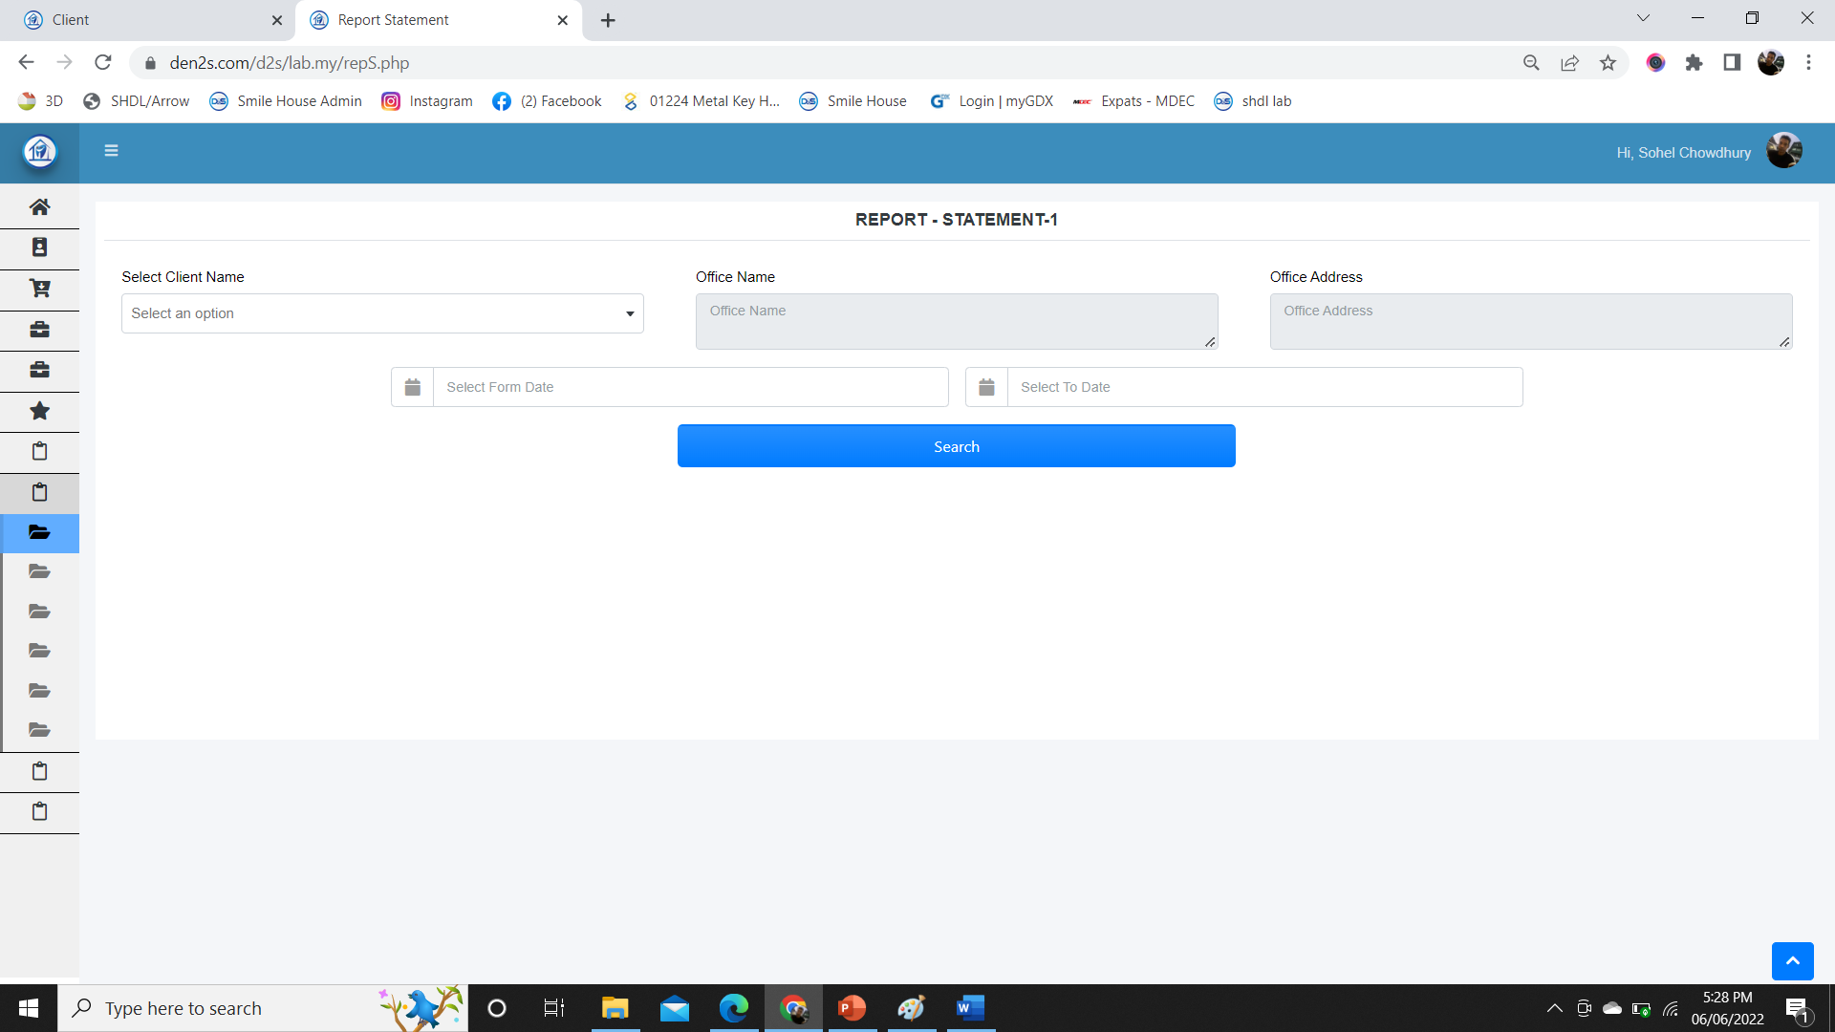
Client report (Client name or clinic name need to be selected from drop-down menu. Details of client will be filled-up. Statement can be generated for all time or from date to date)
Setting
Select Clinic
Select Client
Order
Accounts
Select All or Date to Date
Date From
Date to
Search
Client Report
(Statement)
Work Report
Account Report

Slide 28
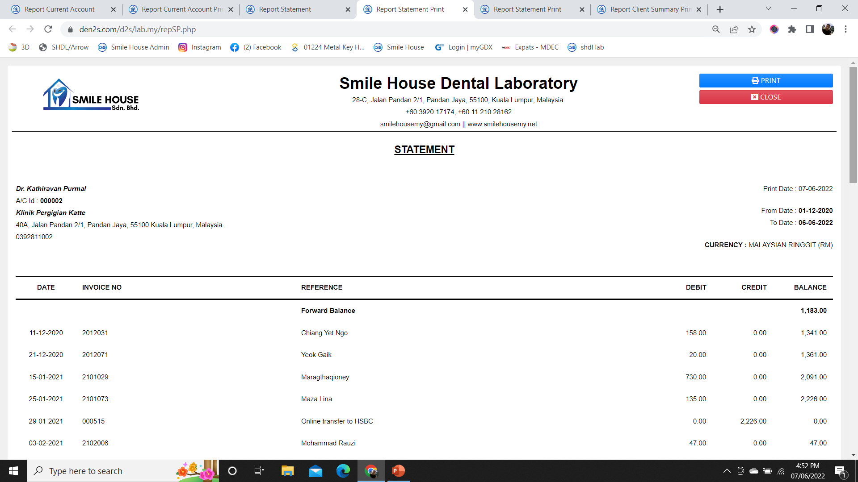
Full Statement view
Setting
Full Statement
Order
Clinic Name
ATTN: Doctor Name
Clinic Address
Phone:
ID:
Print Date
Accounts
Client Report
(1. Full Statement)
Work Report
Account Report

Slide 29
Date to date Statement view
Setting
Date to Date Statement
Order
Clinic Name
ATTN: Doctor Name
Clinic Address
Phone:
ID:
Print Date
Accounts
Client Report
(2. Date to Date Statement)
Work Report
Account Report

Slide 30
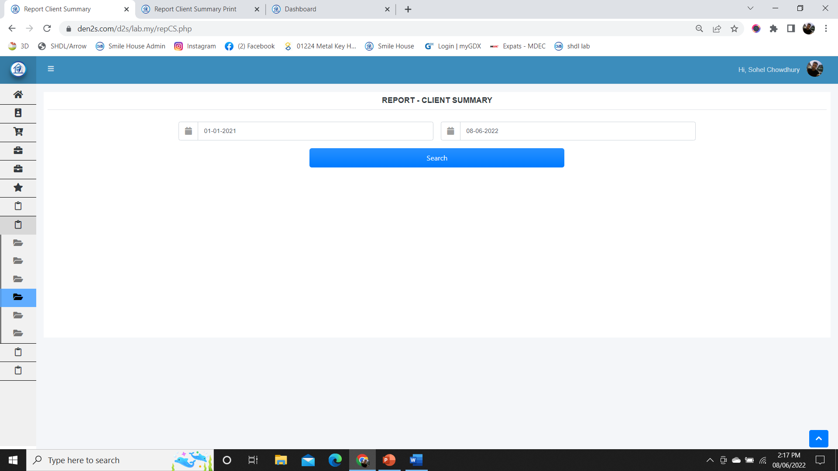
Client Summary (Client summary can be search from date to date)
Setting
Order
Accounts
Client Report
(Client Summary)
Work Report
Account Report

Slide 31
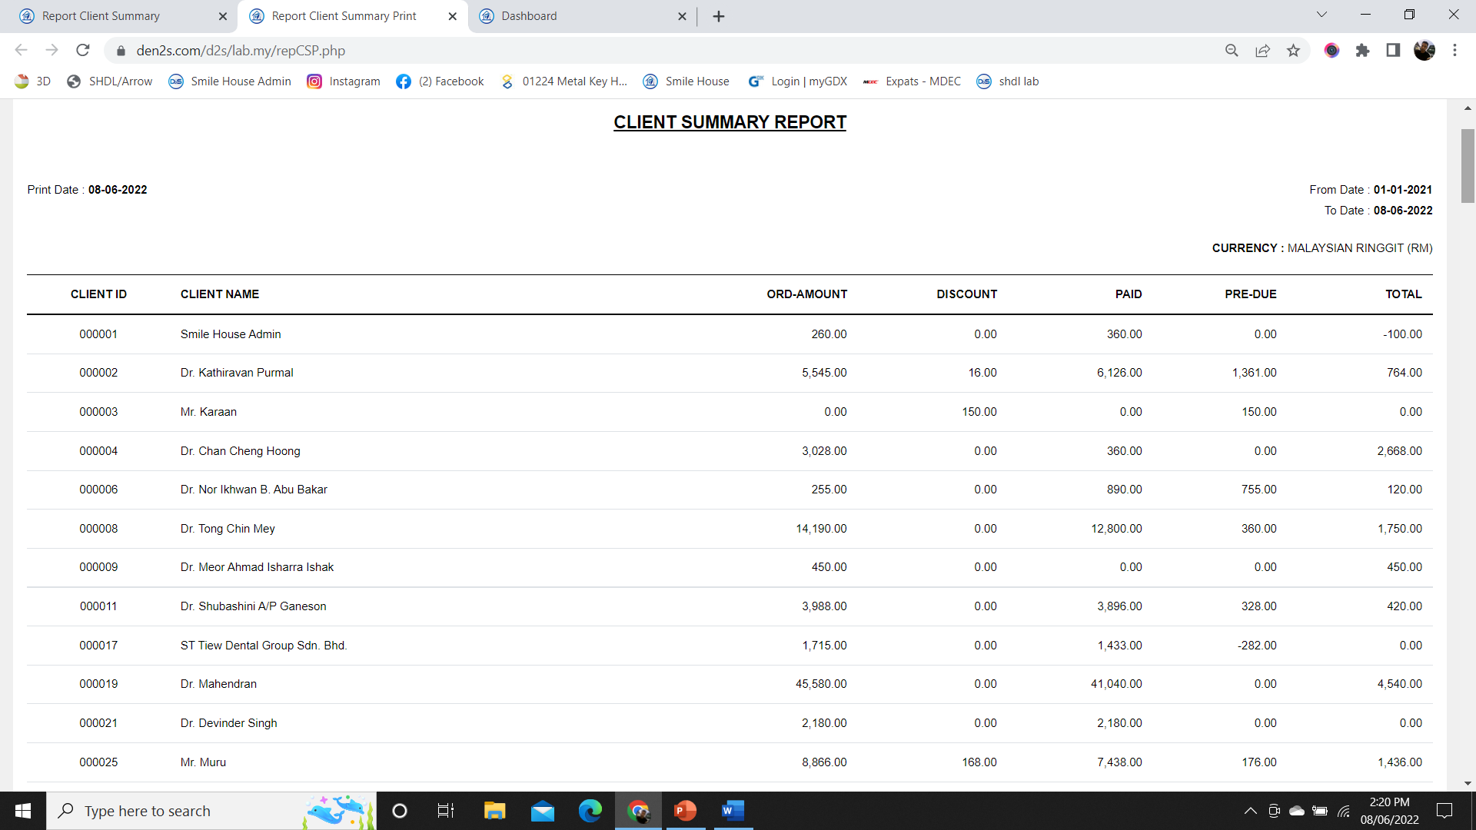
Client Summary View (Client summary can be search from date to date)
Setting
Order
Accounts
Client Report
(Client Report View)
Work Report
Account Report

Slide 32
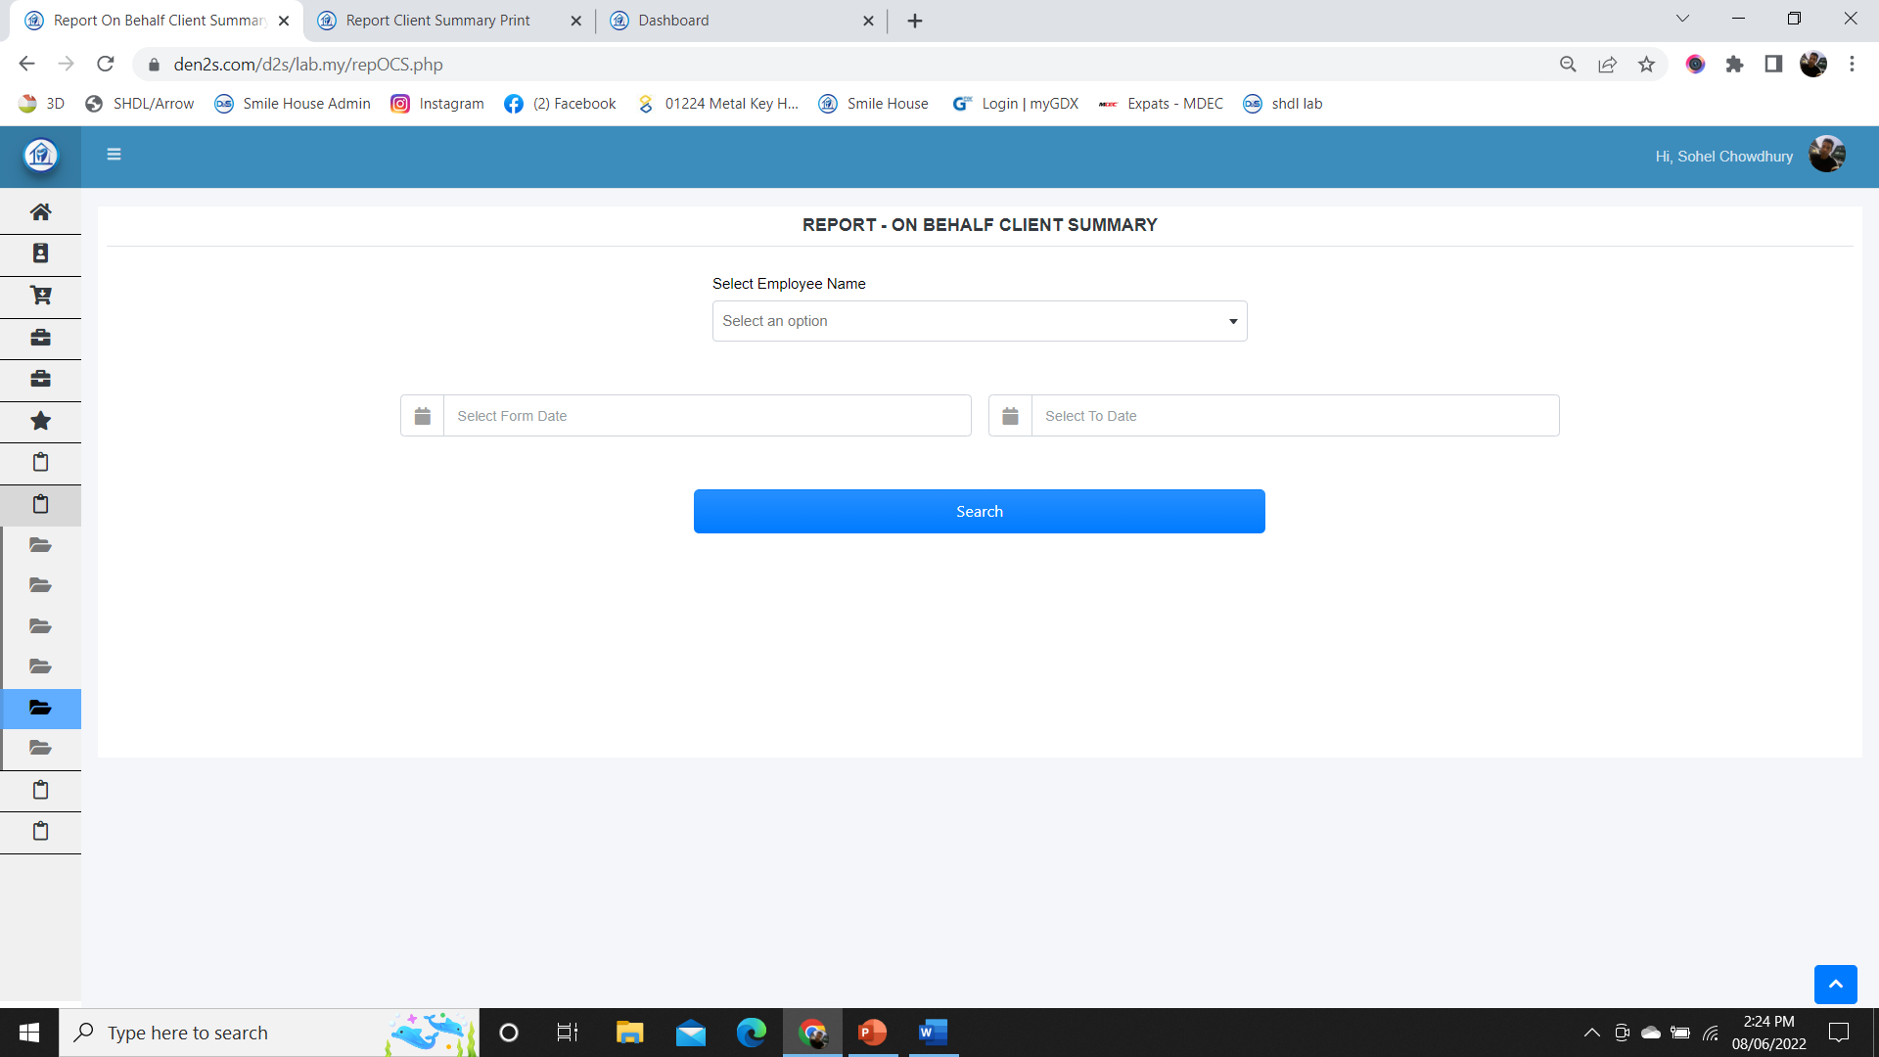
On behalf Client Summary (Representative Can view their respective client summary. Management can see all the user’s information. View should be assigned from the access list)
Setting
Order
Accounts
Client Report
(On Behalf Client Summary)
Work Report
Account Report

Slide 33
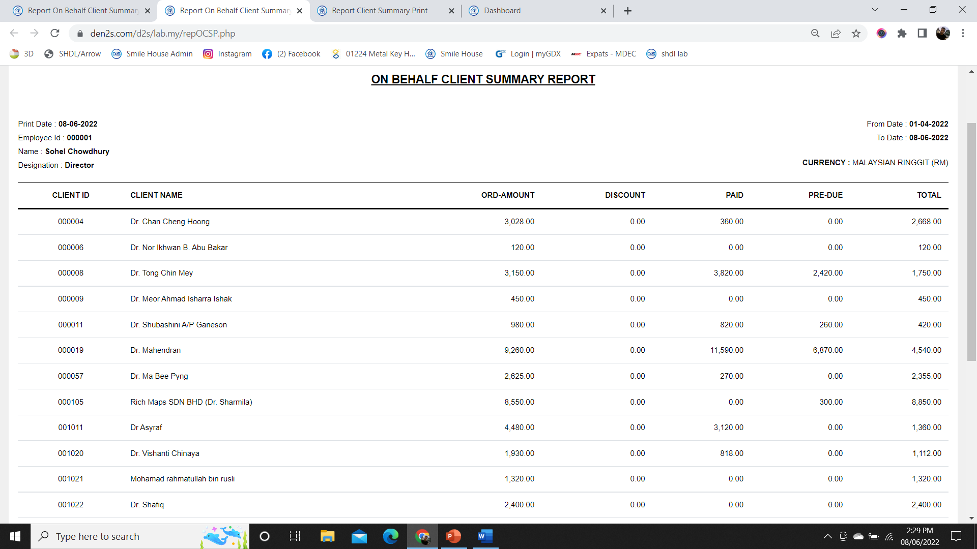
On behalf Client Summary view (View of the On Behalf Client summary Report)
Setting
Order
Accounts
Client Report
(On Behalf Client Summary View)
Work Report
Account Report

Slide 34
Invoice search (Search all the invoice or from date to date)
Search Invoice
Setting
Select Clinic
Select Client
Order
Accounts
Select All or Date to Date
Date From
Date to
Search
Client Report
(Invoice Search)
Work Report
Account Report

Slide 35
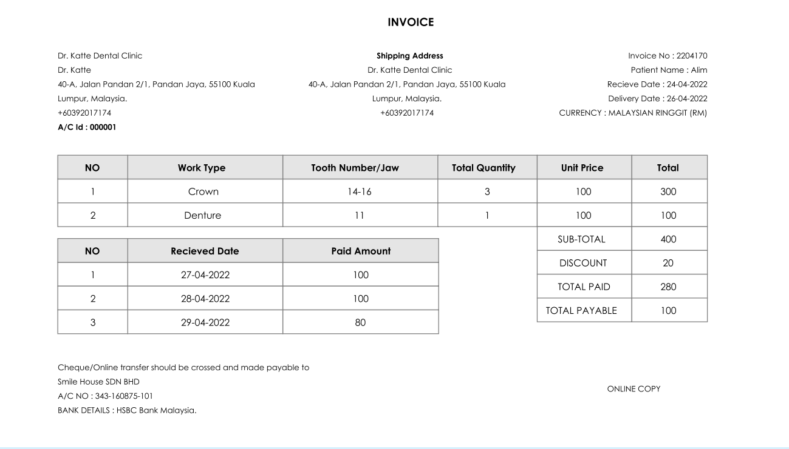
Invoice View and print (The view of the invoice that should be linked to respective report and order list. Should be linked with the Client report section as well.)
Setting
Order
Accounts
Client Report
(Invoice View and Print)
Work Report
Account Report

Slide 36
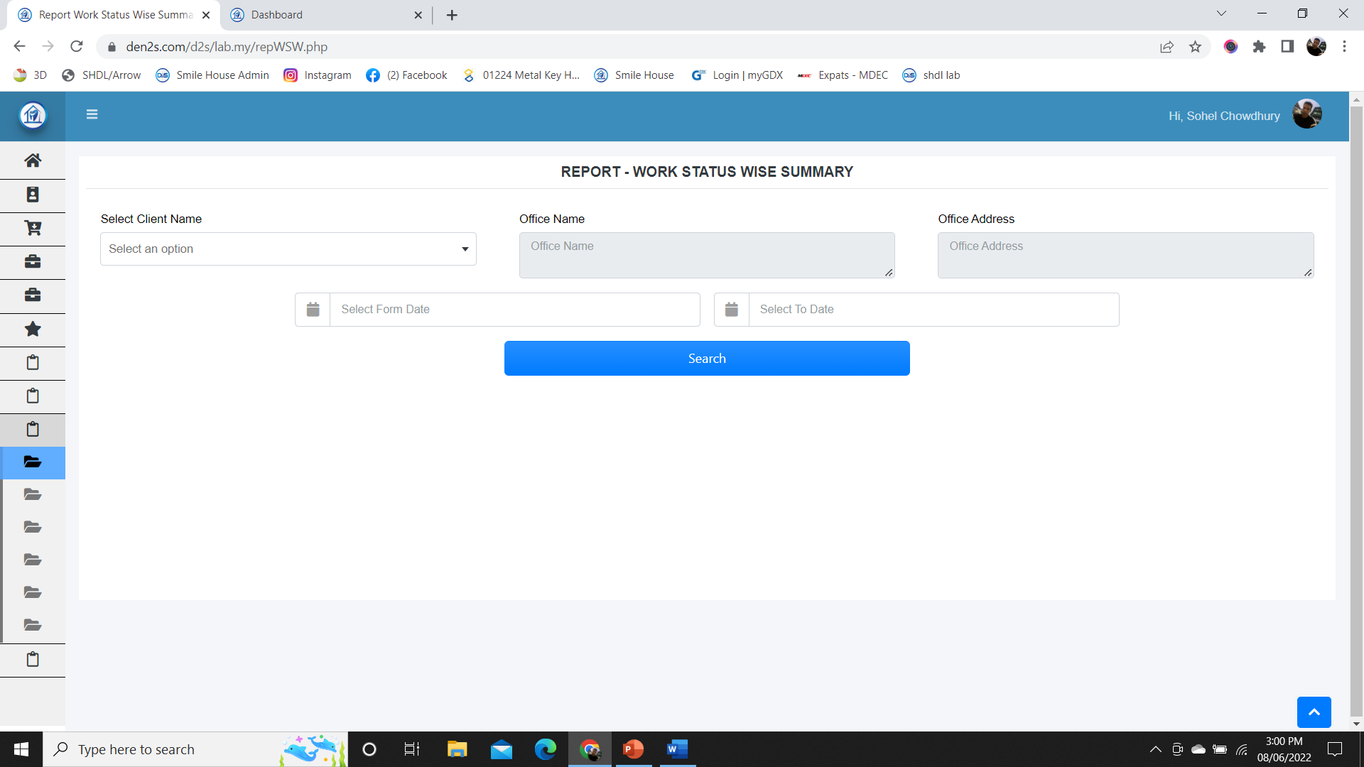
Work status wise summary (The view of the invoice that should be linked to respective report and order list. Should be linked with the Client report section as well.)
Setting
Select Status
Select Work Status
Order
Accounts
Client Report
Work Report
(Work Status Wise Summary)
Account Report

Slide 37
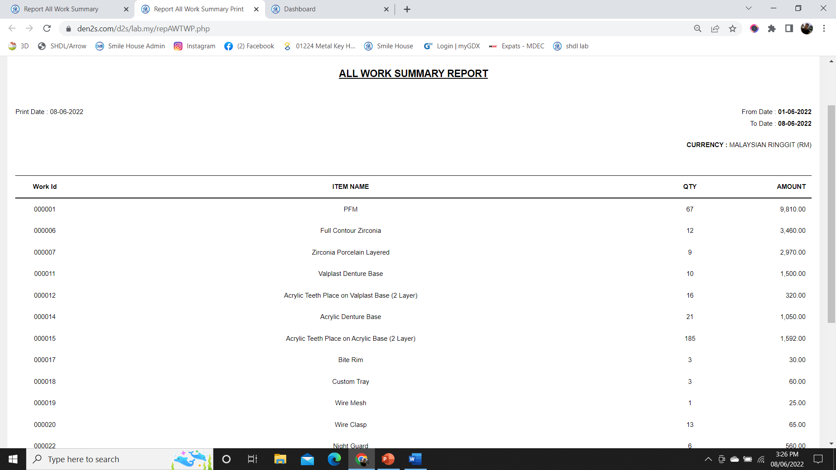
Work wise summary report view (The view of the invoice that should be linked to respective report and order list. Should be linked with the Client report section as well.)
Setting
Order
Accounts
Client Report
Work Report
(Work Wise Summary View)
Account Report

Slide 38
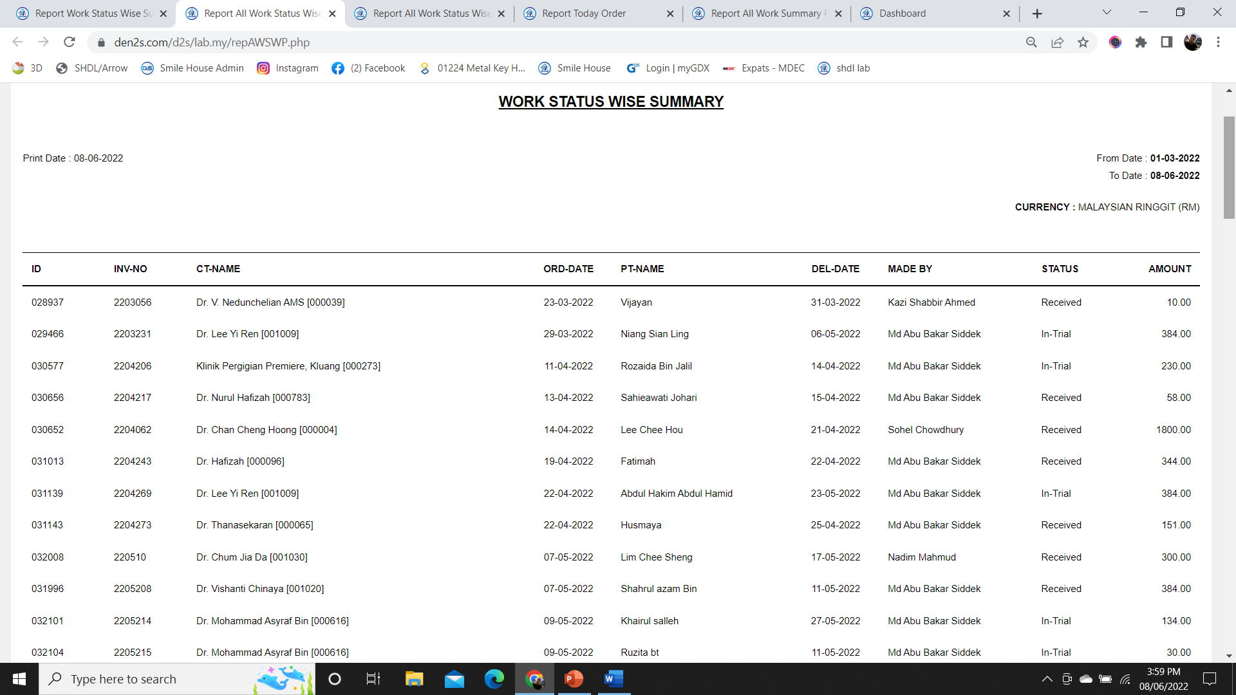
Work status wise summary report view (The view of the invoice that should be linked to respective report and order list. Should be linked with the Client report section as well.)
Setting
Order
Accounts
Client Report
Work Report
(Work Status Wise Summary View)
Account Report

Slide 39
Invoice summary (The view of the invoice that should be linked to respective report and order list. Should be linked with the Client report section as well.)
Setting
Select Status
Order
Accounts
Client Report
Work Report
(Order and Delivery View)
Account Report

Slide 40
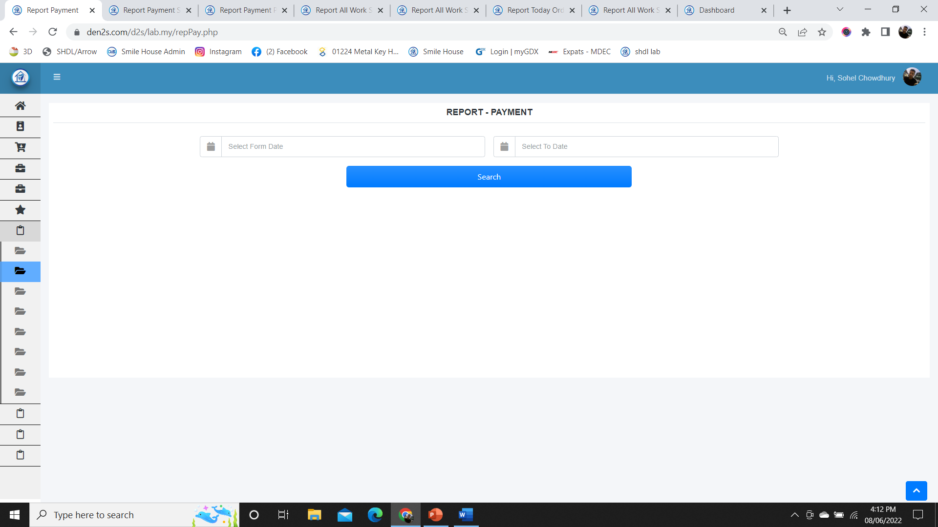
payment summary (The summary of the payment will be displayed upon selection of all payment or individual client wise)
Payment Status
Setting
All Payment
Select Client
Order
Accounts
Client Report
Work Report
Account Report
(Payment Summary)

Slide 41
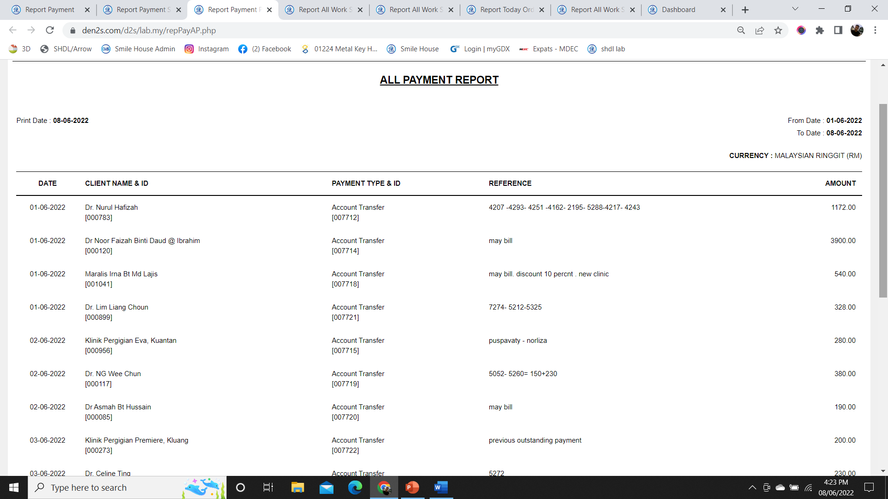
payment summary all payment view (The summary of the payment will be displayed upon selection of all payment or individual client)
Setting
Order
Accounts
Client Report
Work Report
Account Report
(Payment Summary All Payment View)

Slide 42
payment summary client wise view (This will be the view for the individual client payment summary)
Client Payment Summary
Setting
Client Name
Client ID
Order
Accounts
Client Report
Work Report
Account Report
(Payment Summary Client Wise view)

Slide 43
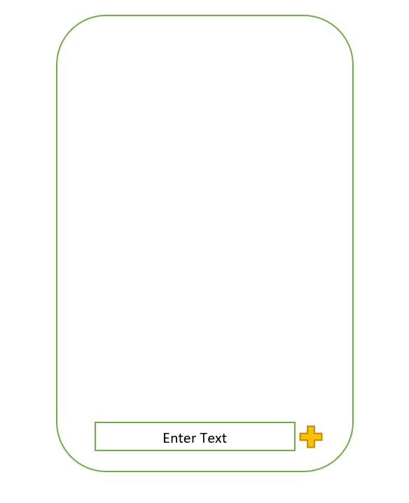
Online Chat option view on doctor’s panel (Upon Click Of The Chat Button On The Panel, this chat area will be opened as the first instance. Doctor will then click the plus sign to add fields like Upload Image, Upload File)
Chat Box View

Slide 44
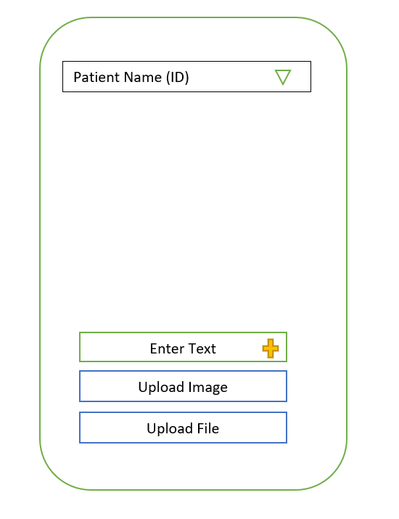
Online Chat option view on doctor’s panel (When the plus sign is clicked, following options will be available for doctor's use. Doctor can upload image or upload file according to the requirement)
Chat Box View

Slide 45
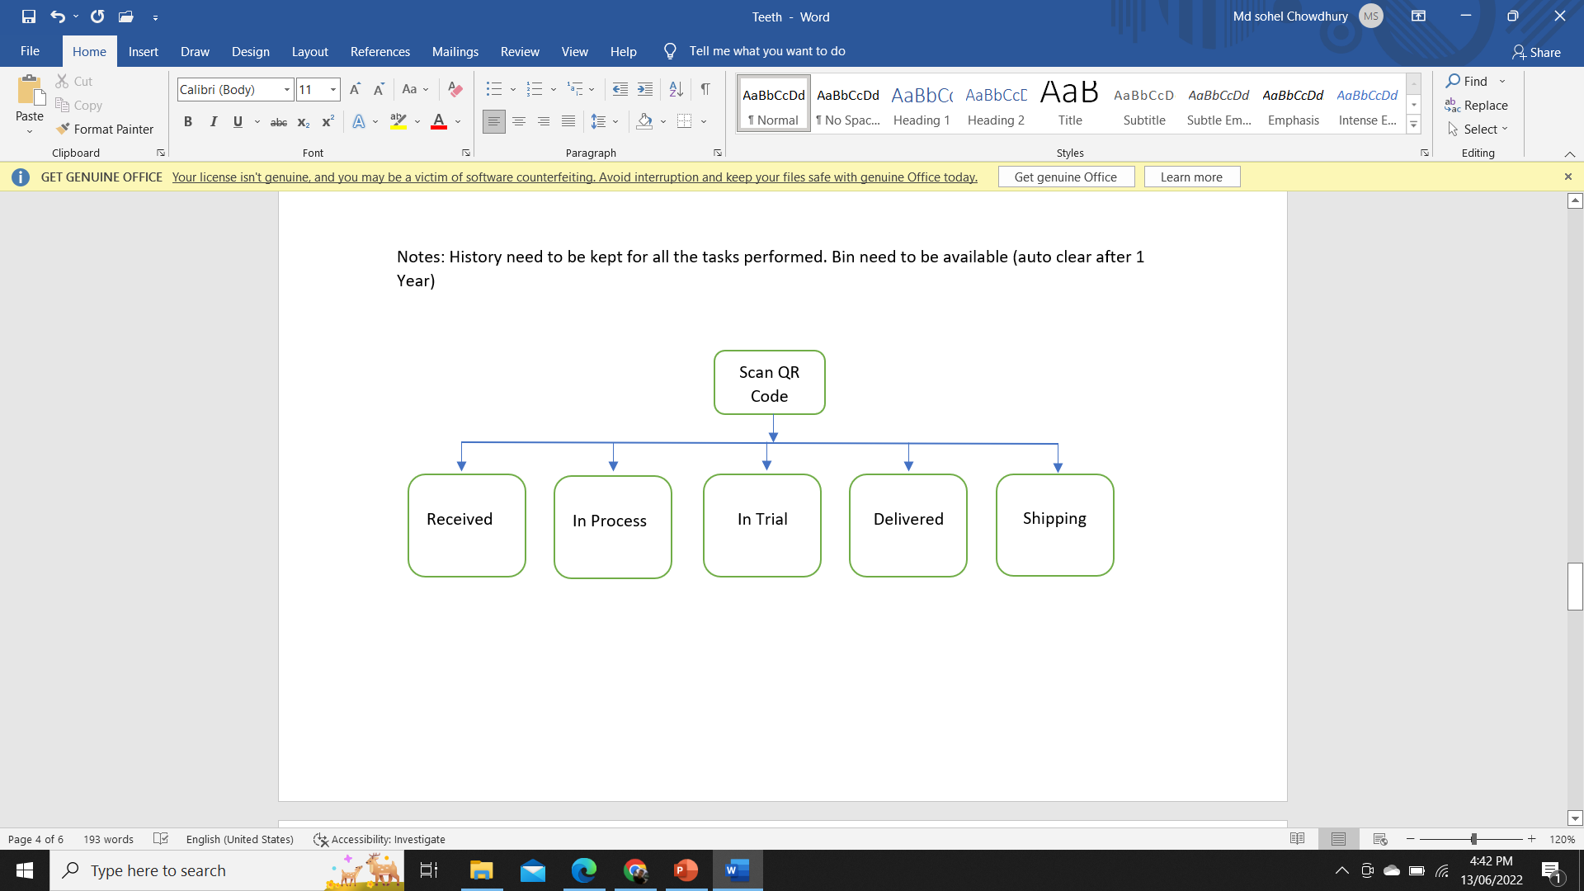
QR code scan option from smartphone (Will be scanned by the respective departments. Respective QR Code Scan Option Will Be Available For An Order, Invoice against an order won’t be available to print unless “Delivered” scan is done. QR code scan option must be available through smartphone. Access rule need to be applied for the users of the QR code option.)
QR Code System

Slide 46
special notes
History need to be kept with date and time for all the tasks performed, even if any item is deleted from the system.
Deleted item need to be archived in the “Bin” so that the item can be restored if required (“Bin” Auto clear after 1 Year).
On the reports, default number of items will be “100”.

