Slide 1

cek ec io
� 2015 AT&T Intellectual Property. All rights reserved. AT&T and the AT&T logo are trademarks of AT&T Intellectual Property AT&T Proprietary (Internal Use Only) Not for use or disclosure outside the AT&T companies except under written agreement

Slide 2
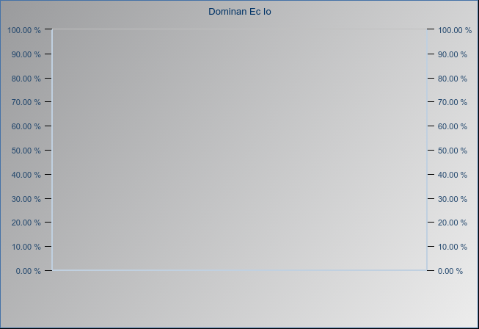
UMTS 1900 Scan - UARFCN.587 Histogram
Ec Io
-33 to -16
-16 to -14
-14 to -10
-10 to -7
-7 to 0
� 2015 AT&T Intellectual Property. All rights reserved. AT&T and the AT&T logo are trademarks of AT&T Intellectual Property AT&T Proprietary (Internal Use Only) Not for use or disclosure outside the AT&T companies except under written agreement

