Slide 1

NE
© 2015 AT&T Intellectual Property. All rights reserved. AT&T and the AT&T logo are trademarks of AT&T Intellectual Property.
AT&T Proprietary (Internal Use Only) Not for use or disclosure outside the AT&T companies except under written agreement

Slide 2
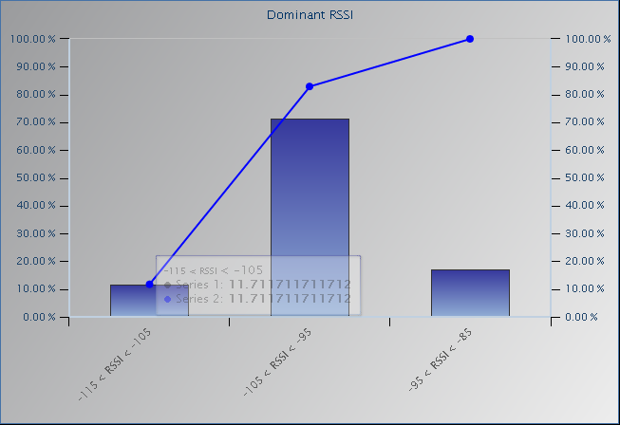
Device - 1 Receiver Ec/Io Histogram
RSSI
-115 to -105
-105 to -95
-95 to -85
-85 to -75
-75 to -65
© 2015 AT&T Intellectual Property. All rights reserved. AT&T and the AT&T logo are trademarks of AT&T Intellectual Property.
AT&T Proprietary (Internal Use Only) Not for use or disclosure outside the AT&T companies except under written agreement

