Slide 1

UMTS 3rd Floor
© 2015 AT&T Intellectual Property. All rights reserved. AT&T and the AT&T logo are trademarks of AT&T Intellectual Property.
AT&T Proprietary (Internal Use Only) Not for use or disclosure outside the AT&T companies except under written agreement

Slide 2
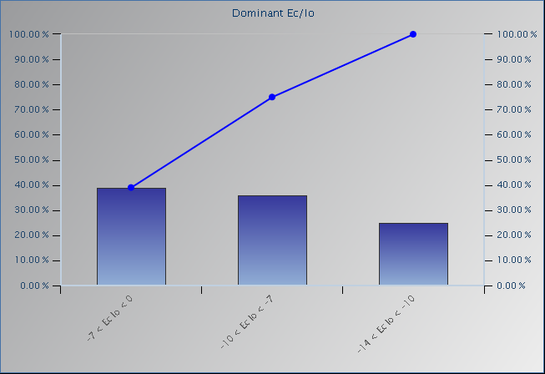
UMTS 1900 Scan – UARFCN 512 Ec/Io Histogram
Ec/Io
-16 to -14
-14 to -10
-10 to -7
-7 to 0
0 to -16
© 2015 AT&T Intellectual Property. All rights reserved. AT&T and the AT&T logo are trademarks of AT&T Intellectual Property.
AT&T Proprietary (Internal Use Only) Not for use or disclosure outside the AT&T companies except under written agreement

Slide 3
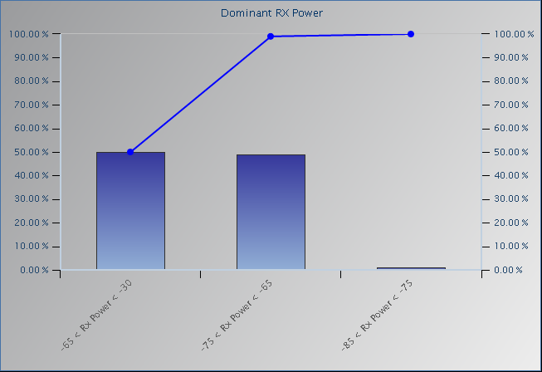
UMTS 1900 Scan – UARFCN 512 Io (RSSI) Histogram
RX Power
-140 to -105
-105 to -95
-95 to -85
-85 to -75
-75 to -65
-65 to -30
© 2015 AT&T Intellectual Property. All rights reserved. AT&T and the AT&T logo are trademarks of AT&T Intellectual Property.
AT&T Proprietary (Internal Use Only) Not for use or disclosure outside the AT&T companies except under written agreement

Slide 4
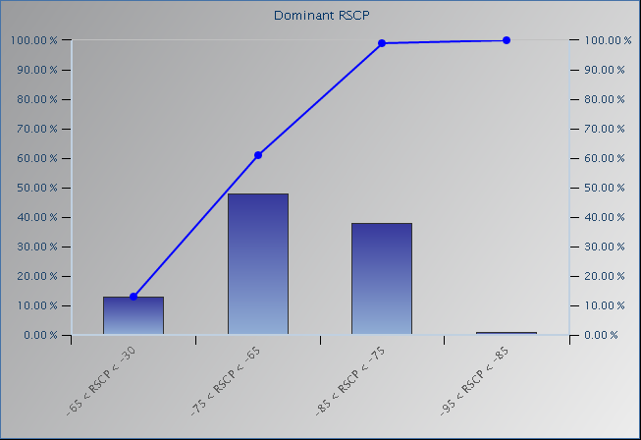
UMTS 1900 Scan – UARFCN 512 Ec (RSCP) Histogram
RSCP
-140 to -105
-105 to -95
-95 to -85
-85 to -75
-75 to -65
-65 to -30
© 2015 AT&T Intellectual Property. All rights reserved. AT&T and the AT&T logo are trademarks of AT&T Intellectual Property.
AT&T Proprietary (Internal Use Only) Not for use or disclosure outside the AT&T companies except under written agreement

Slide 5
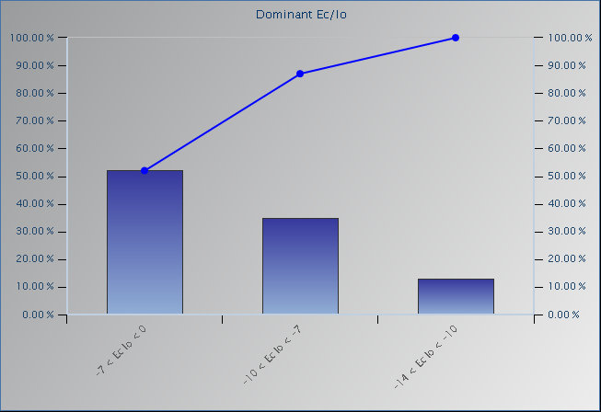
UMTS 1900 Scan – UARFCN 662 Ec/Io Histogram
Ec/Io
-16 to -14
-14 to -10
-10 to -7
-7 to 0
0 to -16
© 2015 AT&T Intellectual Property. All rights reserved. AT&T and the AT&T logo are trademarks of AT&T Intellectual Property.
AT&T Proprietary (Internal Use Only) Not for use or disclosure outside the AT&T companies except under written agreement

Slide 6
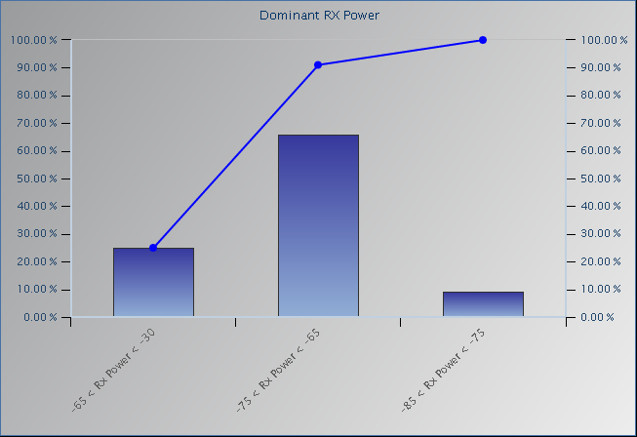
UMTS 1900 Scan – UARFCN 662 Io (RSSI) Histogram
RX Power
-140 to -105
-105 to -95
-95 to -85
-85 to -75
-75 to -65
-65 to -30
© 2015 AT&T Intellectual Property. All rights reserved. AT&T and the AT&T logo are trademarks of AT&T Intellectual Property.
AT&T Proprietary (Internal Use Only) Not for use or disclosure outside the AT&T companies except under written agreement

Slide 7
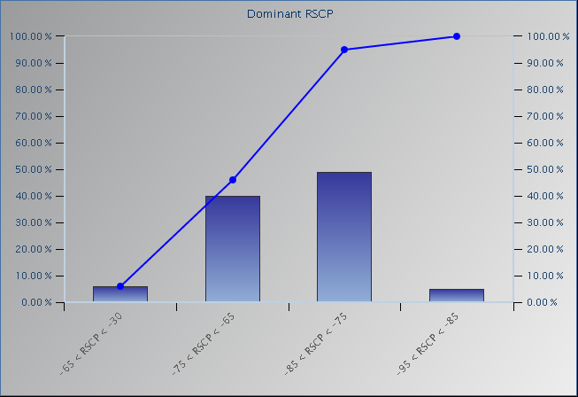
UMTS 1900 Scan – UARFCN 662 Ec (RSCP) Histogram
RSCP
-140 to -105
-105 to -95
-95 to -85
-85 to -75
-75 to -65
-65 to -30
© 2015 AT&T Intellectual Property. All rights reserved. AT&T and the AT&T logo are trademarks of AT&T Intellectual Property.
AT&T Proprietary (Internal Use Only) Not for use or disclosure outside the AT&T companies except under written agreement

Slide 8
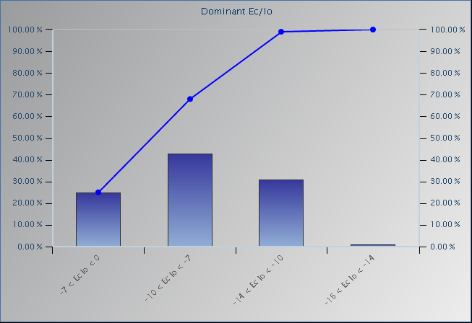
UMTS 850 Scan – UARFCN 4435 Ec/Io Histogram
Ec/Io
-16 to -14
-14 to -10
-10 to -7
-7 to 0
0 to -16
© 2015 AT&T Intellectual Property. All rights reserved. AT&T and the AT&T logo are trademarks of AT&T Intellectual Property.
AT&T Proprietary (Internal Use Only) Not for use or disclosure outside the AT&T companies except under written agreement

Slide 9
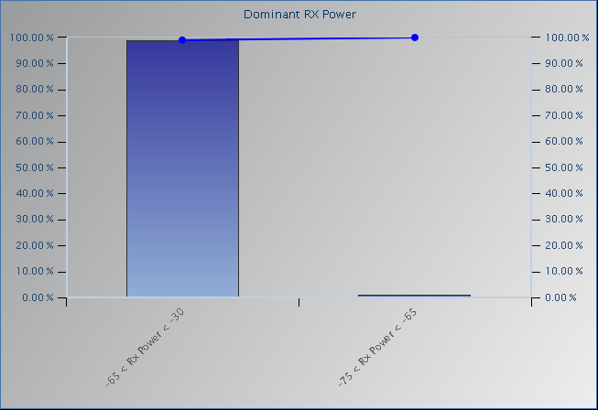
UMTS 850 Scan – UARFCN 4435 Io (RSSI) Histogram
RX Power
-140 to -105
-105 to -95
-95 to -85
-85 to -75
-75 to -65
-65 to -30
© 2015 AT&T Intellectual Property. All rights reserved. AT&T and the AT&T logo are trademarks of AT&T Intellectual Property.
AT&T Proprietary (Internal Use Only) Not for use or disclosure outside the AT&T companies except under written agreement

Slide 10
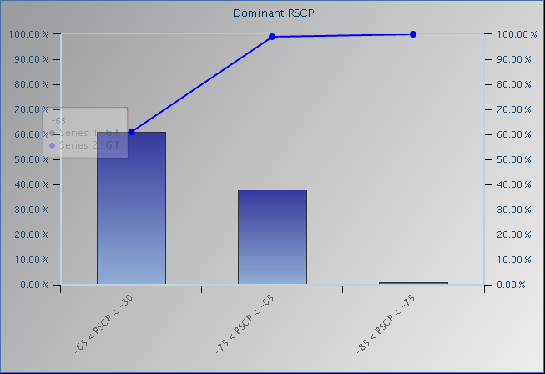
UMTS 850 Scan – UARFCN 4435 Ec (RSCP) Histogram
RSCP
-140 to -105
-105 to -95
-95 to -85
-85 to -75
-75 to -65
-65 to -30
© 2015 AT&T Intellectual Property. All rights reserved. AT&T and the AT&T logo are trademarks of AT&T Intellectual Property.
AT&T Proprietary (Internal Use Only) Not for use or disclosure outside the AT&T companies except under written agreement

