Slide 1

LTE Atrium Perimeter
© 2015 AT&T Intellectual Property. All rights reserved. AT&T and the AT&T logo are trademarks of AT&T Intellectual Property.
AT&T Proprietary (Internal Use Only) Not for use or disclosure outside the AT&T companies except under written agreement

Slide 2
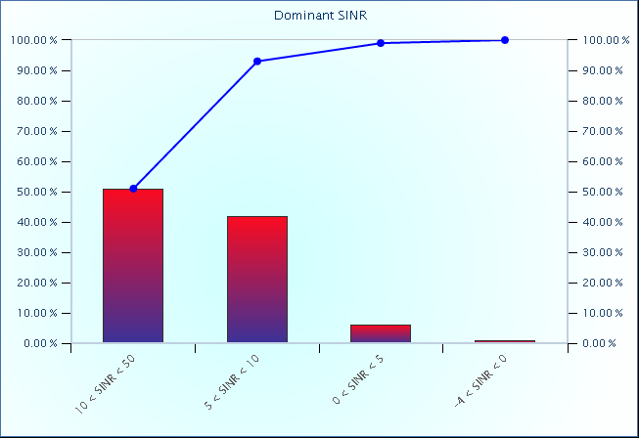
LTE 2100 Scan – EARFCN 2000 SINR Histogram
SINR
-50 to -4
-4 to 0
0 to 5
5 to 10
10 to 50
© 2015 AT&T Intellectual Property. All rights reserved. AT&T and the AT&T logo are trademarks of AT&T Intellectual Property.
AT&T Proprietary (Internal Use Only) Not for use or disclosure outside the AT&T companies except under written agreement

Slide 3
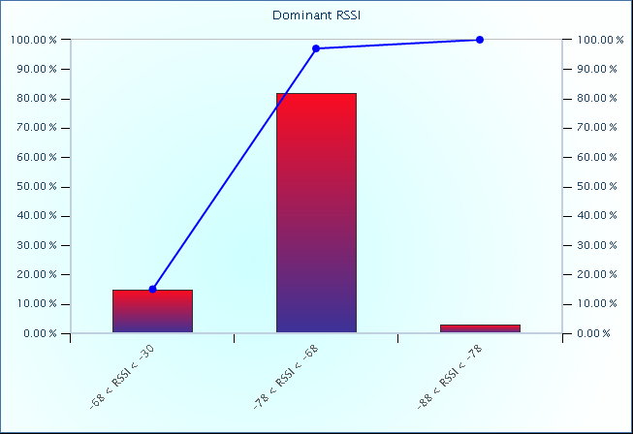
LTE 2100 Scan – EARFCN 2000 RSSI Histogram
RSSI
-140 to -105
-105 to -95
-95 to -85
-85 to -75
-75 to -65
-65 to -30
© 2015 AT&T Intellectual Property. All rights reserved. AT&T and the AT&T logo are trademarks of AT&T Intellectual Property.
AT&T Proprietary (Internal Use Only) Not for use or disclosure outside the AT&T companies except under written agreement

Slide 4
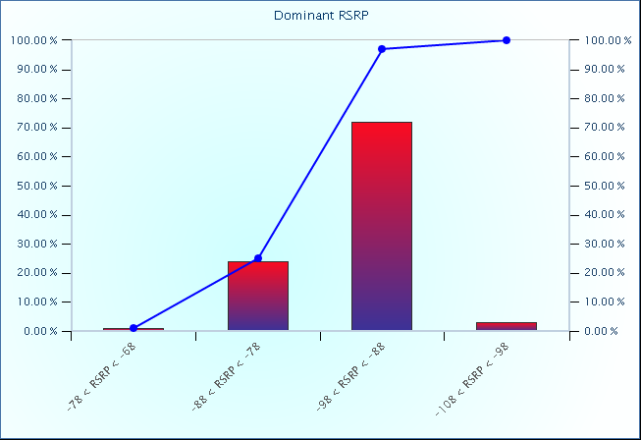
LTE 2100 Scan – EARFCN 2000 RSRP Histogram
RSRP
-140 to -108
-108 to -98
-98 to -88
-88 to -78
-78 to -68
-68 to -30
© 2015 AT&T Intellectual Property. All rights reserved. AT&T and the AT&T logo are trademarks of AT&T Intellectual Property.
AT&T Proprietary (Internal Use Only) Not for use or disclosure outside the AT&T companies except under written agreement

Slide 5
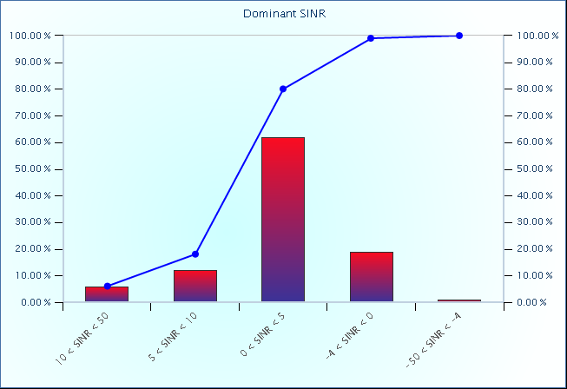
LTE 700 Scan – EARFCN 5780 SINR Histogram
SINR
-50 to -4
-4 to 0
0 to 5
5 to 10
10 to 50
© 2015 AT&T Intellectual Property. All rights reserved. AT&T and the AT&T logo are trademarks of AT&T Intellectual Property.
AT&T Proprietary (Internal Use Only) Not for use or disclosure outside the AT&T companies except under written agreement

Slide 6
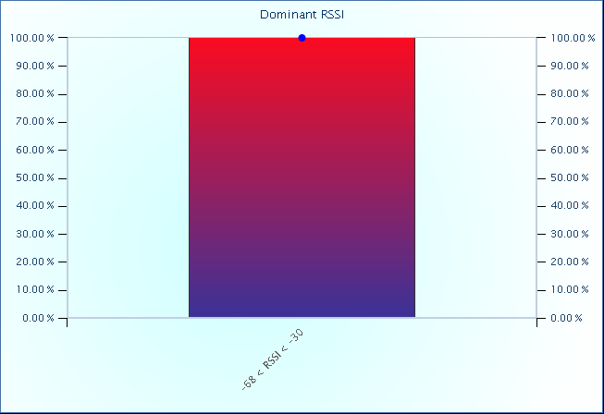
LTE 700 Scan – EARFCN 5780 RSSI Histogram
RSSI
-140 to -105
-105 to -95
-95 to -85
-85 to -75
-75 to -65
-65 to -30
© 2015 AT&T Intellectual Property. All rights reserved. AT&T and the AT&T logo are trademarks of AT&T Intellectual Property.
AT&T Proprietary (Internal Use Only) Not for use or disclosure outside the AT&T companies except under written agreement

Slide 7
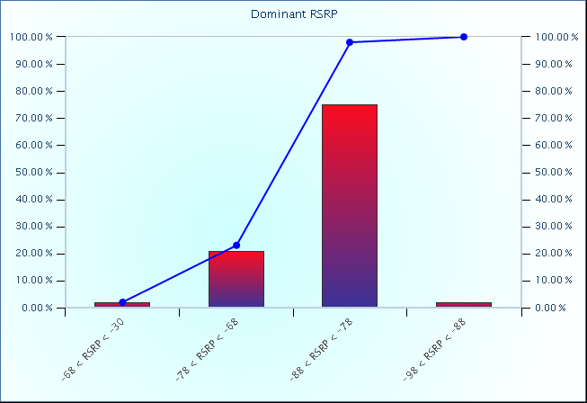
LTE 700 Scan – EARFCN 5780 RSRP Histogram
RSRP
-140 to -108
-108 to -98
-98 to -88
-88 to -78
-78 to -68
-68 to -30
© 2015 AT&T Intellectual Property. All rights reserved. AT&T and the AT&T logo are trademarks of AT&T Intellectual Property.
AT&T Proprietary (Internal Use Only) Not for use or disclosure outside the AT&T companies except under written agreement

