Slide 1

250 ft UMTS Ch.4259
© 2015 AT&T Intellectual Property. All rights reserved. AT&T and the AT&T logo are trademarks of AT&T Intellectual Property.
AT&T Proprietary (Internal Use Only) Not for use or disclosure outside the AT&T companies except under written agreement

Slide 2
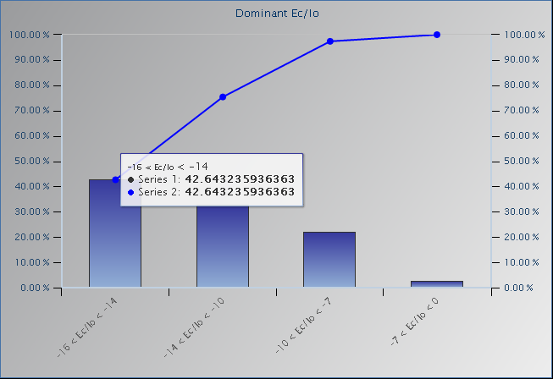
UMTS 850 Scan - UARFCN 4384 Ec/Io Histogram
Ec/Io
-16 to -14
-14 to -10
-10 to -7
-7 to 0
0 to -16
© 2015 AT&T Intellectual Property. All rights reserved. AT&T and the AT&T logo are trademarks of AT&T Intellectual Property.
AT&T Proprietary (Internal Use Only) Not for use or disclosure outside the AT&T companies except under written agreement

Slide 3
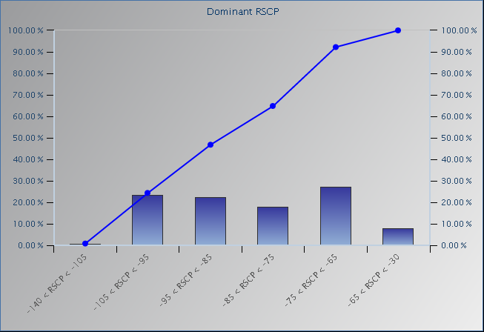
UMTS 850 Scan - UARFCN 4384 Ec (RSCP) Histogram
RSCP
-140 to -105
-105 to -95
-95 to -85
-85 to -75
-75 to -65
-65 to -30
© 2015 AT&T Intellectual Property. All rights reserved. AT&T and the AT&T logo are trademarks of AT&T Intellectual Property.
AT&T Proprietary (Internal Use Only) Not for use or disclosure outside the AT&T companies except under written agreement

Slide 4
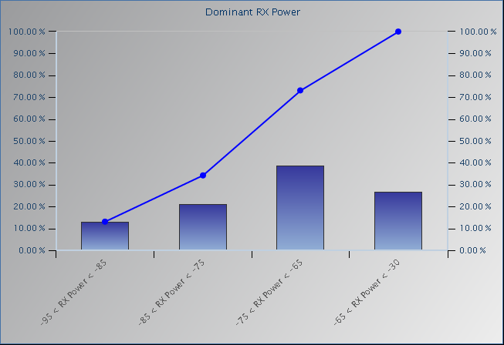
UMTS 850 Scan - UARFCN 4384 Io (RSSI) Histogram
RX Power
-140 to -105
-105 to -95
-95 to -85
-85 to -75
-75 to -65
-65 to -30
© 2015 AT&T Intellectual Property. All rights reserved. AT&T and the AT&T logo are trademarks of AT&T Intellectual Property.
AT&T Proprietary (Internal Use Only) Not for use or disclosure outside the AT&T companies except under written agreement

