Slide 1

UMTS 1900 Scan - Ch.437
© 2015 AT&T Intellectual Property. All rights reserved. AT&T and the AT&T logo are trademarks of AT&T Intellectual Property.
AT&T Proprietary (Internal Use Only) Not for use or disclosure outside the AT&T companies except under written agreement

Slide 2
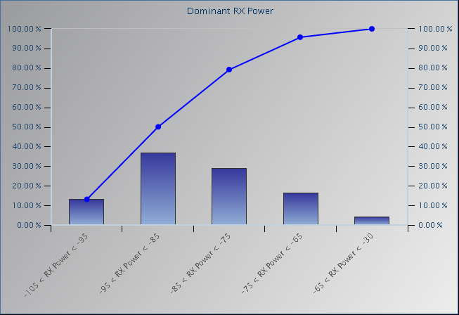
UMTS 1900 Scan - UARFCN 437 Io (RSSI) Histogram
RX Power
-140 to -105
-105 to -95
-95 to -85
-85 to -75
-75 to -65
-65 to -30
© 2015 AT&T Intellectual Property. All rights reserved. AT&T and the AT&T logo are trademarks of AT&T Intellectual Property.
AT&T Proprietary (Internal Use Only) Not for use or disclosure outside the AT&T companies except under written agreement

