Slide 1


Slide 2

A Containers Defined by IBM
a hosted cloud environment on IBM Bluemix. IBM Containers helps you build and deploy containers where you can package your apps and services. Each container is based on an image format, includes a set of standard operations, and is an execution environment in itself

Slide 3

IBM Containers Contain all the dependencies that your web app needs
Different Images have different types of packages that come with them

Slide 4

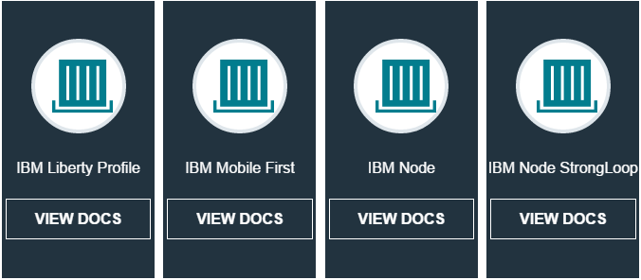

Slide 5

Ubuntu 14.04
IBM Node SDK*
Python, Git, and build-essentials apt-get packages

Slide 6

IBM WebSphere Application Server for Developers V8.5.5 Liberty Profile
IBM Java Runtime Environment 7.1 SR1

