Slide 1
NSF FUTURE MANUFACTURING DATA CHALLENGE | FINAL SUBMISSION
Predicting local DED track width from thermal history
Offline completed-sequence hierarchy with a causal ablation
Team NSF-CHUDS
July 31, 2026 | Nested four-track outer validation
Notes:
Opening: the model separates condition-level geometry from local variation and evaluates every track as untouched once.
[Sources]
- https://doi.org/10.5281/zenodo.21285367
- https://arxiv.org/abs/2607.07965
- results/improved_submission/metrics.json
- results/improved_submission/outer_fold_predictions.csv
[/Sources]

Slide 2
THE PROBLEM
Can thermal history predict local geometry after printing?
A DED track is not a uniform line: width and both boundaries vary along x.
Thermal frames record the moving melt pool; profilometry records final geometry.
The modeling task maps a frame and its causal history to the matching local segment.
A credible result must generalize across laser power and quantify uncertainty.
OUR TASK
Predict local width and boundary position from thermal history
Ground truth: center, width, and boundaries from profilometry
Inputs: completed thermal sequence only
Evaluation: four nested leave-one-track-out outer tests
Source: Team analysis of NSF FMRG multimodal DED dataset (Zenodo 10.5281/zenodo.21285367)
2
Notes:
Challenge framing: local geometry is a spatial signal; useful predictions must preserve width and boundary variation across power conditions.
[Sources]
- https://doi.org/10.5281/zenodo.21285367
- https://arxiv.org/abs/2607.07965
- results/improved_submission/metrics.json
- results/improved_submission/outer_fold_predictions.csv
[/Sources]

Slide 3
THE DATA
Three modalities, one physical x-axis, four untouched outer tests
THERMAL VIDEO
SEM IMAGERY
3D PROFILOMETRY
400 active frames per track
Post-process SEM audit
Local width and boundaries
400 active frames per track at 50 fps.
10 mm/s scan speed gives 0.2 mm per frame.
Size, temperature, gradients, and asymmetry.
Causal history lives in the TIME domain.
Available imagery is post-process.
Unavailable at frame-time inference.
Excluded from predictive candidates.
No causal substrate claim.
Robust cross-track substrate detrending.
Connected 30%-height boundary crossings.
0.40 mm physical smoothing window.
Missing acquisition gaps remain excluded.
Every track is untouched once; model, feature family, preprocessing, and calibration are selected only inside the other three tracks.
Source: Team analysis of NSF FMRG multimodal DED dataset (Zenodo 10.5281/zenodo.21285367)
3
Notes:
Data: all modalities are registered to physical x; the outer unit is the whole experimental track.
[Sources]
- https://doi.org/10.5281/zenodo.21285367
- https://arxiv.org/abs/2607.07965
- results/improved_submission/metrics.json
- results/improved_submission/outer_fold_predictions.csv
[/Sources]

Slide 4
OUR APPROACH
From raw frames to leakage-safe nested predictions
1
2
3
4
Extract
Align
Decompose
Test
Detrend each cross-section and find connected left/right crossings
Use physical x in mm; never normalized row position
Separate condition baseline from local center/log-width residuals
Hold out each track once; select candidates inside the other three
Audit rule: no held-out geometry, test-track labels, or post-process SEM enters prediction or selection. The primary model is offline; the causal ablation forbids future frames.
Source: Team analysis of NSF FMRG multimodal DED dataset (Zenodo 10.5281/zenodo.21285367)
4
Notes:
Pipeline: each outer track is excluded from feature, model, preprocessing, and calibration choices.
[Sources]
- https://doi.org/10.5281/zenodo.21285367
- https://arxiv.org/abs/2607.07965
- results/improved_submission/metrics.json
- results/improved_submission/outer_fold_predictions.csv
[/Sources]

Slide 5
METHOD — STEPS 1–2
Ground truth first: robust boundaries, then physical alignment
STEP 1 - LOCAL GEOMETRY EXTRACTION
STEP 2 - PHYSICAL TIME-SPACE ALIGNMENT
Measure one connected bead in every valid cross-section
Match each thermal frame to measured x in millimeters
Interpolate missing y pixels only within each cross-section.
Fit substrate slope outside the bead shoulders.
Locate connected 30%-of-peak crossings around the central maximum.
Smooth left and right boundaries over 0.40 mm.
Detect laser shutoff; retain the prior 400 active frames.
Extract hot components above a fixed 1500 K threshold.
Convert time to x at 10 mm/s and 50 fps.
Reject frames more than 0.10 mm from valid profilometry.
Source: Team analysis of NSF FMRG multimodal DED dataset (Zenodo 10.5281/zenodo.21285367)
5
Notes:
Geometry: connected profilometry boundaries define positive local width; thermal frames advance 0.2 mm each.
[Sources]
- https://doi.org/10.5281/zenodo.21285367
- https://arxiv.org/abs/2607.07965
- results/improved_submission/metrics.json
- results/improved_submission/outer_fold_predictions.csv
[/Sources]

Slide 6
METHOD — STEP 3
Separate condition width from local variation
CAUSAL MULTISCALE HISTORY
CONSTRAINED NESTED MODEL
Describe the pool now, then summarize how it arrived
Predict a track baseline, then local residuals
Pool axes, temperature, mass, gradients, and asymmetry.
Cooling-tail decay, centroid velocity, and shape change.
5-, 10-, and 20-frame slopes, persistence, and changes.
Robust local normalization isolates within-track departures.
Full-sequence summaries predict baseline center and log-width.
Frame history jointly predicts center and log-width residuals.
exp(log-width) keeps width positive; boundaries stay ordered.
Causal ablation swaps in expanding summaries.
Source: Team analysis of NSF FMRG multimodal DED dataset (Zenodo 10.5281/zenodo.21285367)
6
Notes:
Modeling: completed-sequence summaries predict condition baselines; frame history predicts local residuals. The primary mode is offline.
[Sources]
- https://doi.org/10.5281/zenodo.21285367
- https://arxiv.org/abs/2607.07965
- results/improved_submission/metrics.json
- results/improved_submission/outer_fold_predictions.csv
[/Sources]

Slide 7
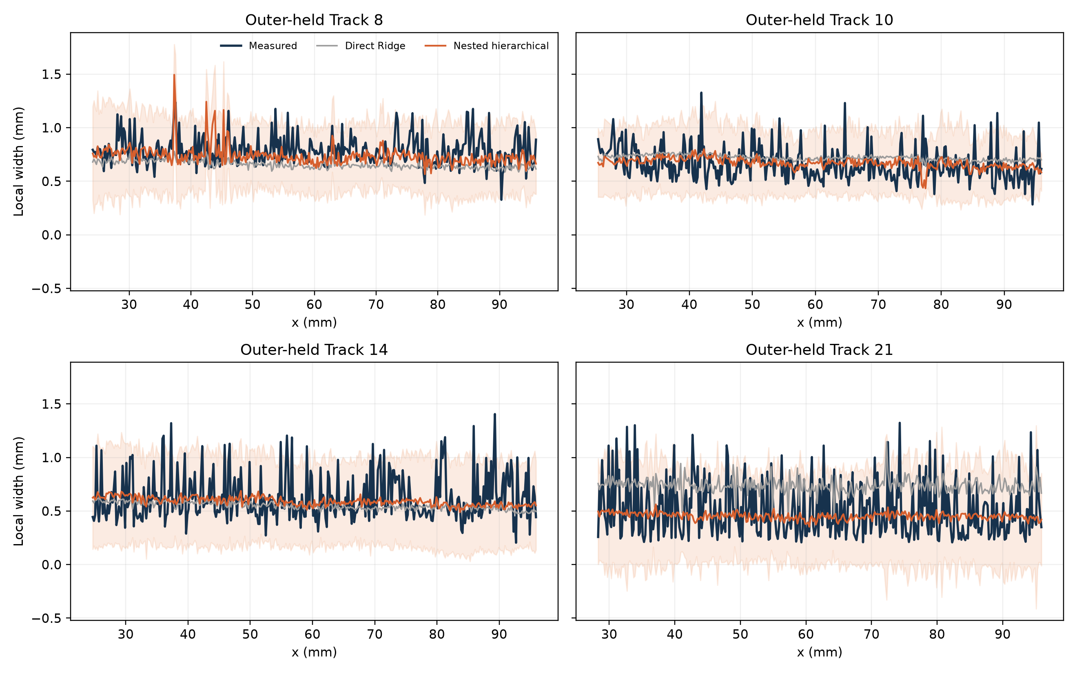
RESULTS
Offline four-track MAE falls 20.7%
EXHIBIT 1 - FOUR UNTOUCHED OUTER TRACKS
148 µm
Track-balanced MAE
20.7% lower
vs. direct Ridge
Track-balanced width MAE: 0.187 → 0.148 mm.
Worst-track MAE: 0.308 → 0.201 mm.
Mean boundary MAE: 0.180 → 0.142 mm.
Track-balanced R²: -0.55 → -0.13.
Source: Team analysis of NSF FMRG multimodal DED dataset (Zenodo 10.5281/zenodo.21285367)
7
Notes:
Result: offline four-track width MAE improves 20.7%, worst-track MAE 34.8%, and boundary MAE 21.1%.
[Sources]
- https://doi.org/10.5281/zenodo.21285367
- https://arxiv.org/abs/2607.07965
- results/improved_submission/metrics.json
- results/improved_submission/outer_fold_predictions.csv
[/Sources]

Slide 8
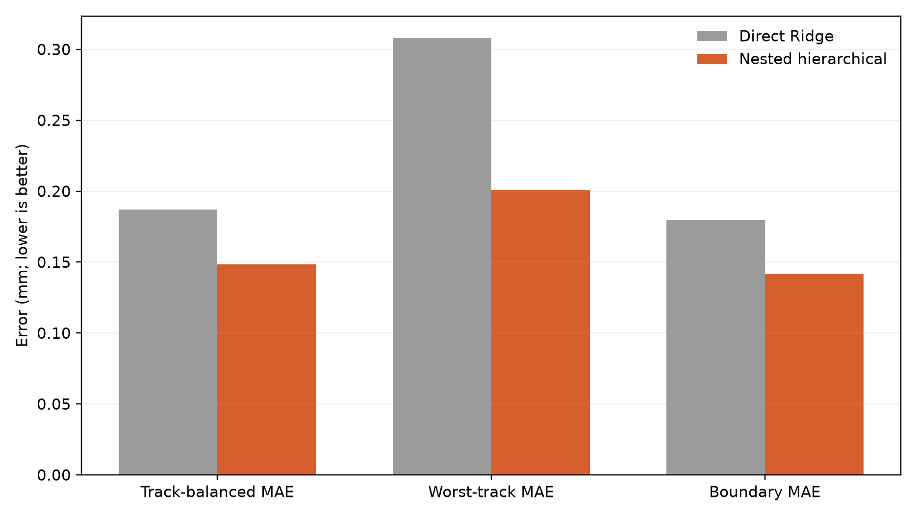
THE KEY INSIGHT
Local scaling recovers variation and sharpens uncertainty
EXHIBIT 2 - BEFORE / AFTER SCORECARD
WHAT CHANGED
Condition baseline + local residual wins
1. Predicted variation grows from 21% to 32% of measured scale.
2. Conditional intervals cover 93.5% at 0.780 mm mean width.
3. Global intervals cover 94.9% but are wider at 0.877 mm.
4. Width expands from 0.629 mm easy to 0.944 mm hard.
Source: Team analysis of NSF FMRG multimodal DED dataset (Zenodo 10.5281/zenodo.21285367)
8
Notes:
Uncertainty: conditional intervals are selected for the primary model; a separate causal ablation tests online potential.
[Sources]
- https://doi.org/10.5281/zenodo.21285367
- https://arxiv.org/abs/2607.07965
- results/improved_submission/metrics.json
- results/improved_submission/outer_fold_predictions.csv
[/Sources]

Slide 9
HONEST ASSESSMENT
Improved, but not ready for closed-loop control
Primary R² improves from -0.55 to -0.13 but remains negative.
Primary mode is offline after the thermal scan completes.
Causal ablation: 0.157 mm MAE and -0.18 R².
Post-process SEM is excluded from prediction.
No closed-loop or causal substrate claim.
WHAT WOULD CLOSE THE GAP
Add more powers, plates, repeats, and substrate pre-scans.
Register SEM before processing instead of inferring substrate from post-scan tiles.
Calibrate intervals by laser-power regime or hierarchical conformal methods.
Predict a full contour distribution, not only center plus width.
Source: Team analysis of NSF FMRG multimodal DED dataset (Zenodo 10.5281/zenodo.21285367)
9
Notes:
Limitations: R2 remains negative, only four tracks are available, and no causal substrate claim is supported.
[Sources]
- https://doi.org/10.5281/zenodo.21285367
- https://arxiv.org/abs/2607.07965
- results/improved_submission/metrics.json
- results/improved_submission/outer_fold_predictions.csv
[/Sources]

Slide 10
TAKEAWAYS
Separate the condition, then learn the variation
1
2
3
Four-track accuracy
Physical consistency
Useful uncertainty
Width MAE falls 20.7%; worst-track error falls 34.8%; boundary MAE falls 21.1%.
Positive width and one shared center reconstruct ordered left/right boundaries.
Conditional intervals reach 93.5% and expand in difficult regions.
“Condition shifts and local variation are different problems.”
Questions? | github.com/alphons3t/nsf-chuds | github.com/joeyperez1-debug/nsfsubmit Generative AI assisted code review, testing, debugging, and layout; measurements were not created or altered by AI.
Source: Team analysis of NSF FMRG multimodal DED dataset (Zenodo 10.5281/zenodo.21285367)
10
Notes:
Close: separating the condition shift from local variation is the main transferable modeling insight. Generative AI assisted code review, testing, debugging, and layout; team members reviewed the outputs, and AI did not create or alter measurements.
[Sources]
- https://doi.org/10.5281/zenodo.21285367
- https://arxiv.org/abs/2607.07965
- results/improved_submission/metrics.json
- results/improved_submission/outer_fold_predictions.csv
[/Sources]

