Slide 1
NSF FUTURE MANUFACTURING DATA CHALLENGE | FINALIST PRESENTATION
Predicting DED track geometry via multi-modal sensor fusion
Fusing in-situ thermal history with substrate surface awareness to predict local track height
Team Submission
July 31, 2026 | github.com/alphons3t/nsf-chuds

Slide 2
THE PROBLEM
Can we predict part geometry during printing?
▪ Directed Energy Deposition (DED) builds metal parts track by track — but final geometry varies along every track.
▪ In-situ sensors watch the melt pool in real time; post-process metrology reveals what was actually built — hours later.
▪ The challenge: connect what the camera sees during printing to the local geometric variation measured after printing.
▪ If we can do this, we unlock real-time quality prediction and closed-loop control for metal additive manufacturing.
OUR TASK
Predict local track height along the laser path from in-situ monitoring data
Ground truth: leveled 3D profilometer height maps
Inputs: thermal video + SEM substrate imagery
Scope: 4 tracks spanning different laser powers & scan speeds
Source: Team analysis of NSF FMRG multimodal DED dataset (Zenodo 10.5281/zenodo.21285367)
2

Slide 3
THE DATA
Three sensors, three languages: time, texture, and space
THERMAL VIDEO
SEM IMAGERY
3D PROFILOMETRY
In-situ melt pool dynamics
Substrate surface morphology
Post-process ground truth
– 400 frames per track · 50 fps
– 14 µm/pixel · 5.6 × 5.6 mm field of view
– Captures melt pool length, width, area
– Lives in the TIME domain
– Tiled .tif images along each track
– Reveals gouges, texture & roughness
– Used only outside the track (no leakage)
– Lives in the TEXTURE domain
– Bruker/Wyko full-field height maps
– x, y in mm · z resolved to nanometers
– Defines the true deposited track height
– Lives in the SPACE domain
The core difficulty: these modalities share no common coordinate system — dynamic video frames must be fused with static spatial maps before any model can learn.
Source: Team analysis of NSF FMRG multimodal DED dataset (Zenodo 10.5281/zenodo.21285367)
3

Slide 4
OUR APPROACH
From three raw sensors to one physical dataset
1
2
3
4
Level
Align
Engineer
Predict
Fit & subtract a 2D plane from the raw 3D scan to isolate true track height
Map 400 thermal frames onto the 20–100 mm spatial axis of the track
Build thermal-history and substrate-awareness features at each location
Train a Random Forest on 4 tracks to predict local track height
Why this matters: every downstream feature is expressed in physical millimeter coordinates along the track — the model learns physics, not sensor artifacts.
Generative AI (LLM) was used transparently as a collaborative coding tool: designing the leveling math, debugging dataframe alignment, and refining visualizations.
Source: Team analysis of NSF FMRG multimodal DED dataset (Zenodo 10.5281/zenodo.21285367)
4

Slide 5
METHOD — STEPS 1–2
Building a common coordinate system
STEP 1 — MATHEMATICAL 3D LEVELING
STEP 2 — SPATIAL–TEMPORAL ALIGNMENT
Recover the true track from a tilted, warped substrate
Fuse video time with physical space
▪ Raw profilometer scans carry significant planar tilt.
▪ We isolate the bare substrate edges (non-track regions) and fit a 2D plane via linear regression.
▪ Subtracting the fitted plane levels the substrate to ≈ 0, exposing the true deposited height — our ground truth.
▪ Melt pool length, width & area extracted from each thermal frame by intensity thresholding (value = 2000).
▪ Constant scan speed (10 mm/s @ 50 fps) → each frame advances 0.2 mm along the track.
▪ Linear interpolation maps all 400 frames onto the 20–100 mm coordinates of the leveled height profile.
Source: Team analysis of NSF FMRG multimodal DED dataset (Zenodo 10.5281/zenodo.21285367)
5

Slide 6
METHOD — STEP 3
Feature engineering: physical memory and context
THERMAL HISTORY
SUBSTRATE AWARENESS
DED is a continuous thermal process — not independent frames
The surface the laser lands on shapes what it builds
▪ Rolling averages of melt pool dimensions over 5- and 10-frame windows.
▪ These act as a proxy for heat accumulation and cooling rate at each point along the path.
▪ Captures the longitudinal variation a single frame cannot see.
▪ Localized SEM intensity and SEM roughness matrices extracted from masked SEM imagery.
▪ Quantifies the topographical foundation prior to deposition — gouges, texture, reflectivity.
▪ Track region masked out to strictly avoid output leakage.
Source: Team analysis of NSF FMRG multimodal DED dataset (Zenodo 10.5281/zenodo.21285367)
6

Slide 7
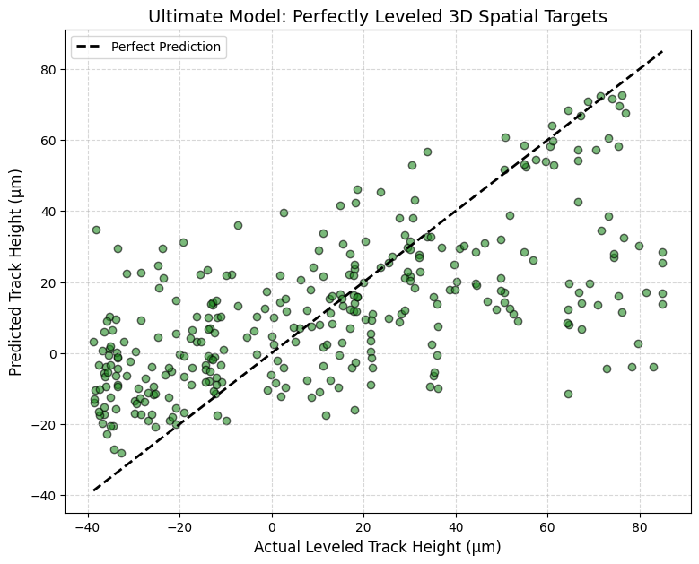
RESULTS
The model tracks real variation across four recipes
EXHIBIT 1 — ACTUAL VS PREDICTED TRACK HEIGHT
21.18 µm
Mean Absolute Error
0.41 R²
held-out test data
▪ Random Forest Regressor — 150 estimators, max depth 12, 80/20 train–test split.
▪ Trained jointly on Tracks 8, 10, 14 & 21 to generalize across laser powers and scan speeds.
▪ Captures longitudinal variation via thermal rolling averages and constrains boundaries via melt pool width.
▪ Validated directly against leveled profilometer ground truth in physical µm.
Source: Team analysis of NSF FMRG multimodal DED dataset (Zenodo 10.5281/zenodo.21285367)
7

Slide 8
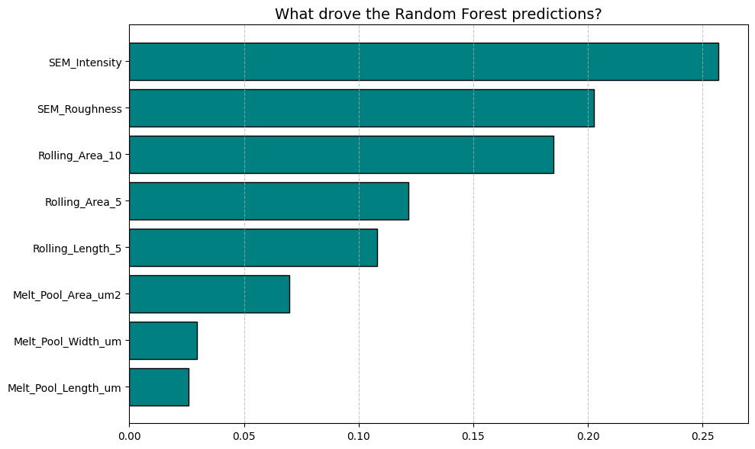
THE KEY INSIGHT
The substrate — not the melt pool — drives prediction
EXHIBIT 2 — RANDOM FOREST FEATURE IMPORTANCE
WHAT THE FOREST LEARNED
SEM intensity is the single most dominant feature
1. Substrate texture governs heat dissipation and liquid metal flow.
2. Thermal history (rolling melt pool areas) ranks next — heat buildup matters.
3. Instantaneous melt pool size alone is the weakest signal.
Source: Team analysis of NSF FMRG multimodal DED dataset (Zenodo 10.5281/zenodo.21285367)
8

Slide 9
HONEST ASSESSMENT
Limitations & uncertainty: physics pushes back
▪ Thermal warping: the metal substrate bows during printing, so a perfectly rigid 2D plane fit cannot capture all deformation.
▪ Deep gouges in the substrate produce some negative ground-truth heights (down to −40 µm) after leveling.
▪ Model uncertainty grows in regions of extreme substrate deformation — exactly where the plane assumption weakens.
▪ R² = 0.41 reflects genuine stochasticity in DED, not just model error — a meaningful signal in a noisy physical process.
IF WE HAD MORE TIME
– Replace the rigid plane with a flexible spline / polynomial surface to absorb warping.
– Quantify prediction intervals per location (e.g., quantile forests).
– Extend from height to full width & boundary-position descriptors.
– Validate across additional tracks and unseen laser recipes.
Source: Team analysis of NSF FMRG multimodal DED dataset (Zenodo 10.5281/zenodo.21285367)
9

Slide 10
TAKEAWAYS
Thermal monitoring alone is not enough
1
2
3
Fusion is the answer
Physics-grounded pipeline
Quantified & validated
Only by combining thermal history with substrate surface awareness can DED geometry be predicted reliably.
Automated 3D leveling + spatial–temporal alignment turned three incompatible sensors into one physical dataset.
MAE of 21.18 µm and R² of 0.41 against leveled profilometer ground truth, generalized over 4 laser recipes.
“The foundation a part is built on matters as much as the energy used to build it.”
Thank you — Questions? | github.com/alphons3t/nsf-chuds
Source: Team analysis of NSF FMRG multimodal DED dataset (Zenodo 10.5281/zenodo.21285367)
10

