Slide 1
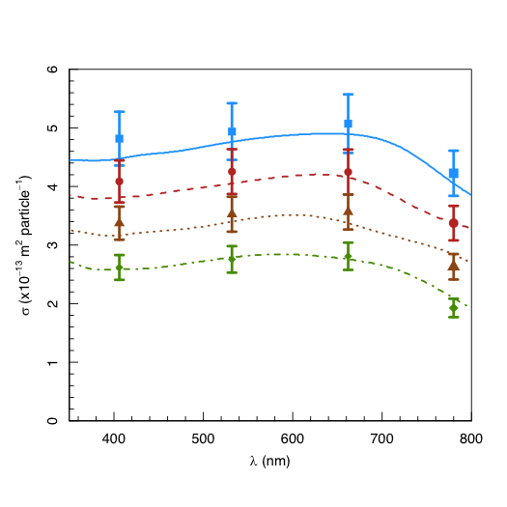
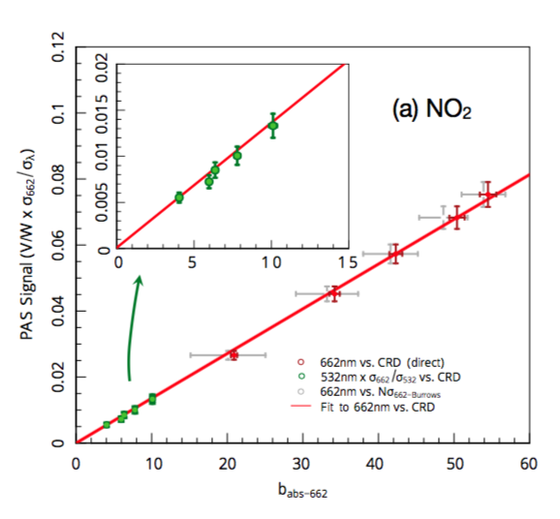
(a) NO₂
(b) Nigrosin
532 nm
650 nm
600nm
PAS Signal (V/W x σ₆₆₂/σ_{λ})
550 nm
σ (x 10⁻¹³ m² particle⁻¹)
662 nm (vs. CRD)
550 nm
b_{abs-662} (Mm⁻¹)
λ (nm)

