Slide 1
github.com/alphonzo79/LessonsLearned

Slide 2
Bodybuilding.com
800+ employees, including 100+ in Engineering
5 domestic distribution centers, including North Las Vegas.
Development offices in Boise, Portland and Costa Rica
World's largest on-line health and fitness supplements retailer
In need of Java web devs, mobile devs (Android and iOS), Linux system engineers, product managers, DBAs, etc
http://www.bodybuilding.com/fun/bbcomcareer.htm

Slide 3
Sql Performance
ContentValues are great for a common interface, especially when using a ContentProvider and ContentResolver
However, in bulk transactions they can take sometimes as much as twice as long
Whether you're using CompiledStatements or ContentValue inserts use transactions!
  When compared to transactional CompiledStatements, non-transactional ContentValue insertions can take as much as 60 times longer!

Slide 4
Layouts and Performance
Conventional wisdom often says that LinearLayout takes fewer resources to manage than RelativeLayout – therefore prefer LinearLayout
  LinearLayouts are more straight-forward and RelativeLayouts are often seen as difficult to maintain
However, deeper nesting will kill your performance more than almost anything else

Slide 5
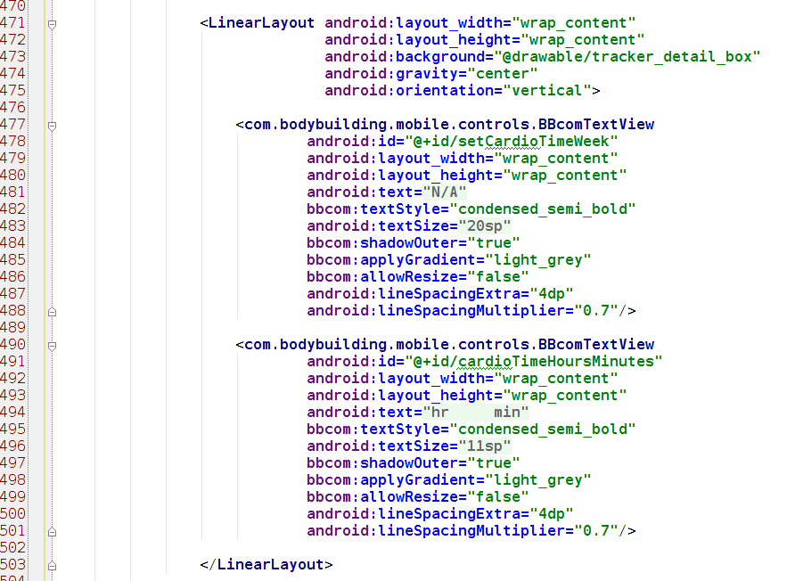
5 Levels of Nesting by Incorporating more LinearLayouts

Slide 6
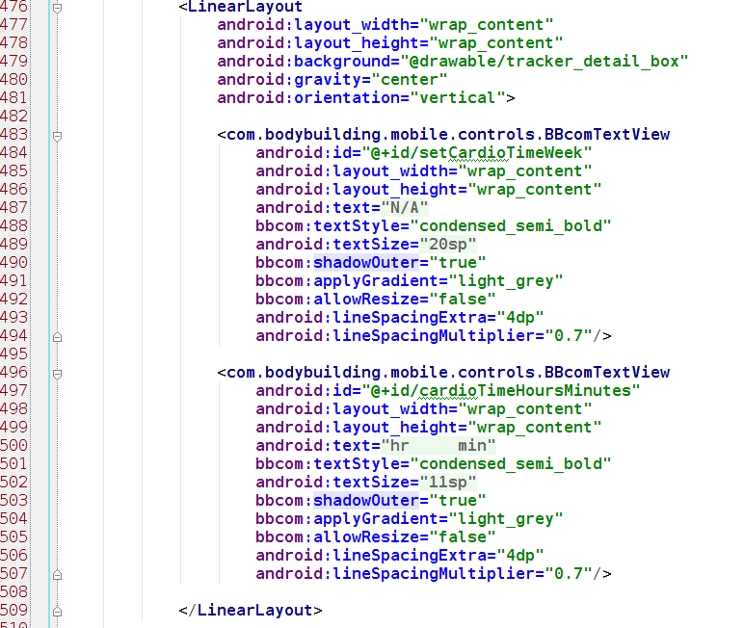
Using RelativeLayout to remove just one level of nesting saves about 50% on layout time

Slide 7
Keeping RelativeLayout Managable
Keep it organized so that things make sense
  Dependencies come first
    Views that are pegged to the right, top or bottom that other views will align against
  This includes code formatting – KEEP IT CLEAN!
Only use @+id when declaring the view's id, never when referring to the view from other views
  Unless you must – this is rare, but sometimes you do
Follow patterns that keep things recognizable
  id first; measurements next; placement, padding and margins; other attributes (or whatever pattern works for you, but keep it consistent)

Slide 8
Other Lessons From This Example
Perceived performance
  Add elements to the UI as they become available and populate TextViews as data come in instead of all at once.
Design for mobile, including considering the constraints of the platform
  Also, design for Android. Don't just build an iOS app on the Android platform.

Slide 9
ImageView#setColorFilter()
Reduce the number of assets loaded into memory by having design provide white assets and setting the color filter at run time
  This method has been in since API level 1!
For stateful ImageViews extend ImageView, provide a color state list and extend drawableStateChanged()
  Get the color for the state and set the filter
  duplicateParentState=true
  Image and text can share the same color state file

Slide 10
Gradle Flavors & Build Types
Just like OOP, share the common and split out what varies
Provide different application ids and base package names
Provide different resources such as app name
Create paid/free versions or production/staging builds. Limit metric tracking and crash reporting to release builds only.
BE CAREFUL – The structure can get messy if you're not careful, and maybe even then.

Slide 11
CursorLoader, CursorAdapter
The “Standard Way”
  Data from the server in json, hydrate into List<POJO> and pass back from the Loader
  Or create the list and populate it with objects hydrated out of the database
  Great because it lets us encapsulate a lot and follow a lot of OOP
  BUT: all those objects are expensive, we hydrate objects we may never use, we cause heap thrash, sometimes we may hold up the UI while we do all this hydrating

Slide 12
CursorLoader, CursorAdapter
The “Cursor Way”
  Just give the adapter a cursor from the database or a ContentProvider
  Or create an extension of AbstractCursor to bridge the json
    Make sure you make provision to provide _id
  You can't encapsulate as much. The adapter must know more about the data structure it's working with
  BUT: More light-weight, flexible (multiple data sources work well), quick, less heap thrash, speeds up ListView when working with very complex data

