Slide 1
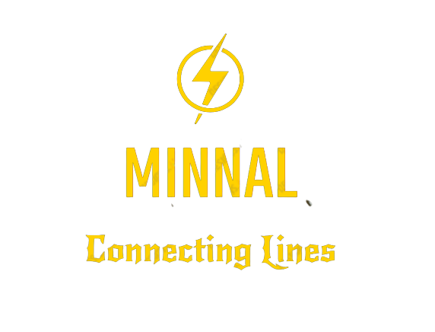
Guided By
Prof. Maria Yesudas
Assistant Professor
Dept. Of Computer Science and Engineering
SJCET, Palai
mariayesudas@sjcetpalai.ac.in
Done By
Team 6
Allwina Anna Soy Jose(S6-CS-B-10)
Alphy George(S6-CS-B-11)
Anita Augustine(S6-CS-B-16)
Anitta Siby(S6-CS-B-18)

Slide 2
Problem Statement
Inability to connect to the electricity board due to busy network lines
and filling forms / telling details from scratch is time consuming.

Slide 3
Project Scope
“Connecting Lines”
It is a platform through which consumers can easily connect with the authority in case of electricity complaints.
This project makes it easy to connect the board with just a click.
This project makes the consumer to fill in the consumer details only once and it will be saved and used for future reference.
There is no limit of adding consumers to this application. Hence, it is scalable. It will be a better way of organizing and connecting consumers to the board

Slide 4
Module Description
1.Administrator
The administrator is the super user and has complete control over the activities that can be performed. The administrator can remove any user.
Function: provide username and password to electricity board.
2.Consumer:
These are the ordinary people who consume electricity. They are the ones affected in case of power disruption.
Function: Register and login ,Report an issue, View status, Receive notification.
3. Board:
These include the authorities at KSEB who are responsible for supplying electricity. They view the complaints and take necessary action to resolve the issue.
They set the issue ‘resolved ‘once it has been taken care of.
Function: send alert messages and notification, set status of issue.

Slide 5
Technology Stack
Flutter
Flutter is an open-source UI software development kit (SDK) developed by Google for building natively compiled apps for mobile, web, and desktop using a single codebase. It uses the Dart programming language and provides a rich set of pre-built UI widgets and tools.
Firebase
Firebase is a popular backend-as-a-service (BaaS) platform developed by Google. It provides a range of cloud-based services for building mobile and web apps, including authentication, real-time databases, storage, and more.

Slide 6
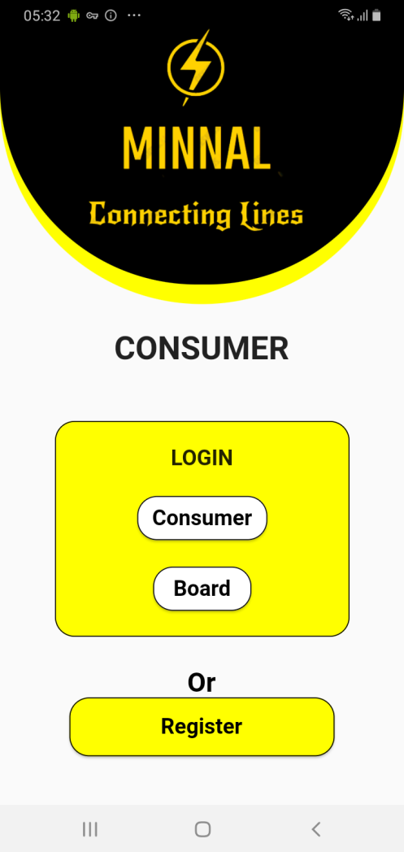
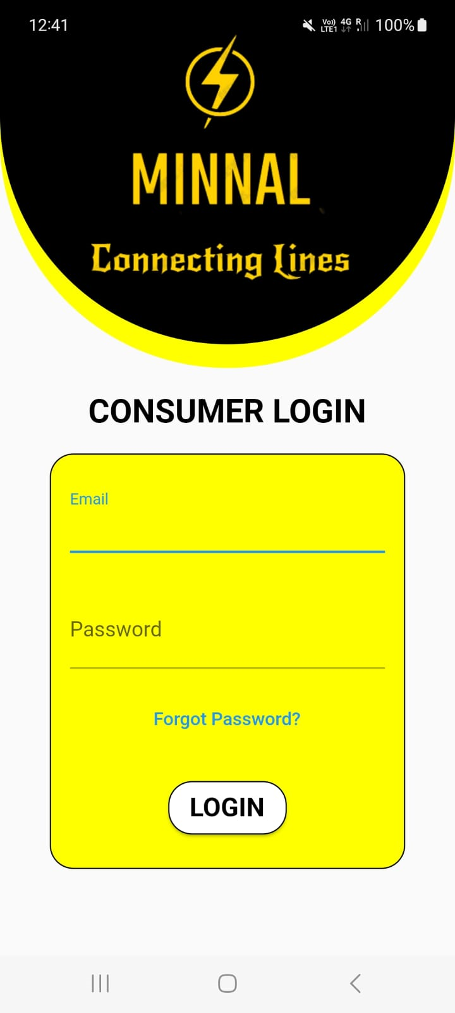
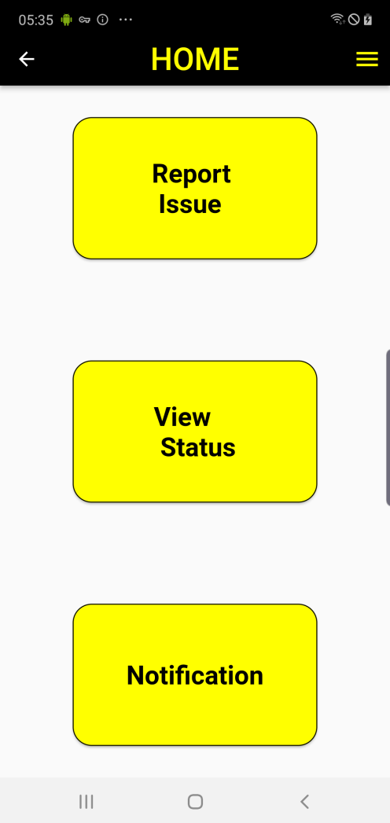
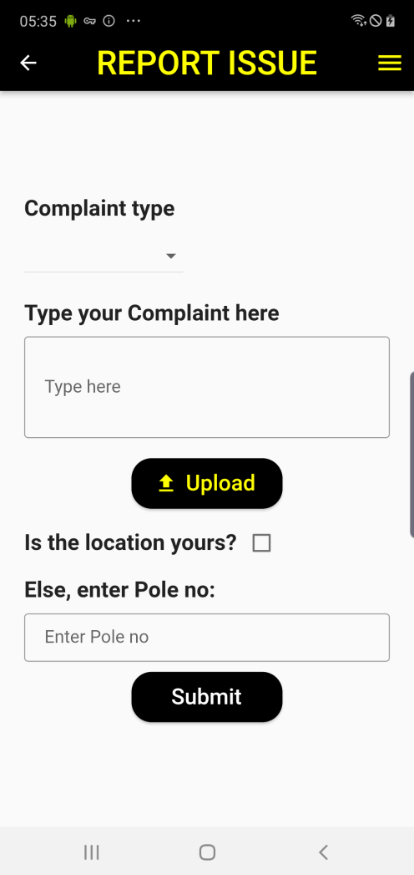
Results/Screenshots

Slide 7
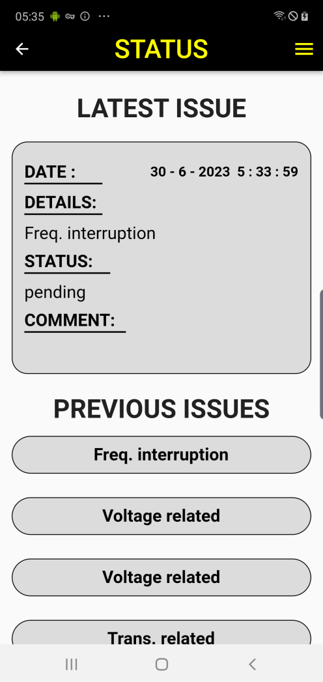
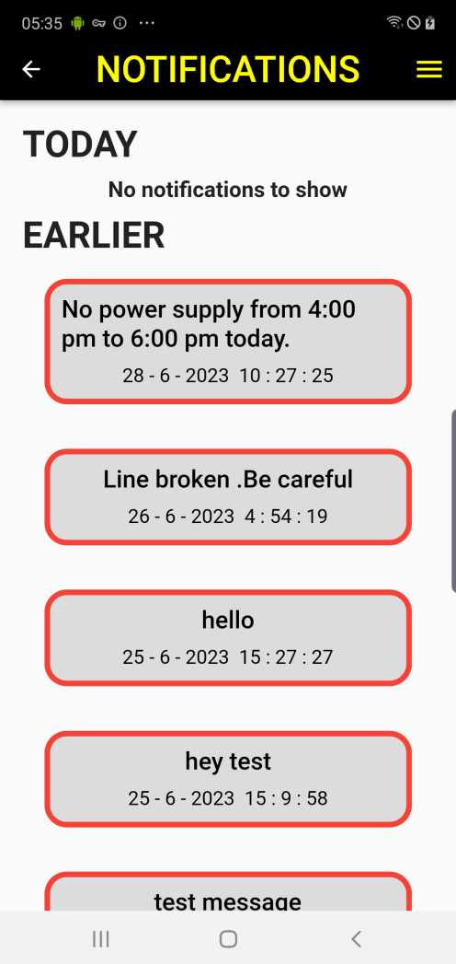
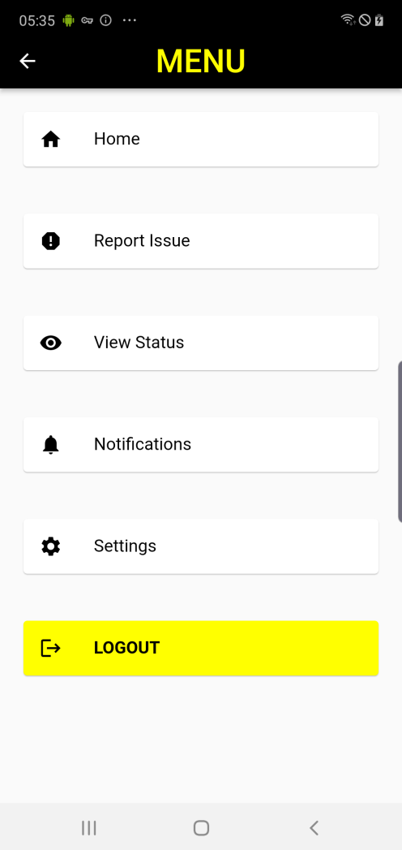
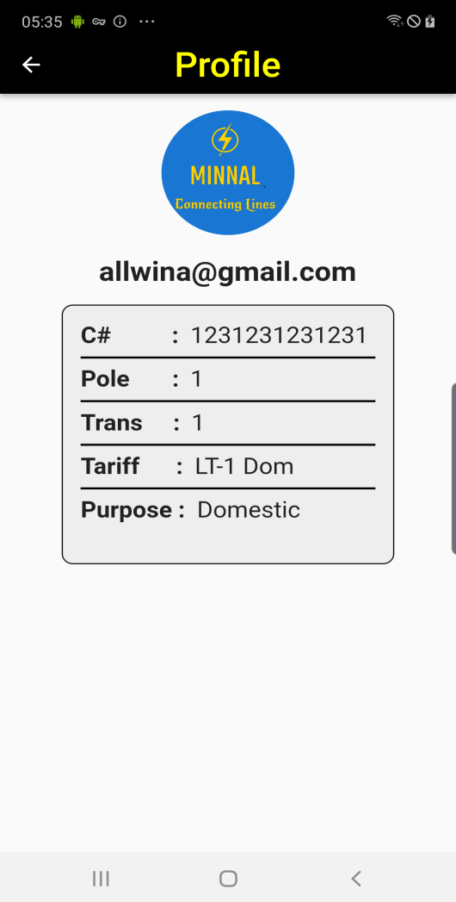

Slide 8
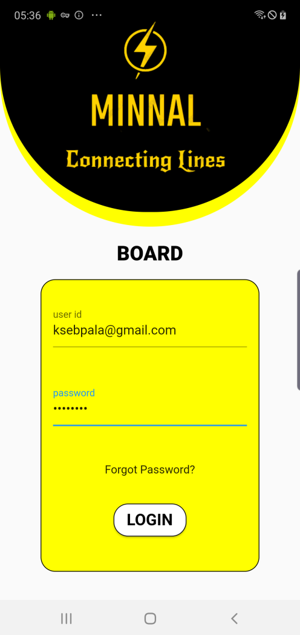
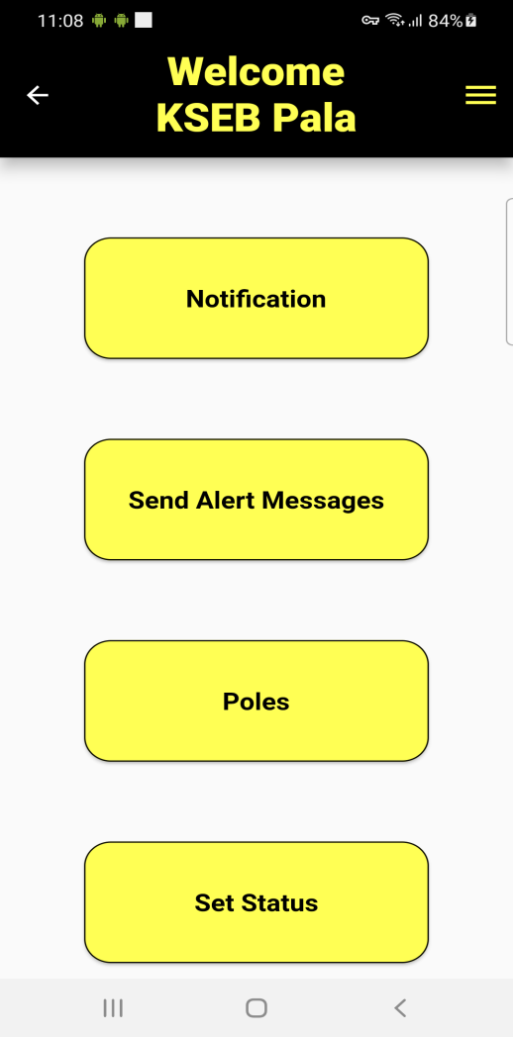
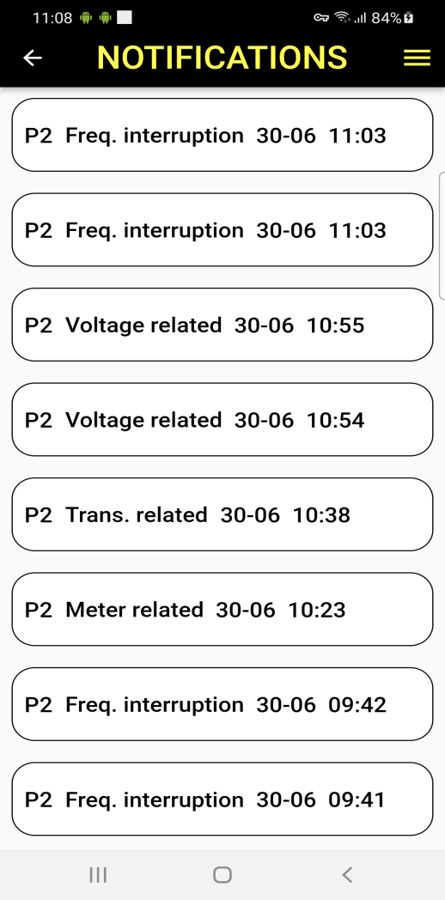
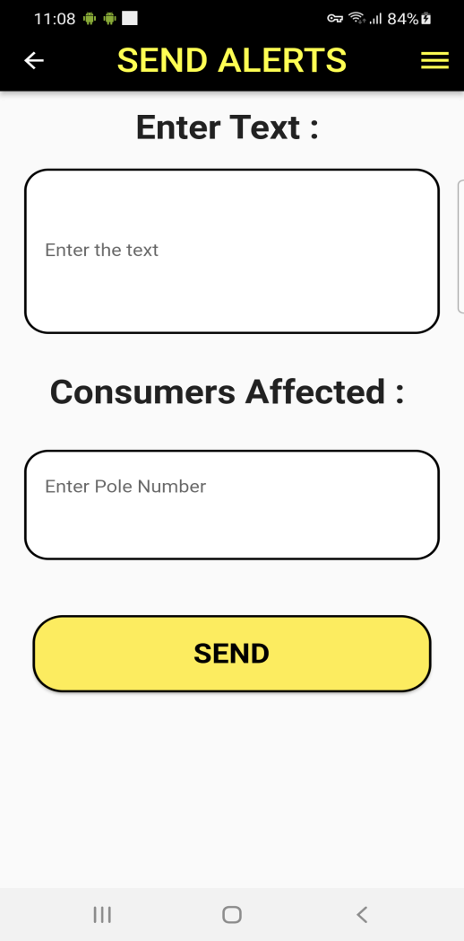

Slide 9
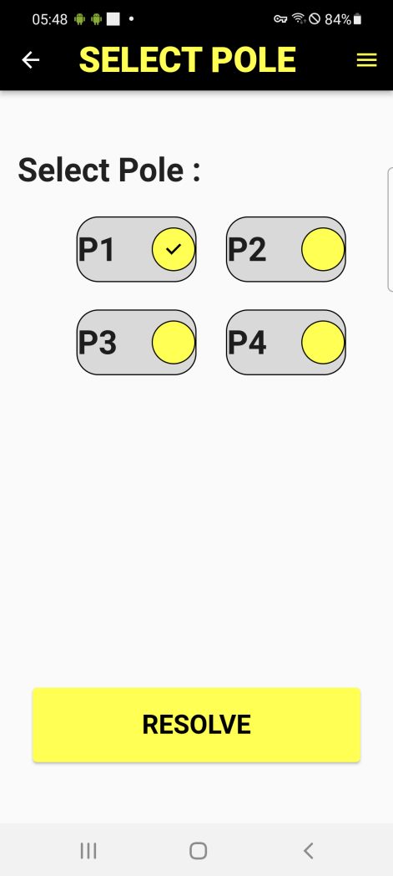
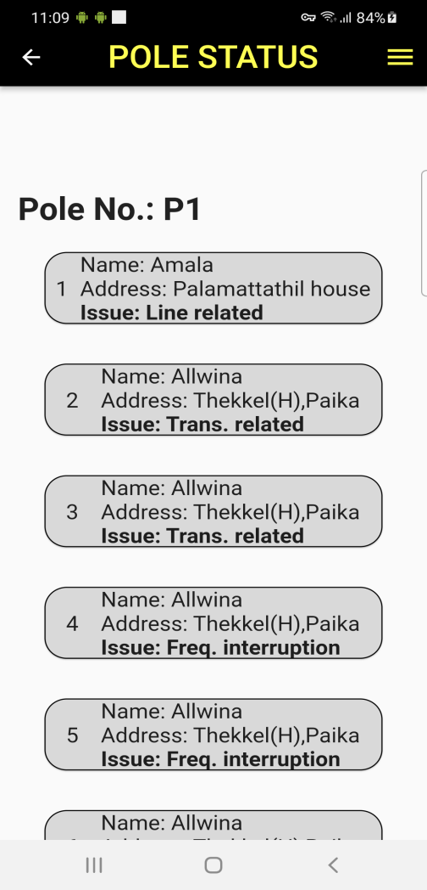
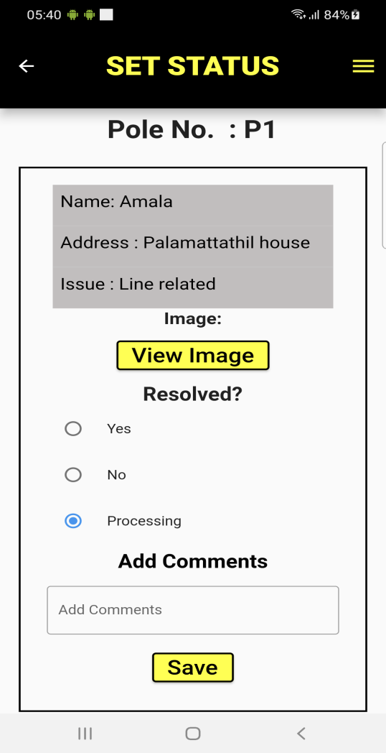
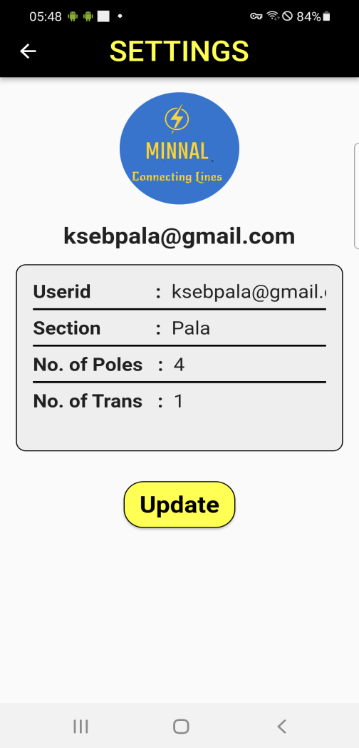

Slide 10
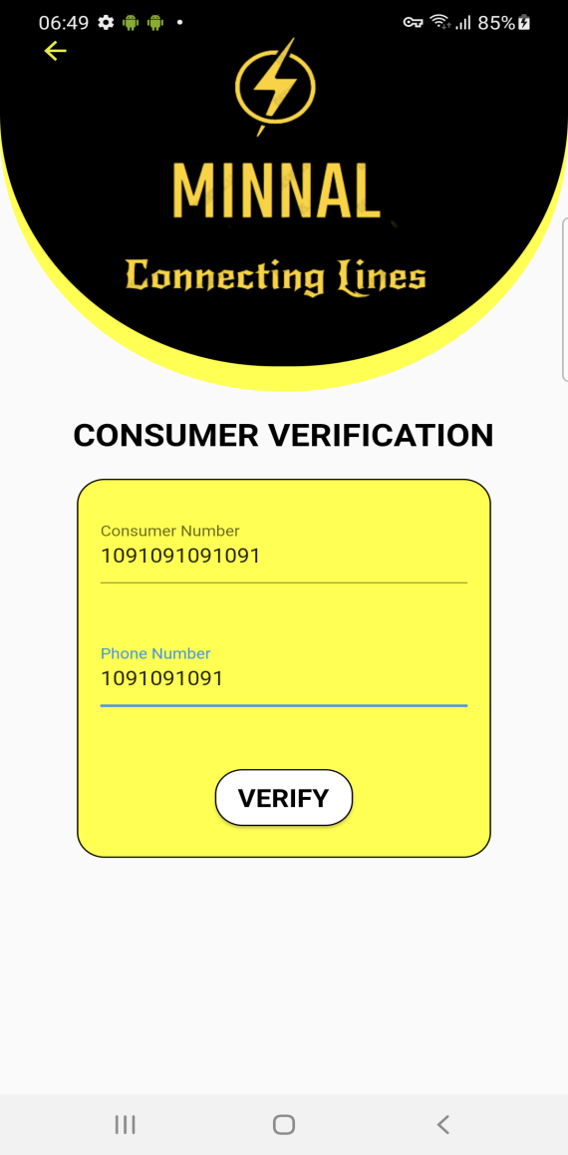
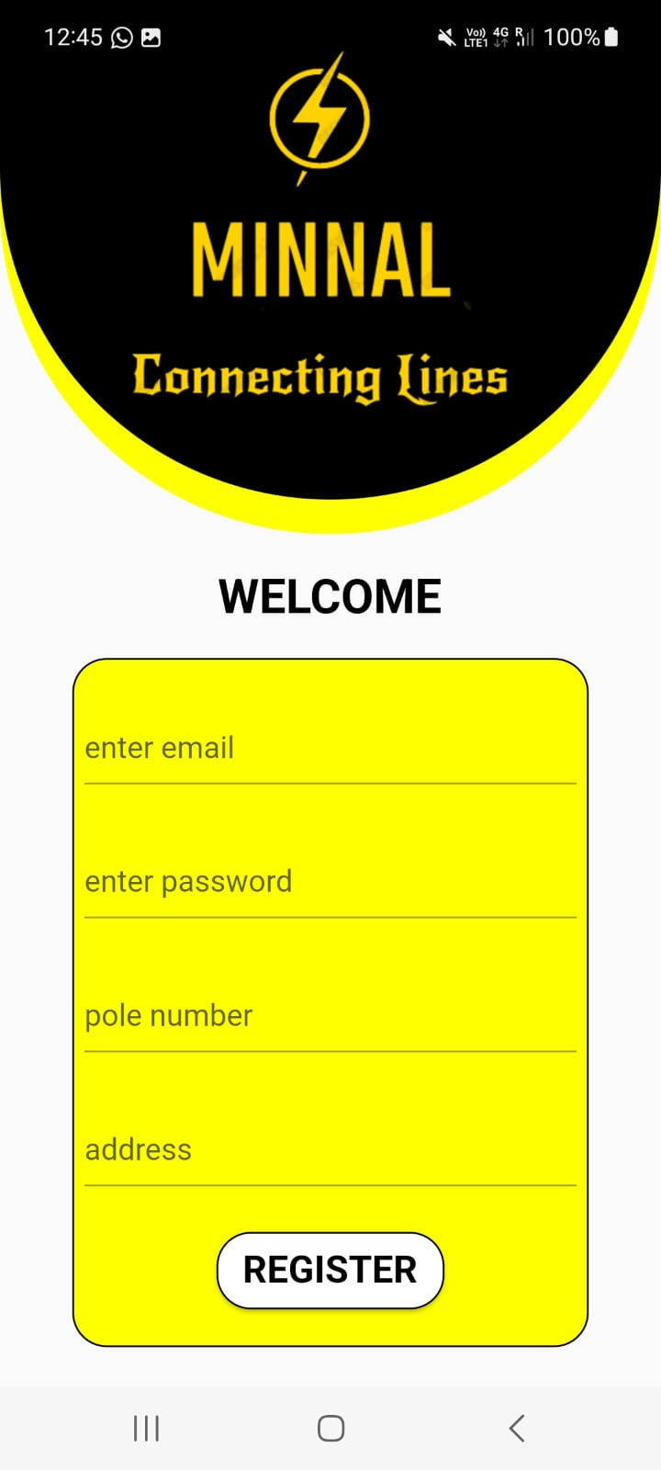

Slide 11
Conclusion
The project aims to provide portable and efficient connectivity between consumers and the board. It addresses and solves various issues, allowing users to report problems, view status updates, and receive notifications. The app offers a user-friendly interface and meets all functional and non-functional requirements successfully.

Slide 12
References
Kerala State Electricity Board (KSEB). "KSEB Official Website." [Online]. Available: https://www.kseb.in. [Accessed: April-June 2023].
Kerala State Electricity Board (KSEB). "KSEB Web Self Service (WSS) Portal." [Online]. Available: https://wss.kseb.in/. [Accessed: April-June 2023].
Flutter: Flutter, "Flutter Documentation," [Online]. Available: https://flutter.dev/docs. [Accessed: April-June 2023].
Stack Overflow: Stack Overflow, "Stack Overflow - Where Developers Learn, Share, and Build Careers," [Online]. Available: https://stackoverflow.com. [Accessed: May-June 2023]
GitHub: GitHub, "GitHub - Where the World Builds Software," [Online]. Available: https://github.com. [Accessed: May-June 2023].

