Slide 1
RDD Dataframe Dataset

Slide 2
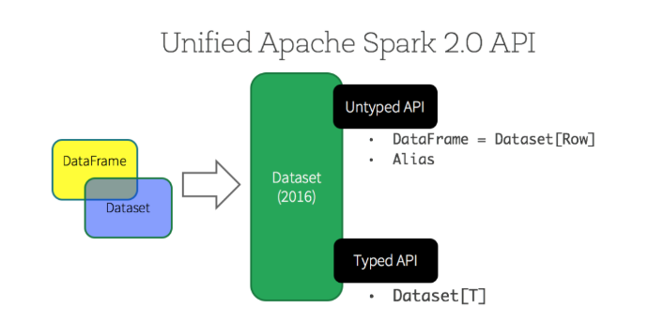
https://databricks.com/blog/2016/07/14/a-tale-of-three-apache-spark-apis-rdds-dataframes-and-datasets.html

