Slide 1
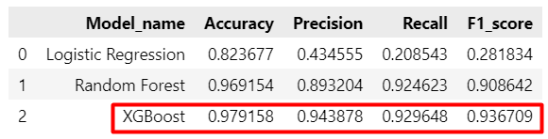
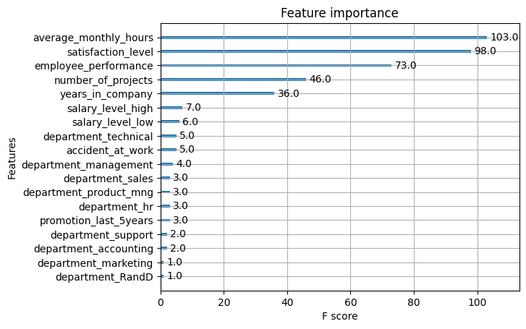
Providing data-driven suggestions for HR project
Executive summary
Currently, there is a high rate of turnover among Salifort employees. Salifort’s senior leadership team is concerned about how many employees are leaving the company. Salifort strives to create a corporate culture that supports employee success and professional development.
The task from the leadership team is to analyze the survey data and come up with ideas for how to increase employee retention.
In order to bring required information it was decided to conduct:
Exploratory data analysis (EDA) of the provided dataset
Build Logistic regression and evaluate its performance
Build tree based machine learning models such as Random Forest and XGBoos, evaluate its performance and choose the best model based on its score.
The XGBoost was chosen as the final model based on its performance score
The model's most predictive features were average monthly hours, following by satisfactory level, employee performance, number of projects and years spent in the company
“average monthly hours”: it is important to keep “gold medium” around 160 -210 hours. All extra hours should be paid according clear company politic or encourage employee not to do extra hours
“satisfactory level”: Extremely low (~0%), a little bit less than average (38% - 48%) and to optimistic (76% - 90%) are the notably values which can suggest that employee is required attention and encourage measure in order not to leave the company
“number of projects”: It is not recommended involve employee in less than 3 but no greater than 5 projects at a time
The XGBoost model performed exceptionally well on the test holdout data. And suggested for usage in order to improve situation
Before deploying the model, it is recommended further evaluation using additional subsets of user data.
It is recommended monitoring the employees data and monitor model performance and its TOP important features in order to ensure that the model remains robust to fluctuations in its most predictive features.

