Slide 1
Needfinding
Irwin El Roi Buada
Angelika Pineda

Slide 2
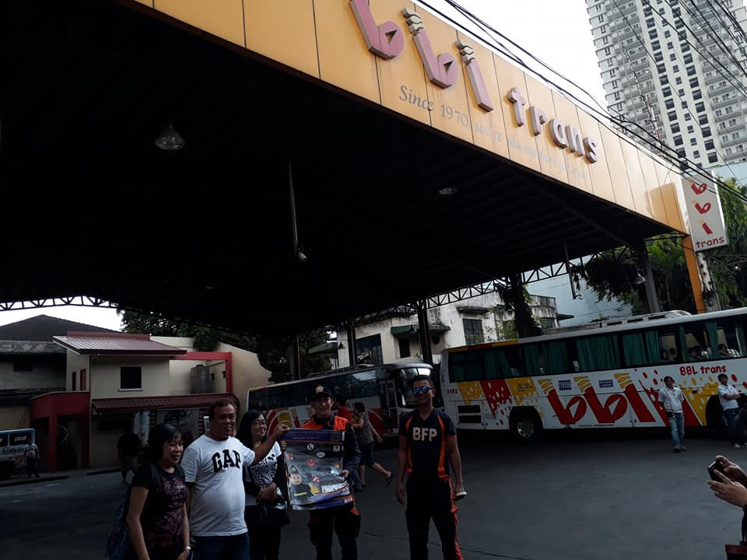
Needfinding Commuting(Bus)
Notes:
Img src = https://www.facebook.com/pasayfire/posts/day-3-oplan-semana-santa-lakbay-alalay-at-bbl-trans-taft-avenue-pasay-city-3rd-s/1303330059767801/

Slide 3
WHY?
One of the proponents commutes on a bus on a daily basis when going to/from school.
One of the proponents lives near BBL Pasay Terminal
Both of the proponents know that commuting can be a dreadful process.

Slide 4
Methods Used:
Observation
Survey
Interview

Slide 5
Observations
No proper queue lines
Queue lines becomes long, especially during rush hour
People usually experience harsh weather when waiting for buses.

Slide 6
Survey/Interview
How often do u ride the bus when going to/from school/work
Do you go to a bus terminal/waiting area to get your ride?
Is it during rush hours?
If you go to a bus terminal, what kind of these do you usually experience (ex: long queues, bad weather, etc.)
If you hail or “para” a ride outside of bus terminals what are the usual things you experience (ex: the bus is already crowded/full)
On a scale of 1 – 5, how do you describe your commuting experience, and why.

Slide 7
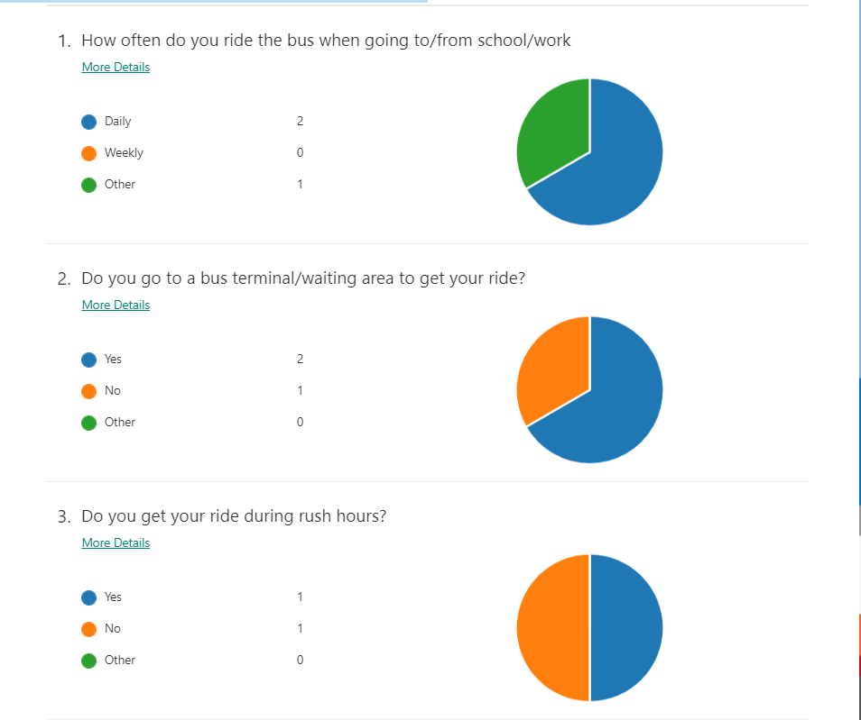
Survey Results

Slide 8
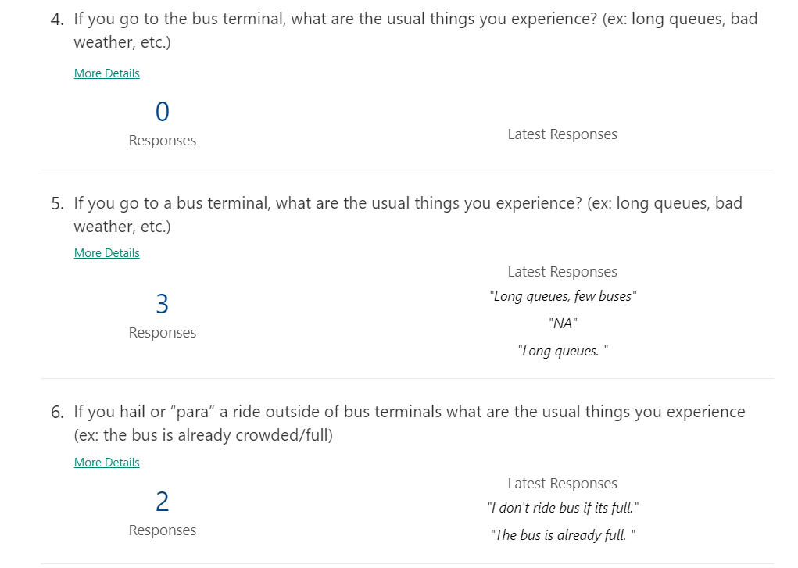
Survey Results

Slide 9

Survey Results

Slide 10
Interview Results (Summarized)

Slide 11
Interview Results (Summarized)

Slide 12
Interview Results (Summarized)
3. Is it during rush hours?
One of the interviewees said that he rides during rush hours when he goes to/from school.
Two said that they only ride during rush hours when going home
One said he does not ride during rush hours.

Slide 13
Interview Results (Summarized)
4. If you go to a bus terminal, what kind of these do you usually experience (ex: long queues, bad weather, etc.)
One of the interviewees said that long queues usually depend on rush hour. (Goes to PITX)
Two said that they always experience full buses when they are going home.
One said he does not experience any long queues even if he needs to wait for the next bus.

Slide 14
Interview Results (Summarized)
5. If you hail or “para” a ride outside of bus terminals what are the usual things you experience (ex: the bus is already crowded/full)
Usually depends, but like 80 % of the time, the buses are already full (standing)
If going to, buses are usually spacious. If going home, usually there are few seats left available despite the number of passengers. There are times were you already need to stand.

Slide 15
Interview Results (Summarized)
6. On a scale of 1 – 5, how do you describe your commuting experience, and why.
On average = 3.75/5
The experience varies if its during rush hours or not.
Kinda good, but not really good, there is room for improvement.
Would give a 5 if the buses are in “pristine” condition.
There are times where the bus seats were unconformable but has enough leg room.

Slide 16
Major insights or Breakdowns
People have similar experiences when commuting via buses.
Their usual concerns mostly occur during rush hours.
Therefore, the usual rating is 3/5 or fair.

Slide 17
What promising unmet needs were identified as a result?
How to make long queues in bus terminals shorter or faster.
How to lessen the issue of full buses, especially during rush hour.
How to improve the experience of those who commute.

