Slide 1














HACKATHON 2026
AI Network Change Safety Guardian
BlastGuard-AI
Intelligent Pre-Deployment Risk Assessment for Network Configuration Changes
Hackathon Project
THE PROBLEM
HOW IT WORKS
THE SOLUTION
Input Data Layer
Frequent & Complex Changes
cisco_config.py • topology.py
Automated Config Analysis
BGP, OSPF etc.. changes across multi-vendor network environments
Example : Nexus 9K NX-OS • Catalyst 6509 IOS • Regex CLI Parsing
Parse and compare proposed changes against current network state
Config Analysis Engine
CiscoConfigParser • Diff Engine
Manual & Static Checks
BGP/OSPF/VLAN Parser • Running-Config Diff
Pre-Deploy Risk Prediction
Approvals rely on human expertise and "stare-and-compare" review methods
Network Graph Analytics
7 ML models auto-select best performer for probability scoring
5 Centrality Algorithms
Unknown Blast Radius
ML Risk Scoring
Explainable AI (SHAP)
Can't predict how a config change propagates through the topology
risk_predictor.py
Clear reasons why a change is flagged as risky — builds trust
Logistic Regression selected out of 7 ML model
Explainability
Cascading Failures
• LLM Explanations • SHAP-style Reasoning
Blast Radius Mapping
One small error can take down critical business services
Risk Advisory Output
Graph traversal visualizes cascading effects across topology
• Blast Radius Map , Risk Probability & Risk Level
TEAM
Alpit Tare
Pratik Sawale
Kanhaiya Chowdhari
Shifa Khan
Menino D'costa
Sagar Gudadari
Python • FastAPI • Scikit-learn • XGBoost • NetworkX • SHAP • Pandas • NumPy

Slide 2

HACKATHON 2026
AI Network Change Safety Guardian
BlastGuard-AI
End-to-End Demo • Real Data • 10 Device DC Topology • 20 Services • 7 ML Models
Demo Pipeline
STEP 1: Demo Input Data
STEP 2: Config Diff + Graph Analytics
STEP 3: ML Risk Scoring
# Core1.cfg (Proposed Change)
hostname Core1
router bgp 65000
no neighbor 2.2.2.2 remote-as 65000
Change Detected:
Model | Risk %
Logistic Regression | 85.40%
Decision Tree | 79.60%
Random Forest | 81.00%
Gradient Boosting | 83.30%
KNN | 100.00%
SVM | 84.80%
XGBoost | 81.80%
BGP_REMOVE • neighbor 2.2.2.2 REMOVED from Core1
NetworkX Graph Centrality (Core1):
Topology: 10 Devices
Metric | Value
Degree Centrality | 0.444
Betweenness | 0.681
Role (Core=2) | 2
Traffic Load | 40%
Core1/2 → Agg1/2 → Edge1/2/3 → Access1/2/3
20 Services (Bank, Retail, Hospital, Finance)
Best Model: Logistic Regression → 96.74%
Training: 200 samples • Features: role, deg, between, change, traffic
STEP 4: SHAP Explainability
STEP 5: Blast Radius Analysis
STEP 6: AI Advisory Output
Feature Contributions (Core1 Bgp Demo):
10
20
Impacted Devices:
98%
BLOCK
HIGH RISK
role (Core=2)
+35%
Core1
betweenness (0.40)
+28%
Core2
Risk
Devices
Impacted
Services
Affected
Agg1
degree (0.33)
+22%
Agg2
Device:
Core1 (Core)
traffic (50%)
+18%
Edge1
Change Type:
BGP_CHANGE
Cascade Logic:
Edge2
Traffic Load:
50% (Non-Peak)
change (BGP)
+15%
Agg routers bridge core ↔ edge
Change propagates to ALL layers
BFS traversal: depth 3 hops
Access1
Mitigation:
Staged rollout + maintenance window
Access2
"Aggregation role + high betweenness = multi-layer impact"
Action:
Email sent → Human-in-the-Loop approval
Python • FastAPI • Streamlit UI • scikit-learn • XGBoost • NetworkX • SHAP • Pandas • Matplotlib • OpenAI LLM Agent
Demo Data: 10 devices • 11 topology links • 20 services • 200 training samples • 8 device configs (.cfg + .csv) • 3 proposed change files

Slide 3
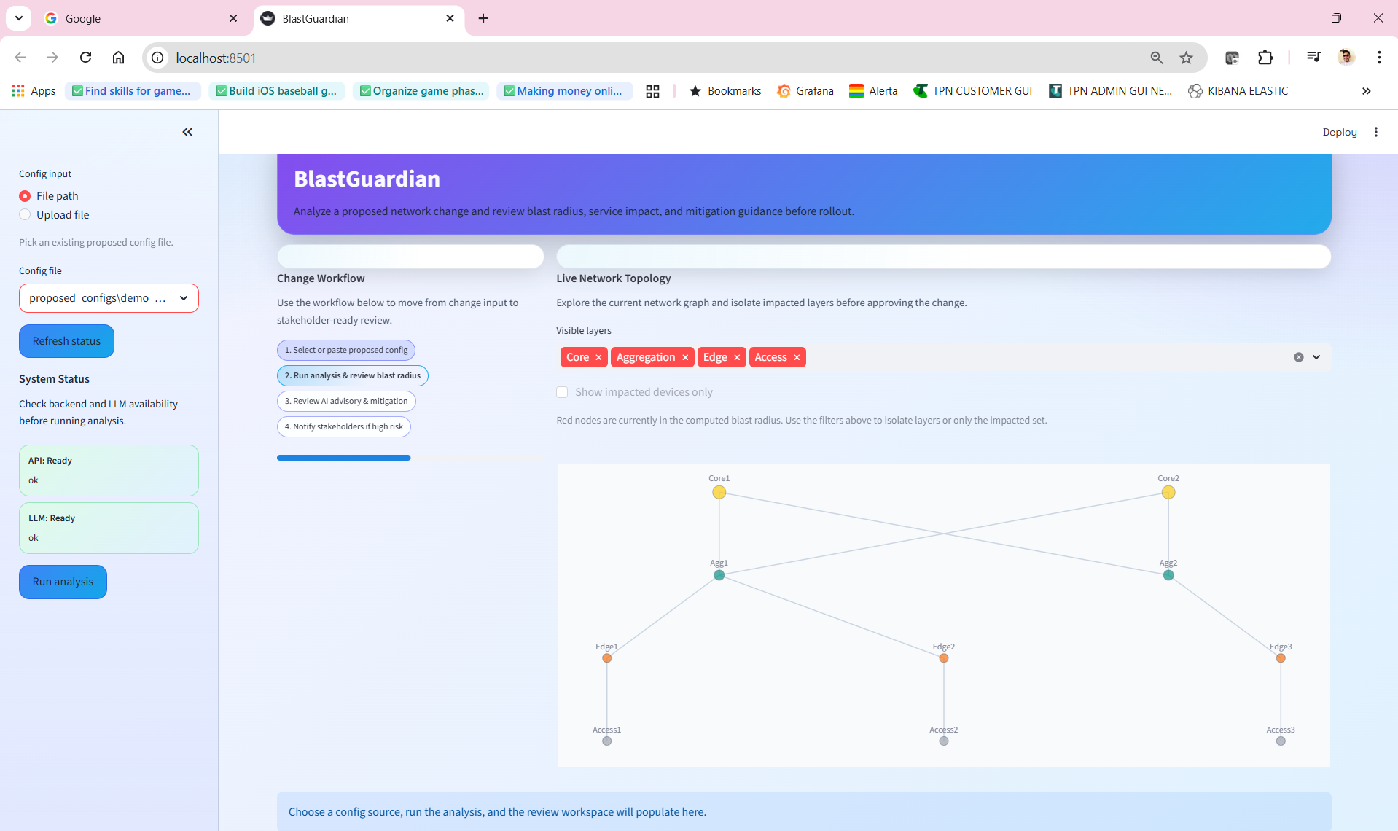
Actual demo slide 1

Slide 4
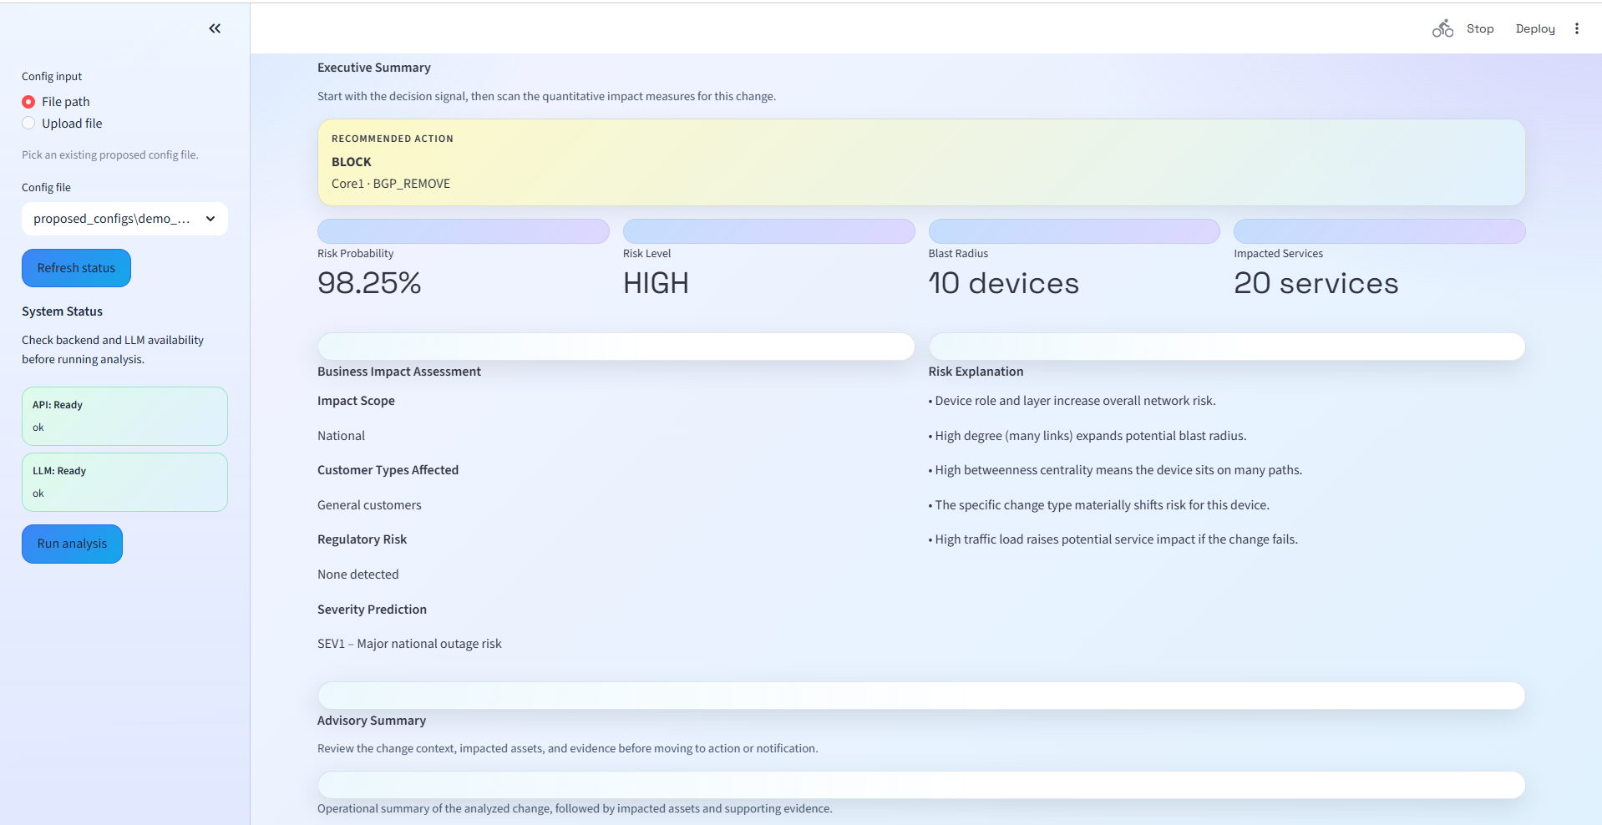
Actual demo slide 2

Slide 5
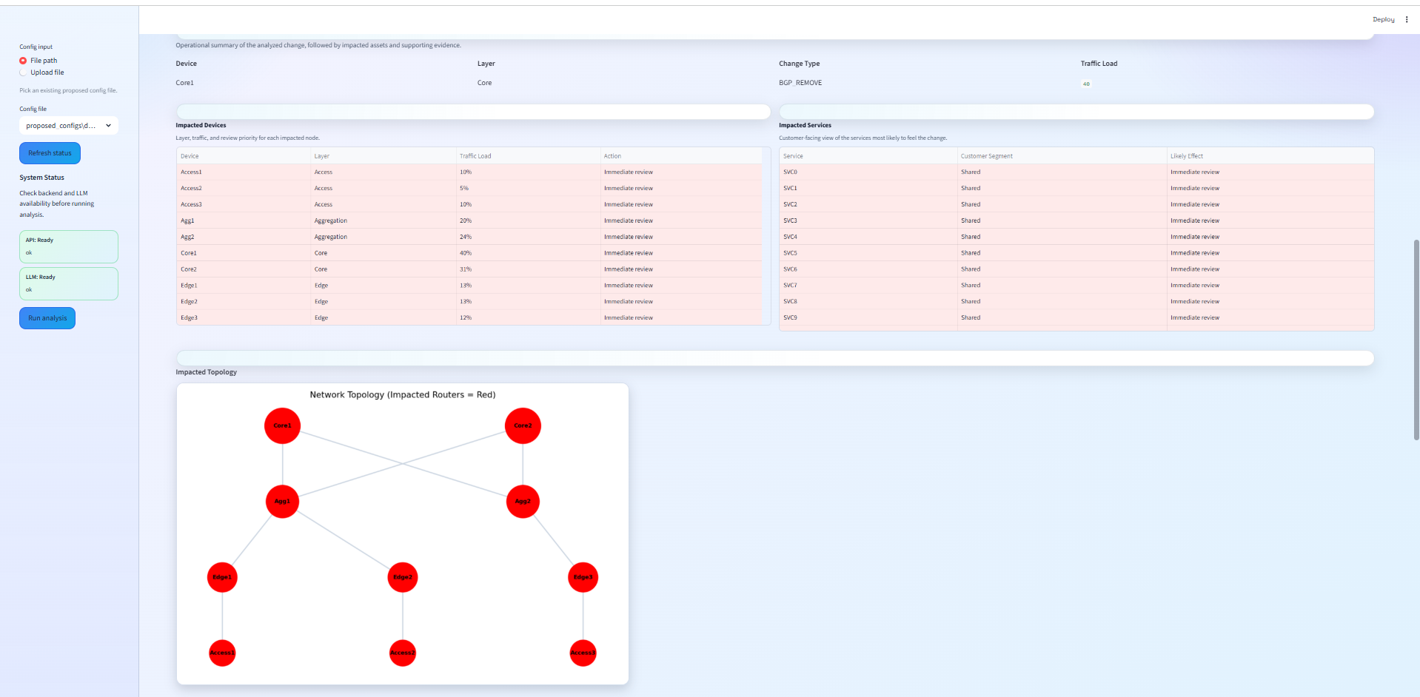
Actual demo slide 3

Slide 6
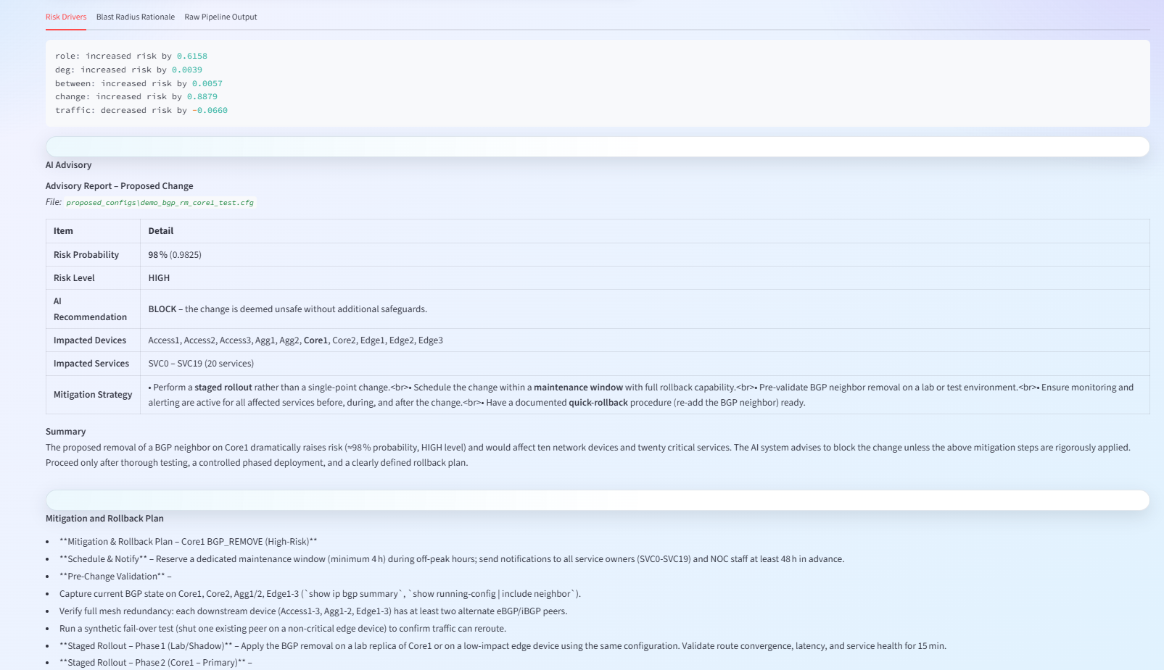
Actual demo slide 3

Slide 7
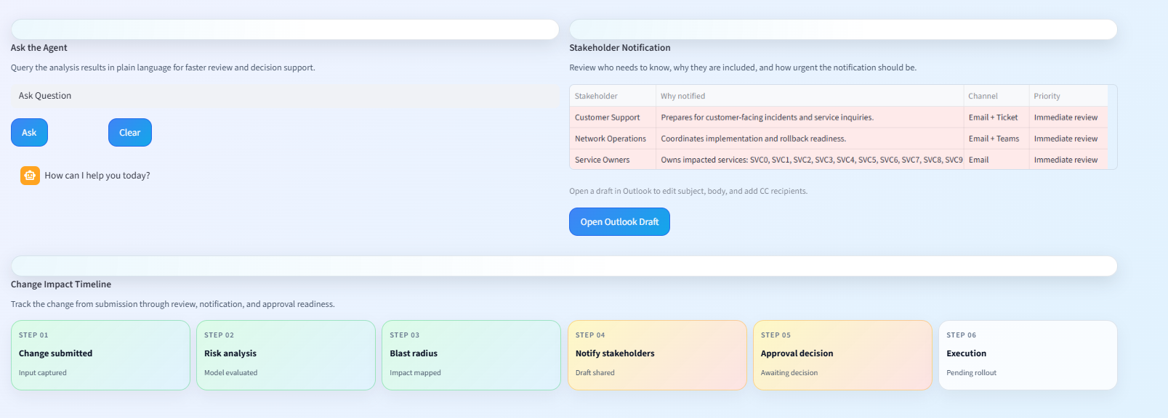
Actual demo slide 4

