Slide 1
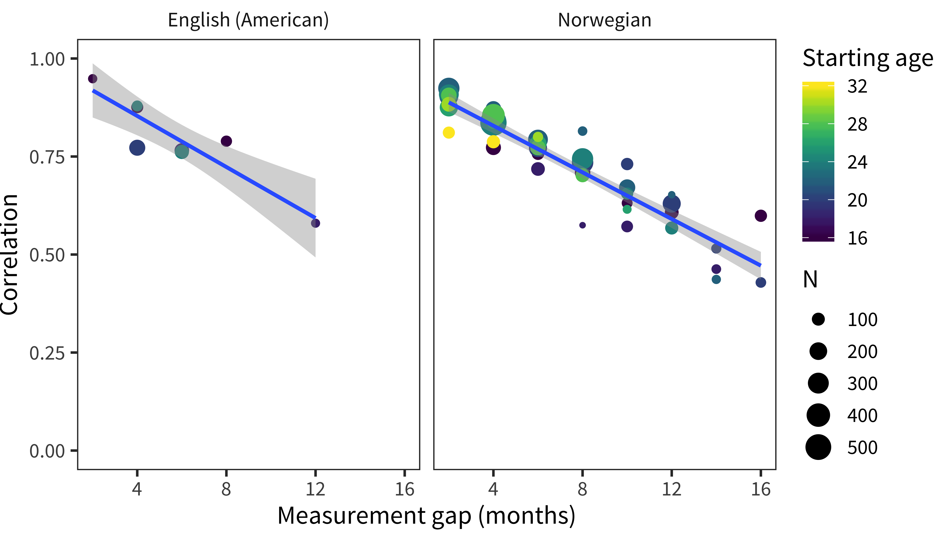

Slide 2
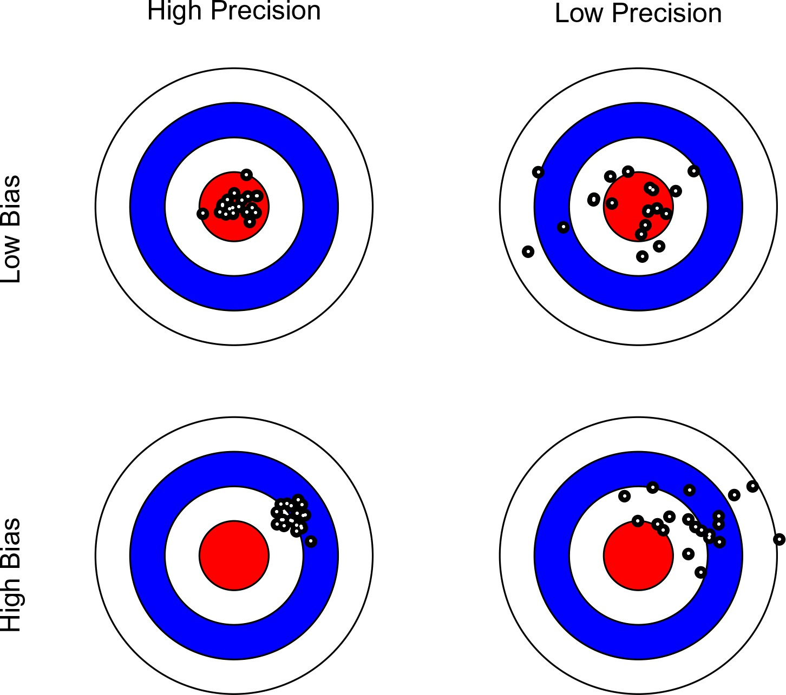

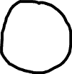

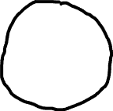
High Precision
Low Precision
High Validity
Low Validity

Slide 3
Neither good nor bad
Extremely bad
Moderately bad
Slightly good
Moderately good
Extremely good
Slightly bad
About half the time
Most of the time
Never
Sometimes
Always

Slide 4


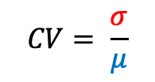

Measuring reliability with a true zero
Standard deviation of individual measures (including measurement error)
Measuring reliability without a true zero
o₁
o₂
Parallel tests
Individual measures (including measurement error)
True height
$$CV= \frac{σ}{μ}$$
Test-retest reliability: $ρ_{o_{1},o_{2}}$
Zero point

