Slide 1






Our tea experiment
All tea drinkers
Milk first
Sample of tea drinkers
Tea quality rating
Tea first

Slide 2
7
Rating
1
Tea-first (T)
Milk-first (M)

Slide 3


Estimation
“best” normal distribution
7
Probability
Rating
θ_{M}
1
θ_{M} is the mean of the best-fitting normal distribution

Slide 4


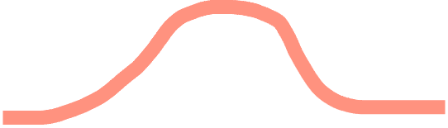
The maximum likelihood curve is the one that maximizes the likelihood of all the points
Probability
Substantially worse curve
Likelihood of an individual point
1
7
Rating

Slide 5
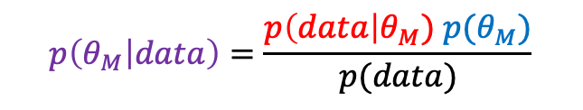
likelihood
prior
posterior
$$p\left(θ_{M} | data\right)=\frac{p\left(data\right|θ_{M}) p(θ_{M})}{p(data)}$$

Slide 6

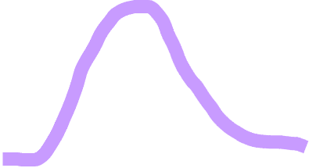
Prior expectation that ratings will be low
Posterior reflects combination of prior and likelihood
Probability
Likelihood
1
7
Rating

Slide 7


With a weak prior, posterior is closer to likelihood
Weak prior expectations about ratings
Probability
1
7
Rating

Slide 8
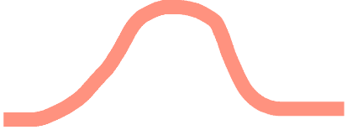
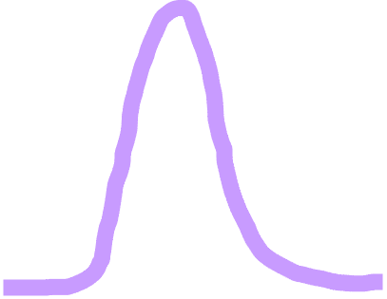

With more data, posterior mean is closer to maximum likelihood mean
Low prior
Probability
1
7
Rating

Slide 9
Estimating the average treatment effect:
β = θ_{M} - θ_{T}
7
θ_{M}
Rating
θ_{T}
β
1
Tea-first (T)
Milk-first (M)

Slide 10
From effect to effect size
Summarize effect with units given by the original rating scale (points of difference in rating
7
Rating
θ_{M}
θ_{T}
2
1
Tea-first (T)
Milk-first (M)
Rating difference
0
-2

Slide 11

Summarize effect with units given by the original rating scale (points of difference in rating)
Divide by standard deviation to get effect size (comparable to other studies with different measures)
7
2
1
Rating
θ_{M}
θ_{T}
Rating difference
Effect size (d)
0
0
1
-2
-1
Tea-first (T)
Milk-first (M)

Slide 13
Run the experiment many times
no effect
ATE from the experiment we just ran
-1
0
1
average treatment effect
β

Slide 14
Run the experiment many times
no effect
-1
0
1
average treatment effect
β

Slide 15

Run the experiment many times
no effect
Distribution of treatment effects
-1
0
1
average treatment effect
β

Slide 16
Run the experiment many times
no effect
Distribution of treatment effects (N=9)
-1
0
1
average treatment effect
β

Slide 17

Run the experiment many times
no effect
Distribution of treatment effects (N=9/group)
Small
experiment
-1
1
Distribution of treatment effects (N=24/group)
Medium experiment
-1
0
1
average treatment effect β

Slide 18

Run the experiment many times
no effect
Distribution of treatment effects (N=9/group)
Small
experiment
-1
1
Distribution of treatment effects (N=200/group)
Big experiment
-1
0
1
average treatment effect β

Slide 19
Run the experiment many times
no effect
Small
experiment
On average, treatment effect is the same for small experiments and big experiments. But small experiments are much noisier in any individual instance…
-1
1
Big experiment
-1
0
1
average treatment effect β

