Slide 1
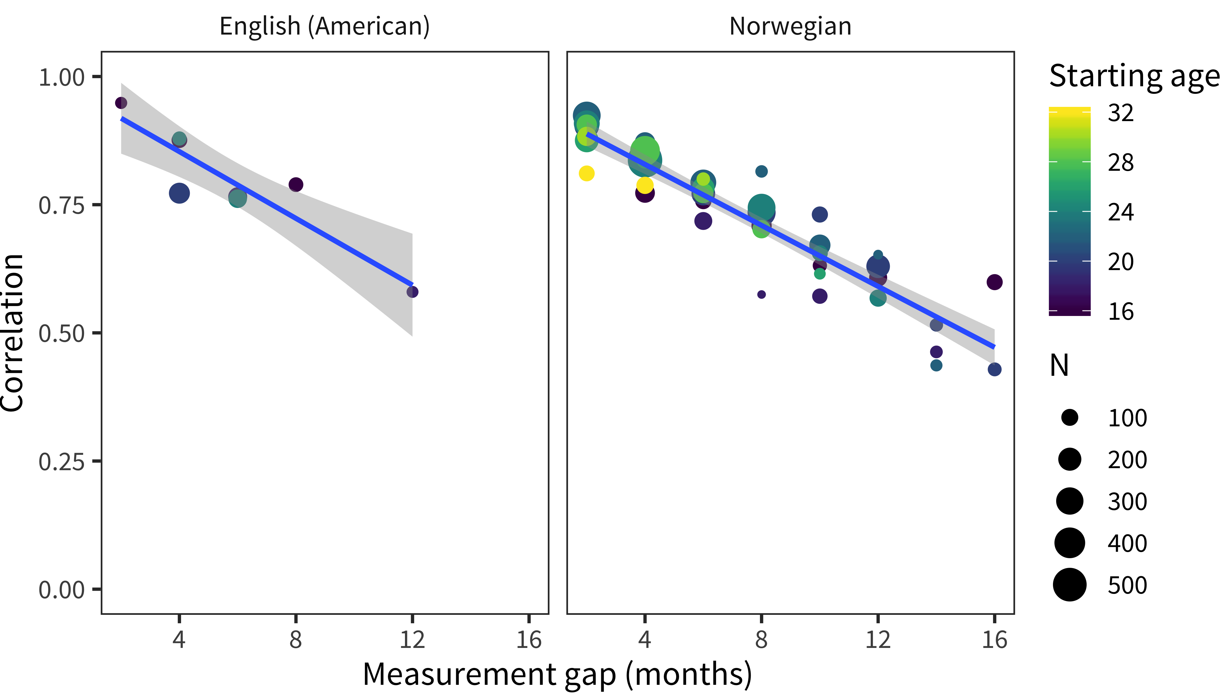

Slide 2
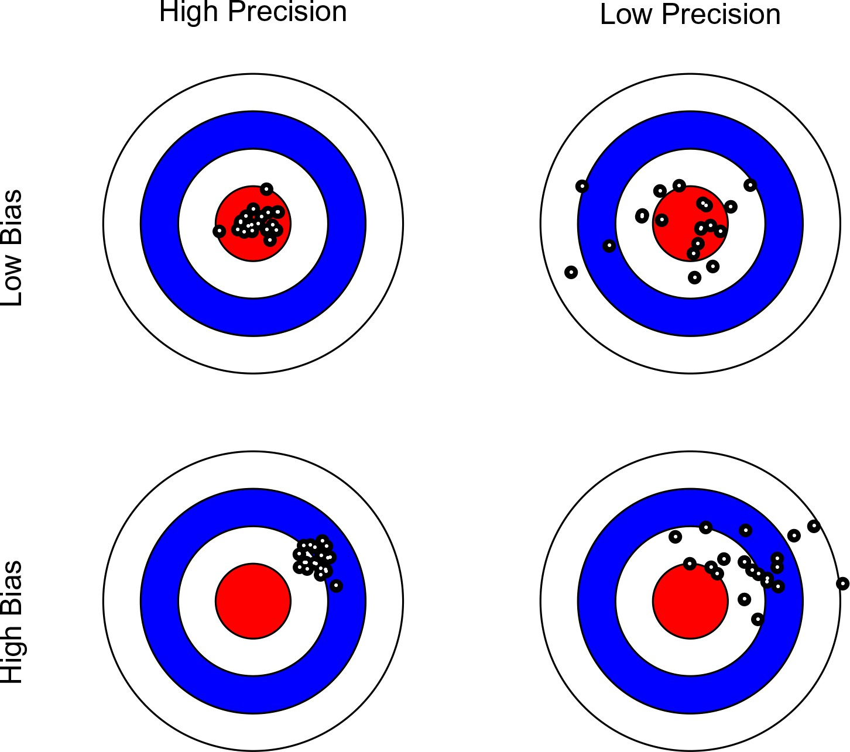

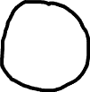

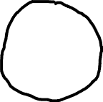
High Precision
Low Precision
High Validity
Low Validity

Slide 3
Neither good nor bad
Extremely bad
Moderately bad
Slightly good
Moderately good
Extremely good
Slightly bad
About half the time
Most of the time
Never
Sometimes
Always

