Slide 1
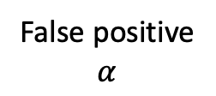

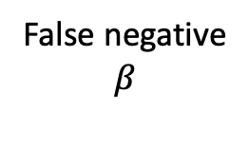

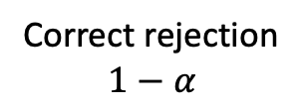
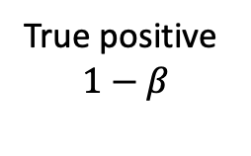
Inference
Reject null (H₀₎
Fail to reject null (H₀₎
Null (H₀₎ is true
False positive
$$α$$
Correct rejection
$$1−α$$
Reality
Null (H₀) is false
True positive
$$1−β$$
False negative
$$β$$

Slide 2
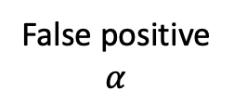


Inference
Reject null (H₀₎
Fail to reject null (H₀₎
Null (H₀₎ is true
False positive
$$α$$
Correct rejection
$$1−α$$
Reality
Null (H₀) is false
True positive
$$1−β$$
False negative
$$β$$
Power to reject the null

