Slide 1








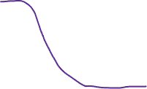


Homogeneous effect
Heterogeneous effect
Representative sample
Sample mean
Population mean
Distribution
Measure
Convenience sample
Bias

