Slide 1
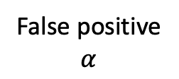

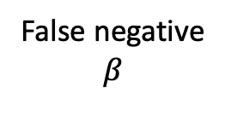

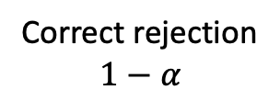
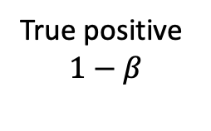
Inference
Reject null (H₀)
Fail to reject null (H₀)
Null (H₀)
is true
False positive
$$α$$
Correct rejection
$$1−α$$
Reality
Null (H₀) is false
True positive
$$1−β$$
False negative
$$β$$

Slide 2
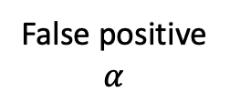


Inference
Reject null (H₀)
Fail to reject null (H₀)
Null (H₀)
is true
False positive
$$α$$
Correct rejection
$$1−α$$
Reality
Null (H₀) is false
True positive
$$1−β$$
False negative
$$β$$
Power to reject the null

Slide 3
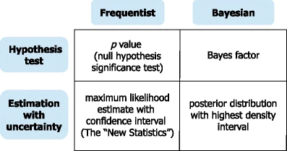


Frequentist
Bayesian
p value from null hypothesis significance test
Hypothesis testing
Bayes factor
Estimation with uncertainty
posterior distribution with credible interval
estimate with confidence interval

