Slide 1

Optimisation of the event selection for the single top quark production in association with a Z boson at the ATLAS detector
Tesi di Laurea di:
Alberto Plebani
Relatore: Dott. ssa Lidia Dell’Asta
Correlatore: Prof. Marcello Fanti

Slide 2
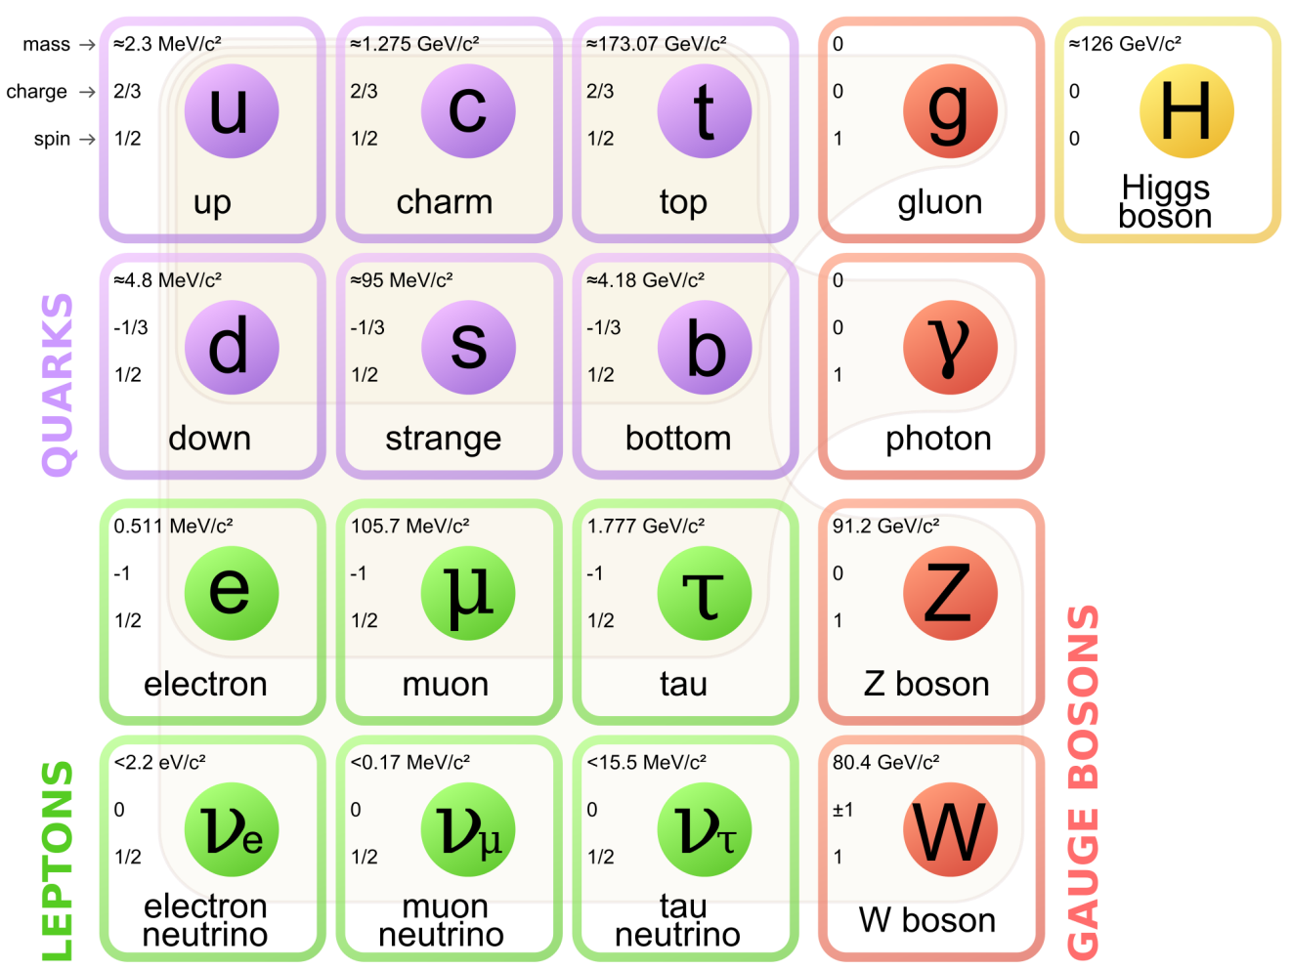
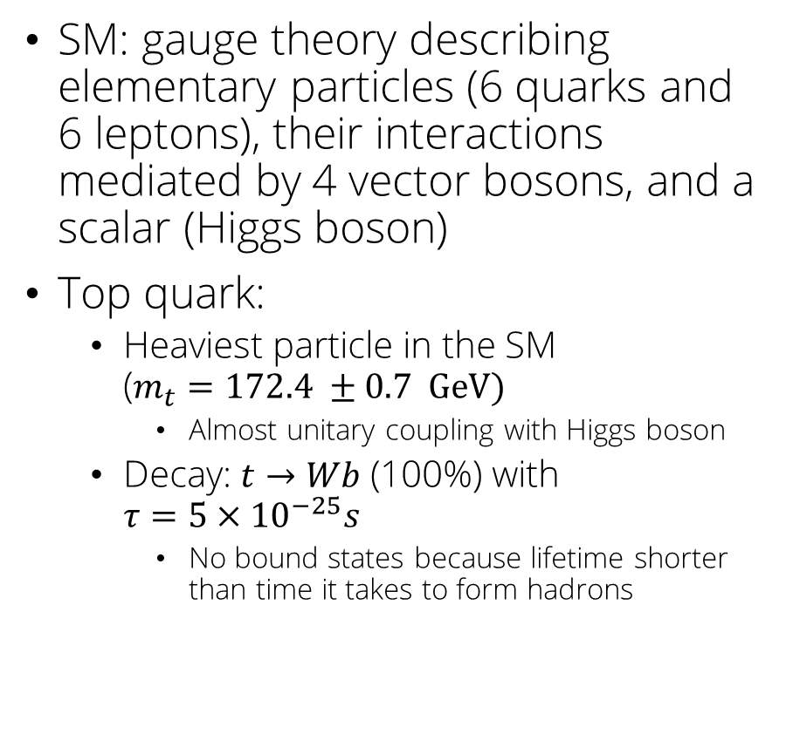
The Standard Model and the top quark
SM: gauge theory describing elementary particles (6 quarks and 6 leptons), their interactions mediated by 4 vector bosons, and a scalar (Higgs boson)
Top quark:
Heaviest particle in the SM ($m_{t}=172.4 ±0.7 GeV)$
Almost unitary coupling with Higgs boson
Decay: $t→Wb$ (100%) with $τ=5×{10}^{−25}s$
No bound states because lifetime shorter than time it takes to form hadrons

Slide 3
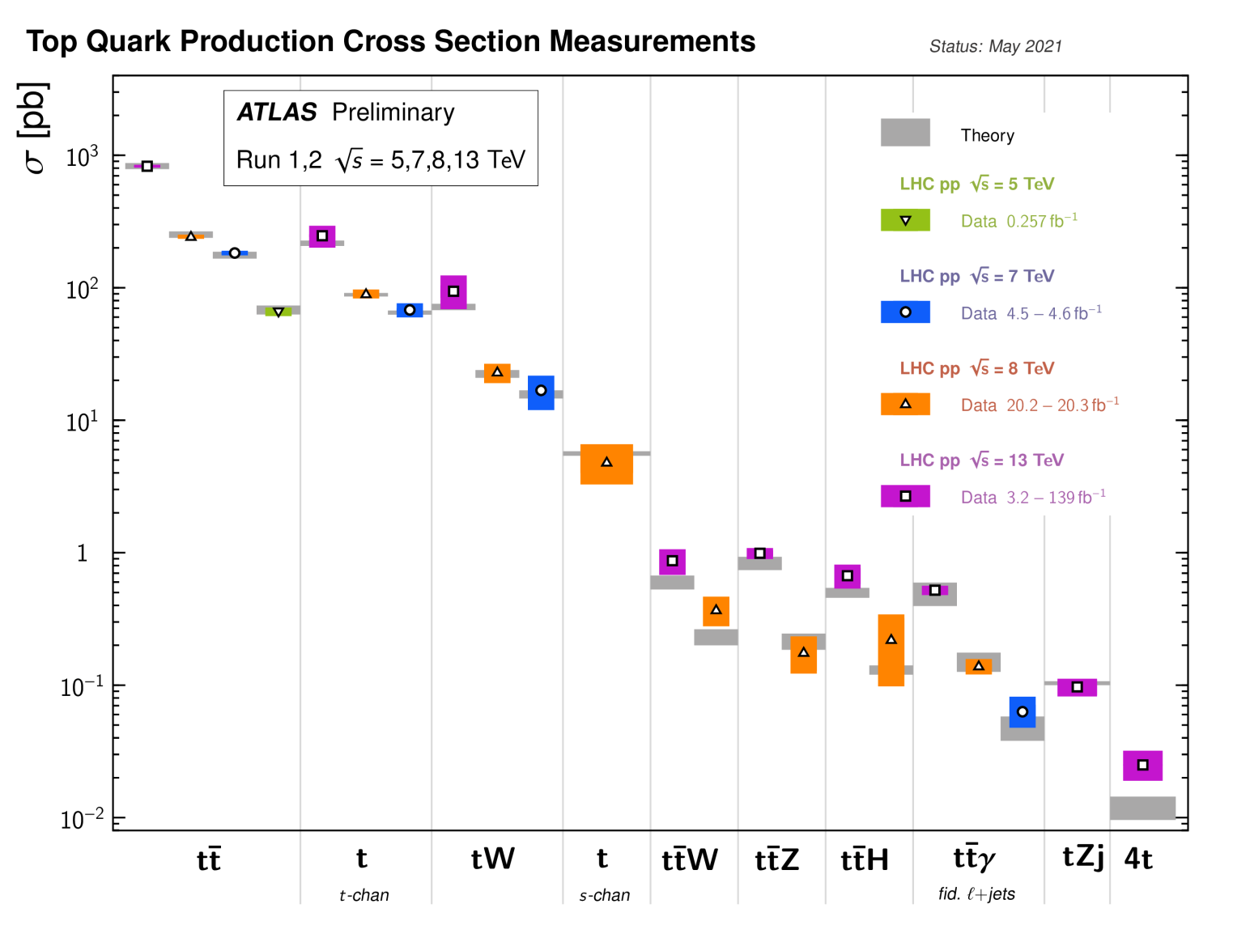

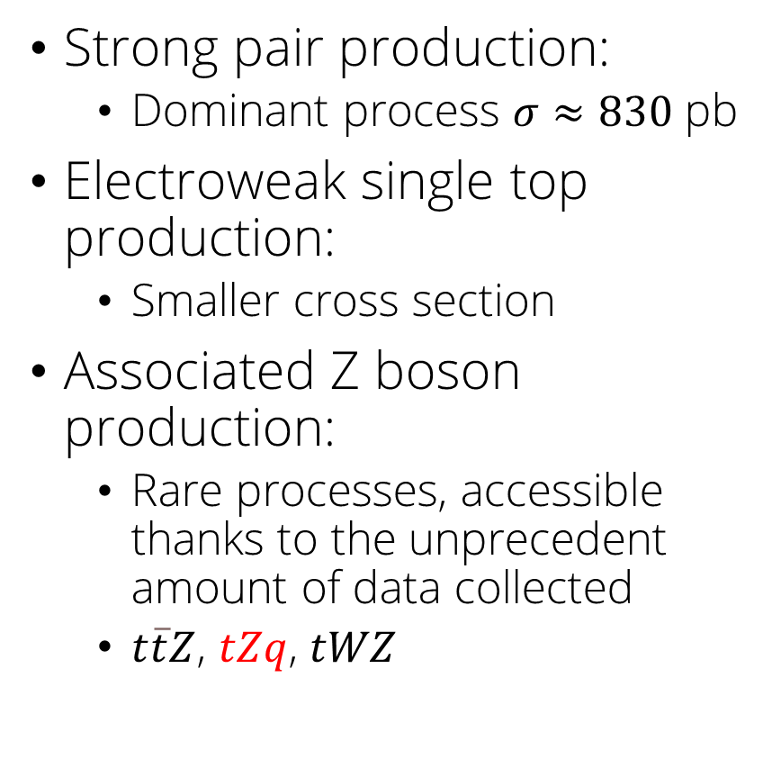
Top quark production at LHC
Strong pair production:
Dominant process $σ≈830$ pb
Electroweak single top production:
Smaller cross section
Associated Z boson production:
Rare processes, accessible thanks to the unprecedent amount of data collected
$t\overline{t}Z$, $tZq$, $tWZ$

Slide 4
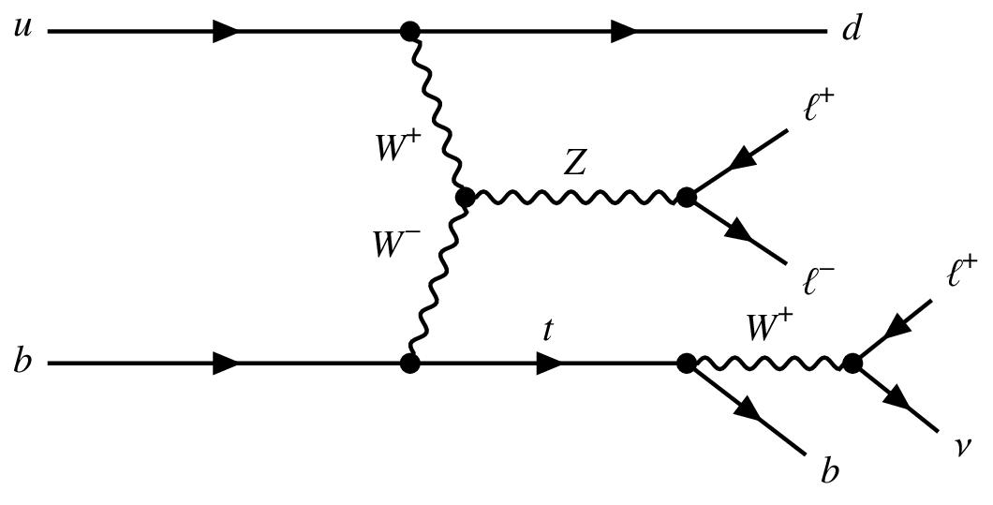
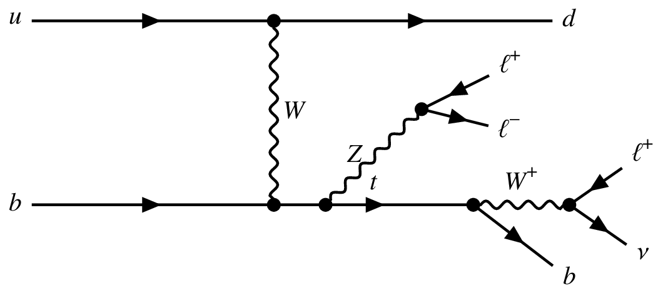
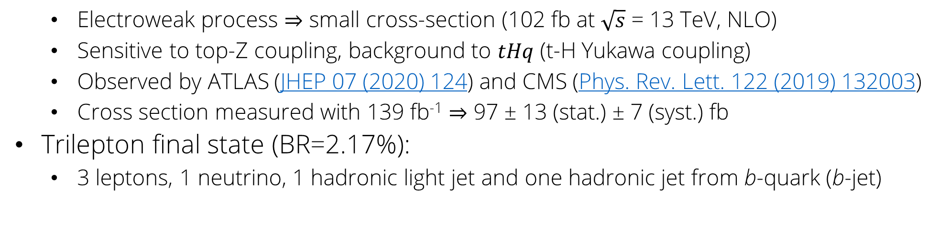

$tZq$ associated production
$tZq$ – single top production in association with a Z boson
Electroweak process $⇒$ small cross-section (102 fb at $\sqrt{s}$ = 13 TeV, NLO)
Sensitive to top-Z coupling, background to $tHq$ (t-H Yukawa coupling)
Observed by ATLAS (JHEP 07 (2020) 124) and CMS (Phys. Rev. Lett. 122 (2019) 132003)
Cross section measured with 139 fb⁻¹ $⇒$ 97 ± 13 (stat.) ± 7 (syst.) fb
Trilepton final state (BR=2.17%):
3 leptons, 1 neutrino, 1 hadronic light jet and one hadronic jet from b-quark (b-jet)

Slide 5
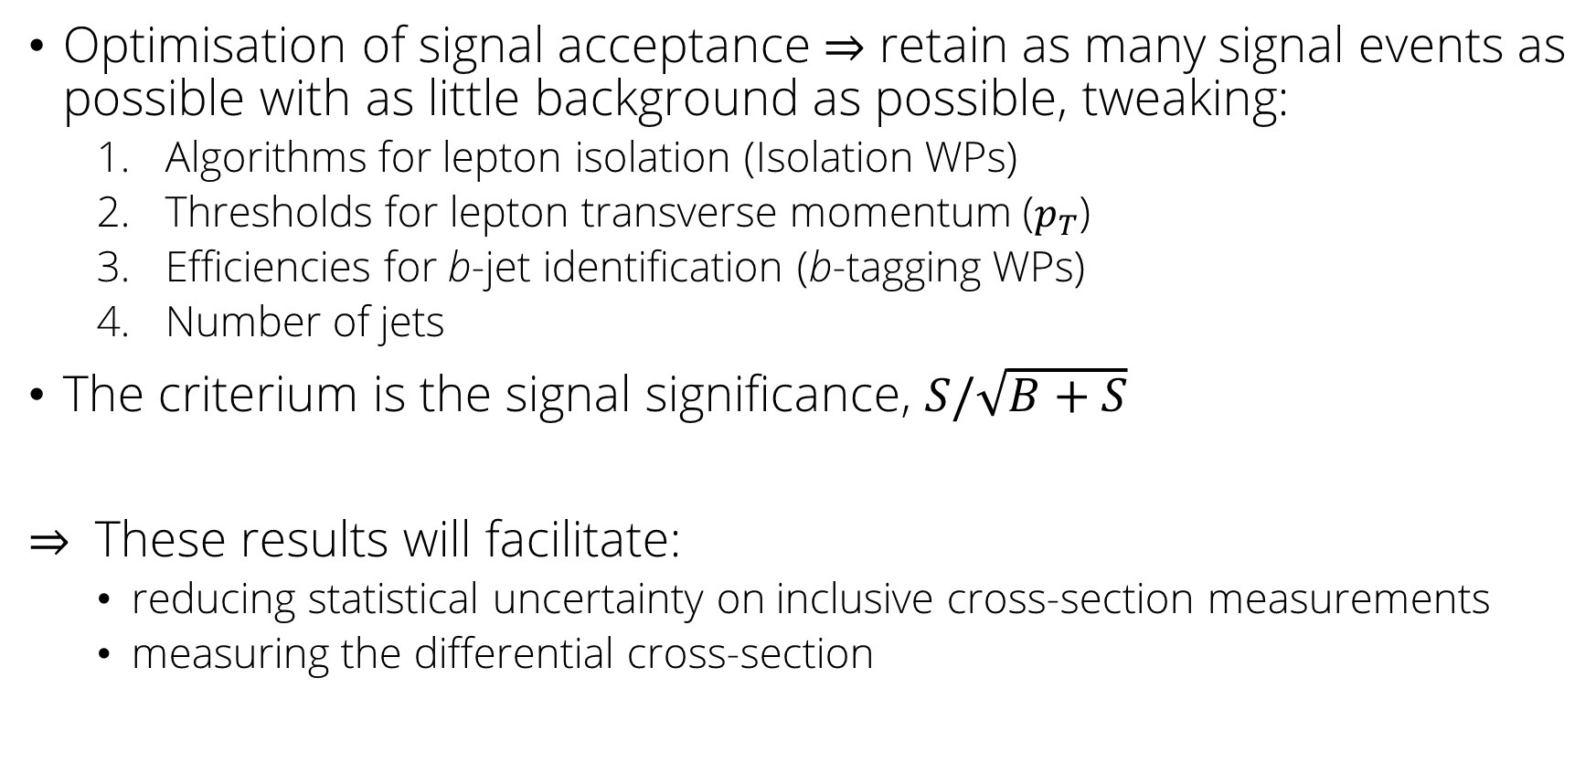
Object of my analysis
Optimisation of signal acceptance $⇒$ retain as many signal events as possible with as little background as possible, tweaking:
Algorithms for lepton isolation (Isolation WPs)
Thresholds for lepton transverse momentum ($p_{T}$)
Efficiencies for b-jet identification (b-tagging WPs)
Number of jets
The criterium is the signal significance, $S/\sqrt{B+S}$
$⇒$ These results will facilitate:
reducing statistical uncertainty on inclusive cross-section measurements
measuring the differential cross-section

Slide 6
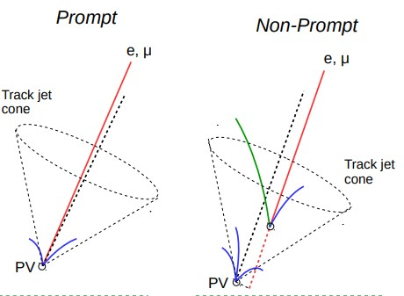
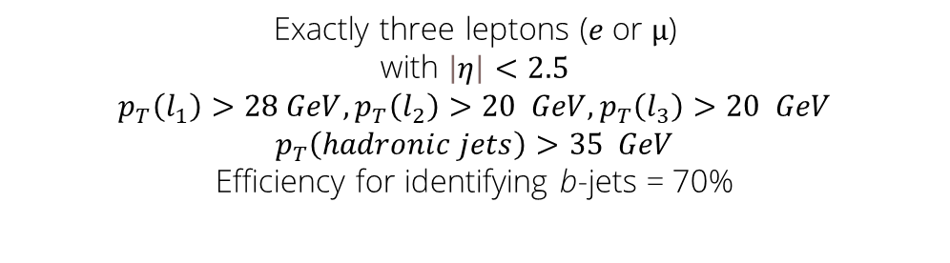
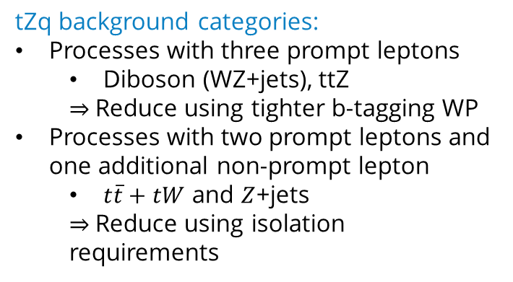
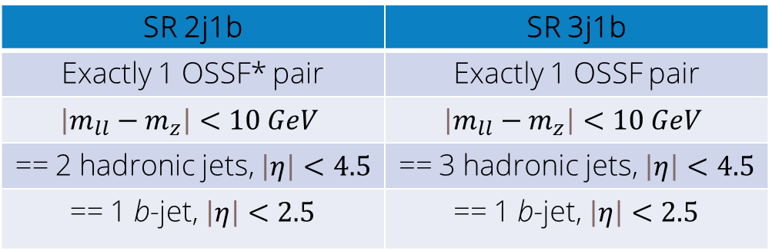
Event selection
tZq background categories:
Processes with three prompt leptons
Diboson (WZ+jets), ttZ
$⇒$Reduce using tighter b-tagging WP
Processes with two prompt leptons and one additional non-prompt lepton
$t\overline{t}+tW$ and $Z$+jets
$⇒$Reduce using isolation requirements
Common selections
Exactly three leptons ($e$or $µ$) with $\left|η\right|<2.5$
$$p_{T}\left(l_{1}\right)>28 GeV, p_{T}\left(l_{2}\right)>20 GeV, p_{T}\left(l_{3}\right)>20 GeV$$
$$p_{T}\left(hadronic jets\right)>35 GeV$$
Efficiency for identifying b-jets = 70%
SR 2j1b | SR 3j1b
Exactly 1 OSSF* pair | Exactly 1 OSSF pair
$$\left|m_{ll}−m_{z}\right|<10 GeV$$ | $$\left|m_{ll}−m_{z}\right|<10 GeV$$
== 2 hadronic jets, $\left|η\right|<4.5$ | == 3 hadronic jets, $\left|η\right|<4.5$
== 1 b-jet, $\left|η\right|<2.5$ | == 1 b-jet, $\left|η\right|<2.5$
*OSSF = Opposite Sign Same Flavour

Slide 7
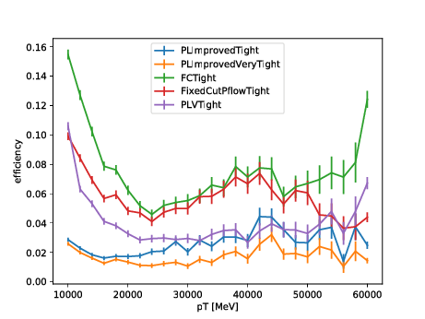
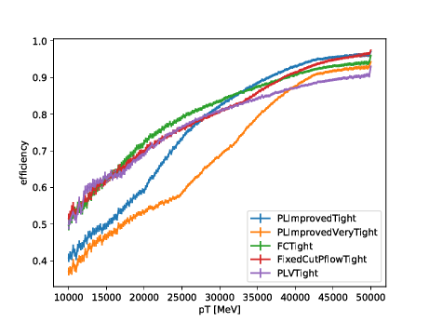


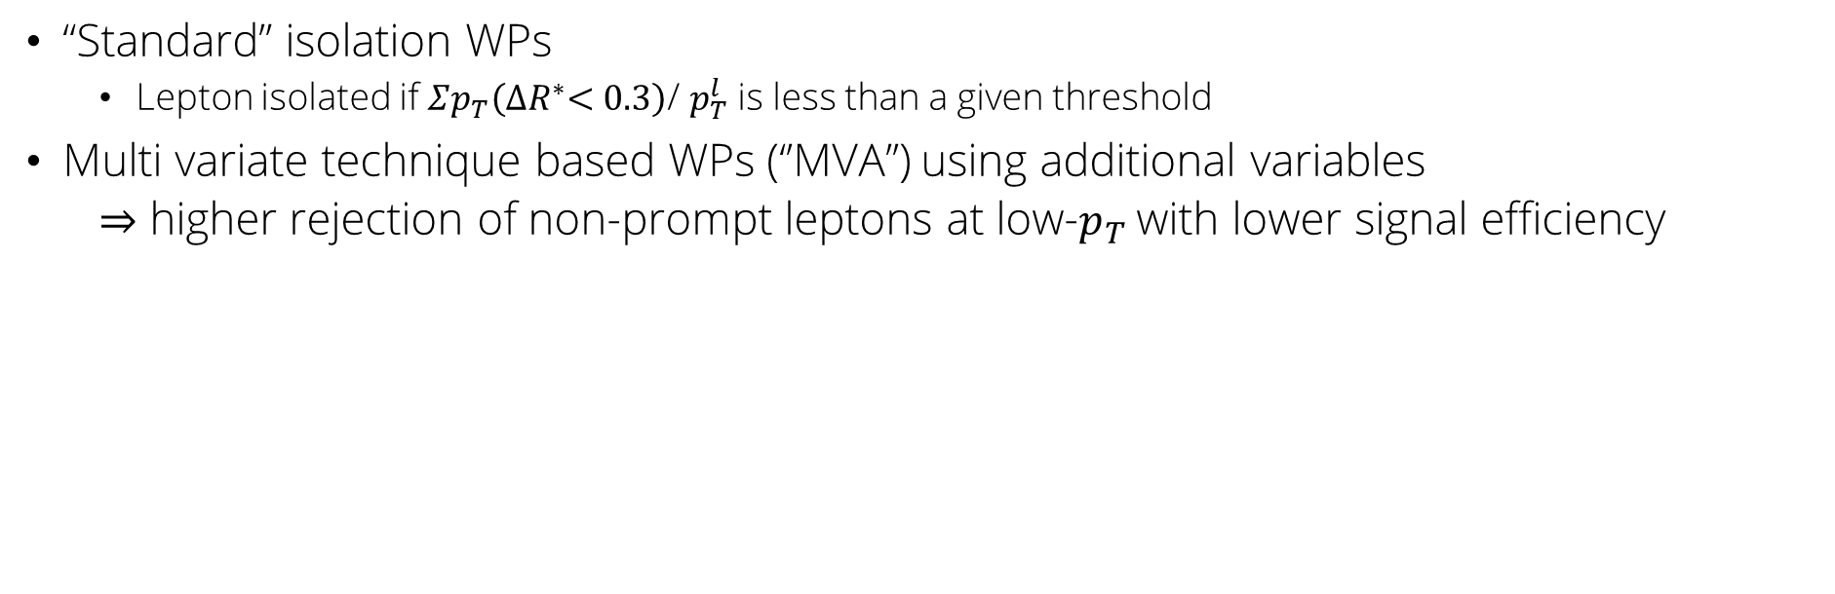
Lepton isolation
“Standard” isolation WPs
Lepton isolated if $Σp_{T}\left({∆R}^{∗}<0.3\right)$/ $p_{T}^{l}$ is less than a given threshold
Multi variate technique based WPs (‘’MVA’’) using additional variables
$⇒$ higher rejection of non-prompt leptons at low-$p_{T}$with lower signal efficiency
($∗∆R=\sqrt{{\left(Δη\right)}^{2}+{\left(Δφ\right)}^{2}}$)
Non-prompt muons
Prompt muons
MVA
Standard
MVA
Standard

Slide 8
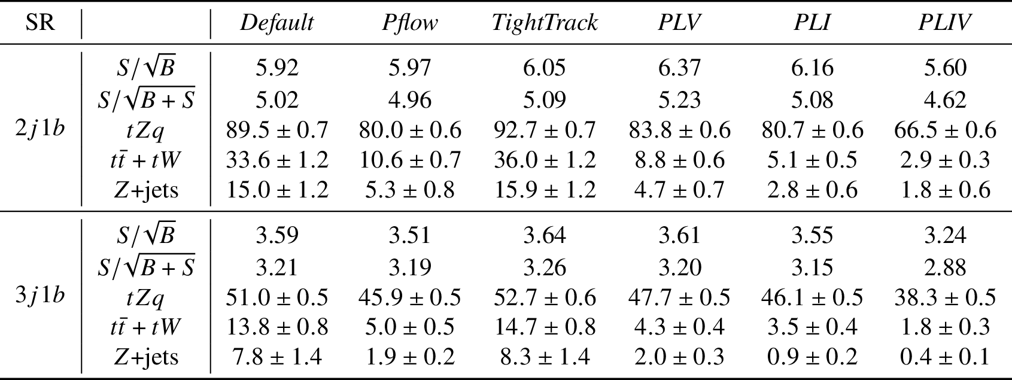

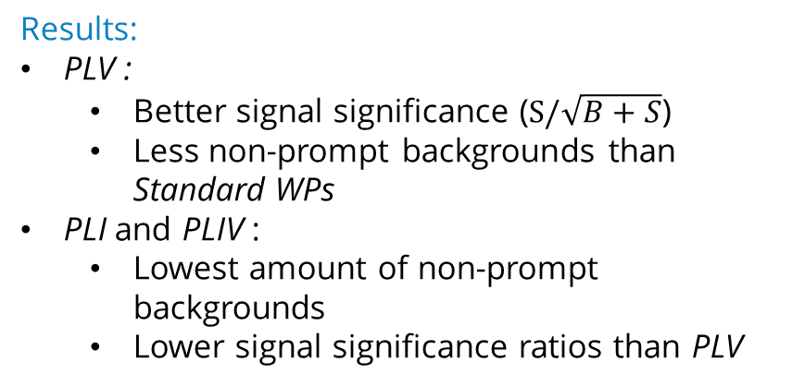
Lepton isolation WP study
MVA
Isolation WP combinations tested:
Default: Gradient (e), FCTight_TrackOnly_FixedRad ($μ$)
Pflow: PFlowTight_FixedCut (e and $μ$)
TightTrack: TightTrackOnly (e) and TightTrackOnly_VarRad ($μ$)
PLV: PLVTight (e and$μ$)
PLI: PLImprovedTight (e and $μ$)
PLIV: PLImprovedVeryTight (e and $μ$)
{
Event yields for all combinations using common selection (slide 6)
standard
{
Results:
PLV :
Better signal significance ($S/\sqrt{B+S}$)
Less non-prompt backgrounds than Standard WPs
PLI and PLIV :
Lowest amount of non-prompt backgrounds
Lower signal significance ratios than PLV
Conclusions:
PLV is the better WP

Slide 9
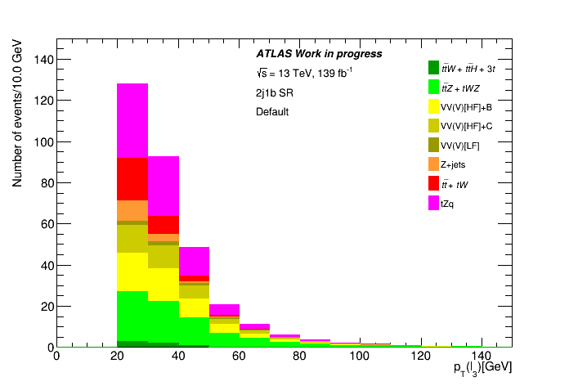
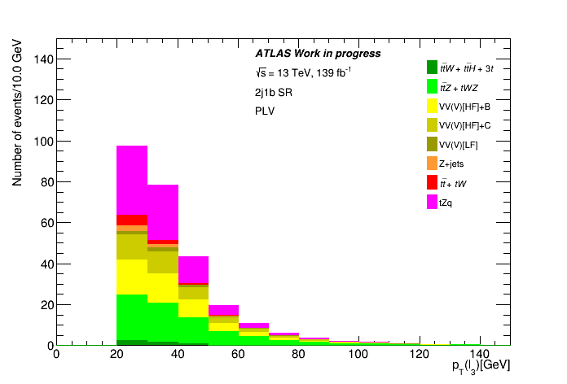

Common selection, $p_{T}(l_{3})$
Standard WP
MVA WP

Slide 10
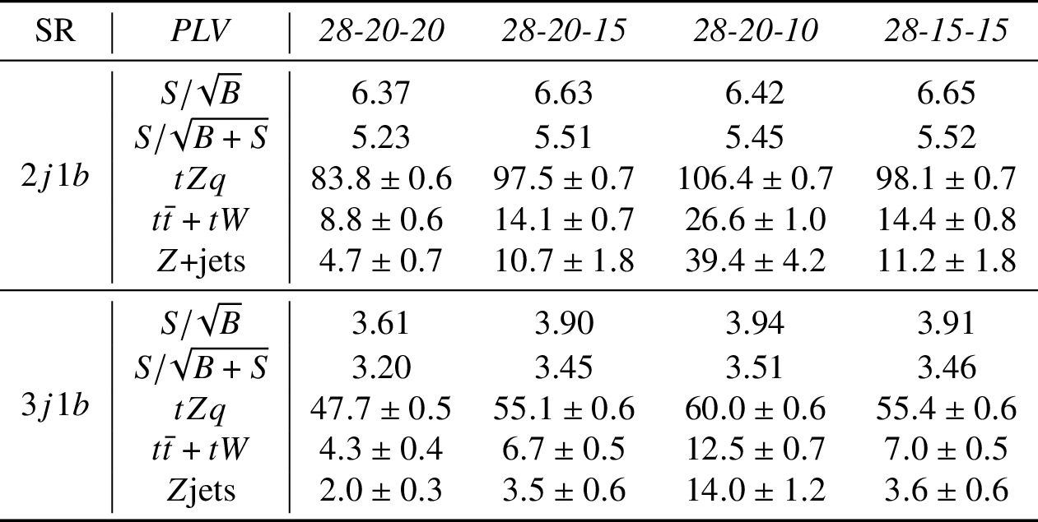
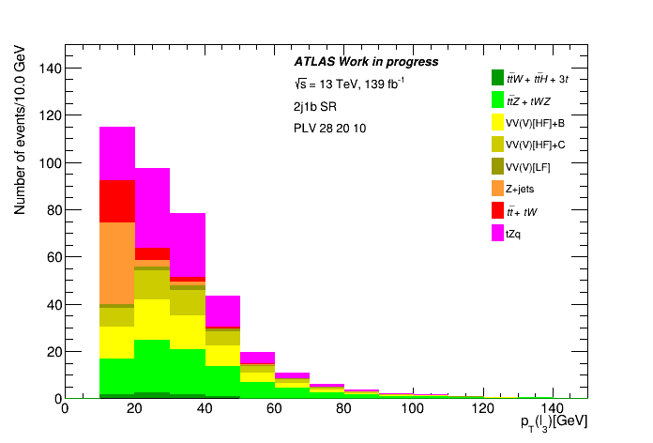

Lepton$p_{T}$ threshold study
10 GeV cut on third lepton
Event yields for all the different cuts with PLV
Conclusions:
Cutting at 15 GeV on the third lepton gives the best signal significance while keeping the non-prompt backgrounds under control.

Slide 11
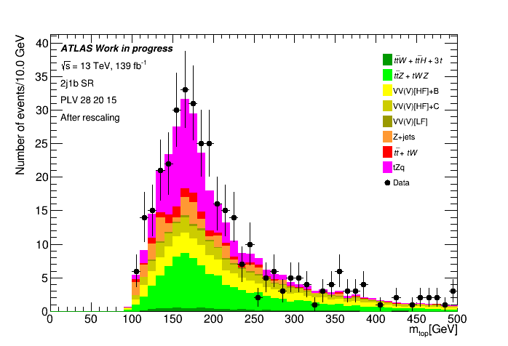
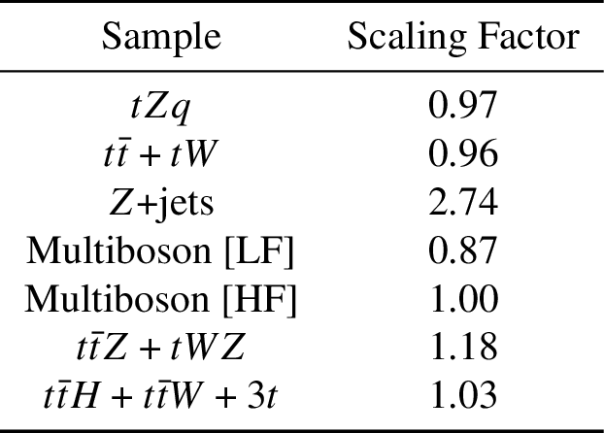
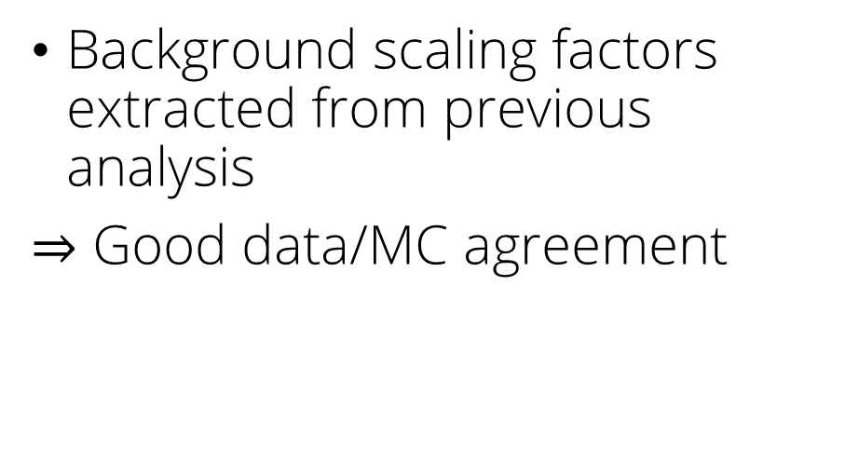
Data/MC agreement
Background scaling factors extracted from previous analysis
$⇒$ Good data/MC agreement

Slide 12
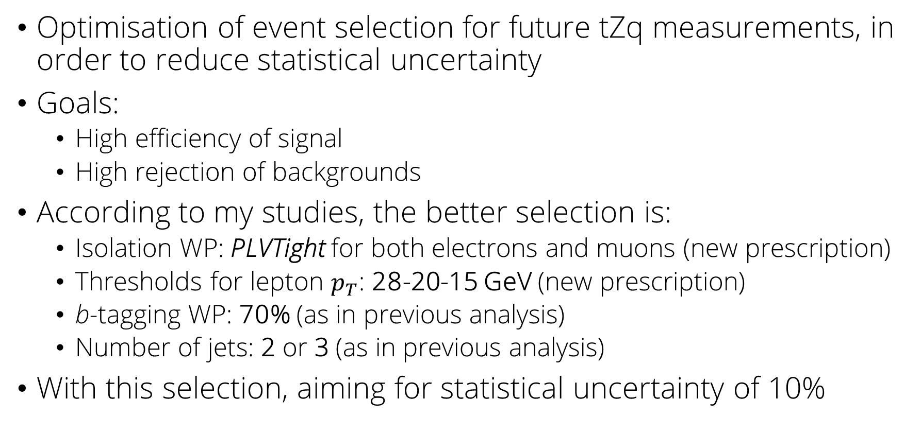
Conclusions
Optimisation of event selection for future tZq measurements, in order to reduce statistical uncertainty
Goals:
High efficiency of signal
High rejection of backgrounds
According to my studies, the better selection is:
Isolation WP: PLVTight for both electrons and muons (new prescription)
Thresholds for lepton $p_{T}$: 28-20-15 GeV (new prescription)
b-tagging WP: 70% (as in previous analysis)
Number of jets: 2 or 3 (as in previous analysis)
With this selection, aiming for statistical uncertainty of 10%

Slide 13
Thank you for your attention Alberto Plebani

Slide 14
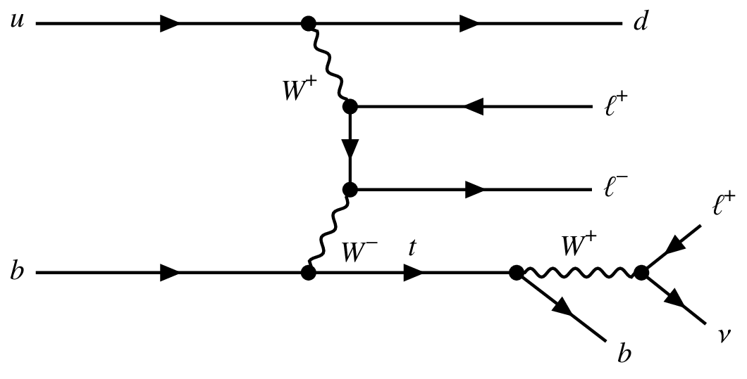
Non-resonant Feynman diagram

Slide 15
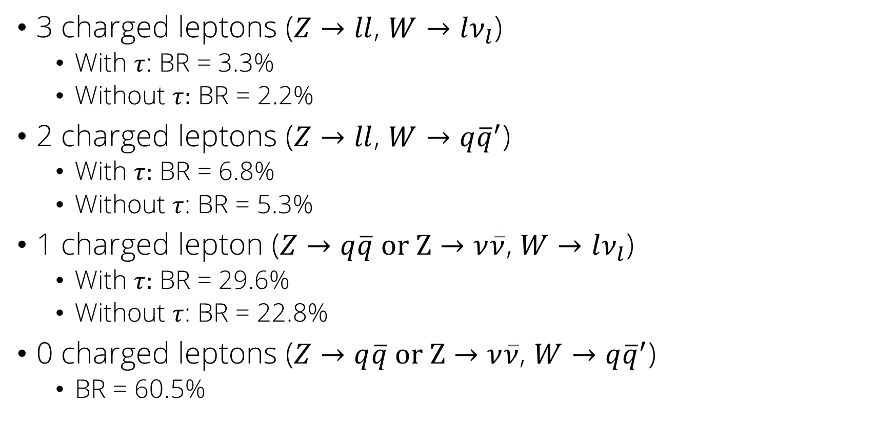
Final states BRs
3 charged leptons ($Z→ll$, $W→lν_{l}$)
With $τ$: BR = 3.3%
Without $τ:$ BR = 2.2%
2 charged leptons ($Z→ll$, $W→q{\overline{q}}^{′}$)
With $τ:$ BR = 6.8%
Without $τ$: BR = 5.3%
1 charged lepton ($Z→q\overline{q} \text{or} \text{Z}→ν\overline{ν}\text{, }W→lν_{l}$)
With $τ:$ BR = 29.6%
Without $τ$: BR = 22.8%
0 charged leptons ($Z→q\overline{q} \text{or} \text{Z}→ν\overline{ν}$, $W→q{\overline{q}}^{′}$)
BR = 60.5%

Slide 16
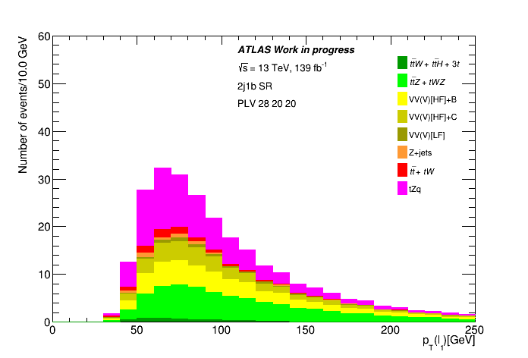

Plot for $p_{T}(l_{1})$

Slide 17
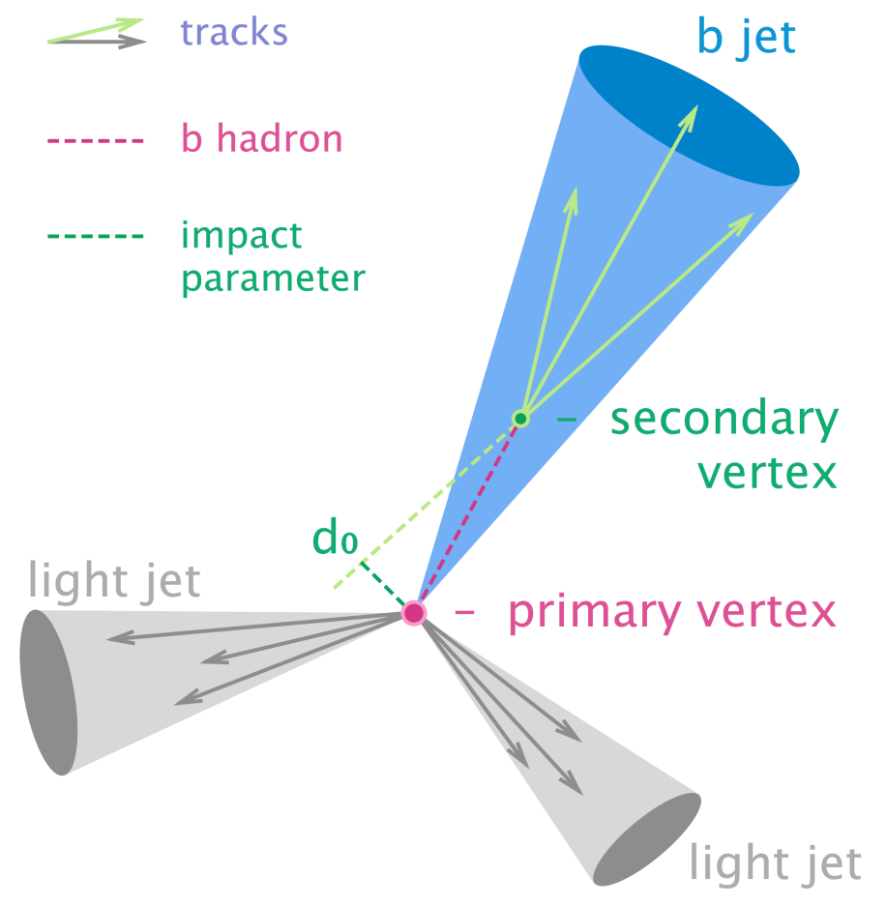
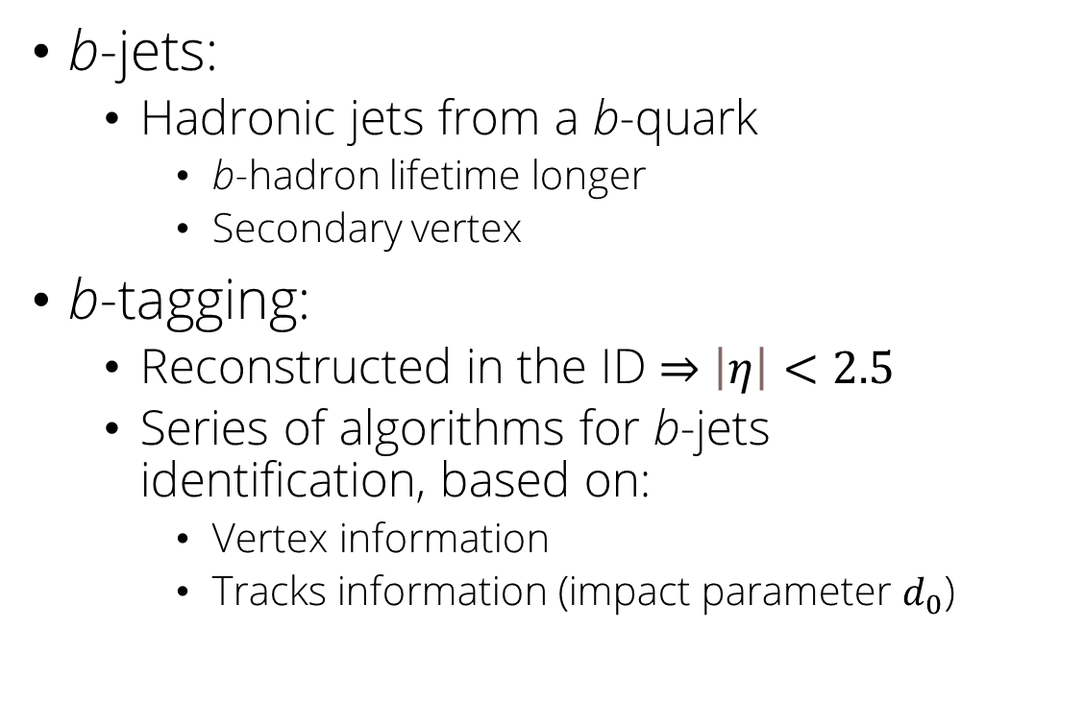
b-tagging
b-jets:
Hadronic jets from a b-quark
b-hadron lifetime longer
Secondary vertex
b-tagging:
Reconstructed in the ID $⇒$ $\left|η\right|<2.5$
Series of algorithms for b-jets identification, based on:
Vertex information
Tracks information (impact parameter $d_{0}$)

Slide 18
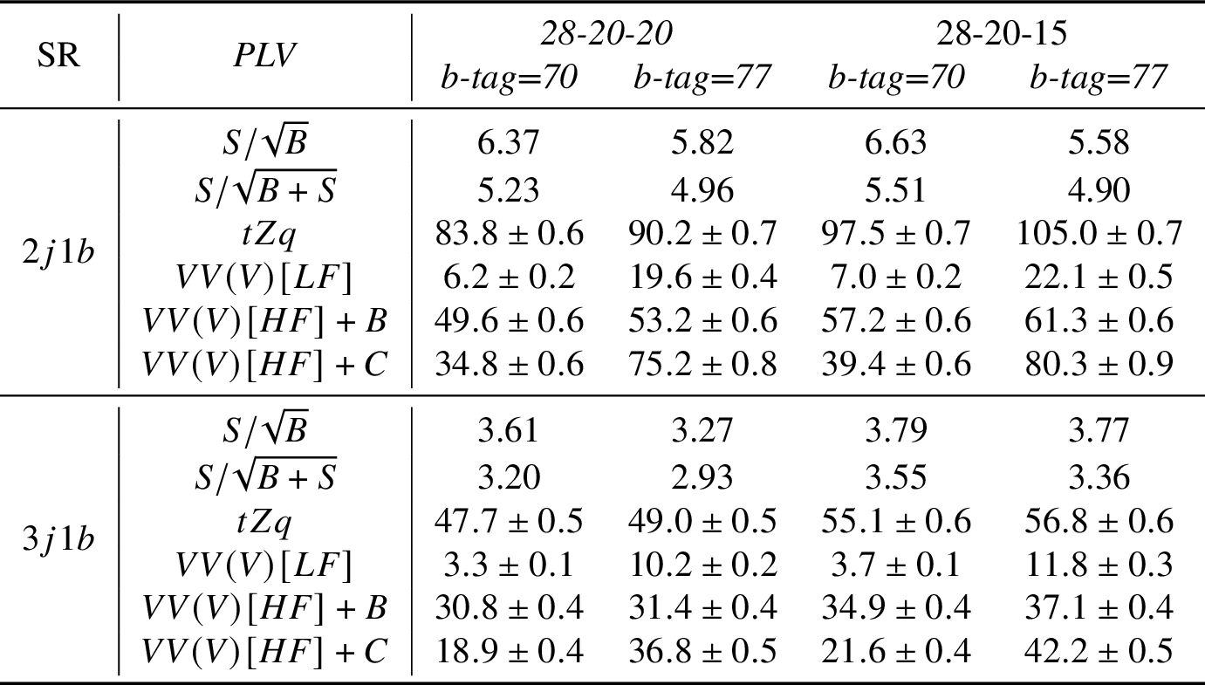
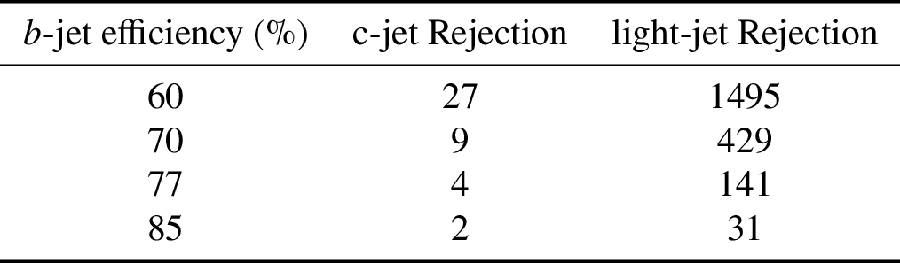
b-tagging WP study
77%:
Double the events for c-jets
Light-jets three times more than 70%
5% increase in the signal
Lower S/B ratios
Analysis on 70% and 77% efficiency b-tagging WP to see the effects it had on the Diboson samples [VV(V)]
Conclusions
70% b-tagging WP is better

Slide 19
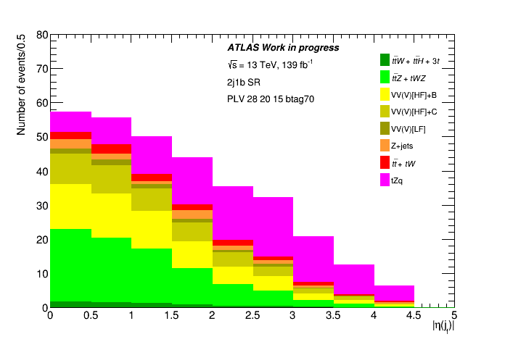
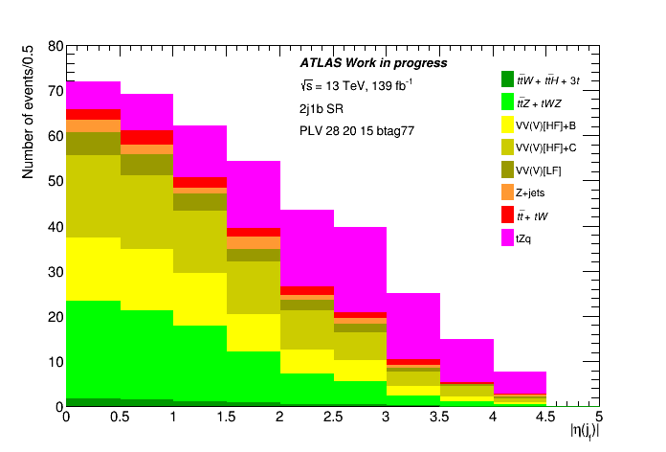
b-tagging analysis, plots for $\left|η\left(j_{f}\right)\right|$

Slide 20
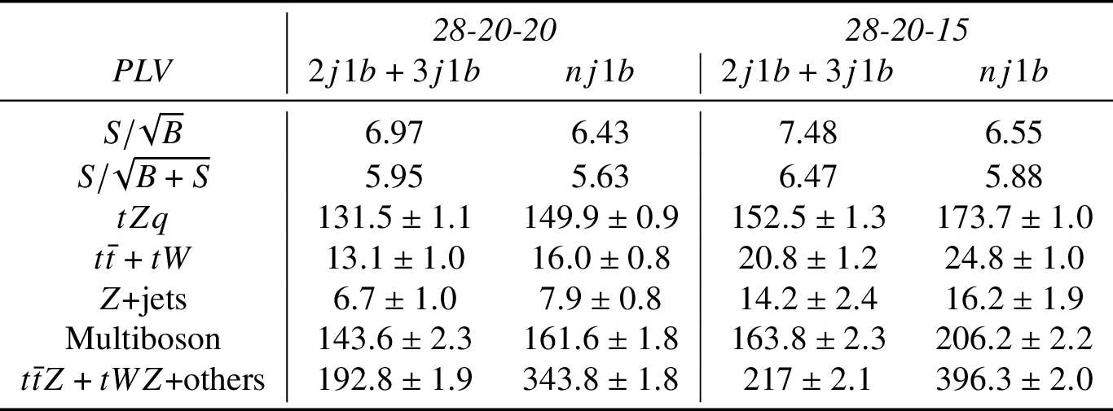
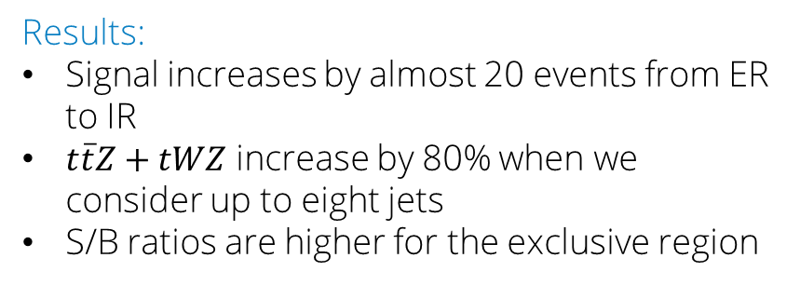
High jet multiplicity SR
SR nj1b (inclusive region IR): 2-8 hadronic jets, 1 b-jet
SR 2j1b+3j1b (exclusive region ER): sum up the events for SR 2j1b and SR 3j1b. Compared to nj1b, we lose the n>3 events of nj1b
Results:
Signal increases by almost 20 events from ER to IR
$t\overline{t}Z+tWZ$ increase by 80% when we consider up to eight jets
S/B ratios are higher for the exclusive region
Conclusions:
ER better than IR for amplifying the signal

Slide 21
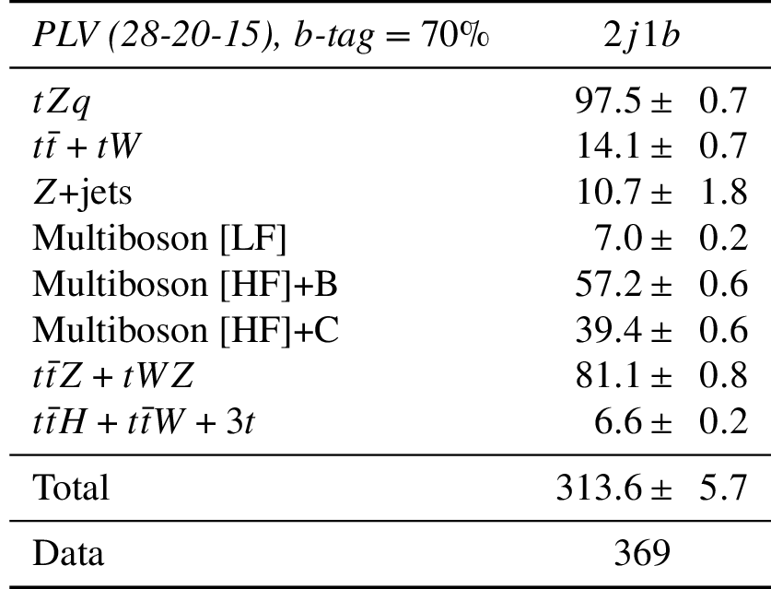
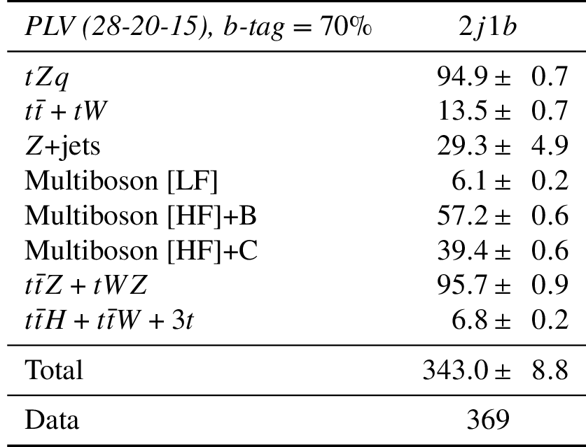
Event yields with Data
Before rescaling
After rescaling

