Slide 1


Curve fitting in Machine Learning and data

Slide 2
Definition
Curve fitting is the process of constructing a curve, or mathematical function, that has the best fit to a series of data points, possibly subject to constraints.
But why ?
Ideally, it will capture the trend in the data and allow us to make predictions of how the data series will behave in the future.

Slide 3
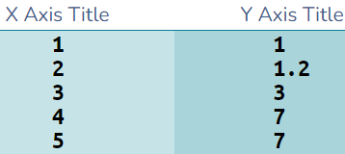
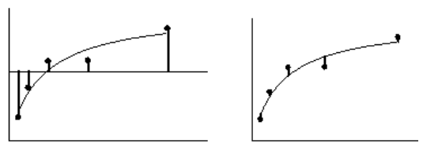
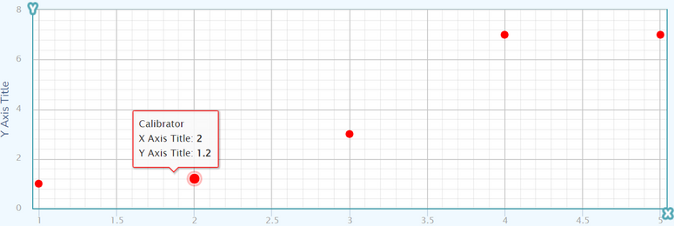
How to do this ?
Now let's imagine having this data :
We now want to find the equation closest to our points in its entirety. We will therefore look for the minimum error between our given points and the points found using the equation.
We will calculate R² which is computed from the sum of the squares of the distances of the points from the best-fit curve.
The left panel shows a horizontal line at the mean of all Y values, and vertical lines showing how far each point is from the mean of all Y values, this is the sum of the square of these distances (SStot)
The right panel shows the vertical distance of each point from the best-fit curve, the sum of squares of these distances (SSres).
R2 is : 1.0 - (SSresiduals/SStotal)
This will equal 1 for a perfect fit and tend towards 0 for a bad fit

Slide 4
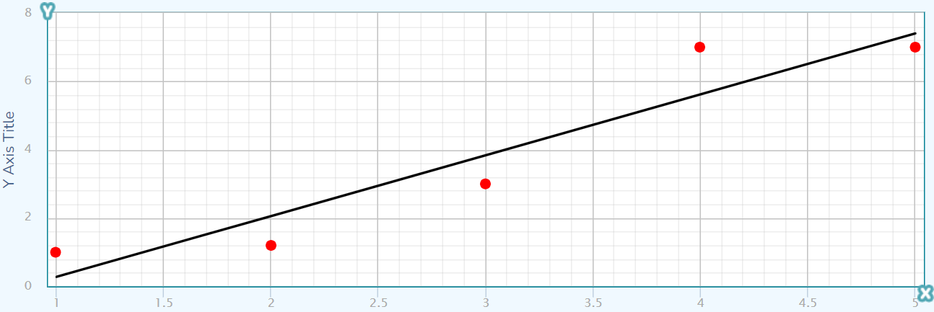
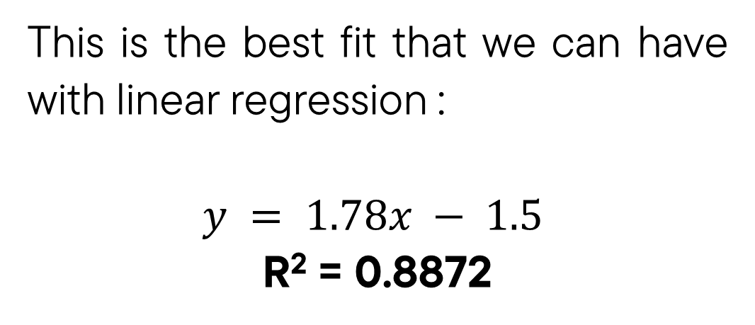
Linear Regression
Linear regression represent the function : $y = ax+ b$which is represented with a straight line. So we will try to find the a and b values with x values to find the best fit (R2).
This is the best fit that we can have with linear regression :
$$y = 1.78x − 1.5$$
R² = 0.8872

Slide 5
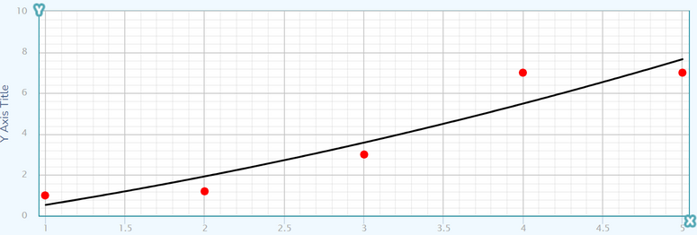
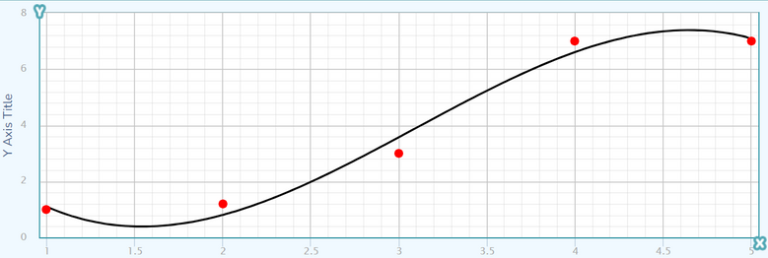
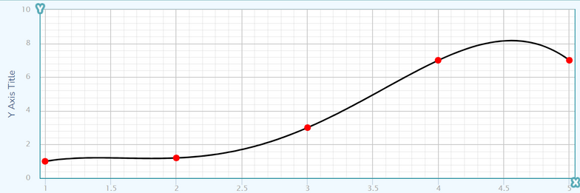
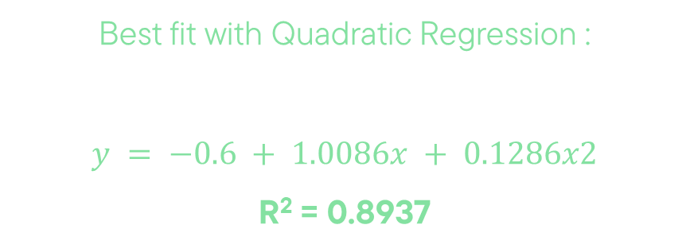
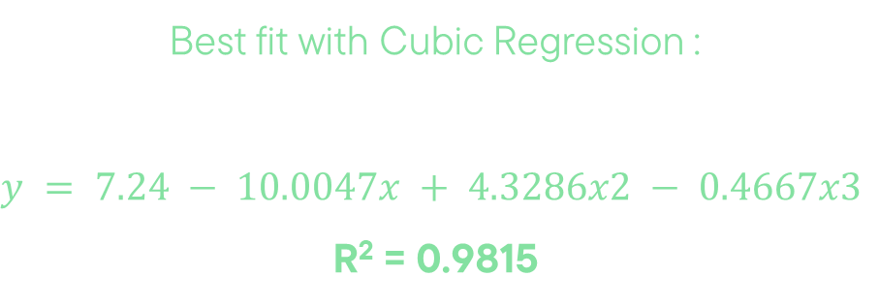
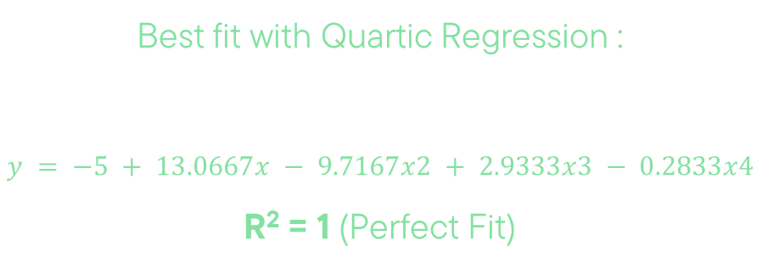
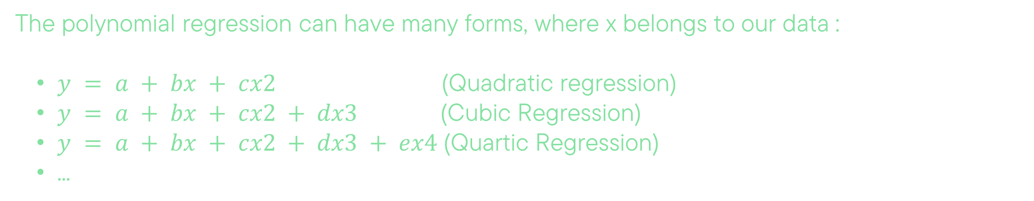
Polynomial regression
The polynomial regression can have many forms, where x belongs to our data :
$y = a + bx + cx2$ (Quadratic regression)
$y = a + bx + cx2 + dx3$(Cubic Regression)
$y = a + bx + cx2 + dx3 + ex4$(Quartic Regression)
...
Best fit with Quadratic Regression :
$y = −0.6 + 1.0086x + 0.1286x2$
R² = 0.8937
Best fit with Cubic Regression :
$$y = 7.24 − 10.0047x + 4.3286x2 − 0.4667x3$$
R² = 0.9815
Best fit with Quartic Regression :
$$y = −5 + 13.0667x − 9.7167x2 + 2.9333x3 − 0.2833x4$$
R² = 1 (Perfect Fit)

Slide 6
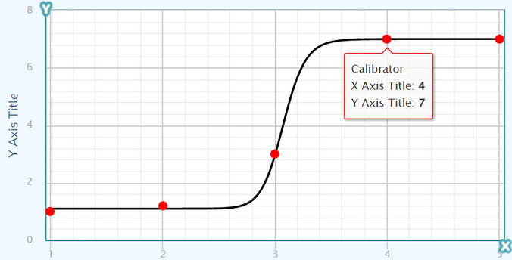
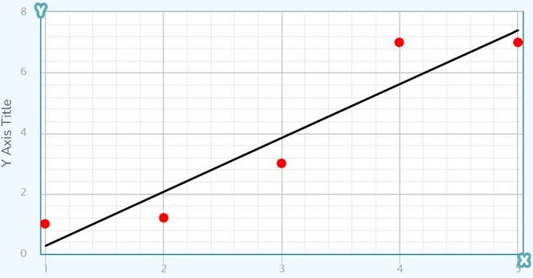
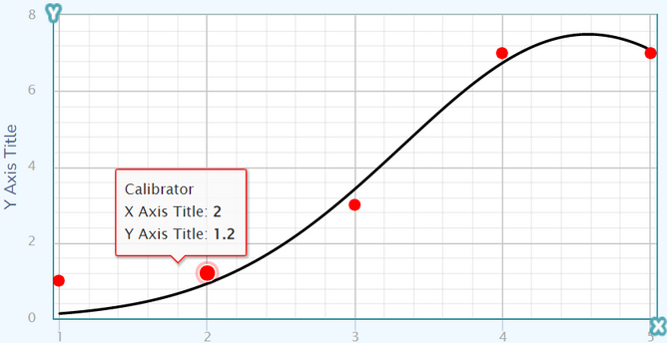
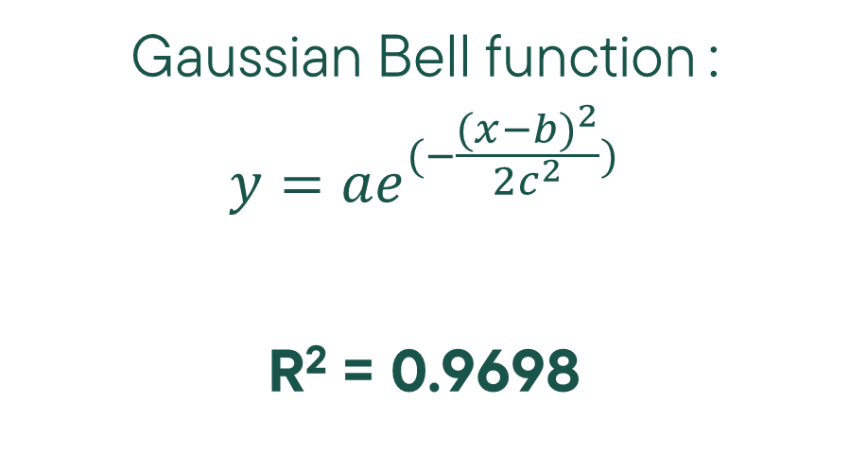
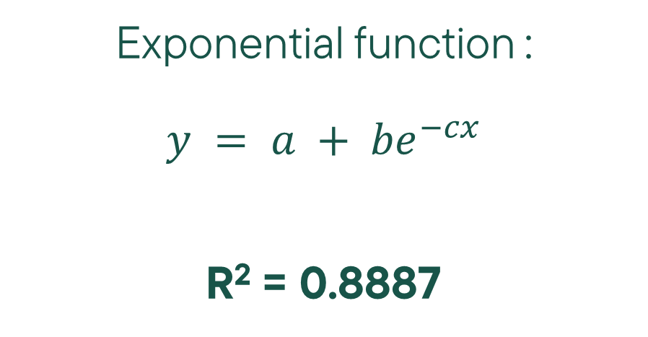
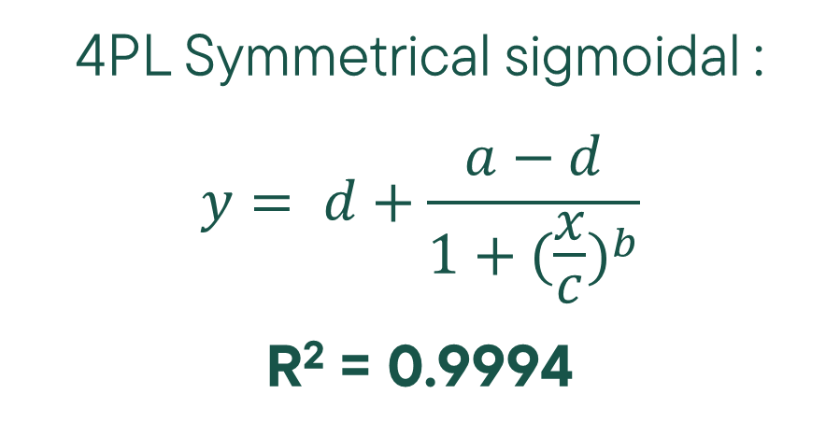
Other Fit Methods
We used some basic fit method because our data wasn't so complicated, but you may have to use more complicated methods that can be usefull to have a better R2 and fit better.
4PL Symmetrical sigmoidal :
$$y= d+\frac{a−d}{1+{(\frac{x}{c})}^{b}}$$
R² = 0.9994
Exponential function :
$$y = a + {be}^{−cx}$$
R² = 0.8887
Gaussian Bell function :
$$y=ae^{(−\frac{{(x−b)}^{2}}{2c^{2}})}$$
R² = 0.9698

Slide 7
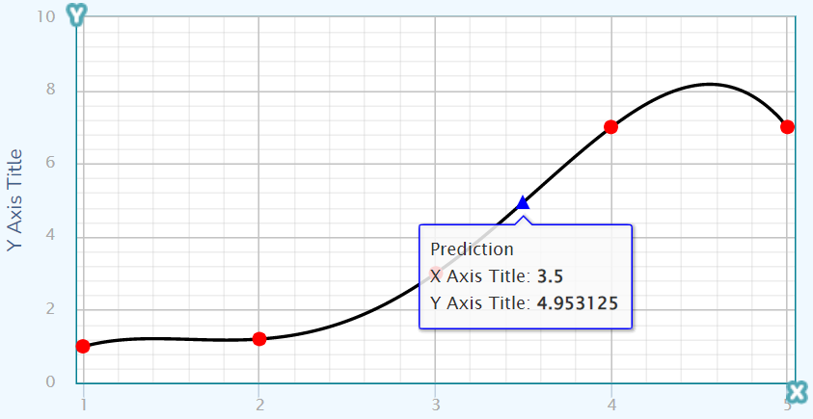
Prediction
Once we have found our function, it is easy to make a prediction, just enter the $x$ of our dataset and get the value of $y$ passed by the best function we have chosen.
With the Quartic function : $y = −5 + 13.0667∗3.5 − 9.7167∗3.52 + 2.9333∗3.53 − 0.2833∗3.54$
$y = 4.9531$

Slide 8
Conclusion
To conclude, we can assure two things :
Each method corresponds to specific cases, a complex method may not correspond to a data set that may seem easy.
The choice of method can be based on a physical aspect of the data (which gives an idea) but it can also be done by comparing the R²s and taking the best possible.

